Slide 1
Verification Requests
Citizen Advisory Committee
  Repeated requests for BMP verification
Chesapeake Executive Order Strategy
  USDA and EPA commitment to develop/implement mechanism for tracking/reporting ‘voluntary conservation practices’ by July 2012
NRC’s Ches Bay Independent Evaluation Report
  Five science-based conclusions focused on ‘accurate tracking of BMPs’
Chesapeake Bay TMDL’s Appendix S
  EPA expectations for offset credit verification

Slide 2
Verification Work Underway
NEIEN
  Successful submission of 2010 progress data
NACD
  2-year project for development of data collection/ verification protocols for non-cost shared ag practices
USGS MOU’s with NRCS/FSA
  Improving access to federal cost shared practice data
USDA Office of Environmental Markets
  Synthesis of verification of environ. credits
Responses to NRC CB Indep. Evaluation Report
  MB’s recommended responses sent to PSC

Slide 3
Proposal to Partnership
Build and work integrated set of recommendations up through CBP Partnership (FWG: Feb-Mar)
  Source Workgroups WQGIT MB PSC
Address full array of practices across all sources
  Agricultural lands, forest lands, developed lands, on-site treatment systems, wastewater dischargers, stream corridors, tidal shorelines
Factor in innovative approaches taken by jurisdictions, local municipalities, and conservation districts
  Recognize unique circumstances across the partnership and that one size does not fit all

Slide 4
Verification Framework
Verification principles
  Partnership agreement on principles to guide the jurisdictions’ development of verification programs
Source sector-specific verification protocols
  Developed through the WQGIT’s source sector workgroups and approved by the Partnership
Verification panel
  Verification experts charged by the Partnership to review/make recommendations on jurisdictions’ proposed verification programs (aka BMP panels)

Slide 5
Draft Verification Principles
Partnership support
Clear definition of verification
Credible/defensible
Consistent application across source sectors
Build off cost-share verification protocols
No lowest common denominator

Slide 6
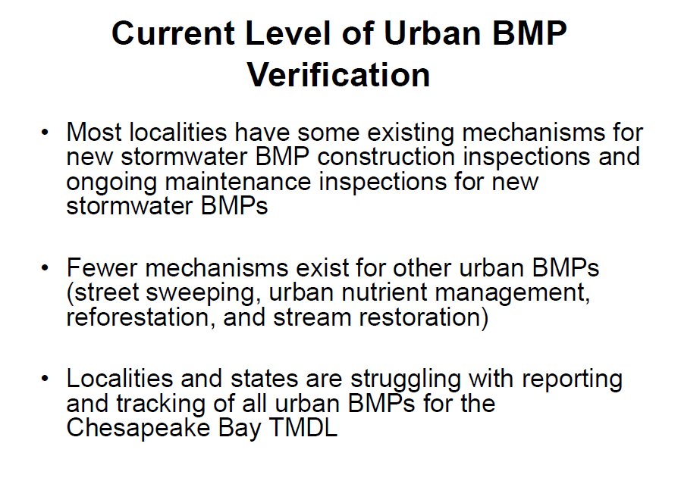

Slide 7
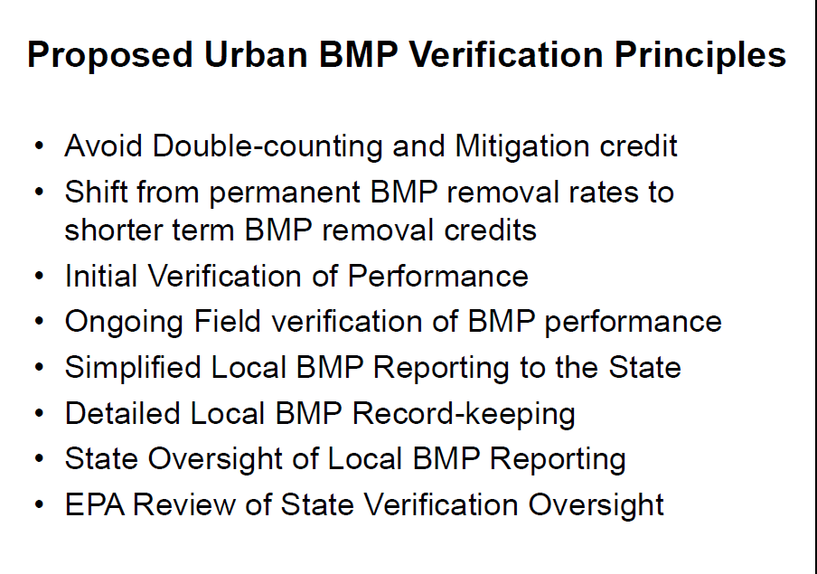

Slide 8
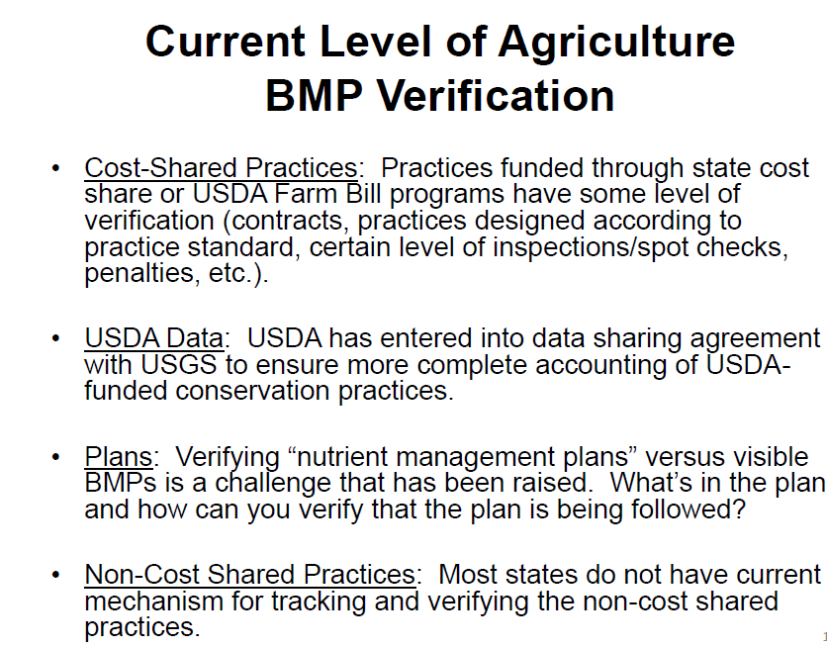

Slide 9
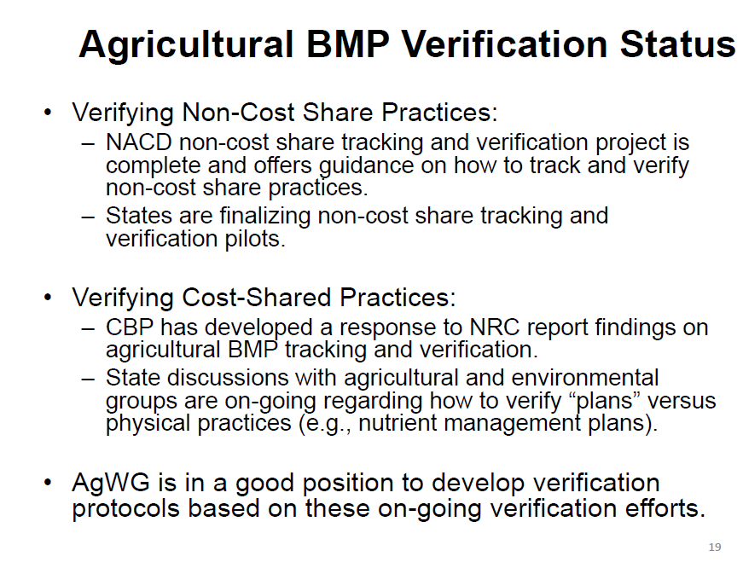

Slide 10
