Slide 1
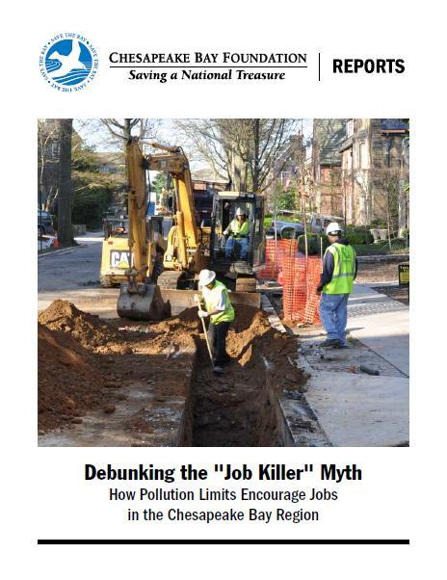
Notes:
Have in your packet don’t have much time
Exec summary quick and dirty
Question – me, tom pelton compiled the info, and fyi 6 pages of end notes that refer to data source many wesbites to find actual data
15 min fly thru
Eyes wide open
Claims env regs kill job
Don’t – regs create jobs and while u r cleaning water the benefits you reap from it is sustaining jobs that depend upon c water – seafood ind, comm fish, rec fishing, water-based tourism etc…
Research comprised of an
-Evaluation indsutries who had cried wolf over new env regs – 70’s new clean air and fuel efficiency standards
bf goodrich
opponets of 1985 phosphate ban (procter and gamble said this legislation would damage your wash machine create 1K in soap factories) etc…
-inflated rhetoric about jobs/regulation in proposed clean air act amendments in 90s – ’03 OMB in bush’s pres. Analysis ben outweighed inv. 4-1
-Bar college dir of ctr for env policy dr eban goodstein no net loss of jobs b/c of env regs

Slide 2
Local examples of job creation

Slide 3
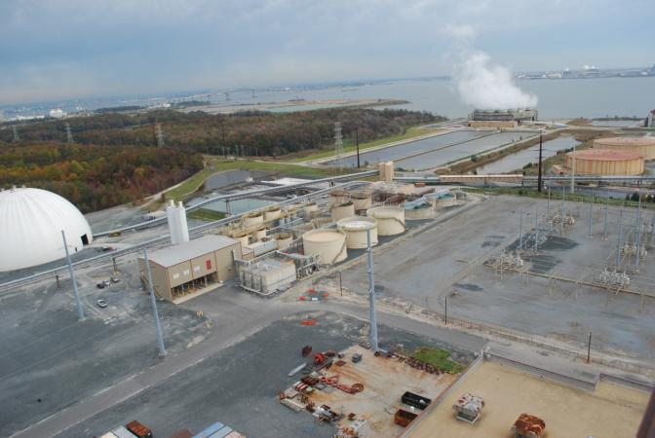

Nearly a billion dollars in pollution control equipment at Brandon Shores power plant
Pollution Control Equipment
Notes:
Clean air act amendments in 90’s - inflated rhetoric “quiet death for businesses around country”
– in ’03 under adm of OMB in G W bush’s pres. Analysis ben outweighed inv. 4-1
Closer to home
Md considered healthy air act to control pollution from coal-fired PP in 06, critics (power com exec) said it would force closure of PP, cause layoffs, cripple reliability of region’s electric system
In fact non of these claims occurred and at constellations brandon shores PP in anne arundel coun, 1300 construction workers were employed on the renovation and 32 ppl were hired in part to run pollution equipment

Slide 4
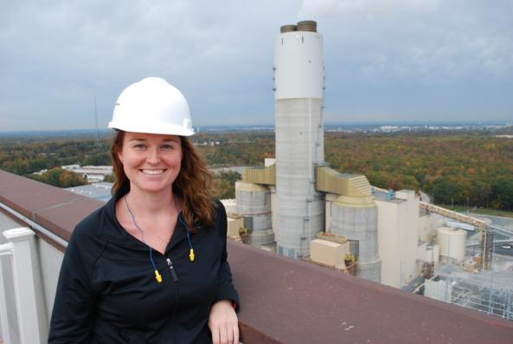
Renovated Power Plant Jobs
Notes:
Claim – layoffs
Reality: chemical technician Melissa sampson is one of those 32 ppl brandon shores coal-fired PP constellation energy employees hired for pollution controls

Slide 5
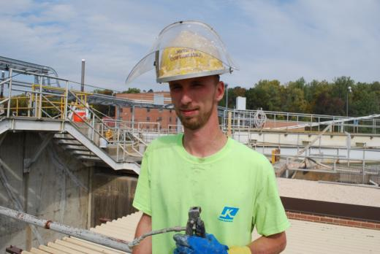
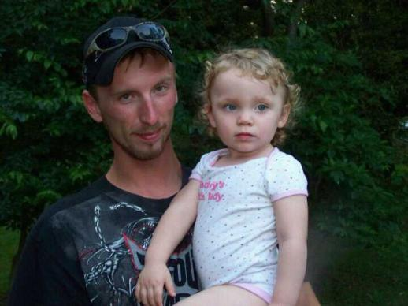
Brandon Stevens, worker at Fairfax County STP upgrade
Sewage Treatment Plant Jobs
Notes:
Page 9 of rpt looks at Norman cole pollution control plant in lorton. At that plant alone – there are 118 contractor jobs working on that upgrade. Mutliply that by the 21 plants across the state being upgraded

Slide 6

Stormwater Jobs
Notes:
Construction is underway in Montgomery County on $305 million in stormwater pollution control projects that will create 3,300 construction
and engineering jobs.
projects will include stream restoration projects, green roofs, and stormwater containment ponds.
Stormwater control projects like the one in Montgomery County could create 36,000 temporary construction jobs across Maryland over the next
five years, as well as 10,000 jobs in the District of Columbia, 80,000 jobs in
Pennsylvania, and 35,000 jobs in Virginia, according to an October estimate by the Economic Policy Institute and an advocacy group called Green
for All.
Mr. irving was Living day to day – happy to be at work

Slide 7
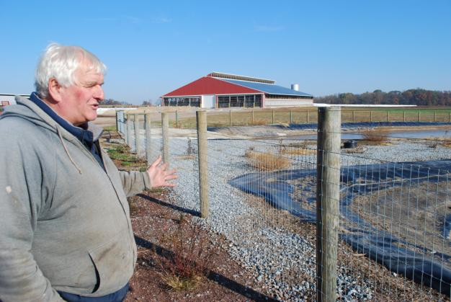
Farmer Leroy Walker with manure storage pit and barn with good ventilation & runoff controls
Notes:
Farm runoff-control Projects
25 workers were hired to build new facilities on Walker’s farm, which reduced runoff pollution and allowed Walker to expand his herd from 170 to 250 cows.

Slide 8
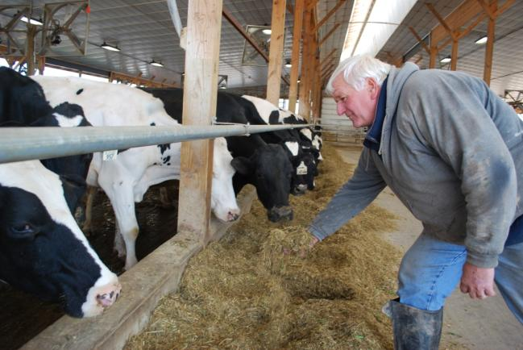
A University of Virginia study projected that 11,751 temporary jobs could be created if Virginia and federal government invested $804 million in farm runoff control projects.
Job Creation on Farms

Slide 9
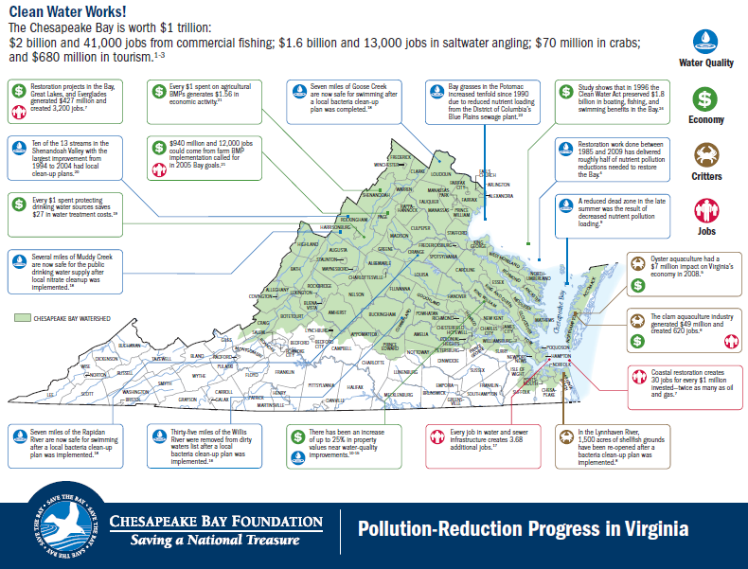
Notes:
Pass this out when wrapping up
For example - In the Lynnhaven River, 1,500 acres of shellfish grounds have been re-opened after a bacteria clean-up plan was implemented.
Ten of the 13 streams in the Shenandoah Valley with the largest improvement from 1994 to 2004 had local clean-up plans.

Slide 10
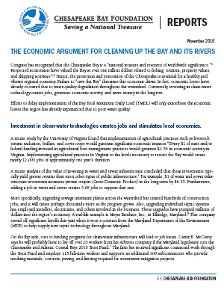

Value of Clean Water
Commercial fishing in VA and MD contribute $2 billion in sales and more than 41,000 jobs
Recreational fishing create $1.6 billion in sales and 13,000 jobs
Tourism brings $3.7 billion a year and 46,000 jobs to Hampton Roads, with $1.4 billion and 11,000 jobs in Virginia Beach alone
Properties near healthy waters can have 5-10% higher property values
For every $1 spent on protection of drinking water, an average of $27 is saved in public water treatment costs
Notes:
10
cbf.org/economic-report or cbf.org in search bar economic report
Or ask me and I can email it to you
6 pages of econ data compiled that combines facts and figures of how clean water translates into dollar bills
3 full pages of end notes w/sources w/links so you can read full reports

Slide 11
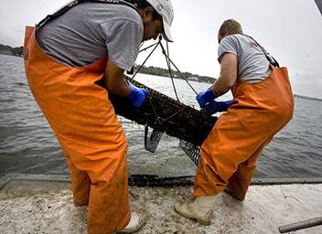
Questions?
Sources: Virginian-Pilot
Notes:
End there – take questions if time allows
This slide is of some friends in my community who can now have aqua operation b/c over the last 8 years water quali improved enough to allow for shellfish consumption which seems like a storybook ending to the clean water debate.

