Slide 1
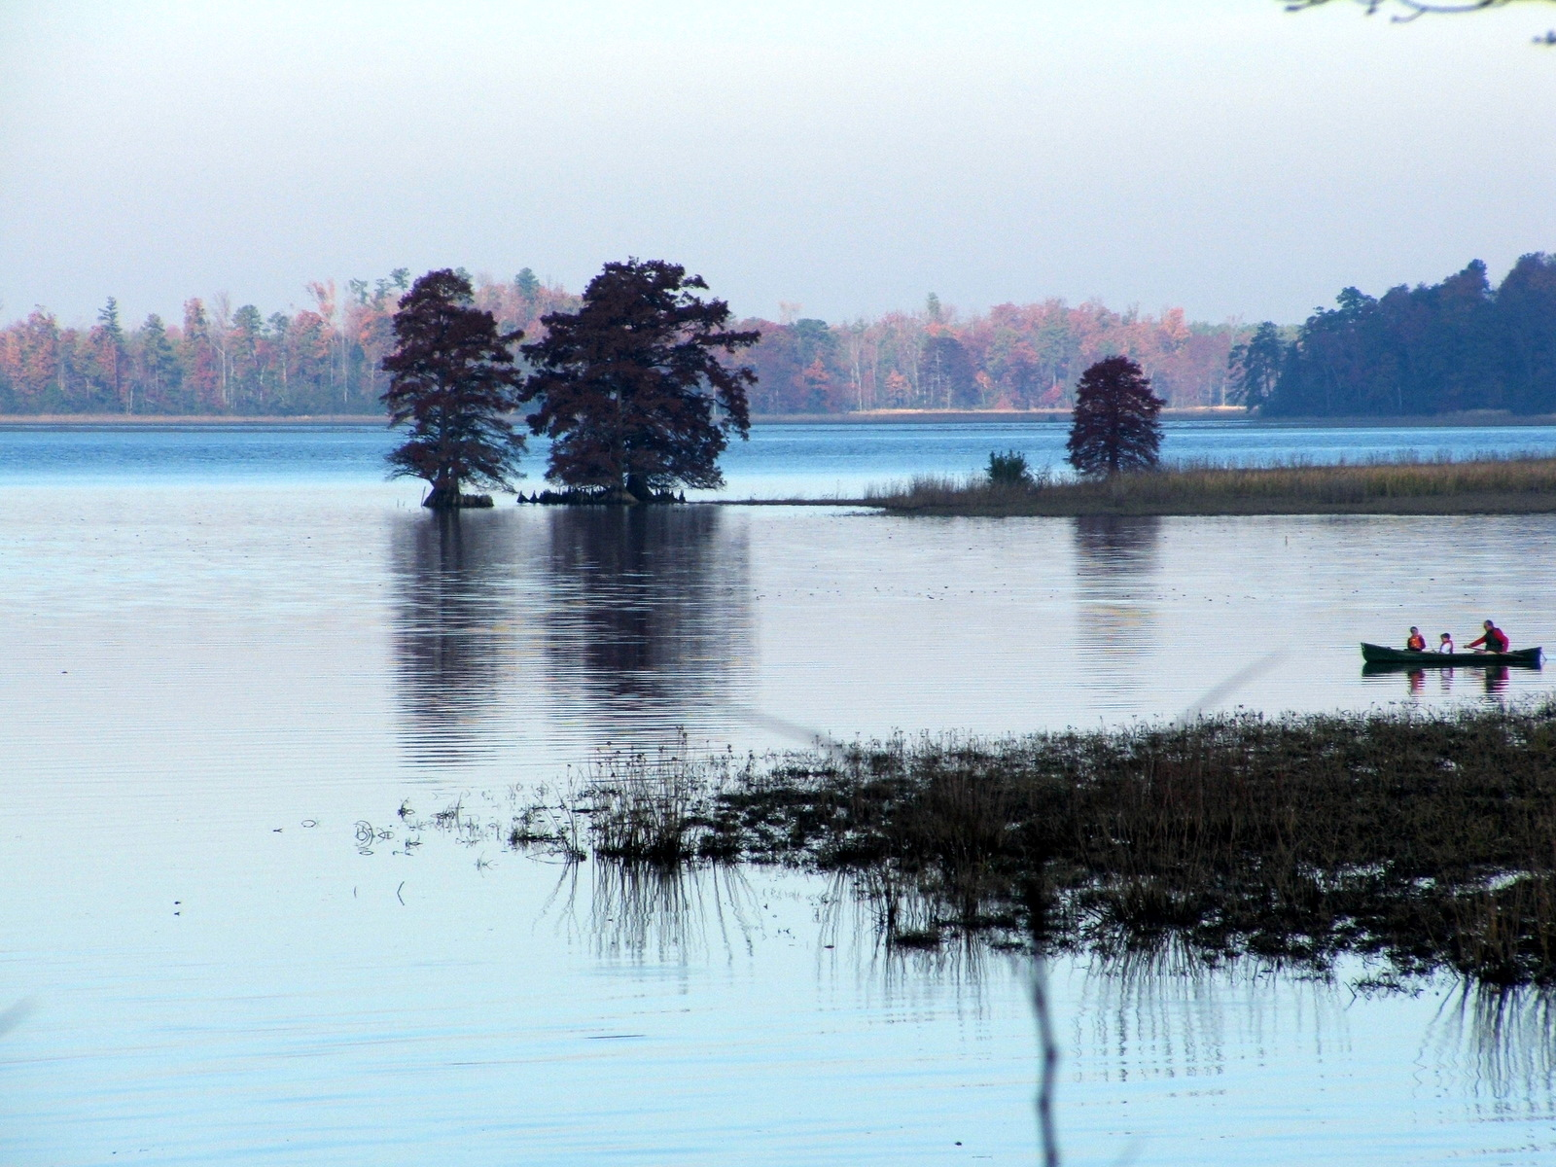
Citizen Engagement
Citizen Engagement
Of another sort
……of another sort

Slide 2
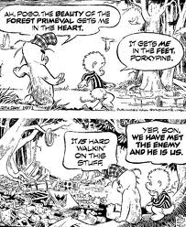

Slide 3
Fundamental problem in restoring Chesapeake Bay is a people problem
“there is a clear correlation between population growth and associated development and environmental degradation in the Chesapeake Bay system.” 1987 and 2000 Bay Agreements

Slide 4

Why can’t people be part of the solution?

Slide 5
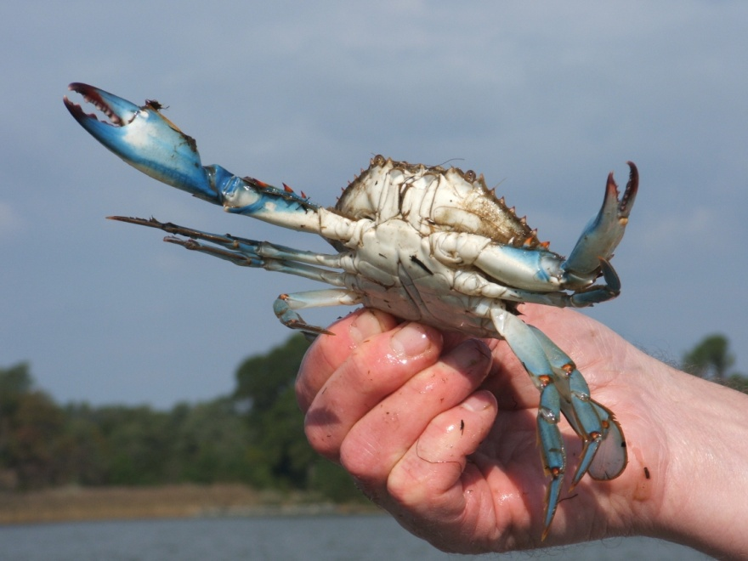

Restoring the Bay is about more than water quality – it’s about values

Slide 6


Slide 7
If environmentalists hope to become
more than a special interest we must
start framing our proposals around
core American values. We must start
seeing our own values as central to what motivates and guides our politics.

Slide 8
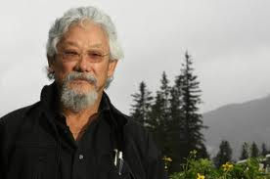
The Fundamental Failure of Environmentalism David Suzuki
It’s almost a cliché to refer to a “paradigm shift”, but that is what we need to meet the challenge of the environmental crises our species has created. That means adopting a “biocentric” view that recognizes we are part of and dependent on the web of life that keeps the planet habitable for a demanding animal like us.

Slide 9
BACK TO BASICS
It’s time to ask: has the U.S. environmental community’s work over the past 30 years laid the groundwork for the economic, cultural and political shifts that we know will be necessary to deal with the crisis? Of the hundreds of millions of dollars we have poured into the global warming issue, only a small fraction has gone to engage Americans as the proud moral people they are, willing to sacrifice for the right cause.

Slide 10
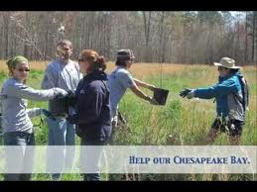
3 ways to engage people in Chesapeake restoration
Regulate
Reward
Educate
Formal
Informal

Slide 11
Congressional actions to promote more citizen engagement
Created EPA Small Watersheds Program
Established Chesapeake Gateways and Watertrails Program within National Park Service.
Created BWET Program in NOAA
Enacted legislation establishing Capt. John Smith Chesapeake National Historic Trail

Slide 12
2 strategies to promote citizen engagement
No Child Left Inside
Expand land conservation and public recreational access.

Slide 13

Amends ESEA.
Engages US Ed.
Authorizes new funding.
Environmental literacy plans.

Slide 14

Other Tactics
State Environmental literacy plans

Slide 15
An Environmental Literacy Executive Order
Make Environmental Education a National Priority.
Direct each Federal agency to make environmental literacy part of its mission.
Create a President’s Council on Environmental Literacy, to develop a comprehensive EE plan.
Establish an Advisory Committee on Environmental Literacy.

Slide 16
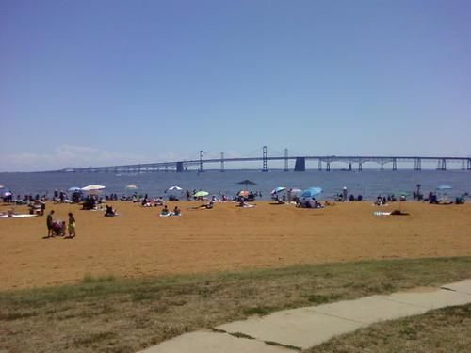
Land Conservation and Public Recreational Access

Slide 17


Slide 18
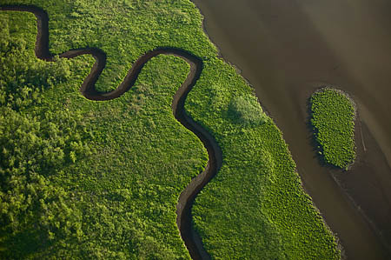

Slide 19
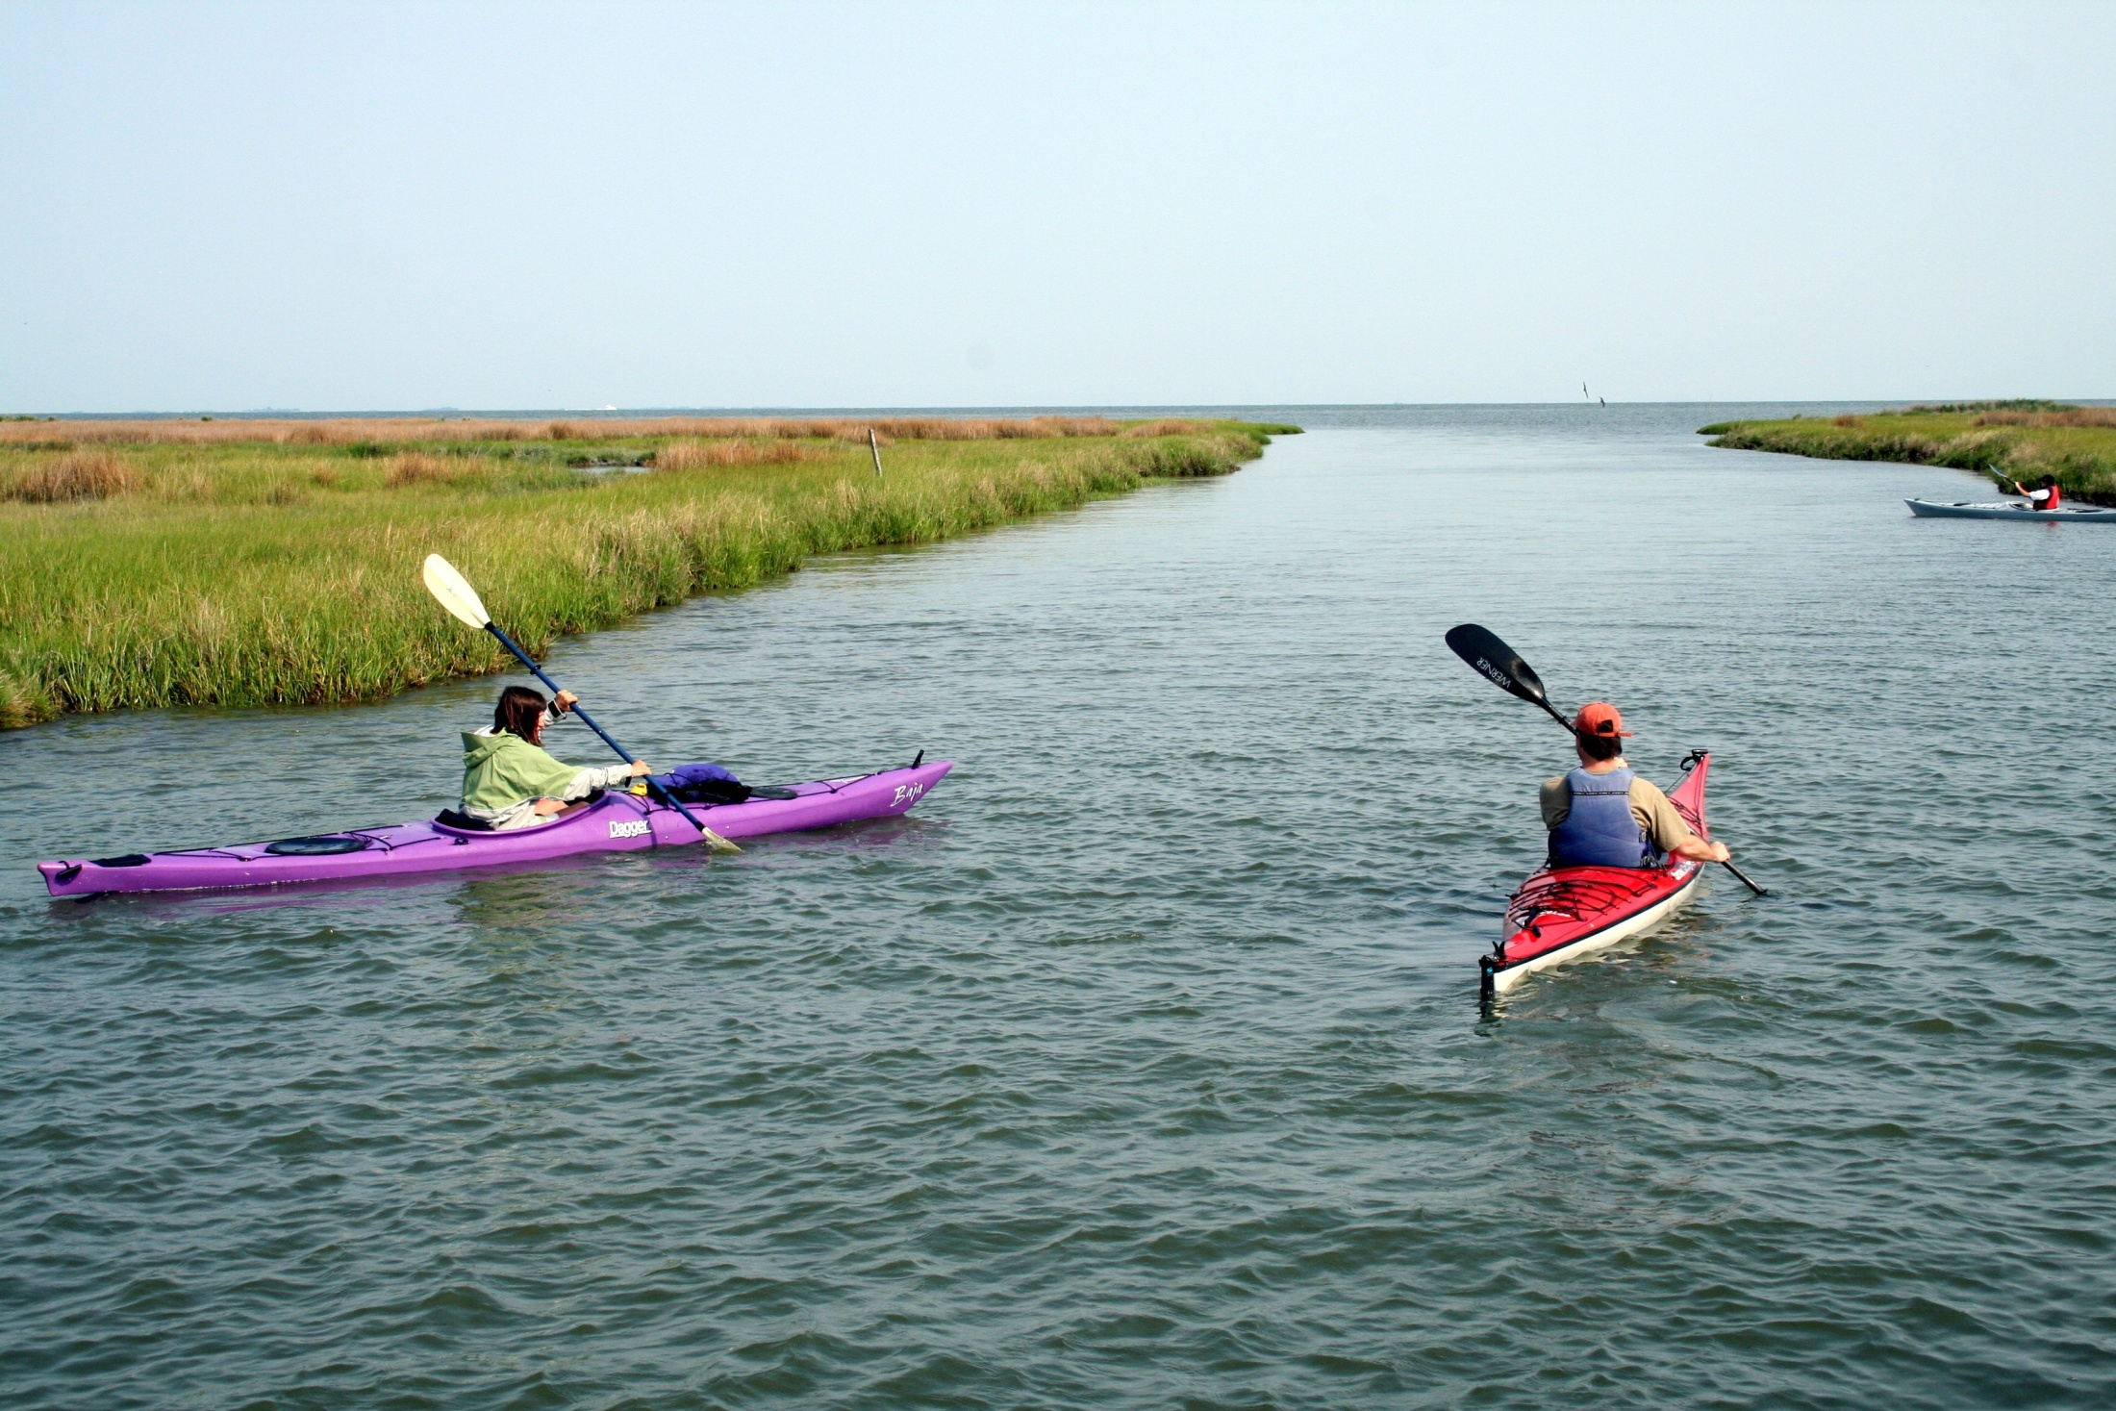

Slide 20
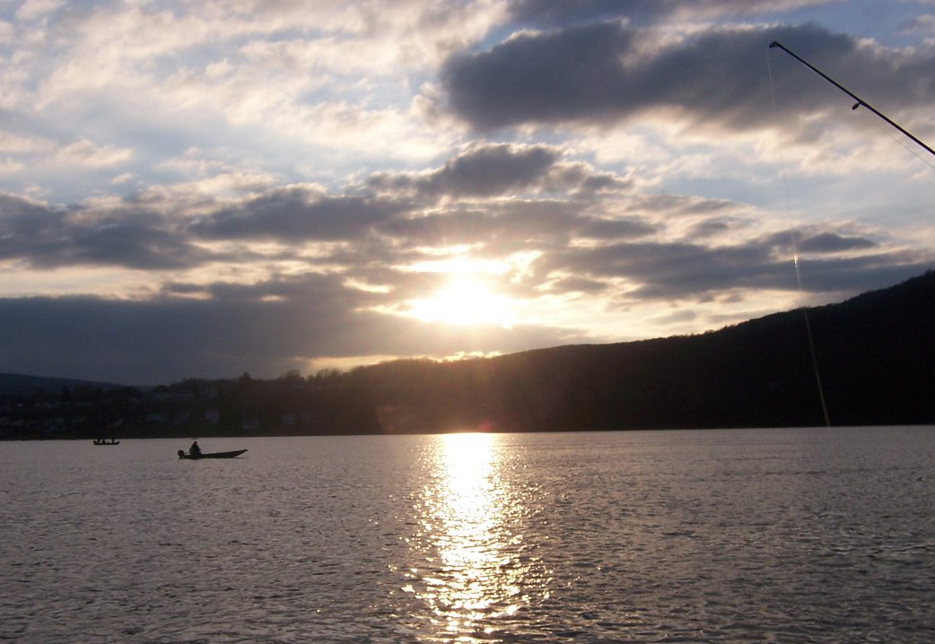

Slide 21
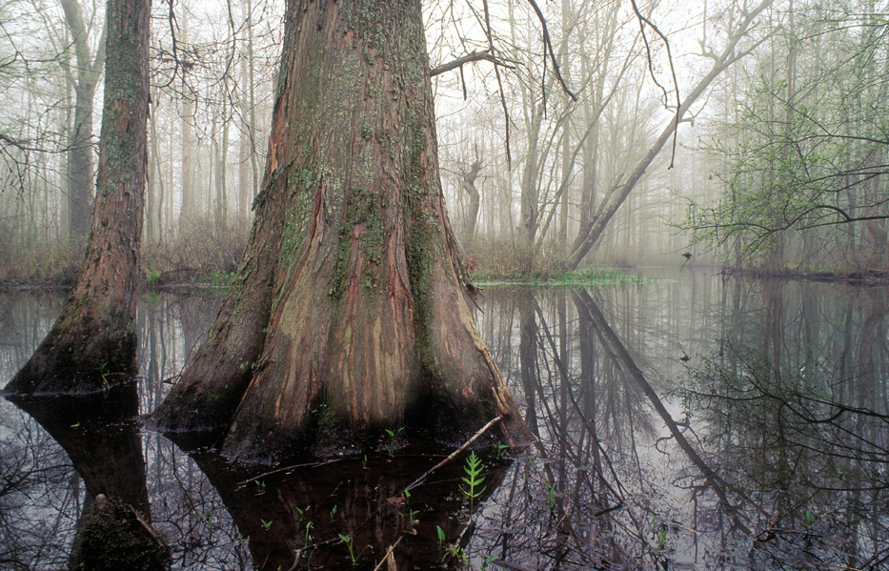

Slide 22
Chesapeake 2000
Permanently preserve from development 20 percent of the land area in the watershed by 2010.
By 2010, expand by 30 percent the system of public access points to the Bay, its tributaries and related resource sites.

Slide 23
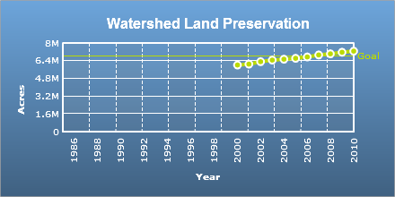
7.3 million acres
In 2010, 102,888 acres were preserved. This brings the total amount of land protected to 7.3 million acres, surpassing the 6.8 million acre goal. Even though the goal has been achieved, land preservation efforts will continue.

Slide 24
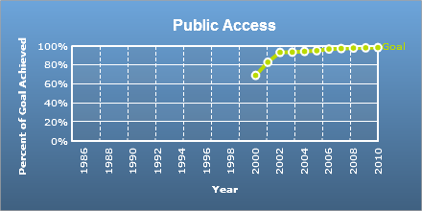
Overall, the Bay Program has achieved 98 percent of its public access goal.
The Bay Program public access goal is comprised of three measures: public access sites, Chesapeake Bay Gateways sites, and water trails.
In 2010:
Six public access sites were acquired, developed or enhanced (for a total of 767), 95 percent of the goal.
Seven new Chesapeake Bay Gateways sites were added (for a total of 173), exceeding the goal.
Water trails remained steady at 2,184 miles, exceeding the goal.

Slide 25
Problems with goals
Acquisitions not necessarily targeted to areas where they could accomplish other benefits for the Bay such as waterfront recreational access, and water quality.
Focus on public access “sites” or “points” – not on providing high quality outdoor recreational experiences which can engage all citizens.

Slide 26
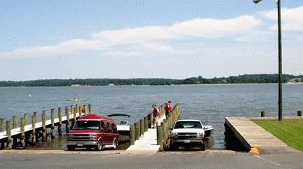

Slide 27
Strategies to enhance land conservation and public access
Protect an
additional 2 million acres of lands
throughout the watershed currently
identified as high conservation priorities
at the federal, state or local level by
2025, including 695,000 acres of forest
land of highest value for maintaining
water quality.
Chesapeake EO By 2025:
Protect additional 2 million acres of lands throughout the watershed.
Increase public access to the bay and its tributaries by adding 300 new public access sites.
Expand Federal role:
Create a Chesapeake Bay National Park;
Fort Monroe
Harriet Tubman
John Smith and Star Spangled Banner Trails
Expand the National Wildlife Refuges
Expand BLM holdings
Create new National Forests

Slide 28
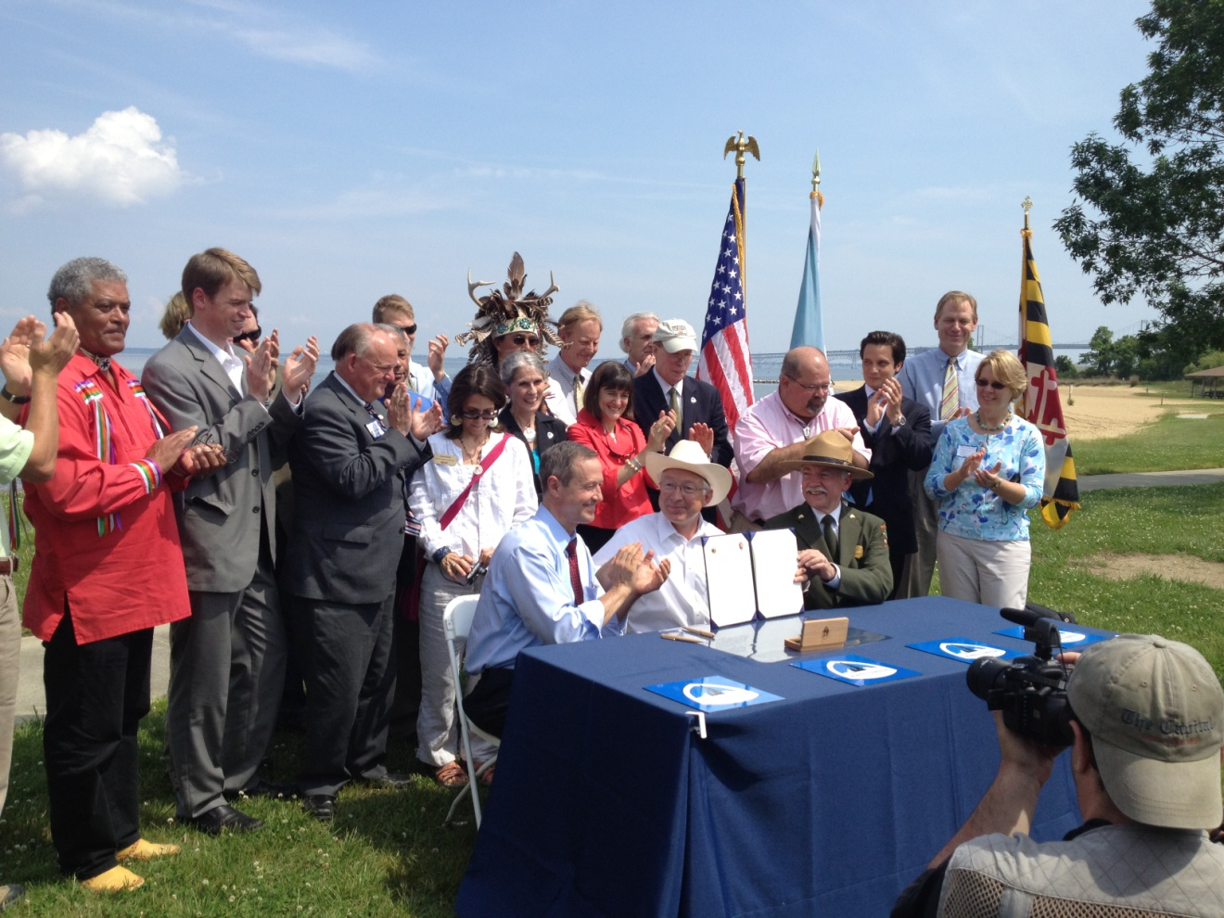
Expanding the John Smith Trail

Slide 29
LWCF Collaborative Landscape initiative
President’s Fiscal 13 budget request includes $109 million in ”collaborative landscape” funds for the U.S. FWS, NPS, BLM and the U.S. Forest Service to “jointly and strategically conserve the most critical landscapes” in the Rockies, Yellowstone and Florida.
None of these funds are allocated for the Chesapeake.
Federal agencies in the Chesapeake have put together a pre-proposal for Fiscal 2014 funding.

Slide 30

Conserving Chesapeake Landscapes report

Slide 31
NPS public access planning
Annapolis, MD (05/31/11) - Where do we need boat ramps or fishing piers, places to swim, or scenic spots to bird watch or just look at the water? In 2010, the federal Strategy for Protecting and Restoring the Chesapeake Bay Watershed set a goal to provide 300 additional public access sites in the Bay watershed by 2025.
The information you provide will help NPS and our partners create the “Chesapeake Bay Region Public Access Plan” due in 2012 to support this commitment for new access.

Slide 32
How can CAC help?
Support No Child Left Inside – State Literacy Plans. Focus on VA and NY.
Comment on draft NPS public access plan. Ensure that access is comprehensive for recreation and not just spots on a map.
Support the recommendations of the Conserving Chesapeake Landscapes report.
Support expanding the Federal role, including adding BLM and OSM to the Federal agencies agreement, and opening up meetings of the Federal agencies committee.

