Slide 1

Market Solutions and Restoring the Chesapeake
The Economics of Nutrient Trading
Ann Swanson
Executive Director
Chesapeake Bay Commission
May 2012

Slide 2

Chesapeake Bay Commission
Tri-State Legislative Commission
PA, MD, VA
Legislative Partner of Chesapeake Bay Program
7 Members Each (21 total)
2 Senate
3 House
Governor or Designee
Citizen At-Large
32 years of Policy for the Bay

Slide 3
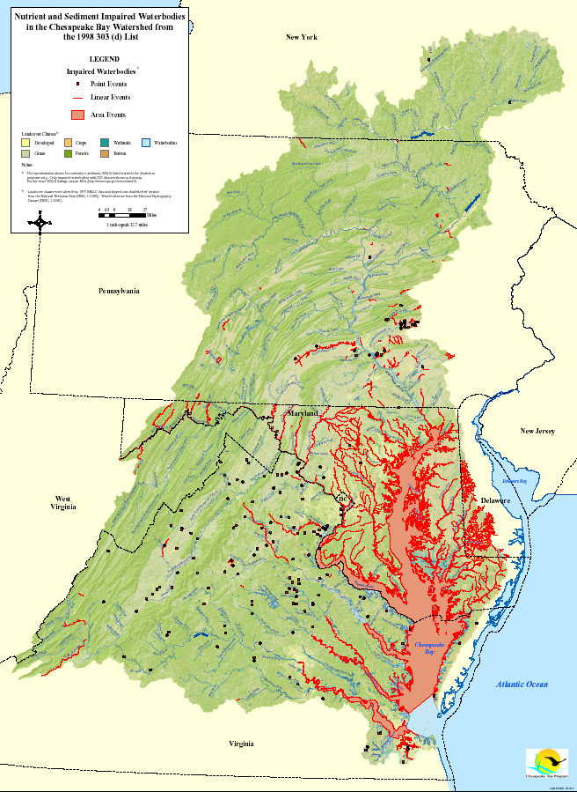
The Chesapeake Bay is impaired
and subject to a federally imposed TMDL.
Notes:
Water Quality standards are not being met. Dissolved oxygen, water clarity and chlorophyll A (algae) all improved by reducing nitrogen, phosphorus and sediment inputs
New solutions are needed for us to reach 60% implementation by 2017 and 100% implementation by 2025.
Part of the solution will be finding new sources of funding, or lowering the cost of restoration, estimated to be billions of dollars.

Slide 4

Nutrient Trading is
One Possible Solution
In our region, 4 states have nutrient trading programs
Pennsylvania
Maryland
Virginia
West Virginia
Notes:
The commission is neither for or against trading. We know that the Watershed Implementation Plans in MD, PA & VA are relying on it and already 4 of 6 Bay states have trading programs in place and evolving. YES, THE HORSE HAS LEFT THE BARN. If we are relying on it, then it must encompass a robust system of verifiable nutrient reductions with program transparency.
The Commission’s responsibility is to provide leaders in the region with the information they need to make meaningful policy decisions.

Slide 5
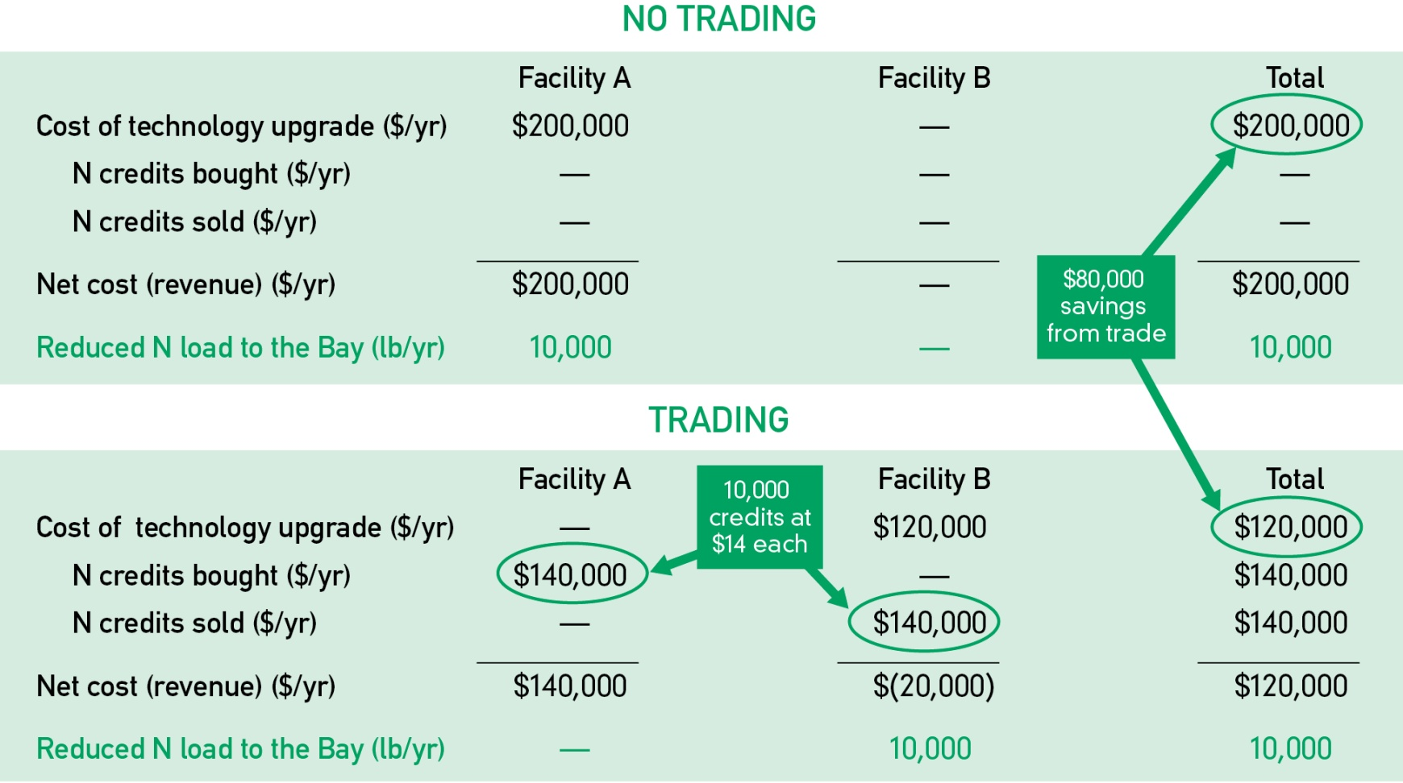
How Can Trading Reduce Costs?
Notes:
Fundamental Trading Example:
Trading can reduce costs when one facility can achieve reductions at a lower cost then another facility and the two “share” the benefit of the cost difference. Facility A spends $140,000 to buy credits from Facility B instead of spending $200,000 to upgrade. Facility B spends $120,000 to upgrade and charges $140,000 for credits sold to Facility A. Facility A saves $60,000/yr and Facility B makes $20,000/yr. Win-win.

Slide 6


Our Approach to the Task
Project Development & Funding
Economics Analysis, Modeling and Report Preparation
Project Management, Policy & Technical Expertise
Transparency, Accuracy & Applicability
    Economics of Trading Advisory Council
Notes:
Thank the various contributors to the success of this study. (If time will allow, may mention that Advisory Council members included state representatives, NRCS, NGOs, folks involved in present Bay state trading programs.)

Slide 7

Purpose of the Study
Is:
To investigate the POTENTIAL cost savings
To estimate how potential savings are affected by different trading scenarios
Is NOT:
To model specific state programs
To predict future trading levels
Notes:
Study Purpose:
Determine if there is a POTENTIAL Cost Saving Opportunity with trading
How is the Cost Saving Potential affected by changing sources and geographic scope
NOT to evaluate current Bay state programs & not predict future activities

Slide 8
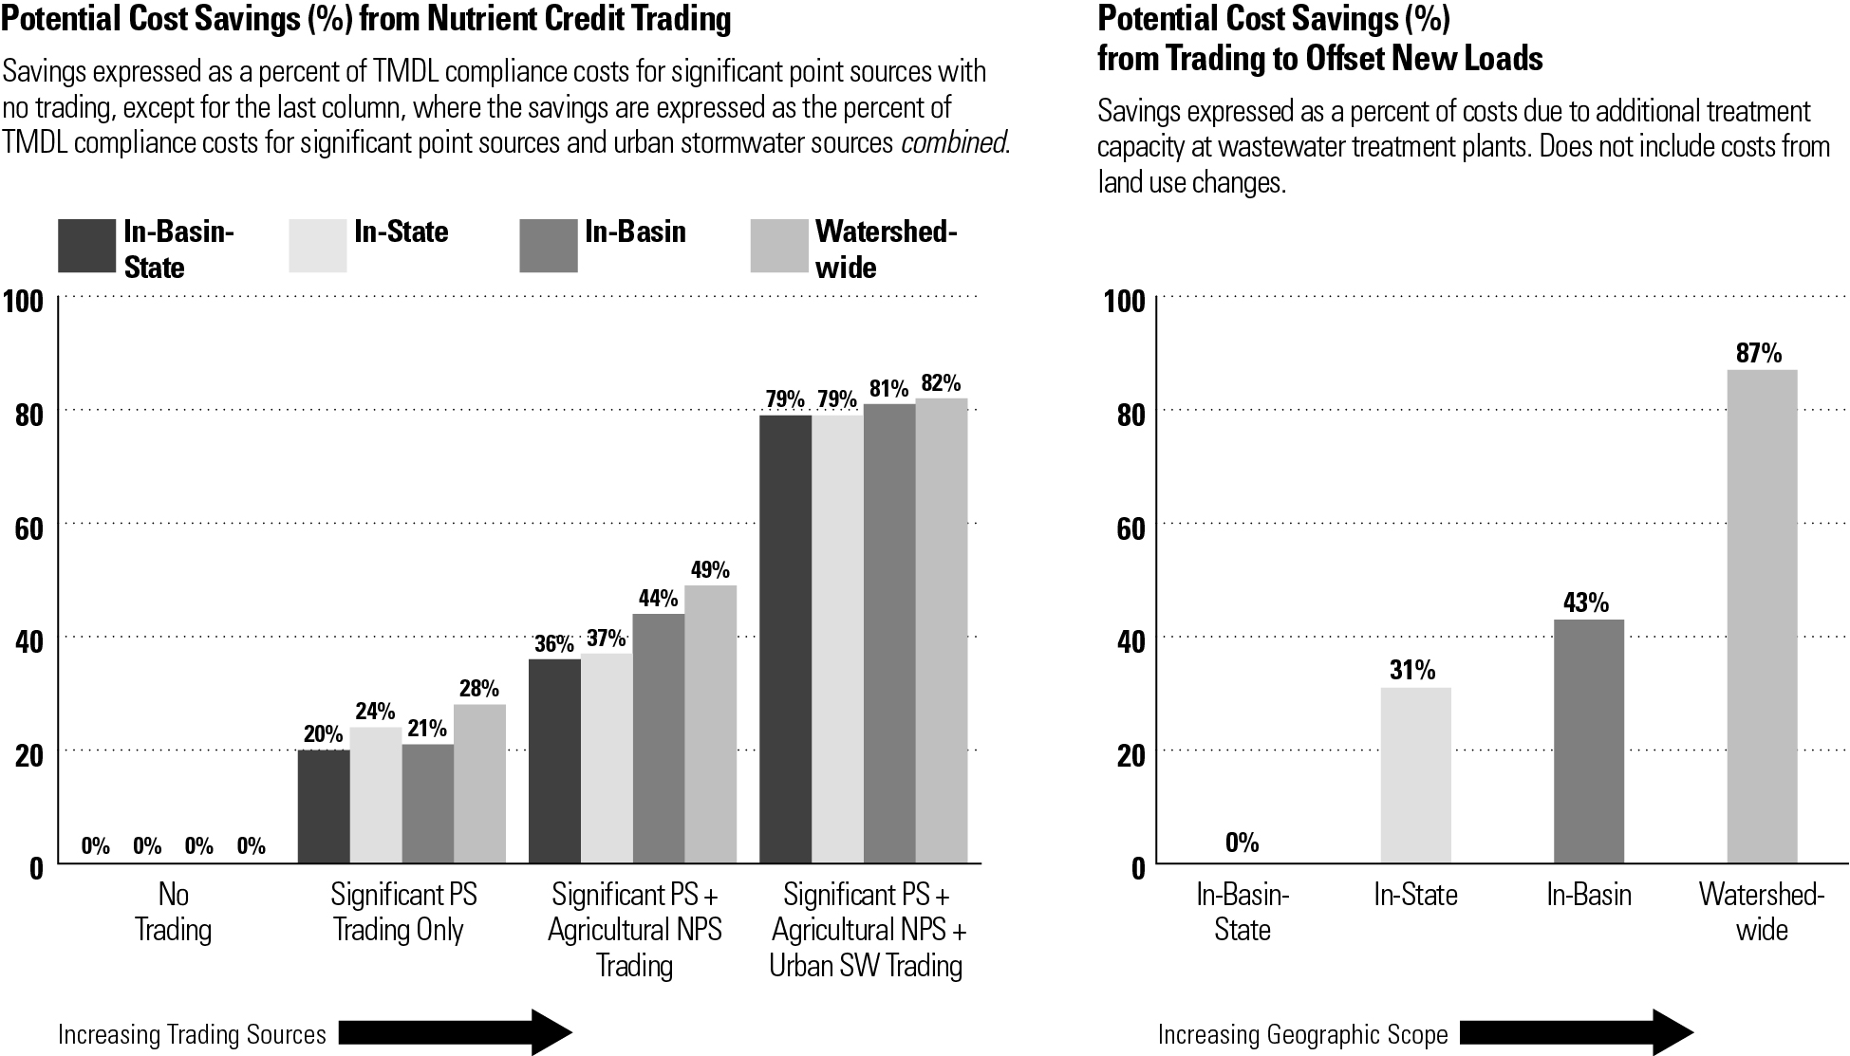
Summary of Findings
Notes:
Here is THE BOTTOM LINE! “Nutrient Credit Trading could deliver significant cost savings!”
(1) Benefits of Trading expressed as “Potential Cost Savings” LEFT Side: trading to meet Bay TMDL & RIGHT side Trading to offset new loads
LEFT CHART:
Savings as percentage of “NO TRADING” TMDL compliance
Individual bars are expanding geographic area left-to-right
X-Axis is increasing eligible source sectors to buy or sell going to right
SigPS; SigPS with AgNPS; SigPS with AgNPS with UrbanSW
RIGHT CHART:
Offset trading to accommodate new or expanding point source wastewater loads beyond TMDL limits
Even if installing “state-of-art” technology there will be a discharge needing an offset
X-Axis shows cost saving greater as geographic area increasing trading opportunities
(these charts are in the Executive Summary)

Slide 9

Why Potential Cost Savings?

Slide 10
A Market Requires
Defined Product
Buyer
Seller
Voluntary Entry
A Marketplace Requires
Rules and Boundaries
Information
Access
In Reality . . .
Markets Do Not Work Perfectly
Policymakers must consider factors other than cost
Notes:
Analysis assumes:
incentive to achieve load reductions at a lower cost
analysis assumes all cost savings opportunities were identified and acted on
In practice:
trading will not exhaust all cost-saving opportunities
Markets do not work perfectly
Regulators must consider other objectives besides cost savings
Therefore, these results should be interpreted as “best-case” or “upper bound” estimates of cost savings

Slide 11
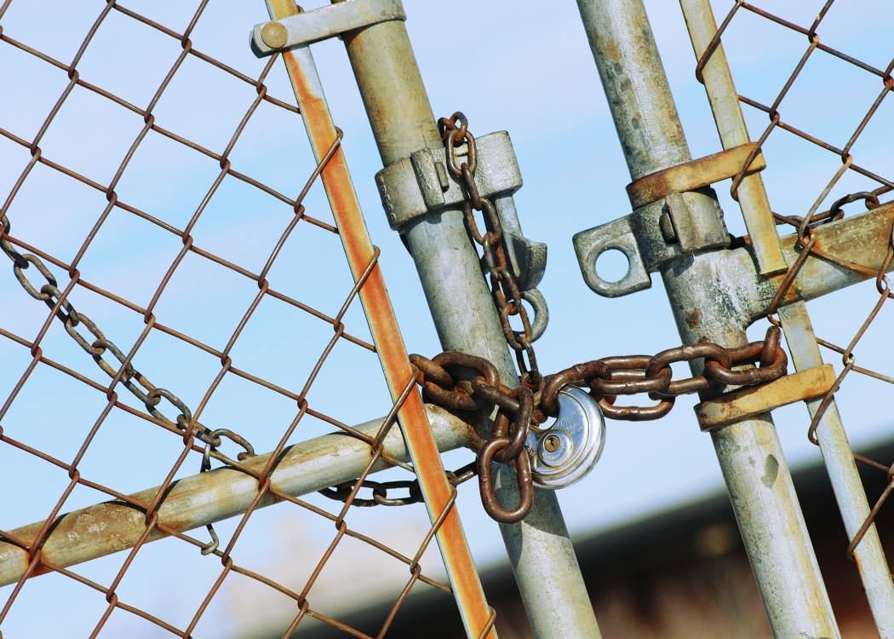
Market Restrictions
Baseline for Agriculture
TMDL implementation
Baseline for Significant Point Sources
TMDL WLA or 2010 load
Protection of Local Water Quality
Trades limited to 9M lbs N; 200,000 lbs P
Trading Ratio
2:1
Transaction Costs
38%
Maintain Productive Farmland
maximum 25% retirement
Notes:
Baseline requirements for AgrNPS
Only BMPs above and beyond TMDL baseline are eligible to generate credits
Baseline requirements for SigPS
Only load reductions relative to (1) 2010 level or (2) TMDL waste load allocation (whichever is less) are eligible to generate credits
Limits on total credit trades
EPA analysis indicates that a maximum of 9 million lbs of N and 200,000 lbs of P could be traded between the 92 tidal segments without causing water quality impairments in these tidal areas
Trading ratio (2:1)
To buy credits from AgrNPS, SigPS and urban sources must buy 2 credits for each 1 credit needed
Accounts for relative uncertainty associated with performance of agricultural BMPs
Transaction costs
38% mark-up for AgrNPS costs to account for relatively high monitoring, verification, reporting and related trading costs (USDA NRCS and Minnesota River Basin) -- p. 27 of report
Limits on Loss of Productive Farmland
No more than 25% of farmland within each land-river segment and land-use category can be idled for BMP implementation

Slide 12
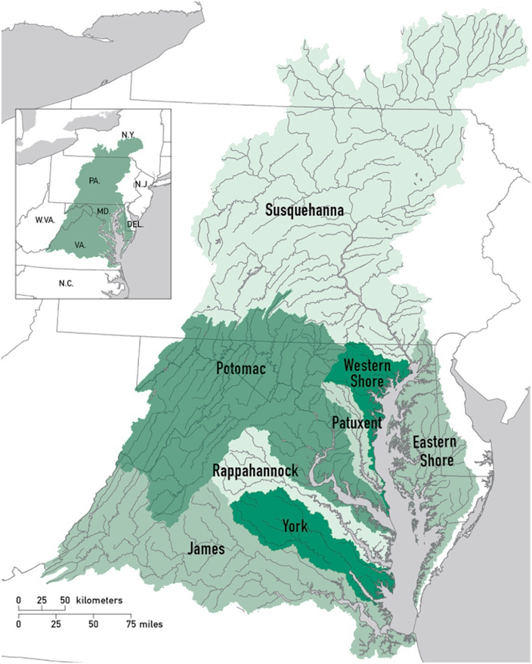
Nutrient Trading Scenarios
Geography
  3 scenarios
  In-Basin-State
  In-State
  In-Basin
  Watershed-wide
Notes:
What geographic limits are placed on participation in the market?
In-Basin-State: Trading only allowed between sources located in the same basin and the same state
In-State: Trading only allowed between sources located in the same state
In-Basin: Trading only allowed between sources located in the same basin
Watershed-wide: Trading allowed between any sources located within the Chesapeake Bay watershed

Slide 13
Nutrient Trading Scenarios
Sources
  3 short term scenarios
  SigPS-Only
  SigPS-AgrNPS
  SigPS-AgrNPS-Urban
  1 long term scenario
  Offset-Only
Notes:
Short Term – means trading to meet the Bay TMDL
3 short term scenarios
SigPS-Only: Trading only among significant point sources
SigPS-AgrNPS: Trading among SigPS and agricultural nonpoint sources
SigPS-AgrNPS-Urban: Trading among SigPS, AgrNPS, and regulated urban stormwater sources
1 long term scenario
Offset-Only: Trading only to offset future growth in wastewater treatment capacity at municipal SigPSs

Slide 14
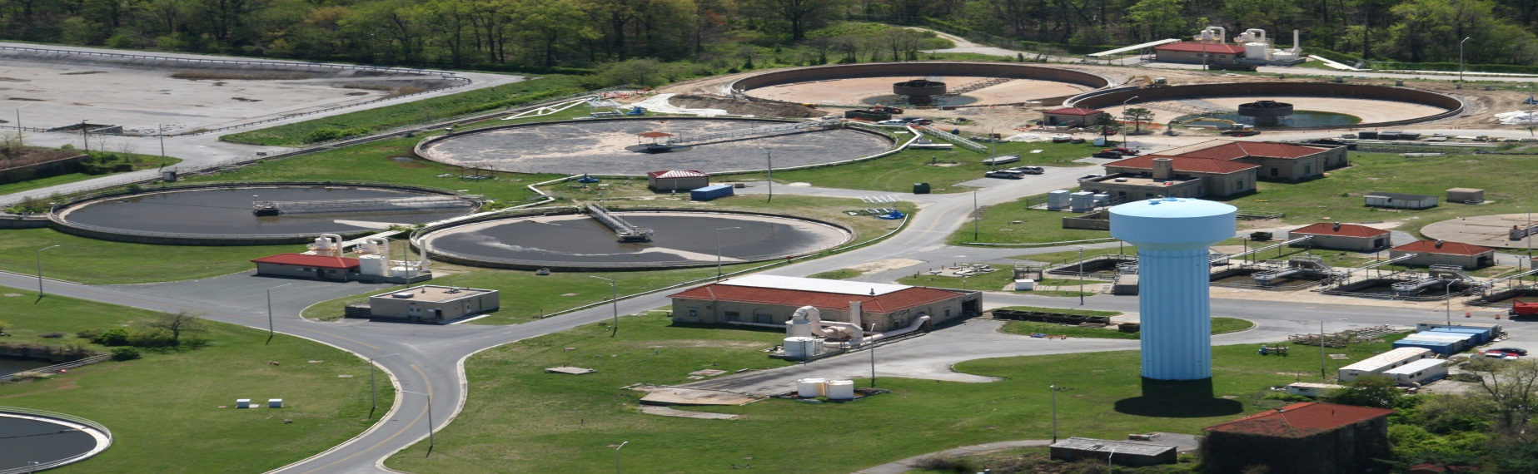
Control Projects, Load Reductions and Annual Costs
Significant Point Sources (SigPS)
475 municipal and industrial facilities
16 tiers of treatment based on:
  8, 5 or 3 mg/L N
  1, 0.5 or 0.1 mg/L P
Annualized costs (capital and O&M) based on EPA’s ongoing cost analysis
Jane Thomas, ian.umces.edu/imagelibrary

Slide 15
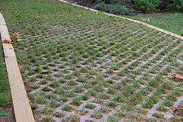

Control Projects, Load Reductions and Annual Costs
Agricultural and
Urban Stormwater BMPs
Annualized unit costs ($/ac/yr)
Includes land, installation and O&M

Slide 16
Aligning Our Work
The Chesapeake Bay Program’s Watershed Model Phase 5.3.2 Provided Key Inputs
Watershed network and segmentation
Land use/land cover
Delivered loads
BMP nutrient removal rates
Acres of BMP implementation
Notes:
Watershed network and segmentation— subdivides the Bay watershed into a linked network of ~2,500 “land-river segments”
Land use/cover—30 land use categories, which we regroup into 3 crop, 2 pasture, and 2 urban categories
Delivered loads— annual N and P loads delivered to the Bay’s tidal waters from each land use in each land-river segment
BMP nutrient removal rates—for AgrNPS and urban stormwater best management practices (BMPs)
Acres of BMP implementation—by land-river segment for
Current (2010) conditions
TMDL conditions, based on states’ Phase 1 watershed implementation plans (WIPs)

Slide 17
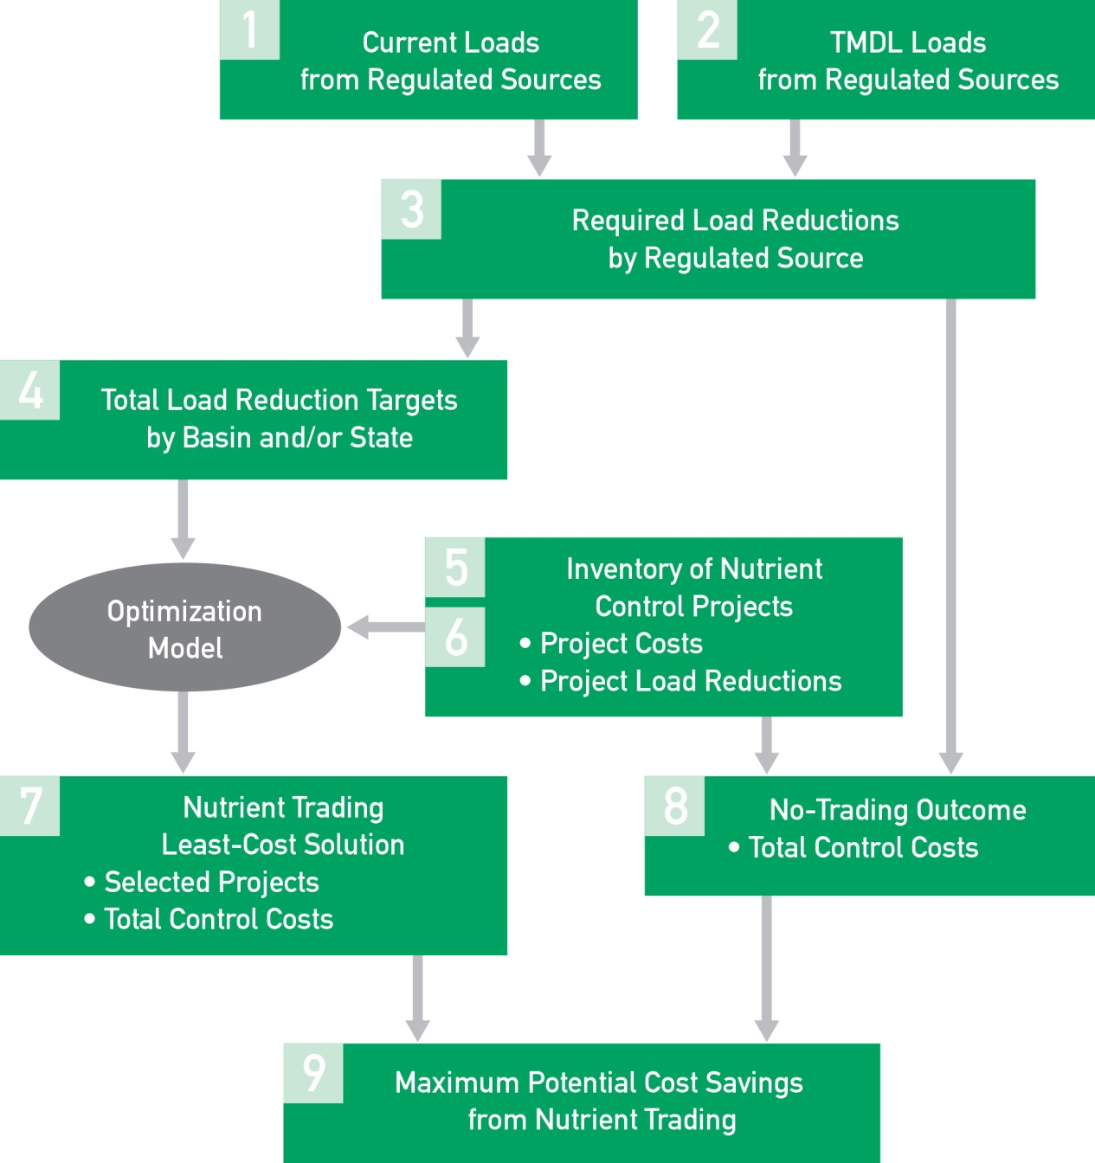


Analytical Framework
9 step process to identify the least-cost solution (representing the trading outcome)
Optimization model used always seeks least cost BMPs first as available within other constraints (basin, state, local water quality, etc.)
Notes:
This framework depicts the method to determine reductions and the “no trading” versus “trading least cost” solution from the Optimization Model used by RTI, International

Slide 18
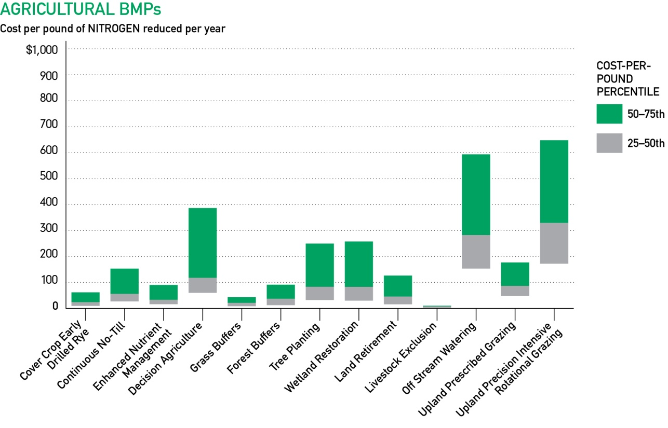
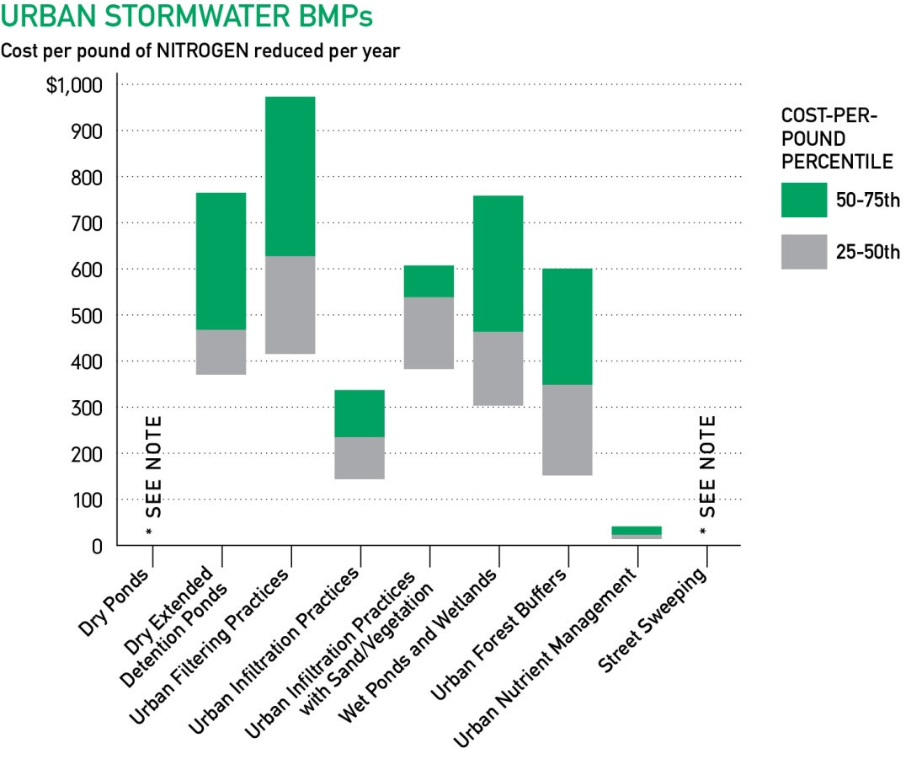
Cost-Effectiveness of Ag BMPs and Stormwater for N Removal Vary Widely
Using N
as an example
*Value ranges for
dry ponds
and street sweeping are above $1,000/lb
Notes:
Key Points for the slide:
1. Explain the full range of cost per BMP expressed 25% to 75% and where 50 percentile is
2. Cost difference between Ag and urban BMPS; Ag to $1,000 on vertical axis; urban $1,000
3. Optimization model used will seek least cost BMPs first as available within other constraints (basin, state, etc.)
Charts for PHOSPHORUS $1,800 for Ag and $90,000 for urban (see full report)

Slide 19
The Findings

Slide 20
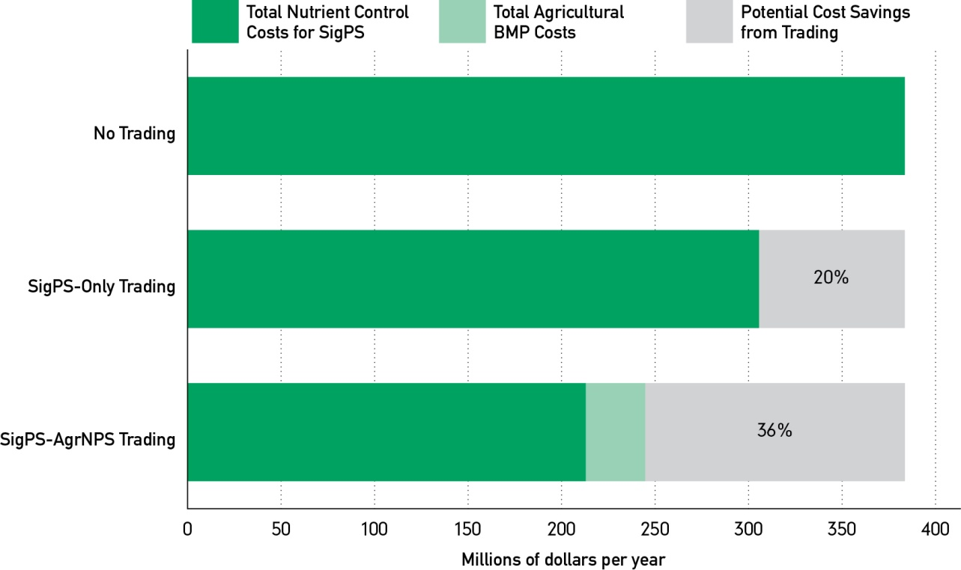
Cost of Meeting SigPS Load Reduction Targets
No-Trading v. In-Basin-State Trading
Notes:
IN-BASIN-STATE (Most restrictive geographic scenerio)
Under NO-Trading the TOTAL ANNUAL COST of compliance is $385 Million/yr
Trading among SigPS only saves $78 Million/yr (20%)
Trading among SigPS and AgNPS saves $140 Million/yr or $245 M instead of $385 M (36%)

Slide 21
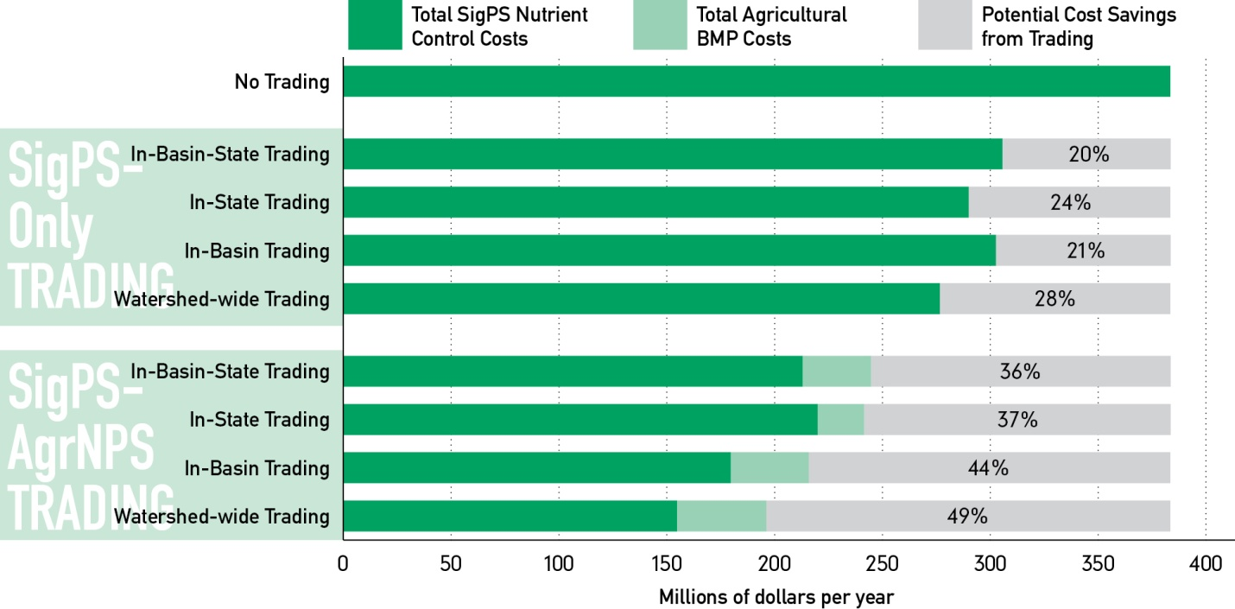
Cost of Meeting SigPS Load Reduction Targets
Notes:
This slide depicts two Source variations, SigPS only and SigPS with AgrNPS across all 4 geographic scopes.
Increasing sources and increasing geographic trading scope increases the potential cost savings.

Slide 22
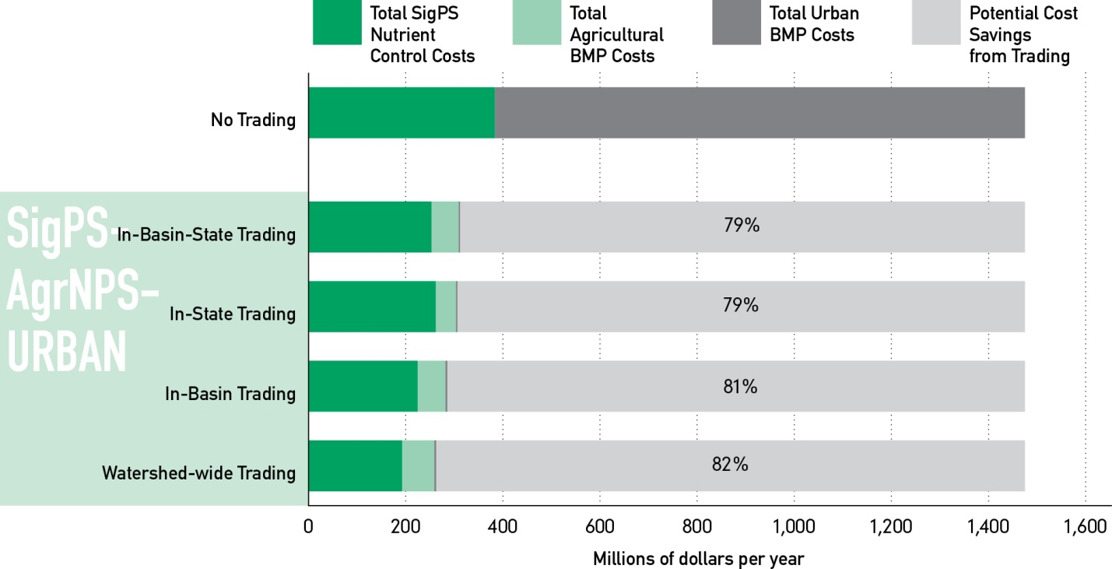
Cost of Meeting SigPS and
Regulated Urban Stormwater
Load Reduction Targets
Notes:
Similar to the previous slide, but now including the very expensive urban stormwater as buyers of credits
The “NO Trading” bar has SigPS and Urban cost of about $1.47 billion/yr (74% is the urban cost)
The potential cost saving rises significantly.

Slide 23
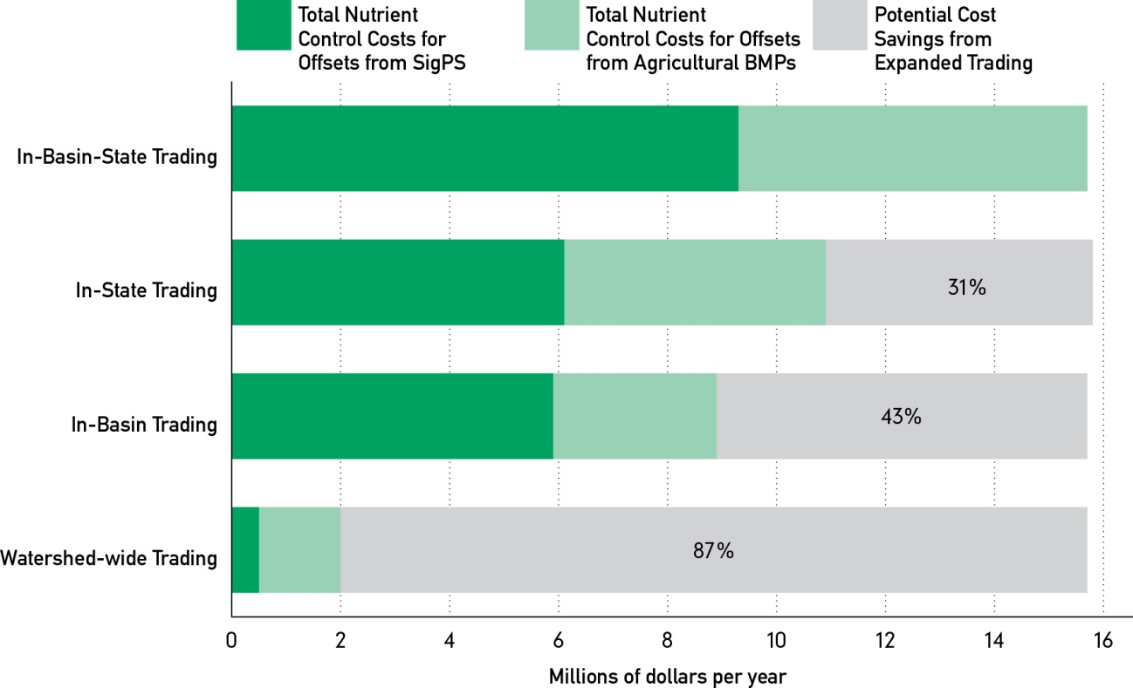
Cost of Offsets for Added Capacity at Municipal SigPS
Long Term Offset-Only Trading Scenarios
Notes:
KEY POINT- This scenario is very different from the last 3 slides;
It is for the offsetting of growth; maintaining the “CAP”, not just achieving the TMDL
Looks to 2025 and population growth and impacts to SigPS that must expand capacity
KEY POINT- only “additions” to capacity at SigPS are eligible to buy credits; they must offset loads in any discharges
This does not account for ongoing changes in landuse, expansion of developed lands or desired offsets for urban areas
(STAFF Note: read REPORT pages 48-50 for details)

Slide 24
Summary of Findings
Notes:
Here is THE BOTTOM LINE! “Nutrient Credit Trading could deliver significant cost savings!”
(1) Benefits of Trading expressed as “Potential Cost Savings” LEFT Side: trading to meet Bay TMDL & RIGHT side Trading to offset new loads
LEFT CHART:
Savings as percentage of “NO TRADING” TMDL compliance
Individual bars are expanding geographic area left-to-right
X-Axis is increasing eligible source sectors to buy or sell going to right
SigPS; SigPS with AgNPS; SigPS with AgNPS with UrbanSW
RIGHT CHART:
Offset trading to accommodate new or expanding point source wastewater loads beyond TMDL limits
Even if installing “state-of-art” technology there will be a discharge needing an offset
X-Axis shows cost saving greater as geographic area increasing trading opportunities

Slide 25


Keys to a Successful Trading Program
Verification
Local Water Quality Protection
Measurable and Enforceable Cap

Slide 26

Questions?
Ann Swanson
Executive Director
Chesapeake Bay Commission
410-263-3420
aswanson@chesbay.us
www.chesbay.us

