Slide 1
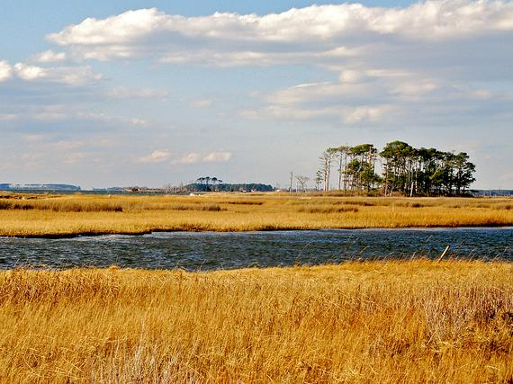
Ensuring Progress:
Oversight of Watershed Implementation Plans and 2-Year Milestones
U.S. EPA Chesapeake Bay Program Office
June 1, 2012

Slide 2
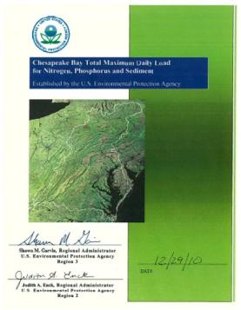
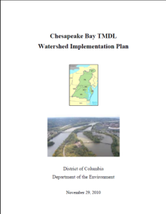
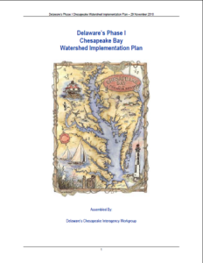
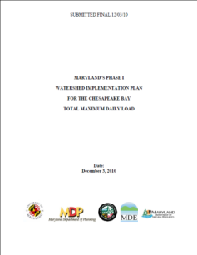
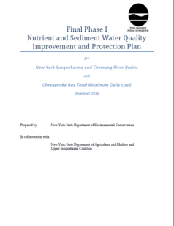
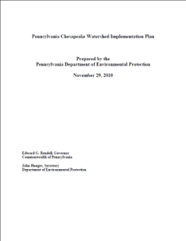
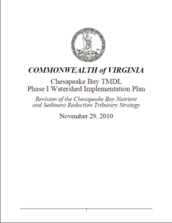
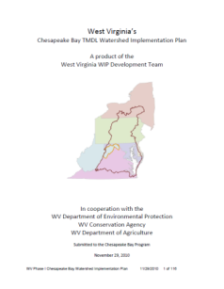
Chesapeake Bay TMDL Based on
7 Watershed Implementation Plans

Slide 3
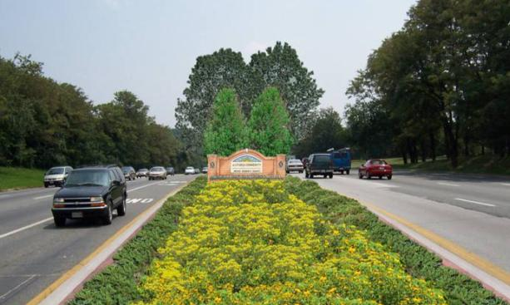
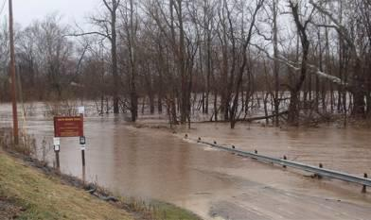
Taking It to the Streets: Phase II WIPs
Increase awareness
Modify strategies for greater benefits to communities
Opportunity to strengthen long-term strategies

Slide 4
Two-Year Milestones
EPA Will Assess if
Milestone
Reductions on Schedule
Interim Target: 60% by 2017
Assumes Upfront Program-Building and Future Reductions
Assumes Constant Reduction Over Time
Assumes Upfront Low-Hanging Fruit and More Difficult Future Reductions

Slide 5
Select Highlights
Delaware: Commitment to address CAFO permit backlog. Stormwater: provided information on compliance monitoring and new regulations.
District of Columbia: Significant engagement with federal agencies
Maryland: Recent legislation to increase funding for POTWs, stormwater, and septic systems. Schedule to reissue MS4 permits with provisions to implement WIP strategies.

Slide 6
Select Highlights
Pennsylvania: Increasing compliance with existing agricultural programs. Guidance and training on Chesapeake Bay Pollutant Reduction Plans.
Virginia: Detailed strategy for Resource Management Program. Commitment to finalize agreement in response to stormwater assessment.
West Virginia: Agricultural strategies based on farmer feedback. Schedule for reissuing Construction General Permit.

Slide 7
EPA Oversight of WIPs
EPA will monitor progress in all states and source sectors. (ongoing oversight)
· Some sectors will require closer monitoring by EPA (enhanced oversight):
o PA and WV agriculture strategies
o PA trading programo VA stormwater program
o The WIPs do not fully explain how these strategies will meet pollution reduction goals.
PA’s stormwater program will require detailed scrutiny (backstop action) to address shortcomings, and EPA is prepared to take steps to ensure progress continues in this sector.

Slide 8
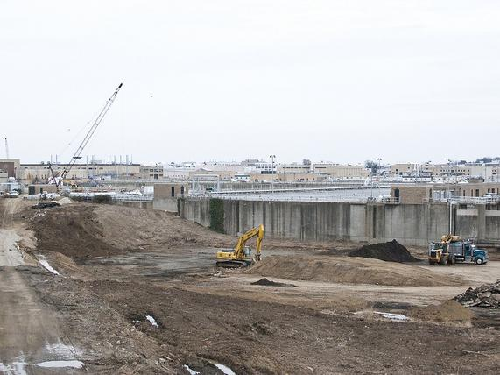
Shifting Focus from Planning to Implementation
Turning plans into on the ground actions
All practices in place by 2025
60% by 2017
Near term actions to support long-term success

Slide 9
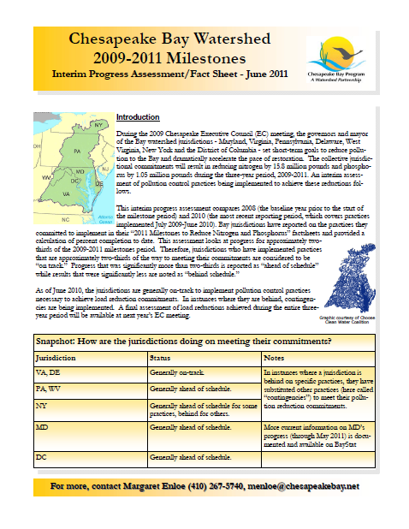
Overseeing Progress
Interim and final reports to Executive Council on milestone progress
Quarterly oversight discussions
Goals:
  No surprises
  Work together to address issues early

Slide 10

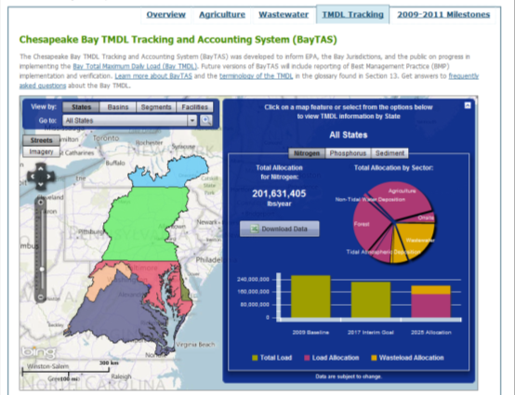
Informing Ongoing EPA Activities
Aligning grant work plans with WIP and milestone priorities
Transparent tracking tools
Permit reviews
Program assessments

Slide 11
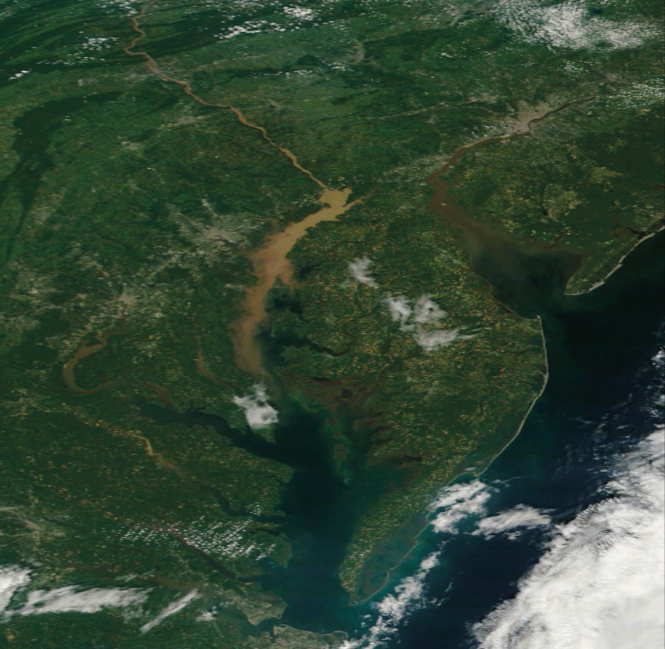
So We Can Have Less of This…

Slide 12
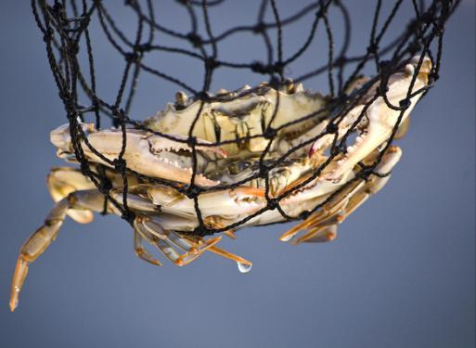
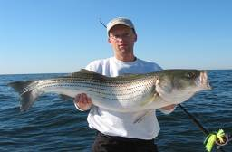
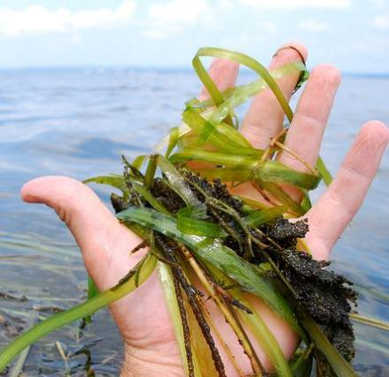
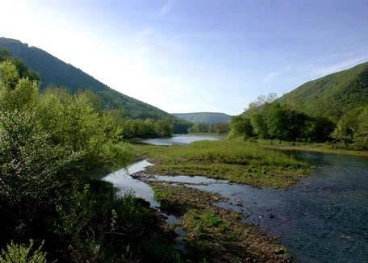

And More of This…

Slide 13
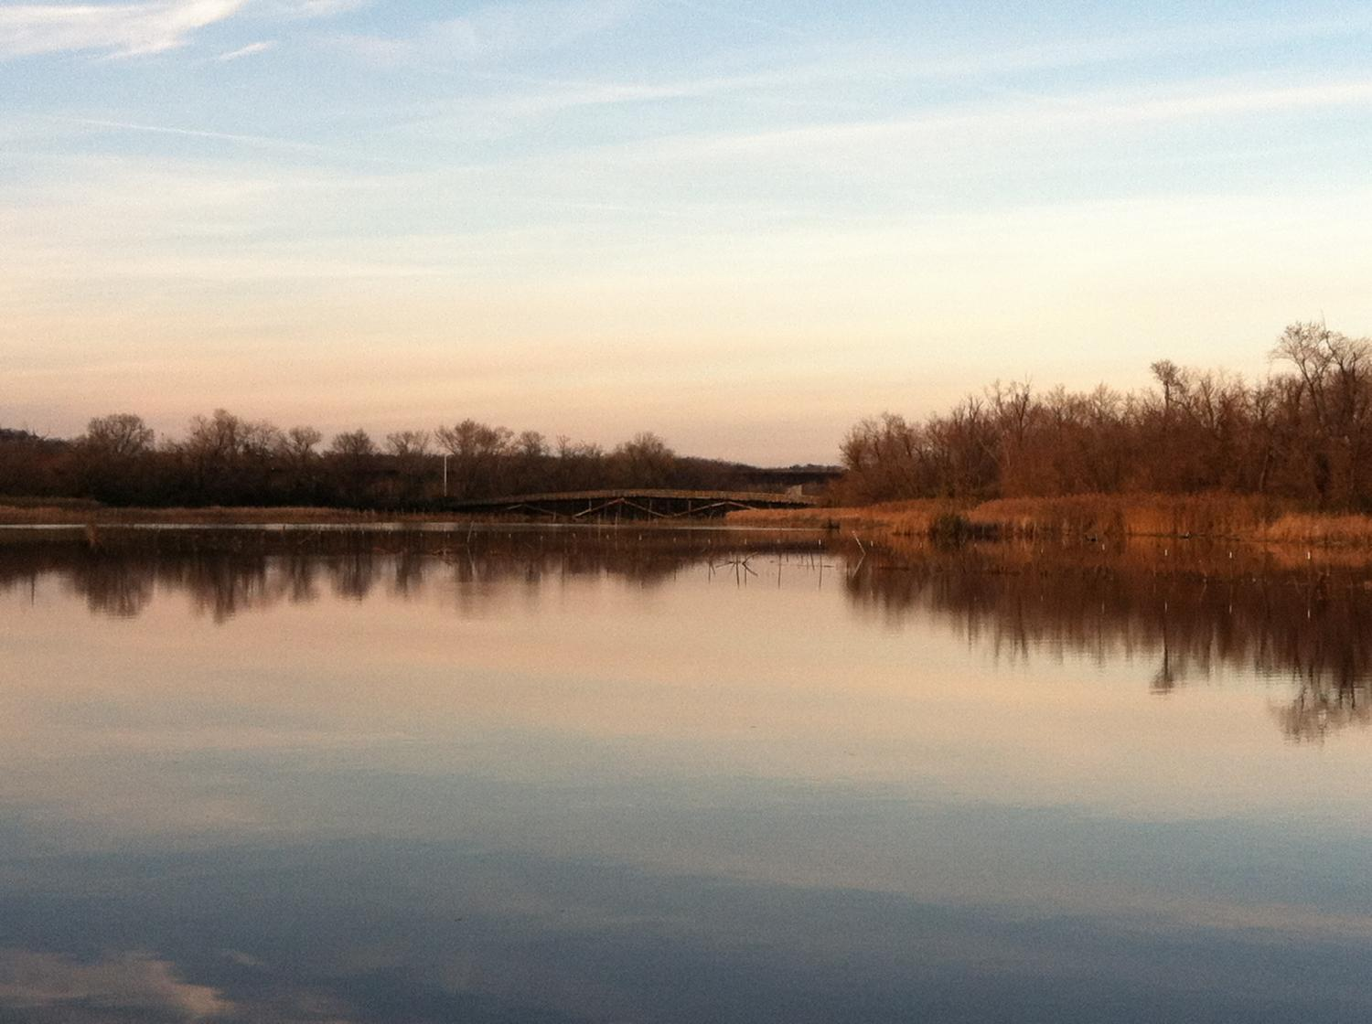
Jim Edward
Deputy Director
U.S. EPA Chesapeake Bay Program
edward.james@epa.gov
www.epa.gov/chesapeakebaytmdl
http://stat.chesapeakebay.net/

