Slide 1
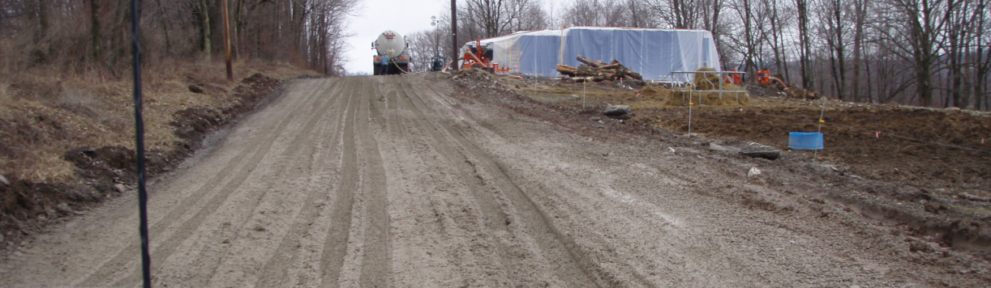
Potential Impacts of Modern Energy Development on Rural Roads and Waterways
Tim Ziegler
PSU Center for Dirt and Gravel Roads
www.dirtandgravelroads.org
Presentation to the Citizens Advisory Committee to the
Chesapeake Executive Council, September 6, 2012

Slide 2
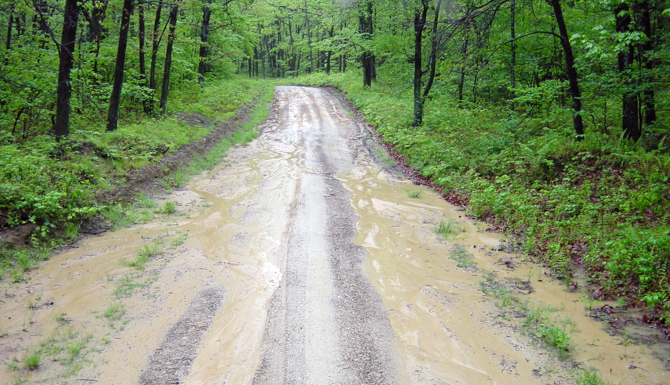
First, let’s look at a program unique to Pennsylvania
DGRMP Goals: - Reduce Sediment Pollution
- Reduce Maintenance Costs

Slide 3











PROGRAM BACKGROUND
Established in 1993, a multi-disciplined
“Task Force” on Dirt and Gravel Roads substantiated the contribution of unpaved public roads related to sediment pollution
in waters of the Commonwealth.
Notes:
Bud Byron Story
In 1991, “ Bud” Byron, an active member of Trout Unlimited, was fishing on a favorite trout stream in Northern PA, when a big storm rolled in. The stream he was fishing immediately clouded up with thick brown sediment. Very upset, Bud hopped in his truck and drove upstream to find the source of the muddy water. He figured it was coming from a logging operation or a gas well site, but none were found. It was then that he realized that all the sediment was coming from the dirt road he was driving on.
Bud was a well respected and determined guy. When he got home he called everyone he could think of who was interested in protecting streams from pollution. As a result, a multi-disciplined task force on dirt and gravel roads was established in 1993 to investigate the problem.

Slide 4

Dirt and Gravel Road Maintenance Program
www.dirtandgravelroads.org
DGRMP History & Goals
Section 9106 (1997) of Pa. Motor Vehicle Code,
The law in a nutshell…
“To reduce sediment and dust pollution to the waters of the Commonwealth through effective and common sense maintenance practices on unpaved public roads”.
Notes:
For those of us that don’t like the legalese of legislative bills, here is is a more straitforward way of saying the same thing.

Slide 5
Dirt and Gravel Road Maintenance Program
www.dirtandgravelroads.org
DGRMP History & Goals
from this law was established the
Pennsylvania Dirt and Gravel Road Maintenance Program
(DGRMP)
To promote the use of Environmentally Sensitive Maintenance (ESM) practices to reduce sediment pollution and long term maintenance costs associated with unpaved public roads.
Notes:
For those of us that don’t like the legalese of legislative bills, here is is a more straitforward way of saying the same thing.

Slide 6

ESMPs
ESM
ENVIRONMENTALLY
SENSITIVE (road)
MAINTENANCE
ESM: Maintenance practices or techniques that works with natural systems to create a better road, and a better environment.
Notes:
ESMPs work with Natural Systems
Better Roads/Better Environment
Backbone of Training
Environmentally Sensitive Maintenance Practices are techniques that work with natural systems to create both better roads and a better environment. These principles are the backbone of this training.

Slide 7

ESMPs
ESM
ESM vs. Traditional Road Drainage
Ditches and Ditch Outlets
Traditional Drainage Practices: (collect and control)
Collection
Armoring
ESM Drainage Practices: (divide and conquer!)
Dispersal
Sheet Flow
Infiltration
Mimic Natural Drainage
Notes:
ALL ESMPs have these five goals
These five principles are the goals of ALL of the Environmentally Sensitive Maintenance Practices we will discuss in the next two days.

Slide 8
ESMPs
ESM
GOALS:
Promote Sheet Flow
Encourage Infiltration
Reduce Sedimentation of Surface Waters
Reduce effects of Sub-surface water on Roads
Reduce Occurrence and Severity of Floods
Reduce Costly Road Maintenance
Requires a change in long held beliefs and accepted methods of stormwater management
(i.e. - traditional road management)
Notes:
ALL ESMPs have these five goals
These five principles are the goals of ALL of the Environmentally Sensitive Maintenance Practices we will discuss in the next two days.

Slide 9
Win-Win
BETTER ROADS – CLEANER STREAMS
Dirt and Gravel Road Maintenance Program
www.dirtandgravelroads.org
DGRMP History & Goals
1997 - 2012
15 Years has Proven!
“improved maintenance techniques will benefit both roads and the environment”
Notes:
If you are here representing a town or township, it’s likely that your main goal is to have the best roads that you budget will allow.
If you are from one of the conservation districts here, you want to see the local roads maintained in a way that reduces their negative impacts on local waters.
In the 13 year history of the D&G Program, it’s been noted that well conceived and executed D&G projects will meet the goals of both the township and the district. Both the taxpayer and the environment win.

Slide 10
Dirt and Gravel Road Maintenance Program
www.dirtandgravelroads.org
DGRMP History & Goals
Began in 1997
Over 8,000 people ESM trained
Completed over 2,000 Worksites
Run by County Conservation Districts
Local public road owning entities work with District to plan and complete projects
Cooperative effort to reduce long term maintenance costs and stream pollution from unpaved roads
Notes:
By adopting D&G principles and working cooperatively, we have a better shot at adapting to the inevitable changes that are going to take place.

Slide 11
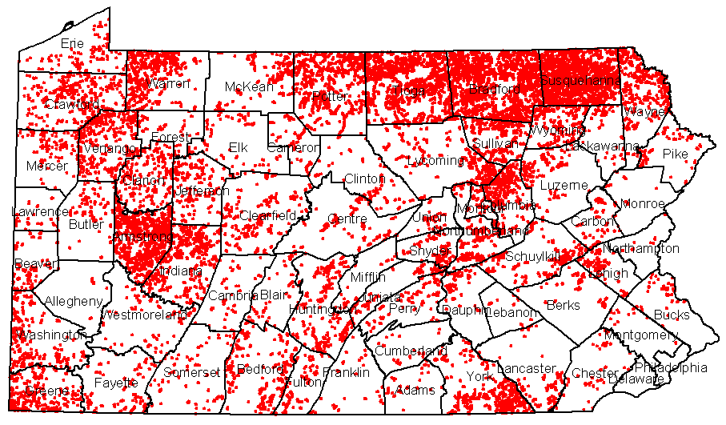
UNPAVED ROAD NETWORK
Public Unpaved Road in Red (16,500 miles)*
*does not include 2,000+ miles of DCNR roads
Blue is Marcellus Shale footprint

Slide 12
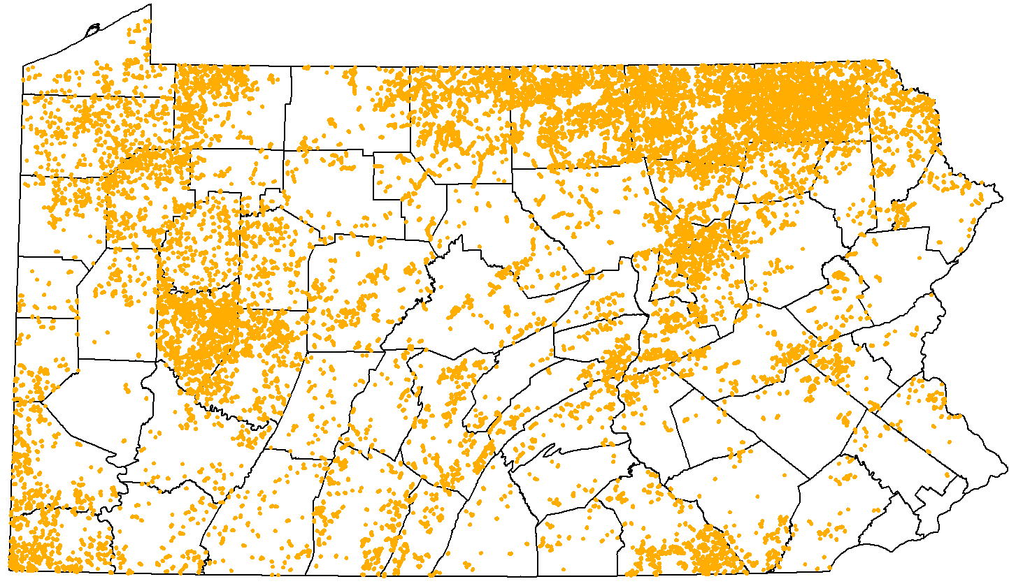
UNPAVED PUBLIC ROADS AND IDENTIFED POLLUTION SITES
16, 500 miles of unpaved public road
16,600 pollution worksites identified
*roughly 1/3 of road drainage is directly connected to a stream

Slide 13
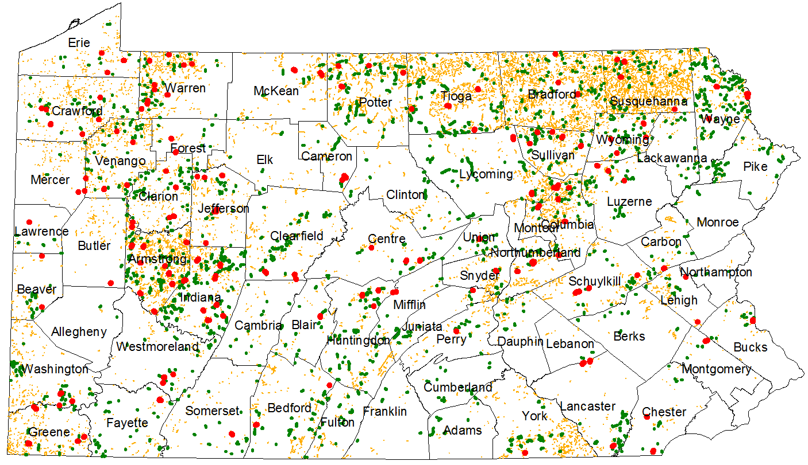
COMPLETED PROJECTS
(known pollution sites addressed)
Unaddressed Pollution Sites (14,500 sites)
All Funded Worksites (2,100 sites)
2010 Funded Worksites (180 sites)
Program Status as of 1/2011

Slide 14
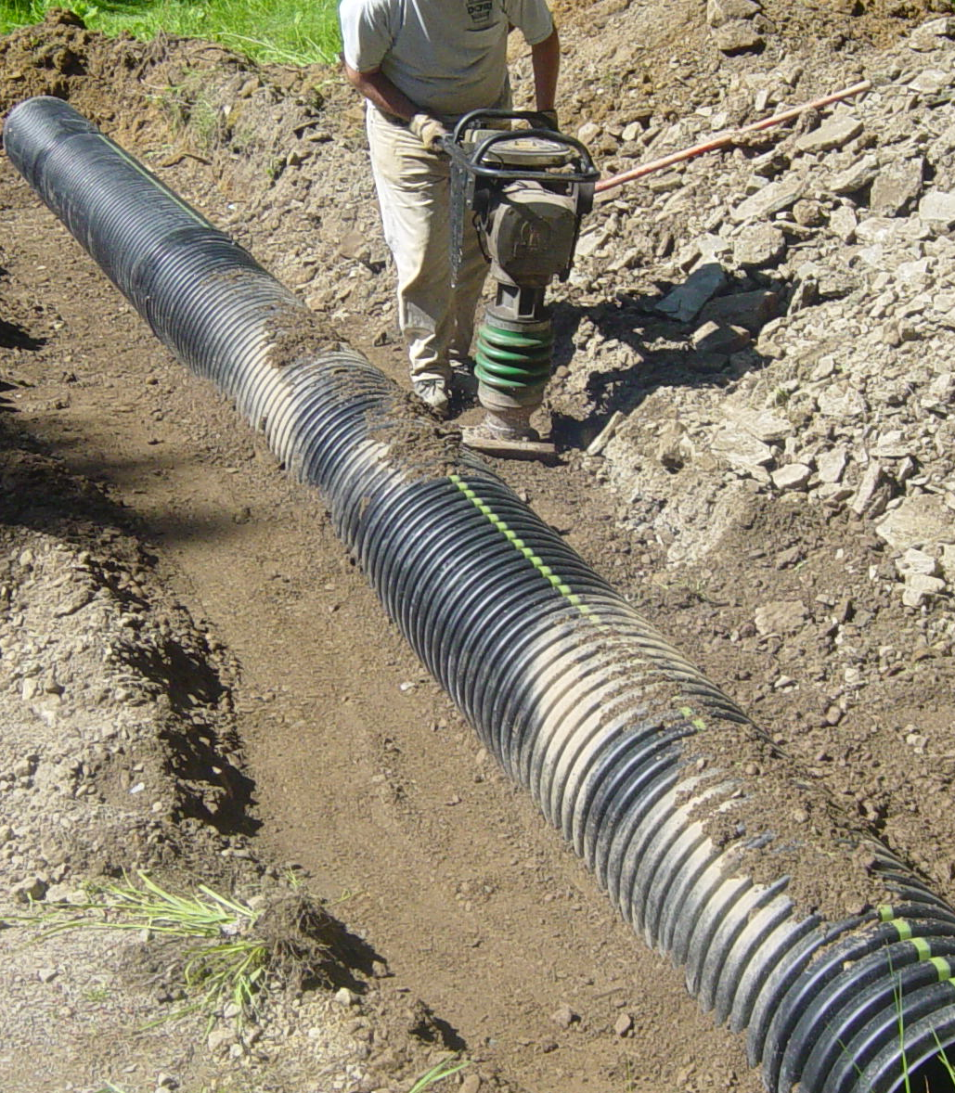
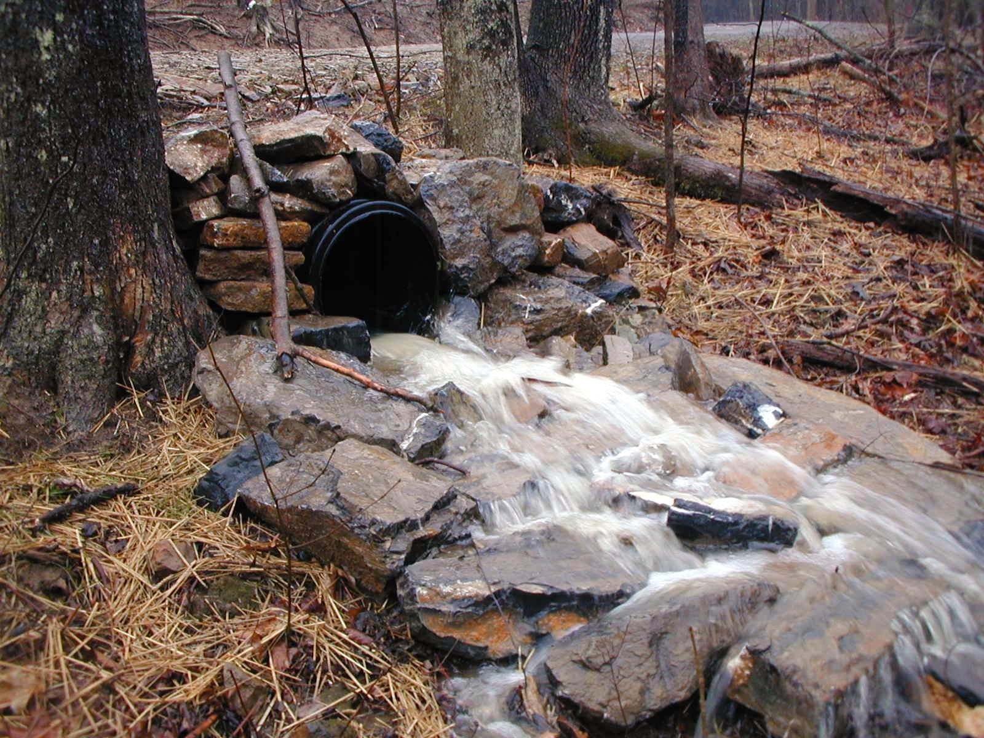
Sample Projects & Practices
This could be, a better use of common practices,
such as the Strategic use of crosspipes
BEFORE AFTER

Slide 15
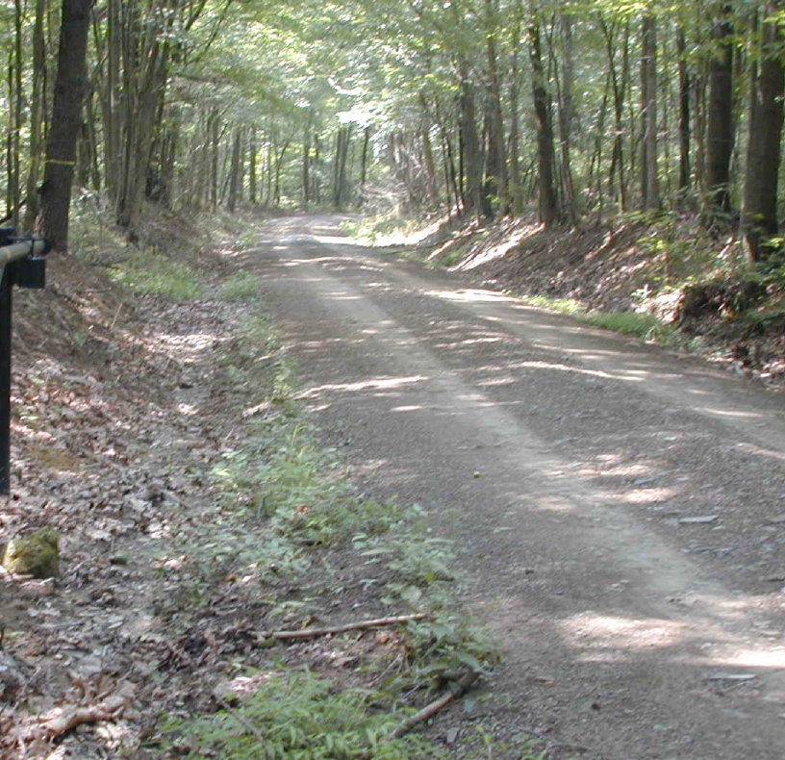
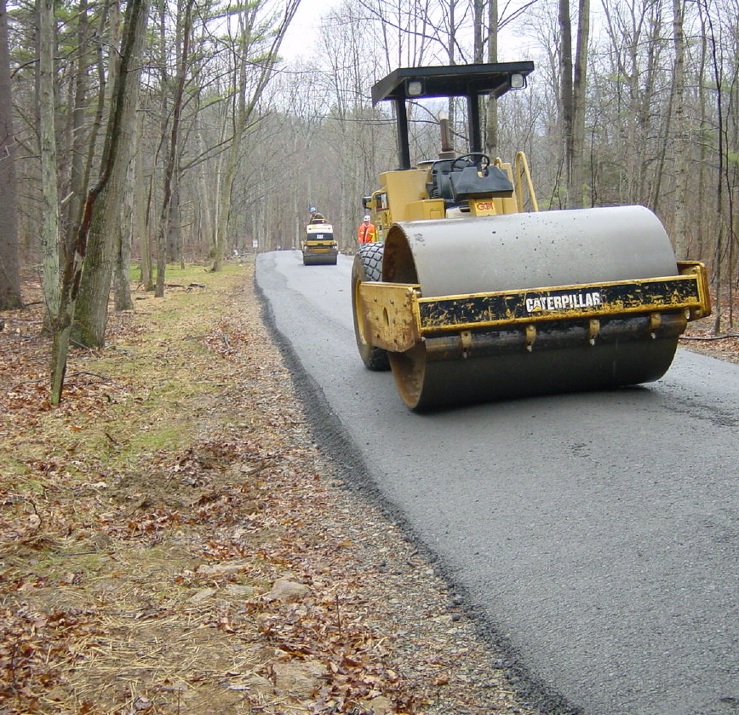
Sample Projects & Practices
It could also include innovative practices like
Filling the road to eliminate ditches
and to reconnect natural drainage
BEFORE AFTER

Slide 16
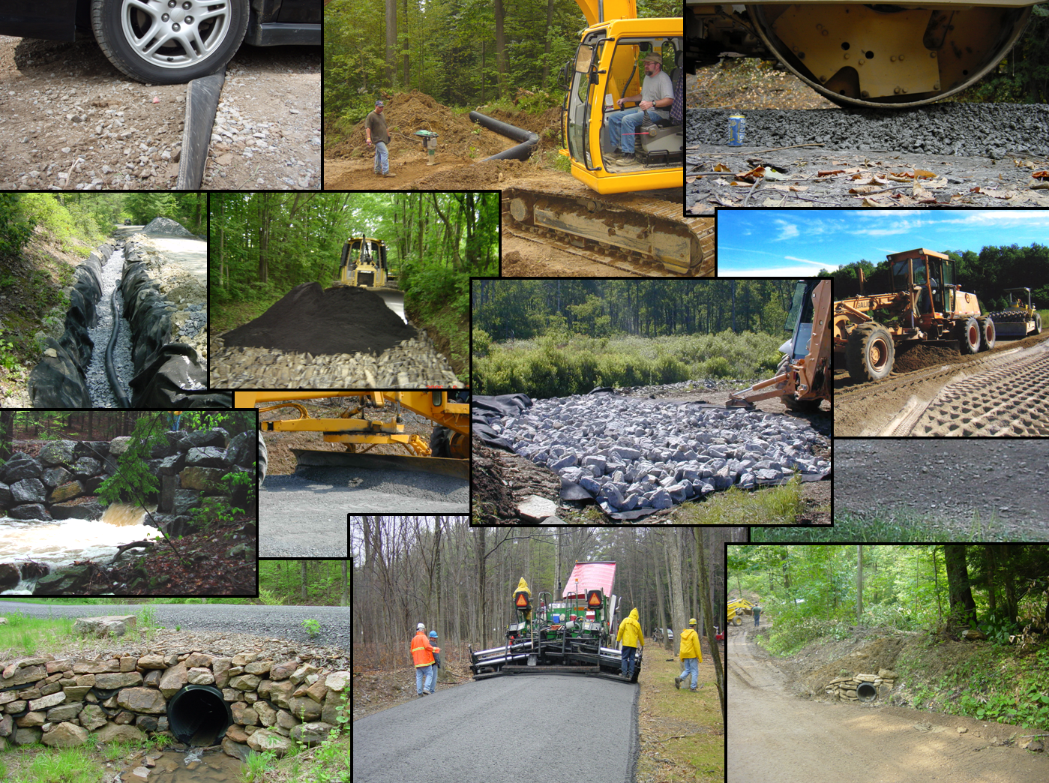
SAMPLE PROJECTS

Slide 17
DGRP PROGRAM FUNDING
To address known pollution sites and provide hands on maintenance training for municipalities the law provides funding
$5,000,000 non lapsing annual allocation
$1,000,000
PA Bureau of Forestry
2,000+ Miles of unpaved road
$4,000,000
PA Municipalities
16,500+ Miles of unpaved road

Slide 18
DGRP PROGRAM EFFICIENCY
(since inception)
$4 MILLION Annual Allocation
-$480,000 Statewide admin / education (12%)
-$530,000 County admin / education (13%)
$3 MILLION Materials, Equipment, and labor
for on the ground projects (75%)
+$1,110,000 Average Annual In-kind ($0.37 per $1)
$4.1 MILLION Annual on the ground spending on
materials, equipment, and labor for
projects. (103%)
A return of $1.37 for every $1.00 spent!

Slide 19
DIRT AND GRAVEL ROAD PROGRAM STRUCTURE
Arguably, the most efficient state program anywhere!
STATE: State Conservation Commission
- Oversees statewide Program
COUNTY: Soil and Water Conservation Districts
- Runs Program within each county.
LOCAL: Municipalities
- Apply to Districts for funding
- Do the work, or contract the work out.

Slide 20

Driving Surface Aggregate Sediment Study
PSU Center for Dirt and Gravel Road Studies
www.dirtandgravelroads.org
Background: Center
Dirt and Gravel Road Maintenance Program
www.dirtandgravelroads.org
Center for Dirt and Gravel Road Studies
  Founded in 2000 to provide educational services to PA Dirt and Gravel Road Maintenance Program.
  Part of Thomas D Larson PA Transportation Institute at Penn State.
  Five full-time employees.
  Collaborates with both public and private sector to complete outside education and research.

Slide 21
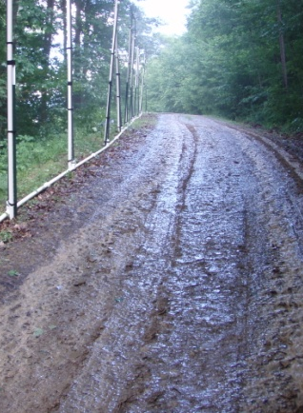
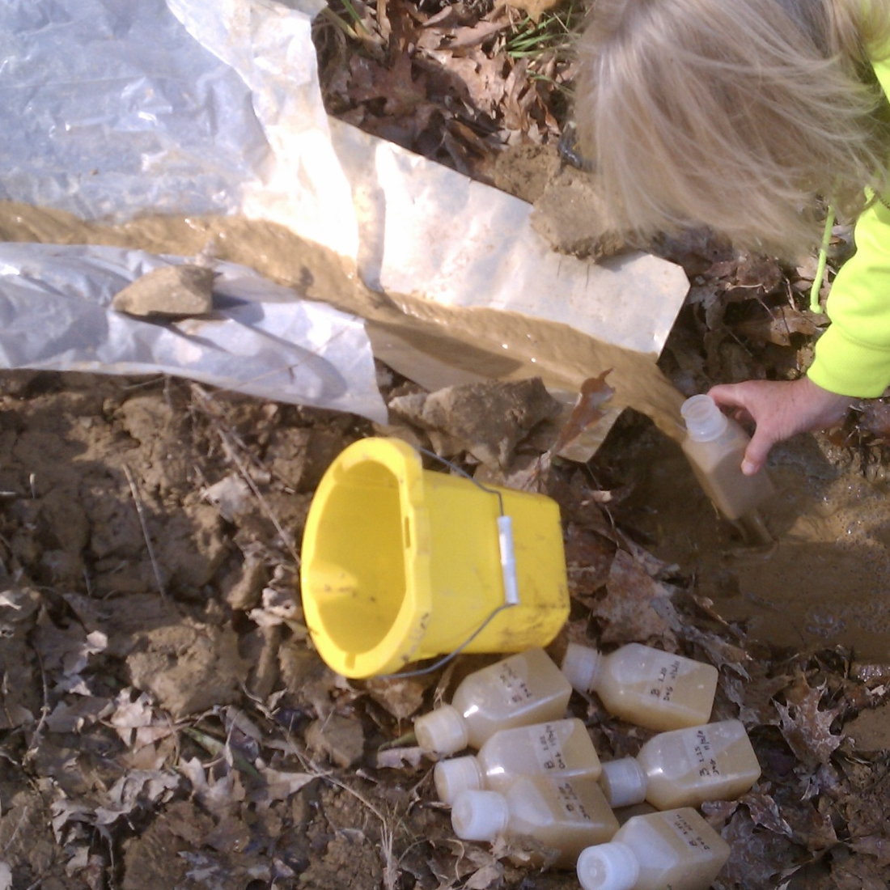
Sediment Study 2010-2011
Using rainfall simulator
On Shallow oil/gas access roads in Allegheny National Forest
Results available www.dirtandgravelroads.org

Slide 22
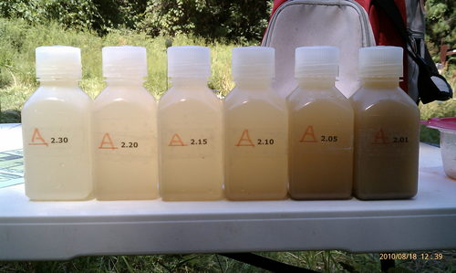
Sediment Study 2010-2011 (grass surfaced road)
30 min
20 min
15 min
10 min
5 min
1 min
Results: from 14 100’ long road segments for 30 minute 0.6” rainfall event
Sediment Loss
  Low: 7 pounds
  High: 60 pounds
  Average: 25 pounds
  - Factor in hydrologic connectivity and…

Slide 23
The Center focuses on
Environmentally Sensitive Maintenance for Low-Volume and Unpaved Roads to:
Driving Surface Aggregate Sediment Study
PSU Center for Dirt and Gravel Road Studies
www.dirtandgravelroads.org
Background: Center
Dirt and Gravel Road Maintenance Program
www.dirtandgravelroads.org
Reduce concentrated drainage.
Reduce hydrologic connectivity/sediment pollution.
Reduce impact of road on the land.
Reduce long-term maintenance costs.
“Better Roads,
Cleaner Streams”
Notes:
The effects of increased erosion are many, but the biggest are increased maintenance problems, as well as excess sediment and chemical runoff to the streams.

Slide 24
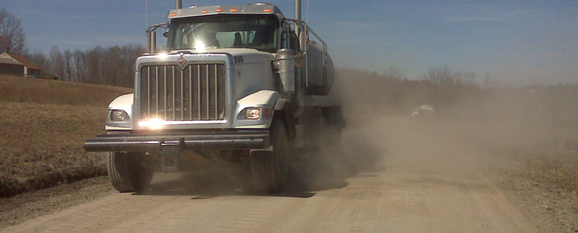
Potential Impacts of Modern Energy Development on Rural Roads and Waterways
Tim Ziegler
PSU Center for Dirt and Gravel Roads
www.dirtandgravelroads.org
September 6, 2012

Slide 25
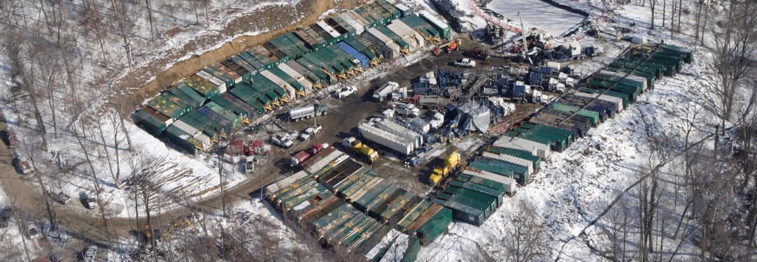
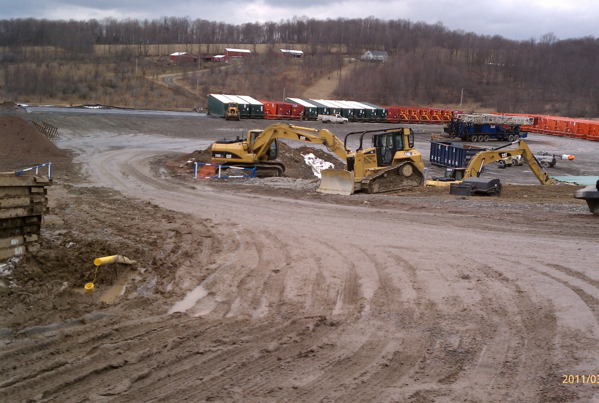
SHALE ENERGY ROAD IMPACTS
ONE well may require upwards of 1,500 water trucks*
* depending on the utilization of pipelines, flow-back recycling, etc.
One Loaded truck = ~1,000 – 10,000 car passes
= 1.5 – 15 Million cars in < 1 month per well
Stone trucks, drill rig, finishing equipment and service vehicles not included
(study estimates /engineering equivalents vary)

Slide 26
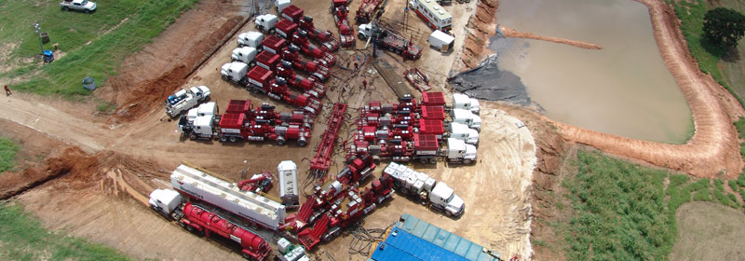
SHALE ENERGY ROAD IMPACTS
1.5 – 15 Million car equivalents per well
x
Average of 7 wells per pad
=
10.5 – 105 million equivalent car passes per pad

Slide 27
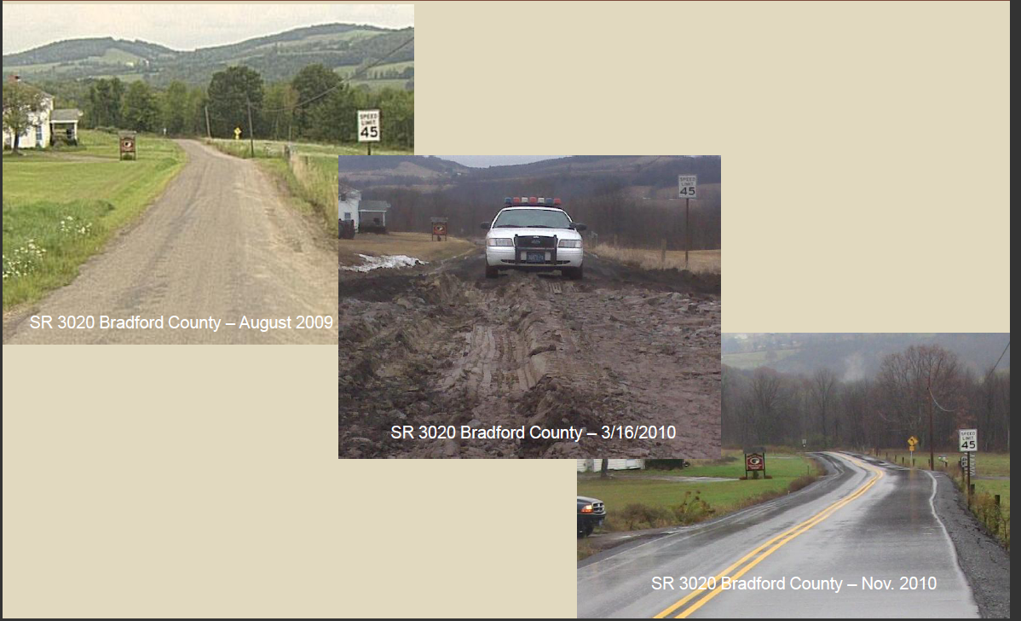
Center for Dirt and Gravel Road Studies
www.dirtandgravelroads.org
Shale Energy Road Impacts
The result can be costly expenditures for road maintenance.
Transportation Patterns and Impacts from Marcellus Development, R. Scott Christie, P.E., PennDOT
“More than $400,000,000 spent in PA”
Kathryn Klaber, MSC President 9/23/2011
Notes:
The purpose of effective surface drainage is to keep water off the road, and reduce problems for drivers and maintenance crews alike.

Slide 28
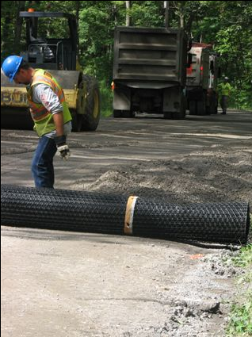
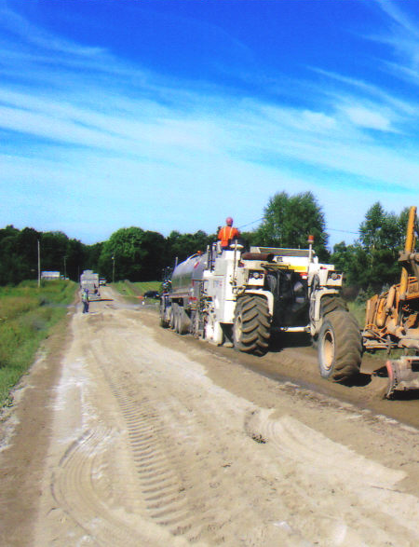
Center for Dirt and Gravel Road Studies
www.dirtandgravelroads.org
Shale Energy Road Impacts
The most current stabilization technologies are being utilized.
Notes:
The purpose of effective surface drainage is to keep water off the road, and reduce problems for drivers and maintenance crews alike.

Slide 29
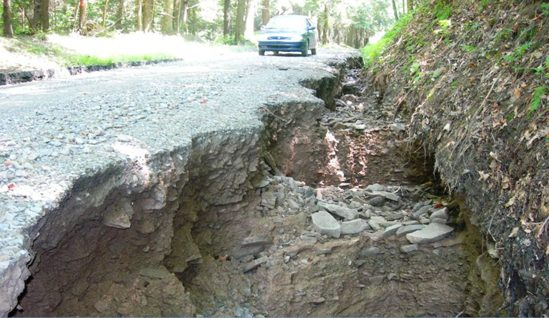
Center for Dirt and Gravel Road Studies
www.dirtandgravelroads.org
Shale Energy Road Impacts
While some basic drainage principles are often overlooked,
Notes:
The purpose of effective surface drainage is to keep water off the road, and reduce problems for drivers and maintenance crews alike.

Slide 30
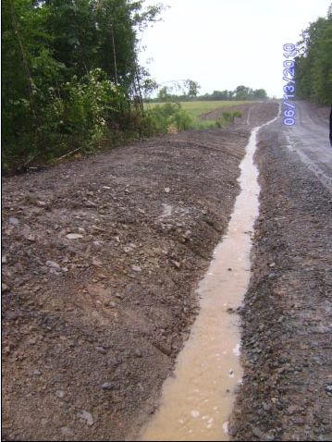
Center for Dirt and Gravel Road Studies
www.dirtandgravelroads.org
Traditional Approach
or are addressed with “traditional” collect and control
stormwater practices.
Commonly accepted as
“The way it’s done”

Slide 31
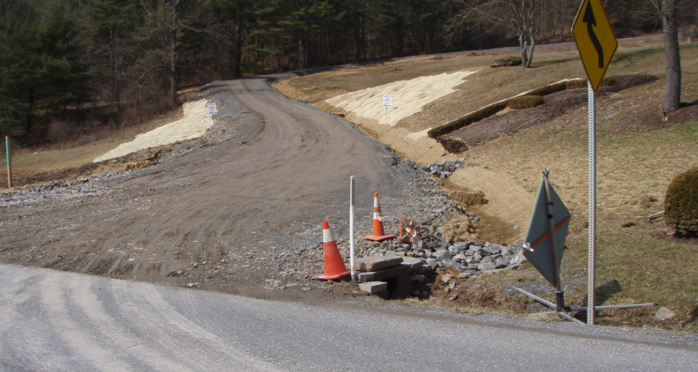
Center for Dirt and Gravel Road Studies
www.dirtandgravelroads.org
Traditional Approach
includes work meeting design and permit criteria

Slide 32
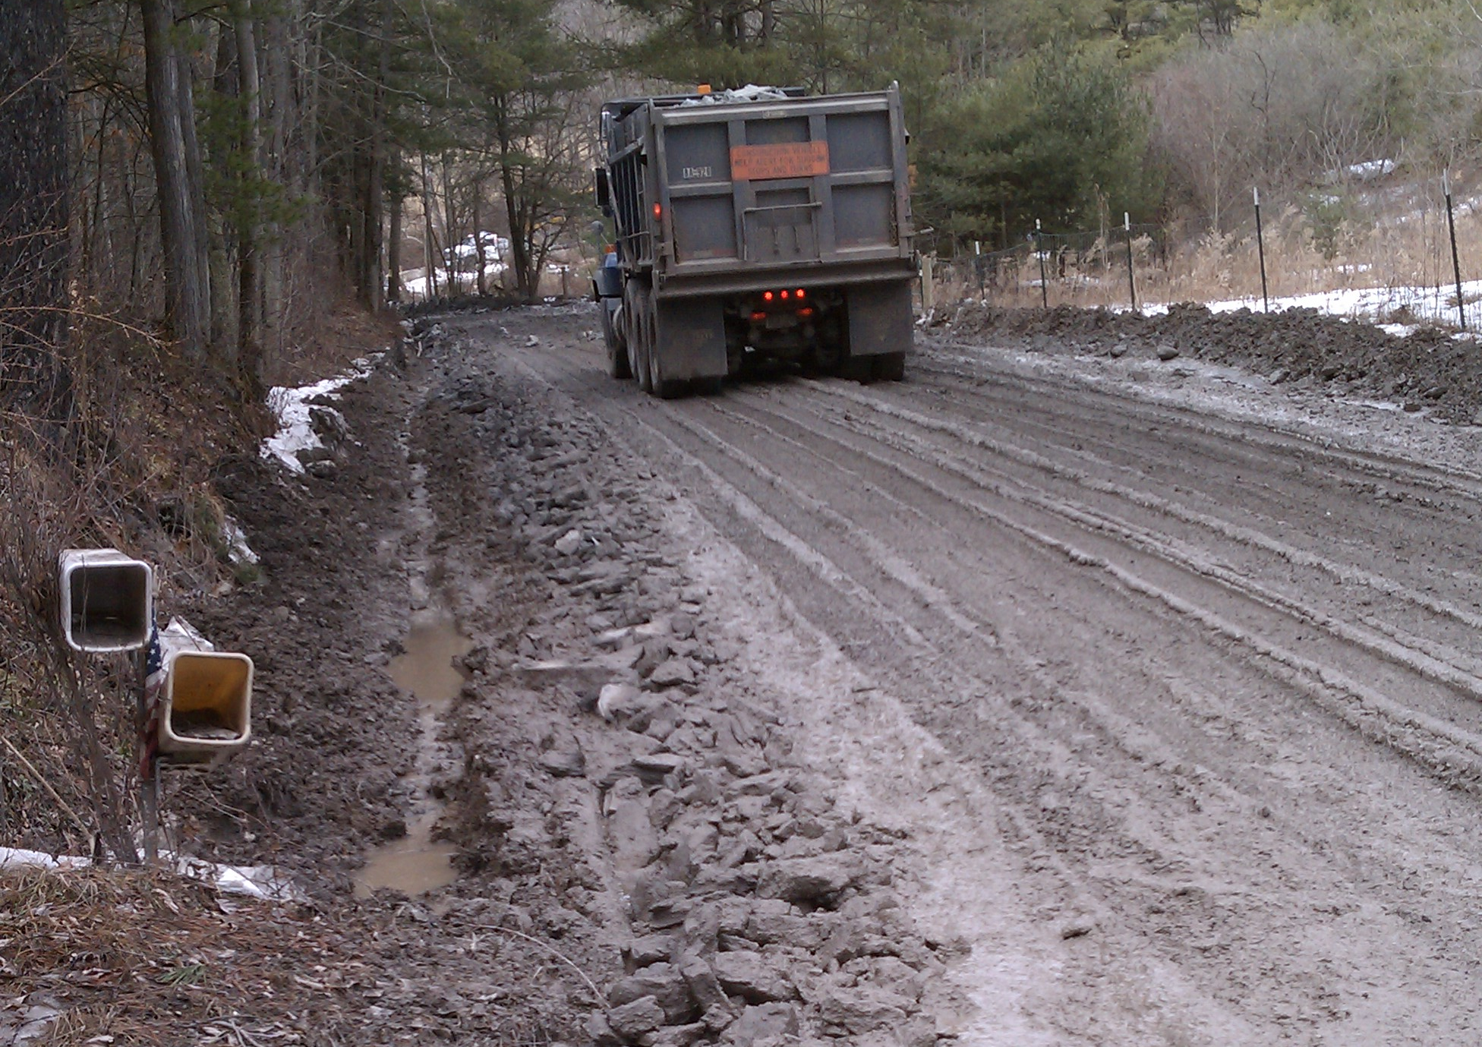

Center for Dirt and Gravel Road Studies
www.dirtandgravelroads.org
Traditional Approach
Many continue to use the traditional “break it and fix it” approach resulting in more sediment loading of streams.

Slide 33
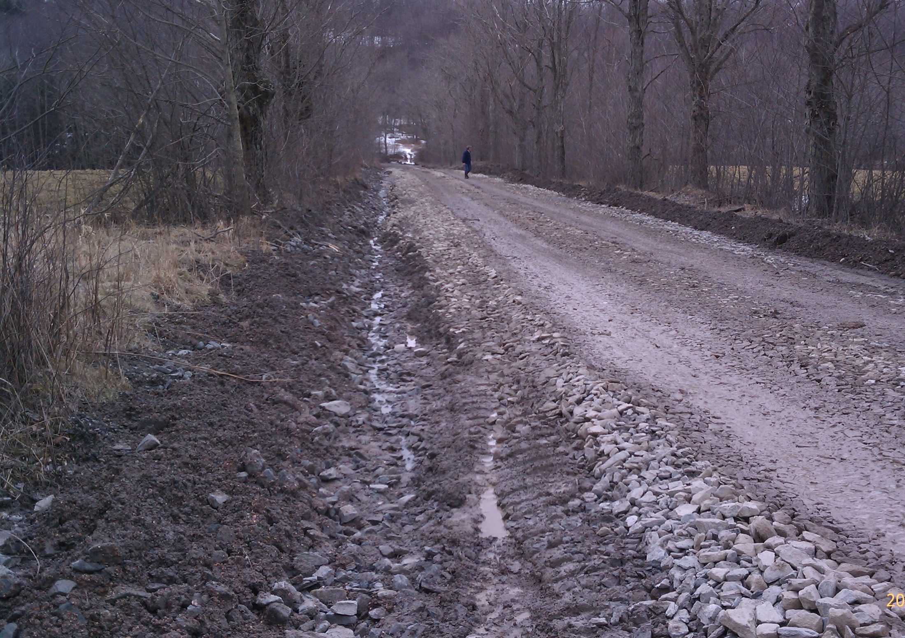
Another road over the hill
Center for Dirt and Gravel Road Studies
www.dirtandgravelroads.org
Traditional Approach
2004
The widespread development, the intensive hauling and the 365/24/7 nature begs for a different approach

Slide 34
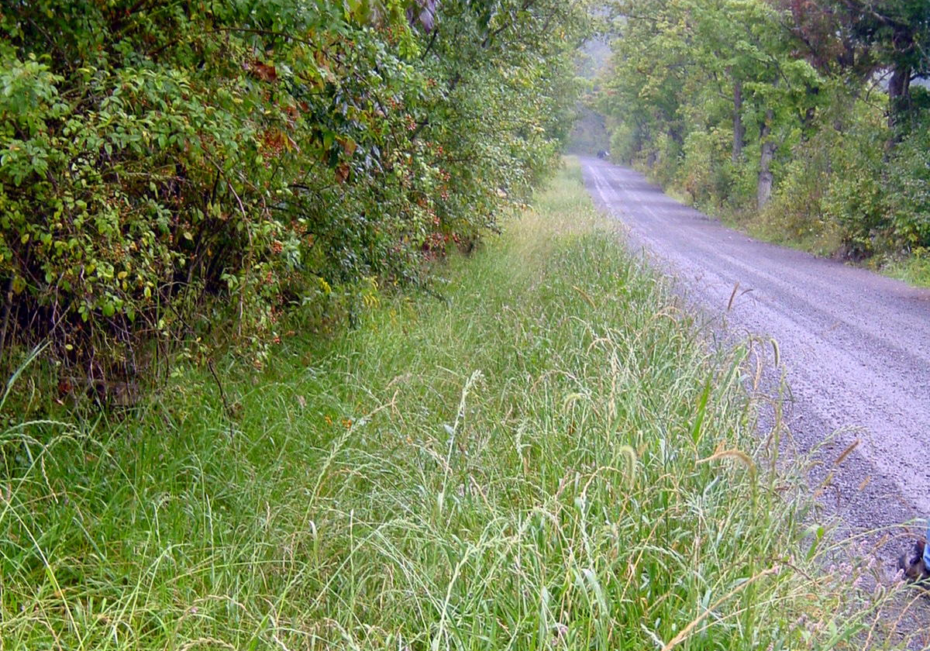
Another road over the hill
Center for Dirt and Gravel Road Studies
www.dirtandgravelroads.org
Traditional Approach
Completed DGRMP projects (addressed pollution sites) may be jeopardized

Slide 35
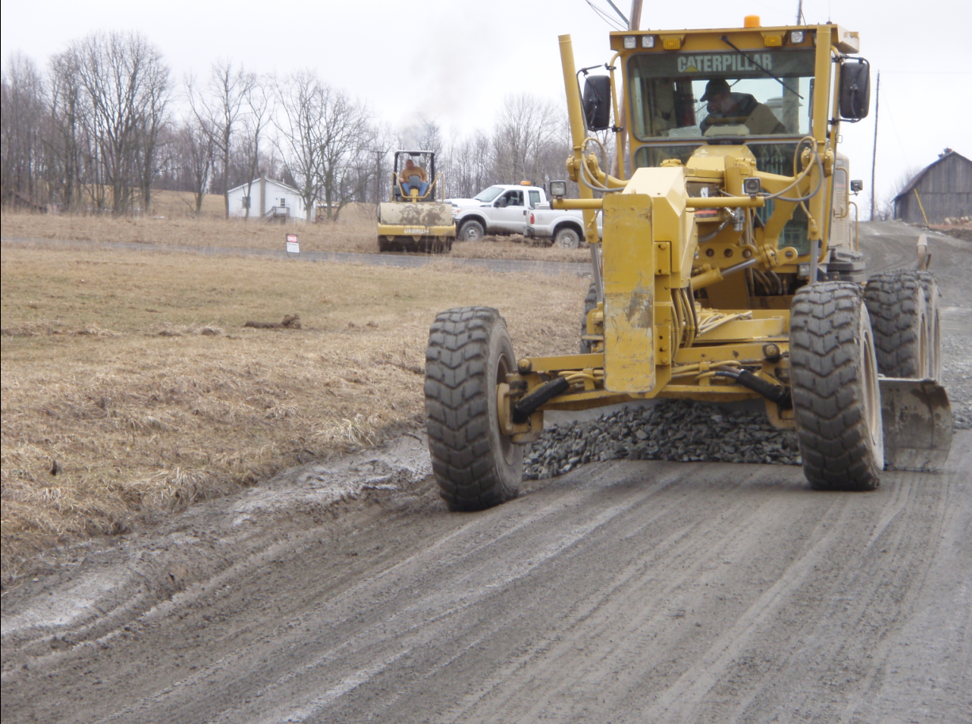
Traditional Approach
Center for Dirt and Gravel Road Studies
www.dirtandgravelroads.org
Energy companies are now the de facto road crews in many rural PA townships

Slide 36
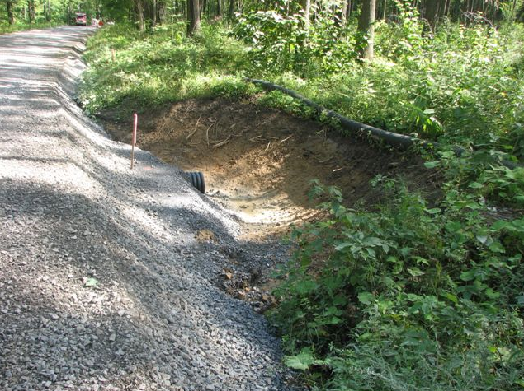
Traditional Approach
Center for Dirt and Gravel Road Studies
www.dirtandgravelroads.org
Most are unfamiliar with ESMPs and up until 2012 moved at “gold rush” pace

Slide 37
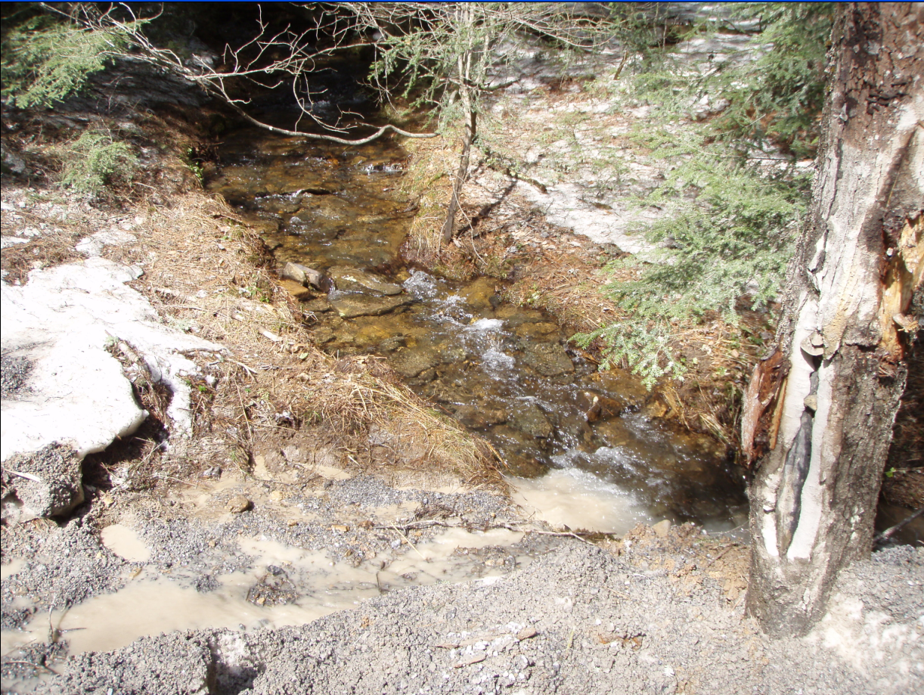
Center for Dirt and Gravel Road Studies
www.dirtandgravelroads.org
DGRMP Goals
The Program’s goal has always been to reduce this

Slide 38
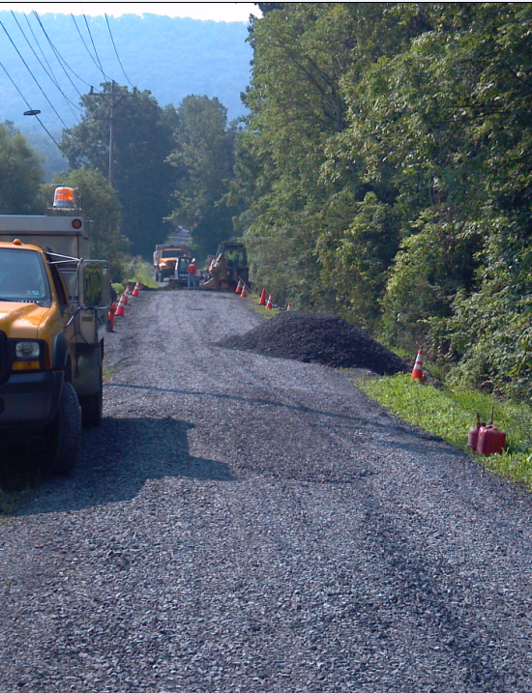
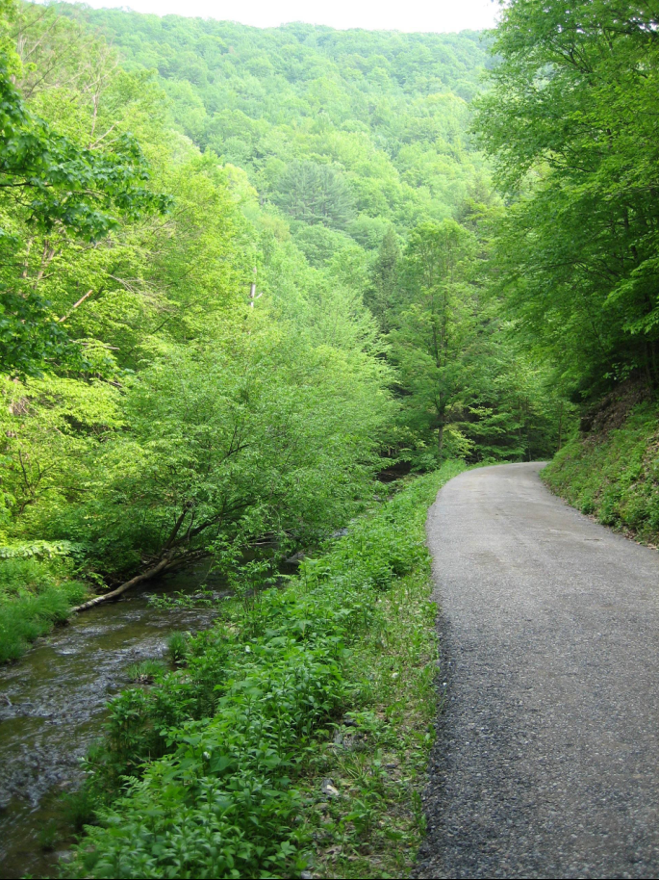
DGRMP Goals
And over the past 15 years much has been accomplished

Slide 39
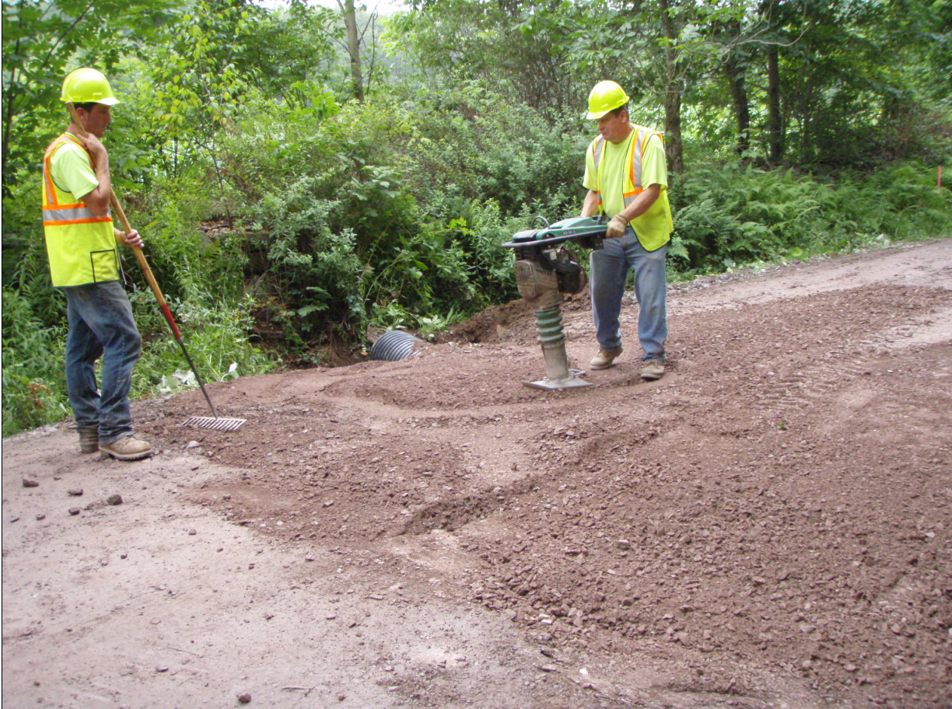
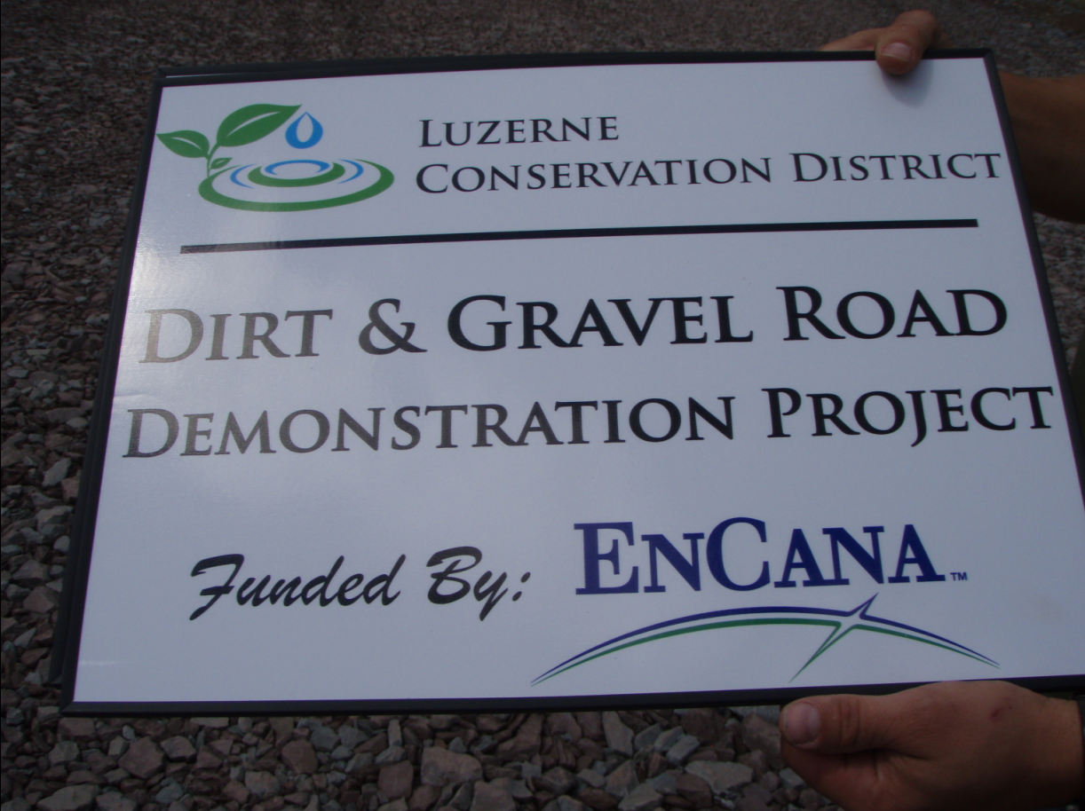
Cooperative Effort
To keep moving forward, we’ve got to work cooperatively

Slide 40
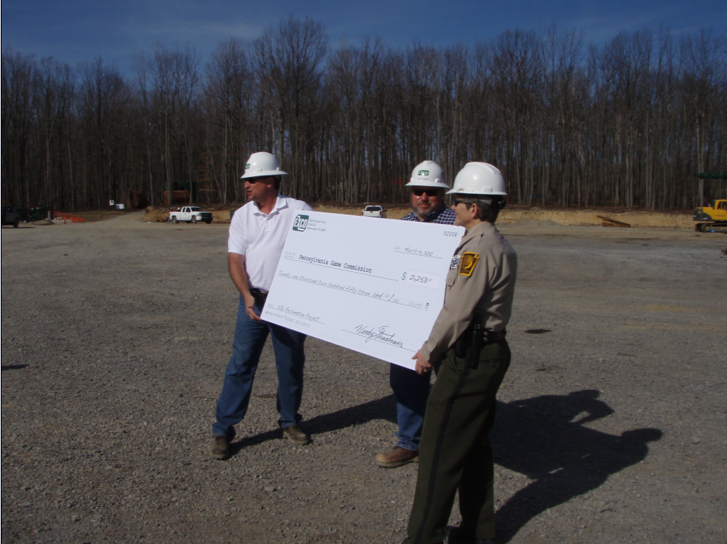
Dirt and Gravel Road Maintenance Program
www.dirtandgravelroads.org
Cooperative Effort
Across both public and private sector stakeholders
Notes:
Put in somewhere

Slide 41
Cooperative Effort
A cooperative effort with industry, government, and all stakeholders that includes:
- Adoption of Simple Principles
  Employ preemptive upgrades (proactive vs. reactive)
  Maintain and restore natural drainage patterns
  Eliminate road drainage directly to streams
- Utilization of Proven ESM Practices
- For long term environmental and economic benefit
Notes:
WE HAVE TO ADDRESS A COMMON ENEMY

Slide 42
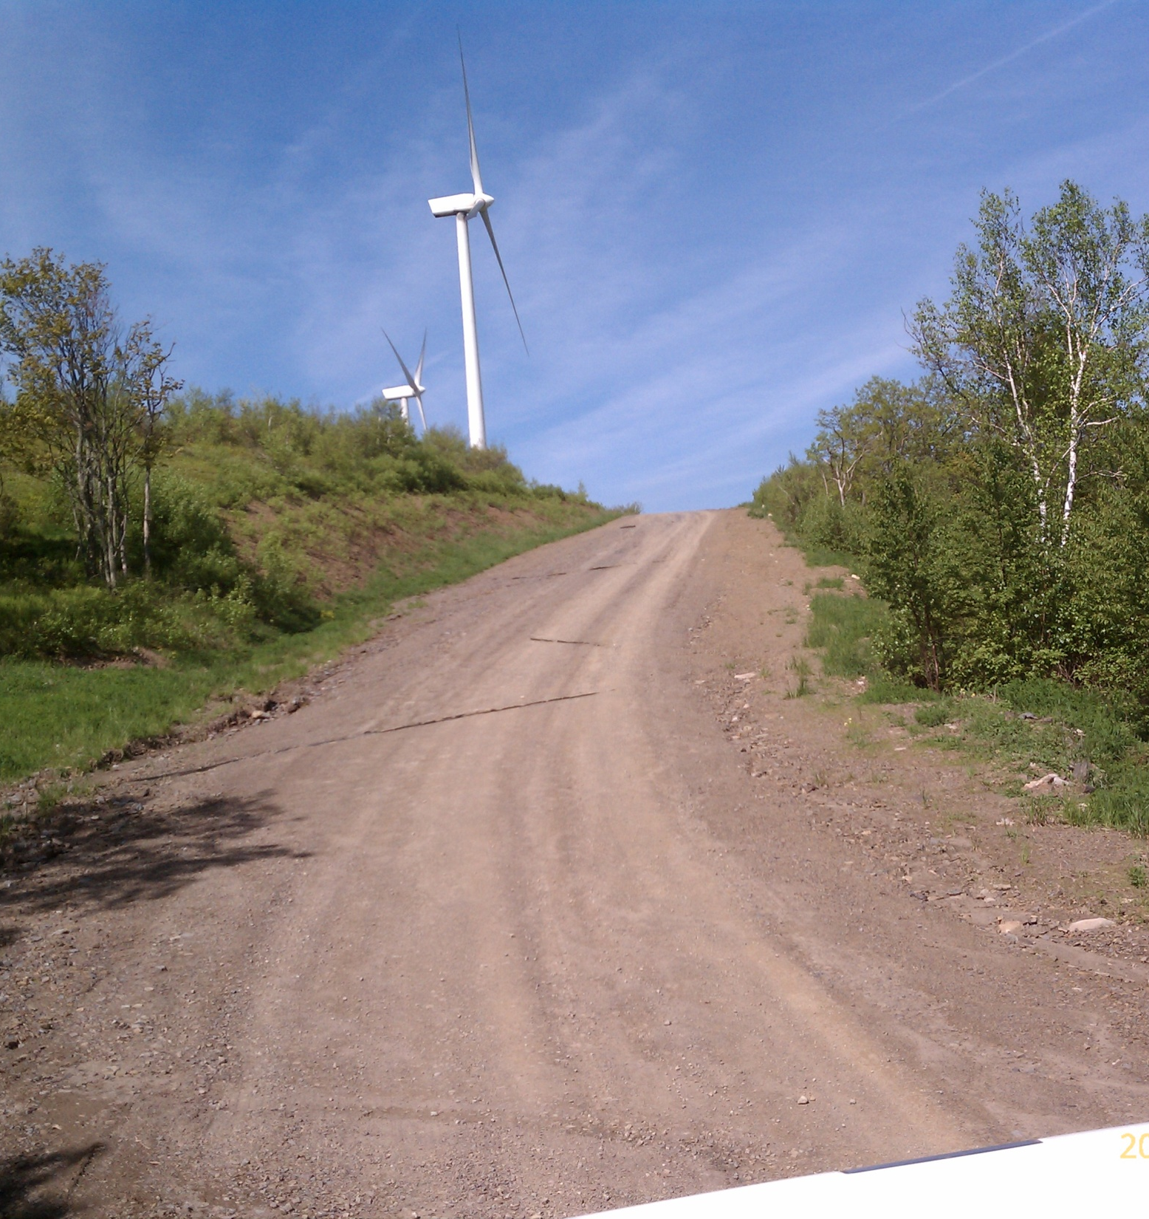
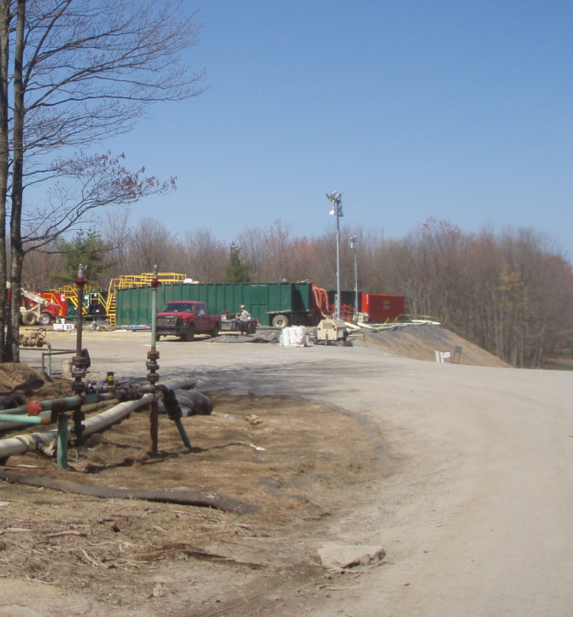
Cooperative Effort
The Challenge: On top of thousands of municipalities in PA, the Program has new players to include in its education and outreach

Slide 43
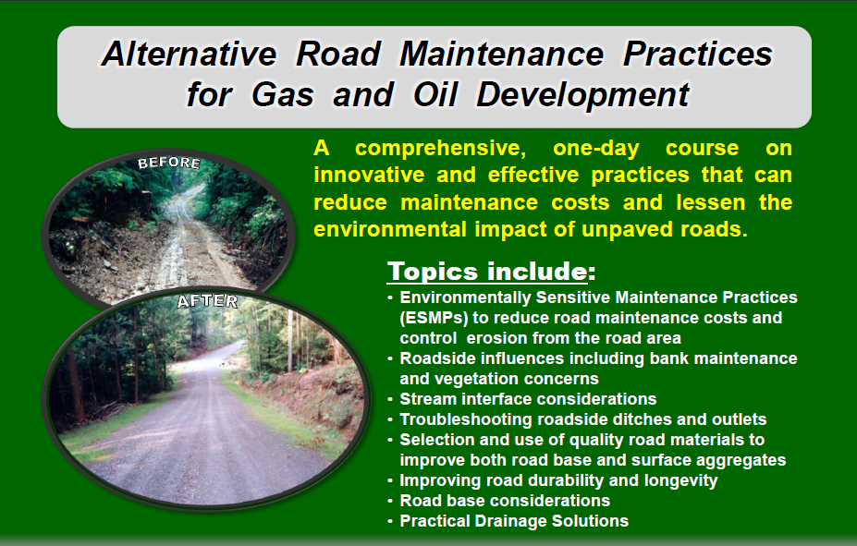
Cooperative Effort
To train innovative and proven techniques…

Slide 44
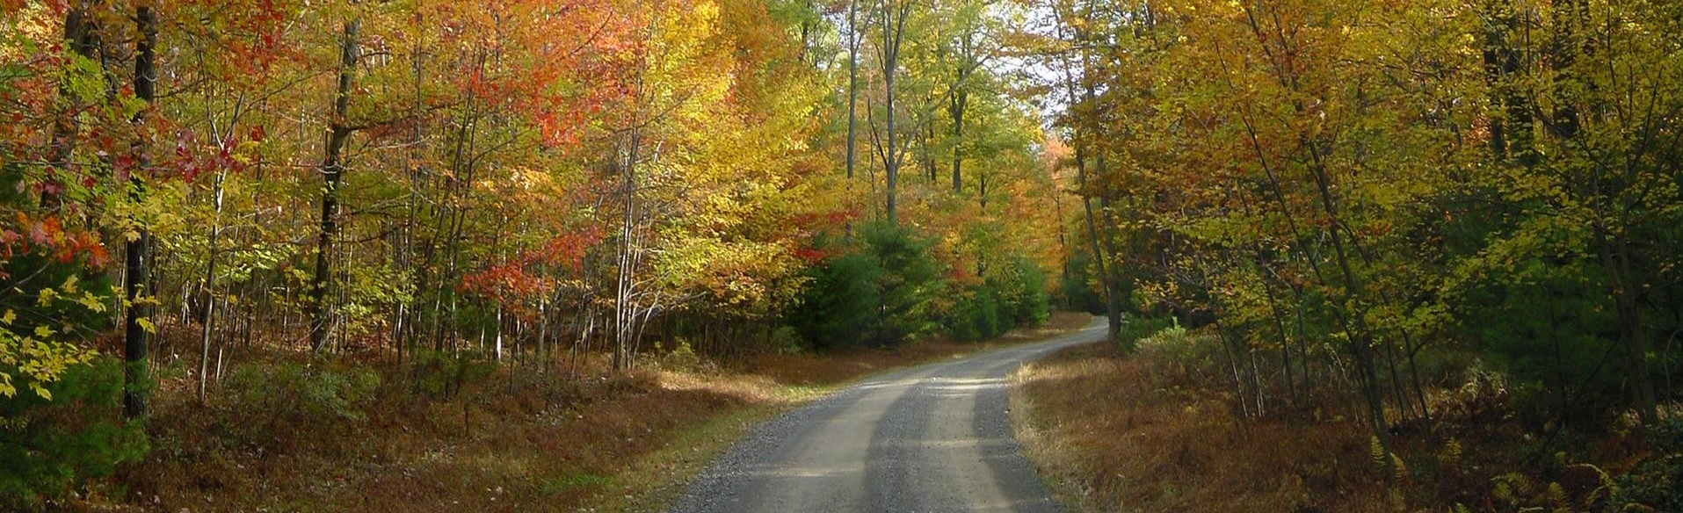
Potential Impacts of Modern Energy Development on Rural Roads and Waterways
QUESTIONS?
Tim Ziegler
PSU Center for Dirt and Gravel Roads
www.dirtandgravelroads.org
Presentation to the Citizens Advisory Committee to the
Chesapeake Executive Council, September 6, 2012

