Slide 1
Conowingo Hydroelectric Power Station and Muddy Run Pump Storage Facility
Welcomes the Citizens Advisory Committee

Slide 2
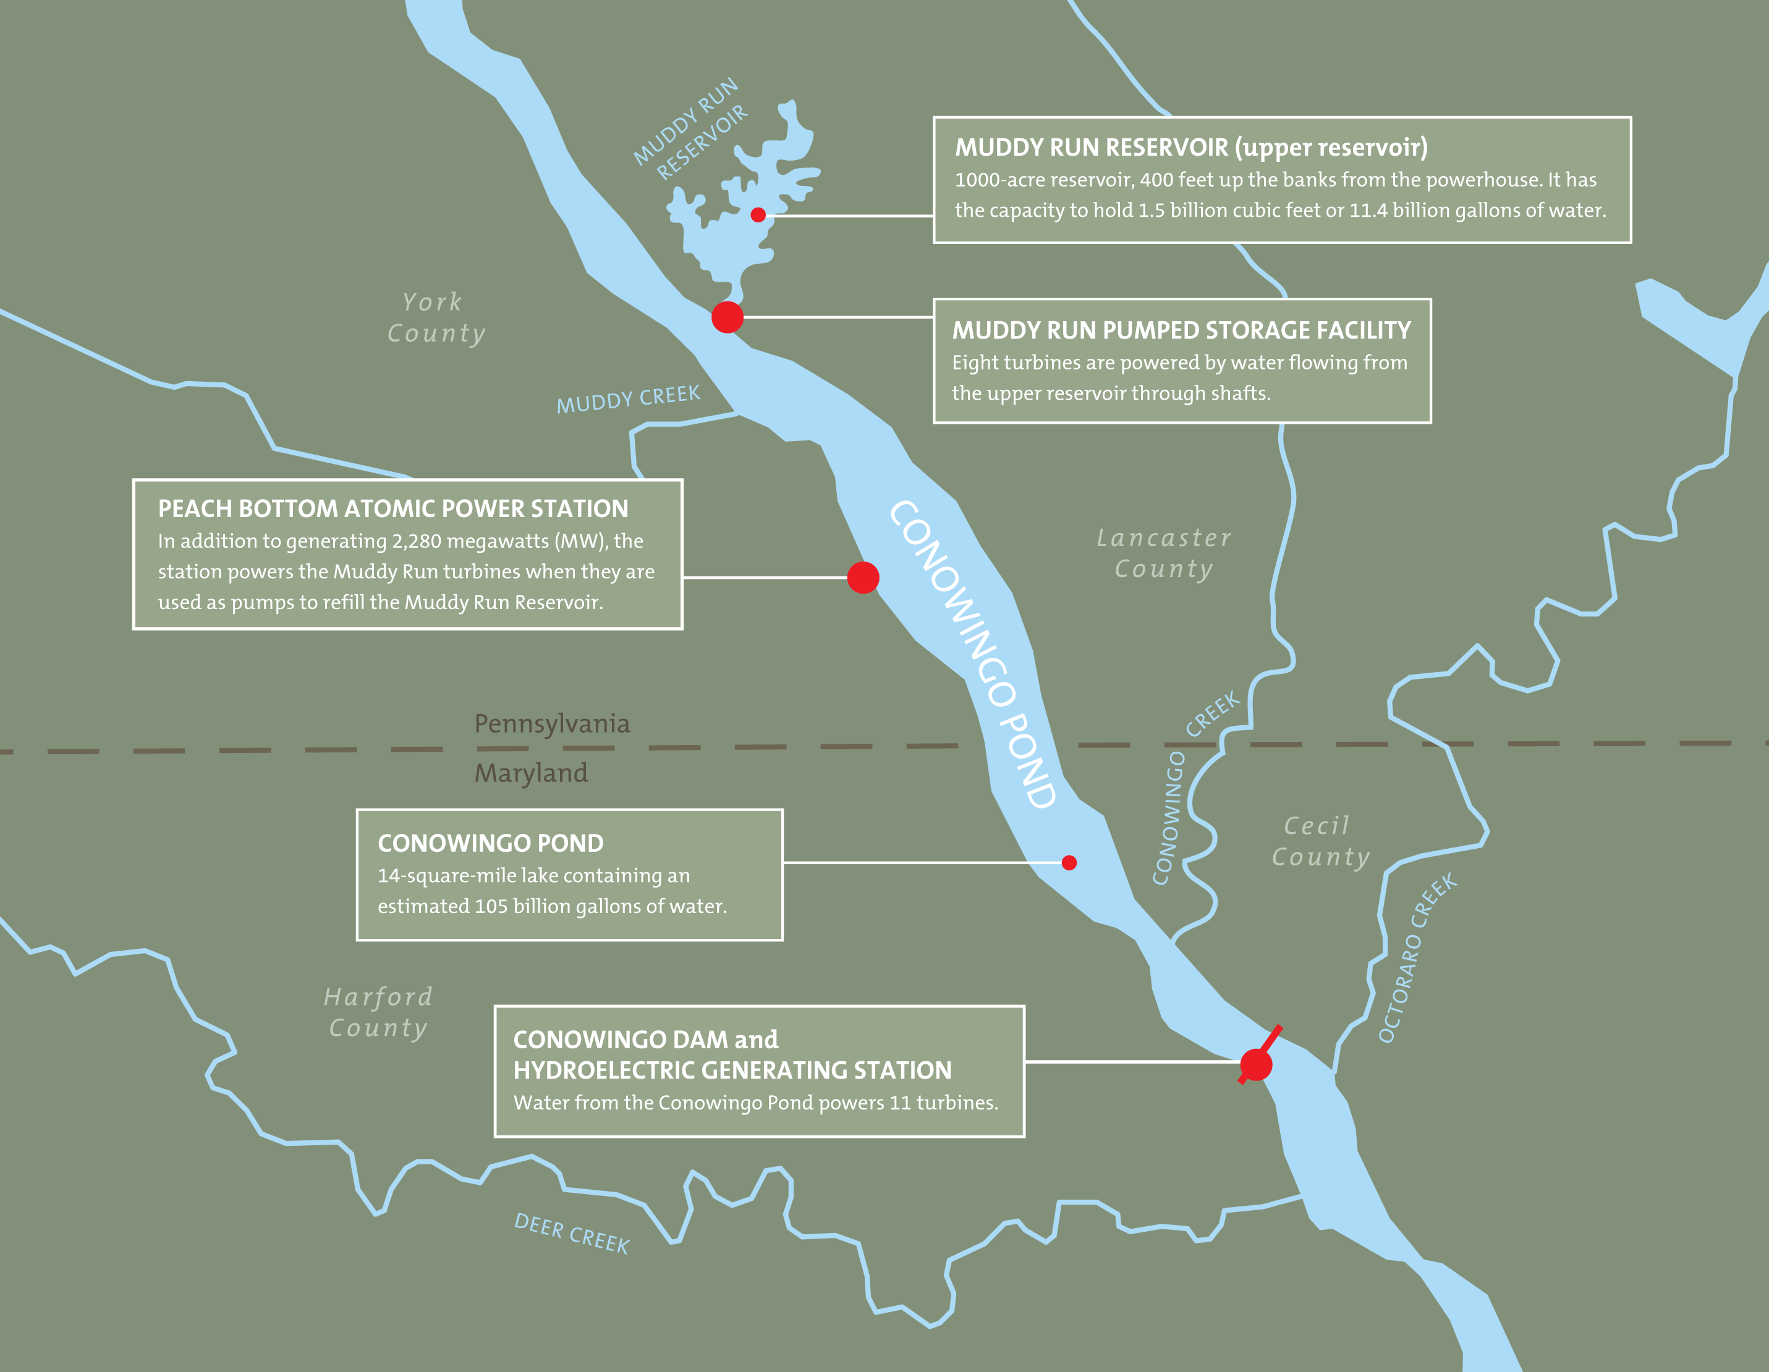
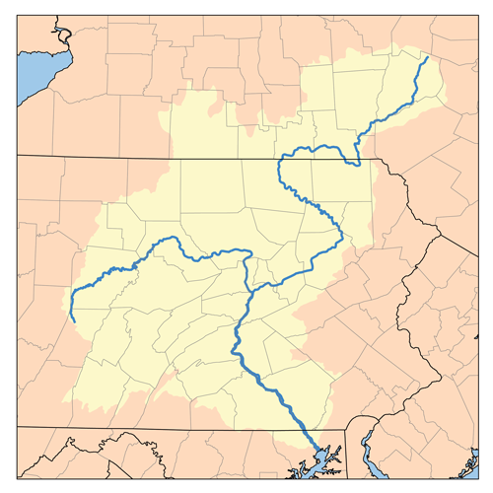
Susquehanna River Basin
New York
27,500 sq miles
Pennsylvania
Maryland
Notes:
The Susquehanna River is approximately 450 miles long and passes through 3 states
Drainage Basin covers 27,500 square miles
Last 40 miles river drop elevation of 225 feet, or 167 feet the last 25 miles
River flows vary from 1,700 cubic feet per second (cfs) to greater than 1,000,000 cfs
Higher volume river flows traditionally occur during winter and spring
Construction of the dam created the reservoir area – 14 sq miles or 105 billion gals or 310,000 acre-feet of storage, 71,000 acre-feet usable storage
Conowingo Pond provides Cooling water source for Peach Bottom Atomic Power Station and Water source for Muddy Run Pump Storage
4 major dam comparisons
York haven 1900s, hydraulic capacity – 17,000 cfs gross head 22’
Holtwood 1910s – 28,000 cfs, gross head 63’
Conowingo 1920s – 86,000 cfs, gross head 89’
Safe Harbor 1930s – 110,000 cfs, gross head 55’

Slide 3
Conowingo Dam
Constructed 1926 to 1928 at a cost of $73M (1928 $s)
4,648 feet long and 104 feet tall
11 generators with a capacity of 572 MWs
Contributes on avg. approx 1.8 million megawatt hours annually to the grid or the equivalent of burning 2100 tons of coal /day
Generating hydraulic capacity is 86,000 cfs; higher flows are managed by opening crest gates
Notes:
Conowingo is the last dam on river thus must pass whatever comes down river (run of river)
Generating hydraulic capacity is 86,000 cfs or 38,000,000 gal/min
Peek construction saw 3725 men employed on power house and dam alone
Construction started on March 8, 1926 – Units #1 & #2 transmitted power to Phila on March 1, 1928
Four new units added in 1965, all the superstructure was part of original construction, intakes, penstock etc

Slide 4
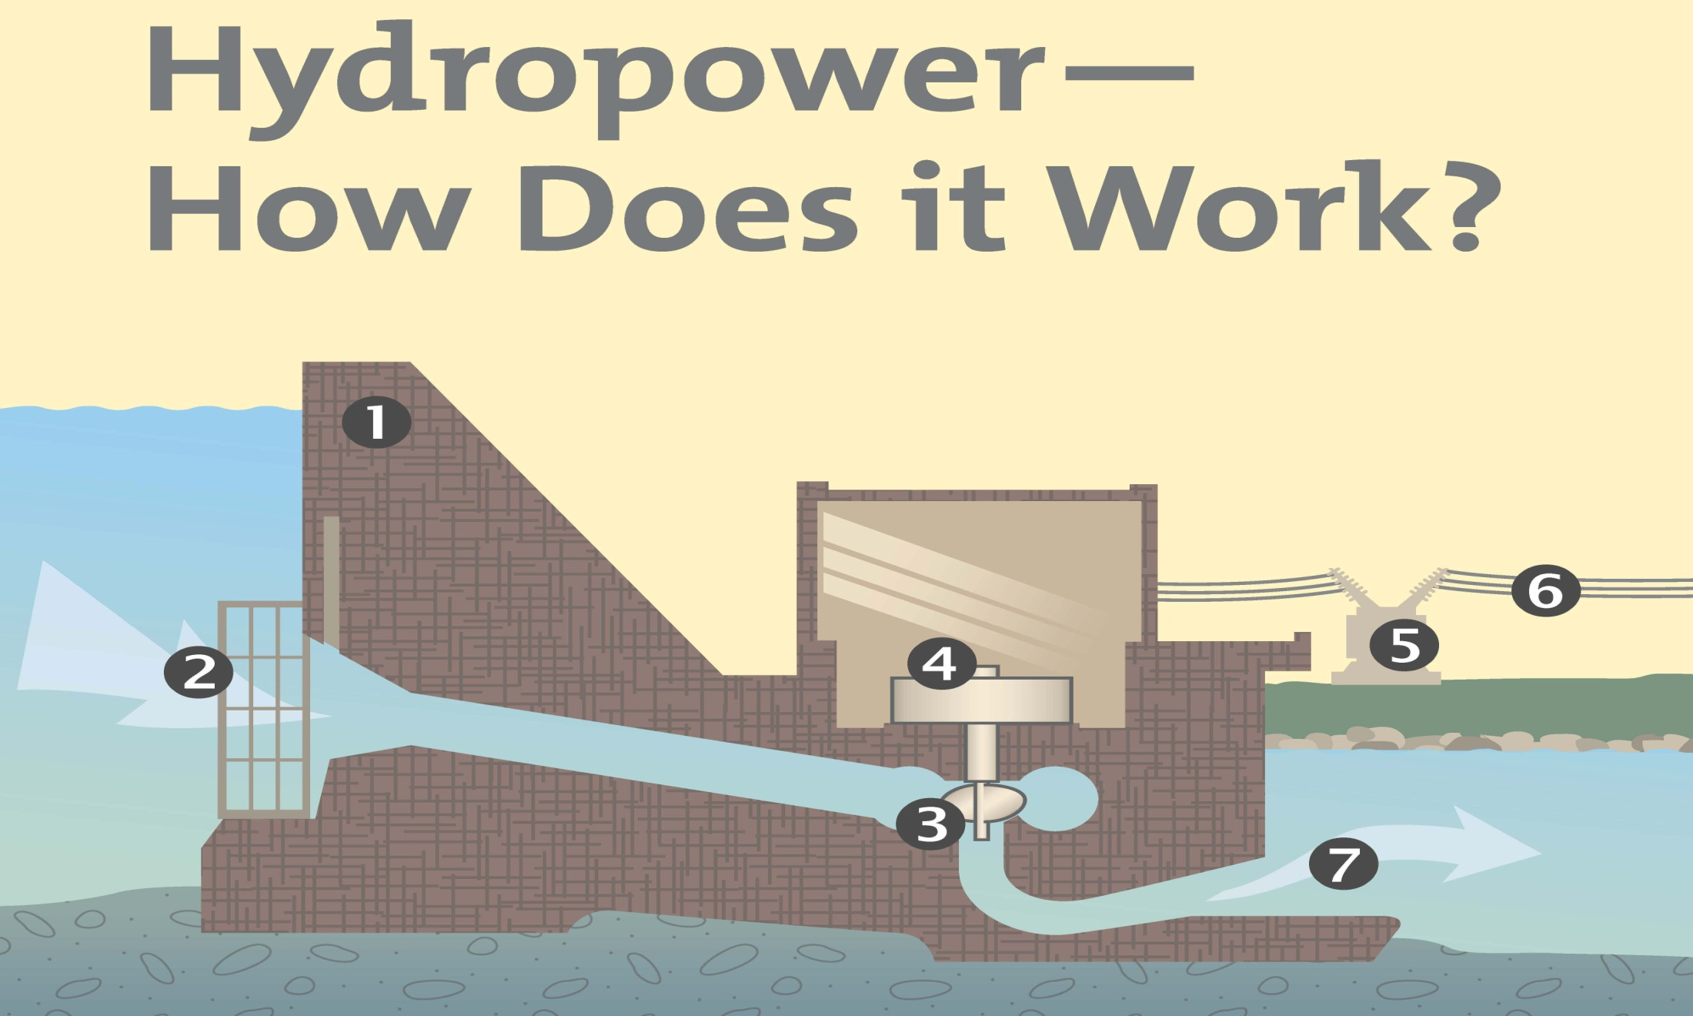
Typical Hydro Plant
1 – Dam face and headworks area 2 – Trash rack and intake 3- Scroll Case and turbine or water wheel 4 – Generator 5- Transformer 13kv to 220 kv 6 – Transmission lines 7- Tailrace or discharge
Notes:
1) Dam face , Total concrete used in dam construction 435,000 cubic yards originally design as a gravity dam, Width at base 85’ @ spill way
2) Intake/Trash racks, water enter the penstock thru the intake. 100’ of trash racks keep debris from entering turbine. Top 25’ of trash rake are made of wood to prevent frazzle.
Not shown is Butterfly valve located in penstock before turbine. Unique feature is the 136 ton, 27’ dia Butterfly valves which can be used to close with maximum flow through the turbine at time of construction they were the largest ever built besting the similar 23’6’’ valves at Niagara Falls.
3) Water imparts energy to Turbine which turns generator Low speed units small units 82 rpm, large units 120 rpm
4) Generator spin and make electricity. Seven small units 36MWs & 42 MWS, four large units 65 MWs, large unit Rotor 260 tons
5) 13.8 KV step up to 200 KV transmission
6) Transmission lines
7) discharge/tailrace
Roughly speaking, one gallon of water per second falling one hundred feet can generate one kilowatt of electrical power.
Conowingo avgs over 1,850,000 MW-HRS/year the equivalent of 770,000 tons of coal or about 2100 tons / day or 4,200,000 pounds of coal/day
Conowingo accounts for nearly 75% of Maryland's renewable power
Conowingo record year was 2003 – generated 2,599,780 MW - HRs

Slide 5
Simplified Hydro turbine - generator
Hydro generating units operate at relatively slow speed 80 rpm
Wicket gates control the flow of water into the turbine

Slide 6
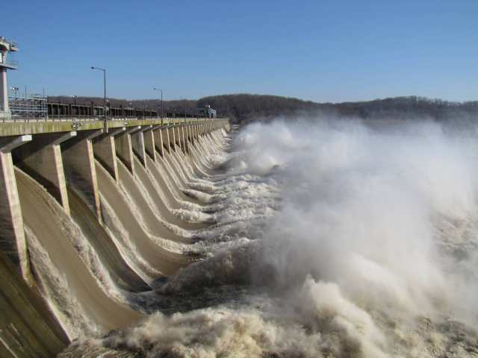
Conowingo Dam – Crest Gate Operations
Crest Gates are use as required to control pond level during high river flows
Conowingo has 50 Crest gates, each passes 16,000 cfs or 7.2 million gals/min
Up to 80 notifications are made to notify downstream emergency services, government agencies and commercial businesses
All fifty crest gates were open only twice in past 1937, 1972
Notes:
River flows that exceed 86,000 cfs station need to use Crest gate to regulate river flow
50 - Stoney type Crest gates – 22.5’ high 41’ long, weigh 40 ton and passes 16,000 cfs or 7,200,000 gal/min
2 - Reg gates are 10’ high x 41 ‘ long – 4000 cfs
With all gates open and full house est passing of 916,000 cfs with raising pond elevation at 108.5’
All 50 gates were only open twice in Dam’s history 1937, 1972 (Hurricane Agnes)
1978 anchored to bedrock to increase design up to 1,170,000 cfs river flow
Average 40 days / year in spill conditions
Up to 80 calls are made to notify downstream emergency services, government agencies, commercial businesses
Sept 7 2011 3rd highest with approx 700,000 cfs and 43 gate opened

Slide 7
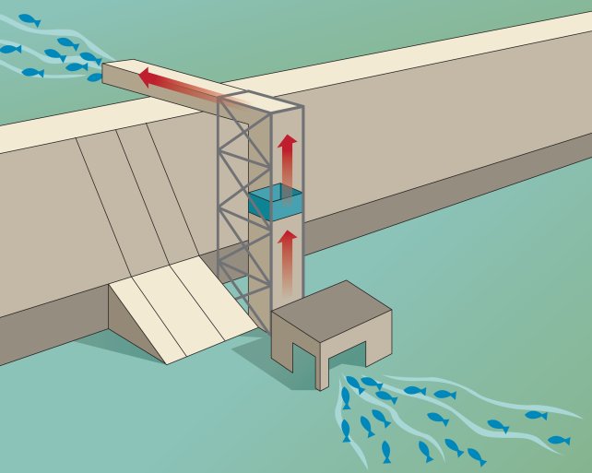
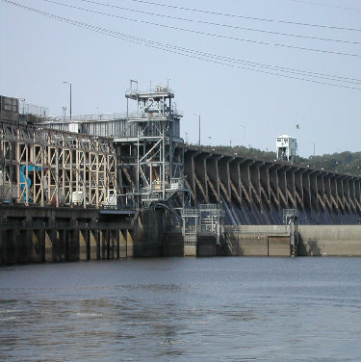
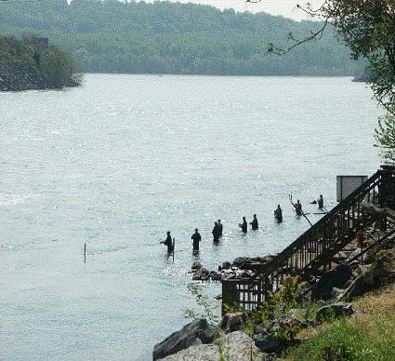
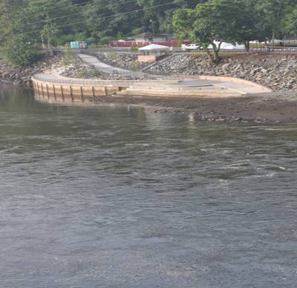
Fish Passage at Conowingo Dam
Conowingo Dam is unique in that it operates two “Fish Lifts”, specialized elevators that Exelon uses to transport American Shad and other fish species
West Fish Lift Constructed in 1972 - Primary use is for US Fish and Wildlife Service hatchery stocking
East Fish Lift Constructed in 1991 - Primary use is for downstream to upstream movement of fish for spawning
Fisherman’s catwalk was closed in 2001 after 9/11 and in response Exelon constructed the Fisherman’s Wharf which was completed in 2009
 | American Shad | Total All Fish
2009 | 29,272 | 915,417
2010 | 37,757 | 857,272
2011 | 20,571 | 289,453
2012 | 22,143 | 1,109,911
Notes:
1980 - FERC license till 2014
1988 - settlement agreement on water quality and fish restoration program
1991 - East Fish Lift built at cost of $12.5 million operation
1998 safe harbor and Holtwood fish go into operation enabling use of the Conowingo fish Lift
Prior to 1997 all fish were sorted by hand and transported by truck to above Harrisburg
Passed a record amount (193,574) of American shad in 2001
Attraction flow is provide by opening a gate (4,000 cfs) old reg gate #1 was dedicated to the fish lift.
Note: 2011 number for fish passage down significantly due to the high river flow for a prolonged period of time in spring of 2011 (in spill for 65 day from feb 28 till June 6.

Slide 8
Muddy Run Pumped Storage Facility
Pump storage in simplest form is like a rechargeable battery
Eight (8) units with a total combined capacity of 800 MWs
When electric demand is low MR pumps up water from the river (charging) to upper reservoir and when demand is high MR generates electricity by releasing same water back into the river
Notes:
Construction started in 1964, first 2 units completed 1967 , all construction finished Feb 1968 – cost $73 million
When built in 1967 it was the largest pump storage facility in the world, currently 6th largest in US, 46th in world
Located 13 miles upstream of Conowingo, water reaches Conowingo in about 45 mins
1000 acre storage pond, usable capacity of 1,466,000,000 gals, 100 acre recreational pond
Approx 410’ of head

Slide 9
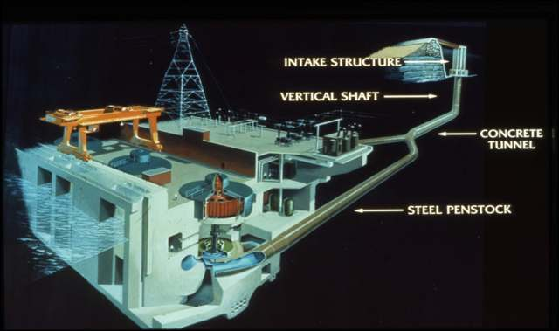
Muddy Run Pump Storage Powerhouse cross section
penstocks
Water is transported from upper reservoir to the generators through tunnels or penstocks
Concrete section is 24.5’ dia, 550’ long; Steel section is 14’ dia , 400 ‘ long
MR units are approx 410 feet below the upper reservoir, turbine is 80’below river level
Generator produce 13 kv power which is stepped up to 220 kv for transmission lines
Notes:
2010 - MR units had over 6300 pump/gen starts and Gen mw-hrs 1,596,881, pump mw-hrs 2,038,006
Switchgear was replaced starting in 2007 last units were replaced in 2010, rated 20% higher, more reliable, less PM required /cycle 500/2 day maint outage to 10,000 cycles
Reversible pump / turbines – 8 Units
Name plate capacity: 110 Megawatts each (138,000 hp)
Turbine shaft rotates at 180 RPM in each direction
Takes 4 kw to make 3 kw

Slide 10
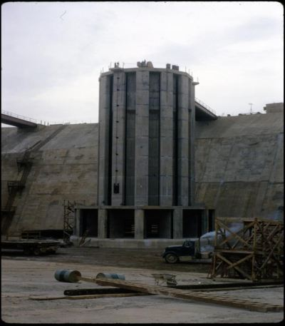
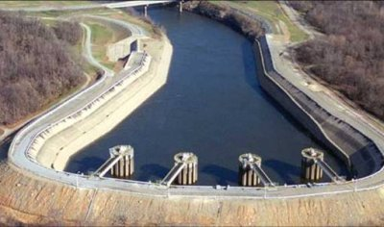
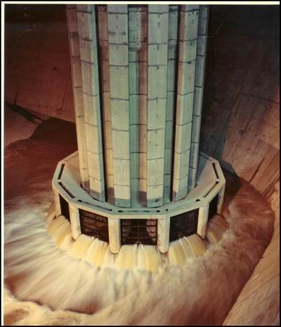
Muddy Run Upper Canal – construction phase
Upper reservoir canal is 2300’ long
Canal is concrete lined and includes a 200’ spillway section

Slide 11
Hydro provides essential services to the grid
Conowingo and Muddy Run provide “Black Start” capability for PJM
Back up power for Peach Bottom Station

Slide 12
Questions ?

