Slide 1
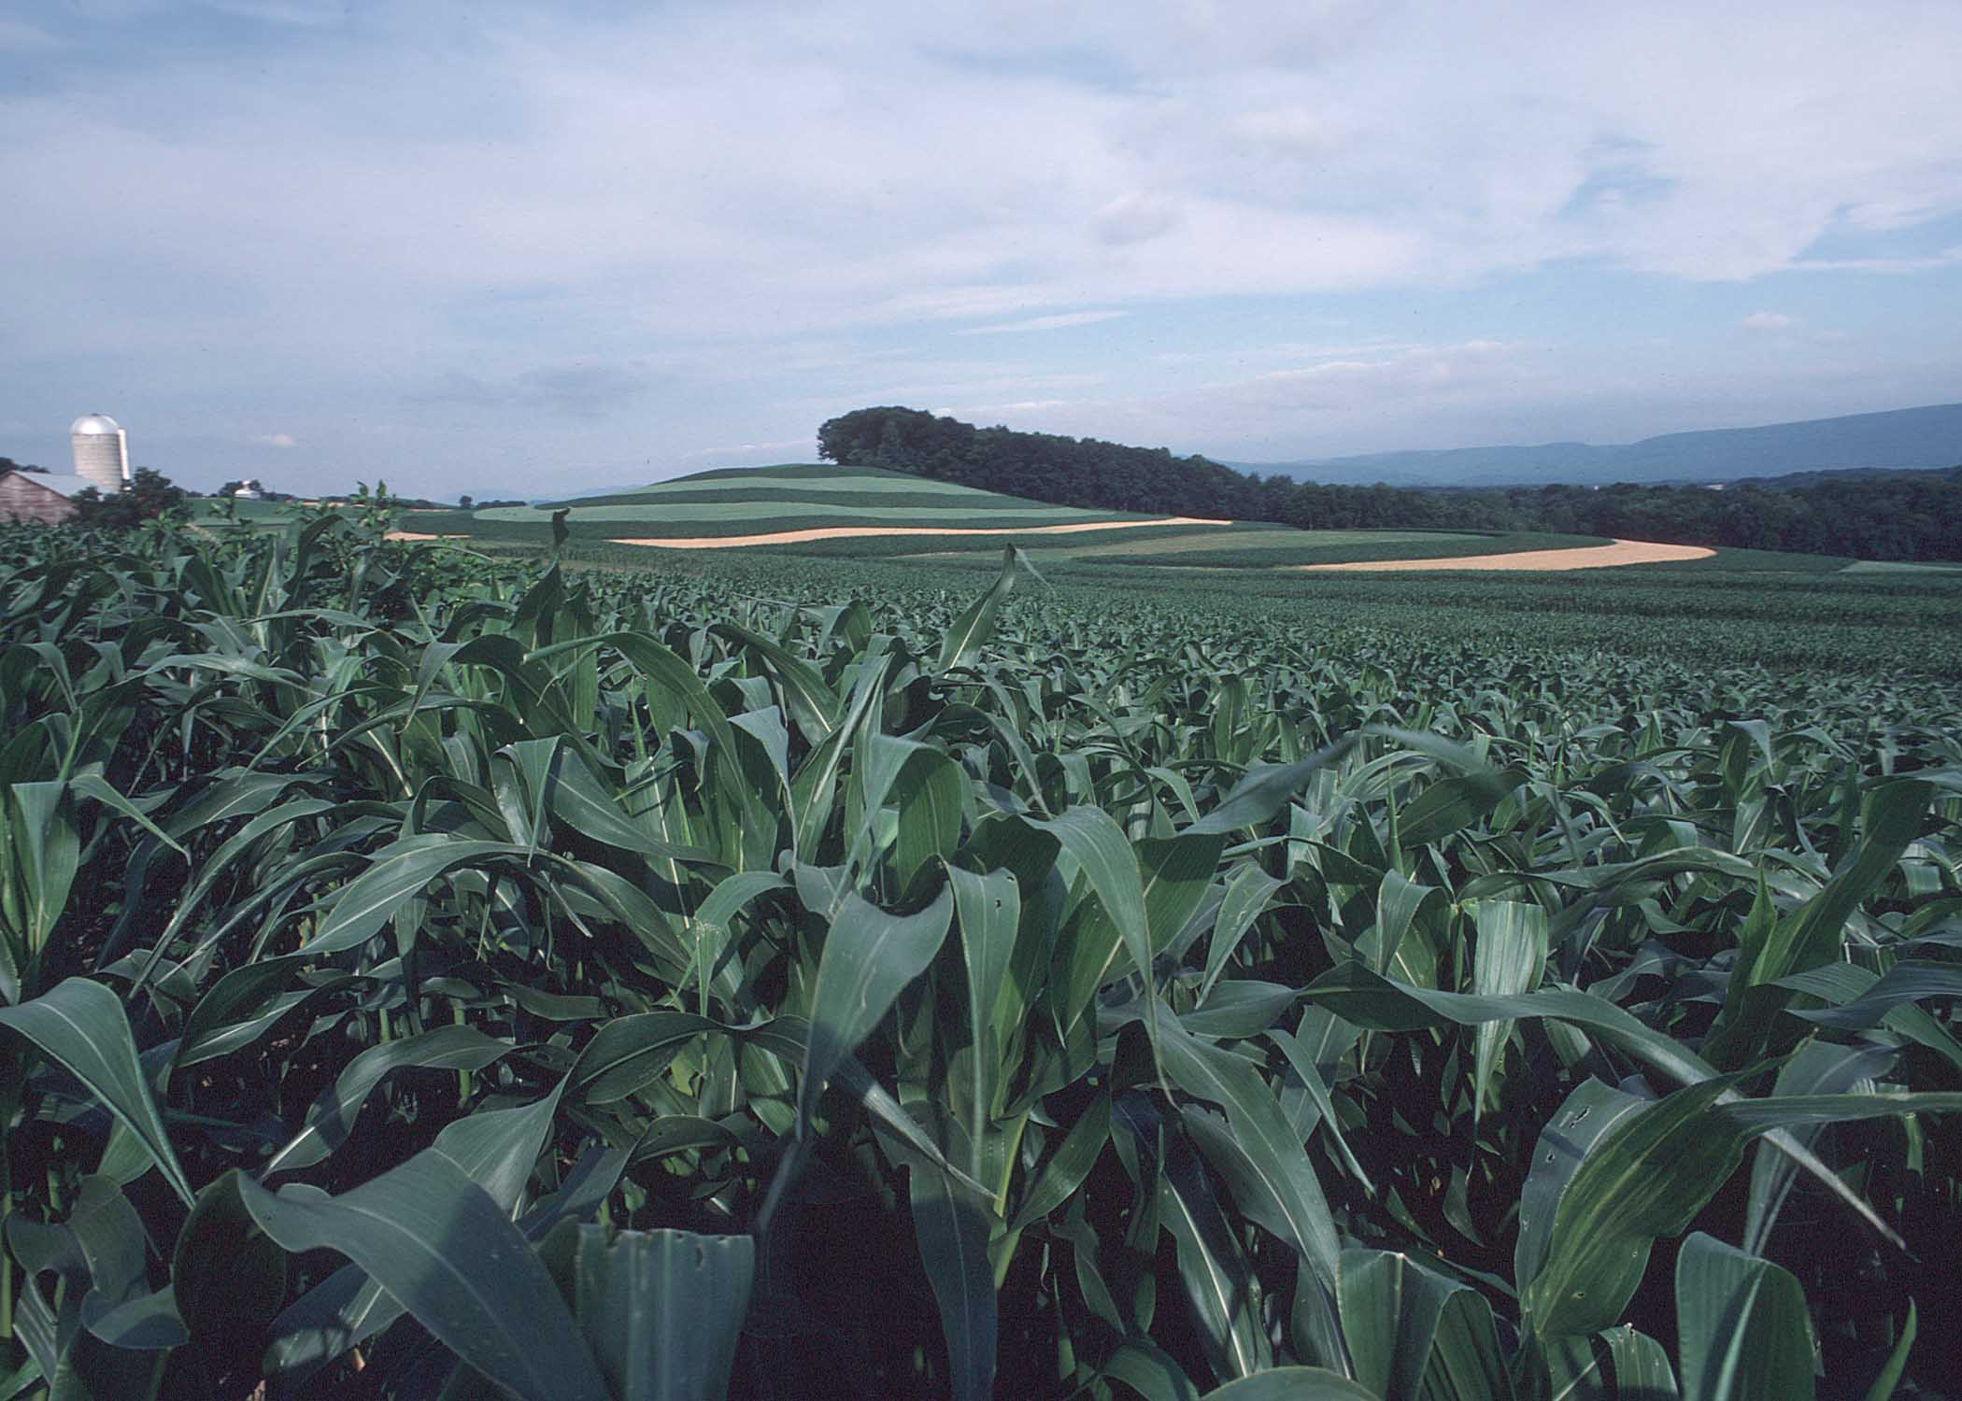
BMP Verification: Gauging Levels of Certainty in Agricultural Best Management Practices
Mark Dubin
Agricultural Technical Coordinator
University of Maryland Extension-College Park
Chesapeake Bay Program’s Citizen Advisory Committee Meeting
Harve de Grace, Maryland
November 30, 2012

Slide 2
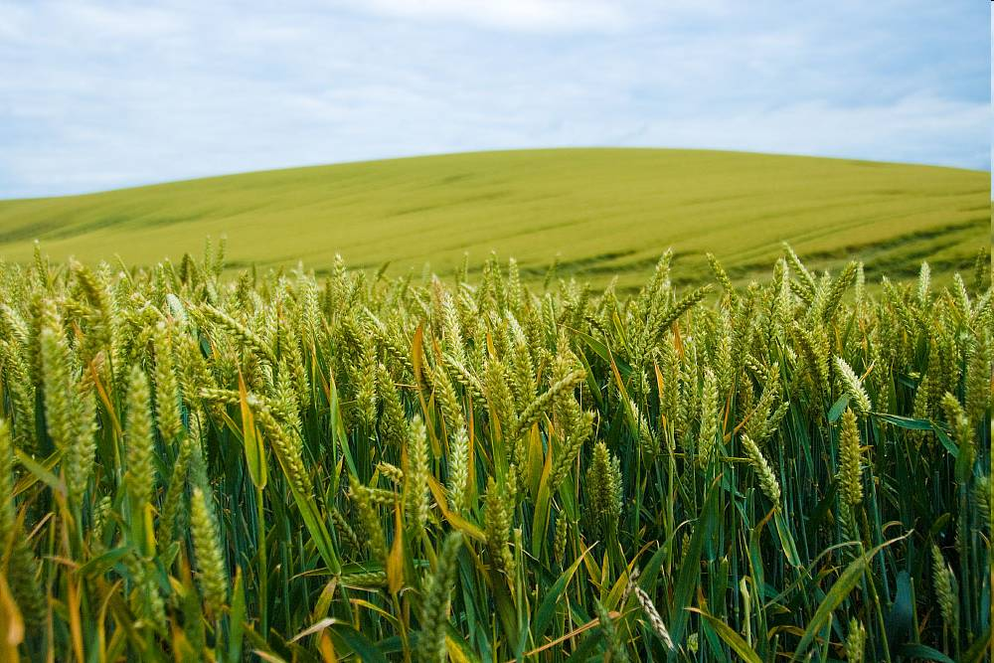




Mark Dubin Agricultural Technical Coordinator
University of Maryland Extension-College Park College of Agriculture and Natural Resources
USDA-NIFA Mid-Atlantic Water Program mdubin06@umd.edu
EPA Chesapeake Bay Program Office mdubin@chesapeakebay.net

Slide 3
Today’s Agenda
Agriculture Workgroup
BMP Verification Development
Agricultural BMP Verification
Questions & Answers
More information http://www.chesapeakebay.net/groups/group/agriculture_workgroup

Slide 4
Agriculture Workgroup
What is the role of the Chesapeake Bay Program’s Agriculture Workgroup (AgWG)?
The charge of the AgWG is to provide expertise and leadership on development and implementation of policies, programs, and research to reduce pollutant loads delivered from agricultural lands and animal operations to upstream waters and the Chesapeake Bay.
The Workgroup reports to the Water Quality Goal Implementation Team.

Slide 5
CBP Organizational Structure and Leadership 8-31-11
Citizens’ Advisory
Committee
Chair – Nikki Tinsley
NT Inc.
Independent
Evaluator
Chesapeake Executive Council
Chair – Lisa Jackson, EPA
Principals’ Staff Committee
Chair – Shawn Garvin, EPA
Local Government
Advisory Committee
Chair – Mary Ann Lisanti
Harford County
Action Teams
Independent Evaluator
Chair – Horan, MdDNR
EC/FLC Alignment
Chair – Bisland, EPA
ChesapeakeStat/Adptv. Mgt.
Co-Chair – Stewart, MdDNR
Co-Chair – Muller, USNA
Management Board
Chair
Nick DiPasquale, EPA
Scientific & Technical
Advisory Committee
Chair – Chris Pyke
US Green Bldg. Council
Communications
Workgroup
Chair – Riggs, DENREC
Vice – Stoltzfus, MDE
Goal Implementation Teams
Science,
Technical Analysis,
and Reporting
Sustainable
Fisheries
Protect & Restore
Vital Habitats
Protect &
Restore Water
Quality
Maintain
Healthy
Watersheds
Foster
Chesapeake
Stewardship
Partnering,
Leadership
& Management
Dennison
UMd
Bennett
USGS
Tango
USGS
Barnes
CRC
Chair
ViceChair
Cdtr
Staff
Robertson
NOAA
O’Connell
MdDNR
Vogt
NOAA
Davis
CRC
Horan
MdDNR
Vacant
Greiner
USFWS
Hession
CRC
Merrill
EPA
Perkinson
VaDCR
Antos
EPA
Streusand/Kilbert
CRC
Bryer
NGO(TNC)
Hall
MdDP
Fritz
EPA
Burnett
CRC
Maounis
NPS
Barrett
PaDCNR
Handen
NPS
Brzezinski
CRC
Foreman
VaDCR
Bisland
EPA
Allen
EPA
Wilke
CRC
Implementation
Workgroups
Implementation
Workgroups
Implementation
Workgroups
Implementation
Workgroups
Implementation
Workgroups
Implementation
Workgroups
Notes:
5

Slide 6
CBP GIT Implementation Workgroup Structure 08-31-11
Goal Implementation Teams
Sustainable
Fisheries
Protect & Restore
Vital Habitats
Protect &
Restore Water
Quality
Maintain
Healthy
Watersheds
Foster
Chesapeake
Stewardship
Enhance
Partnering,
Leadership
& Management
Ches. Bay
Stock Assessment Committee
Fish Passage Workgroup
Agriculture Workgroup
Watershed Health Workgroup
Chesapeake Conservation Corps Action Team
IT Infrastructure Workgroup
Forestry Workgroup
Budget and Assistance Coordination Workgroup
Stream Habitat Workgroup
Land Use Planning Workgroup
Fisheries Ecosystem Workgroup
Reevaluation Technical Workgroup
Education Workgroup
Submerged Aquatic Vegetation Workgroup
Sediment Workgroup
ChesapeakeStat Process Implementation
Workgroup
Land ConservationWorkgroup
Master Watershed Steward Action Team
Single Species Teams
Urban Stormwater Workgroup
Quantitative Ecosystem Teams
Wetlands Action Team
Wastewater Treatment Workgroup
Public Access Planning Action Team
Oyster Metric Team
Watershed Technical Workgroup
GIS Land Conservation Priority System Team
Invasive Catfish Workgroup
Milestone Workgroup
Offsets and Trading Workgroup

Slide 7
Agriculture Workgroup
What are the functions of the Agriculture Workgroup for the Chesapeake Bay Program partnership?
Provide a forum for discussion, exchange of information, and evaluation between federal, state, and local agencies, conservation districts, universities, agri-business, and the corporate sector on sustainable and/or cost-effective agricultural production systems that benefit water and air quality.
Provide recommendations on the prioritization of federal and state technical and financial resources on specific practices in priority watersheds.

Slide 8
Agriculture Workgroup
Provide technical expertise and leadership to support the development and implementation of agricultural elements within the Chesapeake Bay TMDL, Watershed Implementation Plans, two-year milestones, and tracking and reporting mechanisms that support an adaptive management approach towards Bay restoration.
Coordinate with WQGIT Watershed Technical Workgroup to identify, define, quantify, and incorporate pollutant reduction and conservation practices on agricultural lands and animal operations into the Chesapeake Bay Program decision support system. Provide data and support for the Water Quality Goal Implementation Team and Technical and Support Services.

Slide 9
Agriculture Workgroup
Who is represented on the Agriculture Workgroup for the Chesapeake Bay Program Partnership?
Academic Institutions (Land Grant)
Federal Agencies (Agricultural /Environmental)
State Agencies (Agricultural /Environmental)
Local Agencies (Conservation Districts)
NGO’s (Agricultural/Environmental)
Industry (Agricultural)

Slide 10
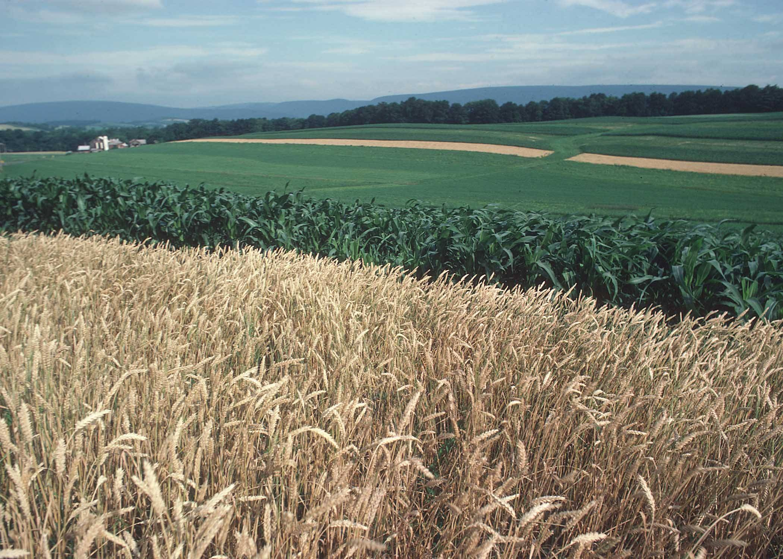
Chesapeake Bay Program’s Verification Development

Slide 11
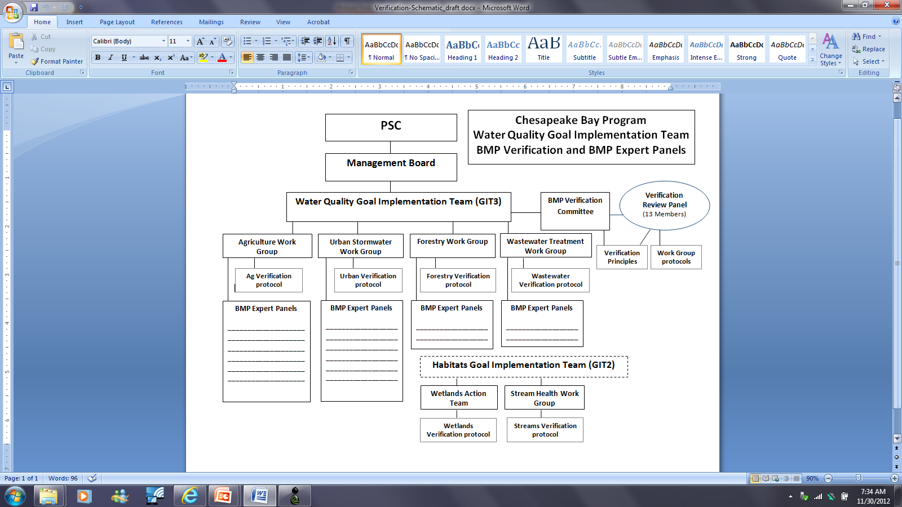

Slide 12
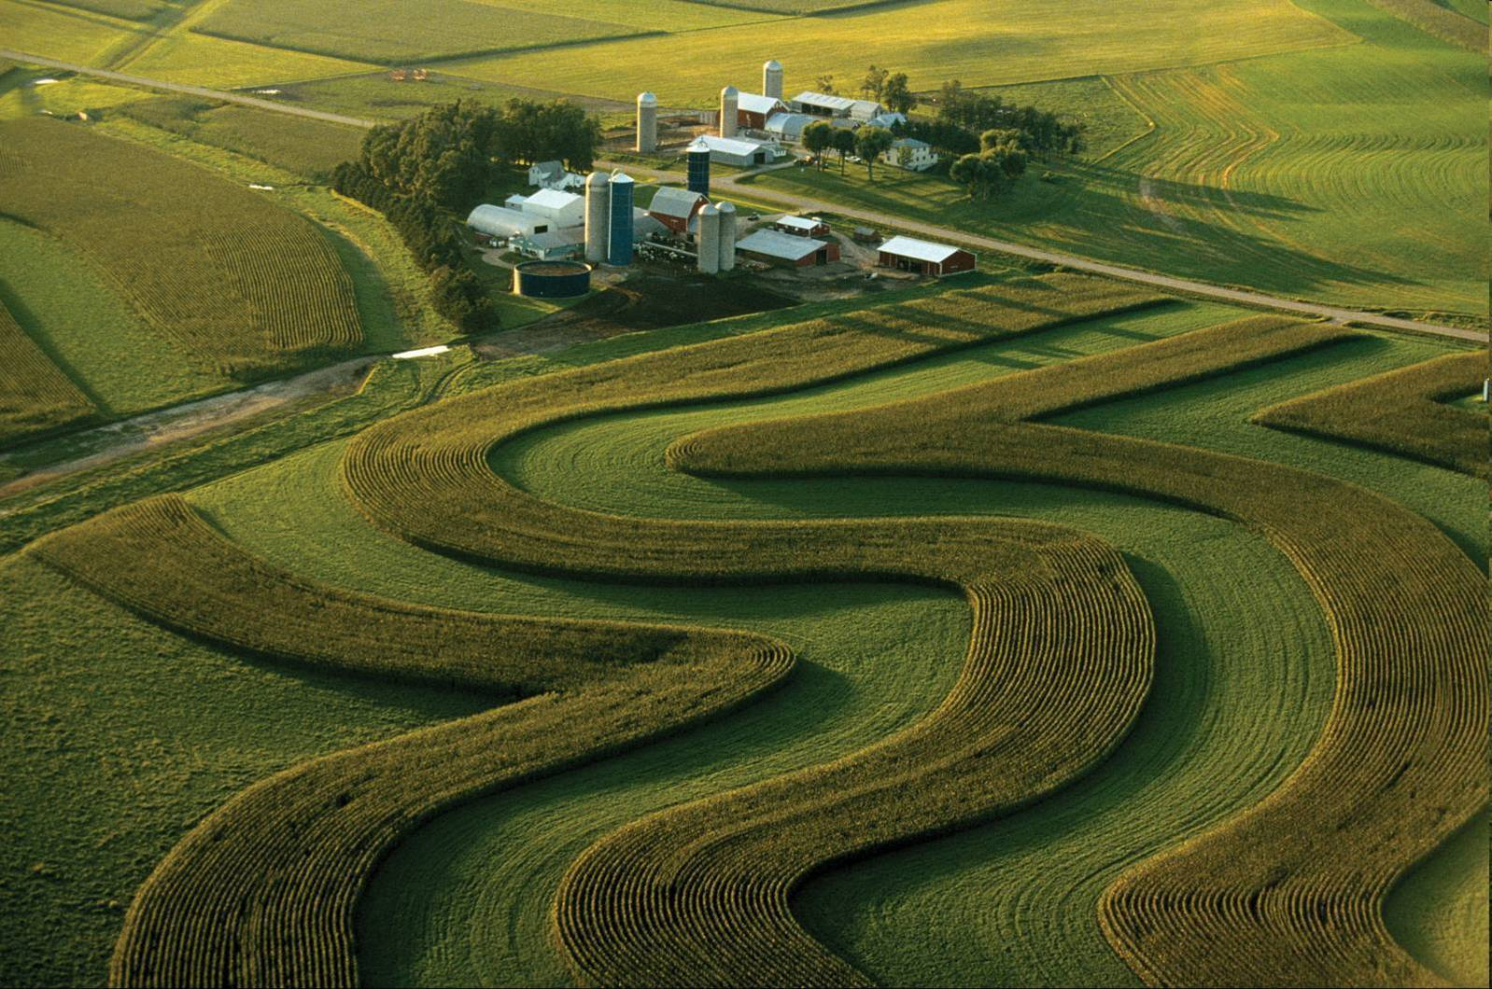
Agricultural BMP Verification

Slide 13
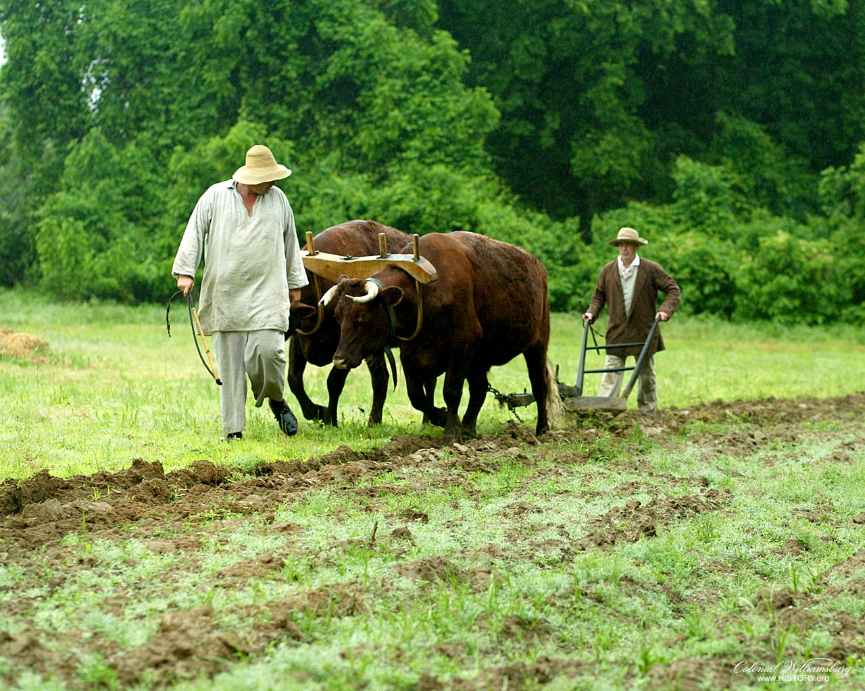
Agricultural Verification
Verification Is Not A New Concept…

Slide 14
CBP Agricultural BMPs
Nutrient Management
Nutrient Management
Precision Agriculture
Enhanced Nutrient Management
Conservation Tillage
Continuous No-Till
Conservation Tillage
Cover Crops
Cover Crops – Late Planting
Cover Crops – Early Planting
Small Grain Enhancement – Late Planting
Small Grain Enhancement – Early Planting
Pasture Grazing BMPs
Alternative Watering Facilities
Stream Access Control with Fencing
Prescribed Grazing
Precision Intensive Rotational Grazing
Horse Pasture Management
Other Agricultural BMPS
Forest Buffers
Wetland Restoration
Land Retirement
Grass Buffers
Forest Buffers
Tree Planting
Carbon Sequestration/Alternative Crops
Conservation Plans/SCWQP
Animal Waste Management Systems
Mortality Composters
Water Control Structures
Non-Urban Stream Restoration
Poultry Phytase
Poultry Litter Management
Dairy Precision Feeding and Forage Management
Swine Phytase
Ammonia Emissions Reductions

Slide 15
Interim CBP Agricultural BMPs
Nutrient Management
Irrigation Management
Passive Hay Management
Manure Management
Liquid Manure Injection
Poultry Litter Injection
Manure Processing Technology
Poultry Litter Amendments
Mortality Management
Mortality Incineration
Soil Amendments
Phosphorus Absorbing Materials
Nursery Management
Nursery Runoff Management
Non-Cost-Shared Practices
Tracking and Reporting

Slide 16
Proposed CBP Agricultural BMPs
Manure Management
Heavy Use Area Poultry Pads
Poultry Litter Management
Stormwater Management
Agricultural Stormwater Management
Sinkhole Management
Sink-Hole Grass Buffers

Slide 17
Agricultural BMP Verification
The Agriculture Workgroup identified the need to scientifically support the development of an agricultural verification protocol.
Technical assistance has been obtained from Tetra Tech under the EPA national contract under the direction of the workgroup.
A summary verification report is being developed to document the findings from a national scientific literature search and through interviews with both regionally and nationally recognized verification experts.

Slide 18
Agricultural BMP Verification
The Agriculture Workgroup has used the BMP verification principles developed by the Water Quality Goal Implementation Team's (WQGIT) BMP Verification Steering Committee.
The workgroup has considered a series of potential options for developing an agricultural verification protocol.
The potential options have each been weighed on their individual merits, and both positive and non-positive attributes identified.

Slide 19
Agricultural BMP Verification
The Agriculture Workgroup has considered multiple options of verification protocols.
Version 1: Create a limited and uniform verification protocol standard for all practices and programs.
Not recommended by the workgroup.

Slide 20
Agricultural BMP Verification
In considering the above verification option, the membership of the AgWG identified concerns with Version 1 in that it did not conform to the diversity of agricultural practices and implementation programs across six jurisdictions.
Implementing a limited verification protocol standard would likely not offer sufficient capacity to allow adequate BMP implementation reporting.
Of the positive considerations, Version 1 option does provide 100% acceptance of tracked and reported practices and the application of 100% of the model BMP effectiveness values.

Slide 21
Agricultural BMP Verification
Version 2.1: Create diverse verification protocol options and identify the levels of confidence for each protocol. Limit the units of BMP implementation reported by the degree of relative data confidence (e.g. 90% relative data confidence x tracked units = reported units). The standard model BMP effectiveness values would be applied to the reported units.
Not recommended by the workgroup.

Slide 22
Agricultural BMP Verification
In contrast with Version 1, Version 2.1 offers multiple potential verification protocol options that are more reflective of the diversity of agricultural practices and programs.
The multiple protocol options also produce varying levels of relative data confidence between the protocol options, as well as between practice types within a single protocol.
To address the issue of widely varying relative data confidence levels, the Version 2.1 implements a calculation method to align the protocol's level of confidence to the units of reported BMPs.
The foremost concern of this method by the AgWG was that by limiting the units of tracked BMPs that would be reported to the CBP models could jeopardize local community support.
In addition, the verification literature search and national expert interview process that was implemented by the AgWG did not yield adequate scientific documentation to assign defensible relative data verification levels to all protocol options for all practices.

Slide 23
Agricultural BMP Verification
Version 2.2: Create diverse protocol options and identify the levels of confidence for each protocol. Limit the model reduction credits for the units of BMP implementation reported by the degree of relative data confidence (e.g. 90% relative data confidence x BMP effectiveness values = modified BMP effectiveness values to be applied).
Not recommended by the workgroup.

Slide 24
Agricultural BMP Verification
Version 2.2 addresses the issue of widely varying relative data confidence levels by implementing a calculation method similar to Version 2.2.
Instead of aligning the protocol's level of confidence to the units of reported BMPs, this version applies the alignment to the model BMP effectiveness values.
Version 2.2 allows all tracked practices to be reported for nutrient and sediment reduction credits, however, the BMP effectiveness values are reflective of the associated level of data confidence. Verification protocols yielding lower relative data confidence levels would receive compensate model BMP effectiveness credit.
The chief concern of the AgWG was that the verification literature search and national expert interview process that was implemented by the workgroup did not yield adequate scientific documentation to assign defensible relative data verification levels to all protocol options for all practices.

Slide 25
Agricultural BMP Verification
Version 3: Create diverse protocol options and apply a standard minimum threshold of relative data confidence to allow 100% of tracked BMP units to be reported and receive 100% of BMP effectiveness values.
Recommended by the workgroup on November 29, 2012.

Slide 26
Agricultural BMP Verification
There are multiple attributes of the Agricultural BMP Verification Protocol Version 3 over previous versions.
The Version 3 protocol encompasses the positive benefits of Versions 2.1 and 2.2 by incorporating multiple protocol options to address the diversity of agricultural practices and jurisdictions.
In contrast to the earlier versions, Version 3 recognizes the widely varying relative data confidence levels between protocol options, as well as between practices within a single protocol, by establishing an up-front standard confidence level threshold for 100% model BMP effectiveness credit.

Slide 27
Agricultural BMP Verification
All protocol options are available to the partnership, but a minimum 80% data confidence threshold is required to be met to allow all tracked BMPs to be reported for full model credit.
The verification literature search and national expert interview process that was implemented by the AgWG appears capable to yield adequate scientific documentation to assign a defensible threshold relative data verification levels to all protocol options for all practices.

Slide 28
Agricultural BMP Verification
Verification Protocol Elements (Version 3.4 Matrix)
Statistical Data Confidence Threshold All tracked BMP data to be reported to and credited by the Chesapeake Bay Program models would be required to meet at a minimum a documented 80 percent level of statistical confidence. The preference would be for the level of statistical data confidence to be higher than the minimum. The proposed figure of 80 percent is based on the mid-point of a range of documented data confidence levels identified by the Tetra Tech verification study commissioned by the Agriculture Workgroup. This level of statistical confidence is representative of a minimum of 80 percent of tracked BMP units (e.g. acres, number, etc.) that could be verified under a full on-site assessment to be implemented, operated and maintained according to the appropriate BMP standards.

Slide 29
Agricultural BMP Verification
Verification Protocol Elements (Version 3.4 Matrix)
Agricultural BMP Verification Protocols A lists of identified categories of verification based on the type of tracking assessment and the type of entity that would be collecting and verifying the data have been established.
Assessment Methods The general assessment methods and the entity that would be collecting and verifying the data have been described for each category of verification.

Slide 30
Agricultural BMP Verification
Verification Protocol Elements (Version 3.4 Matrix)
Conservation Practice Category The appropriate assessment method and its associated data confidence level is affected by the type of agricultural BMPs being assessed. The appropriate verification method for annual practices such as cover crops would likely be different from structural or management BMPs. Management BMPs were further subdivided into Plans and Practices due to the same differences as noted above. Each verification protocol method has been reviewed in terms of the conservation practice categories to determine if the assessment method is appropriate and realistically able to achieve the confidence threshold. Categories with a "Yes" are viewed as appropriate and those with a "No" are not. Even if a assessment method is noted as being appropriate for a category of BMPs, significant verification efforts may still be required to meet the confidence threshold such as increased percentages of QA/QC spot checks or more frequent compliance inspections for example.

Slide 31
Agricultural BMP Verification
Verification Protocol Elements (Version 3.4 Matrix)
Cost-Sharing Information There are denoted potential differences for BMPs designed and financed through federal, state, NGO and private sources for each assessment method. Not all methods are appropriate to track and verify practices implemented, operated, and maintained under these categories.
Other BMP Information This verification matrix describes the ability of each assessment method to verify if the tracked practice meets the appropriate BMP specification, or if it represents a functional equivalent or non-functional equivalent BMP. In addition, the identification of the date of practice implementation is critical to determining if the BMP is considered part of the model calibration period or afterward for reporting purposes.

Slide 32
Agricultural BMP Verification
Verification Protocol Elements (Version 3.4 Matrix)
Verification Methodology Each assessment method utilizes a unique methodology to track, verify and report implemented practices. BMPs being assessed and verified through permit or financial incentive programs are limited to the period of the active permit or contractual agreement for the practice(s). Once outside of the requirements of a permit or financial incentive program, entities are directed to the use of alternative assessment methods for the tracking, verification and reporting of these practices.
Verification Issues Each assessment method poses limitations and potential verification issues that need to be recognized and addressed in order to obtain the statistical data confidence threshold requirements. The frequency of compliance inspections, the use of appropriately trained and certified personnel, and the availability of data at the required scale are examples of potential data errors which may lower the statistical confidence of the data.

Slide 33
Agricultural BMP Verification
Verification Protocol Elements (Version 3.4 Matrix)
Relative Cost The matrix provides a generalist view of the relative costs in comparison to one another. They are represented as high, medium or low based on the range of implementation costs identified in the Tetra Tech research report commissioned by the Agriculture Workgroup.
Relative Scientific Defensibility Relative comparative values of high, medium or low are assigned to each assessment method pertaining to their scientific defensibility based on the findings of the Tetra Tech research commissioned by the Agriculture Workgroup. The values are reflective of available documentation to support the assessment method in verifying data at or above the threshold level.

Slide 34
Agricultural BMP Verification
Verification Protocol Elements (Version 3.4 Matrix)
Relative Accountability Relative comparative values of high, medium or low are assigned to each assessment method pertaining to the accountability of the entity tracking and verifying the data. Data originating from permit or financial assistance programs with potential consequences for misrepresentation of the information will have a relatively high level of accountability for example. Non-cost shared self-reported information would consequently have a low potential value of accountability.
Relative Transparency Relative comparative values of high, medium or low are assigned to each assessment method based on the transparency of the reported data by outside reviewers. Practices identified through permit programs would have a high transparency since the information is part of the public record and are reviewable by outside entities. Assessment methods that aggregate the tracked and verified data to protect individual entities would have a lower transparency for an outside review.

Slide 35
Agricultural BMP Verification
Intended Use of the Verification Matrix and Supporting Documentation
The final approved agricultural verification protocol matrix with supporting documentation is intended to provide the partnership with the structure and expectations of verifying tracked data for reporting to the Chesapeake Bay Program for nutrient and sediment reduction credits.
The completed verification protocol package will include the approved protocol matrix, an expanded version of a supporting document, and the completed Tetra Tech summary verification report providing the documented findings from the national literature search and expert interviews.
The protocol package will be designed to provide the guidance for agencies and partners to develop more program specific and detailed data verification plans for submission to the Chesapeake Bay Program partnership and the independent verification review panel for review and acceptance.

Slide 36
Intended Use of the Verification Matrix and Supporting Documentation
In the absence of documented statistical data confidence information, the services of a qualified statistician could be invaluable to demonstrate that a verification protocol meets the minimum threshold level.
Agency or partner verification plans that fail to meet the minimum confidence threshold will need to consider implementing increased levels of QA/QC procedures, or adopting a more robust assessment method for the particular practice as examples.
Verified tracked data that meets the criteria of the approved agricultural verification protocols will be eligible for reporting to the Chesapeake Bay Program models for full BMP credit reduction values.

Slide 37
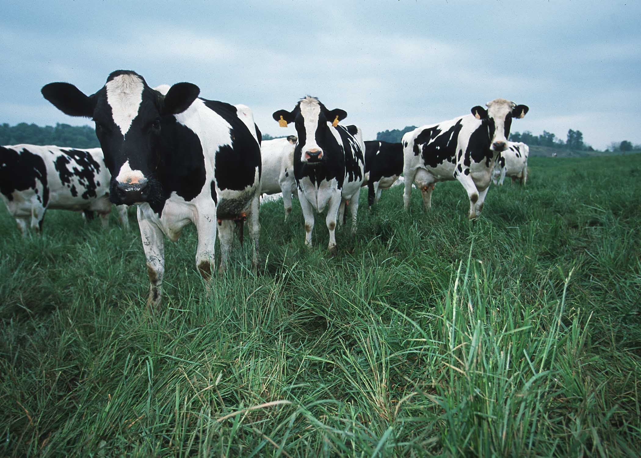
Questions?

