Slide 1
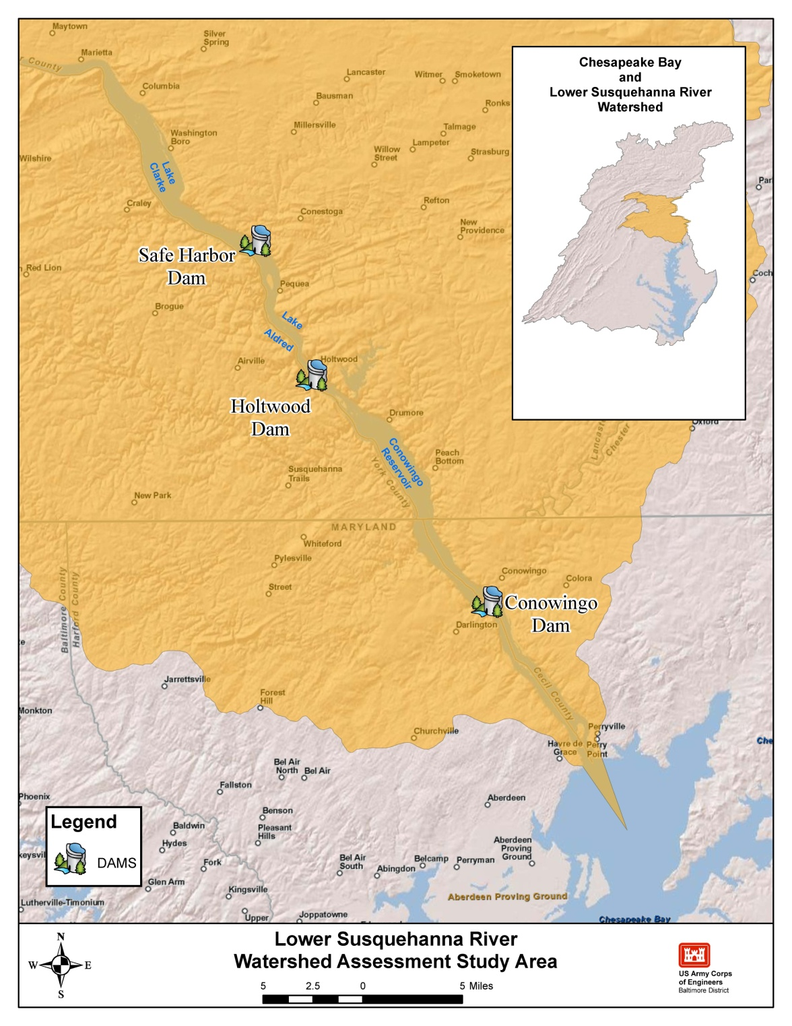








Lower Susquehanna River Watershed Assessment
Citizens Advisory Committee
November 29, 2012
Anna Compton
USACE
Notes:
Issue of the long-term buildup of sediment behind the dams in the lower Susquehanna and the implications of these sediments and associated nutrients to the Chesapeake Bay.
Multi-Agency Partnership.

Slide 2
Assessment Summary
Watershed assessment (Authorized by Section 729 of Water Resources Development Act of 1986)
Cost: $1.376 million
Cost-sharing sponsor = Maryland Department of the Environment
Cost sharing = 75% Federal, 25% non-Federal
Agreement executed September 2011
Study started in earnest November 2011
Study duration expected to be 3 years (assuming funding comes in timely fashion)
Notes:
River basin assessment (Sec 729 of WRDA 1986): What can we do to reduce problem? Where should work be done? Variety of recommendations implemented by different entities.

Slide 3
Assessment Components
Identification of sediment management strategies (Dredging? Innovative Re-use? By-passing? Alter Reservoir Operations? More BMP’s? Other?).
Use of models to link incoming sediment and associated nutrient projections to in-reservoir processes at the hydroelectric dams.
Use of models to forecast effects of sediment management strategies to living resources in Chesapeake Bay.
Integration of the MD and PA Watershed Implementation Plans (WIPs).
Concept-level designs and costs.
Will not lead directly to construction.

Slide 4
Modeling Tools
CBP Partnership-Watershed Model
Sediment and nutrient loads from the watershed at key locations into the reservoirs/Susquehanna River
HEC-RAS 1D Model
Hydrologic conditions and sediment transport into Conowingo Reservoir (from upper 2 reservoirs)
2D Adaptive Hydraulics Model (ADH)
Erosion/deposition within Conowingo reservoir
Sediment transport out of Conowingo reservoir
Response of reservoir and flats to various scenarios
CBP Partnership - Chesapeake Bay Model
Impact of sediments and nutrients on light attenuation, submerged aquatic vegetation, chlorophyll, and dissolved oxygen on Bay
Notes:
CBP- WSM model-Same model used for TMDL’s; POC is EPA; however UMD may run scenarios. Partnership includes, Several Federal and state agencies and NGO’s and private partners.
HEC-RAS-USGS will route sediment through upper 2 reservoirs providing boundary conditions for 2D ADH model.
Chesapeake Bay Model
computes water quality and living resources in the bay system;

Slide 5
Activities Completed to Date
Sediment Data Collection (sediment cores, suspended sediment water quality, grain size analysis)
Bathymetric Surveys
Sediment Characterization (SEDFlume)
Outreach Activities (project website, quarterly email updates, ...)
Literature Search for Potential Strategies – Watershed and Reservoir-Specific
Development of the HEC-RAS Hydraulic Model
Development of the 2-D Sediment Transport Model (AdH)
Set-Up of the Chesapeake Bay Environmental Modeling Package (Bay impacts of sediment effects)
Initial Brainstorming of Available Alternatives
Modeling of Existing and projected conditions of No Action (just started)

Slide 6
Schedule of Upcoming Activities
Modeling of Baseline Conditions Oct-Dec 2012
Modeling of Initial Scenarios Oct-Dec 2012
Sediment Management Strategy
Identification and Site Evaluation Winter 2012-13
Modeling of Alternative Scenarios Apr-Jun 2013
Sediment Management Strategy Development Jul-Sep 2013
Notes:
Base Condition – Water Quality (WQ)/sediment accumulation rate under existing conditions.
Watershed Management – WQ/sediment accumulation rate after implementation of TMDL’s.
What Happens when the Reservoir Fills – Impact on WQ/sediment accumulation rate to the Bay (assume TMDL’s are being met).
Effect of Scouring during Winter/Spring Runoff – WQ/sediment accumulation rate with scouring of the bottom of a full reservoir (utilize Jan ‘96 event).
. Effect of Scouring from a Tropical Storm – Same as Scenario 4 except event will occur in summer (substitute the Jan ‘96 event).
6. Reservoir Bypass – Impacts on WQ/sediment accumulation rates with a system bypassing sediment from behind Conowingo to below the dam.
7. Reservoir Strategic Dredging – WQ/sediment accumulation rate impacts from dredging fines in potentially any reservoir.
8. Modify Dam Operations – Effects of altering the flow and/or the way the Conowingo is currently operated.

Slide 7
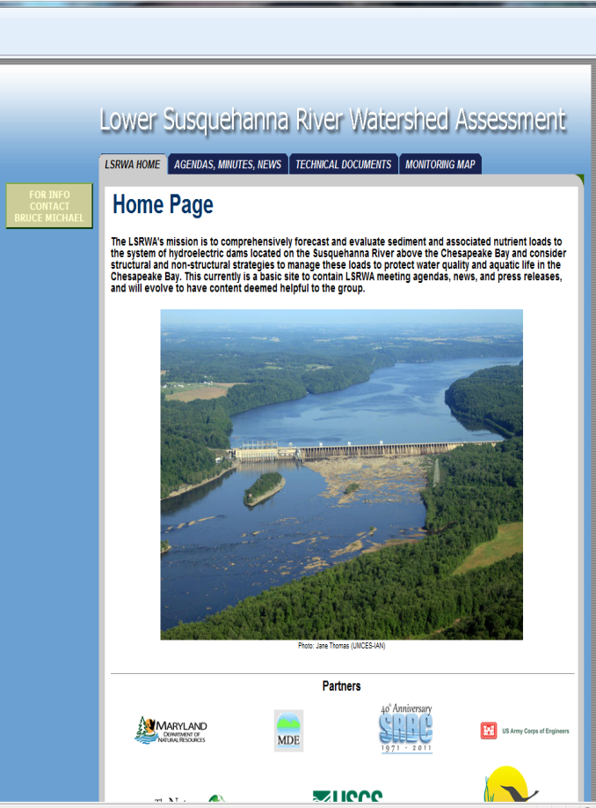
Stakeholder Outreach
Study Initiation Notice February 2012
Agency Coordination Letters February 2012
Facebook Page:
http://www.facebook.com/pages/Lower-Susquehanna-River-Watershed-Assessment/359608094092593
LSRWA Website: http://bit.ly/LowerSusquehannaRiver
Stakeholder Involvement Plan
Email updates: to be added email
Anna.M.Compton@usace.army.mil
Notes:
DNR hosts public website
http://mddnr.chesapeakebay.net/LSRWA/index.cfm

