Slide 1
Citizens Advisory Committee to the Chesapeake Executive Council
November 29, 2012

Slide 2
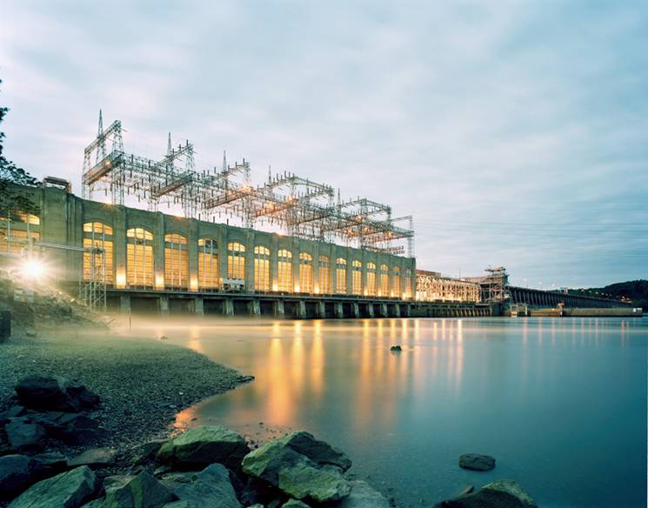
Conowingo Hydroelectric Facility
In 2011, Conowingo produced over 2.5 million MWhs of clean electricity
Conowingo generation displaces generation from fossil fuel sources such as coal and natural gas which results in less emissions of greenhouse gases and other pollutants
Conowingo generates during peak electric demand which helps keep electricity prices lower for the region
The Conowingo and Muddy Run facilities are estimated to lower retail electricity prices by 1.8% to 3.4% in Pennsylvania and Maryland
The Projects provide additional important contributions to the electricity grid by supplying essential services for the proper functioning of a regional electricity grid. These services include Black-start capability and Spinning Reserves
U.S. Department of Energy recently noted the great benefits of the use of hydroelectric power: “Modernizing and optimizing our nation’s hydropower dams is one of the best opportunities to sustainably increase our supply of clean energy. Hydropower’s ability to quickly ramp up power output makes it a natural fit with wind, solar and other renewable energy sources that supply variable power” (Beaudry-Losique, Director, EIA Wind & Water Program, 2010).
572 MW hydroelectric, 11 units
Located in Darlington, Maryland on Susquehanna River
Constructed in 1928
Last licensed August 1980
Projects provides approx. $78.5 million in property and income taxes annually

Slide 3
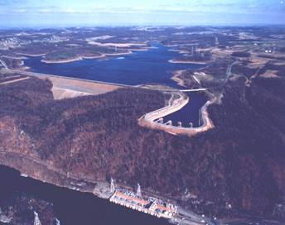
Muddy Run Pump Storage
In 2011, Muddy Run generated over 1.2 million MWhs of electricity
Muddy Run has the ability to store water in the upper reservoir during evening periods when electric demand is low and generate when electricity is needed during peak periods
Pump storage generation displaces higher cost generation from fossil fuel sources (coal and natural gas) which results in less emissions of greenhouse gases and other pollutants
The output of Muddy Run is particularly critical for meeting the electricity needs of the region on hot summer afternoons when electricity demand and the marginal costs of electricity generation are the highest
The Conowingo and Muddy Run facilities are estimated to lower retail electricity prices by 1.8% to 3.4% in Pennsylvania and Maryland
Muddy Run provides stability to the PJM electric grid by having the ability to bring generation on quickly to handle system disturbances and maintain stable prices
Muddy Run also provides additional important contributions to the electricity grid by supplying Black-start capability, Voltage Control, Regulation and Spinning Reserves
800 MW of pump storage, 8 units
Located in Drumore, Pennsylvania on Susquehanna River
Constructed in 1972
Last licensed issued September 1964
Projects provides approx. $78.5 million in property and income taxes annually

Slide 4
Licensing Process
The relicensing team is pursuing relicensing of the Conowingo and Muddy Run using FERC’s integrated licensing process (ILP)
The ILP is a 7 to 9 year process that requires Exelon to consult with regulatory agencies in advance of filing its license application with FERC
The ILP contains mandated time limits in which both FERC and Exelon are required to act
Initial Information Package, Execution of Baseline Studies, Stakeholder Meetings
Execution of Informal Studies, Develop Pre- Application Document
Expected License Issuance and Implementation Planning
File License Application
2006
2007
2008
2009
2010
2011
2012
2013
2014
2015
Formal Study Scoping, File Pre Application Document and Notice of Intent to File Application with FERC
Settlement Negotiations Begin
Informal Study Scoping
Execution of Formal Studies

Slide 5
Studies Associated with Licensing Process
The type of studies conducted as well as the design of each study were developed in consultation with stakeholders.
The ILP processes for the two Projects including 47 studies have cost approximately $22 million dollars.
The studies were conducted from 2010 through 2012.
A variety of aspects were covered by the studies and include areas such as fish and aquatic species communities, fish passage evaluations, instream flow habitat assessments, water quality assessments, sediment introduction and transport as well as recreational and shoreline management assessments.
The results of the studies were included with the Final License Application (FLA) and filed accordingly with the FERC.

Slide 6
License Application
The licensing process and the development of the Final License Application (FLA) for Conowingo is a cooperative and collaborative process involving multiple parties including federal and state agencies as well as local government and various Non-Governmental Organizations (NGOs).
The FLA for Conowingo was filed in August 2012 and addressed stakeholder comments received on the draft license application which was filed in April 2012.
The FLA includes Exelon’s proposal for operations and management of facilities in the future license.
Exelon has proposed environmental measures as part of the FLA that include:
Plans for managing land with rare, threatened and endangered species habitats
Continuation of the operations and preventive maintenance program for the East Fish Lift (EFL)
Best management practices (BMPs) for controlling sediment introduction from Project lands along with conducting a bathymetry study of Conowingo Pond every 5 years to monitor sediment transport and depositional patterns and a sediment management plan to identify benchmarks and thresholds for action to address sediment issues that may affect Project operations.
Recreation and shoreline management plans were also part of the FLA.
Exelon plans to invest approximately $7 million in recreational improvements.

Slide 7
Issue: Sediment Transport
Sediment within the Susquehanna River Basin that affects the Chesapeake Bay is a watershed issue that requires the participation of all parties. To this end, Exelon has been involved with the Sediment Task Force since its original inception in the late 1990’s and continues to support the effort by participating in the Lower Susquehanna River Watershed Assessment (LSRWA).
In conjunction with the LSRWA, Exelon provides in-kind services that have included 2011 bathymetry data for use in modeling and calibration associated with the projects of the LSRWA along with regular participation in meetings associated with the process.
Sediment originates from upland and riverine erosion throughout the 27,500 sq mile watershed that covers parts of the three state area Maryland, Pennsylvania and New York
To quote a recent Fact Sheet from the Chesapeake Bay Foundation
“…The dam, historically, has been the Bay’s best BMP, removing much of what normally would have flowed downstream, particularly phosphorus and sediment.”
The amount of sediment deposited as estimated by the 2008 USGS Bathymetry report is an average of 2,000,000 tons annually. This equates to a 100 ton railcar loaded every 26 minutes 365 days per year just to maintain the same level of sediment.

Slide 8
Wrap Up
Exelon and licensing stakeholders have begun the negotiating phase of the relicensing process. We anticipate that the cooperative and collaborative nature of the previous licensing steps will continue throughout the negotiating stage.
Exelon will continue to provide information to facilitate open discussions during the negotiating sessions of licensing.
In parallel, Exelon will also continue its involvement with the Lower Susquehanna River Watershed Assessment.
Exelon is grateful for the opportunity to participate in today’s panel discussion and appreciates the opportunity to discuss the relicensing process.

