Slide 1
Engaging Younger Generations in the Chesapeake Bay Restoration
Elizabeth Burdick
&
Adam Thompson

Slide 2
Engaging Younger Generations
Young Delegate Perspective
Why We Care
Where is the Disconnect?
Why Young People are Disengaged
2012 CAC Recommendations
Status of the States
Improving Youth Participation
What CAC can do

Slide 3
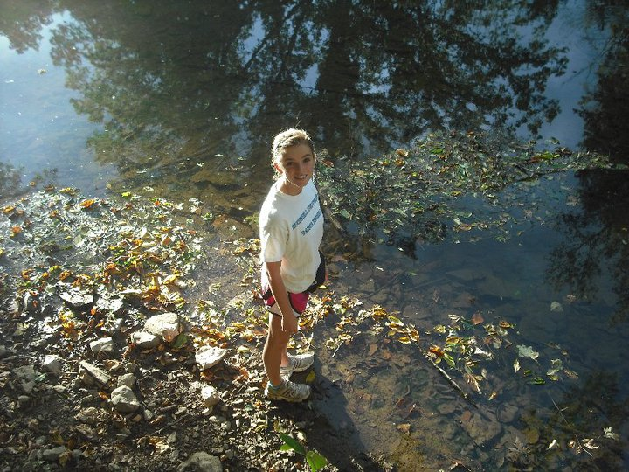
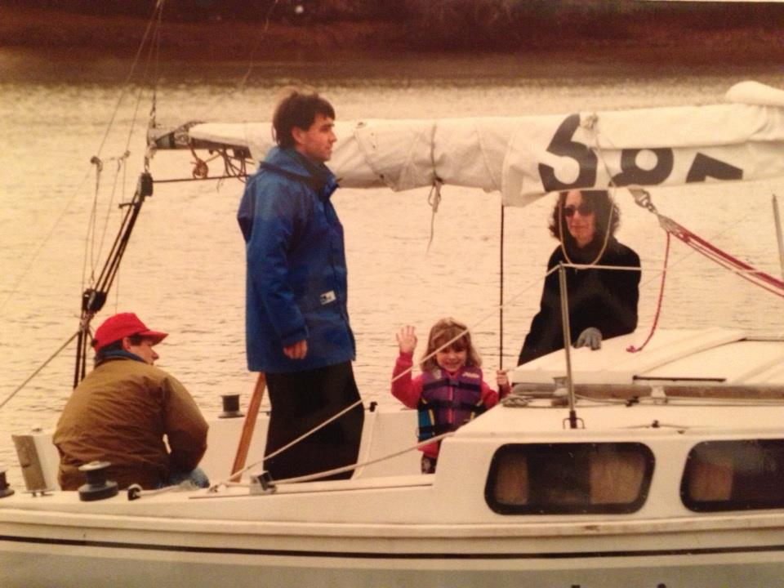
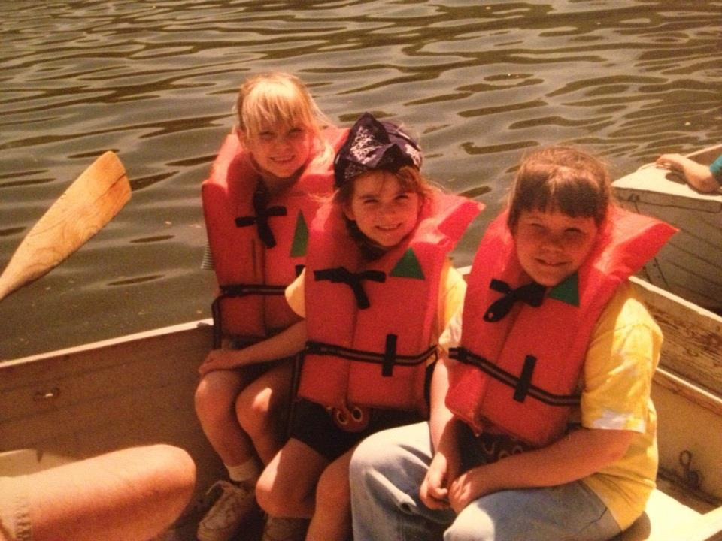
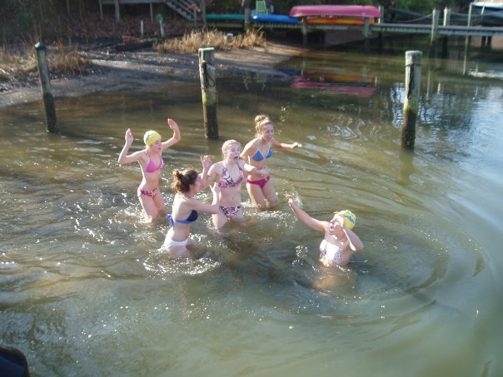
Why I Care

Slide 4
Born and raised in Richmond, VA

Slide 5
Ocracoke Island, NC

Slide 6
Where is the Disconnect?
Keys to engagement:
Creativity
Sense of adventure
Connection
All lacking

Slide 7
Where is the Disconnect?
There are a lot of activities, active and sedentary, that are structured, guided, and tend to remove creativity and exploration.
A young person’s sense of adventure and interest in the Bay that is sparked at a young age, must also be reinforced!
Two kids involved in an environmental education program may have entirely different experiences.
One may connect that experience to a time they experienced the Bay earlier in life
Another’s interest in the Bay may be sparked.
School programs
Summer camps
Extracurricular activities
Connection

Slide 8
Explanations
Technology
Video games
Structured activities
Fear
Access
Connection

Slide 9
What is the Issue?
We need young people to explore and experience the Bay at a young age.
We must provide opportunities and access to opportunities to reinforce a young persons connection to the Bay, or spark a young persons interest.
We have significant competition for young people’s attention.

Slide 10
2012 Recommendations
Three recommendations centered on environmental literacy
Secretary of the U.S. Department of Education sign a formal Memorandum of Understanding (MOU) with the Bay Program
Establish two year milestones for environmental literacy
Approve the Mid-Atlantic Elementary and Secondary Environmental Literacy Strategy

Slide 11
Environmental Literacy where the states are now
Washington DC
Maryland
Virginia
Pennsylvania

Slide 12
Environmental Literacy Washington DC
The District of Columbia Environmental Education Consortium (DCEEC). DCEEC members provide the District of Columbia Schools:
environmental resource expertise
educator workshops and accredited courses
interactive classroom and field studies or investigations
classroom curricula and materials
As mandated by the Healthy Schools Act, the District Department of the Environment (DDOE) has formally formed the DC Environmental Literacy Plan Workgroup .
How you can help! The DC ELP Workgroup meetings are usually on the 4th Tuesday at 2pm at the District Department of the Environment.

Slide 13
Environmental Literacy Maryland
Environmental Literacy Program Approved and Funded
2011-2012 High School Students to Complete EL Program
Maryland Association for Environmental and Outdoor Educators (MAEOE)

Slide 14
Environmental Literacy Virginia
2000: Virginia Naturally
2004: Master plan for environmental literacy developed
Virginia Resource-Use Education Council: creates an action plan annually
State Requirement for K-12 Environmental Education Instruction: legal requirements that school districts and K-12 teachers incorporate EE into their existing curriculum. New standards in Science have watershed concepts such as water quality monitoring; and Chesapeake Bay ecology to the content knowledge student should know.
Coordinated teacher in-service training in EE: mostly funded through grants.
EE curriculum guides:
VA Natural Resources Education Guide
Science Implementation Guidelines
Criteria for Exemplary EE in Schools
Definition of Meaningful Watershed Educational Educations

Slide 15
Environmental Literacy Pennsylvania
Drafted March 2012
Pennsylvania Advisory Council and PA Department of Education
Good Components
Informed Environmental Decisions
Life Long Learners
Lacking Susquehanna Specific Content
PA Association of Environmental Educators

Slide 16
More Information State Environmental Literacy Plans
No Child Left Inside
http://www.cbf.org/ncli/action/environmental-literacy-plans-by-state

Slide 17
Engaging Younger Generations
Younger generations are an untapped resource
Large opportunity here
A lot of us have the passion for change

Slide 18
What CAC Can Do Right Now
Support your state environmental literacy program
Make sure the watershed in question is represented
Support independent contributors to the literacy effort
Bolster Facebook Presence
Provide Opportunities

Slide 19
Engage Younger Generations in our Meetings
Young Delegates
Have each state represented by 2013
Younger Delegates
Shadowing opportunities?
Young delegates bring high schoolers
Inviting local high school and or university clubs to meetings
Make that happen for the next meeting
Community outreach
Utilizing River Keepers

Slide 20
Richard Louv

Slide 21
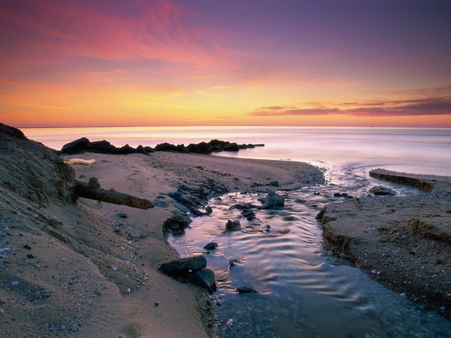
Thank You!

