Slide 1
FY2012 ChesapeakeStat Development Team
Enhancements – content, design, function
Redesign Goal Overview Pages
Objective: Communicate the mission and vision of GITs more cohesively and direct user to Decision Framework content. Array information of importance to MB, GITs and workgroups.
Addition of new Decision Framework content
Redesign and enhance “Cross-Goal & Decision Support” content

Slide 2
Cross-Goal & Decision Support Content
Purpose: Provide access to cross-cutting information summarized across GITs to support MB, PSC, others. Provide organizational framework for the committees, workgroups, and teams.
Audience: MB, PSC, managers, partners

Slide 3
CURRENT:
PROPOSED:
Coordinate, Assess, Adapt, Inform
PARTNER COORDINATION & DECISION SUPPORT
FISHERIES GOAL IMPLEMENTATION TEAM
HABITATS GOAL IMPLEMENTATION TEAM
WATER QUALITY GOAL IMPLEMENTATION TEAM
WATERSHEDS GOAL IMPLEMENTATION TEAM
STEWARDSHIP GOAL IMPLEMENTATION TEAM

Slide 4
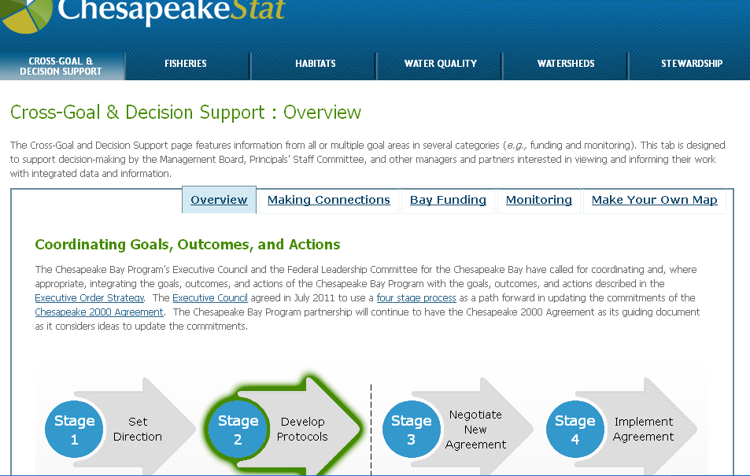
Coordinate, Assess, Adapt, Inform
PARTNER COORDINATION & DECISION SUPPORT
FISHERIES GOAL IMPLEMENTATION TEAM
HABITATS GOAL IMPLEMENTATION TEAM
WATER QUALITY GOAL IMPLEMENTATION TEAM
WATERSHEDS GOAL IMPLEMENTATION TEAM
STEWARDSHIP GOAL IMPLEMENTATION TEAM
Partner Coordination & Decision Support: Overview
The Chesapeake Bay Program is organized into committees, goal implementation teams, workgroups and action teams. Click on the organizational chart below for organizational specific information related to goals and progress. This information supports decision-making by the Management Board, Principals’ Staff Committee, and other managers and partners in the Bay Program. Additional tabs describe the work of the goal implementation teams and their workgroups.
Current Initial View

Slide 5
Coordinate, Assess, Adapt, Inform
PARTNER COORDINATION & DECISION SUPPORT
FISHERIES GOAL IMPLEMENTATION TEAM
HABITATS GOAL IMPLEMENTATION TEAM
WATER QUALITY GOAL IMPLEMENTATION TEAM
WATERSHEDS GOAL IMPLEMENTATION TEAM
STEWARDSHIP GOAL IMPLEMENTATION TEAM
Partner Coordination & Decision Support: Overview
The Chesapeake Bay Program is organized into committees, goal implementation teams, workgroups and action teams. Click on the organizational chart below for organizational specific information related to goals and progress. This information supports decision-making by the Management Board, Principals’ Staff Committee, and other managers and partners in the Bay Program. Additional tabs describe the work of the goal implementation teams and their workgroups.
Meeting Schedules
Proposed Initial View

Slide 6
Coordinate, Assess, Adapt, Inform
PARTNER COORDINATION & DECISION SUPPORT
FISHERIES GOAL IMPLEMENTATION TEAM
HABITATS GOAL IMPLEMENTATION TEAM
WATER QUALITY GOAL IMPLEMENTATION TEAM
WATERSHEDS GOAL IMPLEMENTATION TEAM
STEWARDSHIP GOAL IMPLEMENTATION TEAM
Partner Coordination & Decision Support: Meeting Schedules
The Chesapeake Bay Program is organized into committees, goal implementation teams, workgroups and action teams. Click on the organizational chart below for organizational specific information related to goals and progress. This information supports decision-making by the Management Board, Principals’ Staff Committee, and other managers and partners in the Bay Program. Additional tabs describe the work of the goal implementation teams and their workgroups.
Meeting Schedules
Goal Teams and Workgroups
Proposed Addition

Slide 7
Coordinate, Assess, Adapt, Inform
PARTNER COORDINATION & DECISION SUPPORT
FISHERIES GOAL IMPLEMENTATION TEAM
HABITATS GOAL IMPLEMENTATION TEAM
WATER QUALITY GOAL IMPLEMENTATION TEAM
WATERSHEDS GOAL IMPLEMENTATION TEAM
STEWARDSHIP GOAL IMPLEMENTATION TEAM
Partner Coordination & Decision Support: Goal Teams and Workgroups
The Chesapeake Bay Program is organized into committees, goal implementation teams, workgroups and action teams. Click on the organizational chart below for organizational specific information related to goals and progress. This information supports decision-making by the Management Board, Principals’ Staff Committee, and other managers and partners in the Bay Program. Additional tabs describe the work of the goal implementation teams and their workgroups.
Proposed Addition
Goal Teams and Workgroups

