Slide 1
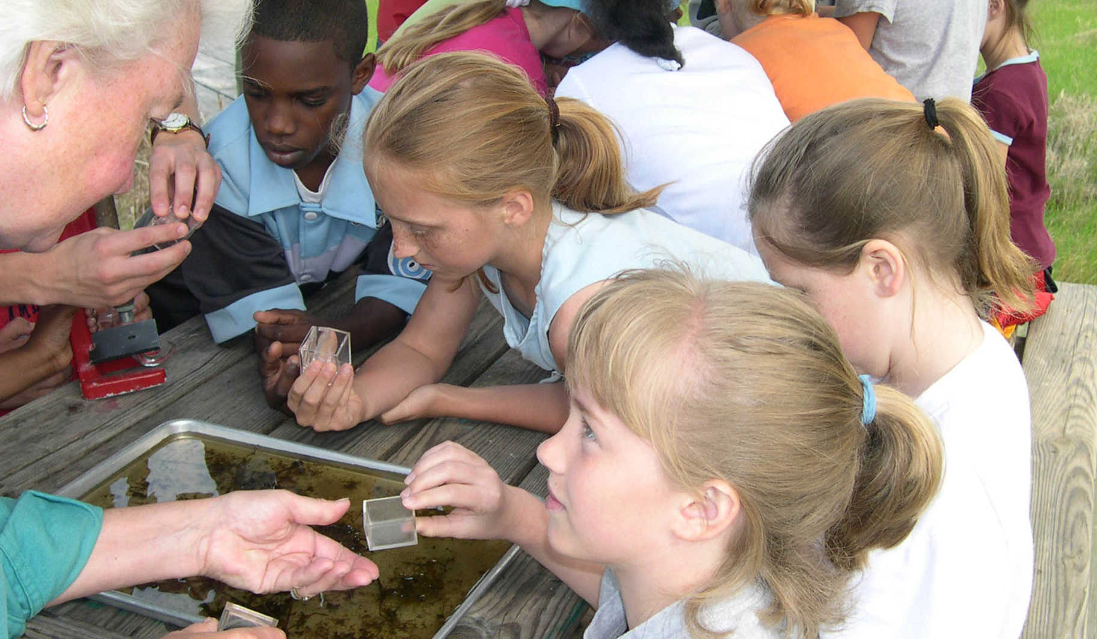
Fostering Chesapeake Stewardship Goal Implementation Team 5

Slide 2
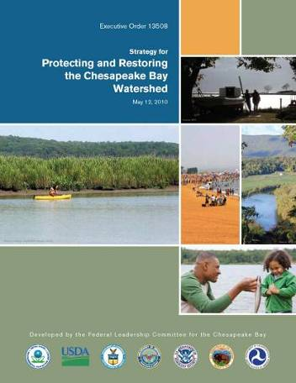
Goals Adopted by GIT 5
Conserve Land and Increase Public Access:
Conserve landscapes treasured by citizens to maintain water quality and habitat; sustain working forests, farms, and maritime communities; and conserve lands of cultural, indigenous and community value. Expand public access to the Bay and its tributaries through existing and new local, state and federal parks, refuges, reserves, trails and partner sites.
Expand Citizen Stewardship:
Foster a dramatic increase in the number of citizen stewards of every age who support and carryout local conservation and restoration.

Slide 3
Fostering Chesapeake Stewardship GIT 5
Education Workgroup
Chesapeake Conservation Corps Action Team
Master Watershed Stewards Action Team
Funding Strategy
Land Conservation Priorities Action Team
Priorities System Development
Public Access Planning Action Team
Metric Tracking and Updates
Landscape Survey
Capacity Building
Metric Tracking and Updates
Environmental Literacy Strategy
Environmental Literacy Summit
MWEE Tracking
New Metric Development
Bay Backpack
Funding Strategy
New Metric Development
Capacity Building
Public Access Strategy
Public Access Guide
Expand Citizen Stewardship Supporting Strategy
Conserve Land and Increase
Public Access Goal

Slide 4
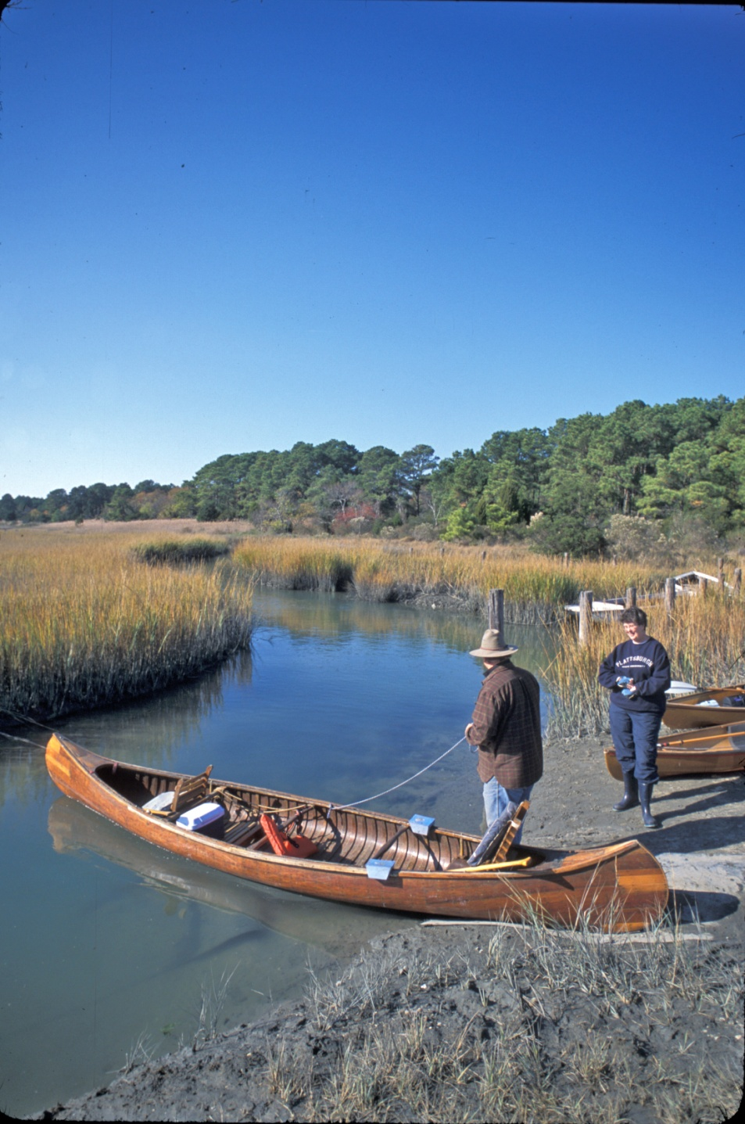
Goal: Increase Public Access
Goal:
Increase public access to the Bay and its tributaries by adding 300 new public
sites by 2025.

Slide 5
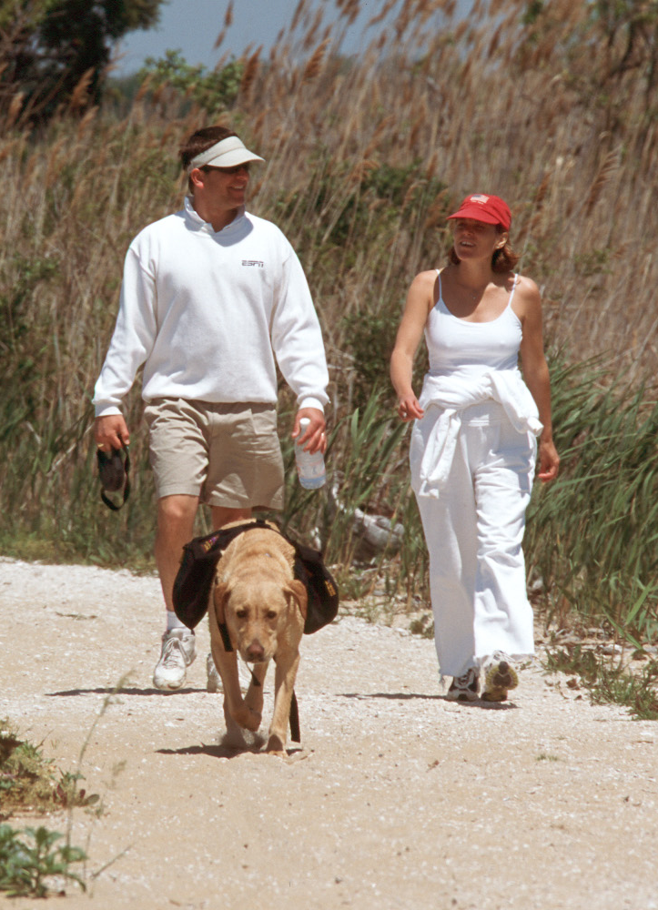
Goal: Increase Public Access
Factors Influencing Attainment:
Funding
Suitable site availability
Density of existing sites
Public support
Policy restrictions to access
Railroad and liability concerns
Additional planning needed
Physical barriers
Water quality
Proximity to underserved populations
Proximity to water trails
Use conflict

Slide 6
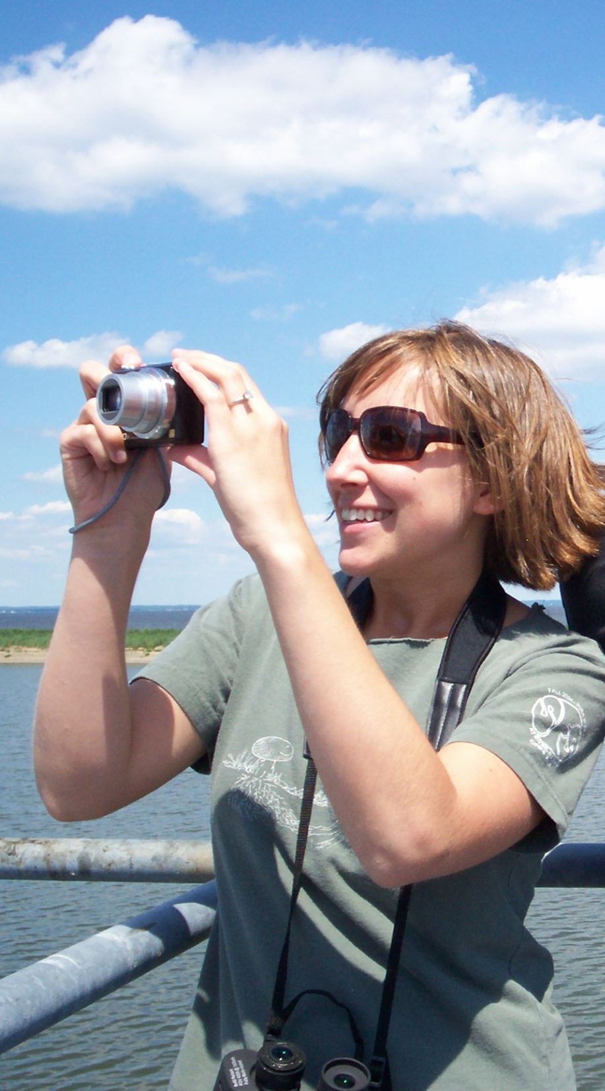
Goal: Increase Public Access
Current Management Efforts:
Two primary influences
Chesapeake 2000 Agreement
Executive Order / Public Access Strategy
Collective management effort limited – tracking not managing (to be continued…)

Slide 7
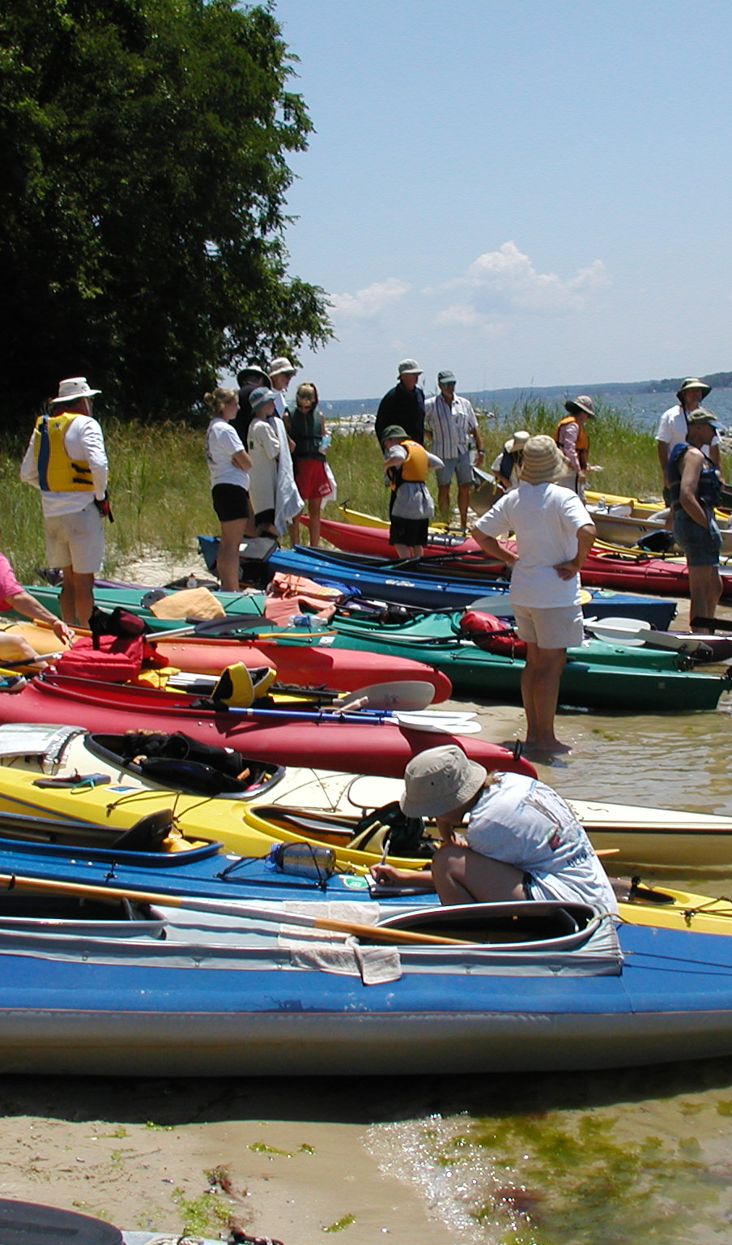
Expand Public Access
Goal: Increase Public Access
Management Strategy (as stated in strategy):
Partnerships and MOUs
Non Traditional Partnerships
Water Trails and Motivation
Grants as Implementation Tools
Working Waterfront Opportunities

Slide 8
Goal: Increase Public Access
Develop Monitoring Program:
Measure increase in public access as per EO goal
Clarified definition of public access site
Expanded scope to headwater states

Slide 9
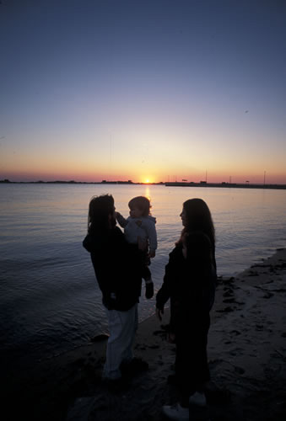
Goal: Increase Public Access
Assess Performance:
No state allocations
Track progress relative to regular increments of the goal

Slide 10
Goal: Increase Public Access
Manage Adaptively:
Lack of dependent funding and other barriers makes future increases unpredictable.
Public access team will assess annual progress and adjust management strategies to favor those that are most effective.

Slide 11
Goal: Increase Public Access
Difficulties with Decision Framework:
Working simultaneously with development of Public Access Strategy
Role of public access team is still evolving. Where does the responsibilities of the team fall between tracking and managing continuum?

Slide 12
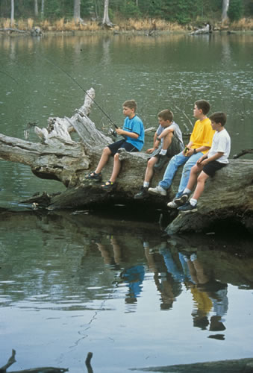
Goal: Increase Public Access
What We Are Learning:
DF has enabled us to document content of Public Access Plan in another way to double check for gaps, etc.
We are only monitoring endpoint – public access – not other factors or efforts.
Management strategies do not necessarily align with factors influencing attainment.

Slide 13
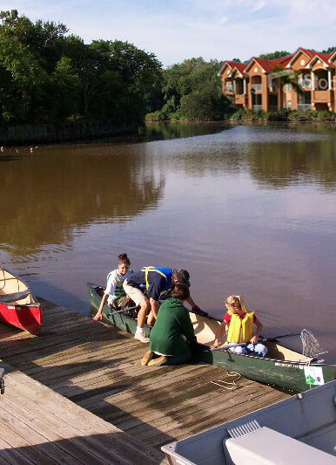
Goal: Increase Public Access
Value to GIT / Other GIT / MB:
Factors influencing attainment
help in focusing management efforts
Site identification – cross area collaboration
Documents our process and provides transparent picture of our work

Slide 14
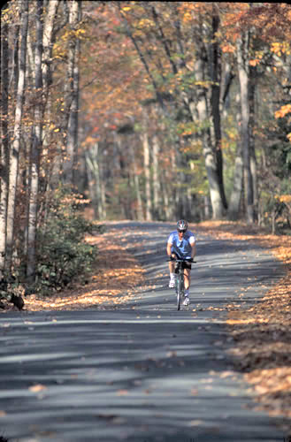
Goal: Increase Public Access
Next Steps:
Finalize Public Access Strategy
Update public access baseline and 2011 increase
Finalize decision framework

