Slide 1
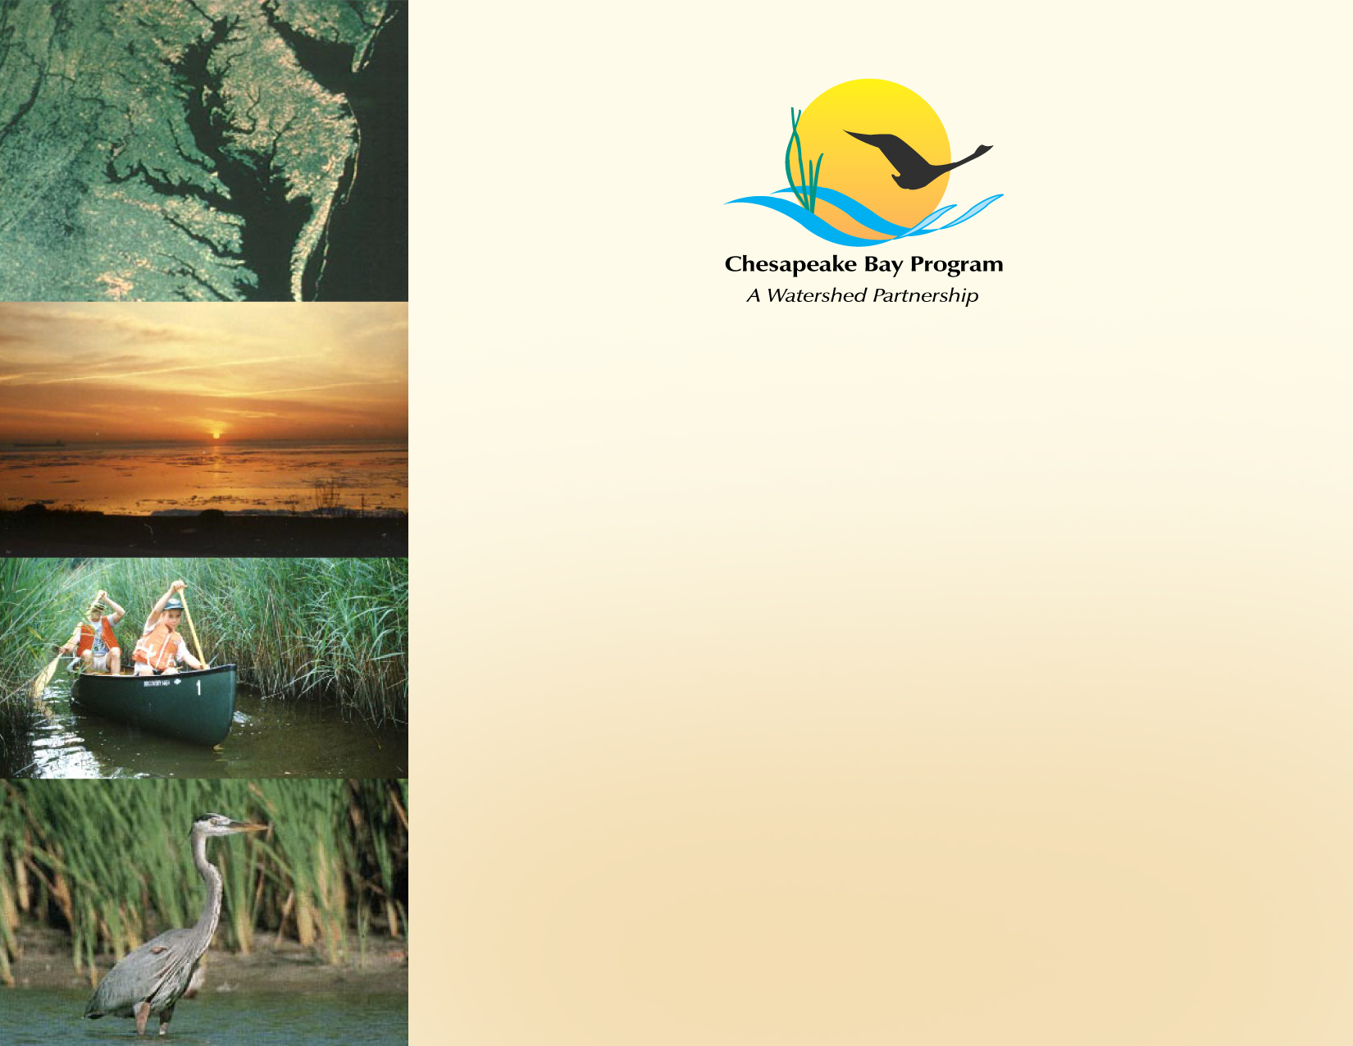
CBP Decision Framework in Action
Jeff Horan, Habitat GIT Chair
February 16, 2012

Slide 2

Goal Implementation Team Chairs Meeting
Meeting Purpose: To agree on the most effective way for the GIT’s to operate and provide leadership within the Bay Program Partnership
The GIT chairs agree with the Executive Council (EC) and the Federal Leadership Committee (FLC) that the GITs should play a major role in strengthening the partnership by providing a forum for coordination, collaboration and for leveraging resources form all partners

Slide 3
Goal Implementation Team Chairs Meeting
Bringing Issues to the MB, PSC and FOD:
Use the seven steps in the Decision Framework to manage adaptively.
GITs need to test and refine goals, milestones, strategies, processes and metrics.
GIT’s need a clear process to bring key issues to the attention of the MB, PSC, FOD, FLC and EC.

Slide 4
Habitat Goal Implementation Team
Restore a network of land and water habitats to support priority species and to afford other public benefits.
Oversee workgroups covering four main focus areas:
    Wetlands
    Fish Passage
    Stream Health
    Submerged Aquatic Vegetation (SAV)

Slide 5
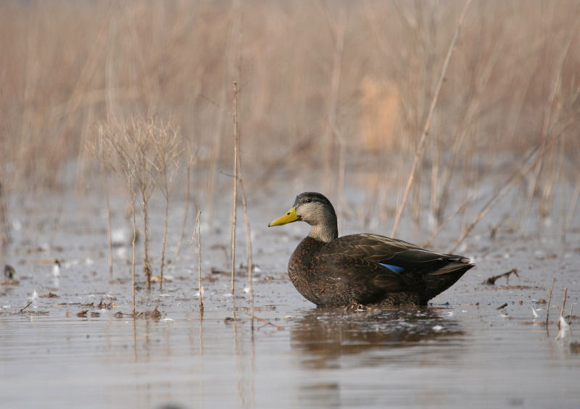
Wetlands
Goal: Restore 30,000 and enhance 150,000 acres of tidal and non-tidal wetlands by 2025
Key factors: slope and residence time, vegetation, private ownership
Strategies: Target areas that benefit living resources (e.g. black ducks) and water quality
Performance assessment: Two year milestones (4,000 acres restored and 20,000 acres enhanced every two years)

Slide 6
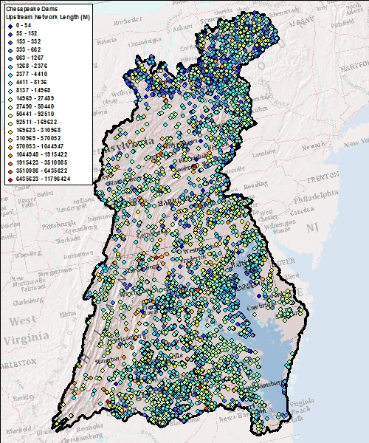
Fish Passage
Goal: Open 1,000 additional stream miles for fish passage by 2025
Key factors: Downstream barriers, target species, hydrodynamic conditions
Strategies: Target priority projects using a collaborative federal and state prioritization process
Performance assessment: Two year milestones (132 miles of stream opened every two years)

Slide 7
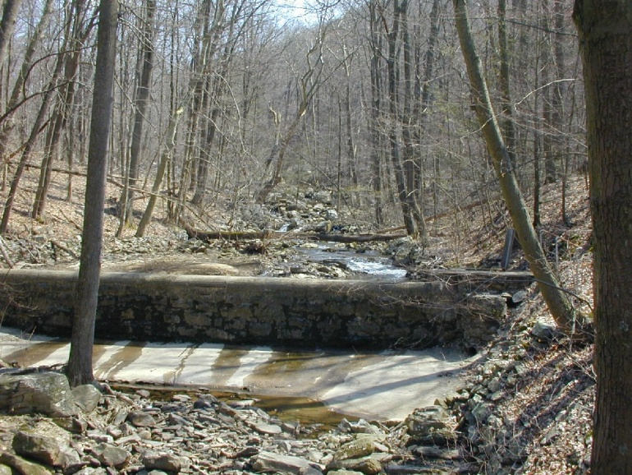
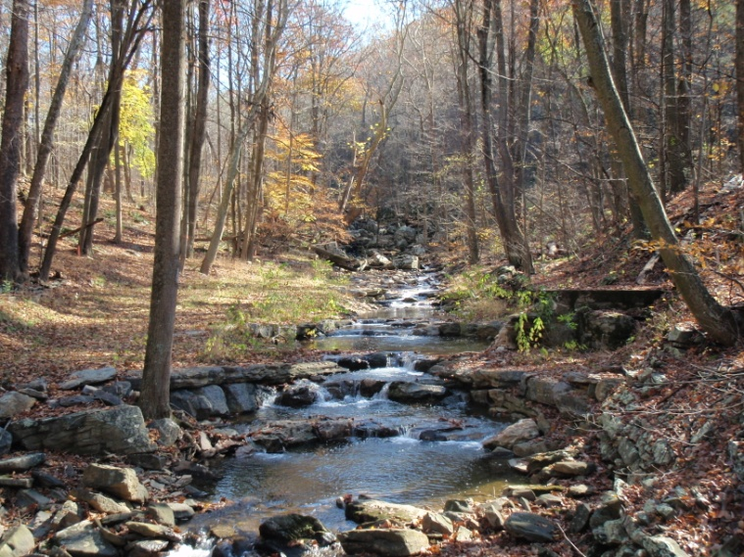
Stream Health
BEFORE
Goal: Coordinate expert input on restoration techniques, funding options, and priority targets for natural channel design
Key Factors: Geomorphology, biodiversity, temperature
Strategies: Implement Stream Functional Framework that identifies critical stream functions to be assessed for stream restoration
Performance assessment: Follow-up monitoring
AFTER

Slide 8
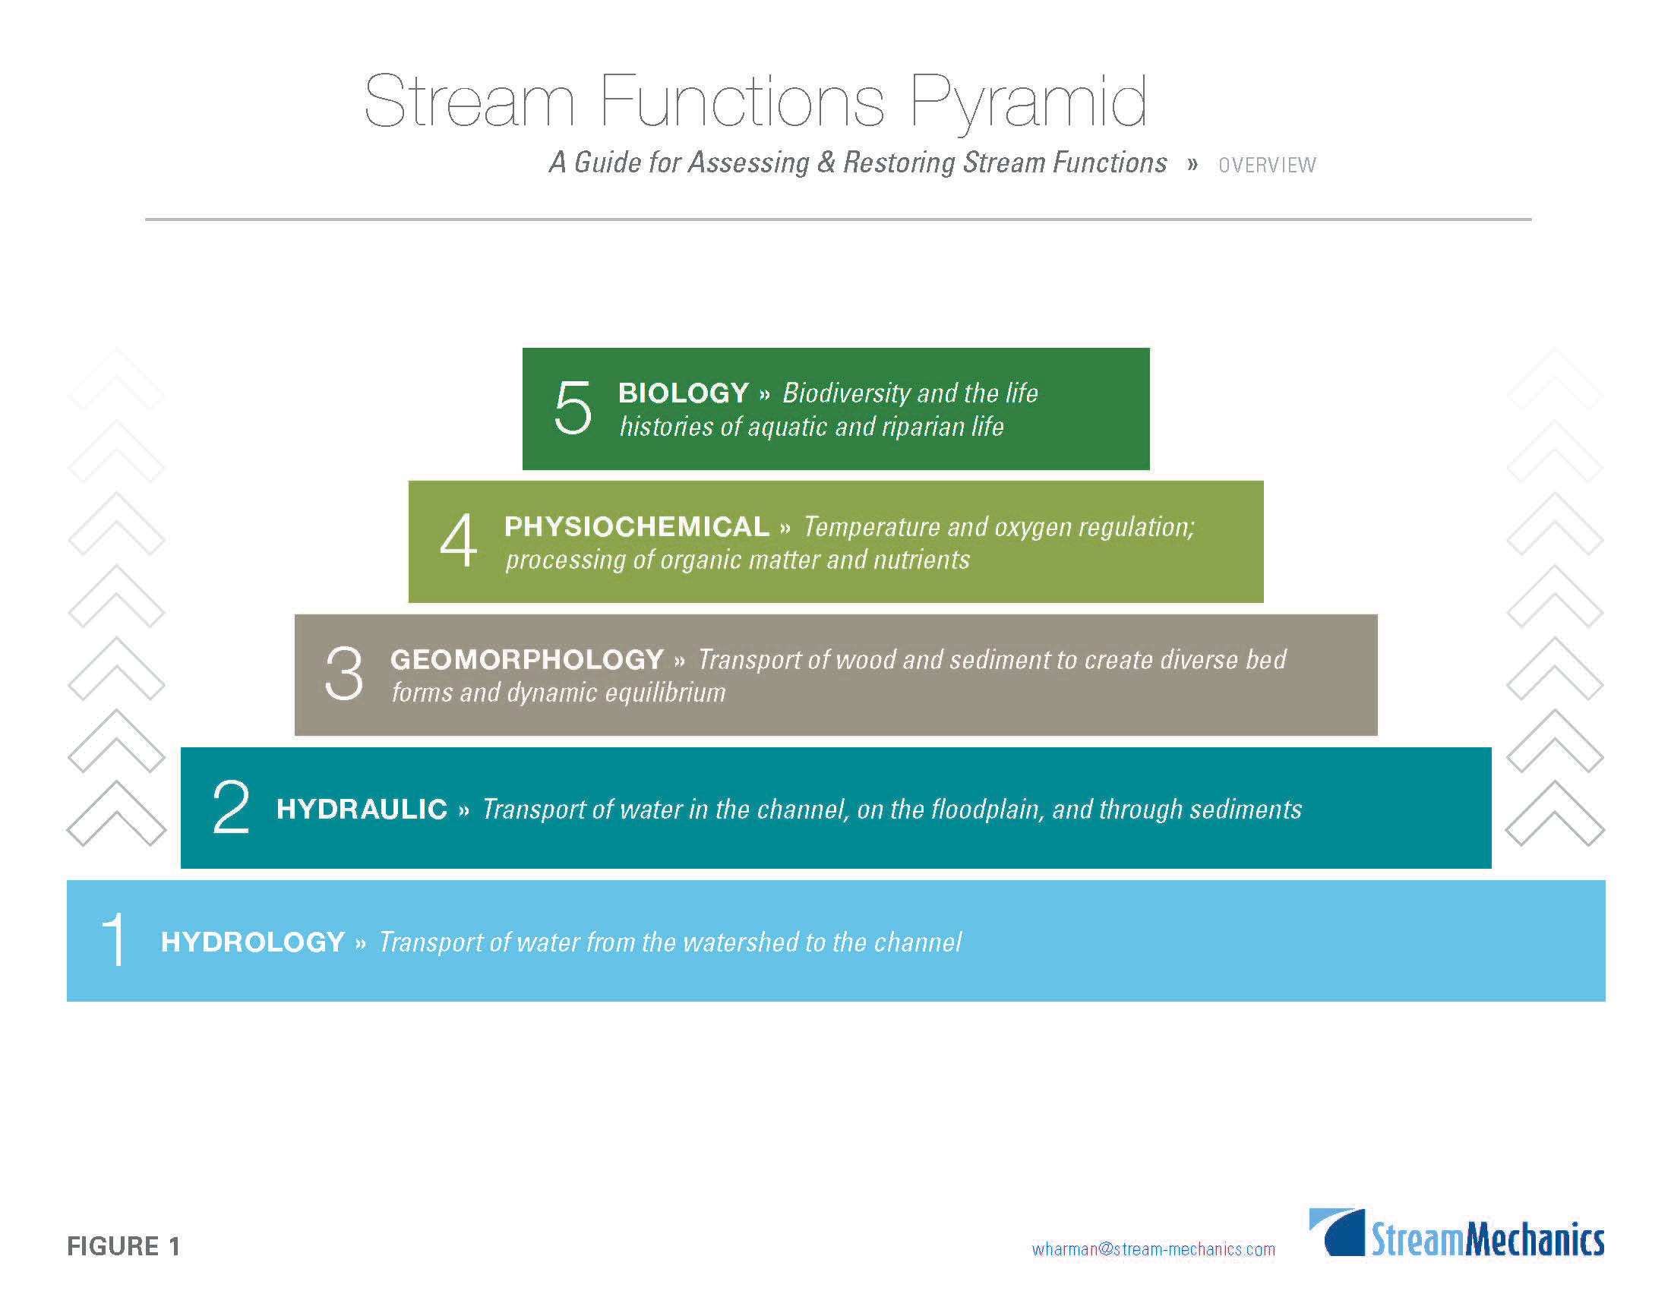
SITE SELECTION
REACH SCALE
IMPROVEMENTS
INDEPENDENT VARIABLES

Slide 9
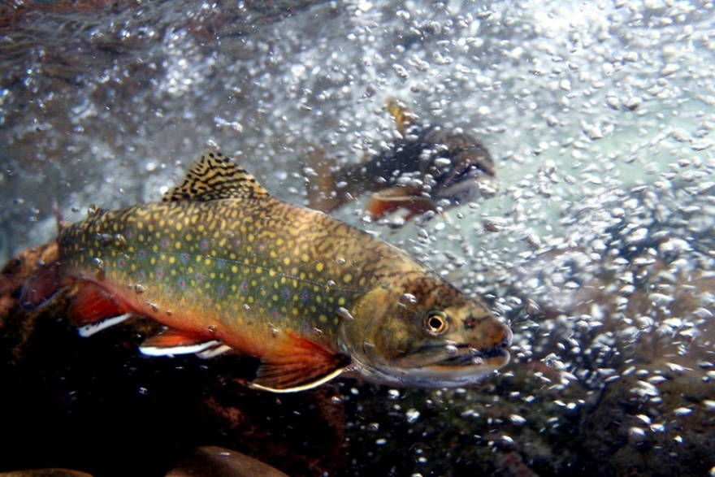
Brook Trout
Goal: Restore brook trout populations by improving 58 sub-watersheds from ‘reduced’ to ‘healthy’
Key Factors: Temperature, non-native species, stream fragmentation
Strategies: Work with EBTJV to identify priority restoration areas
Performance assessment: Two year milestone (improve 10 sub-watersheds every two years)
*GIT and EBTJV working to revise goal and milestone to reflect latest catchment-level data

Slide 10
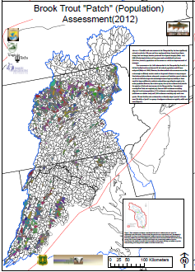
Proposed metric based upon brook trout occupancy of contiguous catchments (patches)
Catchment level goals and data will provide more meaningful information to natural resource managers

Slide 11
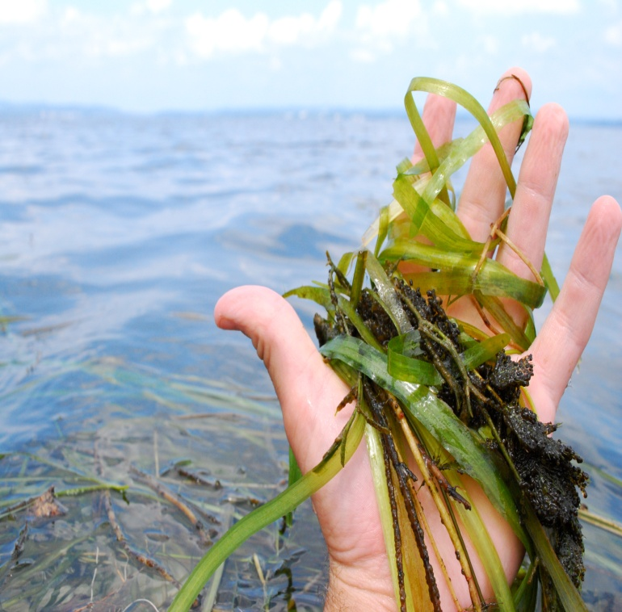
SAV
Goal: Reach 185,000 acres, linked to a restored Bay
Key factors: water clarity, temperature, disruption of existing beds
Strategies: improve water quality through BMPs watershed wide
Performance assessment: annual aerial surveys (progress toward goal) and water quality monitoring (to explain observed patterns with SAV)

Slide 12
SAV
Goal: Plant or seed 20 acres of SAV each year.
Successful plantings persist over time and have attributes of natural SAV beds (sustainability, plant density, improvement to water quality, reproduction and dispersal of propagules, wave attenuation)
Key factors: Water clarity, temperature, physical environment, technical understanding of restoration success (habitat suitability, recruitment)
Strategies: Small scale plantings aimed at increasing understanding of site selection, recruitment, and habitat suitability
Performance assessment: Follow-up monitoring (both field and remote sensing) to assess success of plantings.

