Slide 1
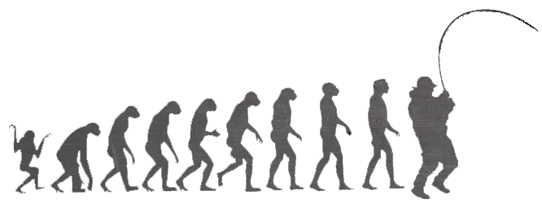
Enabling Effective Adaptive Management in the Chesapeake Bay Program
Sustainable Fisheries Goal Implementation Team
Executive Committee Meeting
March, 26th 2012

Slide 2
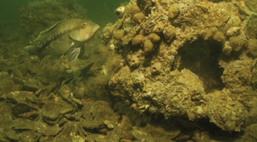
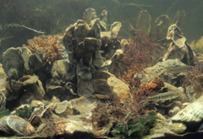
Why Oysters First?
Most migratory species are managed by ASMFC
Blue crab management successful through CBSAC
Adaptive management process already in place
An oyster decision framework allows our GIT to:
Learn about management gaps in oyster restoration
Specifically describe what actions we are taking and why

Slide 3
1. Articulate Program Goal
Restore native oyster habitat and populations in 20 tributaries out of 35 to 40 candidate tributaries by 2025.

Slide 4
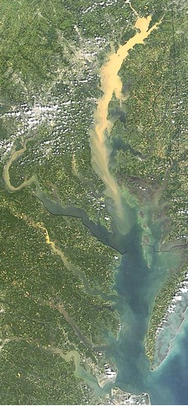
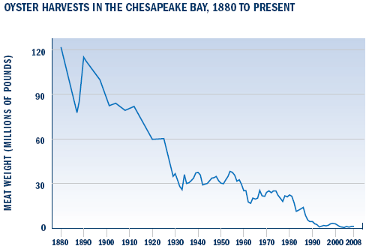
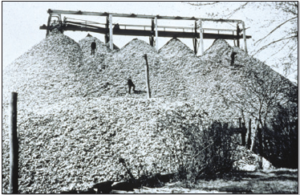
2. Factors Influencing Goal Attainment
Low Population
Reduced Habitat Area
Poor Water Quality
Varying Restoration Approaches between MD and VA
Shell Availability
Budget Limitations

Slide 5
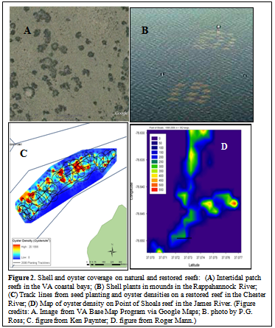
3. Assess Current Management Efforts (and gaps)
Previous efforts relatively small scale
Oyster Restoration Metrics Report (December, 2011)
Establishes a set of peer reviewed scientifically agreed upon targets, metrics, and monitoring protocols for sanctuary reefs
USACE Chesapeake Bay Native Oyster Restoration Master Plan (near completion)
Outlines long-term plan for large-scale native oyster restoration
Identifies target tributaries based on environmental criteria

Slide 6
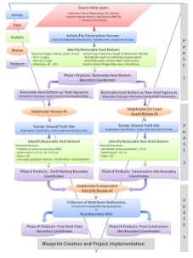
4. Develop Management Strategy
2012 – Tributary Prioritization
Targeting 4-6 tributaries for restoration
Fisheries GIT establishing MD and VA Interagency Workgroups
Lead and monitor restoration of priority tributaries
Utilize habitat mapping tools and spatial analyses to assess the restorable bottom in development of ‘restoration blueprints’
MD → Harris Creek
VA
Great Wicomico and Lynnhaven will be evaluated based on the metrics report
Lafayette and Piankatank rivers → Tributary scale efforts being considered

Slide 7
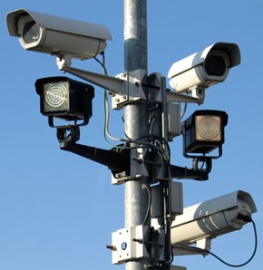
5. Develop Monitoring Program
The Oyster Metrics Report outlines a monitoring protocol to measure progress towards the established targets and thresholds
1. Structure of the restored reef (reef spatial extent, reef height, and shell budget)
2. Population density (as individual abundance and biomass)
3. A total reef population estimate (biomass)

Slide 8
6. Assess Performance
Evaluation of success in oyster restoration efforts:
Several levels over varying spatial and temporal scales
Targets and metrics of operational success required to guide restoration
Individual Reef Monitoring
Required to determine success at various stages by evaluating:
Recruitment success
Post-settlement/planting survival
Natural mortality
Disease status
Growth
Reproduction and shell accumulation
Tributary Level Evaluation
Operational definitions about the area within a tributary needing rehabilitation
Functional measures of the status of those areas several years after the restoration activity

Slide 9
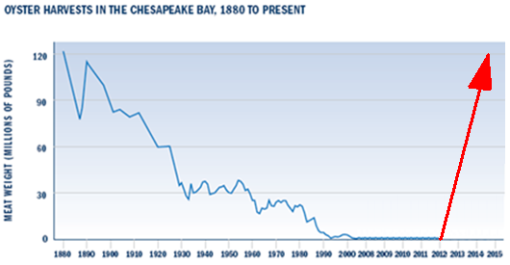
7. Manage Adaptively
Based on the monitoring assessment, system models are amended, and monitoring strategies are revised to improve program performance.
After restoration efforts are undertaken and monitored for their success, we can loop back and assess our strategy

Slide 10
Oyster DF In Action
Presented to Fisheries GIT Executive Committee on March 26th
Executive Committee accepted draft and approved it for submission to CBP

Slide 11
Lessons Learned
This framework is only specifically applicable to sanctuary reefs
Multiple decision frameworks will need to be constructed under each goal in order to fulfill this structure
Factors section contains items outside our control
How can we influence these factors?
Sections: Management Efforts, Management Strategy, Monitoring Program, Performance Assessment, and Adaptive Management
Oyster Metrics Report
USACE-NORMP
Interagency Workgroups,

Slide 12
Issues and Next Steps with DF
Difficult experience with Executive Committee “buy-in” to this structure
They still don’t understand:
The necessity for this process
How does the DF impact a manager as they have jurisdictional authority to do whatever they want with these resources?
Next Steps:
Blue Crab DF
Develop DFs for open fishery areas

