Slide 1
Using a Coupled Groundwater-Flow and Nitrate-Balance-Regression Model to Explain Trends, Forecast Loads, and Target Future Reclamation
Ward Sanford, USGS, Reston, Virginia
Jason Pope, USGS, Richmond, Virginia
David Selnick, USGS, Reston, Virginia

Slide 2
Objectives:
To develop a groundwater flow model that can simulate return-times to streams (base-flow ages) on the Delmarva Peninsula
To explain the spatial and temporal trends in nitrate on the Delmarva Peninsula using a mass-balance regression equation that includes the base-flow age distributions obtained from the flow model
To use the calibrated equation to forecast total nitrogen loading to the Bay from the Eastern Shore
To forecast changes in future loadings to the bay given different loading application rates at the land surface
To develop maps that will help resource managers target areas that will respond most efficiently to better management practices

Slide 3
Ground-Water Model of the Delmarva Peninsula
MODFLOW 2005
500 ft cell resolution
7 Model Layers
4+ million active cells
30-m DEM, LIDAR
300 ft deep
Steady State Flow
MODPATH travel times

Slide 4
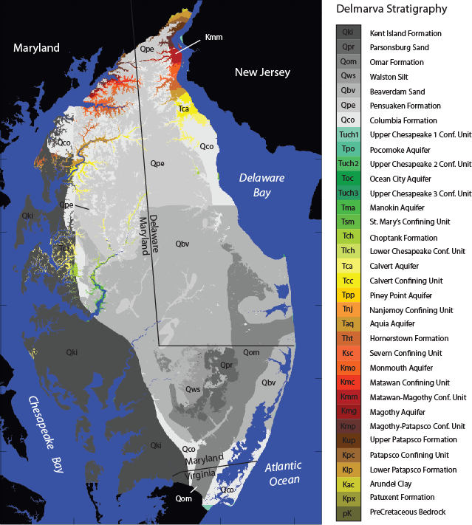
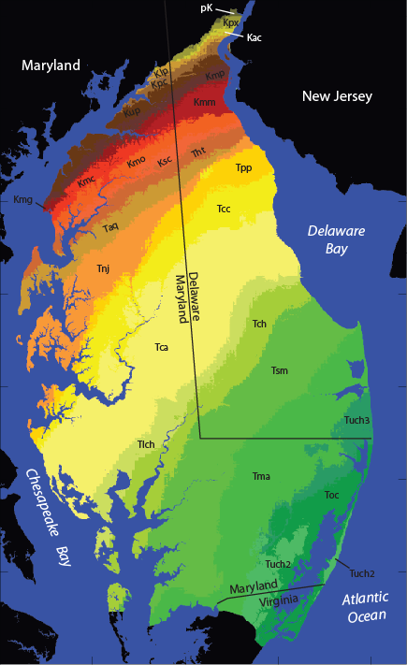

Slide 5
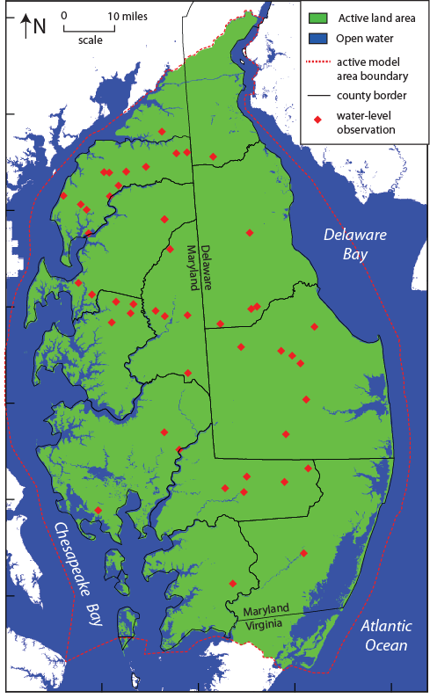
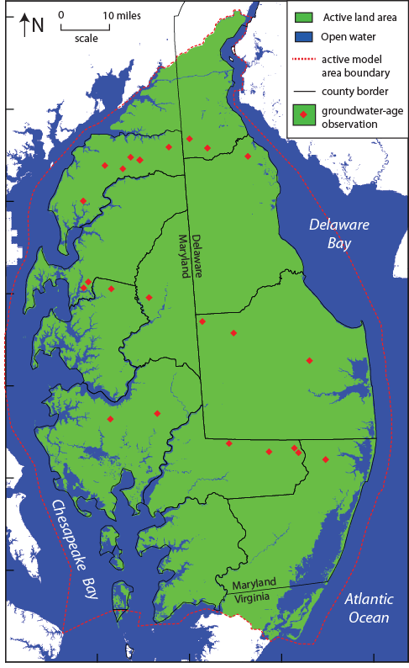
Groundwater
Level
Observations
Groundwater
Age
Observations

Slide 6
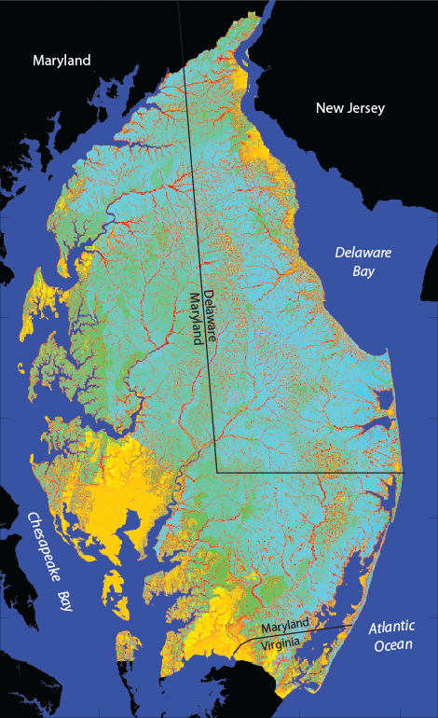

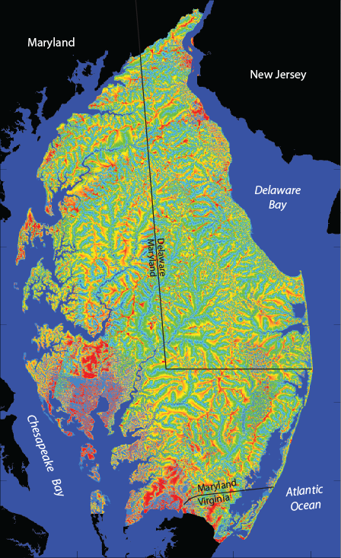


Slide 7
Age Histograms of two of the Real-Time Watersheds

Slide 8
Seven watersheds had
substantial stream nitrate
Data and were used:
Morgan Creek
Chesterville Branch
Choptank River
Marshyhope Creek
Nanticoke River
Pocomoke River
Nassawango Creek
1
2
3
4
5
6
7

Slide 9
Low flow
High flow

Slide 10
Nitrate Mass-Balance Regression Equation
Simulated
surface water
concentration
in stream
Concentration
below ag field
Soil
Term
Riparian
Term
Non-ag
Term
Pre-ag
Term
=
X
X
X
X
– RL
Denitrification
Dilution
Simulated
groundwater
concentration
in ag field well
Concentration
below ag field
=
X
Soil
Term
– RL
FUE & PUE =Fertilizer and Poultry
Uptake Efficiencies
{
[
]
}
Concentration
below ag field
Recharge
Rate
Fertilizer
Load
1 -
Poultry
Load
[
]
=
X
X
FUE
+
X
1 -
PUE
Soil
Term
= (S/5)^{m}
Riparian
Term
= (AREA)^{n}
S = soil drainage
factor
AREA is for the watershed
In square miles

Slide 13
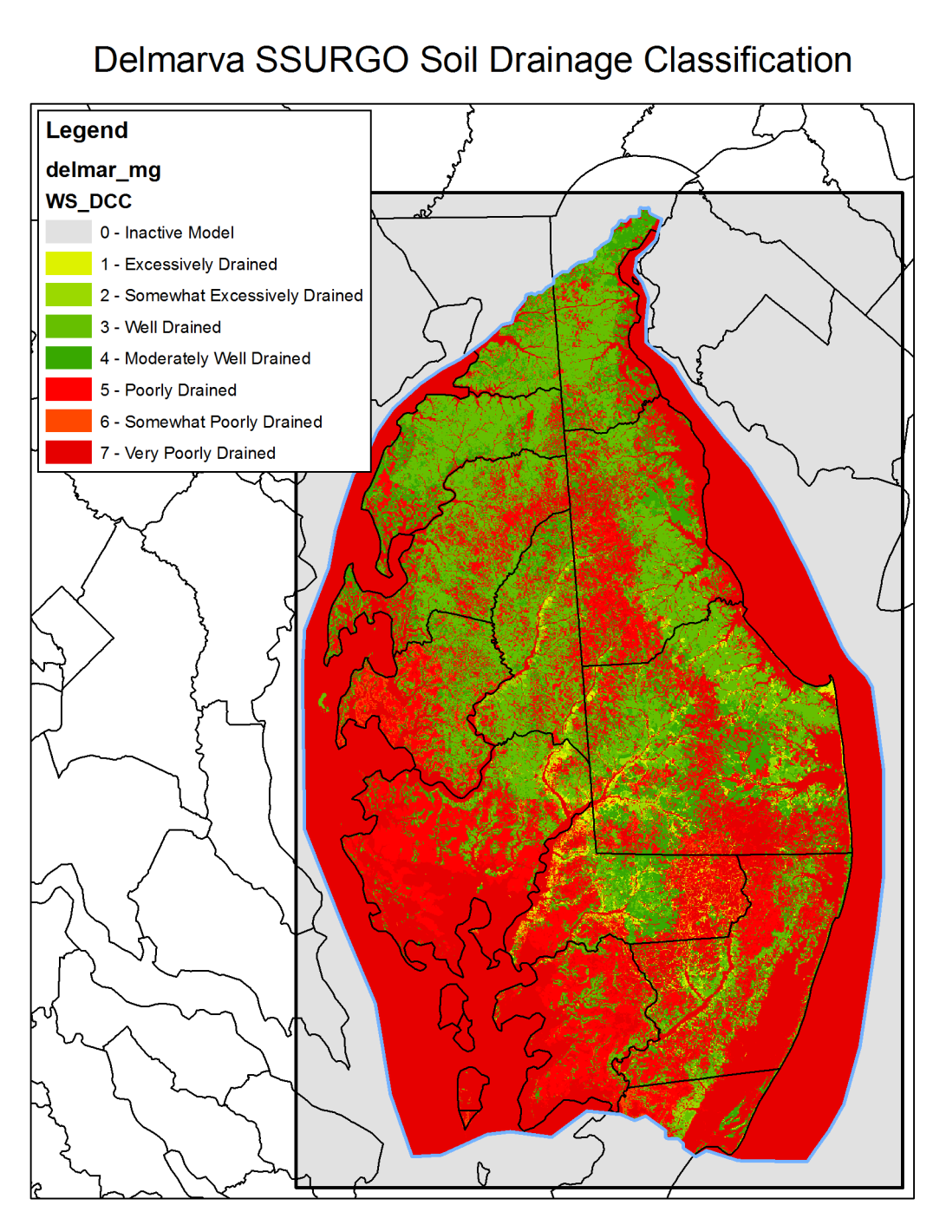
Soil Factor (S) in Equation:
Very poorly drained
Somewhat poorly drained
Poorly drained
Moderately well drained
Well drained
Somewhat excessively drained
Excessively drained

Slide 15
Regression Number | Fertilizer Uptake Efficiency | Manure Uptake Efficiency | Percent Increase in Uptake Efficiencies | Riparian and Stream Denitrificaiton loss exponent | Soil Deintirficaiton loss exponent | Number of Parameters estimated | Sum of Squared Weighted Residuals | Standard Error of Regression
1 | 83% | 83% | 0 | 0 | 0 | 2 | 8388 | 122
2 | 82% | 70% | 0 | 0 | 0.670 | 3 | 5834 | 85
3 | 72% | 63% | 0 | -0.152 | 0 | 3 | 3698 | 54
4 | 74% | 36% | 0 | -0.146 | 0.425 | 4 | 2540 | 37
5 | 67% | 40% | 24% | -0.114 | 0.566 | 5 | 2181 | 33
10% upper parameter value limit | 70% | 62% | 40% | -0.110 | 0.8 | 5 | 2181 | 33
10% lower parameter value limit | 64% | 32% | 12% | -0.140 | 0.2 | 5 | 2181 | 33
10% limits as percent of value | 3% | 25% | 58% | 13% | 80% | 5 | 2181 | 33

Slide 16
Best Fit for Four Parameters
with best-fit changes in
Fertilizer and Uptake Efficiences

Slide 17
Stream
Hydrograph
Surface Runoff
Component
Groundwater Discharge
Component
FLOW RATE →
HIGH N
FLOW
LTMDFR X 1.4
Long-Term Mean
Daily Flow Rate
(LTMDFR)
Low N flow
High N flow
LOW N
FLOW
Graphical Hydrograph
Separation
TIME →
For the Real-time watersheds, the fraction of the water that discharges above
the High/Low N cutoff correlates very well to the fraction of the total streamflow
that is either surface runoff or that which the model calculates as quickly rejected recharge.
Also for the real-time watersheds, the flux-weighted concentration of nitrate in the
high-flow section was consistently equal to about 65% of the low-flow concentration.
These factors combined allow for BOTH a low-flow and high-flow nitrogen flux to be calculated from all of the other watersheds and for the entire Eastern Shore as a whole.

Slide 19
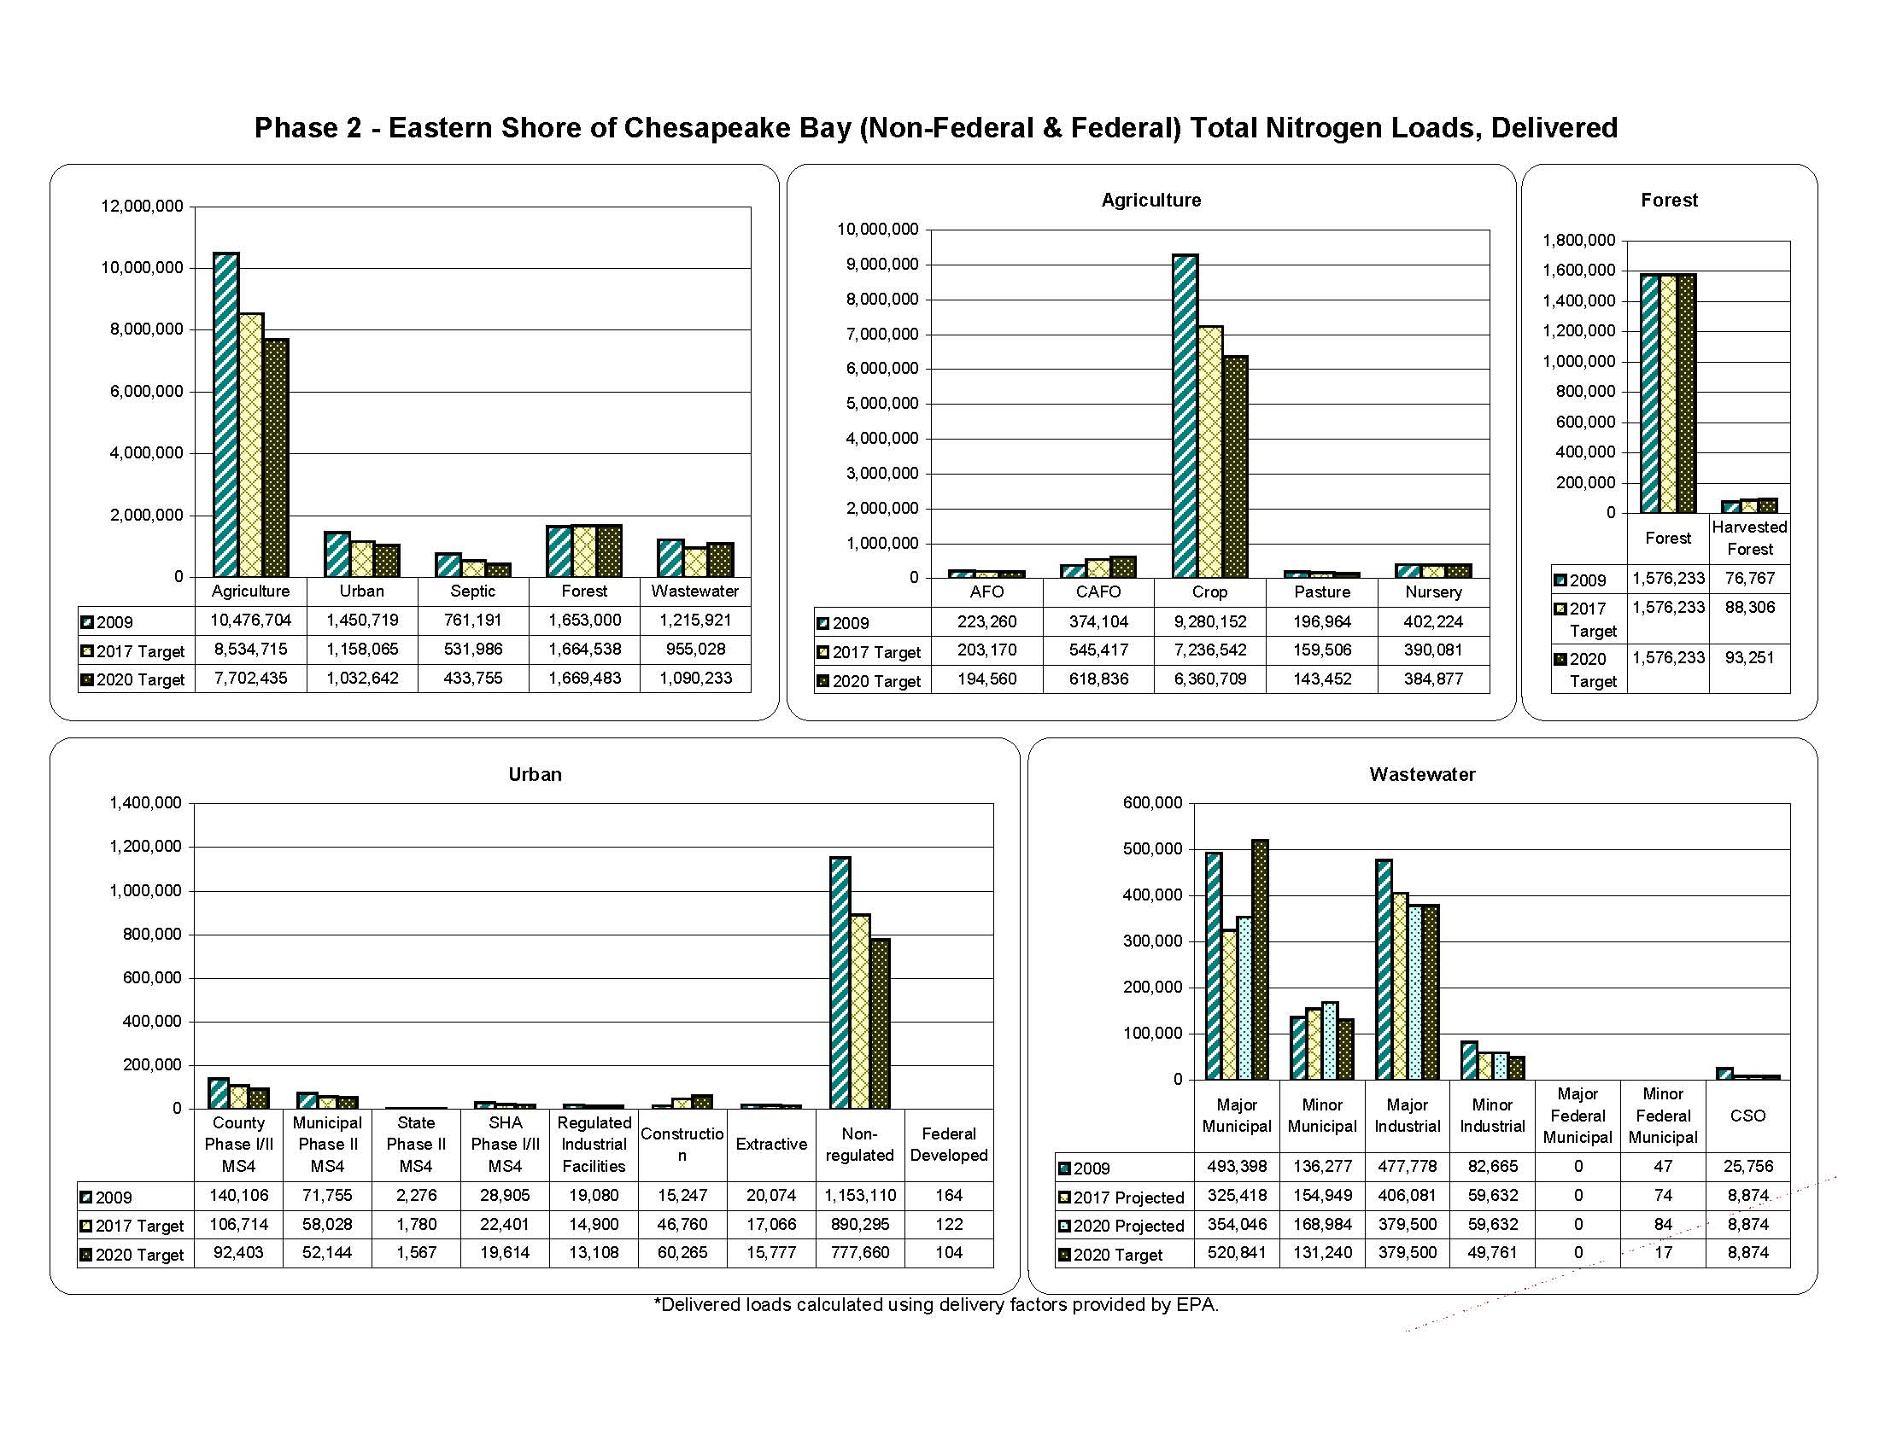

Slide 20
EPA
Targets

Slide 21
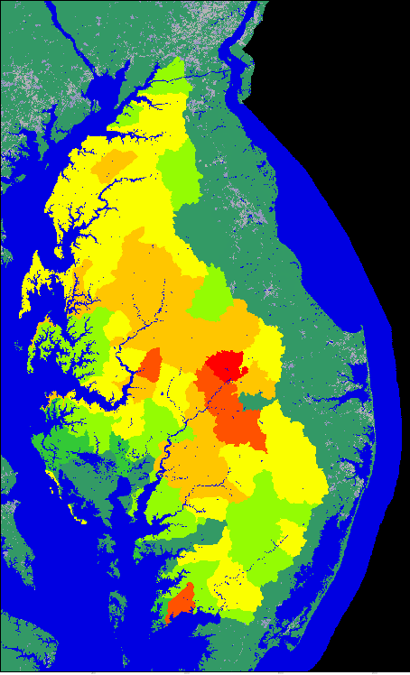
Targeting of HUC-12 Watersheds
by Average Nitrate Yield
Average nitrate yield to local stream
>5 mg/L
5 mg/L
4 mg/L
3 mg/L
2 mg/L
1 mg/L
<1 mg/L or
outside Bay
watershed

Slide 22
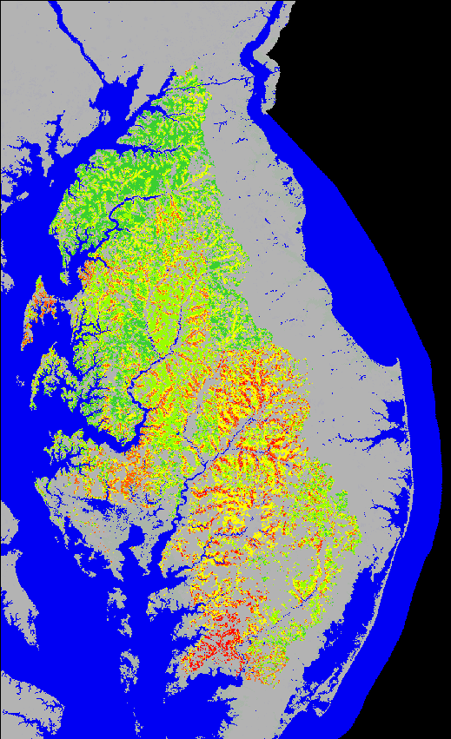
Targeting that Includes Response Time
and Nitrogen Delivered to the Bay
Targeting Matrix
Nitrate
Concentration
< 4 mg/L
5 - 7 mg/L
>7 mg/L
< 7 yrs
7 - 20 yrs
> 20 yrs
Groundwater Return Time

Slide 23
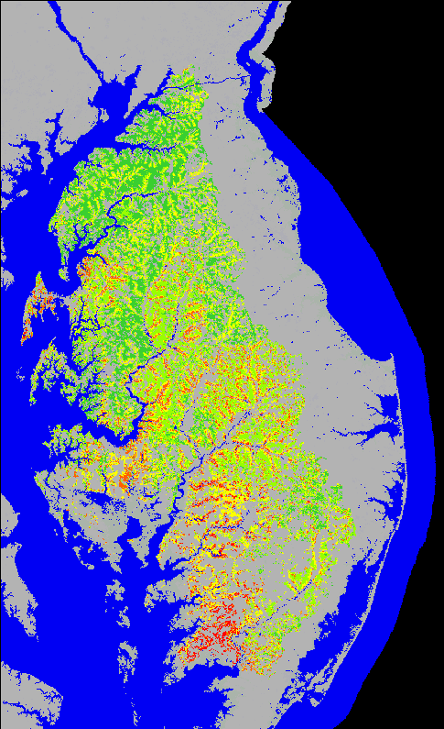
Targeting that Includes Response Time
and Nitrogen Delivered to the Bay
Targeting Matrix
Nitrate
Concentration
< 4 mg/L
5 - 7 mg/L
>7 mg/L
< 7 yrs
7 - 20 yrs
> 20 yrs
Groundwater Return Time
>3 mg/L

Slide 24
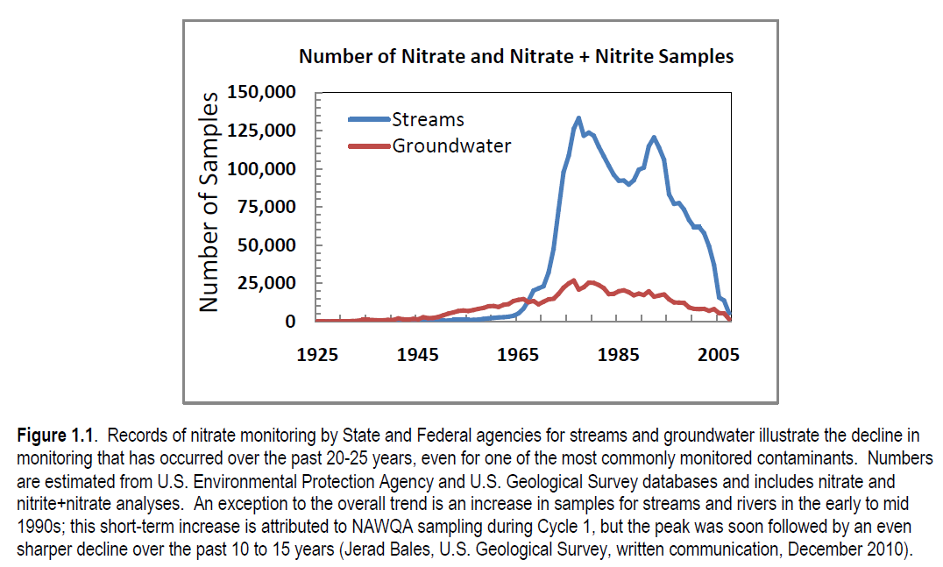
From: USGS NAWQA Cycle 3 Planning Document--unpublished

Slide 25
Summary and Conclusions
Results from a groundwater flow model were coupled to a nitrate-mass-balance regression model and calibrated against stream nitrate data.
The calibrated model suggests that nitrogen uptake efficiencies on the Eastern Shore may be improving over time.
EPA targets for reduced loading of 3 million pounds on the Eastern Shore per year will not likely be reasonably reached for several decades, much less by 2020, even with severe cutbacks in fertilizer use
The model can help target areas where reduced nitrogen loadings would be the most beneficial at reducing total loadings to the Bay.

