Slide 1
2.0
Notes:
Site was launched in January, 2010
Developed through the Chesapeake Bay Program Stewardship Goal Team

Slide 2
www.baybackpack.com
Notes:
Things to point out on the main page:
Teacher resource, Field Studies, Training, Funding, Blog tabs up top
Contact us tab at the top right of the web page
Blogs in the middle
Highlighted resources on the side
MWEE Video

Slide 3
Teaching Resources
Curriculum Guides
Lesson Plans
Books
Data
Multimedia
Posters
Supplies
Notes:
Can browse through all of resources
Can search by
Subject: Art, Language Arts, Mathematics, Science, Social Studies, Technology
School level: Early Learning, Elementary, Middle, High School
Type of Resource: Books & Publications, Curriculum Guide, Lessons and Activities, Multimedia, Posters & Maps, Supplies
Alignment: Delaware, DC, Maryland, New York, Pennsylvania, Virginia, West Virginia, National
Keyword: Acid Rain, Adaptation, Agriculture, Air Pollution, Aquatic Grasses, Biodiversity, etc.
The more features you select to search by, the more restricted your search becomes = fewer results

Slide 4
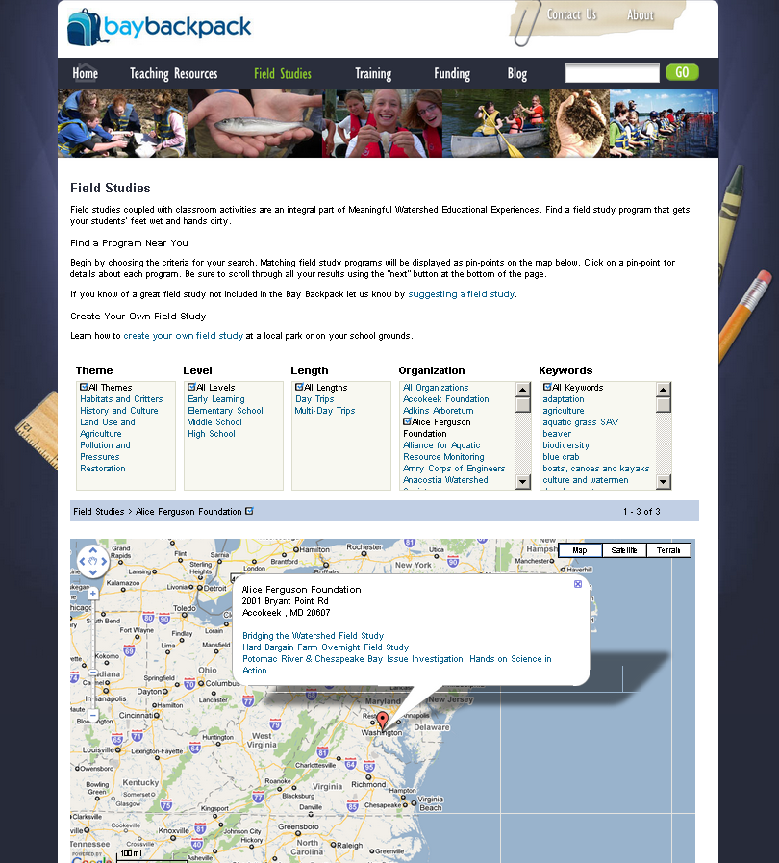
Field Study Programs
Habitats and Critters
History and Culture
Land Use and Agriculture
Pollution & Pressures
Multimedia
Restoration
Notes:
Learn how to create your own field study or search through our database
Search by:
Theme: See slide
School level: Early Learning, Elementary, Middle, High School
Length: Day Trips, Multi-Day Trips
Organization: Annapolis Maritime Museum, Arlington Echo, Chesapeake Bay Foundation, etc.
Keyword: Blue Crabs, Boats Canoes & Kayaks, Dissolved Oxygen, Economics, Ecosystems etc.

Slide 5
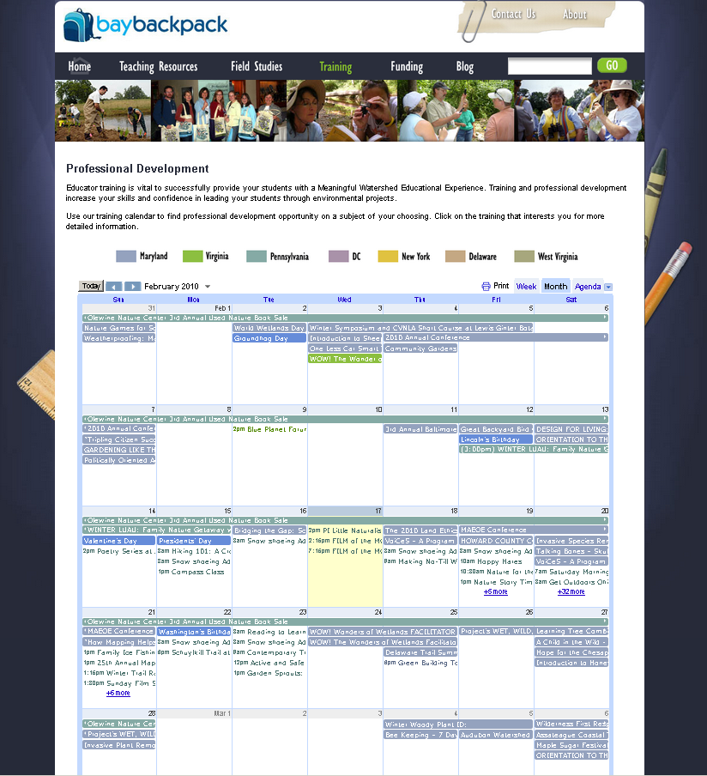
Professional Development
Training Events Sorted by State
Grant Application Deadlines
Fun, Educational Activities for Family, Friends, and Colleagues
Notes:
Educator training is vital to successfully provide your students with a Meaningful Watershed Educational Experience.
Training and professional development increase your skills and confidence in leading your students through environmental projects.
Bay Backpack staff and programmed web engines search for new opportunities and update the calendar that is housed on this page with professional development events in each state
Calendar events include everything from trainings that can earn you continuing education credits to grant application deadlines, to naturalist-lead nature walks for the whole family.

Slide 6
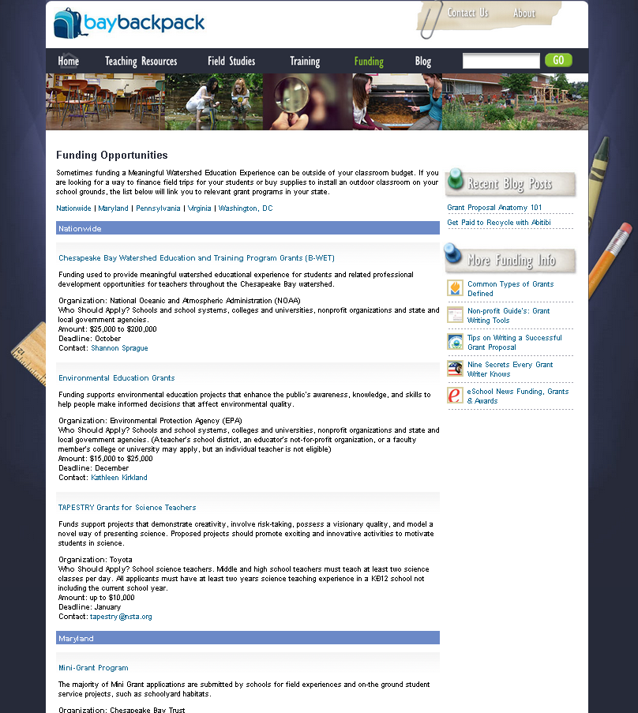
Funding Sources
Grants Sorted by State/Nationwide
Organization
Who Should Apply?
Amount
Deadline
Contact
Notes:
Sometimes funding a Meaningful Watershed Education Experience can be outside of your classroom budget.
If you are looking for a way to finance field trips for your students or buy supplies to install an outdoor classroom on your school grounds, our funding page will link you to relevant grant programs in your state.

Slide 7
Backpack Blog
Why Teach About…
Featured Resources
EE News
Field Study Stories
Funding and Contests
Training
School Spotlight
Notes:
Semi-regular features on our blog include:
Why Teach About… Weather, Environmental Responsibility, Native PPL of Ches.
Teacher Resources: Trout in the Classroom, Why become a Certified EE
News + Lessons: A Frozen Chesapeake Bay, MD incorporates EE into curriculum
Field Studies: Paddling the Potomac: A MWEE to Remember
Funding/Contests: Get Green Video Contest, Teacher/Student of the Year Awards
Training: NOAA’s Chesapeake Climate Workshop
School Spotlight:
Greening Green Valley ES: Using a Rain Garden to Manage Runoff
Landscape for Learning – Buffalo School 90 Courtyard Transformed
Getting Fresh and Local in DC Schools (local produce in the lunchroom)

Slide 8
Bay Backpack 2.0 Suggestions
Field Studies Page
Make it as inclusive and complete as possible
Improve search features - Multiple search parameters, but also a “full list by county”
Might need to restructure the website - longer term, more in-depth projects need to be more prominently featured
“Tag” resources for STEM, service learning, outdoors
Explore the possibility of including a “speakers bureau”
Develop an Environmental Literacy Info page
Potential to begin build-out this fall!

Slide 9
www.baybackpack.com
Sarah Brzezinski
(410) 260-2494
Sarah_Brzezinski@partner.nps.gov
Info@BayBackpack.com

