Slide 1
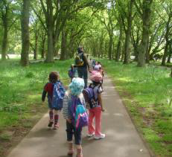
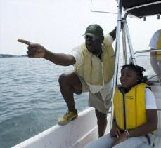
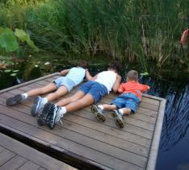
Presentation by: Tonyea Mead, Delaware Dept. of Education, Science Education Associate, CIN Taskforce Member
STATE OF DELAWARE
Children in Nature / No Child Left Inside

Slide 2
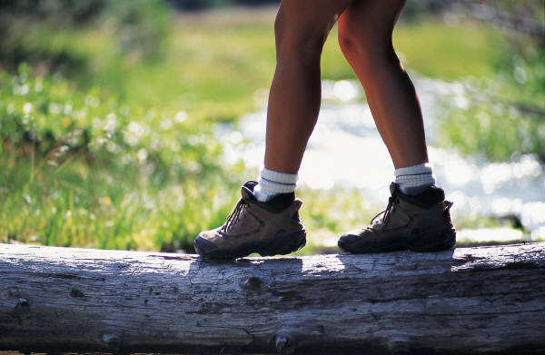
Governor Jack Markell charged the Children in Nature/No Child Left Inside (CIN/NCLI) Taskforce to be proactive in addressing the opportunities afforded by the reauthorization of the Elementary and Secondary Education Act (ESEA) and the status of “nature-deficit disorder” facing the citizens of Delaware.
The members of the taskforce:
Department of Education, Department of Natural Resources and Environmental Control, Nemours Health and Prevention, Delaware Nature Society, US Fish and Wildlife Service, Center for Inland Bays, Department of Public Health, Delaware Greenways and the Delaware Association for Environmental Education.

Slide 3
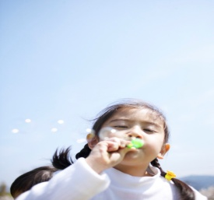
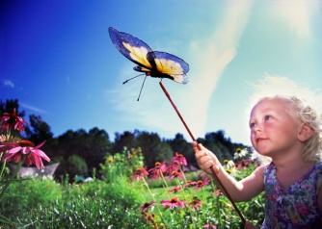
Taskforce Mission
To improve environmental literacy, create opportunities for children to participate in outdoor experiences, promote healthy lifestyles and provide better access to green space through schools and community programs.

Slide 4
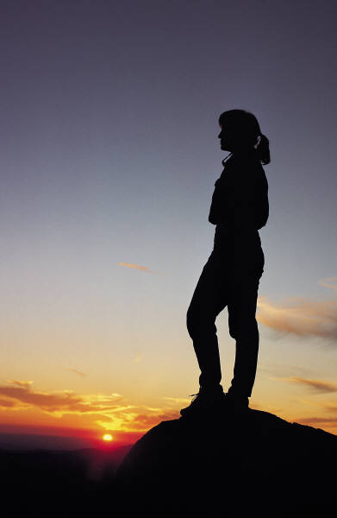
Taskforce Vision
Delaware will be recognized as a leader in progressive environmental education for all of our children. At school and at home, in parks, backyards and other outdoor spaces, children and adults will experience a multitude of ways to improve health and well-being and enhance life-long learning through their encounters with and growing knowledge of the natural world. No child will grow up without having a positive outdoor experience. All families will have access to green spaces. Our children will reconnect with the natural world in meaningful ways and there will be no child left inside!

Slide 5
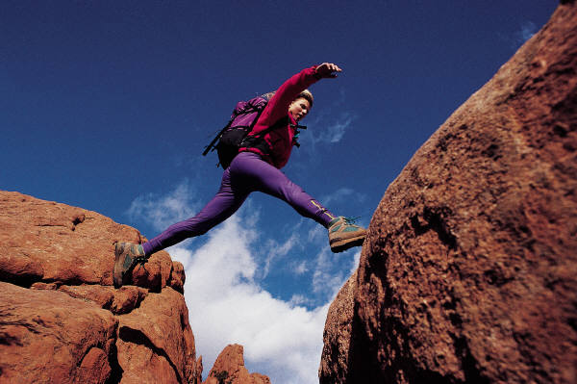
Taskforce Recommendations
The taskforce has researched and developed recommendations and actions in education, access, community, health, plan implementation, marketing and policy and legislative support.

Slide 6

Education
We envision a Delaware where every child has an opportunity to engage in outdoor learning experiences that arouse their natural curiosity to explore and learn by discovery at school and in their community to achieve environmental literacy.
Promote participation in meaningful outdoor and overnight experiences;
Establish “Greener Schools for Delaware” programs;
Develop and integrate school yard natural areas to strengthen and enhance Pre K – 12 education;
Increase collaboration between formal and informal educators;
Increase environmental literacy through development of an environmental literacy plan.

Slide 7
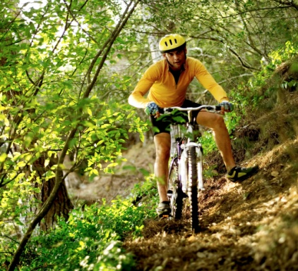
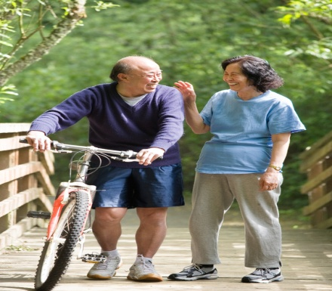
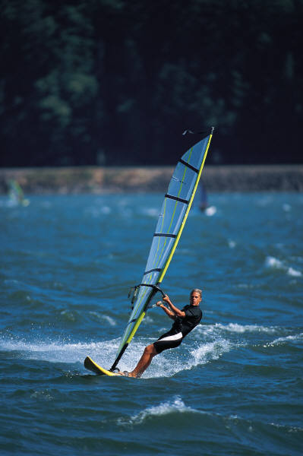
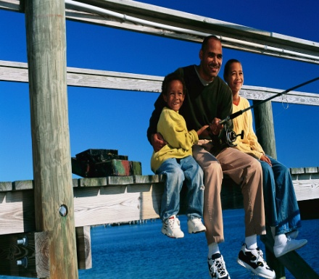
Access
The taskforce envisions a Delaware where children and families have safe and enjoyable outdoor recreation opportunities that are both convenient and provide equal access to nature.
Incorporate natural spaces into the built environment;
Provide access for multi-generational use to increase physical activity for all ages;
Improve and increase accessibility to existing areas;
Share inventory data about the state’s outdoor recreation resources;
Improve walk ability and safe access to natural resource areas.

Slide 8

Community
We envision a Delaware where all members of the community embrace the value of connecting with nature and provide the support needed to maintain longstanding promotion of its benefits for generations to come.
Increase access to recreational facilities through community partnerships;
Develop training and workshops to increase the communities’ understanding of the Children In Nature/No Child Left Inside (CIN/NCLI) movement and increase environmentally literacy statewide;
Bring together full representation of the state’s population, across generations, cultures and economic conditions to help build the Children In Nature/No Child Left Inside unified message;
Address issues that prevent underserved communities from experiencing nature.

Slide 9
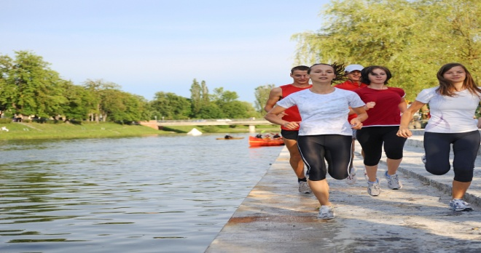

Health
We envision a Delaware with healthier individuals and communities that results from increased awareness of the benefits of time spent in the natural world and a better understanding of the relationship between health and outdoor activities in nature.
Utilizing nature-based activities (such as unstructured outdoor play, hiking in safe outdoor areas, spending time in a green space, etc.) and resources as a health strategy;
Providing outreach and professional development in fields of health care and prevention services;
Conducting research that supports the relationship between health and activity in nature.

Slide 10
For More information contact:
Tonyea Mead, Science Ed. Associate, DDOE (tmead@doe.k12.de.us)
Matt Ritter, Chief of Programs, Delaware State Parks(matthew.Ritter@state.de.us)
John Ray, Health/PE Education Specialists, DDOE (jray@doe.k12.de.us)

