Slide 1

Virginia Resource Use Education Council (VRUEC)
Efforts toward Virginia’s ELP Development

Slide 2
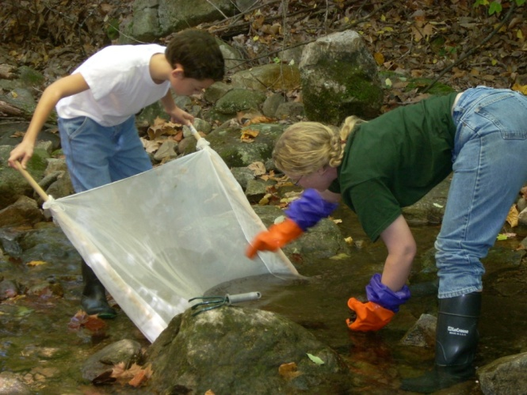
VRUEC Focus Group Efforts
December 2011
  Established a Policy Committee to help promote Virginia’s EE programs to legislators and others
  VRUEC members participated in review of Mid-Atlantic ELP and Goals

Slide 3
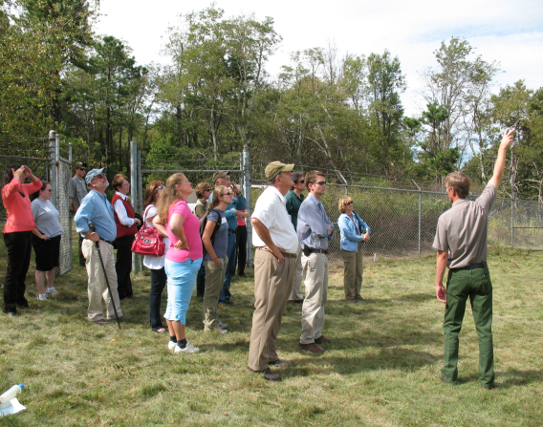
VRUEC Focus Group Efforts
April 2012
  VRUEC convened Stakeholders (business leaders, non-profit organizations, and non-formal educators) meeting at the Environment Virginia Conference
  Had overwhelming support for:
    Experiential experiences for students
    Placed based opportunities – outside!
    Professional development for educators

Slide 4
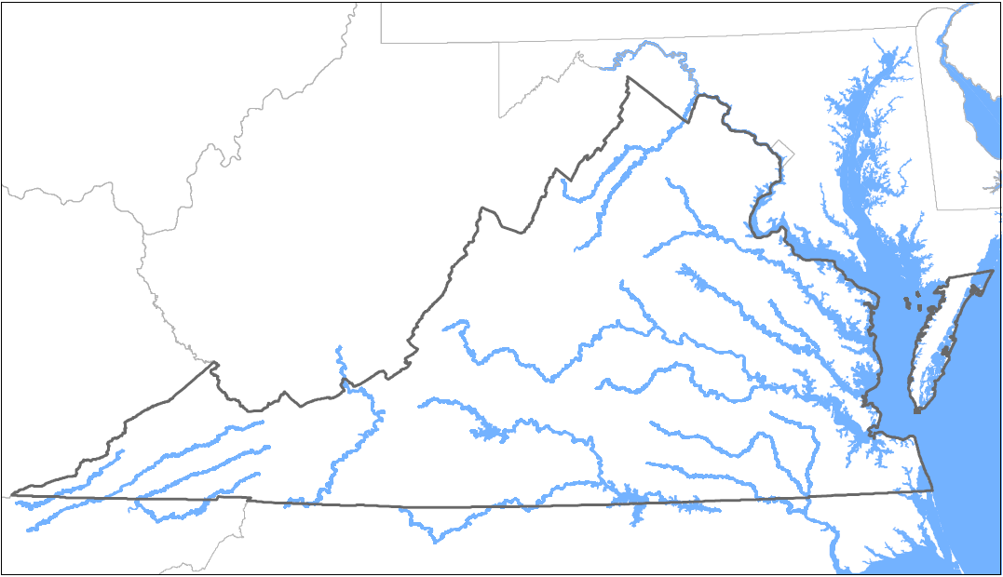
VRUEC Focus Group Efforts
May 2012
  Annual VRUEC
  meeting
  Attended by:
  Virginia Superintendent of Public Instruction
  (Dr. Patricia Wright)
  Virginia Secretary of Natural Resources
  (Doug Domenech)

Slide 5
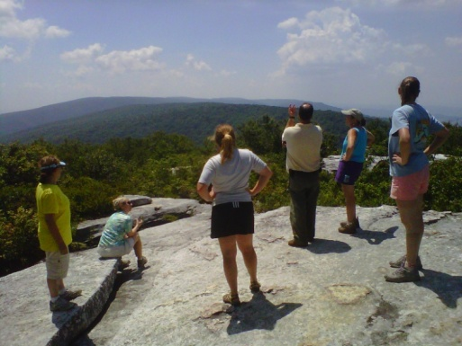
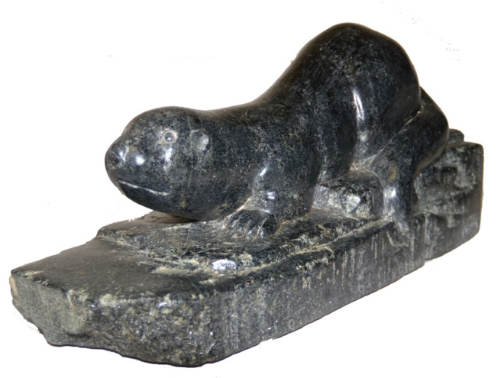

VRUEC Focus Group Efforts
  Presented Awards for:
    USED Green Ribbon Schools
    Environmental Education
    Leadership Program
    Watershed Education Institutes
    The OTTER Award

Slide 6
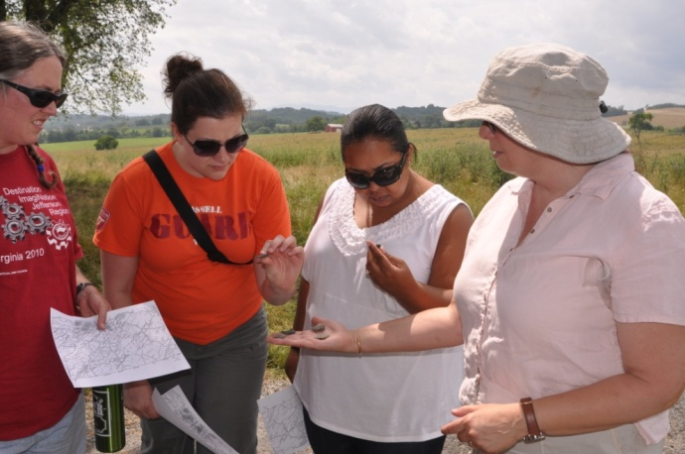
VRUEC Member Professional Development Opportunities
Six Chesapeake Bay Academies
  Funded by NOAA
  Approximately 100 teacher participants
Watershed Education Institutes
  Funded by NOAA
  Nine one-day classes
Virginia Science
Standards Institutes
  Two week-long institutes
  Funded by MSP Grant
  Fifty K-3 teachers and administrators

Slide 7
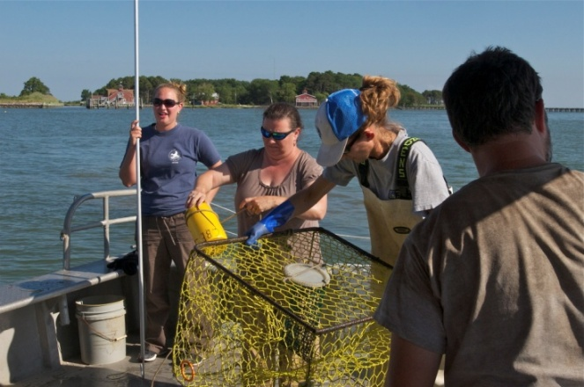
VRUEC Member Professional Development Opportunities
Environmental Education Leadership Program
  Cultivate a corps of highly qualified
  environmental educators
Standards of Learning
(SOL) Institutes
  Funded by VDOE
  Approximately 500 teacher/administrator participants
  Focus on Virginia new SOL which will be implemented Fall 2012
  Increased emphasis on field investigations

