Slide 1

Chesapeake Bay Program Education Work Group
June 6, 2012
For the WVEEA
Frank Rodgers
Vice Chair WVEEA
Director of Education & Outreach, Cacapon Institute
frodgers@cacaponinstitute.org

Slide 2
Key Environmental Issues
West Virginia will key on
WV DEP’s priorities.

Slide 3
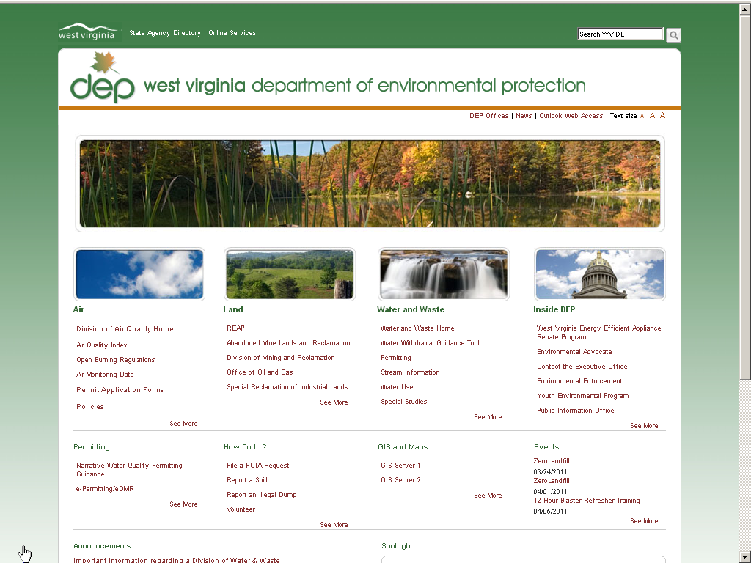
WV DEP is organized by
air,
land,
water & waste.

Slide 4
Air:
Nine cities and many counties are monitored and are included in the State Implementation Plan for air quality attainment.

Slide 5
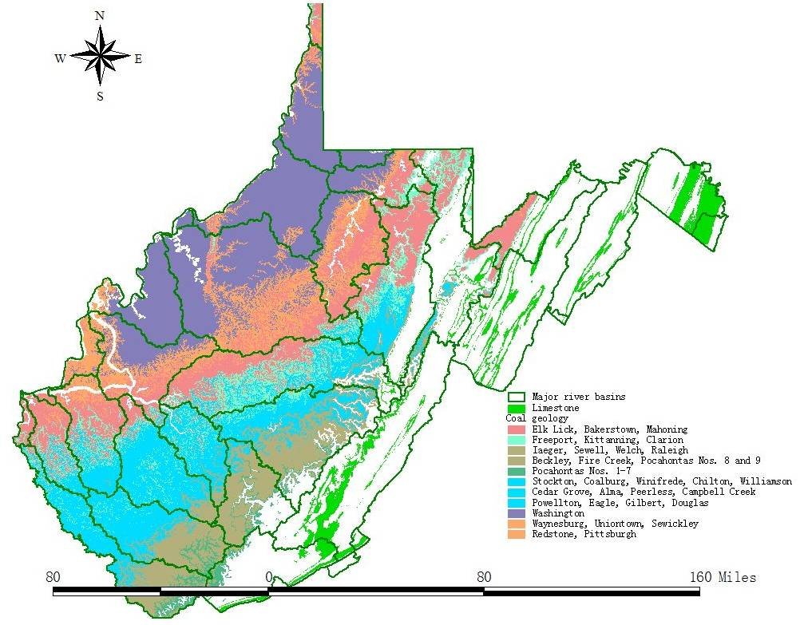
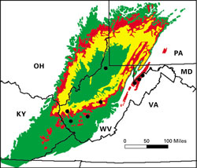

Land:
Acid Mine Drainage
WV: AMD affects over 2000 miles of
streams
Extent of AMD in the mid-Appalachian region

Slide 6
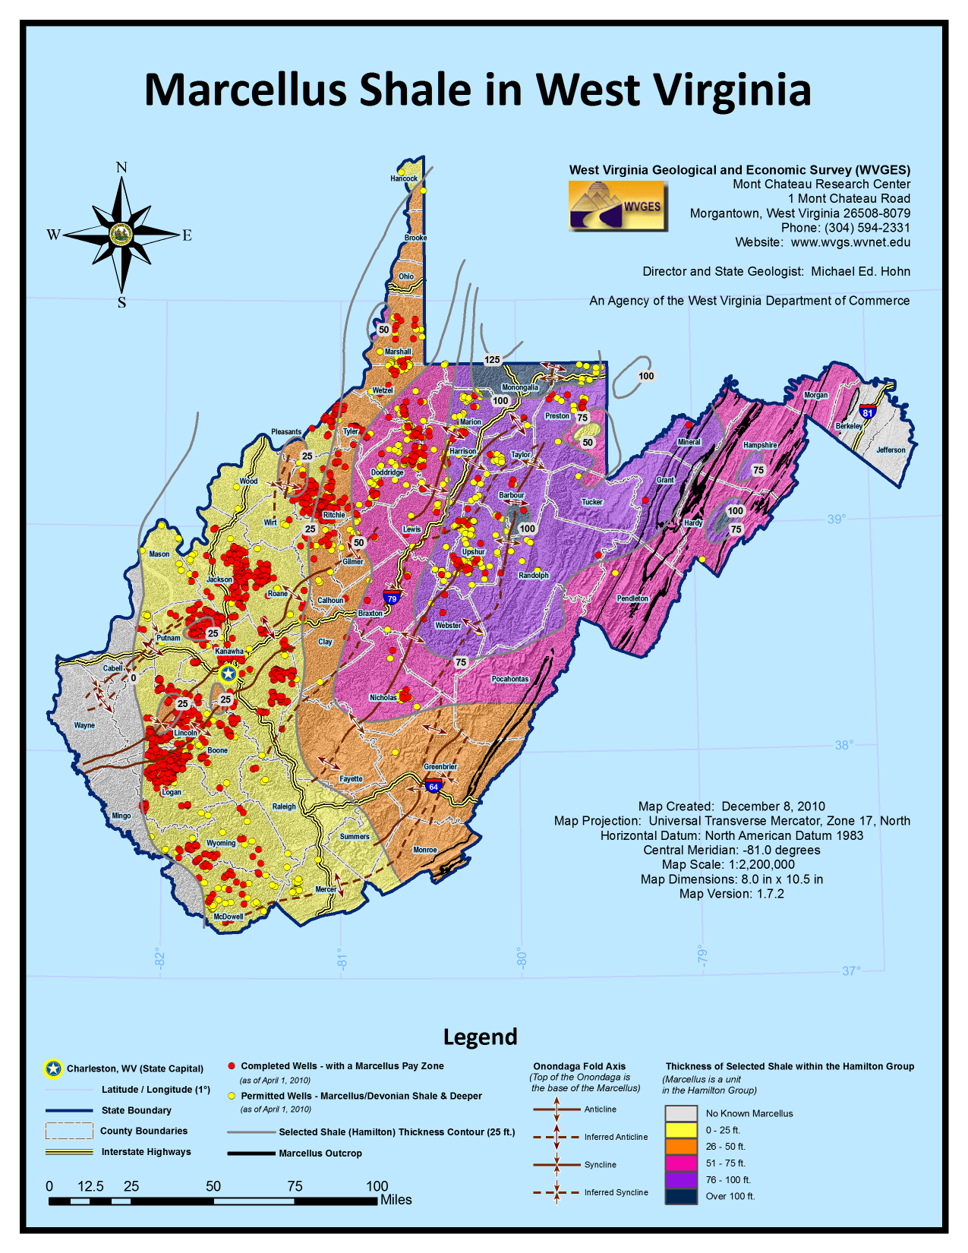
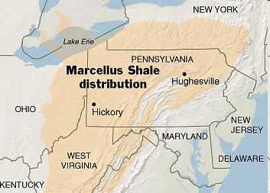
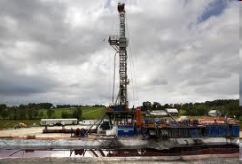
LAND
Resource extraction
Marcellus Shale

Slide 7
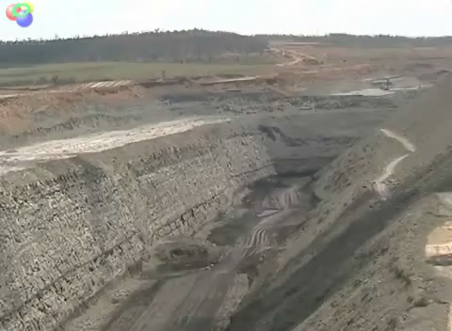

Slide 8
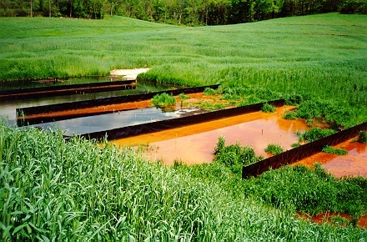
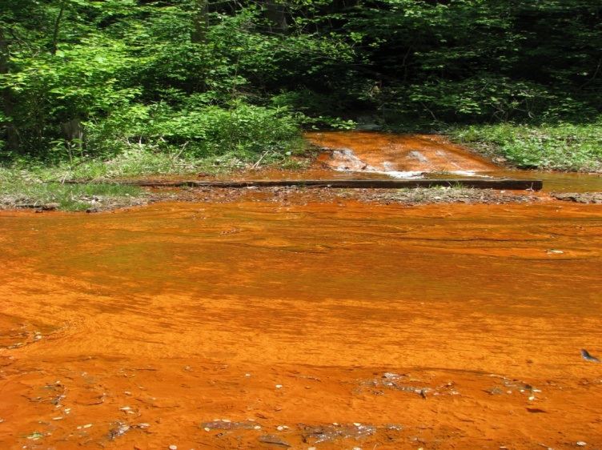
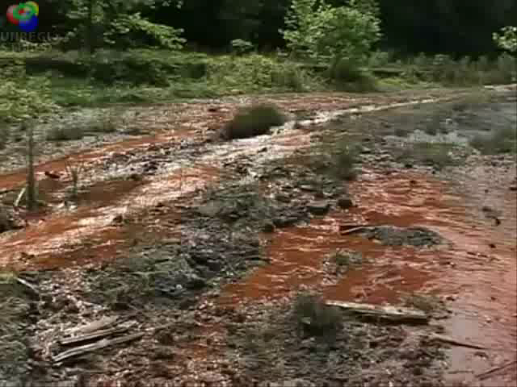
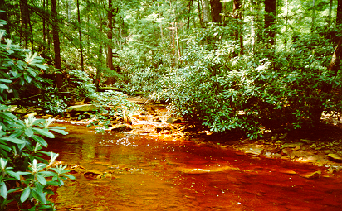
Water:
Results of mining.

Slide 9
Environmental Education Vision: Ultimate Obective
Every student will have a meaningful outdoor PBL, MWEE and/or 21st Century experience
EL embedded in WV DOE’s Constent Standards & Objectives

Slide 10
Status of Literacy Planning
2006 WVEEA Founded
2007 1st WVEEA Conference
2010 EL workgroup proposed
Fall 2010 WV joins Mid-Atlantic EL Roundtable
March 2011 EL session at WVEEA Conference
December 2011 WV Sustainable Schools Program accepts applicants
Fall 2012 WV Sustainable Schools Awards & 2nd round of aplicantions

Slide 11
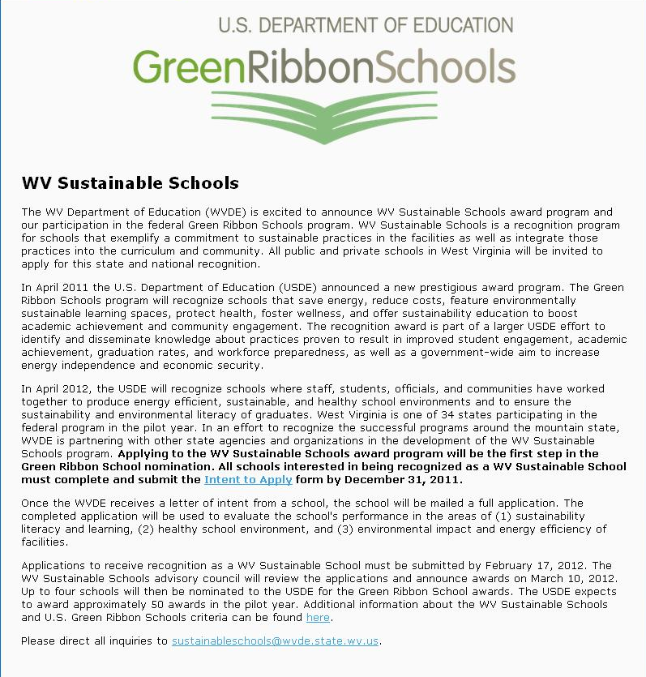
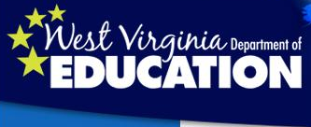


Slide 12
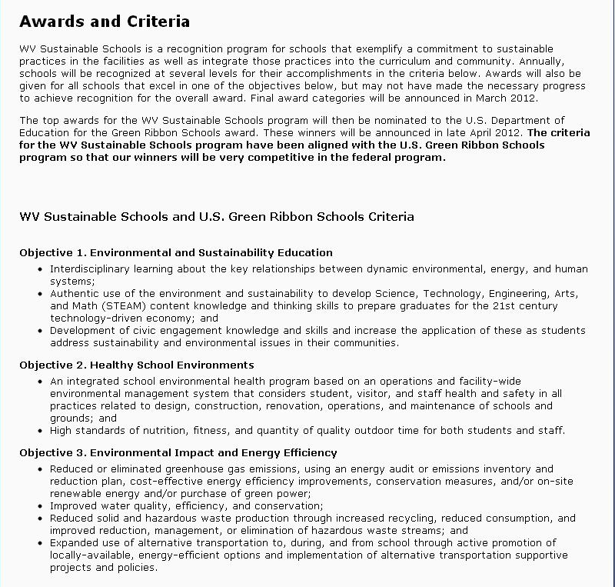

Slide 13
WV Sustainable Schools
In addition to four national referrals WV Sustainable Schools will award 1st place, runner up and honorable mentions under each objective.
Environmental and Sustainable Education
Healthy School Environments
Environmental Impact and Energy Efficiency

Slide 14

WV EL Team
Frank Rodgers, liaison with Fed & States Director of Education & Outreach ISA Certified Arborist MA-4468A Cacapon Institute, P.O. Box 68, High View, WV 26808 304-856-1385 / www.cacaponinstitute.org
Vicki Fenwick-Judy, WVEEA Sustainable
School lead
Canaan Valley Institute
Davis, WV
Education Coordinator
304.259.4739 x257
www.canaanvi.org
Robin Anglin, WV DOE liaison
Science Coordinator, Office of Instruction
1900 Kanawha Blvd. E., Building 6, Room 603, Charleston, WV 25305
ranglin@access.k12.wv.us
Phone: (304) 558-5325
Tim Craddock, WV DEP liaison
Nonpoint Program Coordinator
WVDEP's, Division of Water and Waste Management
601 57th Street, SE, Charleston, WV 25304
timothy.d.craddock@wv.gov
(304) 926-0499 Ext. 1040
http://www.dep.wv.gov/nonpoint
Ellen Murphy, WVEEA Environmental Literacy Workgroup Coordinator
Watershed Educator, Potomac Valley Audubon
pvasmail@gmail.com
304-676-3397
PO Box 578, Shepherdstown, WV 25443
www.potomacaudubon.org
Eriks E. Janelsins, President of WVEEA
Director, Schrader Environmental Center
Oglebay Institute · Wheeling, WV 26003
304.242.6855 · 304.242.5197(fax)· OIonline.com

Slide 15
Chesapeake Bay Program Education Work Group
June 6, 2012
For the WVEEA
Frank Rodgers
Vice Chair WVEEA
Director of Education & Outreach, Cacapon Institute
frodgers@cacaponinstitute.org

