Slide 1
Permanence of Compensatory Mitigation

Slide 2
Compensatory mitigation for 404 (CWA) permits is governed by joint Corps-EPA mitigation regulations AKA “Mitigation Rule”
Notes:
Issued in April 2008 – aimed at improving quality of compensatory mitigation, ensuring that all forms of mitigation including permittee responsible & banks held to equivalent standards. Incorporates recommendations by the NRC to improve mitigation.

Slide 3
Major Themes of the Rule
Sustainable compensatory mitigation
Equivalent standards for all types of mitigation
Use of best available science
Predictable and efficient processes
Expanded public participation
Notes:
Intended to address NRC’s 2001 evaluation of mitigation for 404 purposes as well as concerns raised by regional reviews in VA, NJ, New England, CA, IL, FL, etc.
First, rule is designed to ensure the compensation projects are sited, designed, implemented and managed to be sustainable.
Second, the rule will ensure that all types of mitigation—permitee-responsible compensatory mitigation, mitigation banking and in-lieu fee mitigation—will be held to equivalent, and more stringent, mitigation standards.
Third, the rule emphasizes the use of the best available science. The rule incorporates all of the applicable National Research Council (NRC) recommendations associated with improving the planning, implementation, and management of wetland and stream replacement projects.
Forth, the rule will increase the predictability and efficiency of mitigation project review by clarifying the contents of mitigation plans and standardizing the review process for mitigation bank and ILF proposals
5. Finally, the rule includes important provisions that will expand opportunities for public participation in compensatory mitigation decisions.
The rule does not focus on when mitigation is required - that’s a permit decision.

Slide 4
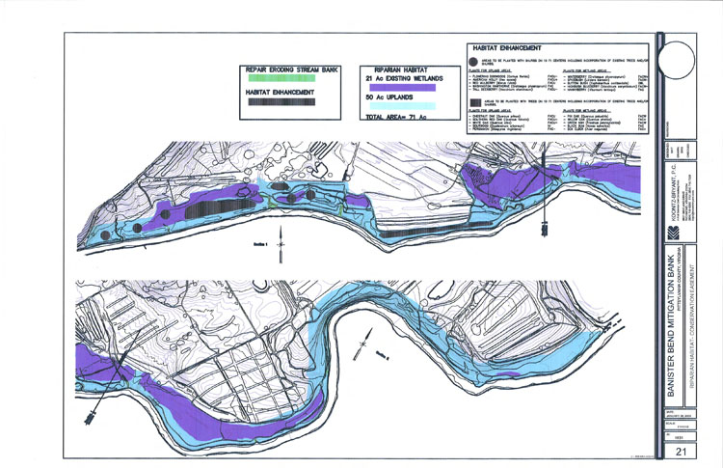
Mitigation Plan Components
Objectives
Site protection instrument
Baseline information
Work plan
Maintenance plan
Performance standards
Monitoring requirements
Financial assurances
Site selection factors
Credit determination
Long-term management plan
Adaptive management plan
Notes:
The goal is to ensure that all forms of mitigation are held to equivalent standards. One mechanism is to ensure similar/equivalent requirements for mit Plans.
All Mitigation plans must have/address these elements: Most have been part of many mitigation plans, including mitigation bank plans

Slide 5
Basic requirement for site protection
“…mitigation project must be provided long-term protection through real estate instruments or other available mechanisms, as appropriate.”
33 CFR 332.7(a)(1)
Notes:
From 332.7
Requirement for site protection applies to overall mitigation project, including buffers, riparian areas, uplands included in project
While the goal of the rule is to ensure permanent protection of all compensatory mitigation project sites, we recognize that the degree of long-term protection afforded by real estate instruments varies from state to state.

Slide 6
Site protection may be provided through:
Conservation easements
Other restrictive covenants
Title transfer
Multiple party agreements
Conservation Land Use Agreements
Federal facility management plans/integrated natural resources management plans
Notes:
Long-term protection may be provided through:
Conservation easements held by entities such as federal, tribal, state, or local resource agencies, non-profit conservation organizations, or private land managers; - we will focus on this but discuss other mechanisms as well
Title transfer to F/S/T/L or non profit
Multiple party agreements where land trust or non-profit is not ultimate land owner.
Government owned property special case
explicit authority has not been given for recordation of conservation easements over federal lands, including Department of Defense lands. Furthermore, under the Property and Administration Service Act of 1949, as amended (40 U.S.C. Sections 471, 483-490) the responsibility for management and disposal of federal property is assigned to the General Services Administration, which prevents many federal agencies from transferring mitigation lands to third parties like non governmental conservation organizations. A number of states also restrict easements over state-owned land.

Slide 7
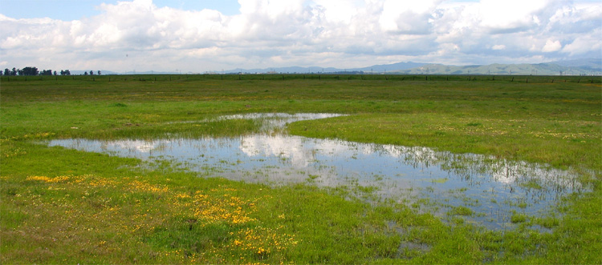
Why long term management?
Mitigation should be self-sustaining but management may be needed to meet objectives
Ensure sustainable mitigation after performance standards are met
Notes:
7
Compensatory mitigation should not require active engineering features such as pumps, but should be appropriately sited to ensure that natural hydrology and landscape position will support long-term sustainability. Long-term management may not be needed on some sites because developed to point where active management was not required
LTM starts AFTER site meets its administrative requirements and performance standards. If bank or ILF, then after all released credits debited, site found to be in compliance with its requirements, and closed

Slide 8
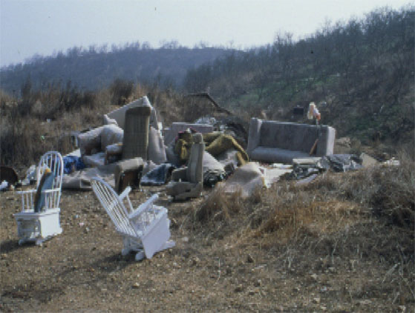
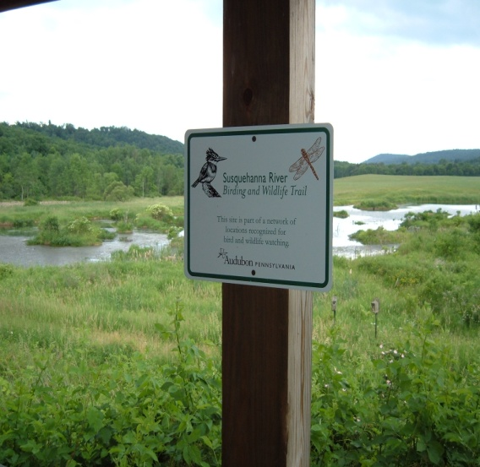
Examples of LTM Activities
Fencing
Signs
Maintain structures
Inventories
Inspection
Species management
Protect from encroachment
Notes:
8
Species management includes prescribed fire, use of herbicides, etc.
Protection from encroachment includes legal defense of site protection instrument, prevention of unauthorized dumping, ORV usage, etc. In other words, defense of easement is an LTM activity
Spp mgmt includes both desirable & undesirable spp.

Slide 9
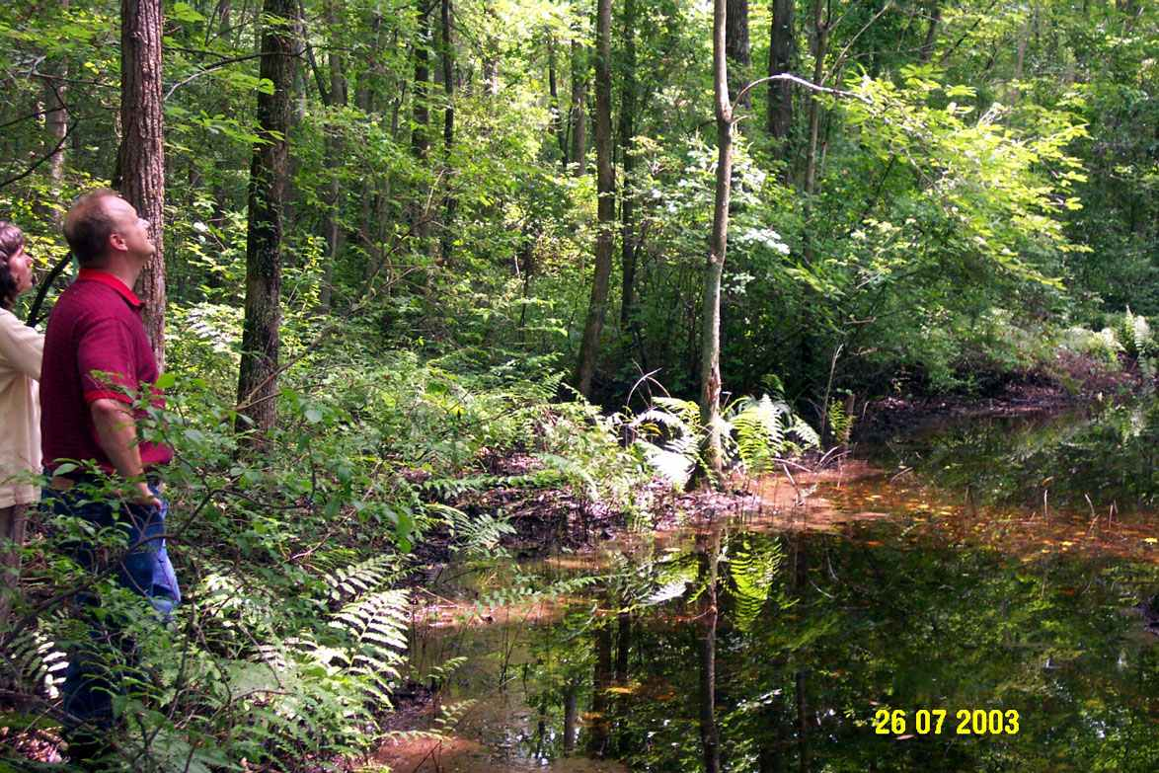
Questions?
Steve Martin
Steven.m.martin@usace.army.mil
(757) 201-7787

