Slide 1
WWDB
Data Reporting System
Wastewater Treatment Workgroup Conference Call
Tuesday, July 10, 2012
Marty Hurd
martin.hurd@tetratech.com

Slide 2
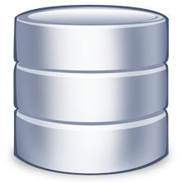
Review:
CBP Data Administrator loads and QA/QC’s data
Required nutrient species determined & non-significant facilities added
Loads calculated from reported measurements & discharge
Feedback & Review reports available online
Jurisdictions supply annual facility data
BayTAS
If changes are required
Data finalized & confirmed

Slide 3
Completed:
Database Design & Build
Data Migration
    Legacy CBP data
    2011 Data Submission
    Data Loader
Validations

Slide 4
Integration
BayTAS
Scenario Builder
Watershed Model
CBP Data Hub
TMDL Tracking & Accounting System (BayTAS)
Chesapeake Assessment & Scenario Tool (CAST)
WIP Appendix Q

Slide 5

Time frame?
March: Integration Tasks
July: Complete DB mods
August: Test – Feedback

