Slide 1
Agricultural Workgroup
BMP Verification Process
Progress to Date
Frank Coale, AgWG Chair
Mark Dubin, AgWG Coordinator
06/19/12

Slide 2
BMP Verification Process
Based on draft “Verification Principles” under development by the WQGIT and the BMP Verification Steering Committee.
An Agriculture-centric focus
  Annual BMPs
  Structural BMPs
  Cost-shared practices
    Federal
    State
    NGO
  Non-cost shared practices
  Functional equivalent practices

Slide 3
Existing Efforts
AgWG surveyed existing state agency procedures for verification of BMP implementation
  Cost shared
  Non-cost shared
AgWG surveyed practices of non-state agency efforts to account for BMP implementation
  Pilot programs
  Cost shared
  Non-cost shared

Slide 4
Utilize Existing Programs & Data
Federal and State verification practices are already in place for most cost-shared BMPs
  Do not duplicate efforts
  Professional evaluation done once is good enough
All verification data generated must be utilized by the CBP model
  Relative accuracy or confidence in verification process will vary by BMP
  Relative credit will necessarily vary by verification process and accounting confidence

Slide 5
AgWG BMP Verification Concept
Introduced to AgWG at May WG meeting
  Distributed for rumination
  Comments and suggestions collected
Rigorous evaluation of compiled comments and suggestions at June AgWG meeting
  Adoption of concept framework
  Agreement on structure
Buy-in from all agency and non-agency partners
Refinements in process

Slide 6
AgWG BMP Verification Concept
Protocol Concept Features
  Provides multiple options for data collection and verification
  Allows different approaches for annual vs. structural BMP data collection and verification
  Incorporates relative cost per unit of data collected for resource comparison
  Each accepted method allows for recognition of all reported BMP data by P5.3.2
  Relative data confidence level influences the effectiveness value of BMPs as applied in P5.3.2

Slide 7
AgWG BMP Verification Concept
Protocol Concept Features
  Defensible relative confidence and credit values will be developed and based on available scientific and statistical data
  Consistent rigor is applied on all collected and verified BMP data regardless of funding source
  Consistency across all agencies & partners for collecting and reporting BMP data with commensurate credit values
  Enables partners to select and apply verification methods based upon available resources and known relative credit value for verification method

Slide 8
Draft Agricultural Verification Protocol Concept
Chesapeake Bay Program Agriculture Workgroup (AgWG)
6/15/2012
Ag Protocol Category | BMP Inventory Assessment Method | Cost-Share Information |  |  |  | BMP Functionality Information |  |  |  |  | Verification Methodology | Verification Issues | Relative Cost | Relative Data Confidence | Relative Data Credit
 |  | Federal Cost Share | State Cost Share | NGO Cost Share | Private Funded | Meets Specs | Functional Equivalent | Partially Effective | Not Effective | Installation Date |  |  | Low: < $1/acre Medium:$1 to $3/acre High: > $3/acre | Annual BMP / Structural BMP (5=maximum, 1=minimum) | Annual BMP / Structural BMP (% of Approved BMP Effectiveness Value)
On-farm Assessment | Farm inventory by trained federal, state, and/or county agency personnel. | Yes | Yes | Yes | Yes | Yes | Yes | Yes | Yes | Yes | Through on-site visit by trained personnel, collecting data, check databases, check on-farm records | Accredited data source through training/certification | High | 5 / 5
On-farm Assessment | Farm inventory by trained independent third-party personnel. | Yes | Yes | Yes | Yes | Yes | Yes | Yes | Yes | Yes | Through on-site visit by trained personnel, collecting data, check databases, check on-farm records | Accredited data source through training/certification | High | 5 / 5
On-farm Assessment | Farm inventory by trained agricultural industry personnel. | Yes | Yes | Yes | Yes | Yes | Yes | Yes | Yes | Yes | Through on-site visit by trained personnel, collecting data, check databases, check on-farm records | Accredited data source through training/certification | High | 4 / 4

Slide 9
Draft Agricultural Verification Protocol Concept
Chesapeake Bay Program Agriculture Workgroup (AgWG)
6/15/2012
Ag Protocol Category | BMP Inventory Assessment Method | Cost-Share Information |  |  |  | BMP Functionality Information |  |  |  |  | Verification Methodology | Verification Issues | Relative Cost | Relative Data Confidence | Relative Data Credit
 |  | Federal Cost Share | State Cost Share | NGO Cost Share | Private Funded | Meets Specs | Functional Equivalent | Partially Effective | Not Effective | Installation Date |  |  | Low: < $1/acre Medium:$1 to $3/acre High: > $3/acre | Annual BMP / Structural BMP (5=maximum, 1=minimum) | Annual BMP / Structural BMP (% of Approved BMP Effectiveness Value)
Farmer Self-Assessment | Farmer completes self-certified inventory survey with 100% check by trained federal, state and/or county personnel. | Yes | Yes | Yes | Yes | Yes | Yes | Yes | Yes | Yes | On-site visit by trained personnel, collecting data, check databases, check on-farm records | Confirmation checks of self reported practices | Medium/High | 4 / 5
Farmer Self-Assessment | Farmer completes self-certified inventory survey with 10% spot check by trained federal, state and/or county agency personnel. | Yes | Yes | Maybe | Maybe | Yes | Maybe | Maybe | Maybe | Maybe | Statistical sample on-site visit by trained personnel, collecting data, check databases, check on-farm records | Statistical sample confirmation checks of self reported practices | Medium | 3 / 3
Farmer Self-Assessment | Farmer completes in-office self-certified inventory with trained federal, state and/or county agency personnel. | Yes | Yes | Maybe | Maybe | Yes | Maybe | Maybe | No | Maybe | Farmer certified during the visit at USDA or governmental office | Farmer Self certification with Professional Assistance | Low/Medium | 2 / 4
Farmer Self-Assessment | Farmer completes self-certified inventory survey. | Maybe | Maybe | Maybe | Maybe | Maybe | Maybe | Maybe | No | Maybe | By Farmer self certification when submitted | Wide variance in knowledge of farmers | Low | 2 / 2

Slide 10
Draft Agricultural Verification Protocol Concept
Chesapeake Bay Program Agriculture Workgroup (AgWG)
6/15/2012
Ag Protocol Category | BMP Inventory Assessment Method | Cost-Share Information |  |  |  | BMP Functionality Information |  |  |  |  | Verification Methodology | Verification Issues | Relative Cost | Relative Data Confidence | Relative Data Credit
 |  | Federal Cost Share | State Cost Share | NGO Cost Share | Private Funded | Meets Specs | Functional Equivalent | Partially Effective | Not Effective | Installation Date |  |  | Low: < $1/acre Medium:$1 to $3/acre High: > $3/acre | Annual BMP / Structural BMP (5=maximum, 1=minimum) | Annual BMP / Structural BMP (% of Approved BMP Effectiveness Value)
Records Review | Review of existing in-office agency records by trained federal, state and/or county agency personnel. | Yes | Yes | Maybe | Maybe | Yes | No | No | No | Yes | Trained personnel verify through knowledge of the farm or through calls made to the farmer | Misses many non-C/S practices | Low/Medium | 4 / 4
Records Review | Review of existing on-farm records by trained federal, state and/or county agency personnel. | Yes | Yes | Maybe | Maybe | Yes | No | No | No | Yes | Trained personnel verify through knowledge of the farm or through calls made to the farmer | Misses many non-C/S practices | Low/Medium | 3 / 3
Records Review | Review of existing on-farm records by trained independent third-party personnel. | Maybe | Maybe | Maybe | Maybe | Yes | No | No | No | Yes | Trained personnel verify through knowledge of the farm or through calls made to the farmer | Misses many non-C/S practices | Low/Medium | 3 / 3

Slide 11
Draft Agricultural Verification Protocol Concept
Chesapeake Bay Program Agriculture Workgroup (AgWG)
6/15/2012
Ag Protocol Category | BMP Inventory Assessment Method | Cost-Share Information |  |  |  | BMP Functionality Information |  |  |  |  | Verification Methodology | Verification Issues | Relative Cost | Relative Data Confidence | Relative Data Credit
 |  | Federal Cost Share | State Cost Share | NGO Cost Share | Private Funded | Meets Specs | Functional Equivalent | Partially Effective | Not Effective | Installation Date |  |  | Low: < $1/acre Medium:$1 to $3/acre High: > $3/acre | Annual BMP / Structural BMP (5=maximum, 1=minimum) | Annual BMP / Structural BMP (% of Approved BMP Effectiveness Value)
Statistical Sampling | Statistical transect survey completed by trained personnel on a County or Watershed scale. | Maybe | Maybe | Maybe | Maybe | Yes | Maybe | Maybe | Maybe | No | Verified by the trained personnel completing the transect survey on the ground | Can only determine existence and quality of practices not source of funding | Low / Medium / High [Determined by design and rigor of sampling methodology] | 1 to 4 / 1 to 4 [Determined by design and rigor of sampling methodology]
Statistical Sampling | CEAP/NRI survey conducted in-person at field-level with NASS trained personnel. | Maybe | Maybe | Maybe | Maybe | No | No | No | No | No | NASS certification procedures | Survey conducted at various watershed HUC scales using specific field points | Low / Medium / High [Determined by design and rigor of sampling methodology] | 1 to 4 / 1 to 4 [Determined by design and rigor of sampling methodology]
Statistical Sampling | NASS survey conducted via survey with NASS trained personnel. | No | No | No | No | No | No | No | No | No | NASS certification procedures | Survey using self-reported information with statistical checks | Low / Medium / High [Determined by design and rigor of sampling methodology] | 1 to 4 / 1 to 4 [Determined by design and rigor of sampling methodology]

Slide 12
Draft Agricultural Verification Protocol Concept
Chesapeake Bay Program Agriculture Workgroup (AgWG)
6/15/2012
Ag Protocol Category | BMP Inventory Assessment Method | Cost-Share Information |  |  |  | BMP Functionality Information |  |  |  |  | Verification Methodology | Verification Issues | Relative Cost | Relative Data Confidence | Relative Data Credit
 |  | Federal Cost Share | State Cost Share | NGO Cost Share | Private Funded | Meets Specs | Functional Equivalent | Partially Effective | Not Effective | Installation Date |  |  | Low: < $1/acre Medium:$1 to $3/acre High: > $3/acre | Annual BMP / Structural BMP (5=maximum, 1=minimum) | Annual BMP / Structural BMP (% of Approved BMP Effectiveness Value)
Remote Sensing | Remote Sensing, aerial photography | No | No | No | No | No | No | No | No | No | Verification by visit to each site or a statistical sample to collect and certify data | Variation in scale and quality of remote imagery effects data quality | Low / Medium / High [Determined by design and rigor of methodology] | 1 to 4 / 1 to 4 [Determined by design and rigor of sampling methodology]

Slide 13
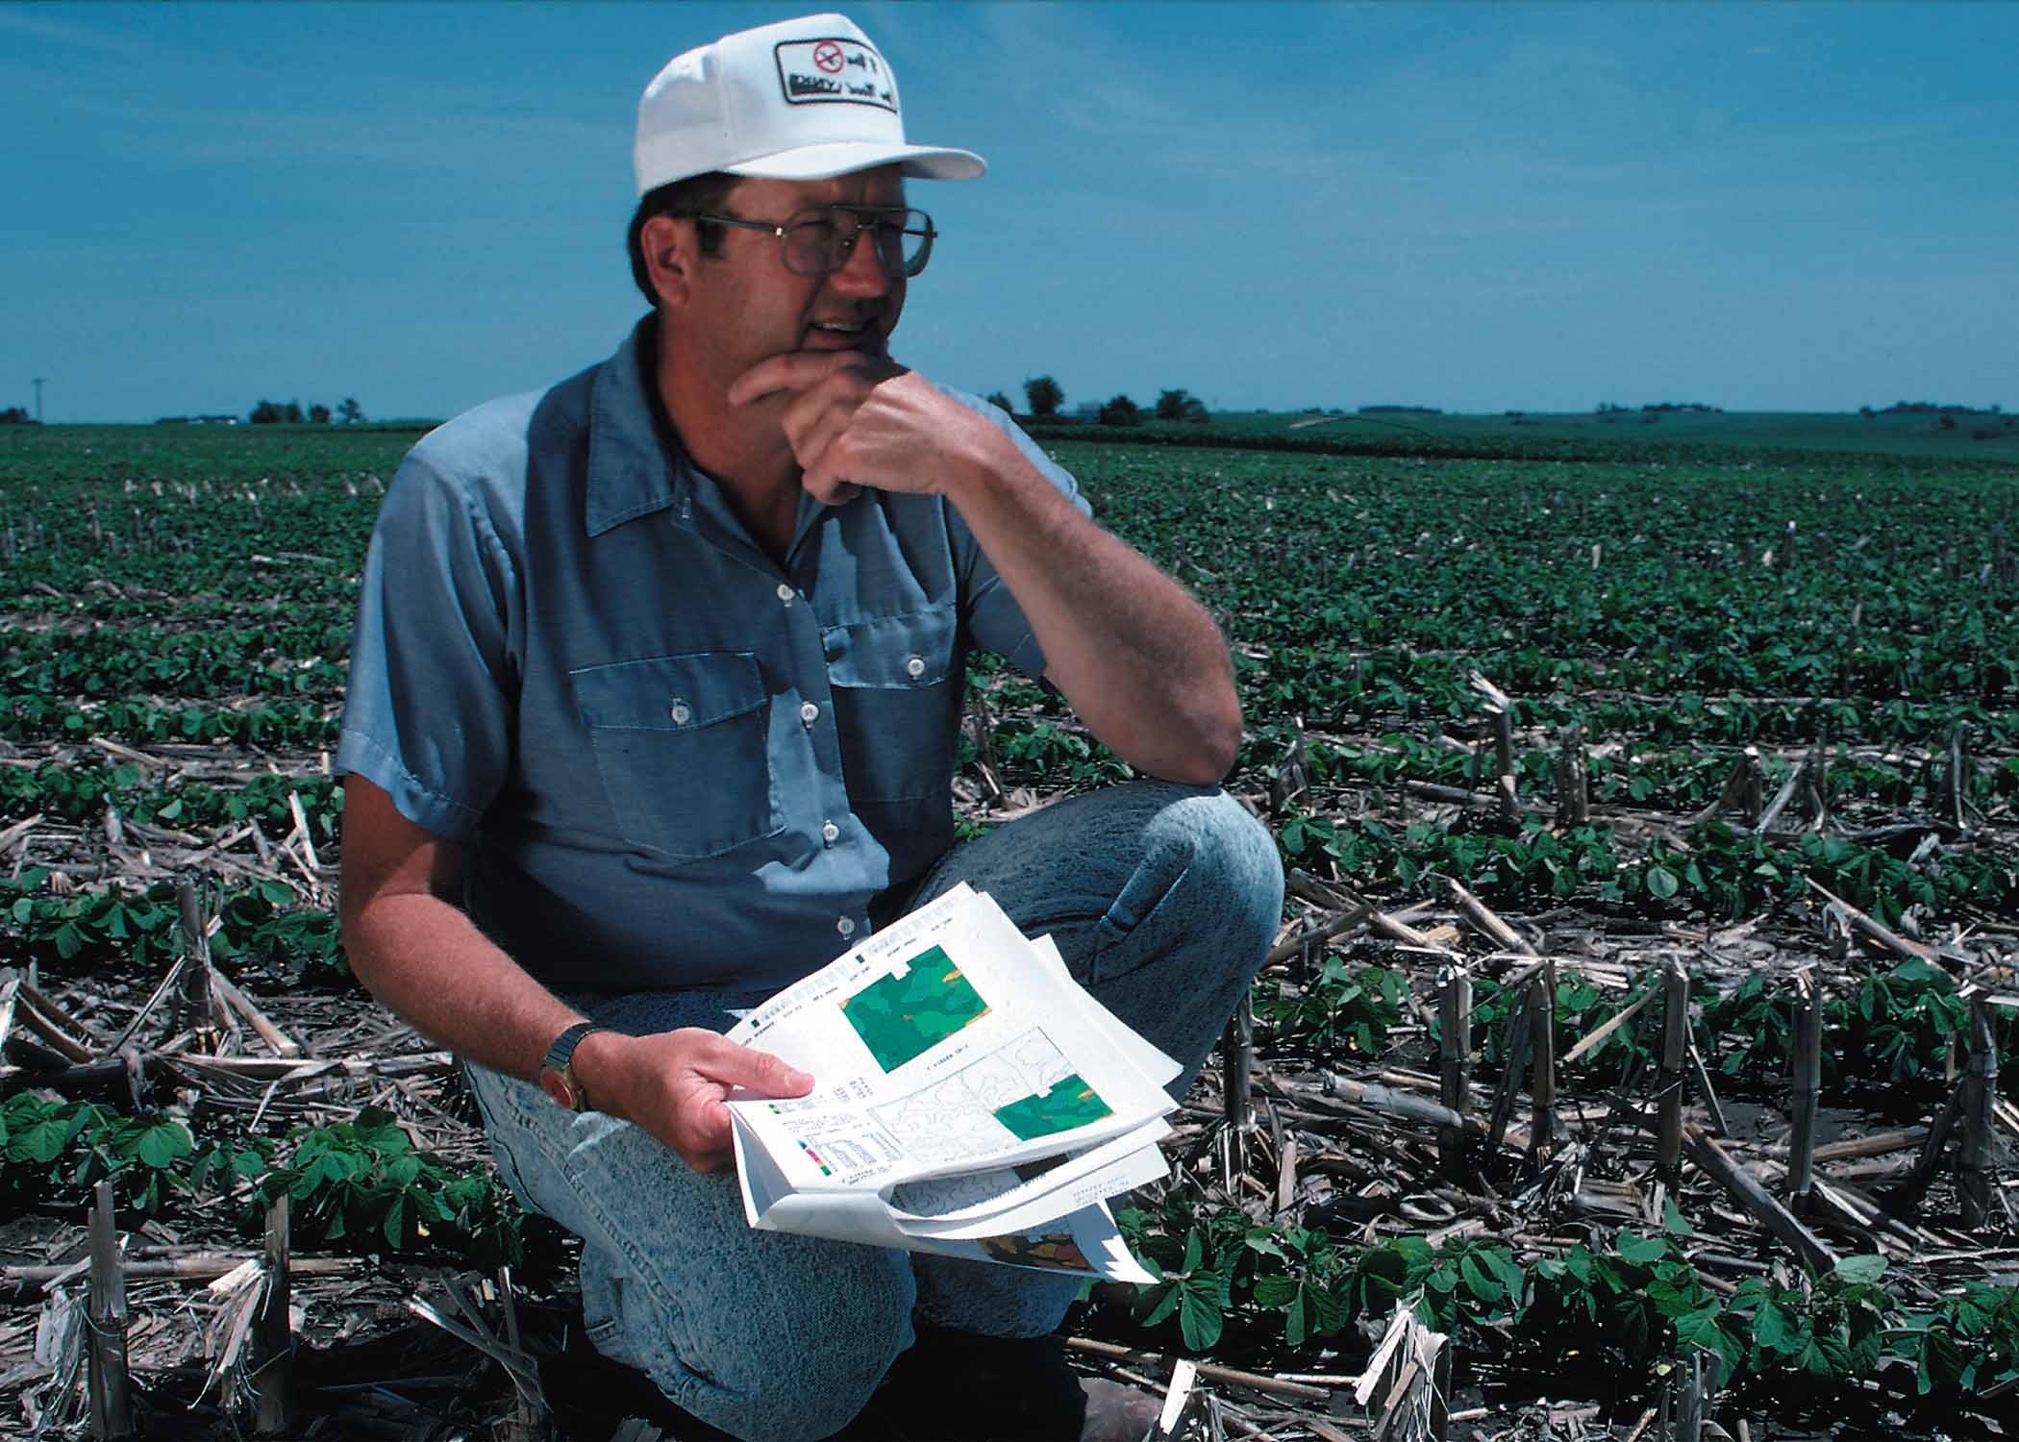
Questions?

