Slide 1
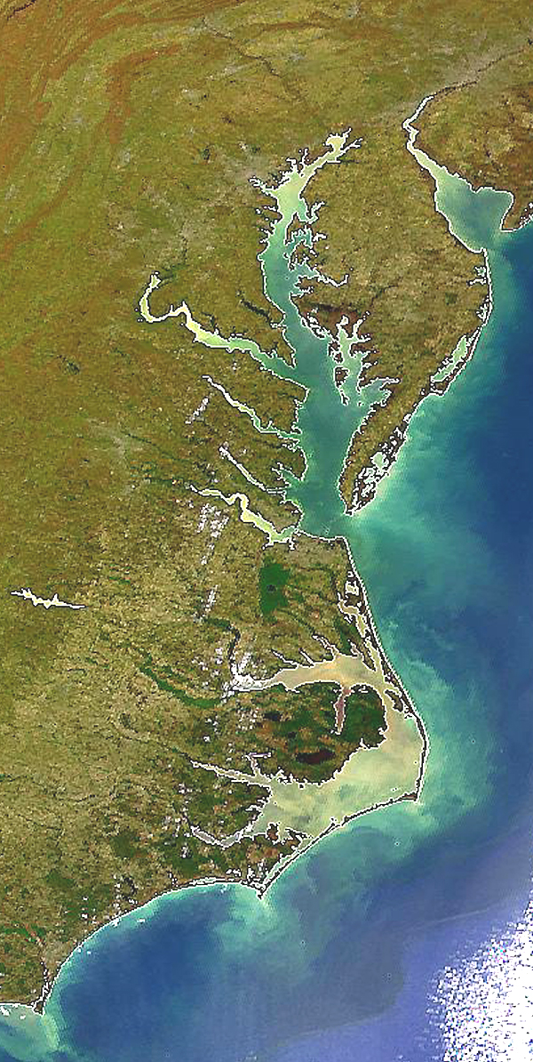

Historic Record of
Practice Implementation
Jeff Sweeney
Environmental Protection Agency
Chesapeake Bay Program Office
jsweeney@chesapeakebay.net
410-267-9844
CBP WQGIT BMP Verification Committee Meeting
Chesapeake Bay Program Office
Annapolis, MD
June 19, 2012

Slide 2

Historic Record of Practice Implementation
For the Phase 5.3.2 Watershed Model, record of implementation covers the period 1985-2011
  In 1985:
    NY = Ag
    PA = Ag and stormwater
    MD = Ag and stormwater
    VA = Ag
    WV = Ag and forestry

Slide 3
Chesapeake Bay Watershed Model
Agricultural Practice Groups
Nutrient Management
Nutrient Management
Decision Agriculture
Enhanced Nutrient Management
Conservation Tillage
Continuous No-Till
Other Conservation Tillage
Cover Crops
Cover Crops and Commodity Cover Crops
  Early, standard, late-planting
  Species
  Seeding method
Pasture Grazing Practices
Alternative Watering Facilities
Stream Access Control with Fencing
Prescribed Grazing
Precision Intensive Rotational Grazing
Horse Pasture Management
Other Agricultural Practices
Forest Buffers
Wetland Restoration
Land Retirement
Grass Buffers
Tree Planting
Carbon Sequestration/Alternative Crops
Conservation Plans/SCWQP
Animal Waste Management Systems
Barnyard Runoff Control
Mortality Composters
Manure Transport
Water Control Structures
Non-Urban Stream Restoration
Poultry and Swine Phytase
Dairy Precision Feeding
and/or Forage Management
Ammonia Emissions Reductions

Slide 4
Chesapeake Bay Watershed Model
Practices on Developed Lands
Stormwater Management
Wet Ponds and Wetlands
Dry Detention Ponds and Hydrodynamic Structures
Dry Extended Detention Ponds
Infiltration Practices
Filtering Practices
(Urban Stormwater Retrofit)
(New State Stormwater
Performance Standards)
Septic BMPs
Septic Connections
Septic Denitrification
Septic Pumping
Other Urban/Suburban Practices
Forest Conservation
Impervious Surface and Urban Growth Reduction
Forest Buffers
Tree Planting
Grass Buffers
Stream Restoration
Erosion and Sediment Control
Nutrient Management
Street Sweeping
Abandoned Mine Reclamation
Dirt and Gravel Road Erosion and Sediment Controls
Shoreline Erosion Control

Slide 5
Historic Record of Practice Implementation
Much of the BMP record was a carry-over from the Phase 4.3 Watershed Model
  Exceptions among jurisdictions and particular BMPs in a jurisdiction
    All available BMP databases were assessed and records submitted through spreadsheets prior to calibration
    On-the-ground assessment done after calibration and new data introduced post-2005
    Assessment of databases done after calibration and new data introduced post-2005

Slide 6
Historic Record of Practice Implementation
Spatial scale that BMPs were reported at varies among BMP types and years
  Conversion to county scale from Phase 4.3 to Phase 5 if jurisdiction did not submit comprehensive history
Landuse types that a BMP applies to can vary among years in a jurisdiction and among jurisdictions

Slide 7
Nutrient Management Plan Submitted Record
Chesapeake Watershed-Wide
Submitted Nutrient Management Landuse Types:
AGFERT = hwm+lwm+hom+hyw+alf+pas
CROPFERT = hwm+lwm+hom+hyw+alf
ROW = hwm+lwm+hom
ROWMAN = hwm+lwm
HAYNUTALF = hyw+alf
hom, hyw, pas

Slide 8
Nutrient Management Plan Submitted Record
Chesapeake Watershed-Wide
Nutrient Management Spatial Scales:
State
TributaryStrategy Basin
Major Basin – County
County
LandRiver segment
Above may have been conversion from Phase 4.3 county-segment or state-segment

Slide 9
Historic Record of Practice Implementation
Need to “clean up” BMP history as best we can
  Better accounting for changes in monitored loads over time

Slide 10
Historic Record of Practice Implementation
Need to “clean up” BMP history as best we can
  Issue of “cut-off” of implementation in the modeling tools
    100% implementation level at the reported scale
      Have considered maximum implementation level in the past, but no consensus agreement
      Some jurisdictions consider life-span for some BMPs – others do not
      Have considered loss of practice in the past due to land conversion, but no consensus agreement
      Many instances of over-reporting because of incorrect units

Slide 11
Historic Record of Practice Implementation
Need to “clean up” BMP history as best we can
  Issue of “cut-off” of implementation in the modeling tools
    Not enough acres, systems, AUs, etc. in the tools
      Supplement data with “local” information but need history and forecast that’s aligned with, for example, landuse definitions

Slide 12
Historic Record of Practice Implementation
Options for historic BMP “clean up”
  Jurisdictional agencies lead with best available records and submit through NEIEN
    Can report tracked individual components of a CBP BMP category
    Many options for spatial scale and units
    Greater defensibility with accurate locations, implementation dates, inspection and maintenance records, funding sources, etc.
    Can include all BMPs – and then “map” when approved for nutrient and sediment reductions
    Consistent with 2010 and 2011 BMP reporting for non-wastewater controls

Slide 13
Historic Record of Practice Implementation
Options for historic BMP “clean up”
  Jurisdictional agencies lead with best available records and submit through NEIEN
    The more source databases connected to NEIEN, the easier the task
    NEIEN (BayTAS) reports readily available
State
Data
State
NEIEN
Node
CBP
NEIEN
Node
Scenario
Builder
P5.3
WSM
Operational
Operational

Slide 14
Historic Record of Practice Implementation
Options for historic BMP “clean up”
  Contractual support to clean up existing submitted BMPs with direction from agencies and CBP following general rules
    Increasing implementation for “cumulative” practices – with consideration of life-span
      Working from current records backwards and would need to know actual implementation year of post-calibration BMPs
    Spatial scale is difficult if already processed to fit in CBP segmentation
    Less defensible if already processed to fit in CBP BMP categories – that could have changed over time

Slide 15
Historic Record of Practice Implementation
Options for historic BMP “clean up”
  Combination of 1) NEIEN source data, and 2) existing submitted history with rules

Slide 16
Historic Record of Practice Implementation
Options for historic BMP “clean up”
  For agriculture, introduce NRCS and FSA data – with assurances for single-counting
  Accommodate federal facilities data
  Accommodate voluntary practice data
    Considerable amount of work in regards to verification and “crediting”

Slide 17
Historic Record of Practice Implementation
Timeline
  By mid-2015 for calibration of the next versions of environmental modeling tools for TMDL mid-point evaluation

Slide 18
Historic Record of Practice Implementation
Next steps and resources to complete tasks and
  Alternative ways to get to the same end-product
    Discussion
  Please let us know how and when you’ll proceed with historic data clean-up and where you need help
    Tetra Tech
    CBRAP grants

