Slide 1
Ensuring Full Access to Federal Cost Shared Conservation Practices W. Dean Hively, Ph.D. U.S. Geological Survey Eastern Geographic Science Center
CBP WQGIT BMP Verification Committee meeting
June 19th, 2012, Fish Shack, Annapolis MD

Slide 2
Our objectives
Draft protocols to assist the process of summarizing USDA conservation practice records and making them public
Support states in NEIEN submission to Chesapeake Bay Model
Help to resolve issues related to State-Federal double counting
Oversee data aggregation protocols to meet 1619 requirements
Improve the accuracy and consistency of Federal data reporting across States
Streamline the process to make everyone’s job a bit easier
Our objective is to facilitate the process, *not* to take over responsibility from the States for the submission of USDA data
Notes:
2

Slide 3
USGS and Chesapeake Bay conservation data
Transfer of site-specific conservation data for Chesapeake Bay farm land from the USDA-NRCS and USDA-FSA to the USGS is now allowed under 1619 Conservation Cooperator Agreements
Includes individual records for each agricultural conservation practice that is Federally financed (~300,000 total)
Data are currently in hand for 2006 – 2011, and 2012 data will be requested in October
The data set is similar to what States with a 1619 agreement in place already receive from State-level NRCS collaborators
Notes:
3

Slide 4
Current status of 1619 Conservation Cooperator
data sharing agreements
A few States have signed 1619 agreements that allow them to handle site-specific USDA conservation data records
States without a 1619 agreement must rely upon aggregated county totals to report USDA data
Notes:
4

Slide 5
Steps in the process
Obtain USDA data from Federal or State NRCS and FSA officials
Address double counting,
select reportable records
Aggregate records to maintain 1619 privacy requirements
Crosswalk USDA practice codes to NEIEN practice categories
Submit records to NEIEN/Scenario Builder
Notes:
5

Slide 6
Obtaining the data
Federal programs
State programs
Farmers
Soil conservation district
Soil conservation district
1619
NRCS Toolkit, FSA database
Combined tracking system
State records
MD
all States
WV, DE
USDA State offices
State NEIEN Responsible
NY, VA
Key:
1619
USDA Federal database
Federal site specific data
PA
1619
Federal aggregated data
USGS
State site specific data
Notes:
6

Slide 7
Obtaining the data
Solutions vary among States
USGS role:
Will request 2012 Federal implementation data in October
Can provide aggregated or site specific records to States, as appropriate
May not be necessary if similar data are already easily obtained from State USDA offices
Notes:
7

Slide 8
Strategies to avoid double counting
Existing solutions are generally adequate, and vary by State
1. Identify practice codes that are impossible to double count, report them
2. Identify practices that might be double counted and:
delete Federal records, report State records, or vice-versa according to practice code and cost share information (PA, WV, DE – no 1619 agreement in place)
examine site specific records and eliminate identical records
(VA – 1619 agreements allow comparison of specific records)
track with sufficient accuracy that a full separation is easy
(MD – 1619 agreements allow tracking of USDA practices outside of USDA record keeping system)
Notes:
8

Slide 9
Strategies to avoid double counting
All of these strategies are adequate, but more detailed information is likely to lead to more through crediting in Scenario Builder
USGS role:
Work with States to document and clarify their methods
Work with States to list practices that can or cannot be double counted
Support the establishment of successful 1619 data sharing agreements
Notes:
9

Slide 10
Data privacy and data aggregation
To fulfill Sec. 1619 privacy requirements, practices can be publicly reported for any area with >=5 farms participating in a particular USDA conservation practice
For 2012, focus on reporting county totals
Non-reportable data can be combined and reported at the state level
States without a 1619 agreement will require data aggregation to occur before they receive USDA data
Notes:
10

Slide 11
Data privacy and data aggregation
Reported totals must meet 1619 requirements (>5 farms/unit)
USGS role:
Document acceptable aggregation protocols
Oversee aggregation of records to meet 1619 guidelines
Provide data aggregation work flow as needed
Notes:
11

Slide 12
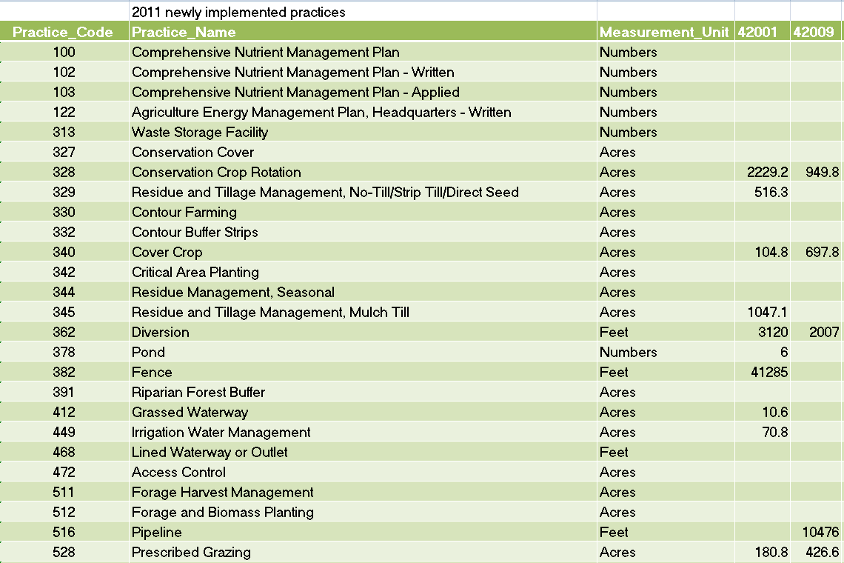
Example aggregated NRCS data

Slide 13
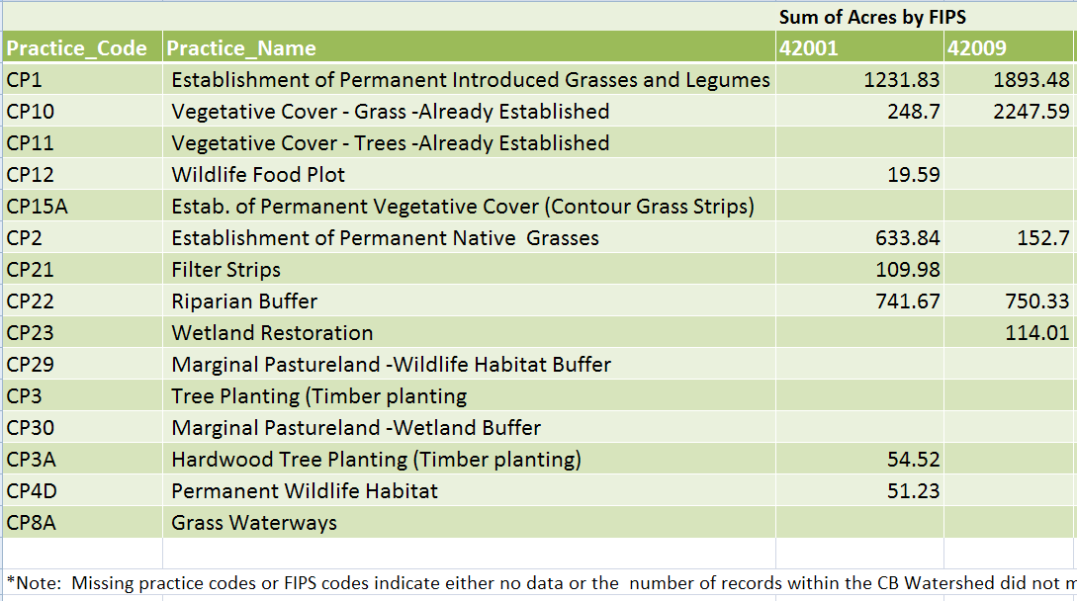
Example aggregated FSA data
Example aggregated FSA data
Slide of column headings
Notes:
13

Slide 14
Crosswalk to NEIEN
A simple crosswalk between USDA practice codes and NEIEN practice categories is highly desirable
Best to develop a consistent interpretation of USDA practices in the context of Scenario Builder model input requirements
This is a moving target, but could be established for 2012
It would save the States a lot of time and confusion
If several USDA codes can be combined into one NEIEN category, then the level of spatial aggregation can be reduced (aim for HUC12 in 2013)
Notes:
14

Slide 15
Crosswalk to NEIEN
The fundamentals of the crosswalk are understood, but the interpretation varies among States and is a source of frustration
USGS Role:
USGS and EPA will work with States to create a documented crosswalk to translate USDA practice codes into appropriate 2012 NEIEN/Scenario Builder practice categories
The crosswalk will be submitted to the watershed technical workgroup, to be approved by the Goal Implementation Team and updated in future years as needed
Notes:
15

Slide 16
Submit recordsn to NEIEN/Scenario Builder
Final data submission best left to the States so that they can maintain credit and responsibility for NRCS and FSA practices applied in their territory, and use these practices to attain implementation targets
While a consistent interpretation of USDA practices is desirable, NRCS records often do not contain as much detail as is requested by Scenario Builder, and average effects will have to be assumed for standard USDA practices. States could possibly increase credit for USDA practices through further documentation of practice details
1619 agreements will likely lead to increased crediting of USDA practices due to more accurate elimination of double counting, and provide the possibility to track increased detail for more accurate crediting
Notes:
16

Slide 17
Steps in the process
Obtain USDA data from Federal or State NRCS and FSA officials
Address double counting,
select reportable records
Aggregate records to maintain 1619 privacy requirements
Crosswalk USDA practice codes to NEIEN practice categories
Submit records to NEIEN/Scenario Builder
Notes:
17

Slide 18
2012 USGS activity timeline
Jul
Jul
Jul
Aug
Sep
Work with NRCS and States to identify exactly what practices are included in NRCS and FSA records and to what extent they might be duplicated in state records
Explain and document State-specific protocols for resolving double counting problems
Document data aggregation protocol, prepare to provide aggregated data records to States as needed
Help to develop a standard crosswalk between USDA and NEIN/Scenario Builder .xml format
Draft final recommendations for 2012 NEIEN submission
Notes:
18

Slide 19
2012 Data Submission – possible strategy
Oct
Nov
Nov
Nov
Dec
Jan
Obtain 2012 USDA dataset in October and make it available to the States
Work with States to remove double counting and identify reportable data
Prepare aggregated data product to protect 1619 privacy
Work with States to apply crosswalk to NEIEN xml format
States make NEIEN submission of State and USDA data
Identify next round of improvements for 2013
Notes:
19

Slide 20
Considerations
It would be helpful to develop a common language for 1619 agreements between USDA and Chesapeake Bay States
It may be helpful to engage NRCS in discussion about expanding their record keeping to support the level of detail desired in tracking conservation practice implementation in the Chesapeake Bay region
Further discussion should occur regarding lifespan, and regarding matching records to model land use parameters
Thank you very much to many hard working people for sharing their time and knowledge
Notes:
20

Slide 21
Thank you - questions?
Dean Hively
USGS Eastern Geographic Science Center
Stationed at USDA-ARS, Beltsville
whively@usgs.gov
301-504-9031
Peter Claggett
USGS Eastern Geographic Science Center
Stationed at CBP, Annapolis
Pclagget@chesapeakebay.net
410-267-5771
Notes:
21

