Slide 1

Two dimensional water environmental model and total wasteload allocation of the lower Gan River
Dr. Zhou Gang
Email: zhougang03@tsinghua.org.cn
Institute of Water Environment, CRAES

Slide 2
Contents
1
Water environmental model
2
Model application in Lower Gan River
3
Total wasteload allocation
4
Summary

Slide 3
1.Water environmental model

Slide 4
2.Water environmental model
Framework
WESC2D
Hydrodynamic
Sediment
（suspend; bedload）
Salinity
dye
Water quality
(9 constituents)

Slide 5
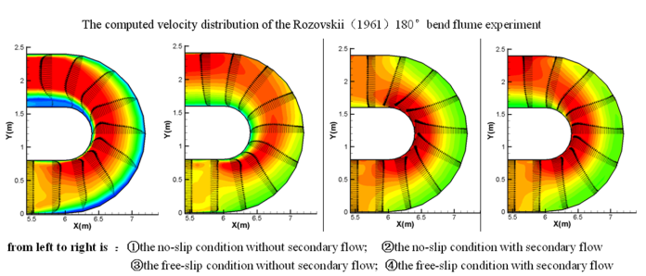
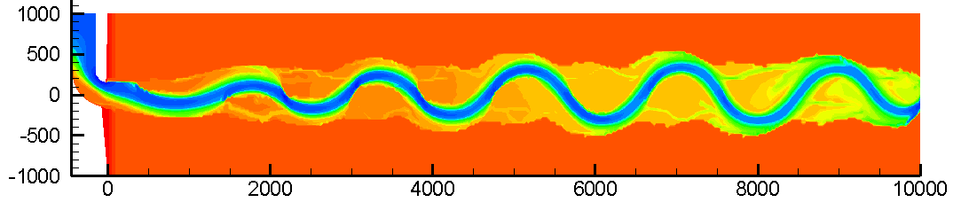
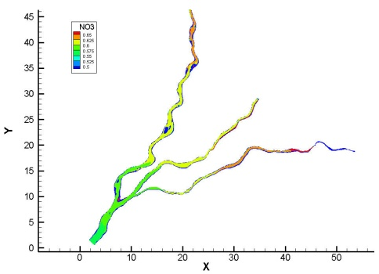
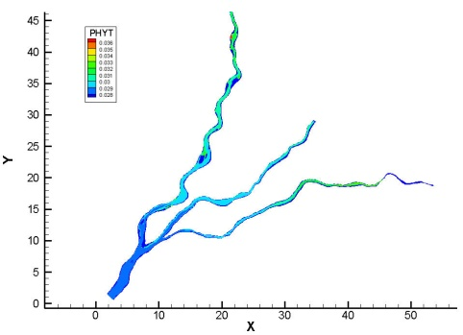
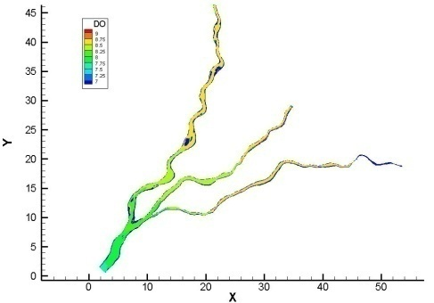
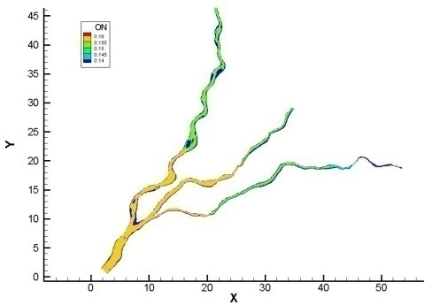
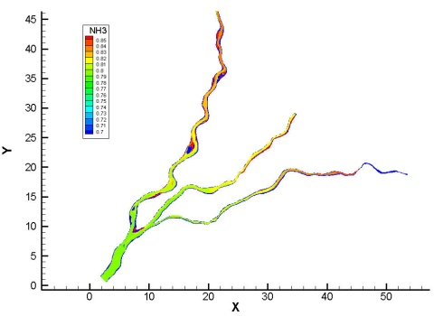
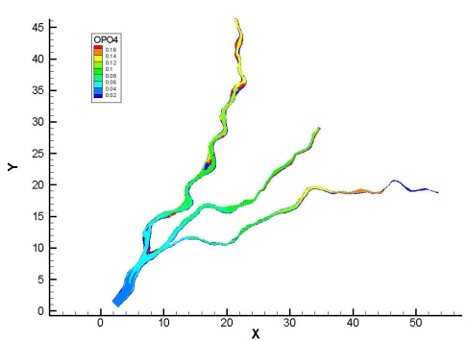
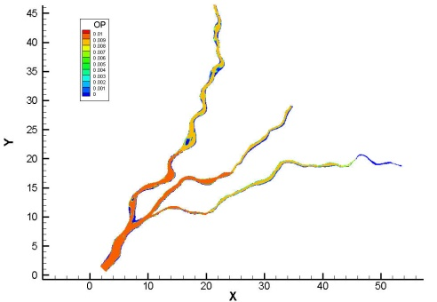
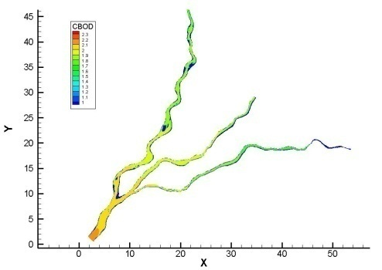
2.Water environmental model
Abstract
WESC2D (2D Water Environmental Simulation Code)
Orthogonal Curvilinear Coordinate System, 2D multifunctional surface water modeling system
ELADI-FDM，High efficiency、Robust，even permit a Courant number of 40。(fortran90)
Hydrodynamics：Unsteady Flow Simulation taking into account secondary flow
Sediment：non uniform suspend and bed load sediment transport, bank erosion and meander migration, channel pattern changes
Water quality：Simulation of NH3、NO3、OPO4、PHYT、CBOD、DO、ON、OP and COD based on WASP5

Slide 6
2.Water environmental model
Hydrodynamic
Governing equations
Continuity
equation
ξ momentum equation
η momentum equation
dispersion stress terms
dispersion stress terms

Slide 7
2.Water environmental model
Hydrodynamic
Modified model
ELADI（Eulerian-Lagrangian alternating direction implicit method）finite difference method by the alternating direction implicit method (ADI) combined with the Eulerian-Lagrangian Method (ELM) for the two dimensional shallow water equations in orthogonal curvilinear coordinate system.
ξ momentum equation
substantial derivative
ξ momentum equation

Slide 8
2.Water environmental model
Hydrodynamic
Discretization
To an example, Form n to n+1/2, discretization method of $ξ$ momentum equation in (i+1/2,j) is
To an example, Form n to n+1/2, discretization method of 𝜉 momentum equation in (i+1/2,j) is

Slide 9
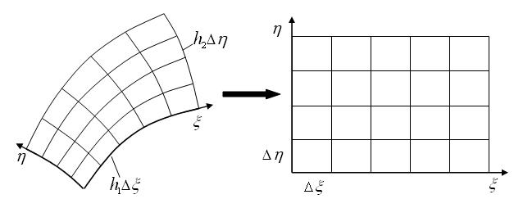
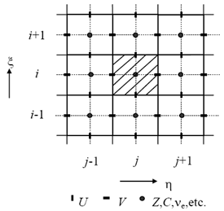
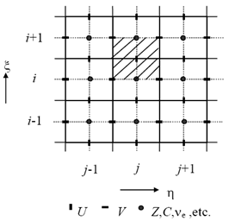
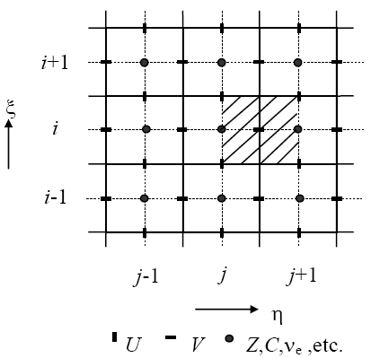
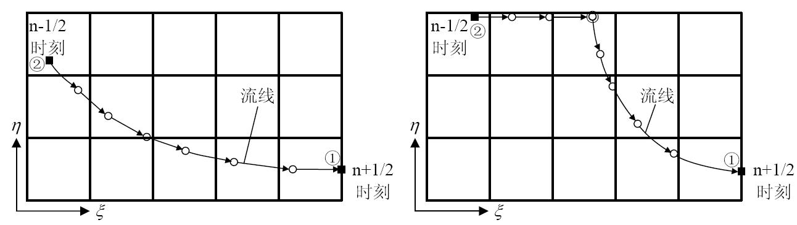
2.Water environmental model
Hydrodynamic
(a)Orthogonal curvilinear coordinates
(b)Computing coordinates
(a) Main control unit (b) U control unit (c) V control unit
Coordinate transformation
The staggered grid system
(a) general (b) special
Backwards tracking along the streamline in Eulerian-Lagrangian mesh

Slide 10
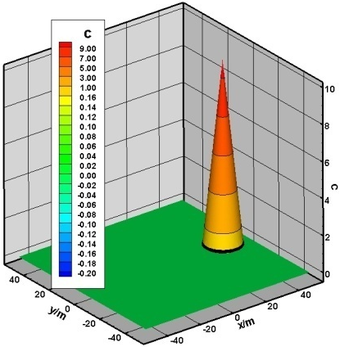

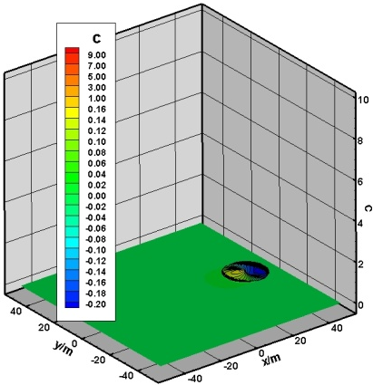
2.Water environmental model
Hydrodynamic
Model test
Conical scalar field is passed in a rotating flow field
Computed result
Num. | Grid length/m | Time step /s | Steps/ n | Initial maximum concentration | Computed max concentration | error/%
1 | 0.5 | 2π/4 | 1000 | 10 | 8.178510099 | 18.21489901
2 | 1 | 2π/4 | 1000 | 10 | 8.178107331 | 18.21892669
3 | 2 | 2π/4 | 1000 | 10 | 8.178757175 | 18.21242825
4 | 0.5 | 2π/4 | 10000 | 10 | 9.821803919 | 1.781960807
5 | 1 | 2π/4 | 10000 | 10 | 9.821792820 | 1.782071799
6 | 2 | 2π/4 | 10000 | 10 | 9.821786753 | 1.782132466
7 | 0.5 | 2π | 4000 | 10 | 8.178544840 | 18.21455160
8 | 1 | 2π | 4000 | 10 | 8.178133336 | 18.21866664
9 | 2 | 2π | 4000 | 10 | 8.178009993 | 18.21990007
10 | 0.5 | 2π | 40000 | 10 | 9.821804106 | 1.781958937
11 | 1 | 2π | 40000 | 10 | 9.821792865 | 1.782071350
12 | 2 | 2π | 40000 | 10 | 9.821786755 | 1.782132453
（a）精确解 （b）数值解 （c）计算误差
第10组数值解与精确解的比较

Slide 11
2.Water environmental model
Hydrodynamic
Model Validation
Rozovskii(1961) 180° bend flume

Slide 12
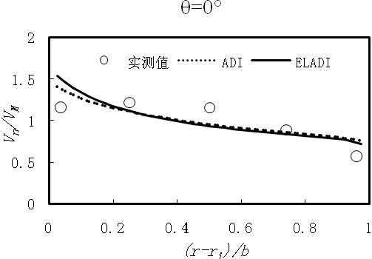
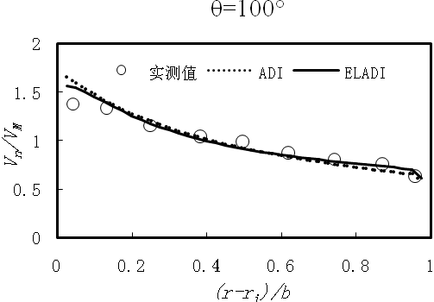
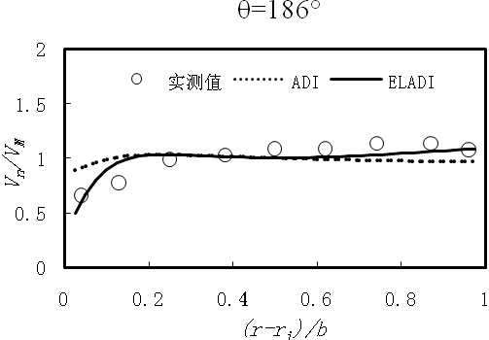

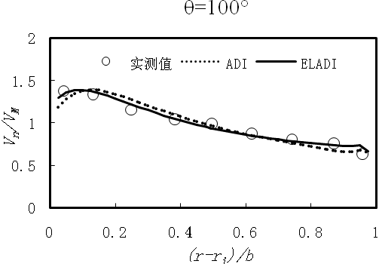
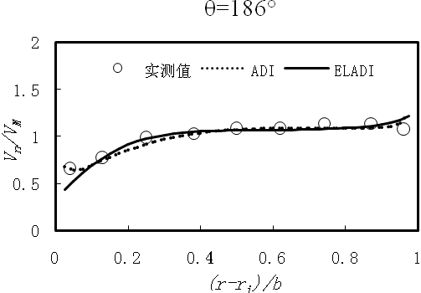
2.Water environmental model
Hydrodynamic
Model Validation
Rozovskii(1961) 180° bend flume
Comparisons between the simulated results with 2 different methods and measured data without secondary flow
Comparisons between the simulated results with 2 different methods and measured data with secondary flow
模型名 | /m | /m | 长宽比 | /m | 平均水深/m | /s | Courant Num. | Cpu耗时/s (Debug) | Cpu耗时/s (Release)
ADI | 59.0480 | 13.4807 | 4.3802 | 28.2136 | 6.9621 | 2.00 | 1.1711 | 857.1460 | 151.3906
ELADI |  |  |  |  |  | 70.00 | 40.9876 | 100.3594 | 15.1875
Comparisons on computational efficiency between two different methods

Slide 13
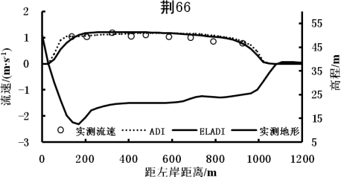
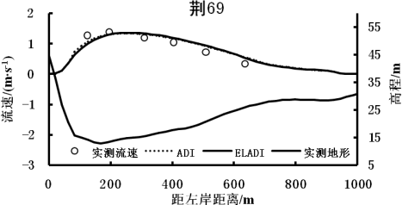
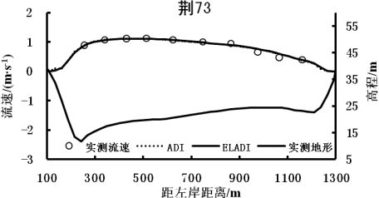
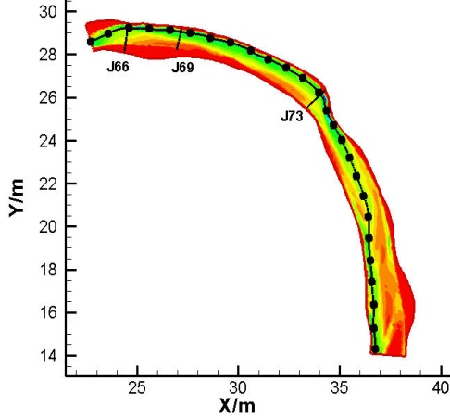
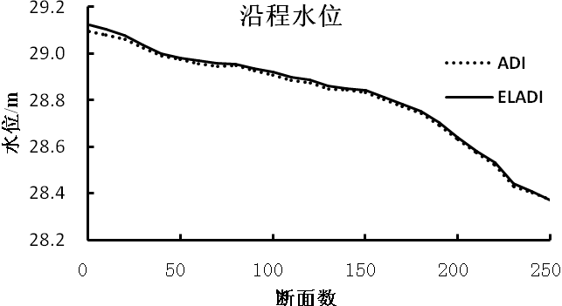

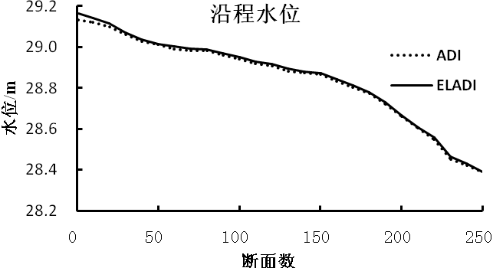
2.Water environmental model
Hydrodynamic
Model Validation
Haoxue bend
Comparisons on velocity of the various cross-sections between two different methods
Channel pattern in Haoxue bend
Comparisons on water surface profile between two different methods
Comparisons on computational efficiency between two different methods
模型名 | /m | /m | 长宽比 | /m | 平均水深/m | /s | Courant Num. | Cpu耗时/s (Debug) | Cpu耗时/s (Release)
ADI | 59.0480 | 13.4807 | 4.3802 | 28.2136 | 6.9621 | 2.00 | 1.1711 | 857.1460 | 151.3906
ELADI |  |  |  |  |  | 70.00 | 40.9876 | 100.3594 | 15.1875

Slide 14
2.Water environmental model
Sediment
Governing equations
Suspended Sediment transport
bed load Sediment transport
bed deformation

Slide 15
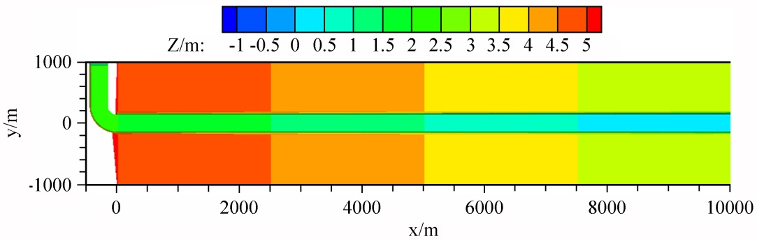
2.Water environmental model
Sediment
Channel pattern changes
Simulated channel pattern changes in a conceptual alluvial channel
A total of 10 runs
Parameters for flow and bank conditions |  |  | Run No.
Q=300m³/s, S=0.0kg/m³ C_{l}=0.011, D_{bk}=0.1mm |  | J=0.0001 | 1
 |  | J=0.0002 | 2
 |  | J=0.0004 | 3
Q=300m³/s, J=0.0002 C_{l}=0.011, D_{bk}=0.1mm |  | S=0.3kg/m³ | 4
 |  | S=1.0kg/m³ | 5
 |  | S=3.0kg/m³ | 6
S=0.0kg/m³, J=0.0002 C_{l}=0.011, D_{bk}=0.1mm |  | Q=300m³/s | (2)
 |  | Q=500m³/s | 7
 |  | Q=700m³/s | 8
Q=300m³/s S=0.0kg/m³ | J=0.0004 D_{bk}=0.1mm | Soft | (3)
 |  | hard | 9
 | J=0.0002 C_{l}=0.011 | D_{bk}=0.1mm | (2)
 |  | D_{bk}=0.2mm | 10
Parameters
(remain constant
unless otherwise
specified)

Slide 16
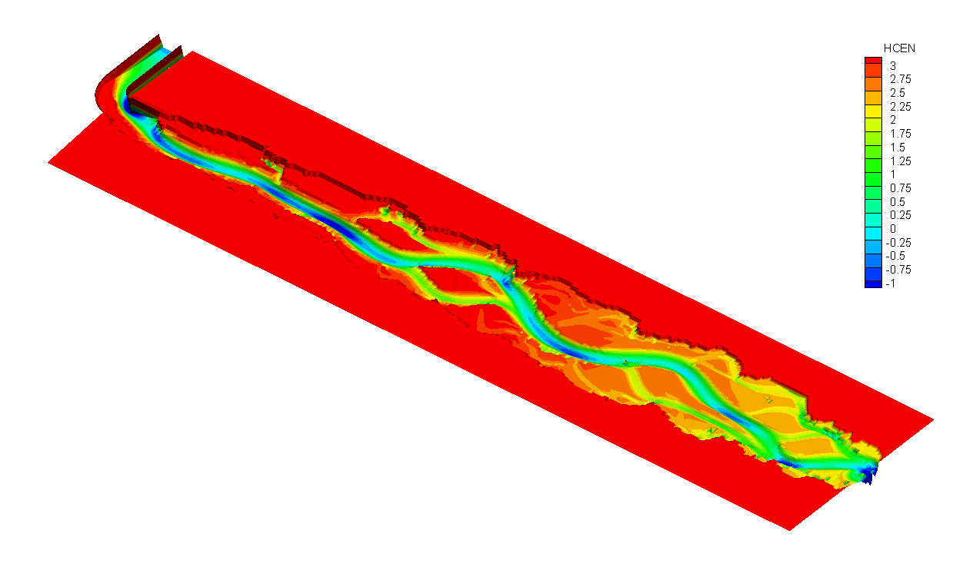
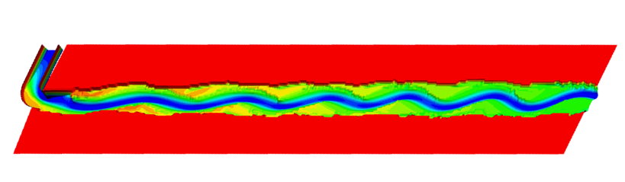
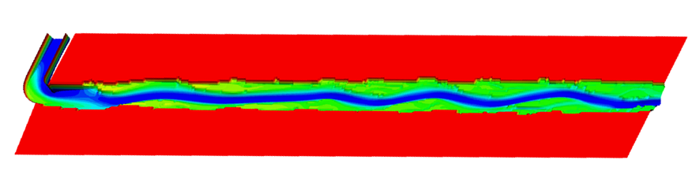
2.Water environmental model
Island braided
(stable)
Initial channel bottom slope
J=0.0004
(Run 3)
J=0.0002
(Run 2)
Q=300m³/s
Downstream deph=1.0m
Inlet S=0.0kg/cm³
Straight
J=0.0001(Run 1)

Slide 17
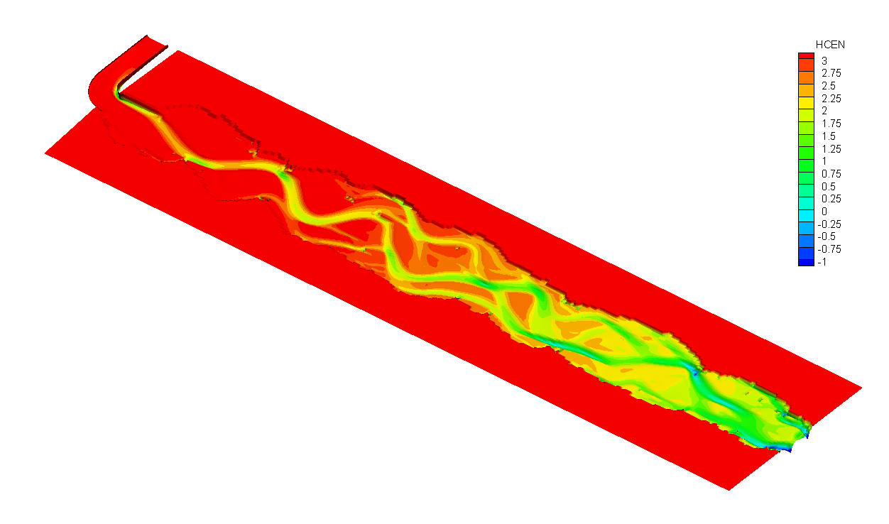
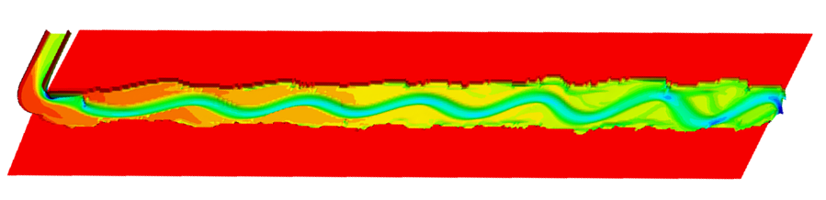
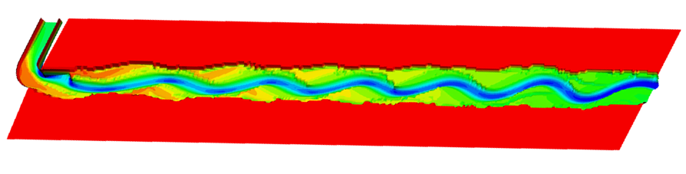
2.Water environmental model
Braided
(unstable)
Sediment supply at inlet
S=3.0kg/m³
(Run 6)
Q=300m³/s
Downstream deph=1.0m
J=0.0002
S=1.0kg/m³
(Run 5)
Meander
S=0.3kg/m³ (Run 4)

Slide 18
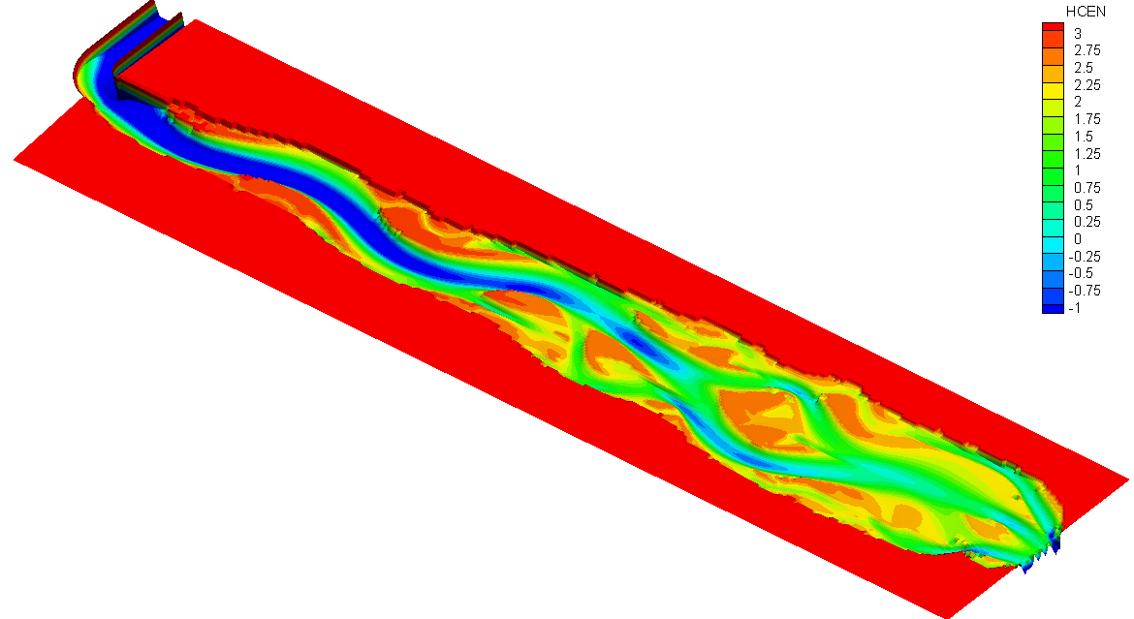
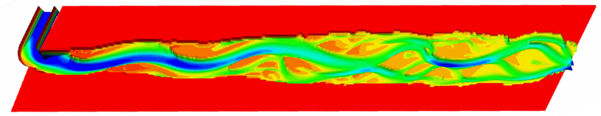
2.Water environmental model
Island braided
(stable)
Water discharge at inlet
Q=700m³/s
(Run 8)
Q=500m³/s
(Run 7)
Downstream deph=1.0m
J=0.0002
Inlet S=0.0kg/cm³
Meander
Q=300m³/s (Run 2)

Slide 19
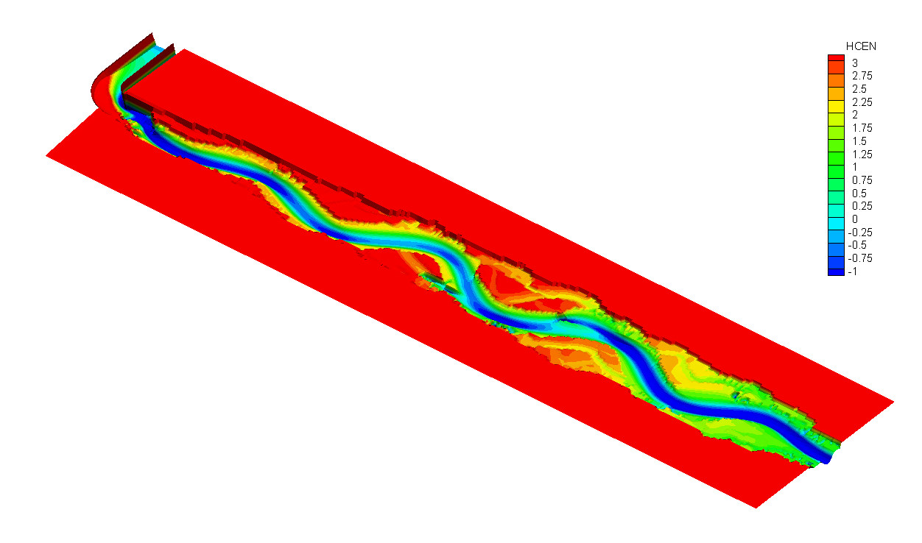
2.Water environmental model
Q=300m³/s
Downstream deph=1.0m
J=0.0004
Inlet S=0.0kg/cm³
Bank is not easily failed
(less sediment entering flow)
Bank is easily failed
(more sediment entering flow)
C_{l}=0.005
C_{l}=0.011
(Run9)
(Run3)
Thalweg meander
Island braided

Slide 20
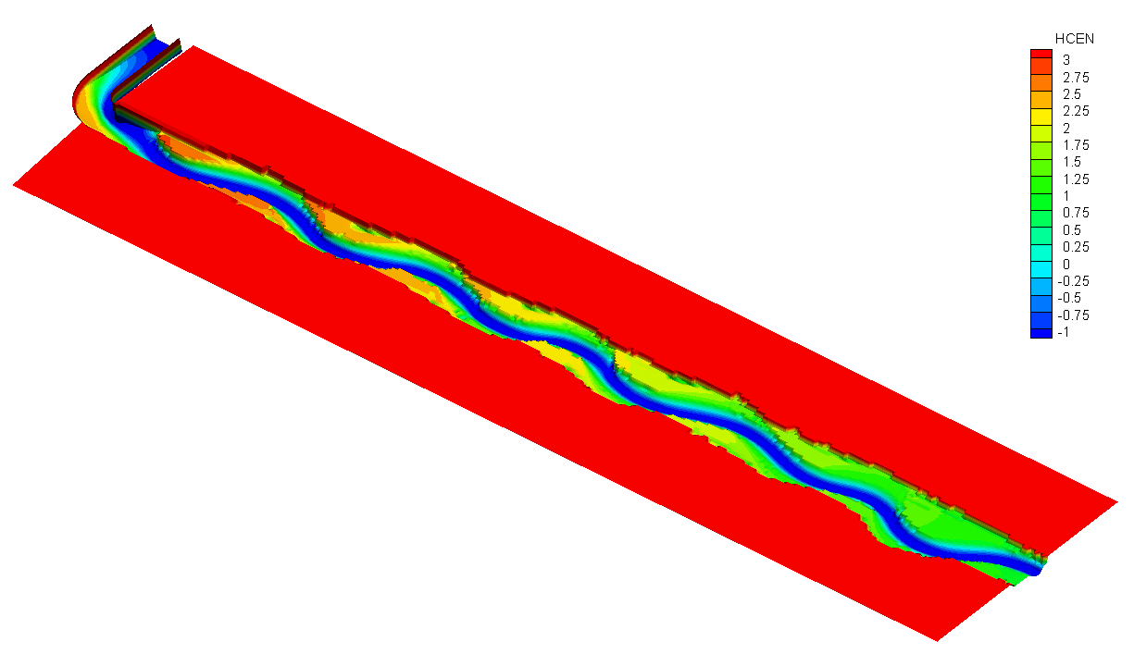
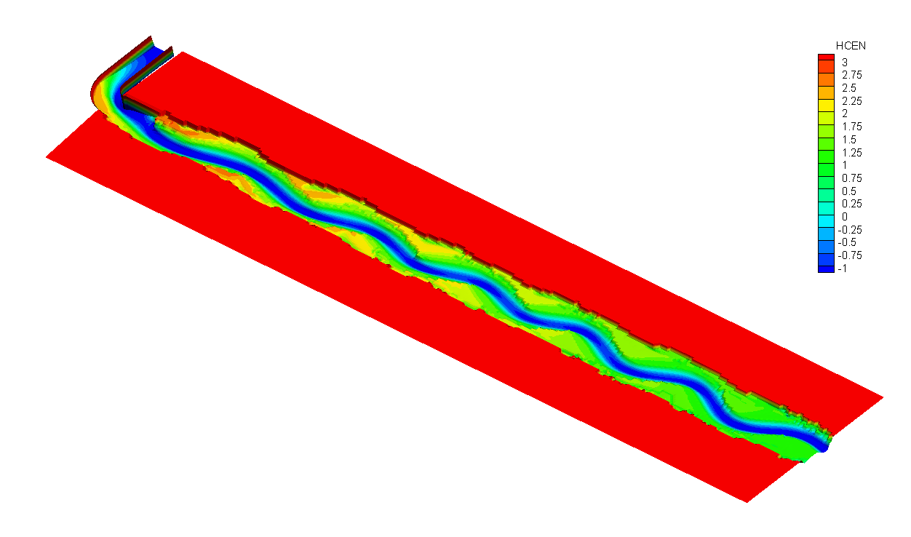
2.Water environmental model
Q=300m³/s
Downstream deph=1.0m
J=0.0002
Inlet S=0.0kg/cm³
Bank material is coarse
Bank material is finer
D_{bk}=0.2mm
D_{bk}=0.1mm
(Run 10)
(Run 2)
(图5.23)
(同图5.7b)
Meander
Meander

Slide 21
2.Water environmental model
Simulated channel patterns in the conceptual alluvial channel
The calculated channel
geometry (such as B^{1/2}/H)
agrees well with observed
data on medium sized
rivers (e.g., the Hanjiang
River, a major tributary of
the Middle Yangtze River).

Slide 22
2.Water environmental model
Water quality
Governing equations
Mass balance equation
Total kinetic transformation rate
Diffusion coefficients

Slide 23
2.Water environmental model
Water quality
Systems and Levels of Complexity
Module Name | System No. | Symbel | Name | Level of Complexity
 |  |  |  | 1 | 2 | 3 | 4 | 5 | 6
EUTRO | 1 | NH3 | Ammonia nitrogen |  | × | × | × | × | ×
 | 2 | NO3 | Nitrate nitrogen |  |  | × | × | × | ×
 | 3 | PO4 | Inorganic phosphorus |  |  |  | × | × | ×
 | 4 | CHL | Phytoplankton carbon |  |  |  | × | × | ×
 | 5 | CBOD | Carbonaceous BOD | × | × | × | × | × | ×
 | 6 | DO | Dissolved Oxygen | × | × | × | × | × | ×
 | 7 | ON | Organic nitrogen |  |  | × | × | × | ×
 | 8 | OP | Organic phosphorus |  |  |  | × | × | ×
TOXI | 9 | COD | Chemical Oxygen demand | × | × | × | × | × | ×
Level | Explanation
1 | “Streeter-Phelps” BOD-DO with SOD
2 | “ Modified Streeter-Phelps” with NBOD
3 | Linear DO balance with nitrification
4 | Simple eutrophication
5 | Intermediate eutrophication
6 | Intermedate eutrophication with benthos

Slide 24
2.Model application in Lower Gan River

Slide 25
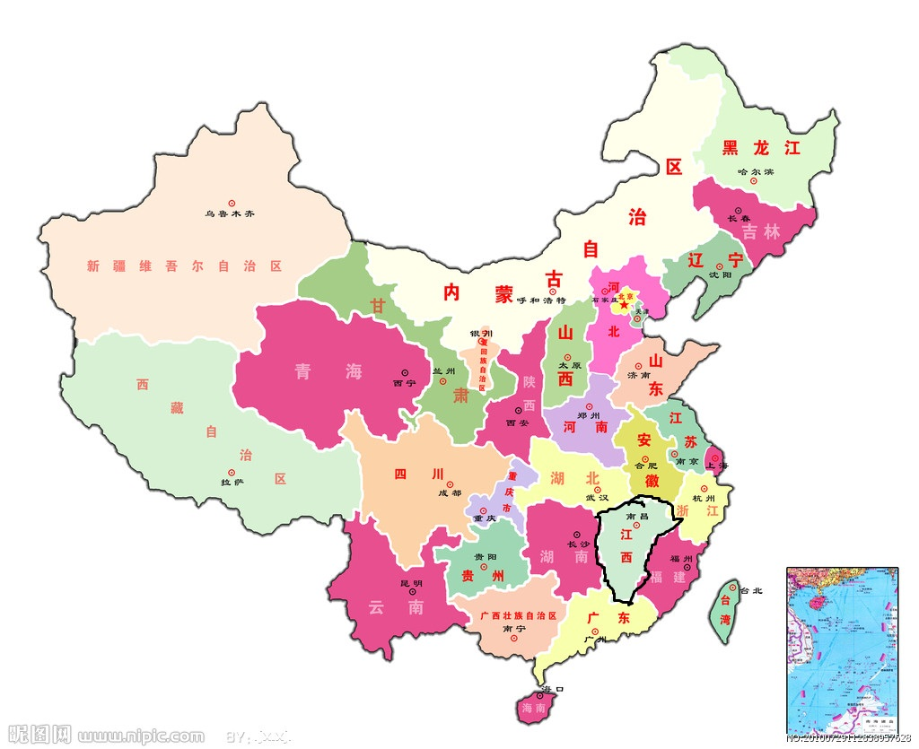
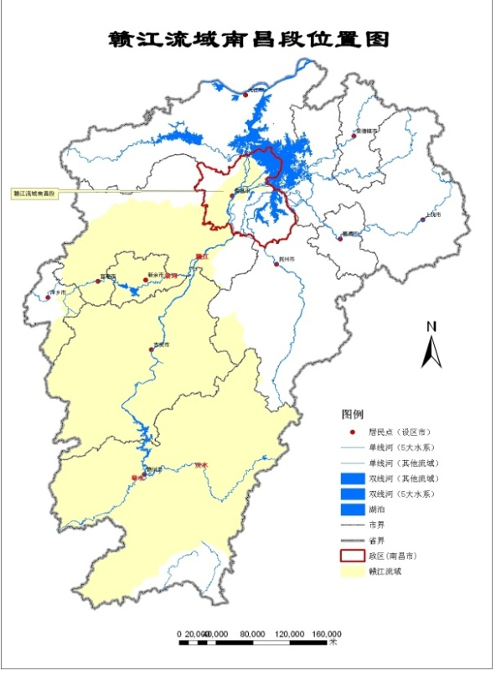
2.Model application in Lower Gan River
Overview
The biggest river in Jiangxi Province, instable runoff flow , large inter-annual changes, annual distribution is extremely uneven, less sand

Slide 26
2.Model application in Lower Gan River
Study area
Yangtze
Rvier
Poyang Lake
Lower Gan River（168km）

Slide 27
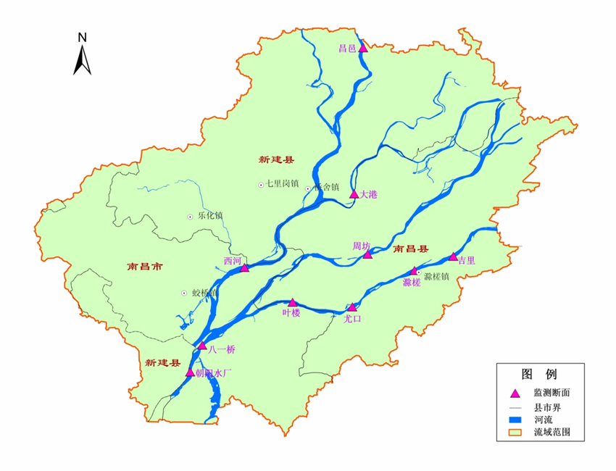
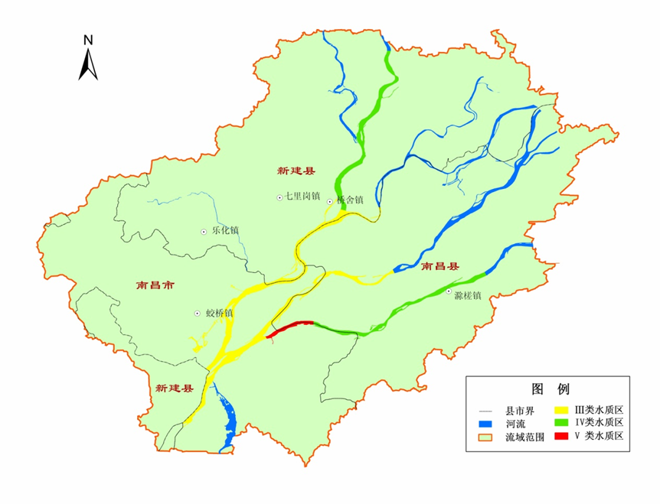
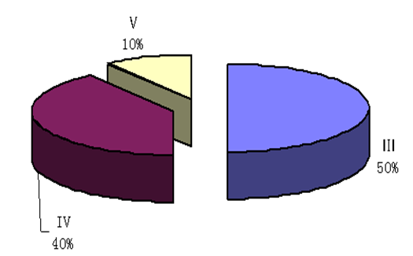
2.Model application in Lower Gan River
Water quality in 2009
11 monitoring sections ,14 Monitoring sites;
slightly polluted overall, 70% sections achieve water quality standards
Water quality of dry season is worse than wet season and common water seanson

Slide 28
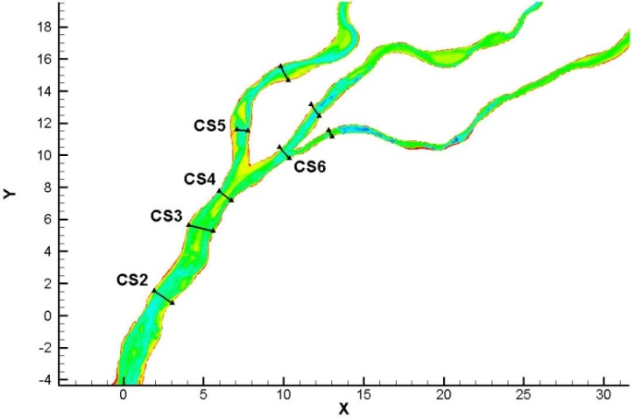
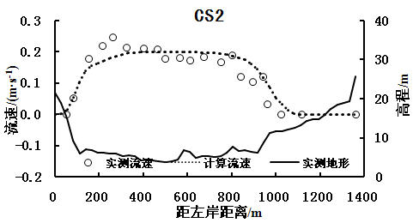
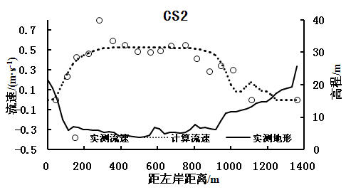
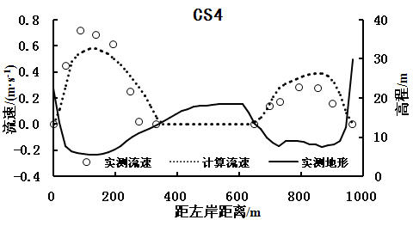
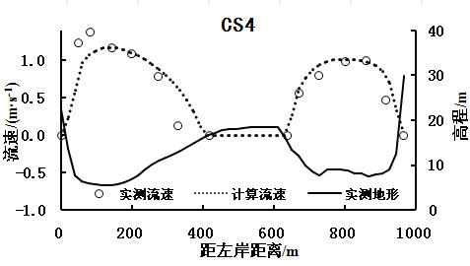


裘家洲
Validation area
18km in length
△t=120s;N=4
Gird num.=112×50
Hydrodynamics simulation
Steady flow validation
Water level comparison
水尺或断面 | Q=1250m³/s
 | measured | computed
外洲水尺（CS2） | 13.56 | 13.571
疏浚处（CS3） | 13.53 | 13.535
西河（CS4） | 13.48 | 13.479
英雄大桥下（CS5） | 13.45 | 13.438
集装箱码头水尺 | 13.43 | 13.430
东河（CS4） | 13.48 | 13.509
洪都大桥下（CS6） | 13.43 | 13.420
水尺或断面 | Q=4600m³/s
 | measured | computed
外洲水尺（CS2） | 16.16 | 16.193
疏浚处（CS3） | 16.10 | 16.123
西河（CS4） | 16.06 | 16.039
英雄大桥下（CS5） | 15.95 | 15.952
集装箱码头水尺 | 15.90 | 15.900
东河（CS4） | 15.86 | 15.814
洪都大桥下（CS6） | 15.75 | 15.750
Q=1250m³/s
Q=4600m³/s
Measured and calculated Dong-Xi diversion ratios
 | Q=4600m³/s |  | Q=1250m³/s
 | Xi river | Dong river | Xi river | Dong river
Measured | 62.80% | 37.20% | 77.60% | 22.40%
Computed | 61.20% | 38.80% | 71.03% | 28.97%
error | 1.60% | -1.60% | 6.57% | -6.57%

Slide 29
Hydrodynamics simulation
Unsteady flow validation
Validation area
60km in length
△t=120s;N=4
Gird num.=440×50

Slide 30
2.Model application in Lower Gan River
Water quality validation
Main pollution constituents are NH3-N, BOD, DO, COD; Modified S-P model was used
10 sewage outfalls, including 5 industrial enterprises, 4 gates and 1 sewage treatment plant (2007)
Reaeration
NBOD：
NO₃
CO₂
NBOD¹
DO
CBOD
CBOD：
Nitrogenous
Deoxygenation
Carbonaceous
Deoxygenation
DO：
Settling
Settling
Sediment Oxygen
Demand
1 use NH3
Modified Streeter-Phelps state variable interactions.

Slide 31

2.Model application in Lower Gan River
Water quality validation
Notation | Description | Value | Units
$$k_{d}$$ | 20℃ Deoxygenation rate | 0.16 | day⁻¹
$$Θ_{d}$$ | 20℃ Temp. coeff. | 1.047 | -
SOD | Sediment Oxygen Demand | - | g/m²-day
$$Θ_{S}$$ | Temp. coeff. | 1.08 | -
$$k_{2}$$ | 20℃ Reaeration rate | 0.1 | day⁻¹
$$Θ_{2}$$ | Temp. coeff. | 1.028 | -
$$C_{s}$$ | DO saturation | equation（5-4） | mgO₂/L
$$f_{D5}$$ | Fraction dissolved CBOD | 0.5 | -
$$v_{s3}$$ | Organic matter settling velocity | - | m/day
$$f_{D3}$$ | Fraction dissolved NBOD | 0.5 | -
$${ k}_{n}$$ | 20℃ Nitrification rate | 0.05 | day⁻¹
$$Θ_{n}$$ | Temp. coeff. | 1.08 | -
$$k_{COD}$$ | COD degradation coefficients | 0.1 | day⁻¹
$$k_{l}$$ | Diffusion coefficient in the Longitudinal direction | 13.0 | -
$$k_{t}$$ | Diffusion coefficient in the lateral direction | 1.0 | -
CBOD and DO Reaction Terms

Slide 32








朝阳
八一桥南

Slide 33







叶楼南
尤口南

Slide 34
3.Total wasteload allocation

Slide 35

3.Total wasteload allocation
Allocation method

Slide 36



3.Total wasteload allocation
Water quality objective constraint
1、Bayidaqiao section（G1）$≤$ Grade III standard，outall① outside mixed area$≤$ Grade III standard
2、Xihe section（G2）$≤$ Grade III standard ，outfall②③ outside mixed area $≤$ Grade IV standard
3、 Interface between function zone188 and189$≤$Grade II standard
4、Outfall④~⑩outside mixed area$≤$Grade IV standard，Yelou section（G4），Youkou section（G5）$≤$Grade IV standard
5、Chucha section（G6）$≤$ Grade III类 standard
江西省水环境功能区划示意图
Water environmental function zone
Mixed area 400m-600m in length，60m-200m in width

Slide 37

3.Total wasteload allocation
Middle tributary
Design conditions
Xi River
South tributary
For steady-state modeling
Waizhou
Waizhou station:30B3=347.9m³/s，30Q10=290.9m³/s
Xi River:30B3=45.0m³/s， 30Q10=131.8m³/s
Middle tributary:30B3=13.6m³/s， 30Q10=3.5m³/s
South tributary: 30B3=1.0m³/s， 30Q10=0.9m³/s
In general, Node balance method：W$aizhou=$Xi River+Middle tributary+South tributary
But, Xi River+Middle tributary+South tributary<<Waizhou, in this case, water environment capacity of south tributary is difficult to calculate. So, hydrological process of ten successive years were used。

Slide 38











3.Total wasteload allocation
Capacity calculation method（optimization）
Linear optimization
Objective
function：
$$max\sum_{j=1}^{m}{X_{j }}$$
Constraint
equation ：
$$\sum_{j=1}^{m}{a_{ij}}X_{j}≤C_{i}, i=1,2,…,N，X_{j}≥0$$
Objective
function：
$$f\left(X\right)=max\sum_{j=1}^{m}{X_{j}}$$
Constraint
equation ：
$${St}_{k}=\sum_{j=1}^{m}{a_{kj}}X_{j}, k=1,2,…,d$$
$$X_{j}≥0$$
Upper limit and lower limit
of decision variables
$${ASt}_{l+29}=avg\left(\sum_{k=l}^{l+29}{{St}_{kj}}\right), l=1,2,…, d−29$$
$$X_{jmin}≤{ X}_{j}≤{ X}_{jmax}$$
Nonlinear constraint optimization problems(Objective function is linear, constraint equation is nonlinear)
Similar to 30B3 for unsteady flow(10 years):30-day averaging periods and a frequency of once every three years on the average
$${No}_{l}=\left\{\begin{aligned}0, {ASt}_{l}≤C_{i}, l=30,31,…, d,i=1,2,…,s \\ 1, {ASt}_{l}>C_{i}, l=30,31,…, d,i=1,2,…,s \\ 0, l=1,2,…, 29.or.l=d+1,d+2,…,d+29\end{aligned}\right.$$
$${SNo}_{l}=\sum_{k=l}^{l+29}{{No}_{l}}, l=1,2,…,d$$
$${DNo}_{l}=\left\{\begin{aligned}0, {SNo}_{l}<1 , l=1,2,…,d \\ 1, {SNo}_{l}≥1, l=1,2,…,d \end{aligned}\right.$$
$$G_{i}=\sum_{l=1}^{d}{{DNo}_{l}}≤允许破坏段数，i=1,2,…,n$$

Slide 39
3.Total wasteload allocation
Maximum allowable discharge calculation
Maximum allowable discharge of COD_{Cr}、NH₃-N
Serial number | Function zone No. | Outfall name | Maximum allowable discharge
 |  |  | COD_{Cr} |  | NH₃-N
 |  |  | kg/d | t/a | kg/d | t/a
1 | 184 | 新洲闸 | 14243.0 | 5198.7 | 800.7 | 292.3
2 | 187 | 六孔闸 | 24363.5 | 8892.7 | 1428.3 | 521.3
3 | 187 | 江西晨鸣纸业有限责任公司 | 60888.4 | 22224.3 | 3852.0 | 1406.0
4 | 193 | 青山闸 | 1139.0 | 415.7 | 21.6 | 7.9
5 | 193 | 江西华源江纺有限公司 | 900.1 | 328.5 | 51.7 | 18.9
6 | 193 | 南昌宏狄氯碱有限公司 | 14447.0 | 5273.2 | 605.2 | 220.9
7 | 193 | 南昌青山湖污水处理厂 | 15818.6 | 5773.8 | 597.7 | 218.2
8 | 193 | 鱼尾闸 | 1081.9 | 394.9 | 33.8 | 12.3
9 | 193 | 南昌长力钢铁股份有限公司 | 7981.5 | 2913.2 | 414.1 | 151.1
10 | 193 | 昌九生物化工江氨分公司 | 3988.4 | 1455.8 | 103.7 | 37.9
合计 |  |  | 144851.5 | 52870.8 | 7908.9 | 2886.7

Slide 40



3.Total wasteload allocation
Reasonable evaluation index
$$TCRI=\sum{α_{k}I_{k}}$$
$α_{k}$,Weight coefficient，$\sum{α_{k}}=1$；$I_{k}$,Individual index(0-1)，
Max load ：
$f_{1}\left(X\right)=max\left(α_{1}I_{1}\right)，α_{1}=1$
Max TCRI：
$$f_{2}\left(X\right)=\max\left(\sum{α_{k}I_{k}}\right)，k=2,∙∙∙,6$$
Multiple objective function is transformed into a single objective function：
$f\left(X\right)={ωf}_{1}\left(X\right)+\left(1−ω\right)f_{2}\left(X\right)$
Temporarily$,ω=0.5$

Slide 41
3.Total wasteload allocation
Final load allocation
排污口序号 |  | 1 | 2 | 3 | 4 | 5 | 6 | 7 | 8 | 9 | 10 | 合计
排污口名称 |  | 新洲闸 | 六孔闸 | 晨鸣纸业 | 青山闸 | 华源江纺 | 宏狄氯碱 | 青山湖污水厂 | 鱼尾闸 | 长力钢铁 | 江氨分公司
人口（人） |  | 572500 | 300000 | 3645 | 953431 | 8000 | 600 | 300000 | 150000 | 131000 | 203300 | 2622476
GDP（万元） |  | 810000 | 1012000 | 7821.3 | 2259632 | 57672.2 | 8000 | 1000000 | 500000 | 1781097 | 76428.4 | 7512650.9
现状排放COD（kg/d） |  | 3778.7 | 2237.1 | 2817.5 | 32348.2 | 145.1 | 22.7 | 13577.8 | 949.9 | 933.8 | 6168.7 | 110465.8
最大允许排放量（kg/d） |  | 14243 | 24363.5 | 60888.4 | 1139 | 900.1 | 14447 | 15818.6 | 1081.9 | 7981.5 | 3988.4 | 144851.4
最大允许排放量（t/a） |  | 5198.7 | 8892.7 | 22224.3 | 415.7 | 328.5 | 5273.2 | 5773.8 | 394.9 | 2913.2 | 1455.8 | 52870.8
Final solution | 分配负荷份额（kg/d） | 14243.0 | 24364.1 | 60888.2 | 1235.0 | 767.6 | 14461.4 | 15812.5 | 949.9 | 4477.1 | 4935.0 | 142133.7
 | 分配负荷份额（t/a） | 5198.7 | 8892.9 | 22224.2 | 450.8 | 280.2 | 5278.4 | 5771.6 | 346.7 | 1634.1 | 1801.3 | 51878.8
现状排放NH₃-N（kg/d） |  | 379.3 | 455.9 | 282.2 | 5748.2 | 2 | 7.1 | 3703.2 | 45.9 | 155.1 | 2313.8 | 13092.7
最大允许排放量（kg/d） |  | 800.7 | 1428.3 | 3852 | 21.6 | 51.7 | 605.2 | 597.7 | 33.8 | 414.1 | 103.7 | 7908.8
最大允许排放量（t/a） |  | 292.3 | 521.3 | 1406.0 | 7.9 | 18.9 | 220.9 | 218.2 | 12.3 | 151.1 | 37.9 | 2886.7
Final solution | 分配负荷份额（kg/d） | 800.0 | 1428.6 | 3851.4 | 74.7 | 2.0 | 7.1 | 704.3 | 45.9 | 155.1 | 148.0 | 7217.1
 | 分配负荷份额（t/a） | 292.0 | 521.4 | 1405.8 | 27.3 | 0.7 | 2.6 | 257.1 | 16.8 | 56.6 | 54.0 | 2634.2

Slide 42
4.Summary

Slide 43
4.Summary
Water environment model, as an important tool, is very useful for interpreting and predicting water quality responses to natural phenomena and manmade pollution for various pollution management decisions. However, these models still need improvements to compute efficiently and accurately
Total pollutant load allocation, as an advanced basin water environment management practices , can reduce discharge load and protect the ecological function of the watershed. And it is more suitable for chinese situation

Slide 44

Thank You !

