Slide 1
Update:
2013 Communications Planning
Comm. Workgroup meeting
November 8, 2012
Margaret Enloe (Alliance for the Bay)
Director, CBP Communications & Coordinator, Comm. Wkgp.

Slide 2
Purpose of Presentation
Update: MB Decisions (Oct.14)
2013 CBP Communications strategy
Continued efforts
Report on the Bay
Notes:
3 decisions by MB relating to communications
2013 strategy to meet our goals:
foster better internal communications and understanding thereof
further public awareness and action through engaging, accurate storytelling & news
Things we’ll do to meet these goals

Slide 3
Update: MB Decisions – Oct 14 mtg
Decision: Agreed - CBP decide on the embargo of data on a case-by-case basis.
  In general, data will not be embargoed unless leadership and the communications team decide there is a good reason to do so. If there is an embargo, no information will be shared either publicly or on the website until the embargo ends.
Decision: Agreed - CBP Comm Office—with STAR support as needed—should continue to communicate relevant stories and information on topics of interest to the public.

Slide 4
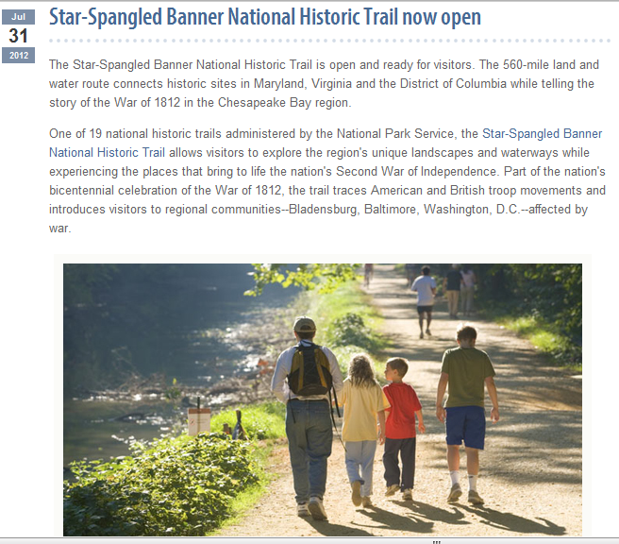
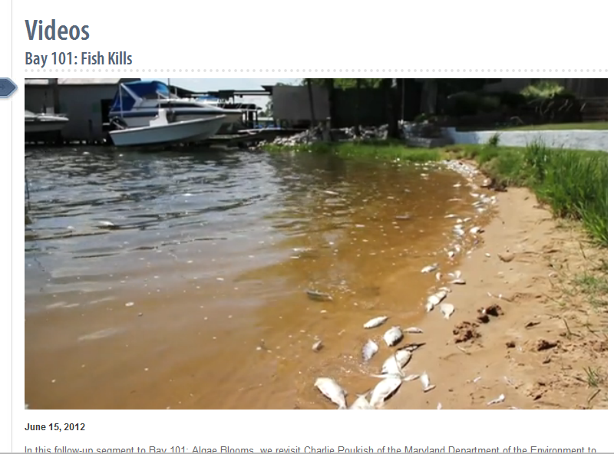
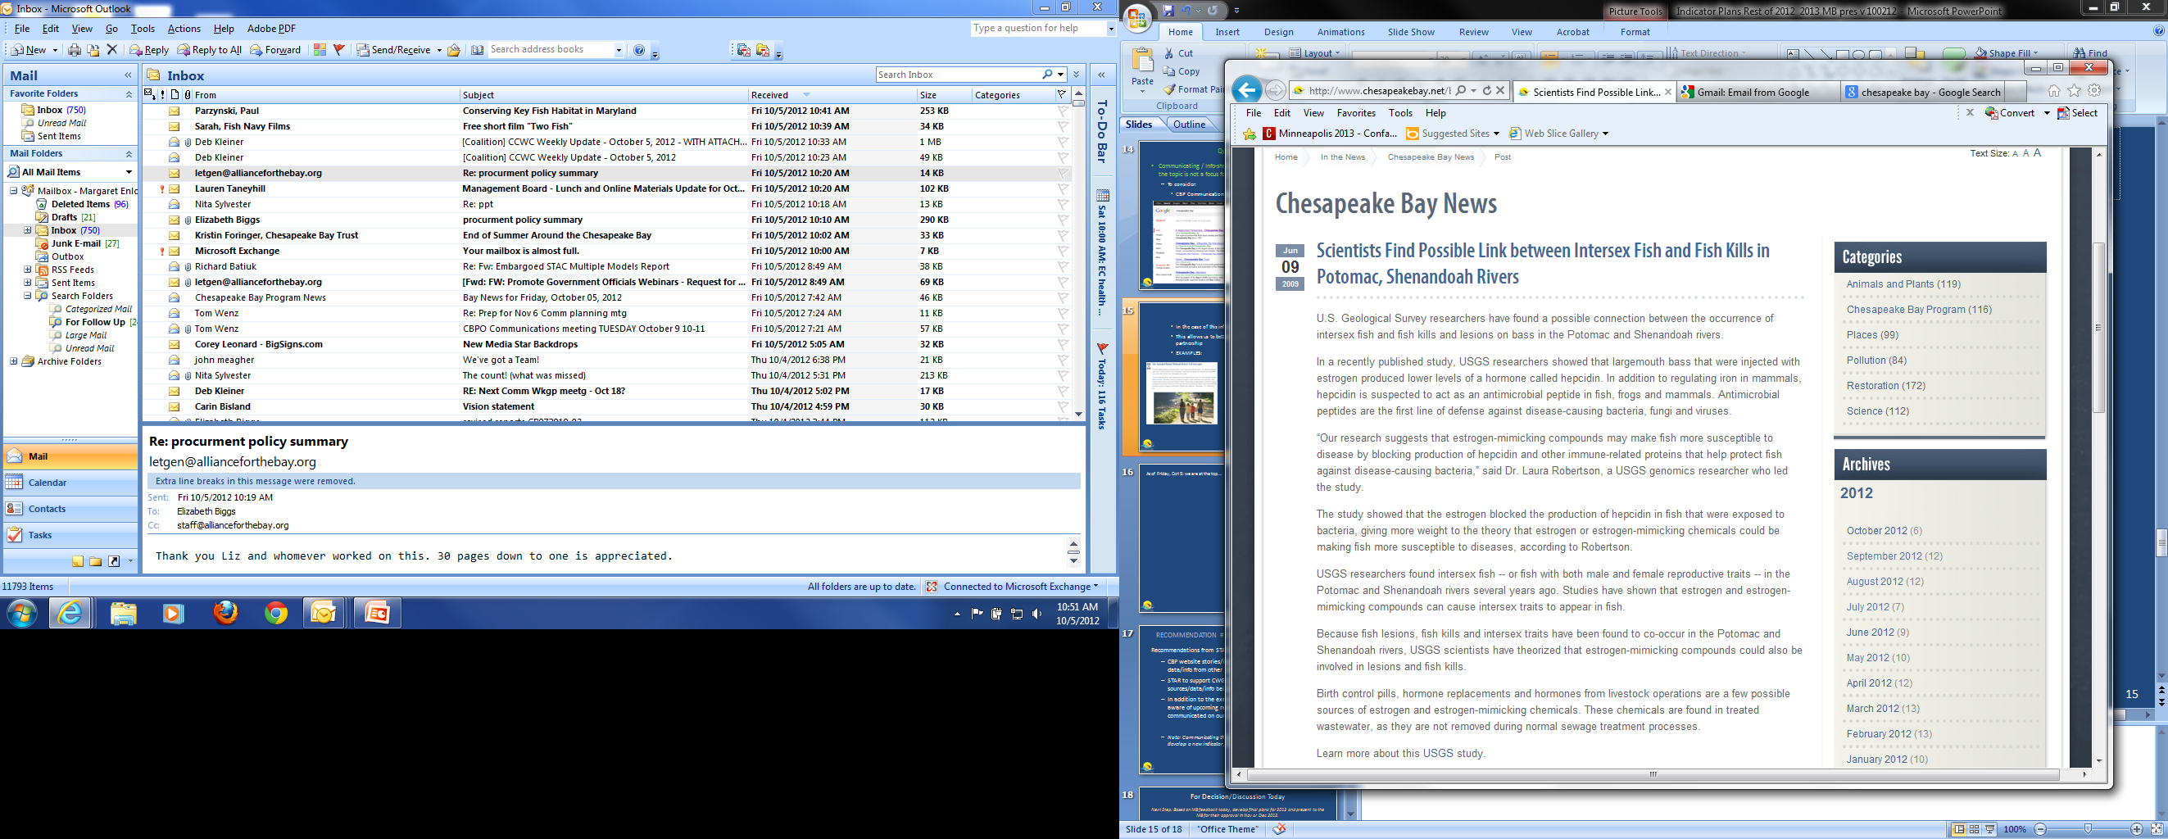
  About stories that are not based on CBP indicators.
    They allow us to better leverage & cross-promote news across the partnership
    In the case of this info, we are the conduit only
    Sometimes, it gives us a publicly relevant opportunity to make further use of our existing products.
Learn more about this USGS study
Notes:
Fish Kill video: 2,500 views

Slide 5
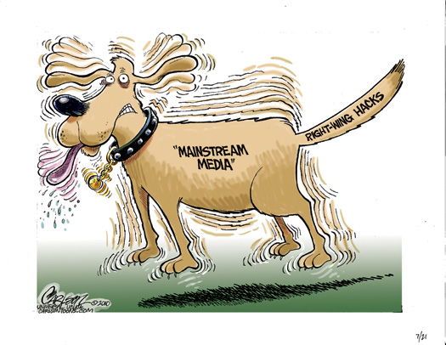
Update: MB Decisions – Oct 14 mtg
Decision: Agreed - CBP Comm Office should develop a more proactive plan for communicating stories in 2013.
  Story releases will not wait on indicator data not submitted in a timely fashion.
Goals & Indicators
Communications
5
5

Slide 6
  Be more publicly relevant as a partnership
  Build our presence as “the” resource for Bay science, restoration and partnership
Notes:
In short, it gives our communications some stability as the partnership moves through this transitional period at CBP.
It allows us to look ahead and supports our goals to:
Be more publicly relevant as a partnership
Get our news and info out to public in a way that’s meaningful to our audience (create stories)
Build our presence as “the” resource for Bay science, restoration and partnership
Increase potential for web visits, media inquiries, data and resource use
creates a balanced approach where we are offering messages/stories that are timed and relevant to public interest.
Where we are bringing people along:
To our website and resources
In a way they find easy, engaging to what THEY want to know.

Slide 7
Communications Strategy – 2013 Top Focus/Messages
    1. Real People are making a difference
      Use Personal/local voices to make Bay issues/restoration "real" .
      Connecting individuals/local groups to larger whole
    2. A healthy watershed is everyone’s concern
      We are all pulling in the same direction. The Bay is all one system .
Notes:
Real ppl
Grass roots folks – w’shed groups, watermen, field staff, Scientists are “real ppl” too – ie: Modeling team story; videos that give identity to those doing the work;
this is how to get at our technical items (BMP verif., monitoring, ag practices)
H’thy w’shed not political
May change this slightly

Slide 8
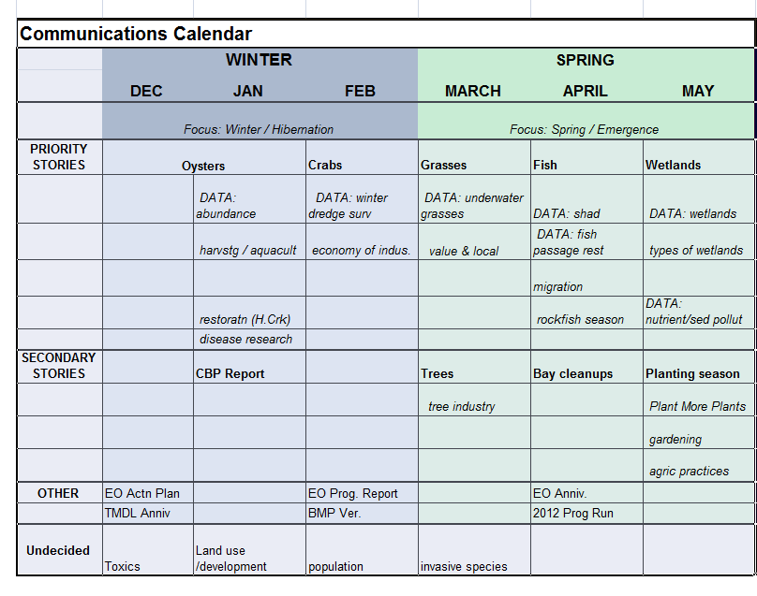
2013 Comm Planning Calendar
Notes:
Will share this widely across CBP (leadership, GIT’s)
We will be using all our tools on each story
By season, with theme each season
This is not ALL we’ll be doing because we will continue to support partners’ and others relevant stories.
balanced approach where we are offering messages/stories that are timed and relevant to public interest.

Slide 9
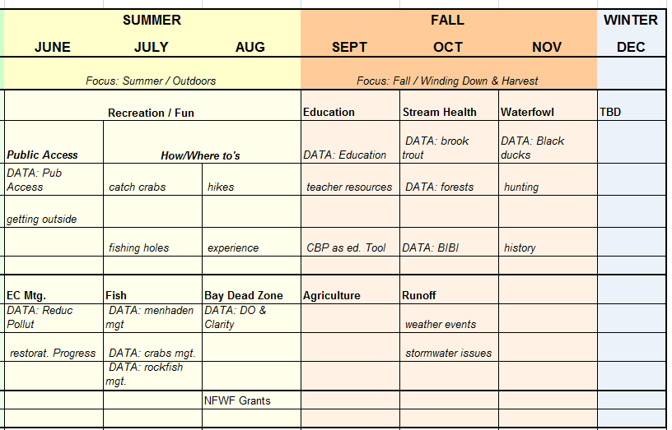
2013 Comm Calendar (cont’d)
Notes:
Remember this reflects:
Only the news cycle
Our news (there will be other stories)
web page updates

Slide 10
Ongoing
CBP will continue to work to:
Better understand our audiences & sources
Keep our messages simple (ie: using our indicators as the raw materials for our stories)
Be “the” proactive source for news on the Bay
Improve the way science is communicated
  Both within CBP and sharing externally
Notes:
creates a balanced approach where we are offering messages/stories that are timed and relevant to public interest.
Where we are bringing people along:
To our website and resources

Slide 11
Report on the Bay
Goals & Indicators
Public Reporting
Notes:
In terms of our overall reports, this is what we’ve had.
The 2013 comm plan unhooks us from news that’s dependent on indicator readiness, expired goals or as-yet established new goals/deadlines. We need to also apply this to reporting in some fashion.

Slide 12
Good communications is a partnership….
Notes:
This is what we should be going for – communications partnership with public, where we bring them along.
As the 1st 2013 public piece, we should start with this report.
Where we are bringing people along:
To our website and resources
uld be easy to absorb/understand, engaging,

Slide 13
What “IS” and Looking Ahead
Notes:
This report should tell a story about “what IS” based on the most recent data and look ahead if possible
- Downplay focus on it being date-specific info (esp since this year is an issue)

Slide 14

Reach – how do we improve this?
Notes:
We need to do a better job at distribution
E comm
Mailing?
Also measure success – based on Communications metrics for public tools

