Slide 1
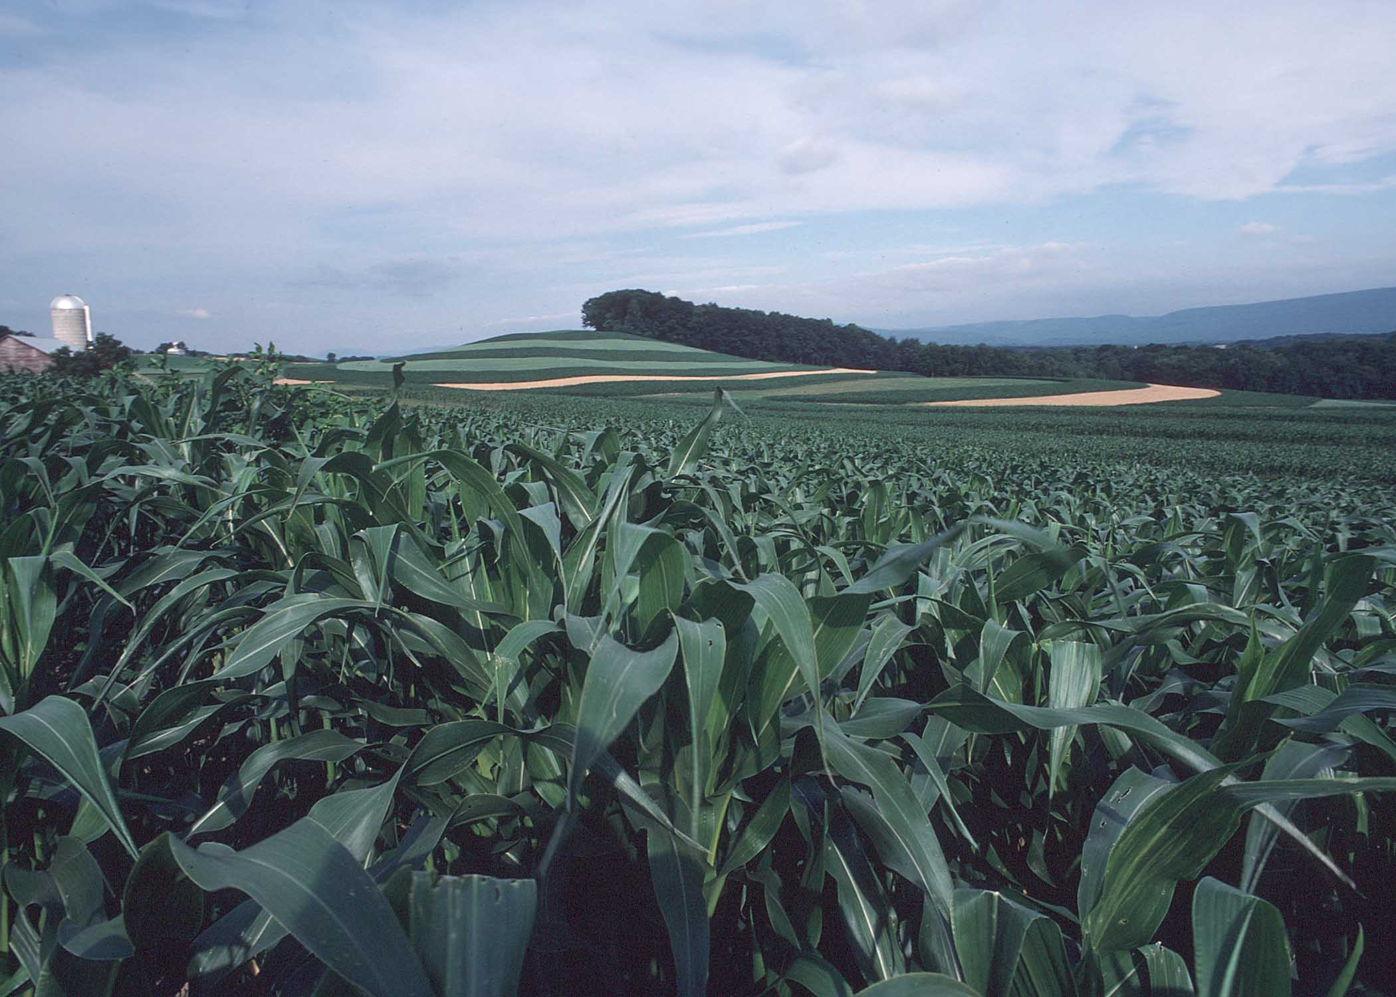
Agricultural BMP Verification Protocols for Best Management Practices
Frank J. Coale
Mark P. Dubin
Chesapeake Bay Program Partnership’s
Agriculture Workgroup
BMP Verification Review Panel Meeting
Annapolis, Maryland
December 6, 2012

Slide 2
Agriculture Workgroup
What is the role of the Chesapeake Bay Program’s Agriculture Workgroup (AgWG)?
Provide technical expertise and leadership on development and implementation of policies, programs, and research to reduce pollutant loads delivered from agricultural lands and animal operations to upstream waters and the Chesapeake Bay.

Slide 3
Agriculture Workgroup
What is the primary function of the Agriculture Workgroup for the Chesapeake Bay Program partnership?
Provide a forum for discussion, exchange of information and evaluation between federal, state, and local agencies, conservation districts, universities, agri-business, and the corporate sector on sustainable and/or cost-effective agricultural production systems that benefit water and air quality.

Slide 4
Agriculture Workgroup
Who is represented on the Agriculture Workgroup for the Chesapeake Bay Program Partnership?
Academic Institutions (Land Grant)
Federal Agencies (Agricultural /Environmental)
State Agencies (Agricultural /Environmental)
Local Agencies (Conservation Districts)
NGO’s (Agricultural/Environmental)
Industry (Agricultural)

Slide 5
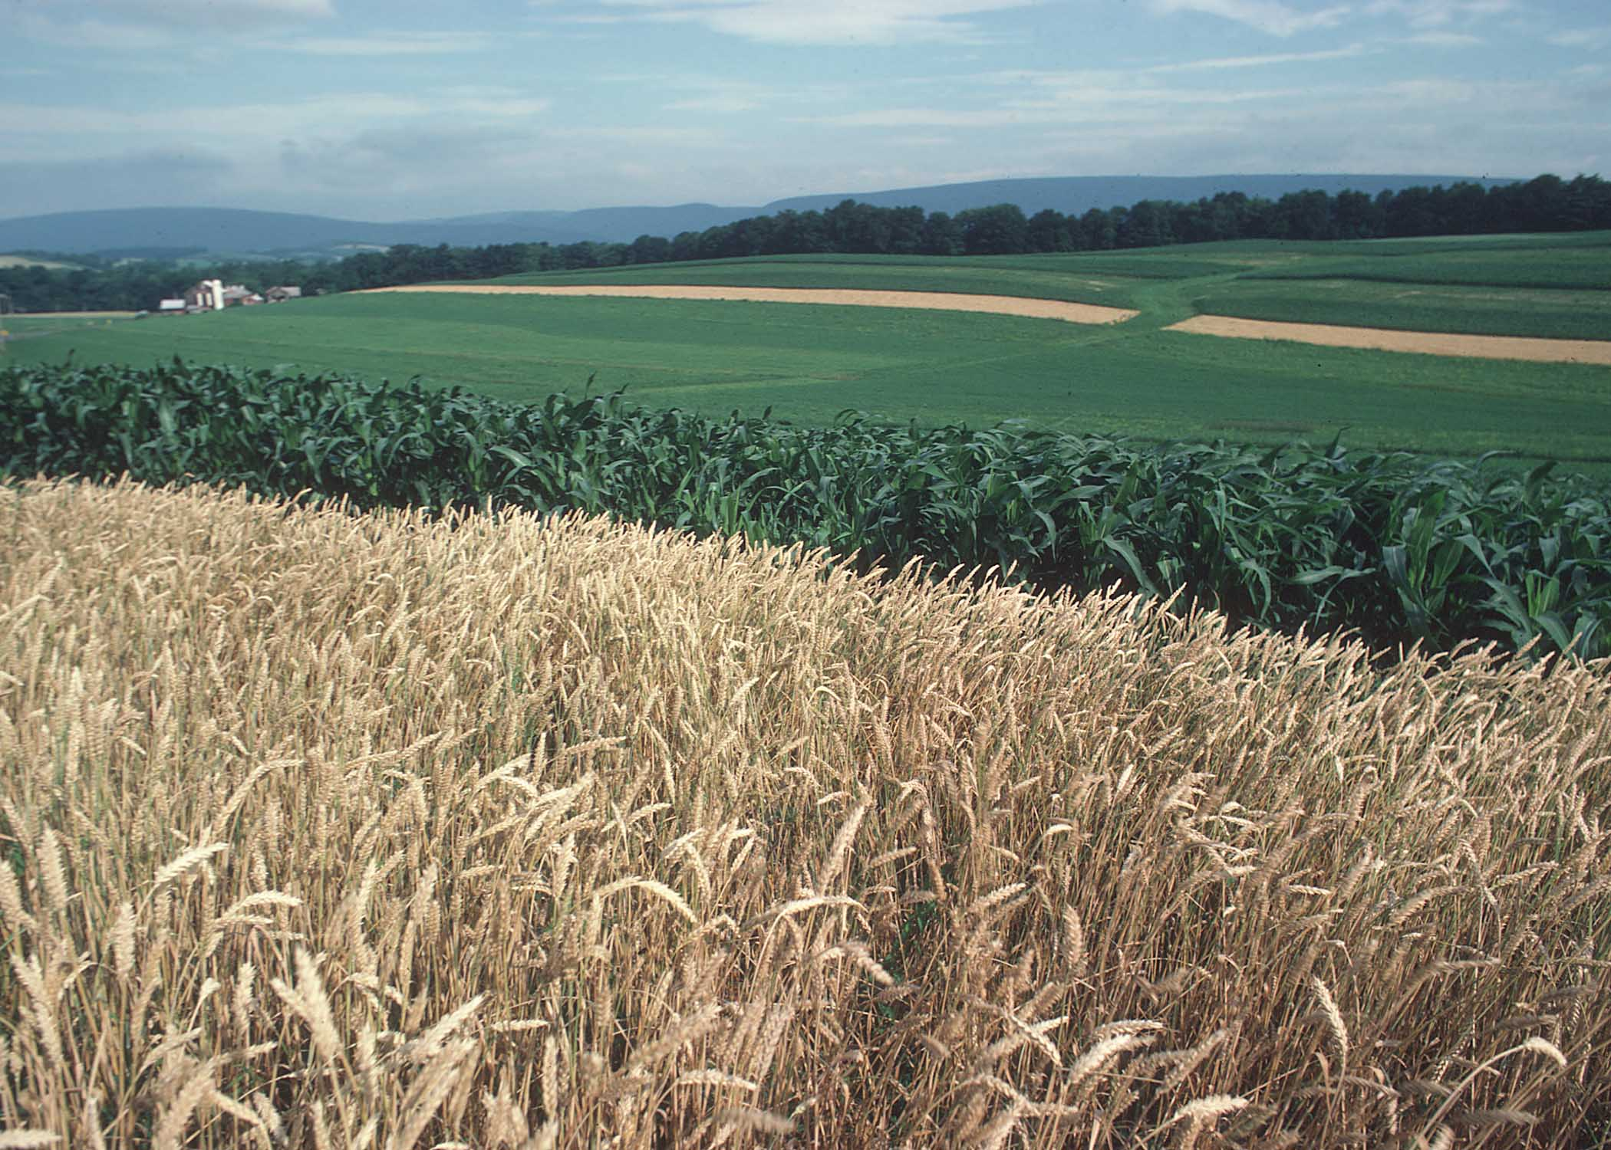
Chesapeake Bay Program Agricultural BMPs

Slide 6
Agricultural BMPs
Agricultural BMPs represent the largest and most diverse group of conservation practices and management systems within the Chesapeake Bay Program partnership.

Slide 7
Approved CBP Agricultural BMPs
Nutrient Management
Nutrient Management
Precision Agriculture
Enhanced Nutrient Management
Conservation Tillage
Continuous No-Till
Conservation Tillage
Cover Crops
Cover Crops – Late Planting
Cover Crops – Early Planting
Small Grain Enhancement – Late Planting
Small Grain Enhancement – Early Planting
Pasture Grazing BMPs
Alternative Watering Facilities
Stream Access Control with Fencing
Prescribed Grazing
Precision Intensive Rotational Grazing
Horse Pasture Management
Other Agricultural BMPS
Forest Buffers
Wetland Restoration
Land Retirement
Grass Buffers
Forest Buffers
Tree Planting
Carbon Sequestration/Alternative Crops
Conservation Plans/SCWQP
Animal Waste Management Systems
Mortality Composters
Water Control Structures
Non-Urban Stream Restoration
Poultry Phytase
Poultry Litter Management
Dairy Precision Feeding and Forage Management
Swine Phytase
Ammonia Emissions Reductions

Slide 8
Interim CBP Agricultural BMPs
Nutrient Management
Irrigation Management
Manure Management
Liquid Manure Injection
Poultry Litter Injection
Manure Processing Technology
Mortality Management
Mortality Incineration
Soil Amendments
Phosphorus Absorbing Materials
Nursery Management
Nursery Runoff Management
Non-Cost-Shared Practices
Tracking and Reporting

Slide 9
Proposed CBP Agricultural BMPs
Manure Management
Heavy Use Area Poultry Pads
Poultry Litter Management
Stormwater Management
Agricultural Stormwater Management
Sinkhole Management
Sink-Hole Grass Buffers

Slide 10
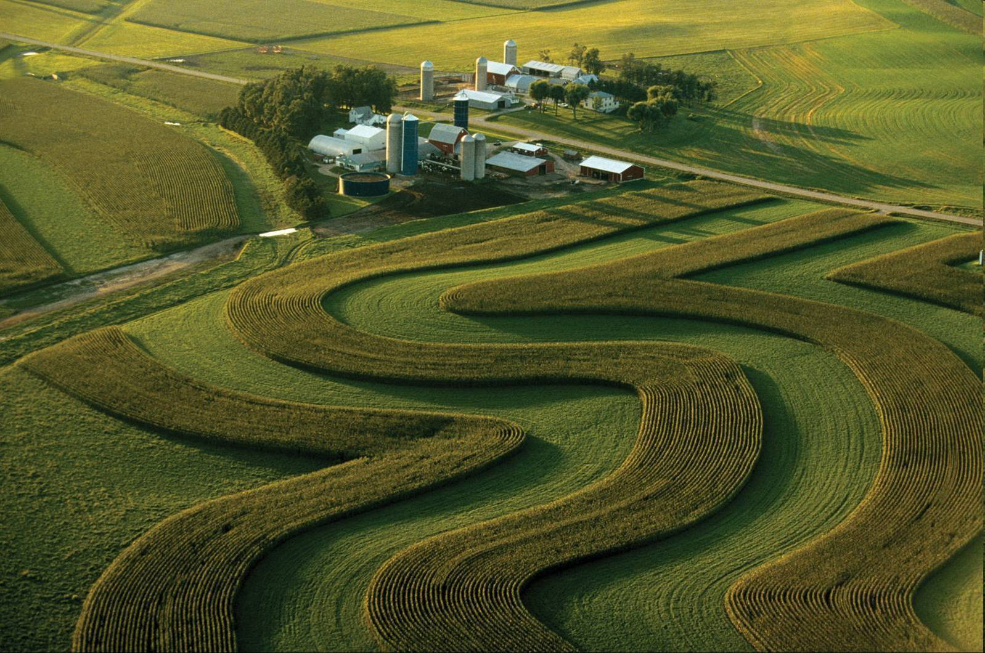
Agricultural BMP
Verification

Slide 11
Agricultural BMP Verification
The Agriculture Workgroup identified the need to scientifically support the development of an agricultural verification protocol.
Technical assistance obtained from Tetra Tech under the direction of the workgroup.
A summary verification report will document the findings from a national scientific literature search…
…and through interviews with both regionally and nationally recognized verification experts.

Slide 12
Agricultural BMP Verification
The Agriculture Workgroup has used the BMP verification principles developed by the Water Quality Goal Implementation Team's (WQGIT) BMP Verification Steering Committee.
The workgroup considered multiple options for developing an agricultural verification protocol.
Both positive and non-positive attributes identified for each option.

Slide 13
Agricultural BMP Verification
Four distinct options have been considered by the Agriculture Workgroup to establish protocols for verifying agricultural BMPs.
Version 1
Version 2.1
Version 2.2
Version 3

Slide 14
Agricultural BMP Verification
Version 1: Create a limited and uniform verification protocol standard for all practices and programs.
Not recommended by the workgroup.

Slide 15
Agricultural BMP Verification
Benefits
Simplistic approach.
Provides 100% model acceptance of reported practices.
Provides 100% of the model BMP effectiveness values.
Concerns
Does not conform to the diversity of agricultural practices and implementation programs across six jurisdictions.
A limited verification protocol standard would not offer sufficient capacity for adequate BMP implementation reporting.

Slide 16
Agricultural BMP Verification
Version 2.1: Create diverse verification protocol options and identify the levels of data confidence for each protocol.
Limit the units of BMP implementation reported by the degree of relative data confidence
Not recommended by the workgroup.

Slide 17
Agricultural BMP Verification
Benefits
Multiple potential verification protocol options reflective of the diversity of agricultural practices and programs.
Application of 100% of the model BMP effectiveness values.
Concerns
Produces varying levels of relative data confidence between the protocol options, as well as between practice types within a single protocol.
The scientific documentation to assign defensible relative data verification levels is not adequate.
Limiting the units of tracked BMPs that could be reported could jeopardize local community support.

Slide 18
Agricultural BMP Verification
Version 2.2: Create diverse protocol options and identify the levels of confidence for each protocol.
Limit the model reduction credits for the units of BMP implementation reported by the degree of relative data confidence.
Not recommended by the workgroup.

Slide 19
Agricultural BMP Verification
Benefits
Offers multiple potential verification protocol options that are more reflective of the diversity of agricultural practices and programs.
Provides 100% model acceptance of reported practices.
Concerns
Produces varying levels of relative data confidence between the protocol options, as well as between practice types within a single protocol.
The scientific documentation to assign defensible relative data verification levels is not adequate.
Limiting the model credit values of reported BMPs could jeopardize the scientific defensibility of the BMP effectiveness values.

Slide 20
Agricultural BMP Verification
Version 3: Create diverse protocol options and apply a uniform minimum threshold of relative data confidence to all protocols.
Recommended by the workgroup on November 29, 2012.

Slide 21
Agricultural BMP Verification
Benefits
Multiple potential verification protocol options reflective of the diversity of agricultural practices and programs.
The scientific documentation to assign defensible relative data verification levels is adequate.
Provides 100% model acceptance of reported practices.
Provides 100% of the model BMP effectiveness values.
Concerns
Produces varying levels of relative data confidence between the protocol options, as well as between practice types within a single protocol.
Requires attaining the standard confidence level threshold for reporting any BMP implementation.

Slide 22
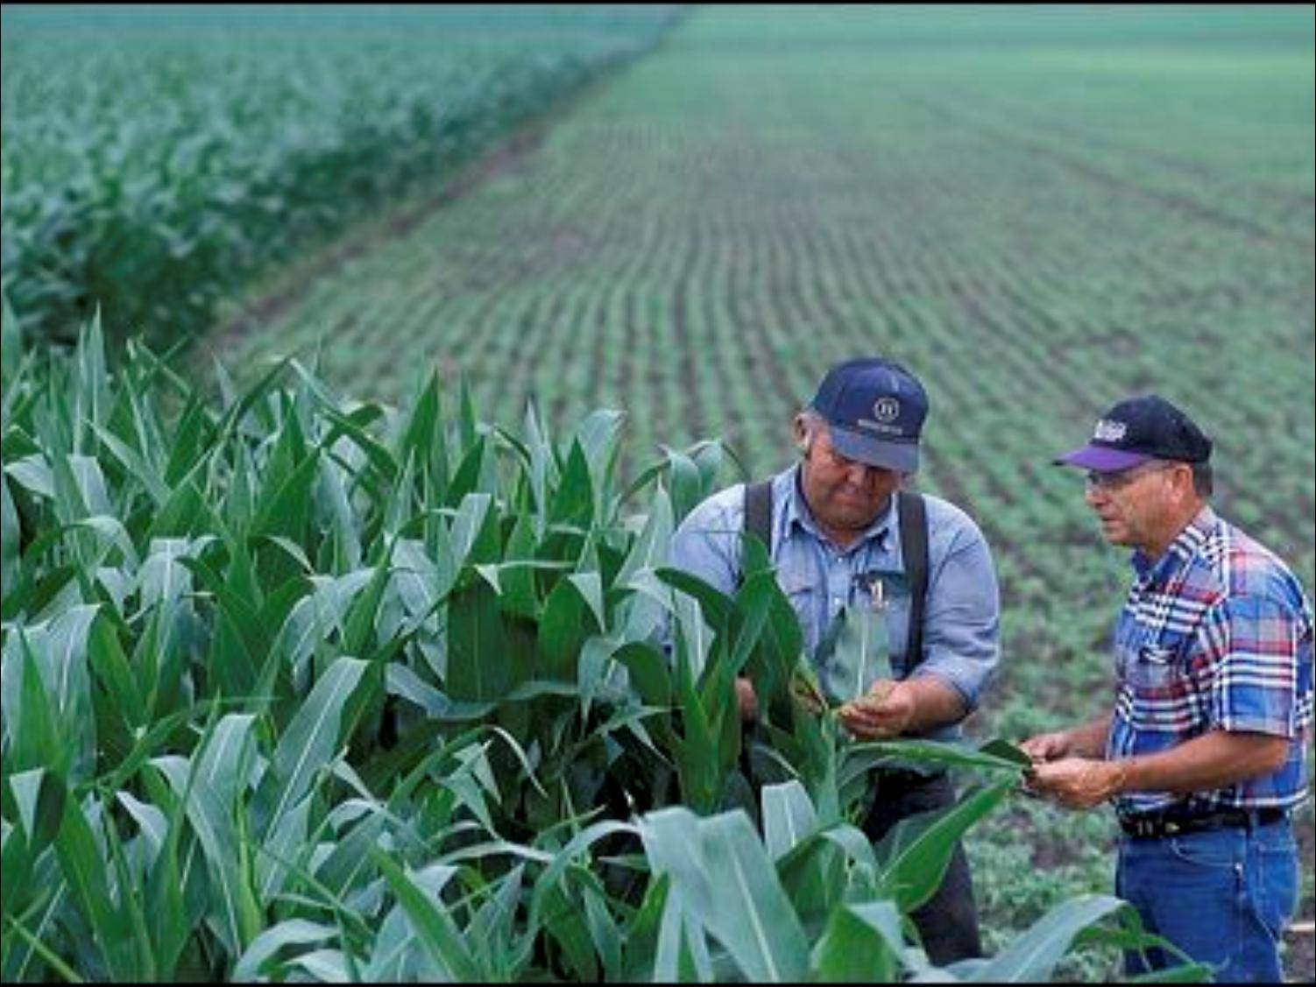
Agricultural Verification Protocol Elements

Slide 23
Verification Protocol Elements
Verification Protocol Version 3.5 Matrix
Statistical Data Confidence Threshold
All BMP data to be reported to and credited by the Chesapeake Bay Program models would be required to meet a minimum documented 80 percent level of statistical data confidence.
The figure of 80 percent is based on the mid-point of a range of documented data confidence levels identified by the Tetra Tech research study.

Slide 24
Verification Protocol Elements
Verification Protocol Version 3.5 Matrix
Agricultural BMP Verification Protocols Identified general categories of verification protocols.
Assessment Methods Assessment methods and entity that would be collecting and verifying the data.

Slide 25
Verification Protocol Elements
Verification Protocol Version 3.5 Matrix
Conservation Practice Category
Assessment methods and associated data confidence levels are affected by the type of agricultural BMPs being assessed.
Assessments methods were evaluated for each BMP category to determine if the method was realistically appropriate.
Significant verification efforts may still be required to meet the data confidence threshold.

Slide 26
Verification Protocol Elements
Verification Protocol Version 3.5 Matrix
Cost-Sharing Information Potential differences for BMPs designed and financed through federal, state, NGO and private sources for each assessment method.
Other BMP Information Ability of each assessment method to verify if the practice meets the BMP specification, a functional equivalent, or non-functional equivalent BMP. Identifies date of practice implementation for model reporting purposes.

Slide 27
Verification Protocol Elements
Verification Protocol Version 3.5 Matrix
Verification Methodology Methodologies to track, verify and report implemented practices. BMPs being assessed and verified through permit or financial incentive programs are limited to the period of the active permit or contractual agreement. Alternative assessment methods are also identified.
Verification Issues Limitations and potential verification issues that need to be addressed to obtain the statistical data confidence threshold requirements.

Slide 28
Verification Protocol Elements
Verification Protocol Version 3.5 Matrix
Relative Cost Relative costs in comparison to one another. Based on range of implementation costs identified in the Tetra Tech research report.
Relative Scientific Defensibility Relative comparative values are assigned to each assessment method pertaining to their scientific defensibility based on the findings of the Tetra Tech research report.

Slide 29
Verification Protocol Elements
Verification Protocol Version 3.5 Matrix
Relative Accountability Relative comparative values assigned to each assessment method pertaining to the accountability of the entity reporting, tracking and verifying the data.
Relative Transparency Relative comparative values assigned to each assessment method based on the transparency of the reported data by outside reviewers.

Slide 30
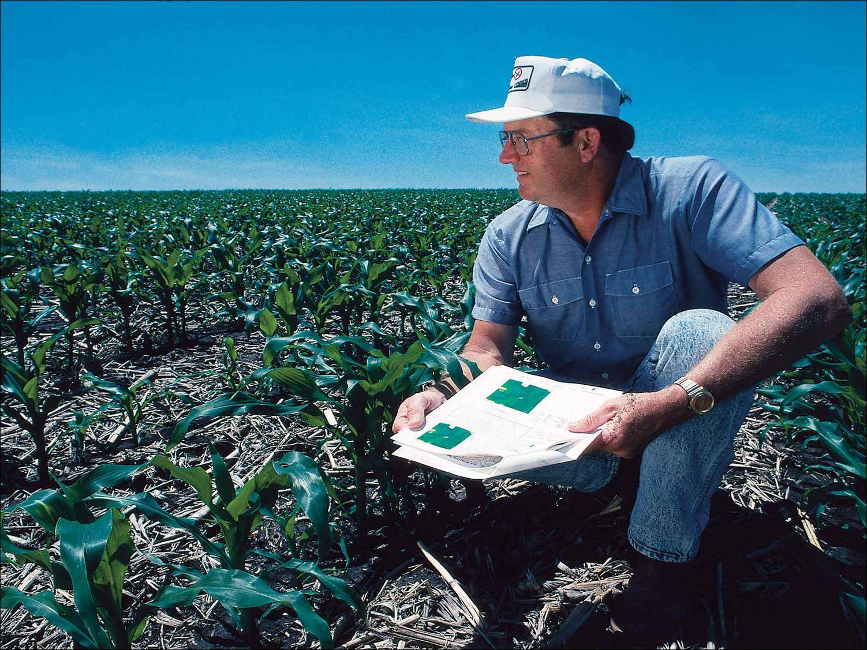
Agricultural Verification Protocol Packet

Slide 31
Verification Protocol Packet
The Agricultural Verification Protocol Packet being developed will include the following elements:
Verification Protocol Matrix
Verification Guidance Document
Summary Verification Research Report
Verification Planning Tools

Slide 32
Verification Protocol Packet
Packet is intended to provide…
…structure and expectations of verifying tracked data for reporting to the Chesapeake Bay Program for nutrient and sediment reduction credits.
…guidance for agencies and partners to develop program specific and detailed data verification plans for submission to the Verification Review Panel and partnership for review.
…guidance for the Verification Review Panel and the partnership to review and recommend verification plans.

Slide 33
Verification Protocol Packet
Estimated date of packet completion and Agriculture Workgroup recommendation… February 2013

Slide 34
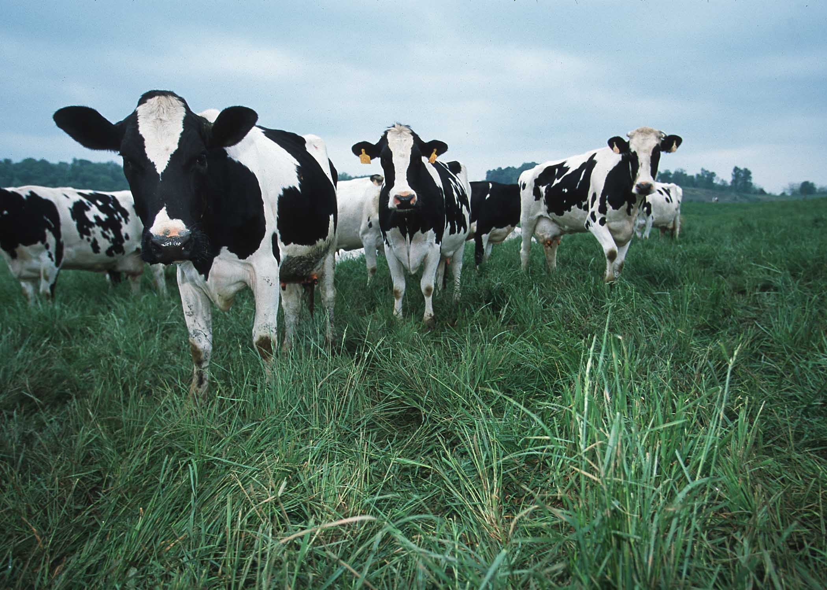
Questions?

