Slide 1
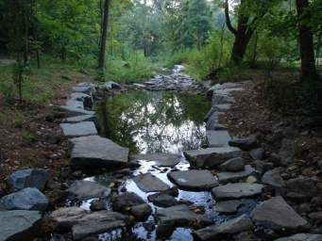
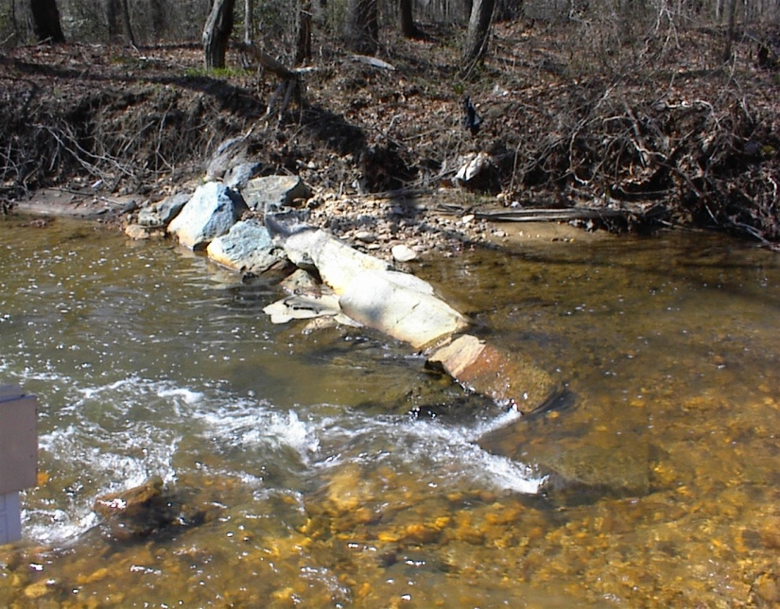
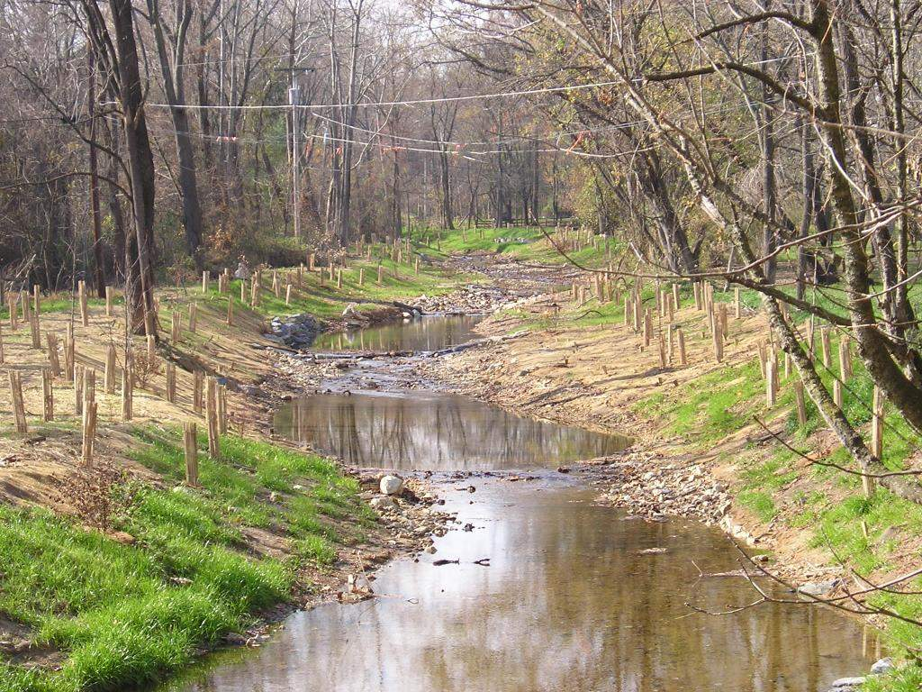

Recommendations of the Expert Panel to Define Removal Rates for Individual Stream Restoration Projects
Presentation at Water Quality Goal Implementation Team Meeting
May 13, 2013

Slide 2
Status of Expert Panel Report
Expert Panel Reached Consensus and Review Period Completed
Response to 150 Pages of Comments and Revised Report Released in Feb
(EPA, PADEP, VADCR, WVDEP, Consultants, JHU, MSRA…)
Urban Stormwater Technical Work Group approval in Feb
Briefing of Federal Stream Permitting Agencies in March
Approval by WQTWG in April and Final Version Prepared
Agricultural Work Group approval in May
Seeking WQGIT approval today

Slide 3
Expert Panel on Stream Restoration
Panelist | Affiliation
Deb Cappuccitti | Maryland Department of Environment
Bob Kerr | Kerr Environmental Services (VA)
Matthew Meyers, PE | Fairfax County (VA) Dept of Public Works and Environmental Services
Daniel E. Medina, PE | Atkins (MD)
Joe Berg | Biohabitats (MD)
Lisa Fraley-McNeal | Center for Watershed Protection (MD)
Steve Stewart | Baltimore County Dept of Env. Protection and Sustainability (MD)
Dave Goerman | Pennsylvania Department of Environmental Protection
Natalie Hartman | West Virginia Department of Environmental Protection
Josh Burch | District Department of Environment
Dr. Robert C. Walter | Franklin and Marshall College
Dr. Sujay Kaushal | University of Maryland
Dr. Solange Filoso | University of Maryland
Julie Winters | US Environmental Protection Agency CBPO
Bettina Sullivan | Virginia Department of Environmental Quality
Panel Support
Tom Schueler Bill Stack |  | Chesapeake Stormwater Network (facilitator) Center for Watershed Protection (co-facilitator)
Other Panel Support: Russ Dudley – Tetra Tech, Debra Hopkins – Fish and Wildlife Service, Molly Harrington, CBP CRC, Norm Goulet, Chair Urban Stormwater Work Group, Gary Shenk, EPA CBPO, Jeff Sweeney, EPA CBPO

Slide 4
Review of the Old Rate
Initial CBP-Approved Stream Restoration Credit (2003)
Removal Rate per Linear Foot of Qualifying Stream Restoration
Source | TN | TP | TSS
Spring Branch N=1 | 0.02 lbs | 0.0035 | 2.55 lbs
At some point applied to non-urban stream restoration projects.
Approved Interim Rate
Edge-of-Stream 2011 Interim Approved Removal Rates per Linear Foot of Qualifying Stream Restoration (lb/ft/yr)
Source | TN | TP | TSS*
New Interim CBP Rate | 0.20 | 0.068 | 310 (54.2)
Derived from six stream restoration monitoring studies: Spring Branch, Stony Run, Powder Mill Run, Moore's Run, Beaver Run, and Beaver Dam Creek located in Maryland and Pennsylvania *The removal rate for TSS is representative of edge-of-field rates and is subject to a sediment delivery ratio in the CBWM to determine the edge-of-stream removal rate. Additional information about the sediment delivery ratio is provided in Appendix B.

Slide 5
Why the initial credit needed to be changed and a universal restoration credit doesn’t make sense
Streambank Erosion Rate
(lb/ft/yr)
Interim Restoration Credit
Initial Restoration Credit

Slide 6
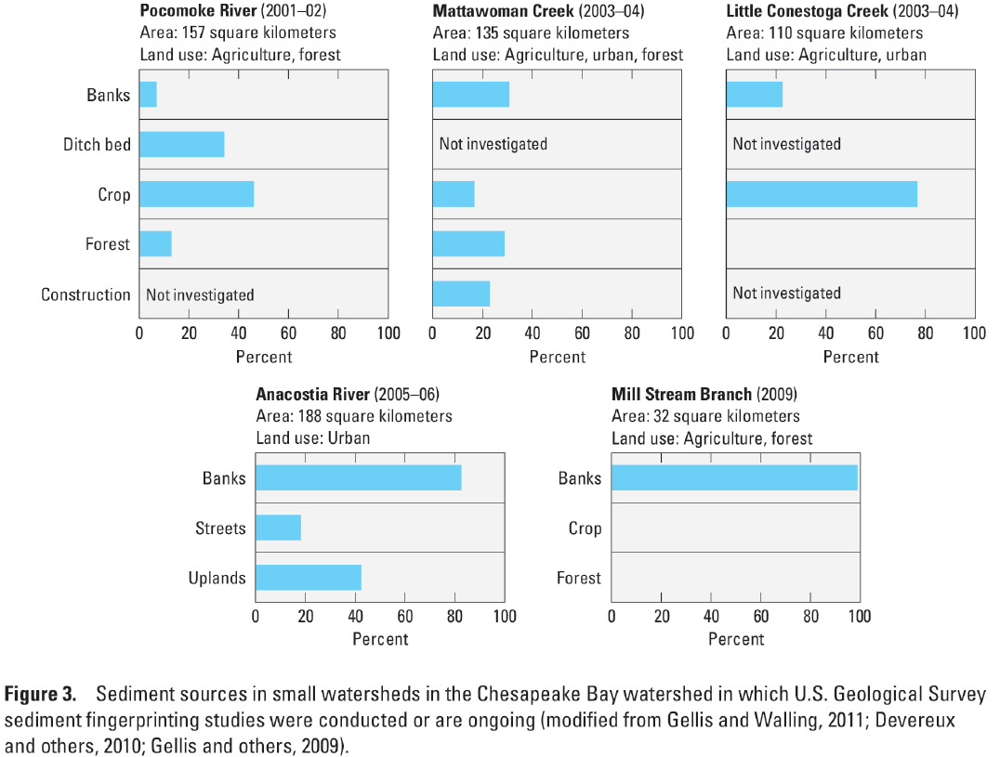
USGS Data Supports Stream Bank Erosion as a Major Source to the Bay

Slide 7
Summary of Recommended Protocols
Protocol 1: Credit for Prevented Sediment during Storm Flow -- This protocol provides an annual mass nutrient and sediment reduction credit for qualifying stream restoration practices that prevent channel or bank erosion that would otherwise be delivered downstream from an actively enlarging or incising urban stream.
Protocol 2: Credit for Instream and Riparian Nutrient Processing during Base Flow -- This protocol provides an annual mass nitrogen reduction credit for qualifying projects that include design features to promote denitrification during base flow within the stream channel through hyporheic exchange within the riparian corridor.
Protocol 3: Credit for Floodplain Reconnection Volume-- This protocol provides an annual mass sediment and nutrient reduction credit for qualifying projects that reconnect stream channels to their floodplain over a wide range of storm events.
Protocol 4: Credit for Dry Channel Regenerative Stormwater Conveyance (RSC) as an Upland Stormwater Retrofit-- This protocol provides an annual nutrient and sediment reduction rate for the contributing drainage area to a qualifying dry channel RSC project. The rate is determined by the degree of stormwater treatment provided in the upland area using the retrofit rate adjustor curves developed by the Stormwater Retrofit Expert Panel.

Slide 8
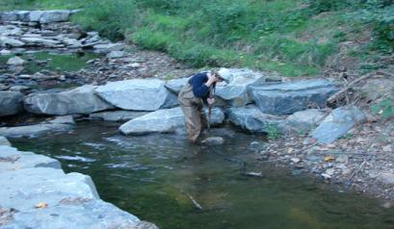
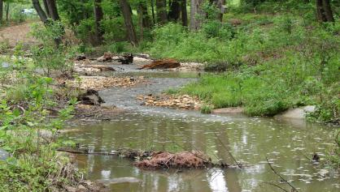
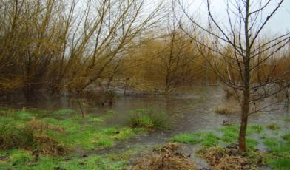
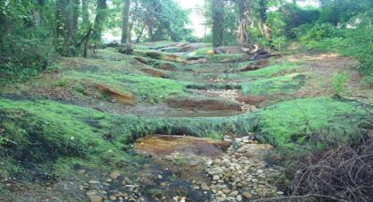
Stream Restoration Protocols
1. Prevented sediment approach
2. In-stream denitrification
3. Flood plain reconnection
4. The “tweener” Dry Channel RSC

Slide 9
Protocol 1: Credit for Prevented Sediment during Storm Flow
This protocol provides an annual mass nutrient and sediment reduction credit for qualifying stream restoration practices that prevent channel or bank erosion that would otherwise be delivered downstream from an actively enlarging or incising urban stream.
Estimate stream sediment erosion rates
Convert erosion rates to nitrogen and phosphorus loadings
Estimate reduction efficiency attributed to restoration

Slide 10
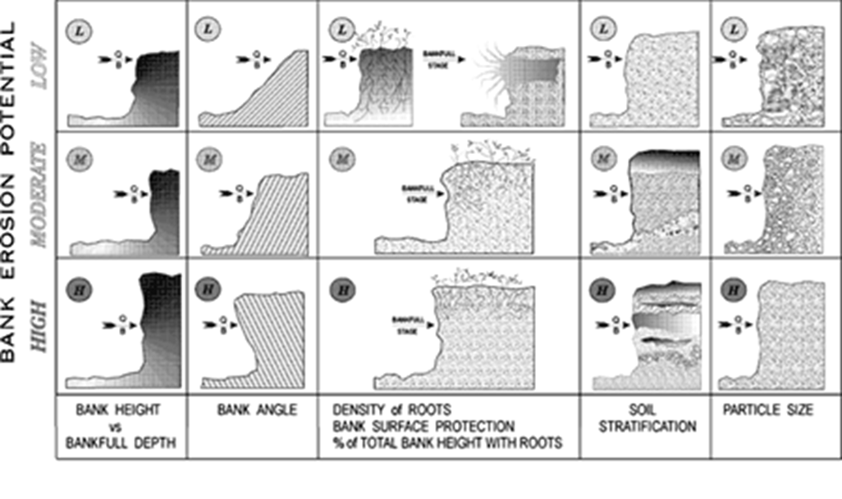
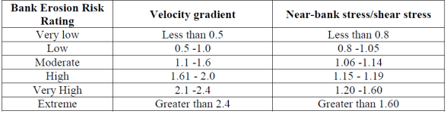
Step1.Estimate Stream Sediment Erosion Rates Using the BANCS Method
Protocol 1: Credit for Prevented Sediment during Storm Flow
Streambank Characteristics used to develop BEHI
Velocity Gradient and Near-Bank Stress Indices

Slide 11
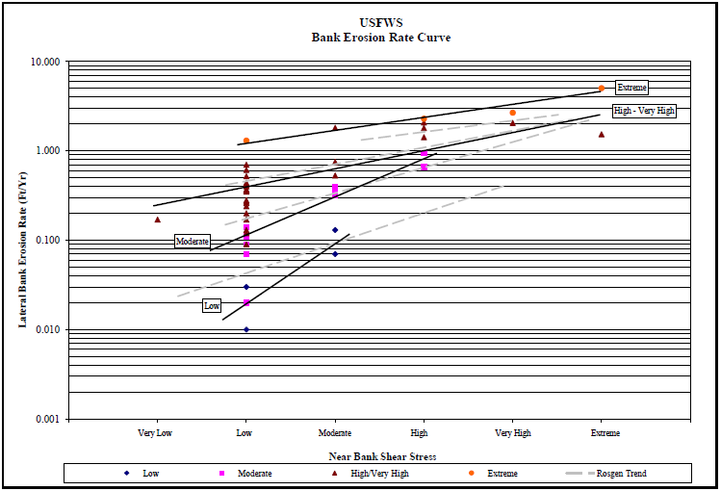
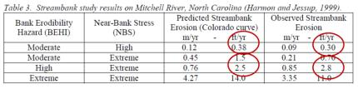
Regional Curve for Determining “R” in equation: S = ∑(c×a×r)
Protocol 1: Credit for Prevented Sediment during Storm Flow
Curve for Hickey Run – Washington DC- USFWS

Slide 12
Step 2.Convert erosion rates to loadings
Protocol 1: Credit for Prevented Sediment during Storm Flow
S=∑(c x A x R ) / 2,000
Where: S = sediment load (ton/year) for reach or stream
c = bulk density of soil (lbs/cubic foot)
R = bank erosion rate (feet/year) (from regional curve)
A = eroding bank area (square feet)
2,000 = conversion from lbs to tons

Slide 13
Multiply sediment load times TN and TP concentrations
Table 5: TN and TP Concentrations in Sediments in Different Parts of the Urban Landscape¹
Location | Median TP | TP Range | Median TN | TN Range | Location | Reference
Upland Soils | 0.045 | 0.0025-0.577 | 0.8 | 0.05-3.3 | MD | Pouyat et al. 2007
Street Solids | 0.52 | 0.19-0.72 | 1.08 | 0.324-2.71 | MD | Diblasi, 2008
Catch Basin³ | 0.49 | 0.057-0.97 | 1.74 | 0.055-6.27 | MD | Law et al. 2008
BMP Sediments | 0.29 | 0.014-1.38 | 1.47 | 0.11-5.6 | National | Schueler, 1994
Streambank Sediments | 0.439 | 0.19-0.90 | -- | -- | MD | BDPW, 2006
 | 0.445 | 0.072-4.43 | 1.35 | 0.0015-4.13 | MD | Stewart, 2008
 | 1.61 |  | 3.81 |  | MD | Stewart, 2012
 | 0.357 | 0.23-4.69 | 1.1 | 0.7-1.7 | PA | Land Studies, 2005²
 | 1.05 | -- | 2.28 | -- | PA | Walters et al, 2007²
¹ all units are lb/ton ² the Pennsylvania data on stream bank sediments were in rural/agricultural subwatersheds ³ catch basin values are for sediment only, excluding leaves

Slide 14
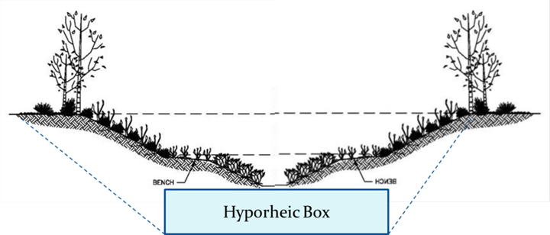
Protocol 2: Credit for Denitrification in the Hyporheic Zone during Base Flow (for projects that qualify for Protocol 1 but not Protocol 3)
Step 1.Determine the total post construction stream length that has been reconnected using the bank height ratio of 1.0 or less (for NCD) or the 1.0 inch storm (other design approaches that do not use the bank full storm)
Step 2. Determine the dimensions of the hyporheic box
Step 3. Multiply the hyporheic box mass by the unit denitrification rate
5 feet + stream width + 5 feet
5 feet depth

Slide 15
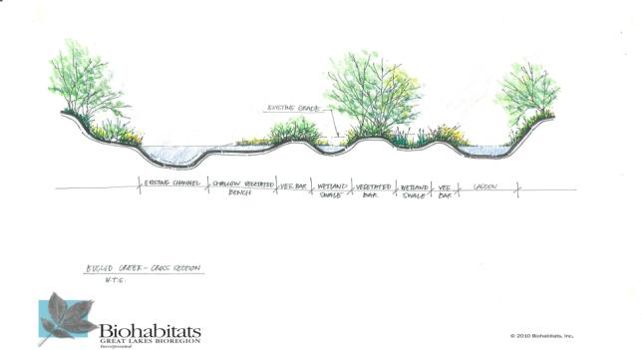
Protocol 3: Credit for Floodplain Reconnection (for projects that qualify for Protocol 1 but not Protocol 2)
Annual mass nutrient reduction credit for projects that reconnect stream channels to their floodplain over a wide range of storm events

Slide 16
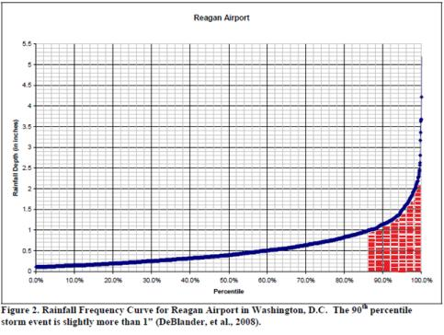
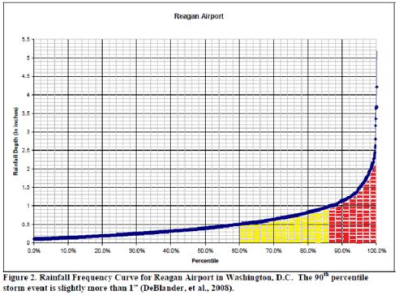
Protocol 3: Credit for Floodplain Reconnection Volumes during Storm Flow
Step 1.Estimate the floodplain connection volume
Annual runoff volume going to floodplain wetlands when floodplain is accessed at 1.0”
Annual runoff volume going to floodplain wetlands when floodplain is accessed at 0.5”
In-channel flow

Slide 17
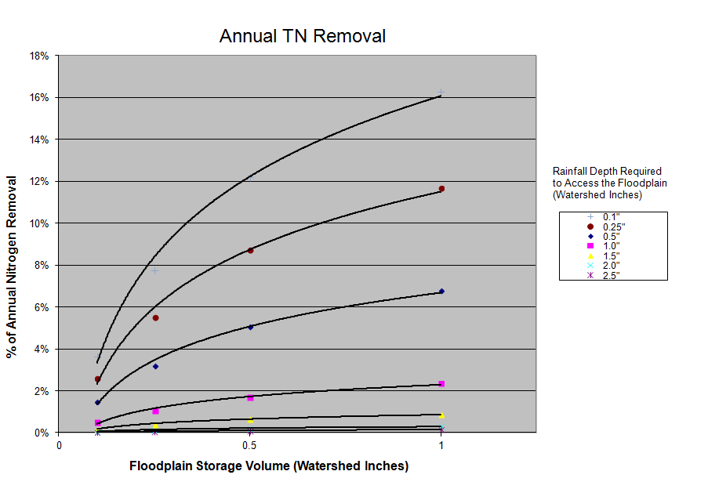
Protocol 3: Credit for Floodplain Reconnection Volumes
Step 2.Estimate the N and P removal rate attributable to floodplain reconnection (using Jordan 2009 study)

Slide 18
Protocol 4: Dry Channel RSC as a Stormwater Retrofit
The Panel decided to classify dry channel RSC systems as an upland stormwater retrofit. Designers should use the protocols developed by the Urban Stormwater Retrofit Expert Panel to derive the sediment and nutrient removal rates.
The general process is to determine runoff reduction credit from adjustor curves that determine TP, TN, and TSS removal rates based on the depth of rainfall captured over the contributing impervious area treated by the RSC.
The final removal rate is then applied to the entire drainage area to the dry channel RSC project.

Slide 19
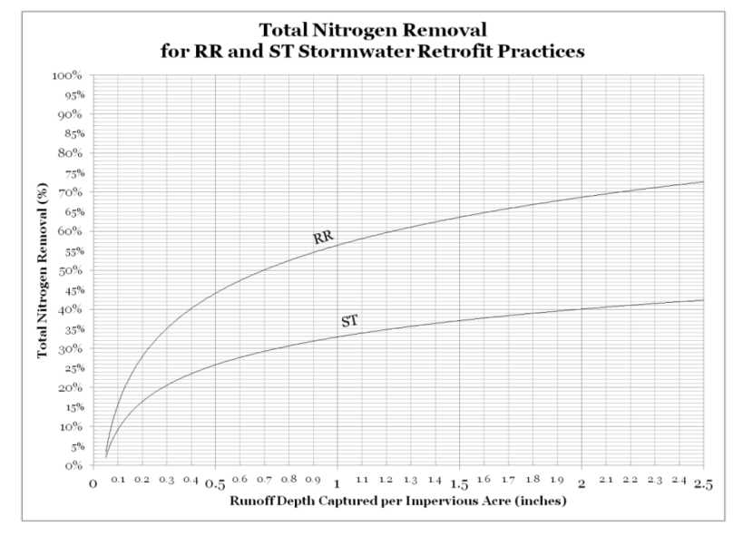
Protocol 4: Dry Channel RSC as a Stormwater Retrofit

Slide 20
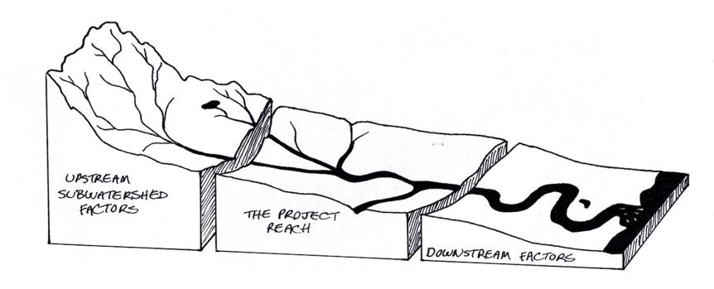
Upland Restoration vs. Stream Restoration

Slide 21
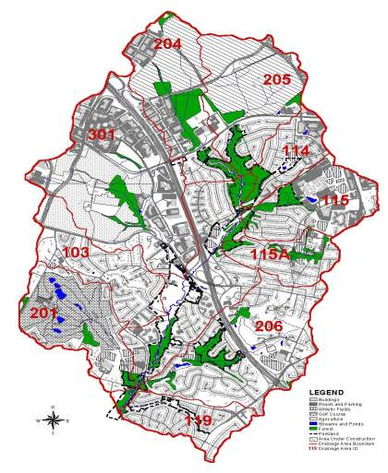
Comprehensive Watershed Restoration Approach
Panel endorsed a comprehensive watershed approach to install restoration practices in the uplands, the stream corridor, and in appropriate settings, within the stream itself
No current science to recommend what proportion of practices should be applied to uplands vs. stream corridor

Slide 22
Qualifying Conditions
Stream restoration projects that are primarily designed to protect public infrastructure by bank armoring or rip rap do not qualify for a credit.
The urban stream reach must be greater than 100 feet in length
The project must utilize a comprehensive approach to stream restoration design, involving the channel and banks.
Stream restoration project MUST provide a NET watershed removal benefit in order to be eligible for either a sediment or nutrient credit.
NO removal credit will be granted for any project that is built to offset, compensate, or otherwise mitigate for an impact to a stream or waterway elsewhere in the watershed

Slide 23
Environmental Concerns
Each project must comply with all state and federal permitting requirements, including 404 and 401 permits, which may contain conditions for pre-project assessment and data collection, as well as post construction monitoring.
Stream restoration is a carefully designed intervention to improve the hydrologic, hydraulic, geomorphic, water quality, and biological condition of degraded urban streams, and cannot and should not be implemented for the sole purpose of nutrient or sediment reduction.
There may be a few classes of legacy sediment stream restoration projects that do not fall into the preceding statement. Also, there may instances where limited bank stabilization is needed to protect critical public infrastructure (which may need to be mitigated and does not qualify for any sediment or reduction credits).

Slide 24
Environmental Concerns
A qualifying project must meet certain presumptive criteria to ensure that high- functioning portions of the urban stream corridor are not used for in-stream stormwater treatment (i.e., where existing stream quality is still good). These may include one or more of the following:
Geomorphic evidence of active stream degradation (i.e., BEHI score)
An IBI of fair or worse
Hydrologic evidence of floodplain disconnection
Evidence of significant depth of legacy sediment in the project reach
Stream restoration should be directed to areas of more severe stream impairment, and the use and design of a proposed project should also consider the level of degradation, the restoration needs of the stream, and the potential functional uplift.
Before credits are granted, stream restoration projects will need to meet post-construction monitoring requirements, document successful vegetative establishment, and conduct initial project maintenance.
A qualifying project must demonstrate that it will maintain or expand riparian vegetation in the stream corridor, and compensate for any project-related tree losses in project work areas.
All qualifying projects must have a designated authority responsible for development of a project maintenance program that includes routine and long-term maintenance.

Slide 25
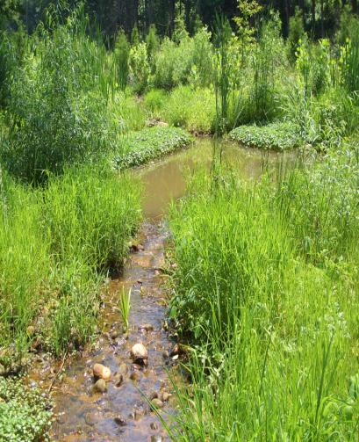
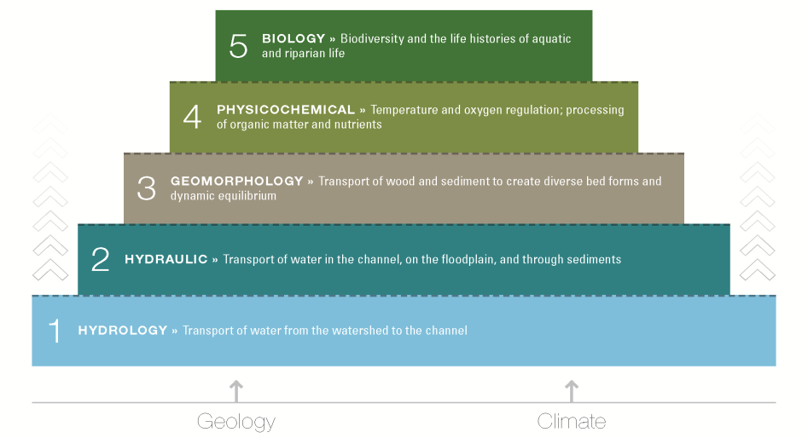
Functional Uplift in Streams
5 minutes

Slide 26
The “Test-Drive” Process
Recommended protocols are new, somewhat complex and will require project-based interpretation on the part of practitioners and regulators alike.
Panel strongly recommends that both groups should "test-drive" the protocols on real world projects over the next six months.
Based on their collective experience, convene a Bay-wide meeting to develop any additional supplemental information or procedures to effectively implement the protocols.
Series of webcast or workshops to deliver a clear and consistent message to the Bay stream restoration community on how to apply the protocols.

Slide 27
Initial Verification of Performance
Prior to submitting the load reduction to the state tracking database, the installing agency will need to provide a post-construction certification that the stream restoration project:
was installed properly,
meets or exceeds its functional restoration objectives
hydraulically and vegetatively stable,
Initial verification is provided either by the designer, local inspector or state permit authority

Slide 28
Verification of Stream Restoration Credit
Max duration for the removal credits is 5 years
Credit is renewed based on a field performance inspection that verifies the project still exists, is adequately maintained and operating as designed.
Credit is lost if project cannot be verified (i.e., does not pass inspection).
This creates strong incentive for localities to monitor the long term performance of their projects

Slide 29
Reporting Requirements
Historic
Project
Stream Project
Conforming
Project
Use new Protocols
Use interim efficiency removal rate
Non-Conforming
Project
Reporting Needs:
Type
Length
Protocol(s) Used
12 Digit Watershed
Date Installed
Location, DA and land cover treated
Projected TSS, TP and TN Load Reduction
Wetland area and FP connection storm
Hyporheic box dimensions and BH ratio
Use Interim removal rate
Reporting Needs:
Length
Date Installed
Location
More detailed project data and protocol computations to be archived in permit files, a subset of which may be audited or cross-checked by state agencies

Slide 30
Questions?

