Slide 1

Understanding the Effectiveness of BMPs:
Synthesizing Lessons Learned from Water Quality Monitoring Studies
Tidal Monitoring and Analysis Workgroup (TMAW) Meeting
February 7, 2013
Annapolis, MD
Katie Foreman and Liza Hernandez
University of Maryland Center for Environmental Science at the Chesapeake Bay Program

Slide 2
Background
Synthesizing the state of knowledge from monitoring studies that look at the effectiveness of BMPs
  2009 MRAT recommendations
  April 2011 STAR topical meeting with WQGIT
  WIPs and verification of practices
  Aid in the decision framework

Slide 3
Process
completed
Current and upcoming
Literature Review
  ~30 Chesapeake Bay Watershed (CBW) studies
  ~20 National and International studies
“Synthesis” workshop
Storyboarding session
Writing phase
Review
  Synthesis Team → NTWG/TMAW → STAR → WQGIT → edit → WQGIT → MB → CBP publication

Slide 4
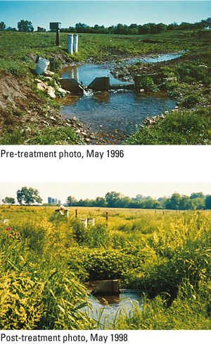
Synthesis, Part 1
1) Are BMPs working?
  4 Lessons
  4 Recommendations
Big Spring Run : Riparian areas pre- and post-cattle stream exclusion and riparian replanting (Galeone et al. 2006).

Slide 5
Lesson 1
Lesson
Recommendation
At the scale of the CBW, the quickest and most obvious improvements in water quality have been from wastewater treatment facility upgrades.
WWTP have substantially reduced their loads via upgrades, however, continuing established practices and making improvements is crucial to the continuance of progress toward reducing loads and offsetting population growth.

Slide 6
Lesson 2
Lesson
Recommendation
Practices which focus on reducing the initial input of nutrients into the system through on-the-ground actions that target water and air quality improvements have shown to be effective at reducing nutrient transport.
Comprehensive plans and innovative technologies are necessary to reduce fertilizer use (for residential and agricultural sources), solids (biosolids and animal manure), and air emissions.

Slide 7
Lesson 3
Lesson
Recommendation
Many nonpoint source BMPs will take years to decades to improve water quality in the watershed; once water quality improvements reach the estuary, the response can be rapid (years).
Now is the time to accelerate nonpoint source BMPs; detecting measureable improvements in water quality will require persistence and patience

Slide 8
Lesson 4
Lesson
Recommendation
Improvements in water quality as a result of BMPs may be offset by increasing nutrients in other sources.
Restoration goals and expectations should be set knowing that the offsets are a reality and that desired outcomes from some BMPs might be eclipsed by increases in other nutrient sources.

Slide 9
Synthesis, Part 2
2) How do we design and implement BMPs to be more effective and inform the Adaptive Management Cycle?
  4 Lessons
  4 Recommendations
Articulate program goals.
Develop management strategy.
Develop monitoring program.
Assess performance.
Manage adaptively.
Describe factors influencing goal attainment.
Assess current management efforts (and gaps)
CBP Decision Framework

Slide 10
Lesson 5
Lesson
Recommendation
In order to observe significant water quality and habitat responses, relatively large amounts of focused implementation (both type and location) are required to address the location-specific sources of pollution.
Identify the sources, location, and magnitude of nutrient inputs within the project area to target the appropriate site and type(s) of implementation as well as the amount of effort needed to achieve desirable outcomes.

Slide 11
Lesson 6
Lesson
Recommendation
Apart from point source tracking, information is limited at the sub-county scale to track BMP implementation.
Improvements are needed for local tracking of voluntary and cost-share BMPs to enhance models for targeting of BMP implementation and for being able to evaluate the effectiveness of specific BMP projects.

Slide 12
Lesson 7
Lesson
Recommendation
A very limited percentage of watershed-wide BMP projects have been monitored for their effectiveness and of those, most are not monitoring at the scale necessary to access BMP effectiveness.
Improvements are needed to enhance monitoring of BMPs as well as water quality and habitat responses.

Slide 13
Lesson 8
Lesson
Recommendation
Most BMP implementation is not designed using lessons learned from rigorous evaluation results.
Evaluating the effectiveness of water quality and habitat monitoring programs and BMP projects will require a better understanding of the lessons learned from past BMP projects and the application of those lessons learned through adaptive management.

Slide 14
Products and Timeline
Spring 2013
  Technical Report
Spring/Summer 2013
  Newsletters
  Booklet
    For targeted audiences

