Slide 1
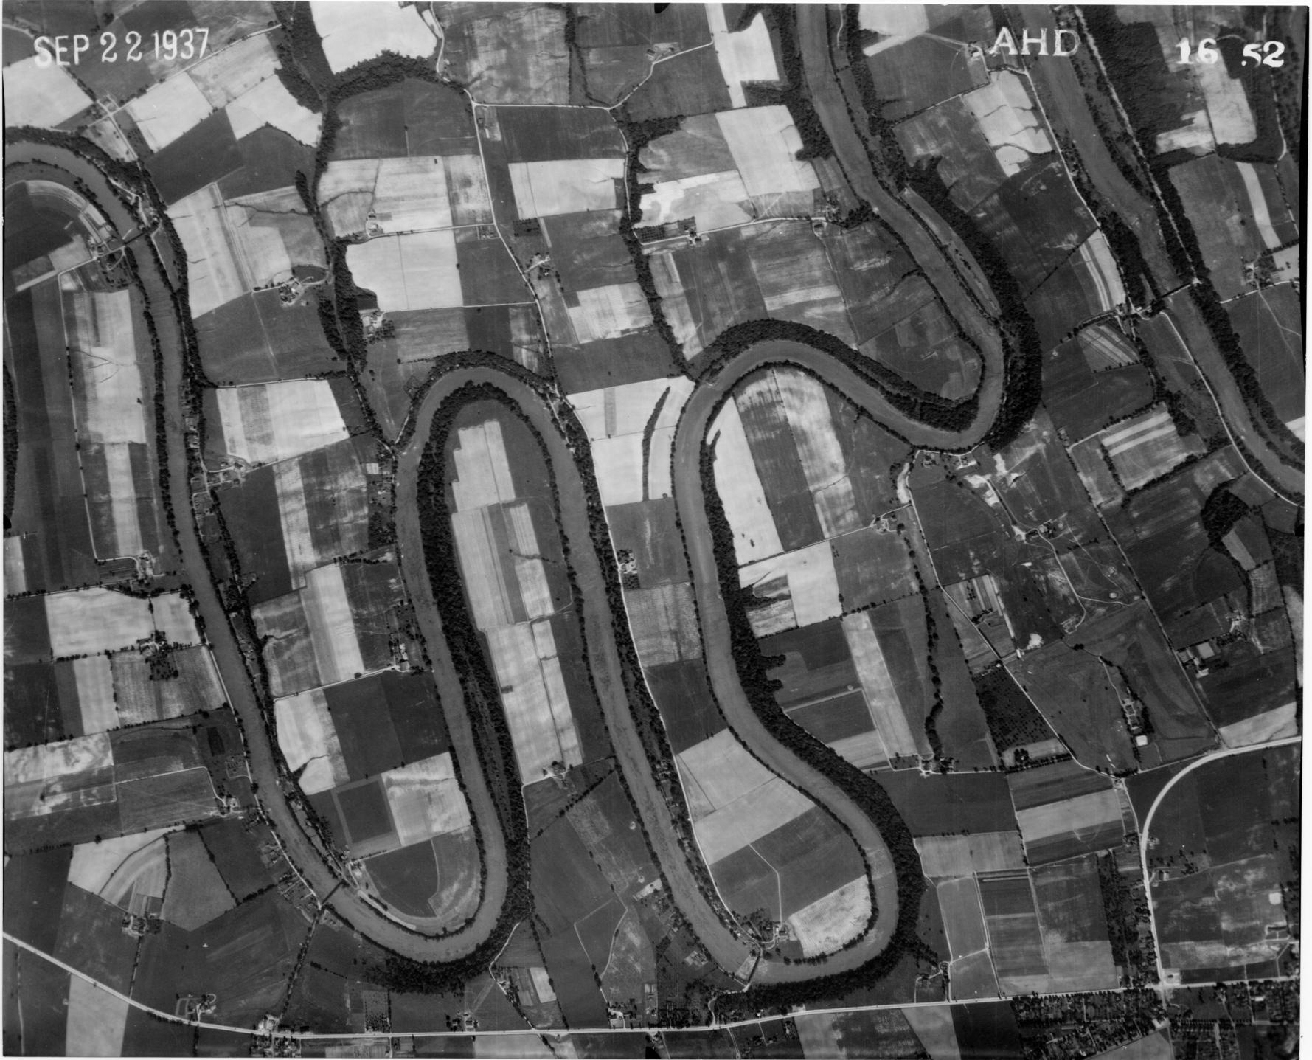

Slide 2
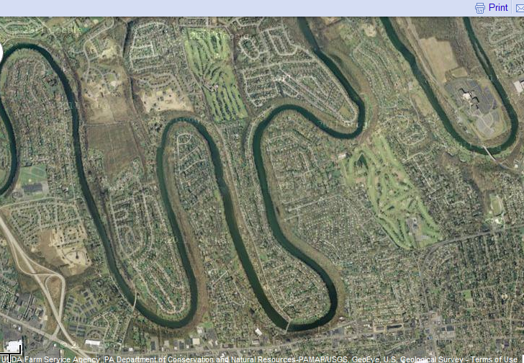

Slide 3
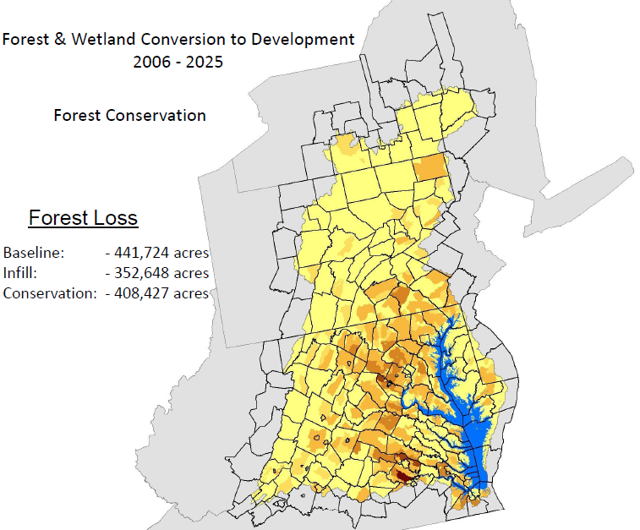
8 million new pounds of nitrogen
(10% of the TMDL)
$28 billion in offsets
Map courtesy of Peter Claggett, USGS

Slide 4
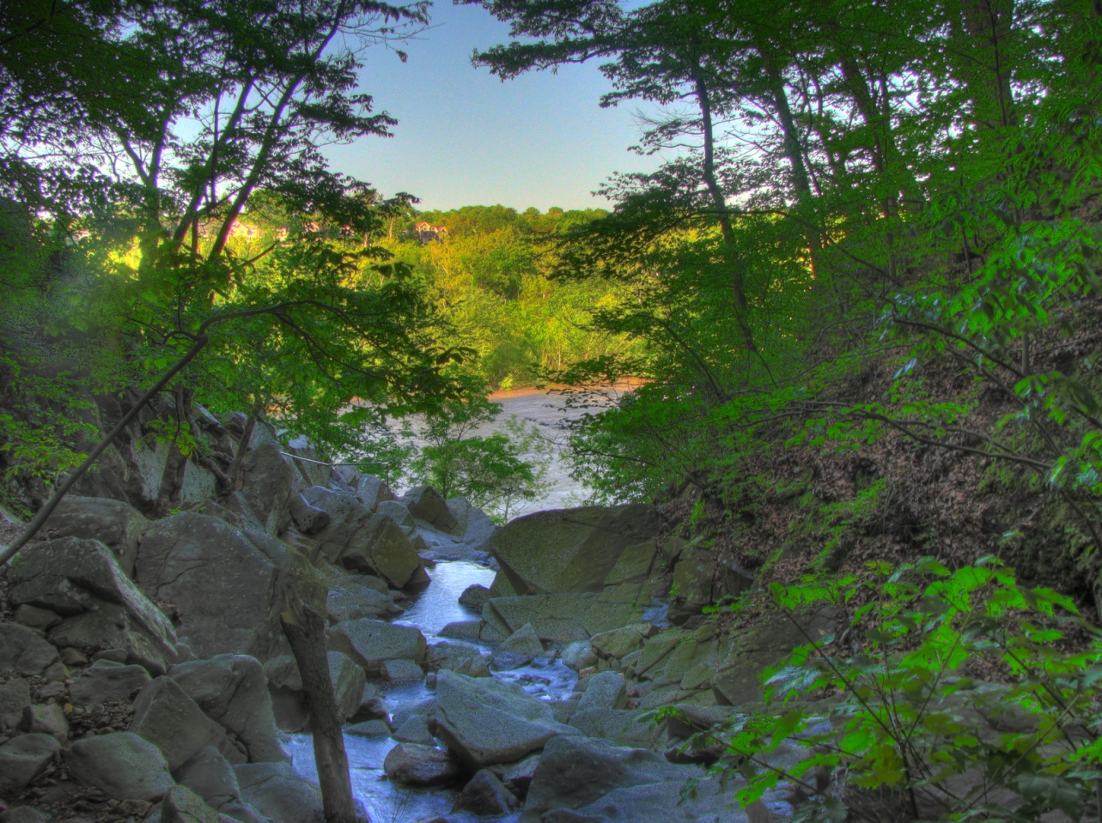

Slide 5
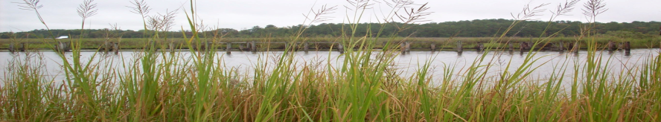
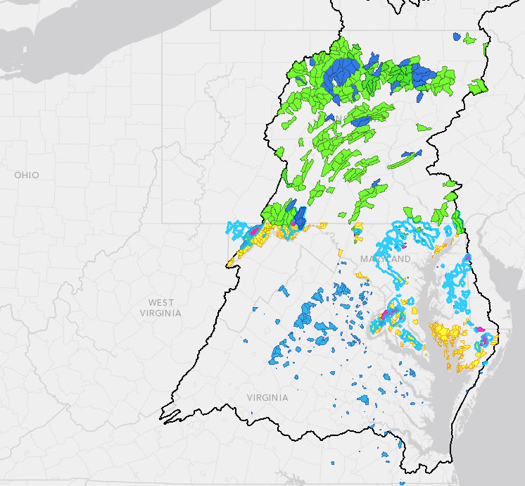
State Criteria for Healthy Watersheds
MARYLAND:
High Priority Water Quality Protection Watersheds
Priority Cold Water Conservation Areas
Sentinel Site Watersheds
Tier II Catchments
PENNSYLVANIA:
Exceptional Value (Designed & Existing Use)
High Quality (Designed & Existing Use)
VIRGINIA:
INSTAR Healthy Watersheds
MARYLAND:
High Priority Water Quality Protection Watersheds
Priority Cold Water Conservation
Areas
Sentinel Site Watersheds
Tier II Catchments
PENNSYLVANIA:
Exceptional Value (Designed & Existing Use)
High Quality (Designed & Existing Use)
VIRGINIA:
INSTAR Healthy Watersheds
Notes:
Here are the state definitions for “healthy watersheds” which were used:
Maryland Dept of Natural Resources and Dept of Environment have several classifications of watersheds, of which we used several for choosing localities to survey.
PA defines Exceptional Value and High Quality Waters that are part of the Pennsylvania Water Quality Standards
For VA we used INSTAR Healthy Watersheds, which is a stream ecological integrity assessment developed by VCU’s Center for Environmental Studies

Slide 6
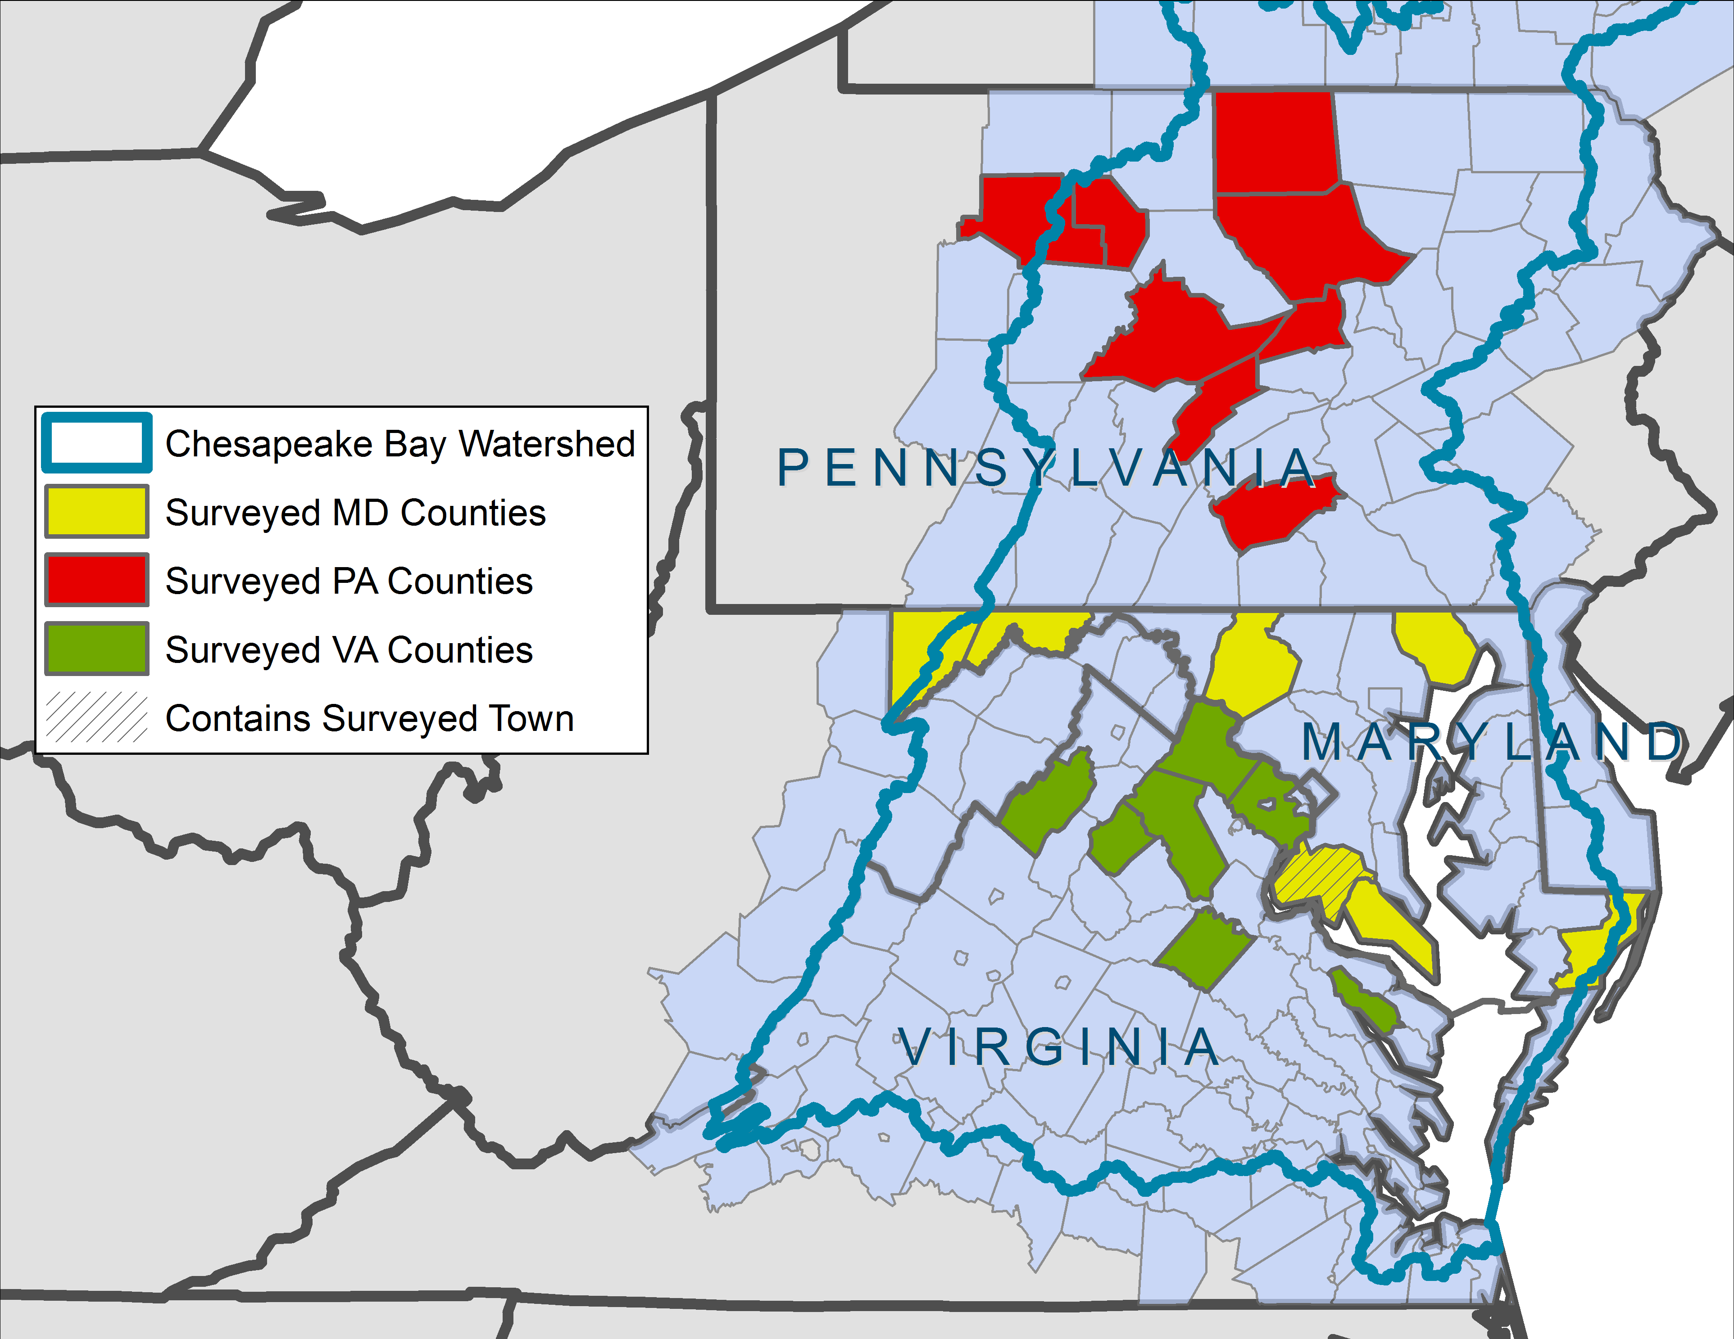
Surveyed Localities
MARYLAND:
High Priority Water Quality Protection Watersheds
Priority Cold Water Conservation
Areas
Sentinel Site Watersheds
Tier II Catchments
PENNSYLVANIA:
Exceptional Value (Designed & Existing Use)
High Quality (Designed & Existing Use)
VIRGINIA:
INSTAR Healthy Watersheds

Slide 7
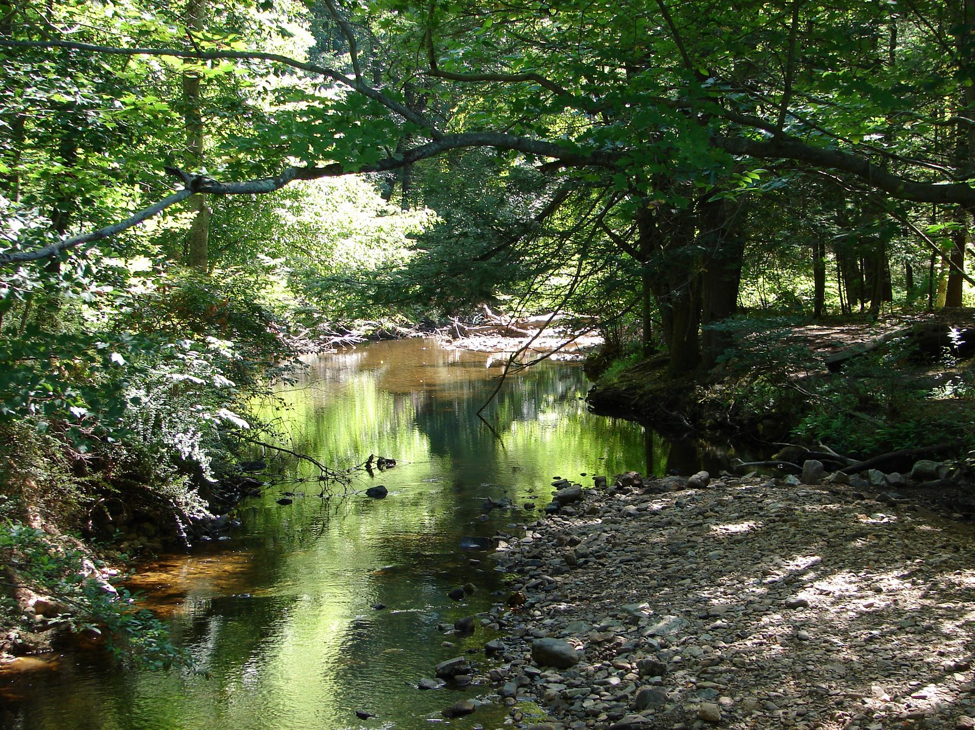
© Doug Cook
Notes:
Places that we all know and love…

