Slide 1
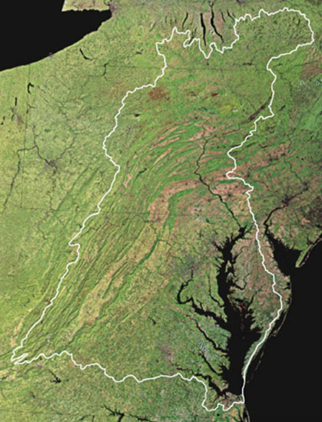
“The strength
of our commitment to the health
of the land
and to each other is written in the quality
of water
we send downstream.”
Luna Leopold
Notes:
Our mission is to bring together individuals, organizations, businesses, and governments to find collaborative solutions, to build a strong commitment to stewardship, and to deliver innovative, broadly supported programs that benefit the land, waters, and residents of the Chesapeake Bay watershed.

Slide 2

Reedy Creek Coalition Pilot Project
Engage community
Stormwater Audits
Audit Report
Financial Incentive Program

Slide 3
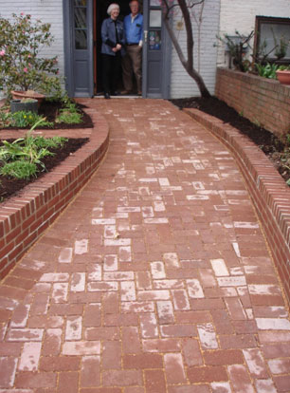
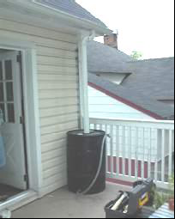
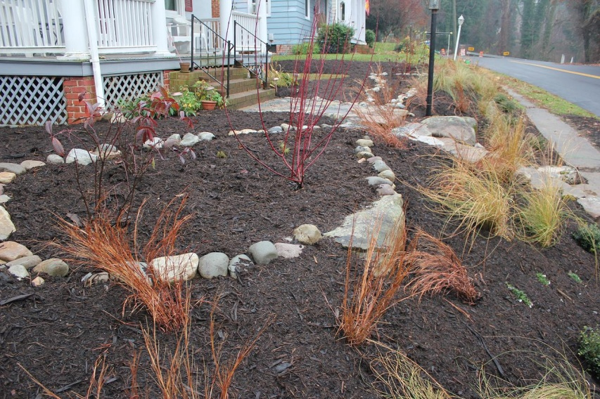
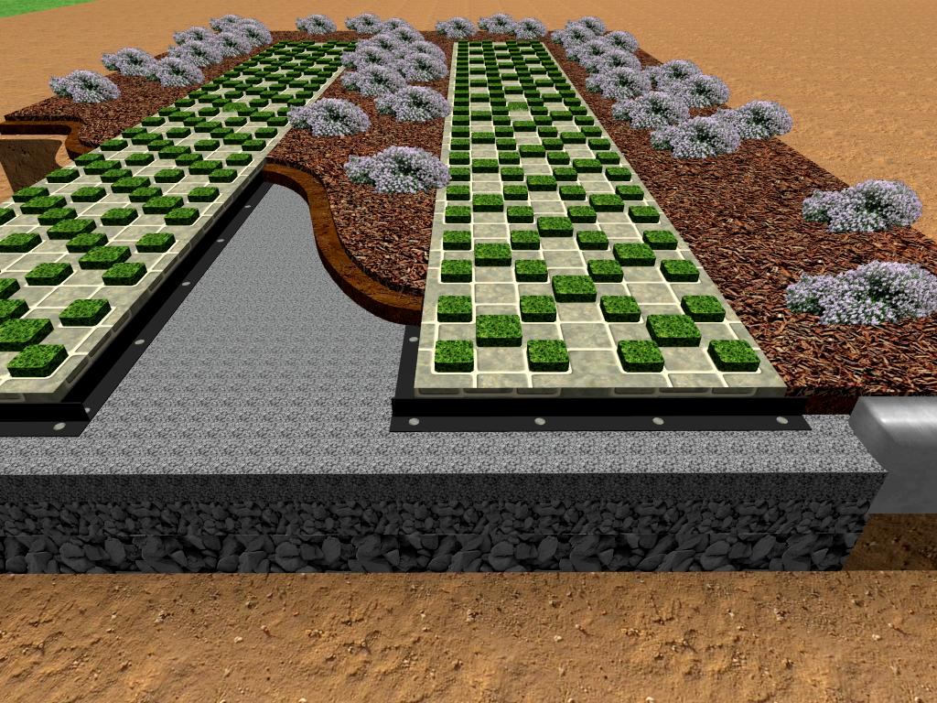
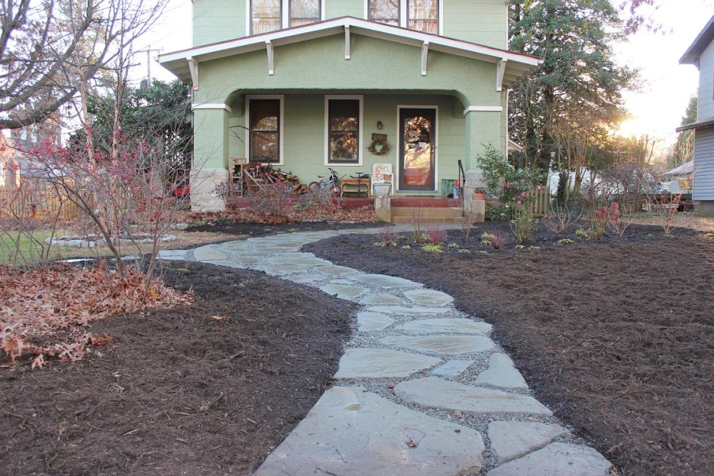
Chesapeake RiverWise Communities
Notes:
VA: we’ve partnered with the Reedy Creek Coalition
- residential and commercial stormwater management practices incentive program
- audit properties, prepare report
- financial incentives to install:
- rain barrels, trees, rain gardens, bayscapes, permeable pavers

Slide 4

Chesapeake RiverWise Communities
Engage
Inform
Advise
Implement
Track & Report
Maintain
Training & Certification
Stormwater Game
Stormwater Audits
Audit Reports
Financial Incentives
Mobil Tracking Tool
Inspection & Monitoring Protocols
Workshops
Notes:
What will RiverWise DO?

Slide 5
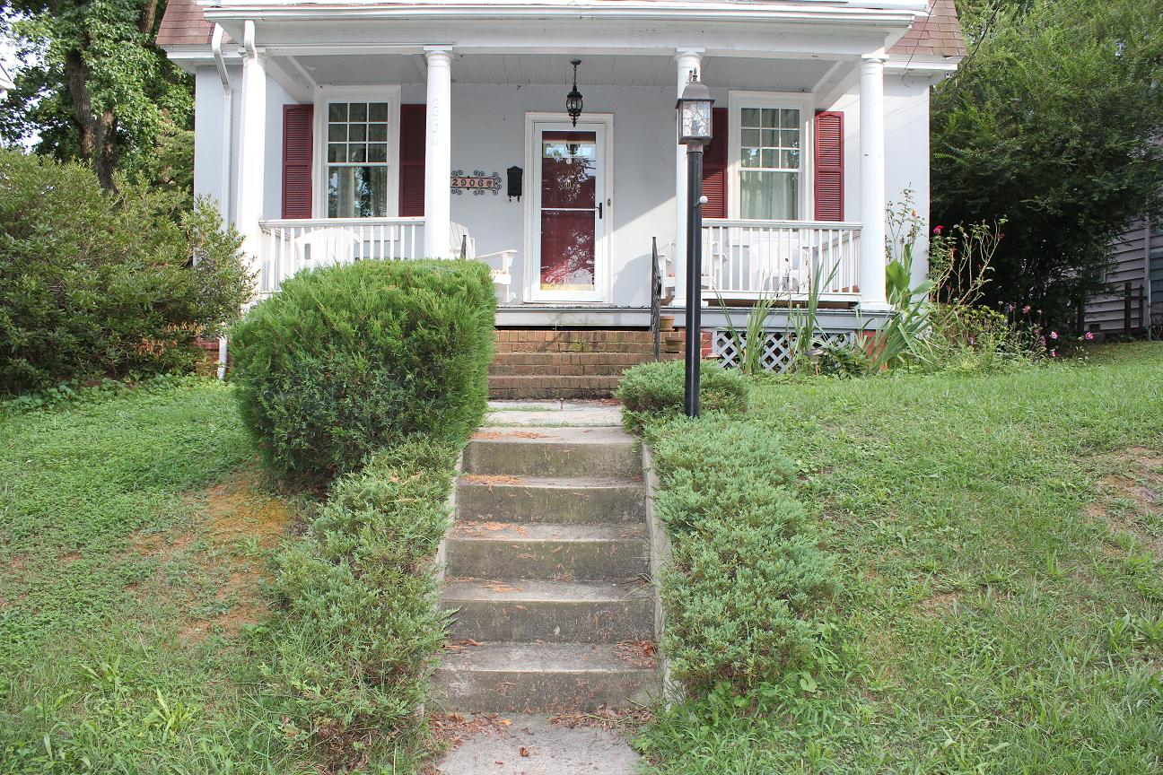
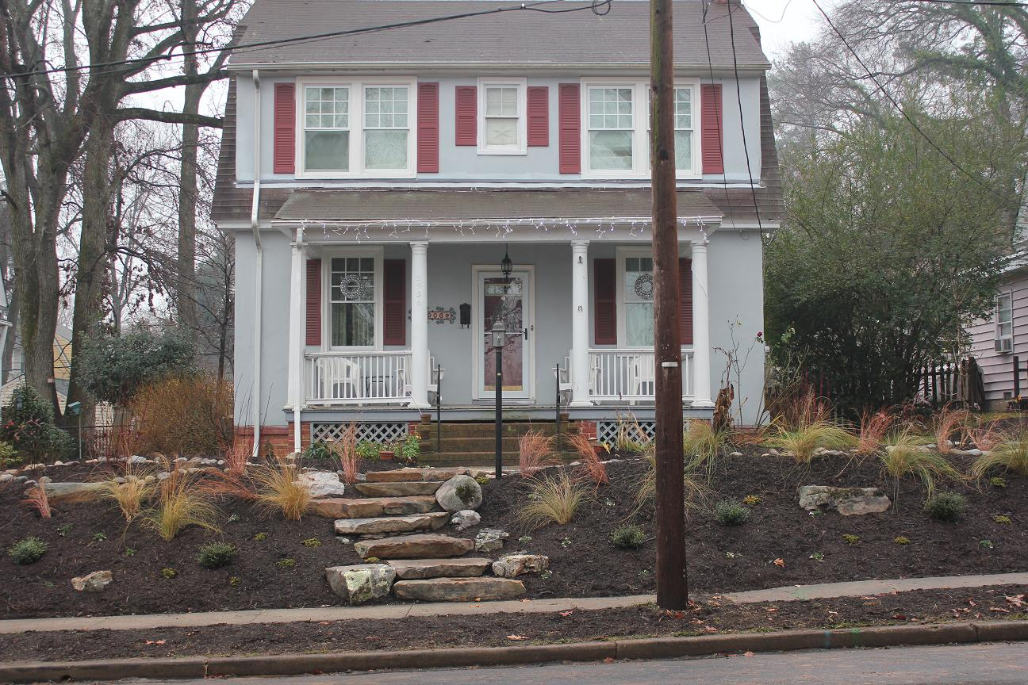
Chesapeake RiverWise Communities
Before
After
Notes:
Our program focuses on educating the public about the changes you can make in your own yard to help prevent stormwater pollution from getting into local rivers and streams. It’s amazing what difference just some seemingly aesthetic changes can actually make to improve water quality. On this slide and the next you see before and after shots of what one of our contractors has done. We’ve gone from mostly grass lawns, which don’t infiltrate much stormwater, to walkways made of permeable pavers and rain gardens and BayScapes that absorb and infiltrate stormwater and utilize native plants to attract beneficial wildlife. This particular property will have the bayscape installed in the spring.
As we continue to develop the components of our program, we will develop more tools that help us estimate and track pollution reductions, report those reductions to state and federal officials, and offer technical assistance and training to others on how they can implement this program in their watershed.

Slide 6
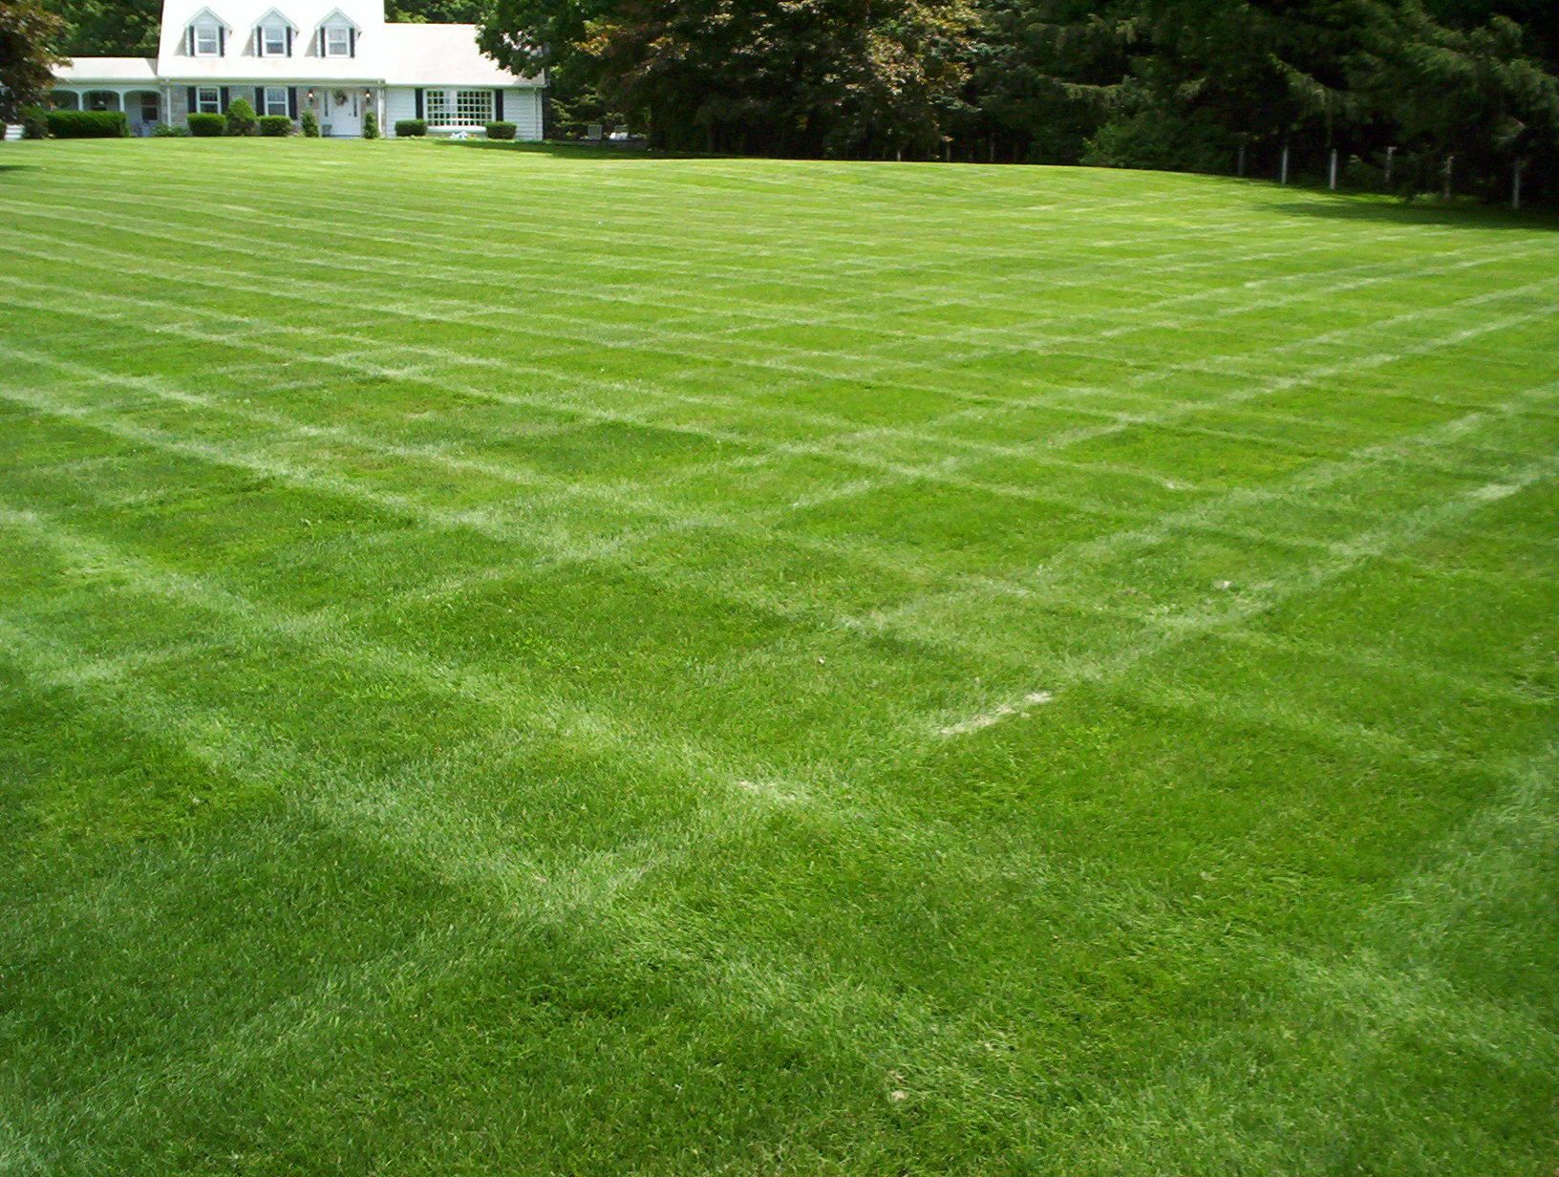


Slide 7
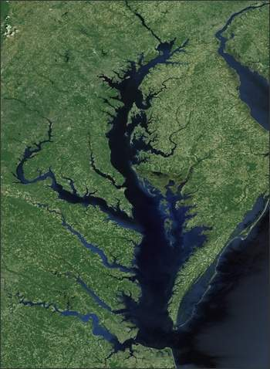

Crediting
Homeowner BMPs
to Help Meet the
Bay Pollution Diet

Slide 8
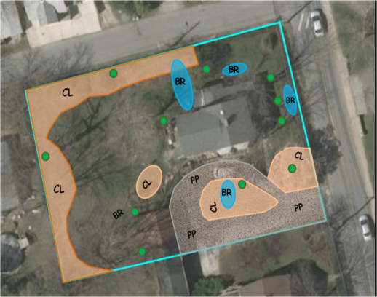
Homeowner BMP Crediting
UNM Plan for 9200 Bradford Pear Lane: 0.5 acres
1 | Get Expert Lawn Advice | ✓
2 | Maintain Dense Cover on Turf | ✓
3 | Choose NOT to fertilize | ✓
4 | Recycle Lawn Clippings and Compost Fallen Leaves | ✓
5 | Correct Fertilizer Timing | N/A
6 | Use Slow Release Fertilizer | N/A
7 | Set Mower Height at 3 inches | ✓
8 | No off-target fertilization | N/A
9 | Fertilizer free buffer zones around water features | ✓
10 | Increase soil porosity and infiltration | ✓
Urban Nutrient Mgmt
Rain gardens
Rainwater Harvesting
Downspout Disconnection
Tree Planting
Conservation Landscaping
Permeable Driveways

Slide 9
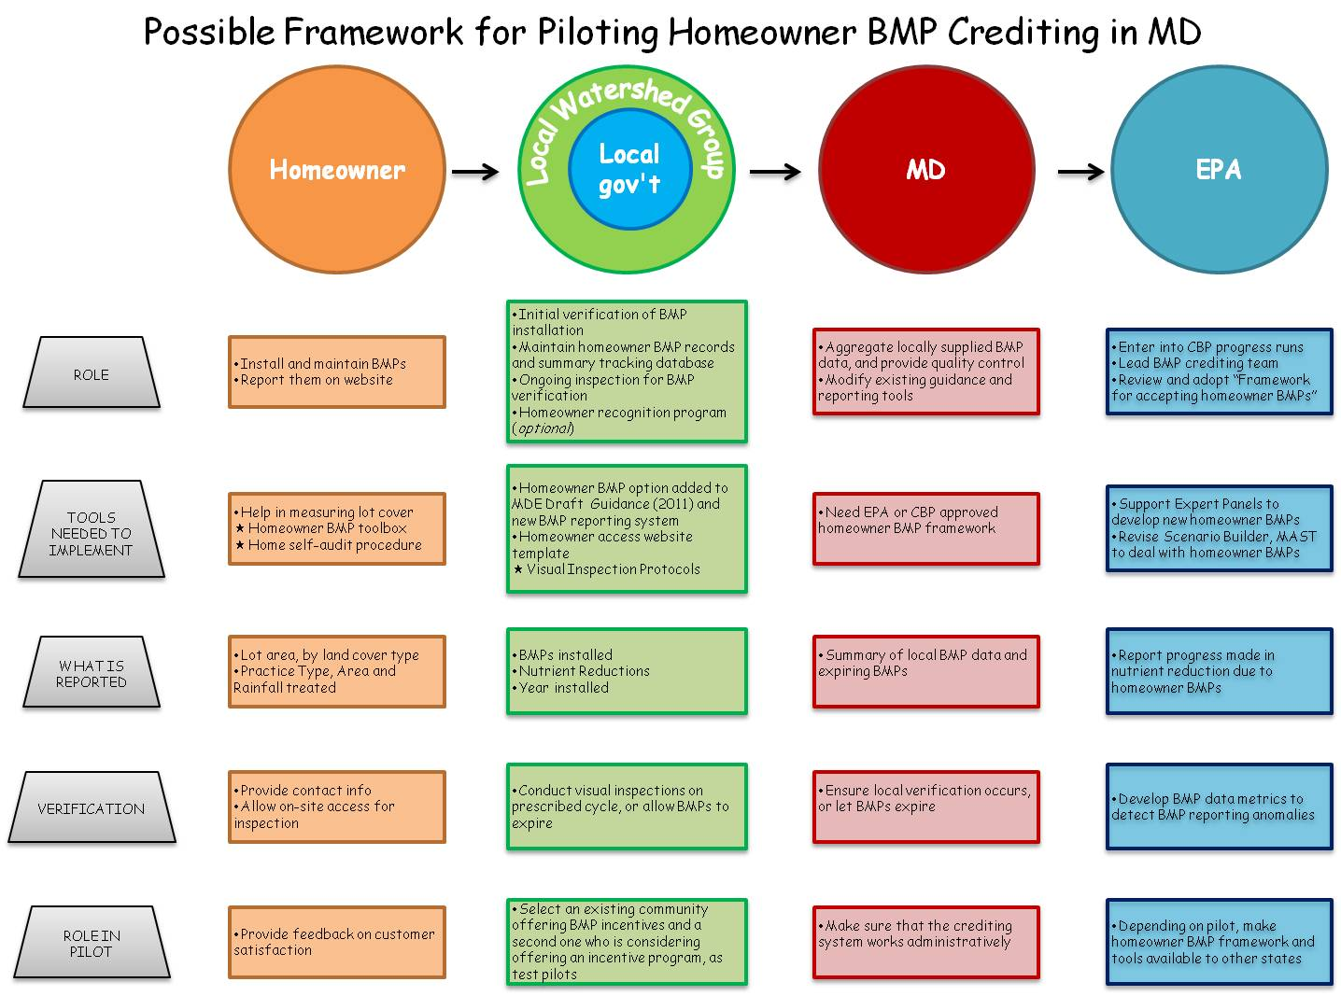

Slide 10
Homeowner uploads basic data to local web site
Other tools to manage and aggregate homeowner BMP from local and state databases directly into CBWM
Removal rates are based on expert panel reports

Slide 11
Next Steps
Conduct pilots in MD in 2013 to test tools, data management issues and verification capacity (MDE)
Homeowner BMP guide (Riverwise/CSN)
Ad hoc crediting team (EPA CBPO)
Bay-wide rollout to take credit for 2014 progress runs

Slide 12
Homeowner BMP Delivery Issues
Expand to non-residential properties
Link to local BMP incentive/subsidy programs
Credit BMPs installed to reduce stormwater utility fees
Training of on-site homeowner BMP evaluators
Link to other practices inside the home (e.g., energy conservation)

Slide 13
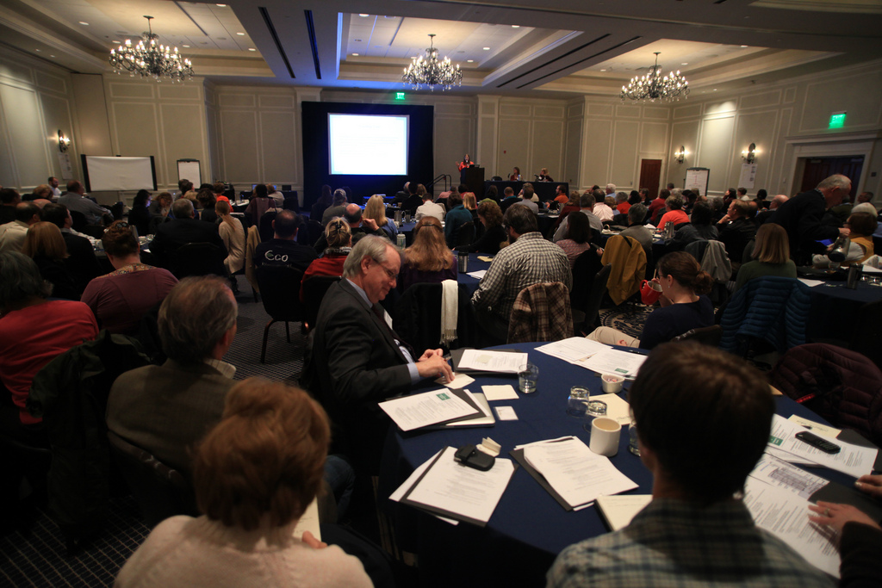
Collaborative Summit Feb 13 -14
Notes:
We know there are LOTS of other groups out there working toward the same or very similar initiatives who’ve developed amazing resources and tools. We heard there’s a few common needs out there:
A networked group of professionals
Consistent methodology for calculating pollutant load reductions that is accepted and applicable BAY-wide
Tracking tool that can be used universally, throughout the watershed to report load reduction and implementation data to localities, states, bay program
Innovative citizen engagement tools that will facilitate behavior change and encourage adoption of practices
Training tools, resources, programs
FUNDING FUNDING FUNDING
Nearly 200 attendees:
Private sector – nursuries, landscape architechts, engineers
Nonprofit organizations
State, local, federal government representatives
Soil and water conservation districts
Discussed current efforts, needs, resources, and impediments to homeowner BMP implementation – lots of feedback and volunteers to work with us on developing RiverWise program resources that meet broad spectrum of needs.

