Slide 1
READY Rain Gardens
Summer 2012
Notes:
Prelude
To share with you a program we launched for the summer of 2012
A program that combined watershed protection through stemming stormwater runoff, and solves another problem, the lack of jobs for young adults.
We call this program READY ....

Slide 2
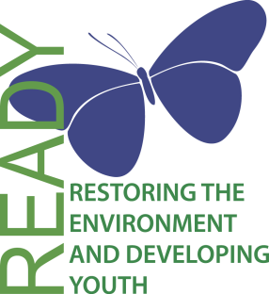
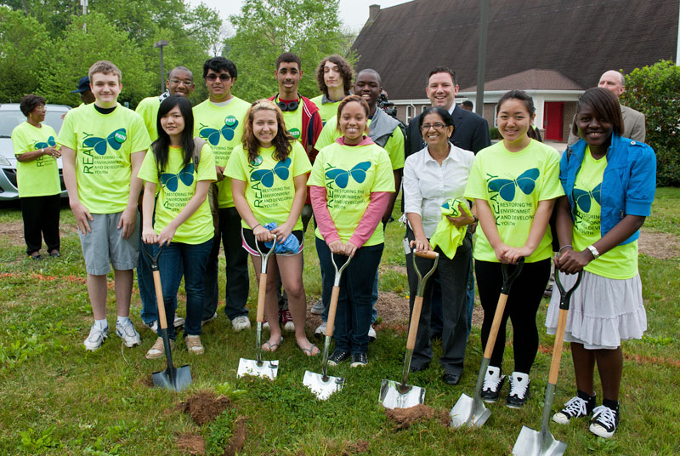
Restoring the Environment and Developing Youth (READY)
Creating green jobs for young adults, working to improve watershed health through reduction of stormwater runoff
Notes:
... Which stands for Restoring the Environment and Developing Youth.
In short, the READY program created 31 green jobs for young adults in Howard County
We put them to work building rain gardens and conservation landscapes on institutional properties
(picture from the 2 May 2012 groundbreaking / kickoff with Ken Ulman)
What I will cover in these next few minutes
Topics
Drivers
Overview of how we structured READY and got participation
Program goals
Delivery of the program
Ensuring practices are installed correctly and provide pollution reduction
Successes
Lesson-Learned

Slide 3
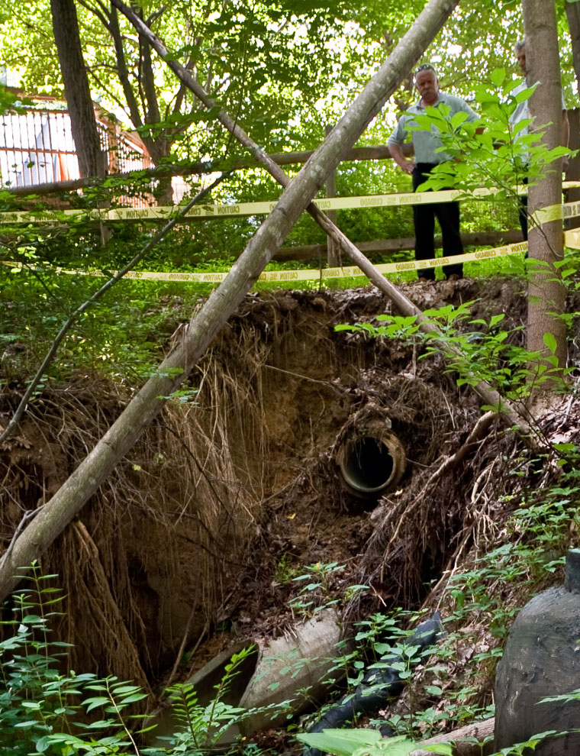
Drivers
Increasingly difficult for young adults to find jobs
2012 MS4 permit will, short-term, require treating 30% of impervious surfaces that have little stormwater runoff treatment
Implementation of Stormwater Remediation Fee affects all, including non-profits
Notes:
The key drivers for launching the READY program were, and are:
The lack of good jobs for young adults. Across the country youth (16-24) unemployment was 17.1% for July 2012. The BLS projection shows civilian labor force participation dropping to 48.2% in 2020, down from 55.4% in 2010. Some of what drives this are the babyboomers are staying in their jobs longer. While Howard County‘s unemployment in the aggregate at the end of 2012 was 6.6% seasonally adjusted, it is nonetheless harder, and will become increasingly harder for our young adults to get jobs. So job creation targeted at this age group makes sense. In 2012 almost 50% of the jobs for young adults across the country were in the hospitality (including food services) and retail sectors. We think green infrastructure is an emerging sector. Training young adults in this kind of work potentially gives them a leg up on starting meaningful careers.
2012 MS4 permit. 20 points over our targeted 10% target for treating impervious surfaces is a daunting challenge.
The Stormater Remediation Fee, will help deal with our TMDL bogies and provide funding for programs such as READY. However, the fee also affects non-profits such as churches which have huge paved parking lots. READY will prioritize work for congregations and non-profits so that they can apply for reductions of the fee. It‘s also a concrete way to show how the stormwater funds are being used.

Slide 4
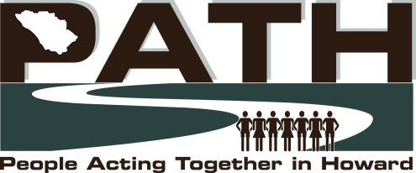

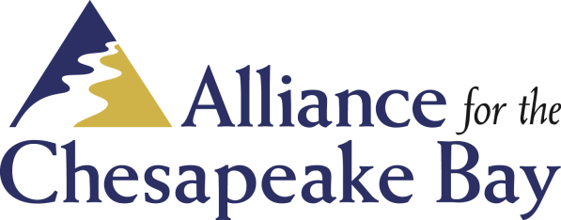


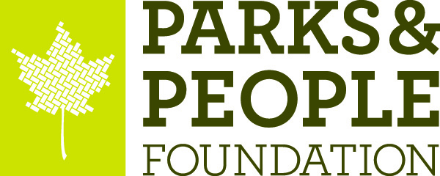
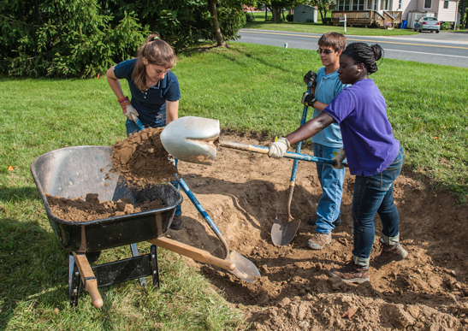
Organization and Participant Network
14 Congregations
representing
>15,000 people
31 young adults, ages 16-24
Paid living wages
Rain gardens and conservation landscaping
Environmental education
Exposure to potential future employers
Notes:
The idea for READY actually arose from within the Howard County community. PATH, People Acting Together in Howard, is an Industrial Areas Foundation affiliate. They operate something like union organizers. In Howard, PATH is comprised of 14 congregations representing more than 15,000 people. That community pinpointed the issues of jobs for young adults and the need to become better stewards of the environment.
Approached Ken Ulman, the CE, to discuss how the county and the community could partner to address those issues.
Our office, OES, was asked to spearhead implementing the READY solution.
We brought in the ACB for its experience in building these kinds of programs.
The Columbia Association Watershed Manager provided invaluable coaching and support, and introduced READY to many HOA's in Columbia
We also partnered with UMD Sea Grant Extension and P&PF for their knowledge of rain garden design and field work expertise.
Provided funding through a grant to the ACB from the county.
PATH screened the applicants, putting in some 250 man-hours. Many of the applicants came from PATH community, but we also had youth who were not associated with PATH. The ACB hired the young adults for the summer of 2012.
Paid living wages ($10 for Crew Members, $14 for Crew Leaders)
Trained the young adults to work safely to build rain gardens and cons landscapes
Provided them a day a week of environmental education on various Chesapeake ecology topics, and gave them opportunities to learn about green jobs in the industry.

Slide 5
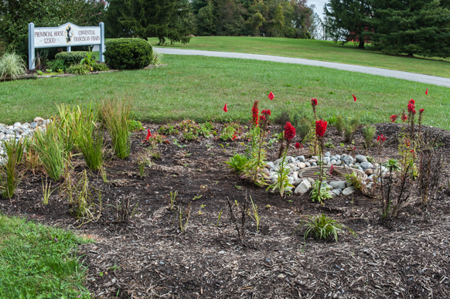
What READY Accomplished
LOCATIONS
In 2012, 31 rain gardens and conservation landscapes
Treated ˜200,000 sq. ft. of impervious surfaces
Locations: prominent institutional properties (schools, congregational grounds, homeowner association properties)
Beth Shalom Congregation Bethany United Methodist Church
Dorsey Emmanuel United Methodist
The Enclave at Ellicott Hills
Forest Ridge Elementary School
Franciscan Friars’ Provincial House
Glen Mar United Methodist Church
Howard Community College
Manor Woods Elementary School
Morningside Park Senior Apartments
Oakland Mills Interfaith Center
Owen Brown Interfaith Center
Rockburn Elementary School
Spring Breeze Community Association
Temple Isaiah
Wilde Lake Interfaith Center
Notes:
READY was totally an experiment for Howard County. Nothing like this has been done in the County before, so we had no way to calibrate the targets. We set a target of treating 120,000 sq. ft. of impervious surfaces, and thought they would be hard-pressed to get 4 properties to sign up.
All told the READY team installed 31 rain gardens and conservation landscapes across Howard County
Collectively these measures treat some 200,000 sq. ft. of impervious surfaces
beating the target
Worked at institutional properties including congregational grounds, schools, home owner associations, and other non-profits

Slide 6
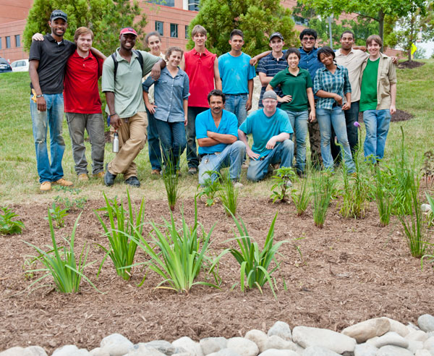
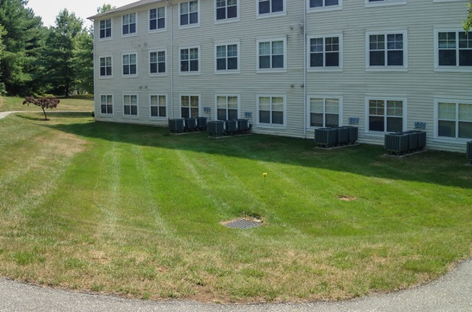
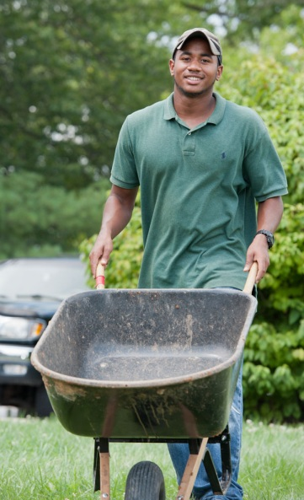
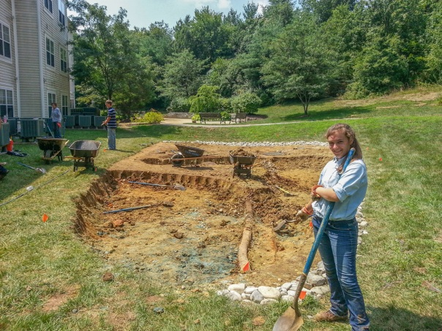
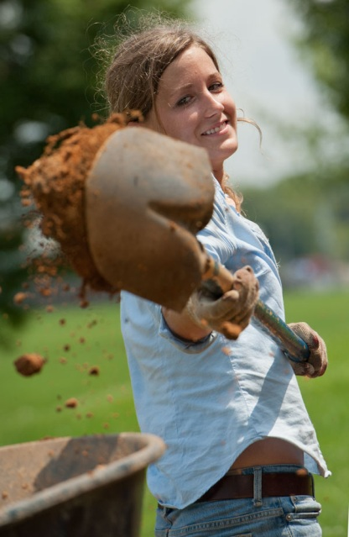
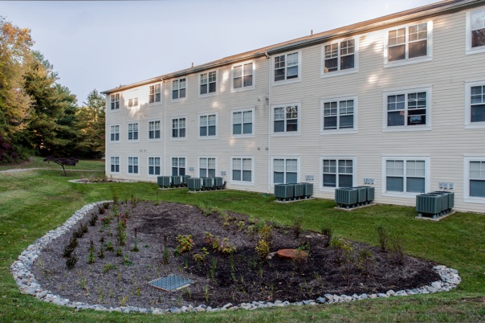
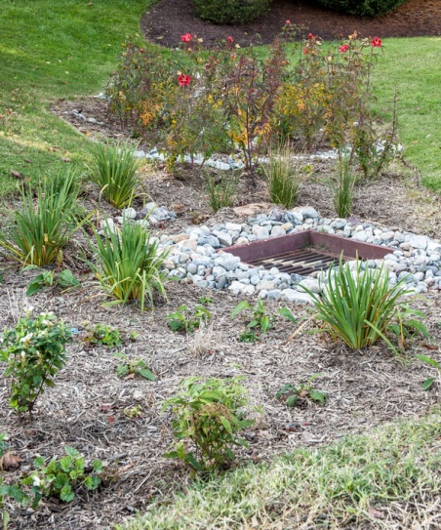
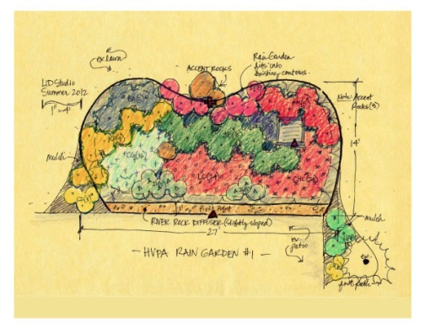
Working, Learning, Making a Difference
Notes:
The READY team was divided into crews of 6, each with one Crew Leader and five Crew Members.
They deployed to different sites, sometimes as single crews, in many cases as groups of two or more crews depending on the size of the site.
Pictured here are before, during, and after stages of the work at Morningside Park Senior Apartments, one of our Howard County Public Housing facilities. The READY team built 4 rain gardens here, three relatively small ones plus this big one. Together the rain gardens are about 2600 sq. ft. treating somewhere around 22,000 sq. ft. of rooftop, pavements, and actuall y the grassy areas that were simply sheeting water toward a storm sewer in the middle.
One thing we noticed at a lot of locations are how landscapes have been constructed to empty into storm sewers. Since these are always at the lowest spots, we thought about creating some pooling through raising the storm sewer openings by adding a couple courses of bricks beneath the grates. An expedient measure which seems to work was to install a collar made of 2x6's around the opening, effectively raising the opening.

Slide 7
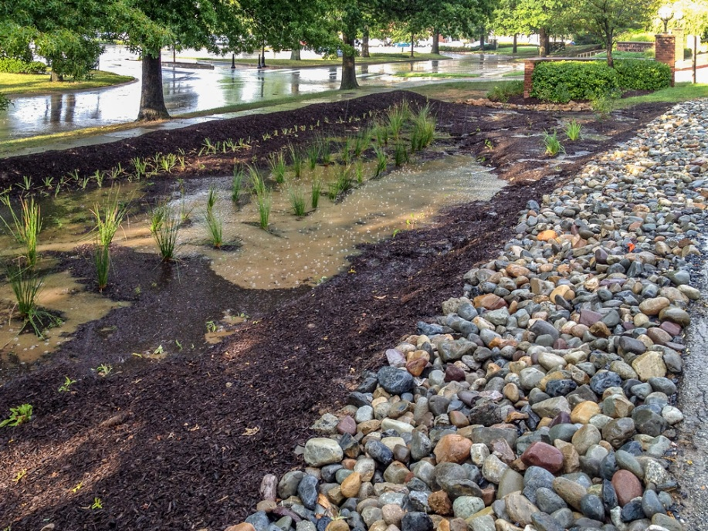
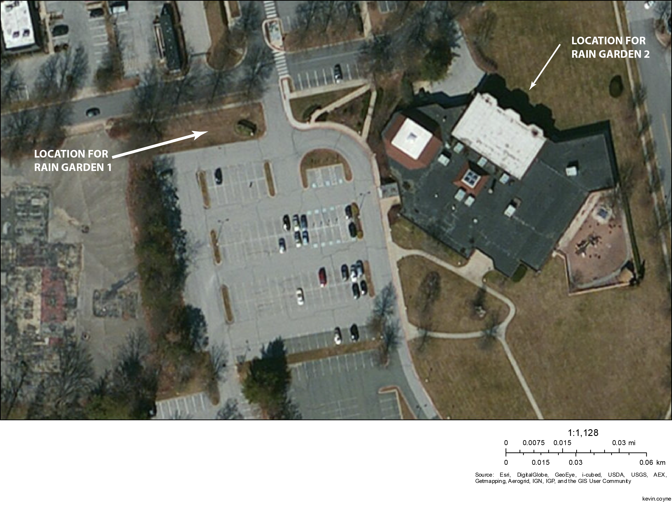
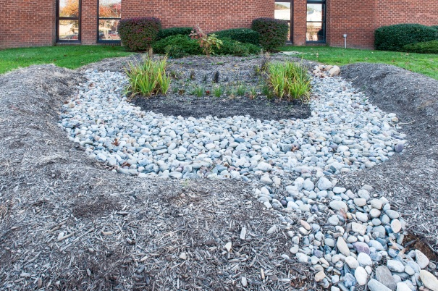
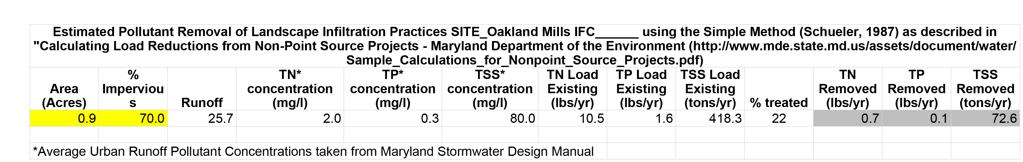
Oakland Mills Interfaith Center
Rain Garden 1 treats ˜22,000 sq. ft. of parking lot surface. Rocks prevent pooling of water and undercutting of pavement edge.
Rain Garden 2 ties in three downspouts piped underground to treat ˜8,000 sq. ft. of rooftop. Installation eliminates erosion down the side of a driveway.
Notes:
Here's another example. This site is the Oakland Mills Interfaith Center in Columbia MD.
The aerial shows the large parking lot and the rooftop surfaces of the building.
Part of the parking lot, again amounting to 22,000 sq. ft., drains into a previously grassy swale that used to just move the water onto the adjacent property to the west.
The picture on the left shows the parking lot rain garden partially filled during a thunderstorm.
The east side of the building is where we put in a second rain garden. Two of three downspouts, flowing water from around 8,000 sq. ft. of the roof, used to splash out onto a driveway to the north of the building. That water had eroded and undercut one edge of the driveway to the point the pavement was crumbling. All three downspouts are tied in through trenched hoses with cleanouts to the rain garden (bottom photo). The building manager gave us some footage that shows the rain garden filling up during a storm. He said that by the next day there was no water left on the surface of the garden.
This is an example of an additional value to doing these kinds of watershed protection measures on properties. In many cases the customers had flooding and erosion problems that the rain gardens now cure.
We did some pollution removal estimates using the simplified Schueler method.

Slide 8
Lessons-Learned
What worked
Combining job creation for young adults with stormwater runoff reduction was an experiment for Howard County – and it was a success!
Training is key – no accidents
Environmental education elements help these students become watershed protection ambassadors
What needs work
Logistics and supply chain management can be challenging
Maintenance and auditing of distributed stormwater systems across the county will become ever more important to ensure long-term viability
Evolve READY into a more general-purpose youth conservation corps
Add other grant and funding sources to increase number of jobs
Notes:
Summarize with some what worked, and what we could do better:
The young adults clearly found value in the READY program. For many the money is helping them to pay for school. One woman is finally able to start paying her grandmother back for years of piano lessons. Each of the young adults has an interesting story.
The young adults are also flexible. Many instantly changed their habits about water usage. As you heard one say in the video, many also said they "had no idea" about the problem of stormwater runoff. READY might be a drop in the bucket, so to speak, but if we could spread such behavior change we could make a difference in less than a generation.
Training was a key factor. Fortunately we had no accidents in 2012 because we stressed safety. But think about it. These young adults
learned about first aid and emergency procedures
using tools efficiently
got some exposure to the why's and practices of rain garden design
got Environmental Education about Chesapeake ecology, hydrology, aquaculture, invasive species, endangered species, and water reclamation
learned how to work and communicate as teams under harsh conditions
Put that together, that's one helluva learning experience that most would not get from a summer job in retail or fast food service.
(Continues on next page)

Slide 9
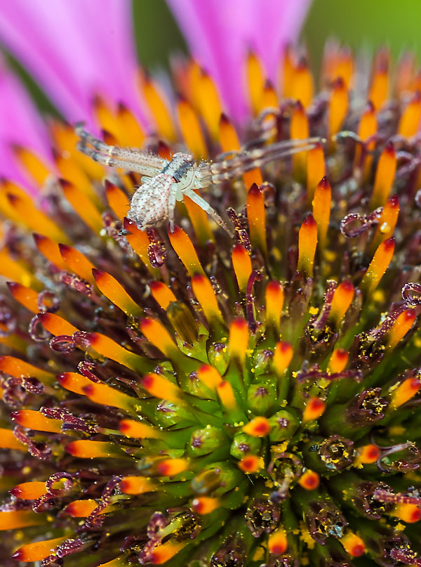
Thanks for Your Attention!
For further information, contact:
Jim Caldwell
Watershed Manager
Office of Environmental Sustainability
Howard County
jcaldwell@howardcountymd.gov
Notes:
What needs work?
Logistics and supply chain management were issues. None of the building rain garden guides tell you what to do with excess soil, and you tend to have to replace a lot of our Piedmont clays with bio-soils around here. In 2012 we had to find all sorts of ad hoc ways to get rid of the excess soil. For 2013 we are making arrangements to collaborate with other HC organizations to help with that issue, in part by trying to mix our own bio-soil using some of the excess soil which may also drive down costs. Another issue we had was the supply of plants. Though the work was targeted for the summer, one really needs to place orders for plants early, alongside the landscapers that work year-round.
We know that we cannot get to our TMDL bogies just through big construction projects downstream -- we have to move upstream to capture rainwater where it falls. That means watershed protection measures will have to be distributed, even to the homeowner and commercial entity level, not just the READY rain gardens. And that will pose the challenge of maintaining the watershed protection measures to ensure they remain functional, and inspecting them to verify the functionality. As for READY, their first task for 2013 will be to inspect what they put in last year. We know the gardens all structurally survived the rains of Superstorm Sandy. Some could use some tweaks. Mainly we want to see that the property owners are taking care of the gardens.
Evolve the program into a more general purpose conservation corps (you elaborate)
The partnership will apply for more grant funding to expand to cover more jobs.

