Slide 1

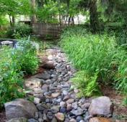
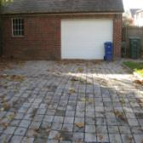
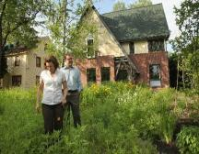


DC RiverSmart Homes Program
…to reduce stormwater pollution in the capitol

Slide 2
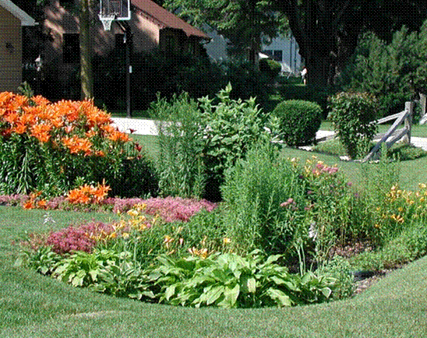
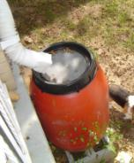
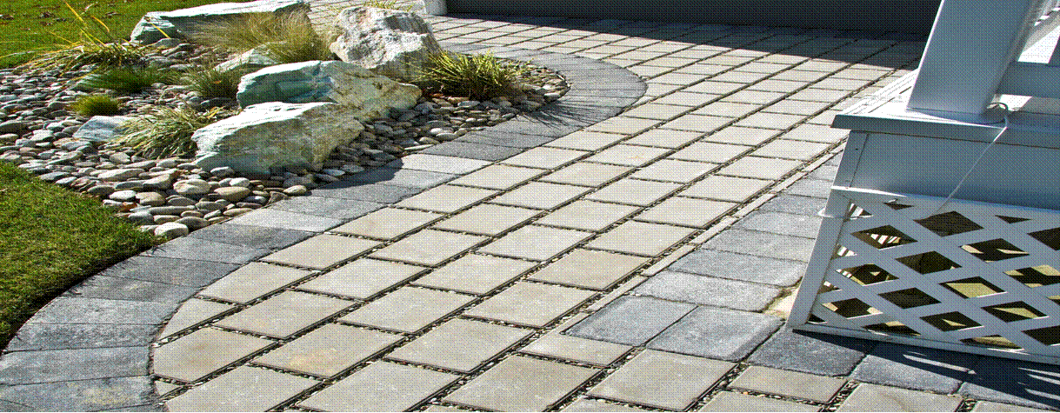
RiverSmart Programs
River Smart Homes - Homeowners who install rain gardens, BayScapes, Rain Barrels, Trees, and remove impervious surface.
River Smart Schools – DDOE Hands-on Education
River Smart Communities – Apartments and Condos

Slide 3
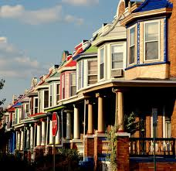
RiverSmart Homes
The program is available to residents of DC only.
Homeowners contact DDOE for a ‘stormwater audit’ of their property.
Auditors suggest BMPs and homeowner selects.
Rain Barrel (DC Greenworks)
Rain Garden
BayScapes
Reduction of Impervious Surface
Tree Planting (Casey Trees)
Downspout Disconnection

Slide 4
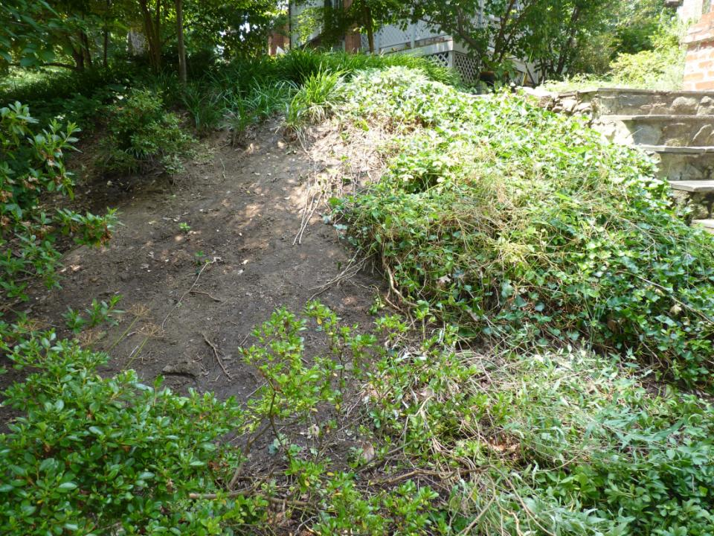
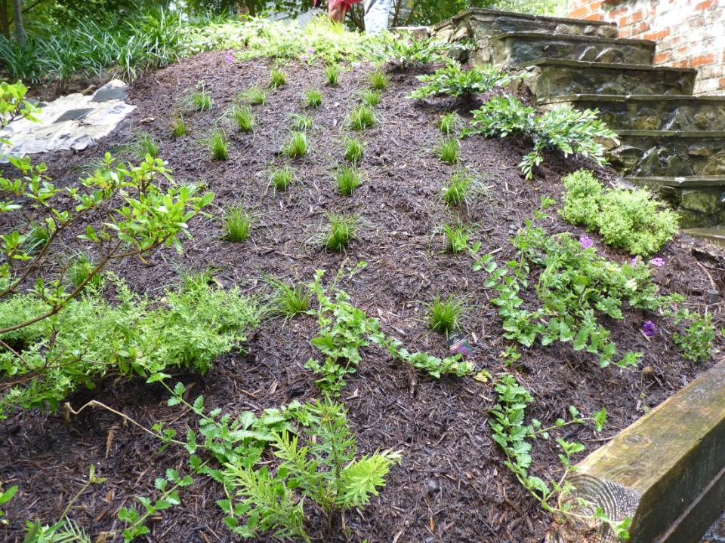
Notes:
Click to show before and after bayscape stabilizing a slope

Slide 5
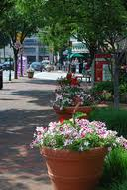
RiverSmart Homes Process
Homeowners choose to install rain gardens, BayScaping, or reduce imperviousness.
The Alliance assigns these homeowners to participating trained contractors.
Homeowners pay:
A $75 copayment for a rain garden
A $100 copayment for a BayScapes
Contractors install for $1,200
Pavement removal or pervious pavement is more expensive and homeowners agree to pay the difference over $1200.
DDOE(and Alliance ) do maintenance checks
Notes:
DC Greenworks handles the rain barrels. Casey Trees does the tree planting. In order to be a RiverSmart contractor you must attend a training and follow our installation guidlelines. Homeowners are notified of their assignment and are given a Maintenance Agreement and copayment form.

Slide 6
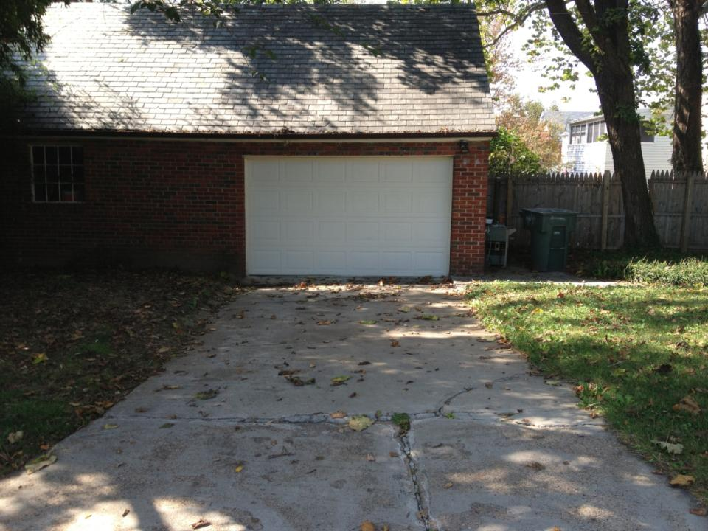
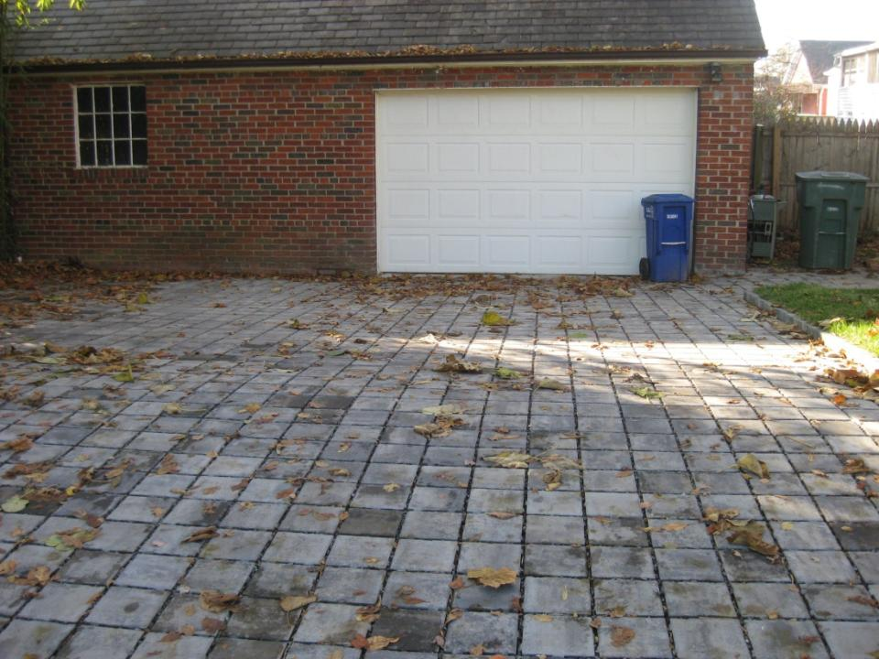
Notes:
Click to show before and after of pavement

Slide 7
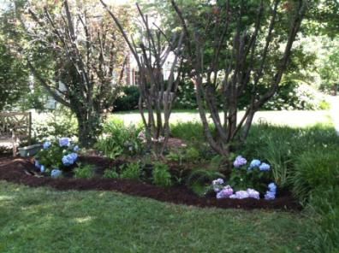
RiverSmart Homes
River Smart Rebate Pilot Program – up to $1000 for >400 sq ft with Alliance certification.
Since 2009, Alliance has completed over 1000 residential projects.
Success is measured by amount of impervious surface treated with rain gardens and pervious pavement, and number of homeowners that have participated.

