Slide 1
Extent and Severity of Toxic Contaminants in Chesapeake Bay and the Watershed
Scott Phillips (USGS) and Greg Allen (EPA)
Notes:
Provide a quick overview of an upcoming report about the extent and severity of toxic contaminants in the Chesapeake Bay and its watershed. Being prepared by several federal agencies including EPA, USGS, and FWS.

Slide 2
Report and Objectives
Contaminants effect fish and wildlife
CBP Toxics 2000
EO Strategy
Summary Report released
  Extent and severity
  Biological effects
Used by EPA and CBP to consider:
  Goals for reducing contaminants
  Monitoring and research
Notes:
-We did the report because CBP was concerned about toxic contaminants. CBP had developed the Toxics 2000 Strategy to reduce their impacts. Since 2000, new concerns have arisen such as compromised reproductive systems in fish and wildlife. Due to existing and new concerns, the Chesapeake Executive Order Strategy called for a : “Report on the extent and severity of contaminants in the Bay and watershed”
-Findings to be used by the CBP to consider:
-new goals for reducing toxic contaminants as part of alignment process (Carin presented current goals previously)
-help guide potential future research and monitoring activities
So for today I want to discuss key findings and major revisions we made to address comments provided by technical and CBP partner reviewers.
Get initial feedback from the MB on process for considering goals.

Slide 3
Contaminant Groups
Polychlorinated biphenyls
Dioxins and Furans
Polycyclic aromatic hydrocarbons
Petroleum hydrocarbons
Pesticides
Pharmaceuticals
Household and Personal Care Products
Polybrominated diphenyl ether Flame Retardants
Biogenic hormones
Metals and Metalloids
Effects on fish and wildlife
Notes:
We classified the extent and severity of these contaminant groups.
Combination of traditionally monitored groups and also groups of emerging concern.
We also summarized information on effects on fish and wildlife.

Slide 4
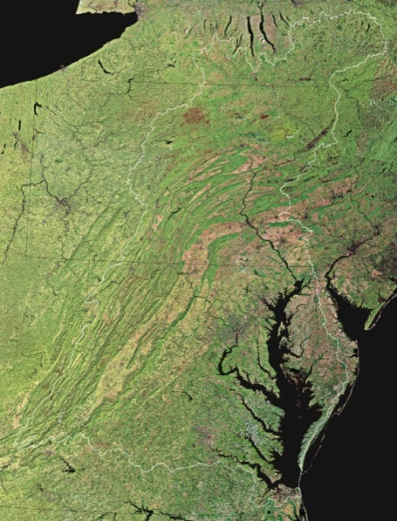
Assessment Approach
Define extent and severity
  Widespread, localized, or uncertain
  Information used and limitations
Extent
  Widespread: throughout watershed
  Localized: limited watersheds
Severity
  Widespread: impairments listed at many locations
  Localized: few locations
Uncertain: lack of monitoring or standards
Notes:
The report defines both in extent and severity of contaminant groups with three possible classifications: widespread, localized, or uncertain. The findings in this report are based on a review of integrated water-quality assessment reports from the jurisdictions in the Bay watershed (Delaware, Maryland, New York, Pennsylvania, Virginia, West Virginia, and Washington, D.C.), Federal and State reports, and articles in scientific journals. Two revisions we made based on reviewer comments was a had an uncertain “classification” if data were not available. We also focused on more recent information --summarizing results of studies conducted mostly since 2000 and, in particular, the 2010 jurisdictional water-quality assessment reports were used.
The approach we used and associated decision rules to define extent and severity were as follows:
Extent is characterized as “widespread,” contaminant has been detected throughout the watershed or “localized” if only in a limited number of subwatersheds.
Severity was based entirely on the jurisdictions’ impairment determinations as identified in the integrated assessment reports. Contaminants that have caused impairments in many locations are considered to have widespread severity, contaminants associated with impairments in few locations are classified as having localized severity,
Uncertain: not adequate monitoring information to define occurrence or did not have water-quality standards to identify impairments, Help to identify monitoring/Research gaps.
Let’s go through some results—first for extent and then severity

Slide 5
Extent
Widespread:
  PCBs, PAHs, Mercury
  some herbicides (atrazine, simazine, metochlor, and their degradation products)
Localized:
  Dioxins/furans, petroleum hydrocarbons
  Insecticides (aldrin, chlordane, dieldrin, DDT/DDE, heptachlor epoxide, mirex)
  Metals: Al, Cr, Fe, Pb, Mn, Zn
Uncertain: pharmaceuticals, care products, flame retardants, some pesticides, hormones
Notes:
Widespread extent: For polychlorinated biphenyls (PCBs), polycyclic aromatic hydrocarbons (PAHs), herbicides (primarily atrazine, simazine, metochlor, and their degradation products) and mercury, available information indicate widespread extent thought the Bay watershed.
Localized extent: For dioxins/furans, petroleum hydrocarbons, some chlorinated insecticides (aldrin, chlordane, dieldrin, DDT/DDE, heptachlor epoxide, mirex), and some metals (aluminum, chromium, iron, lead, manganese, zinc), the report identifies localized extent of contamination.
Uncertain extent: For pharmaceuticals, household and personal care products, flame retardants, some pesticides, and biogenic hormones, information was not adequate to determine extent. However, the widespread distribution of known sources of these contaminants (e.g., wastewater effluents, agricultural runoff, etc.) in the watershed and the summarized occurrence data indicate that some contaminants from each of these groups may have the potential to be found in many locations throughout the Bay watershed. So this was a monitoring gap.

Slide 6
Severity
  Widespread: PCBs and mercury
  Localized:
  dioxins/furans, PAHs, petroleum,
  Insecticides: aldrin, chlordane, dieldrin, DDT/DDE, heptachlor epoxide, mirex
  Metals: Al, Cr, Fe, Pb, Mn, Zn
  Uncertain:
  pharmaceuticals, care products, flame retardants, biogenic hormones
  herbicides (atrazine, simazine, metochlor, and their degradation products)
Notes:
Key overall conclusions about the severity of contaminant groups examined in this report are:
Widespread severity: PCBs and mercury have impairments identified in all of the watershed jurisdictions, meaning concentrations are known to compromise the health and quality of aquatic organisms. PCBs and mercury also create a risk to human health through consumption of contaminated fish.
Localized severity: For dioxins/furans, PAHs, petroleum hydrocarbons, some chlorinated pesticides (aldrin, chlordane, dieldrin, DDT/DDE, heptachlor epoxide, mirex), and some metals (aluminum, chromium, iron, lead, manganese, zinc), the report identifies localized severity based on impairments in a limited number of areas in the Bay watershed.
Uncertain severity: pharmaceuticals, household and personal care products, flame retardants, and biogenic hormones, severity could not be determined. For many pesticides including herbicides that had widespread occurrence (atrazine, simazine, metochlor, and their degradation products), water-quality standards were not available to determine impairments for these contaminant classes. However, some research shows sublethal effects for some compounds at environmentally relevant concentrations. So this is a research gap.

Slide 7
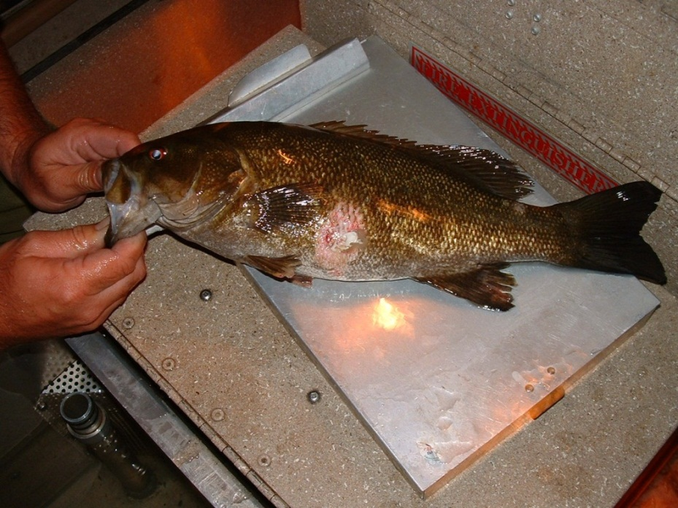
Biological Effects
Degraded fish health
  Infections and parasites
  Feminization
  Reduced reproduction
  Tumors
Wildlife: Reproductive impairment in water birds
  Eggshell thinning (DDE)
  Embryo lethality (pesticides)
  Hatching success (PCBs)
Notes:
Additional supporting information on the toxic effects of contaminants on fish and wildlife was summarized to inform the discussion of severity. This information provides insights that can be used in assessing the cumulative and interacting effects of toxic chemicals as well as other stressors on fish and wildlife.
The following indicators of degraded aquatic ecosystems have been observed within fish populations in the Chesapeake Bay watershed: increased incidence of infectious disease and parasite infestations contributing to increased mortality in several species of fish; feminization (intersex) of largemouth and smallmouth bass and other signs of endocrine disruption; reduced reproductive success and recruitment of yellow perch in tributaries in certain highly urbanized drainage basins; and tumors in bottom-dwelling fish. The evidence for associations between exposure to toxic contaminants and these indicators of compromised fish health are discussed.
Indications of responses to contaminant exposure have also been found among wildlife in the Chesapeake Bay watershed, primarily wild birds.
-eggshell thinning associated with p,p’-DDE is apparent
-organochlorine pesticides are found in eggs of predatory birds at concentrations associated with embryo lethality.
-PCB concentrations in addled bald eagle eggs may have been high enough to contribute to the failure to hatch

Slide 8
Monitoring and Research Gaps
Monitoring to better define extent
  Groups with “uncertain” or “localized” occurrence
Research-Severity
  Exposure studies
  Multiple contaminants and stressors
  Effects of newer contaminants
  Sources, pathways and exposure
Notes:
Two major gaps:
Monitoring to better define extent
Research on severity to fish and wildlife

Slide 9
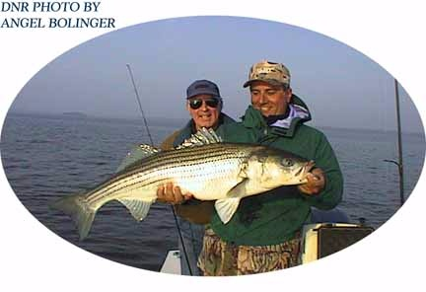
Need for Partnership Goal
Required in CBP reauthorization
Widespread extent and severity of contaminants
Current controls producing minimal reductions
Effects other CBP goals (fish, habitat, water quality) and human health
Benefit from coordination
Notes:
Beyond the question of available resources, there are reasons why the contaminants issue fits with the Bay Program partnership
Pollutant are widespread and flow address jurisdictional boundaries so partnership would benefit
Current controls producing minimal reductions (level of impairments not changing based on impairments in Bay and tidal waters)
Impacts to CBP goals—three in particular sustaining fisheries, recovering habitat is focused on wildlife, and water quality is working to improve conditions for fisheries. Also advisors about eating contaminated fish from the Bay and its watershed.
State and federal agencies would benefit from coordination of varies existing approaches to reduce impacts of contaminants.
All of these items are considerations why the CBP should think about working together to reduce these impacts to meet existing goals.

Slide 10
Concept for Goal Types
PCBs
Mercury
Dioxin, Petroleum, Insecticides, Metals
Multi-component strategy
Reduction Goals and Strategies
Track national air regs.
Local impairments
Additional Information and Analysis Needed
Are goals warranted based on extent and effects?
PAHs
Pesticides
Herbicides
Pharmaceuticals
Hshld/Personal Care
Flame Retardants
Biogenic Hormones
Research and/or Monitoring
Monitoring for occurrence
Research for sublethal effects and mixtures
DRAFT For discussion purposes only. Final goal decisions TBD

Slide 11
PCB example for goal/strategy
PCBs are widespread in extent and severity …
Possible PCB Goal Structures
Concentrations in fish tissue
Pounds of PCBs remediated
Number of transformers decommissioned
Site cleanups completed
Possible PCB Reduction Strategies
Optimize reductions from nutrient/sediment TMDL
Partner voluntary removal of PCB fluids
Coordination with regulatory programs
Contaminated sediment remediation
DRAFT For discussion purposes only. Final goal decisions TBD

Slide 12
Next Steps and CAC
Next steps
  CBP consider toxic contaminants in future efforts
  Balance focus on nutrients/sediment
  WQ GIT, MB, PSC, EC
CAC opportunities
  Support inclusion of toxic contaminant goal at upcoming CBP discussions/decisions
  Meet directly with states and federal agencies
  Facilitate informing watershed groups about concerns due to toxic contaminants
  Other?

