Slide 1
GIT 6 Goals and Governance Planning Session and Retreat
February 8, 2013
10:00 am – 3:00 pm

Slide 2
Welcome
Carin Bisland
Vice Chair - Goal Team 6

Slide 3
Purpose and Outcomes
Purpose: To develop organizational options that best support the Chesapeake Bay Program
Outcomes:
Acknowledgement of the dynamics impacting the Chesapeake Bay Program
Agreement on organizational options and alternatives to present to the Management Board
Partnership Goals
Structure/membership
Rules and procedures
Decision making
Assignments and next steps

Slide 4
Introductions
My name is _________________
I represent _____________________
From MY perspective the Partnership is important because ….
HELLO
my name is

Slide 5

Today’s Agenda
10:00 am – Session Begins
Welcome and Introductions
Outcomes: Leadership’s expectation for the day
Appreciation for who is attending the session
Context Setting
Outcome: Shared understanding of the meeting purpose, outcomes and flow
Brainstorming Considerations and Concerns
Outcome: Thoughts and guidance to jumpstart solution generation
Sketching Issue Solutions with Pros and Cons
Outcome: Viable draft options for the Management Board
12:00 pm - Working Lunch
Outcome: Continued focus and readiness to present issue solutions ideas and options
Presenting and Upgrading Issue Solutions and Options
Outcome: Consensus around the issue solutions to be presented to the Management Board
Mapping Out Next Steps
Outcome: Agreement on how to ensure a successful Management Board meeting
3:00 pm – Session Adjourns

Slide 6



What Kind Of Meeting Is This?
Information and
Recommendations
Decisional
Creative or
Brainstorming

Slide 7


Dilemma
Organization
vs
Partnership

Slide 8
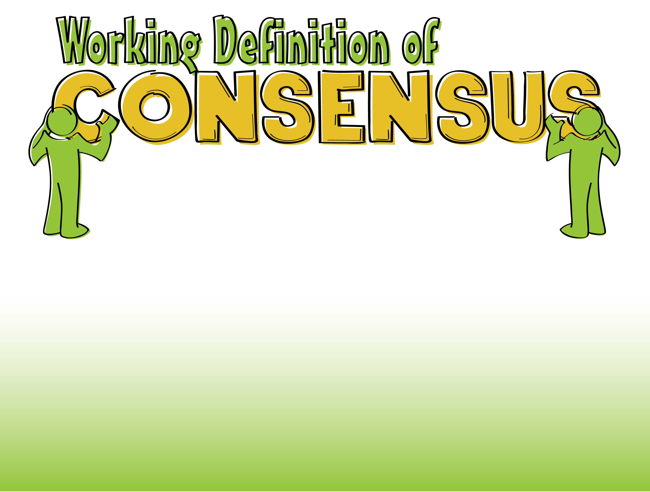
The process we used was explicit, rational & fair
I was treated well, my input was heard
And I can live with the outcomes

Slide 9
Ground Rules
Notes:
Need to have flipchart with a box and the following words:
Listen
Reframe my thinking
Have an open mind
Be Curious

Slide 10

Interview Themes

Slide 11
The Numbers
Talked to 12 people across the Partnership
States
Feds
Non-profits
Tenured and neophyte members
Interviews lasted ~30 minutes and were conducted between 1/28 – 1/31
All were forthcoming, candid and thoughtful

Slide 12
The Good
We’re passionate environmentalists, dedicated conservationist and devoted scientists
The Partnership is a model program with a proud history
However it is said – all have the highest hope for the Bay
It’s about the Bay’s restoration
It’s about the Bay’s ecosystem
It’s about cleaning the Bay

Slide 13
When It Comes to GIT 6 …
We have a good purpose – fixing governance
Provide Partnership-wide cohesion
Develop a framework to promote continuity and sound management across the GITs
Having a clear task has helped pull the group together
We’re making the time and energy to meet
Our information exchange works well
Keep people up-to-date on decisions and what needs to happen
There tends to be good representation and dialogue

Slide 14
However GIT 6 Is Also …
Managing uneven team knowledge, experience and responsibilities
There are several new or returning GIT6 members
There is no onboarding process – it can be overwhelming
Many wear multiple hats at their home institutions and with the Program
Dealing with the “nuts and bolts” versus working on real Bay issues
Things seem to be moving slow and we’re bogged down
There is so much process - Adaptive Management is good in theory and very hard in practice, especially in the current environment
Trying to move from plans/policies to how to do the work/implement
Struggling to navigate the new paradigm
Seriously constrained state and federal budgets
Thorny political environment
Shift from a voluntary program to a regulatory focus

Slide 15
GIT 6’s New Paradigm
We’re trying to operate like the stress of this reality does not exists
The Agreement | The Executive Order
Leaders signed | Leaders are assigned
The Gang of 6 (Then the Gang of 9) | Broad range of membership
Driven by collaboration and consensus | Enforced by law and nutrient levels
Worked on relationship Labor of love | Work on tasks Labor of the law
Voluntary efforts to advance restoration strategies | TMDLs – Regulated to do the right thing

Slide 16
As a Result GIT 6 …
Has competing viewpoints
The states only seem to be concerned with states rights – what happened to consensus?
I’m responsible for representing what my state wants – even if my personal or professional perspective differs
The states use to go back and convince state leadership
Environmental politics and leadership has changed dramatically since 2000
There are many feds with many inconsistent demands
The states are putting up barriers – even though it may already be happening in other parts of their organization or state
Collectively agree things need to be different
Need a new agreement – it’s effective and outdated
Has to be different - too many commitment and numeric goals
Has to address the new paradigm – budget, politics and regulations

Slide 17
Partnership Goals …
Has to make sense for a cross-partnership
Look to Section 117 to guide our thinking
What is truly required?
The focus on water quality is leaving a gap in other goals
Consider states have limited resources and competing state concerns as it relates to the goals
Perhaps pick and choose goals that you can commit to
Consider providing guidance and frameworks versus specific numerical goals

Slide 18
Structure/Membership …
Need to be realistic and clear what is means to be a partner and to fully participate
What if a partner has limited resources and wants a specific focus?
Currently have lots of chiefs at the table
Determine how the headwater states and non-EPA feds fit in
Resources and politics are impacting membership
Some states may not be willing to sign a regulatory focused/based Agreement
Can grants and budgets be divided/distributed differently
Will encourage greater participation

Slide 19
Rules and Procedures …
Need to determine who writes policy and how the policies are endorsed or not
Who decided what the GITs’ focus?
GITs come up with stuff and the states are responsible to make it happen - how do we reject and endorse plans and strategies?
Consider developing a check list of what the GITs, MB, PSC and EC does

Slide 20
Decision Making …
Be clear when and how we make decisions
Voting (majority rules), document consenting views, consensus, etc.
Have to be more strategic how we use decision makers
Seem to be asking the PSC to do mundane tasks – rubber stamp reports versus talking about the future of the program
Perhaps EC sets direction (the what) and PSC determines by what means (the how), and MB focus on the science we need or should consider
Decisions seem to get stalled and rehashed at the MB – how can the MB be more effective
Need greater distinction between the MB and PSC
Have same people on GITs and MB – is that a conflict?
Decision readiness for the MB, PSC varies across the Partnership

Slide 21
Thoughts and Reactions
Notes:
Put interview themes on flipchart

Slide 22
Brainstorming
Notes:
Put interview themes on flipchart

Slide 23
Brainstorming
Put yourself in the role of a thought leader. What advice, thoughts or concerns would you offer:
Partnership Goals
Structure/Membership
Rules and Procedures
Decision Making
Brainstorming Rules
Timed boxed
All thoughts make the flipchart
Questions of clarification only – no critiques
Notes:
Have four flipcharts around the room labeled w/each issue

Slide 24
Sketching Issue Solutions
Select the Issue you have the most to offer
Breakout Group 1: Decision Making
Breakout Group 2: Rules and Procedures
Breakout Group 3: Structure and Membership
Breakout Group 4: Partnership Goals
Go to your Issue Solution room
Decision Making, Room: 305 - Friendly Nudge & Scribe: Tim
Rules and Procedures, Room: Fishshack Lobby - Friendly Nudge & Scribe: Greg A.
Partnership Goals, Room: Fishshack Split Conf Rm 1 – Friendly Nudge & Scribe: Philipia
Structure/Membership, Room: Fishshack Split Conf Rm 2 – Friendly Nudge & Scribe: Greg B.
Partner with your Issue Team to develop viable options w/pros and cons
Use the resources in your room to guide and focus your thinking
Be prepared to report out around 1:30 pm

Slide 25
Issue:
Current State (What’s the current situation)
Desired Future State (How should the issue operate)
Viable Issue Solutions
Pros
Cons
Notes:
1: Decision Making:
Voting Rules
Voting privileges
2: Rules and Procedures
Approving externally developed documents: recommend, adopt or endorse
Approving GIT developed documents: recommend, adopt or endorse
Approving federal partner developed documents :recommend, adopt or endorse
Structuring Adaptive Management Reviews (What)
Scheduling Adaptive Management Reviews (When)
3: Structure and Membership
CBP Membership (Signatory members, Headwater and Stakeholders)
Options for Governing Bodies
Representation of Governing Bodies
4: Partnership Goals
Privileges of Partnership
Updating Goals and Outcomes
Participatory Document (Agreement, MOU – Memorializing the Partnership)

Slide 26

Suggested Issue Solutions Timing
5 minutes
Super quick introductions and share why you came to this Issue topic
25 minutes
Scope the issue
Current State
Future State
60 minutes
Develop Issue Solutions
45 minutes
Frame Pros/Cons for each solution
15 minutes
Determine who will report-out
Prep for report out
Lunch will be delivered at 12:00

Slide 27
Report Out and Upgrades
Notes:
Put interview themes on flipchart

Slide 28
Report Out and Upgrades Process
Present Your Issue Solutions
Crisp, concise and quick
Share Your Input
Green: Cool! Ready to move on
Yellow: Have some thoughtful upgrades
Red: Have serious concerns
Jot Down Additional Comments and Thoughts
Give your additional views to your Issue Team’s Friendly Nudge and Scribe

Slide 29

Next Steps

Slide 30
Adjourn

