Slide 1
Chesapeake Forest Restoration Strategy
Kick-off webinar May 2011
5 Strategy Teams
60+ representatives
30+ federal, state, ngos
Draft/public input July 2012
Final Strategy signed Dec. 5
Available on CB Executive Order website

Slide 2
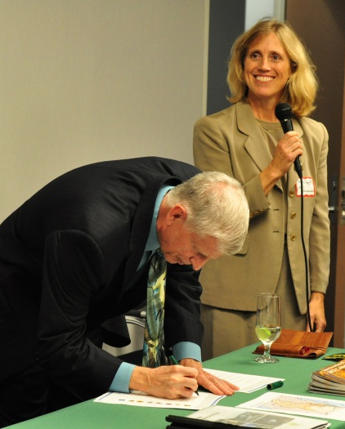
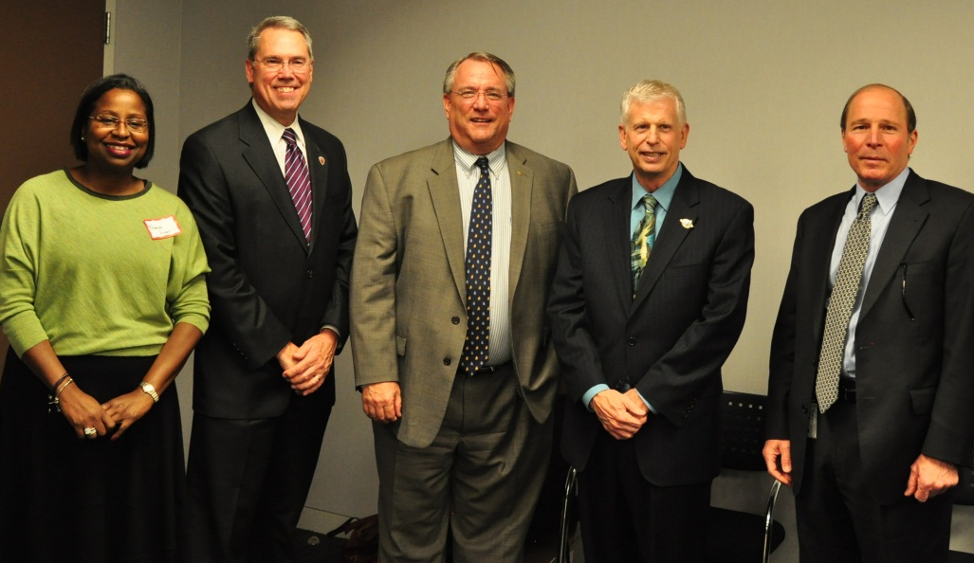
Signing Ceremony 12/5/12
USFS Chief Tidwell
Bay State Foresters
CBPO Director

Slide 3
Restoring forests in priority areas…
Section 2: Fish & Wildlife Habitat
Green Infrastructure Brook Trout

Slide 4
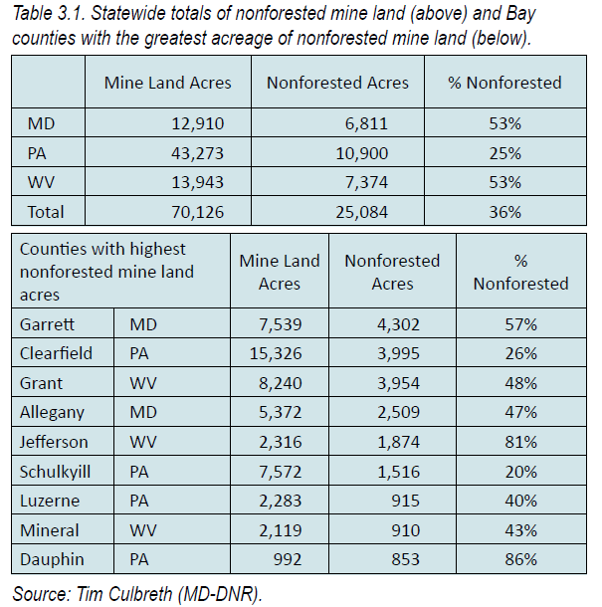
Restoring forests in priority areas…
Section 3: Mine Lands

Slide 5
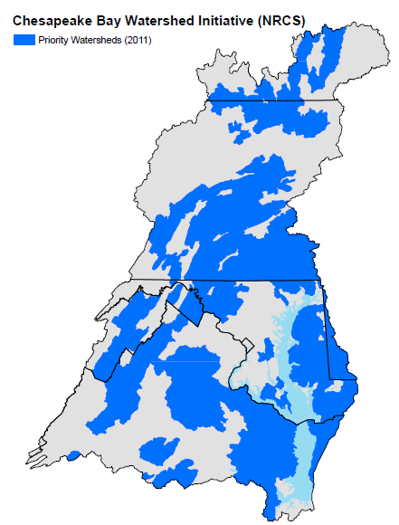
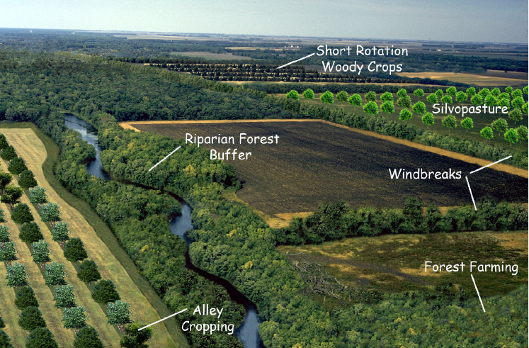
Restoring forests in priority areas…
Section 4: Agroforestry

Slide 6
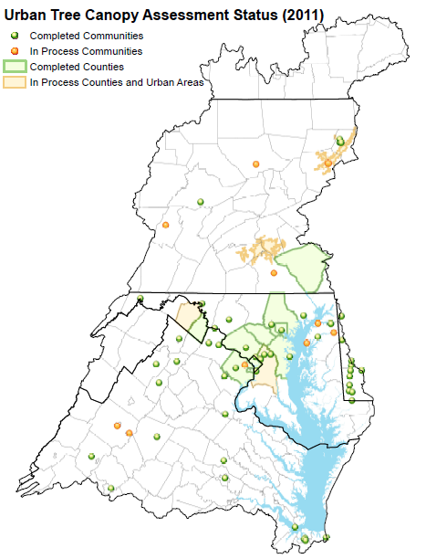
Restoring forests in priority areas…
Section 5: Urban & Community
UTC Assessments complete:
~70 communities, 9 counties
Canopy Goals set: 45
Implementation Plans: 23

Slide 7
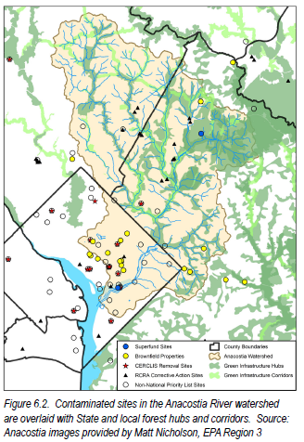
Restoring forests in priority areas…
Section 6: Contaminated Lands

Slide 8
Next Steps…
Develop web content and communication plan for getting the Strategy out to target groups and engaging their participation
Reconvene Strategy teams in April-May for input on next steps in the specialty areas (fish and wildlife habitat, mine lands, agroforestry, urban/community, and contaminated lands)

Slide 9
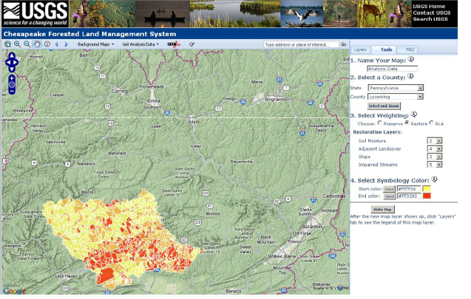
Next Steps…
Add Strategy GIS layers to USGS-COAST forest mapper tool

Slide 10
Next steps...
Identify opportunities to implement Strategy actions through ongoing CB watershed forestry grants and other possible funding sources (FY2013 grants and beyond)
NGO partner programs- Potomac Watershed Partnership, Forestry for the Bay, Bay Bank/Land Server, Growing Native
Chesapeake NFWF grants
CB state forestry grants and FS competitive grants (CARP)
What others??
FWG Round Robin on priority actions in each state

Slide 11
Round Robin – FWG Responses
Select the Strategy actions that you think hold greatest opportunity in your state/region in the next 1-3 years
What network of existing or new partners could be engaged in your state/region to move this action forward?
List specific ideas for how to move this action forward in your state and how your organization could contribute.

