Slide 1
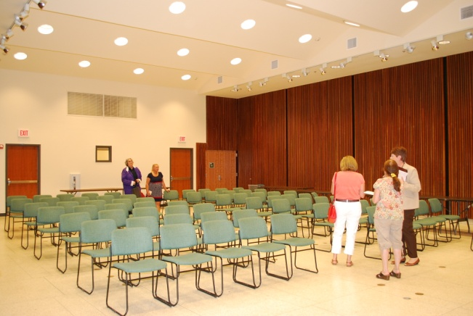
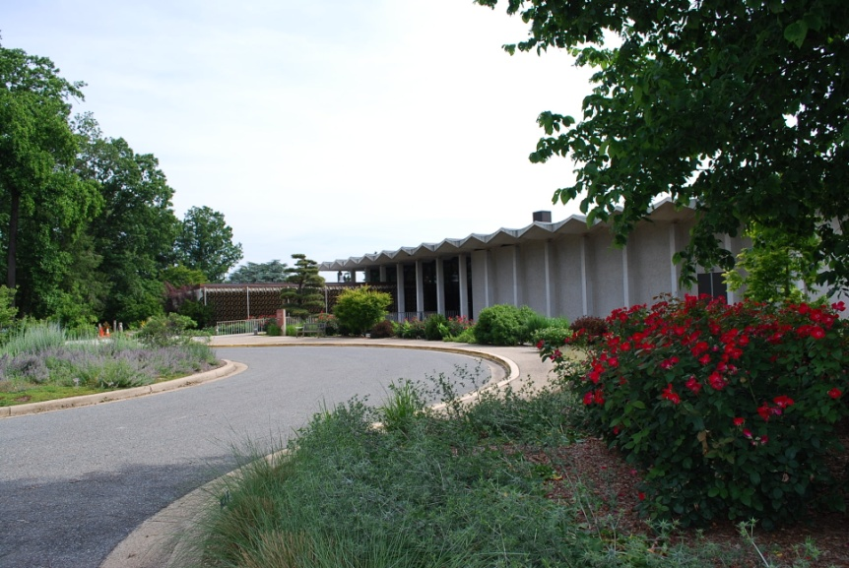
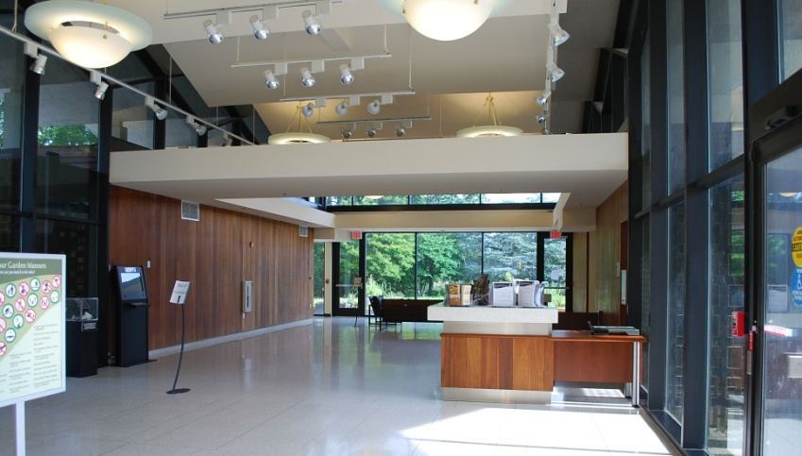
2013 Chesapeake Executive Council
Recognizing Our History;
Planning for Our Future
U.S. National Arboretum – Washington DC
Dec 12, 2013

Slide 2
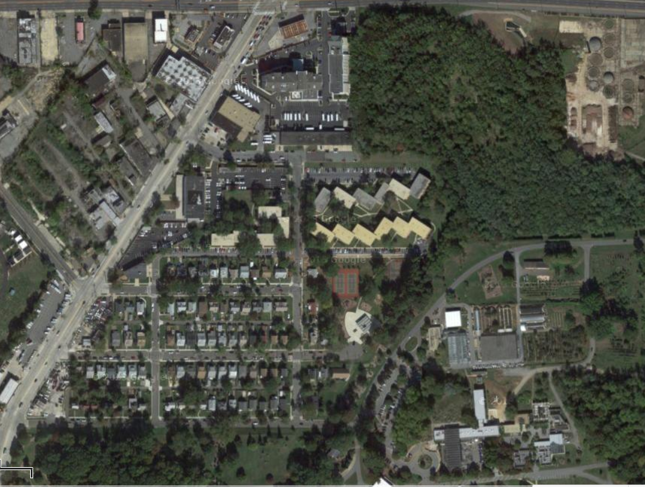
New York Ave
Bladensburg Rd
24th Street NE
Parking
R Street
Big Sign – “Arboretum”
Entrance gate
Visitor Center

Slide 3
Visitors Center layout
Parking
Sidewalk
Entrance
EC Breakfast
Restrooms
Arboretum Offices
Visitors Center Lobby
Circle drive for drop off
Construction Area
kitchen
Press conf.

Slide 4
Logistics
Executive Council Member Confirmation
Confirmed Members
Contact: Margaret Enloe 410-267-5740 menloe@chesapeakebay.net
Availability Confirmed
Unconfirmed Members
CAC Chair
LGAC Chair (Dave Dunmyer)
STAC Chair
DC Vincent Gray, Mayor (EC Chair)
MD Martin O’Malley, Governor
CBC Delegate Maggie McIntosh, Chair
VA Bob McDonnell, Governor
PA Tom Corbett, Governor (Acting Sec. Christopher Abruzzo , DEP)
EPA Gina McCarthy, Administrator (Dep. Admin. Bob Perciasepe, EPA)
DE Jack Markell, Governor (Secs. Kee & O’Mara, DNREC)
WV Earl Ray Tomblin, Governor (Asst. Dir.Teresa Koon, DEP)
NY Andrew Cuomo, Governor (Sec. Jim Tierney, DEC)
USDA Tom Vilsack, Secretary (Dep. Under Sec., Ann Mills, USDA)

Slide 5
Content
EC Agenda
Contact: Margaret Enloe 410-267-5740 menloe@chesapeakebay.net
Status
At a Glance
EC Event 9:45a.m. – 12:45 p.m.
9:45-10:00am EC members arrive, get settled
10am-12noon PRIVATE Breakfast (Agreement focused)
12:00-12:45pm News conference

Slide 6
Meeting Agenda - Annotated
9:45-10 EC members arriving; get breakfast and take seats
10-12 Private Breakfast
10 – 10:10 Welcome, Agenda, 30yr Reflections – Chair (Mayor Gray, DC)
10:10-10:15 Showing of Video PSA – Margaret Enloe
10:15-10:55 Briefings on draft Chesapeake Watershed Agreement
10:15-10:25 Agreement Overview – Nick DiPasquale
10:25-10:55 Advisory Committee comments on Agreement (5 min + 5 min q&a ea.)
Citizens Advisory Committee (CAC) – John Dawes
Scientific, Technical Advisory Committee (STAC) – Kirk Havens Local Government Advisory Committee (LGAC) – David Dunmyer
10:55-11:45 EC Agreement discussion & vote on Chair for 2014
11:45-11:55 Press conference prep/group photo – Margaret Enloe
11:55-12 Move to press conference
Notes:
Suggestion to be made to shift times forward/later so that a “stage setting” CBP video can be shown at beginning of meeting. Morning session to end at 12:00.

Slide 7
Meeting Agenda – Annotated (contd)
Press Conference
12:00 – 12:45 Press Conference
12:00-12:05 Welcome by Dr. Colleen Heffernan, Director, National Arboretum
12:05-12:10 Mayor Gray remarks
12:10-12:15 Mayor Gray announces election of new EC Chair
12:15-12:20 Governor O’Malley remarks
12:20-12:25 Governor McDonnell remarks
12:25-12:30 Chair McIntosh Remarks
12:30-12:45 Media Q&A

Slide 8
Communications
Media Planning
Contact: Margaret Enloe 410-267-5740 margaret.enloe@chesapeakebay.net
Status
Components:
Media Advisory - drafted
News Release – drafted – awaiting final quotes/comments
Media Outlets
Messaging
Communications Workgroup – to be updated Thurs, Dec 5
Partner Leads – need EPA & VA contacts
Timeline

Slide 9
Communications
Media Plan
Status
Due Date: Dec 5/9
Components:
Media Advisory – Dec 5(informal) AND Dec 9(formal)
There will be two advance notices to media announcing the EC Meeting. The 1st will be an unofficial notice; the 2nd formal advisory will go out first thing Dec 9. The media advisory will focus on the theme of CBP 30 year history, planning for future, and expected EC Chair announcement. The advisory will include listing of key public figures participating and details on event location and time. Media will be asked to confirm attendance.
Media Outlets
Advisory & E-versions of Media Kit to:
400 media outlets on Communication Office’s comprehensive list of media in the watershed. - 8-10 select pitches/phone calls:
  - The Associated Press, The Richmond Times-Dispatch, Virginian Pilot, The Daily Press in Norfolk, The Washington Post, The Baltimore Sun, The Capital in Annapolis, DC radio stations.

Slide 10
Communications
Media Plan
Components:
News Release & Media “kit” – Dec 12 – 1:00pm
Embargoed copy: Wednesday, December 11
Final copy: Dec. 12 at 1:30pm – at end of EC press event, after new Chair announced.
Messages:
Recognizing CBP Progress and partnership over last 30 years
Planning for the Future of Bay restoration science/efforts
Announcement of new EC Chair
Media Outlets – same as those who rec’d advisory

Slide 11
Communications
Media Plan
Messaging
The news release will provide key messaging and language for the overall theme and specific topics of the EC meeting.: Recognizing 30 Year History, Planning for the Future, New EC Chair
The other documents in the media kit will support meeting (agenda, agreement backgrounder, Arboretum materials). A short summary of key messages on 30 year history is available for EC briefing books at the webpage: http://www.chesapeakebay.net/ecbrief/2013_executive_council_briefing_book
Communications Workgroup and Partner Leads
All media materials and plans will be reviewed by members of the Chesapeake Bay Program Communications Workgroup and the communications representatives identified by partners for the EC meeting. The purpose of this is to gain the expert advice of multiple communications professionals representing the full partnership.
Media Kit & Contents
A media kit will be provided via email and hard copy on the day of the EC meeting. It will contain:
  Contents: News release, Agreement backgrounder, Arboretum materials

Slide 12
Communications
DEADLINES/DUE DATES
Thur., Dec 5 | Remaining FINAL EC Memb/rep bios submitted by COB – ltaneyhill@chesapeakebay.net
Thurs. Dec 5 | All Security contacts to Lori Mackey – mackey.lori@epa.gov
Wed. Dec 4 | Media materials to partners for review and approval
Thur, Dec 5 (reminder Mon Dec 9) | Early notice to Media / Formal Media Advisory
??? | Briefing of EC Chair (Mayor Gray)
Thurs. Dec 5 (noon) Mon. Dec 9 (COB) | Approval of media advisory Approval of all other media materials (News Release)
Thurs – Dec 5 (4pm) | CBP Bay Brief distributed with EC info
Mon Dec 9 | Reminder - media advisory
Wed Dec 11 | Deadline: media to confirm attendance; Logistics team setting up at Arboretum
Event day | ECBreakfast & Press Event – staff on site by 8a.m.
Notes on Handling of Media:
  Media will be invited to Press Conference only --- Start time: 12:30pm
  Media check-in: Required. There will be a check-in table at a convenient location TBD.
  Press Conference: Media should use the microphone when asking questions and identify themselves and their news organization during the news conference.
  Interviews with EC members: Requests to interview specific EC members will be referred to the partner’s communications lead – Margaret Enloe - and take place after the news conference concludes. Time: TBD

Slide 13
Logistics / Set up
To patio
Windows to garden
Buffet Breakfast – Menu: TBD
Breakfast (10am-12noon)
Visitor Center Classroom
Entry from HALL
DC +1 DC MD MD +1
Checklist:
Arboretum to provide:
All tables & chairs needed to:
  seat 19 ppl at EC table,
  offer buffet
  side table for 3ppl
CBP to provide:
Buffet breakfast & beverages for EC
Linens, place settings, etc.
CBC +1
CBC
VA
VA +1
NY
NY +1
USDA
USDA +1
+1 EPA
EPA
PA
PA +1
WV
DE
DE +1
EC Table
Inset Counter
podium
6 Chairs for AC
3 Chairs – DiP.,
Bisland, Enloe
+2’s will be seated in chairs around edge of room, where possible
screen

Slide 14
Logistics / Set up
News Conference 12 – 12: 45pm
Visitor Center Conf Room (Open to the Public)
Extra exit
Checklist:
Arboretum to provide:
Wireless internet
Podium
Electricity
Chairs (75)
6ft tables (4) with chairs (5)/table
will use lobby counter for press regist. & materials
CBP to provide:
Flags
Logo
Sound system
  Table Mics
  Mult box
Water pitchers & glasses (10)
Table linens
Name plates
Flags
Flags
USDA DE PA VA CBC
DC MD EPA NY WV
2 - 6ft tables w/ 5 chairs
and water
2 – mics
Podium w/mic &
Speaker
CBP Logo
&
MULT BOX
2 – 6ft tables w/ 5 chairs
and water
2 – mics
35 Chairs
~28 Chairs
Aisle
No chairs; t.v. media section
Press
Entry

