Slide 1
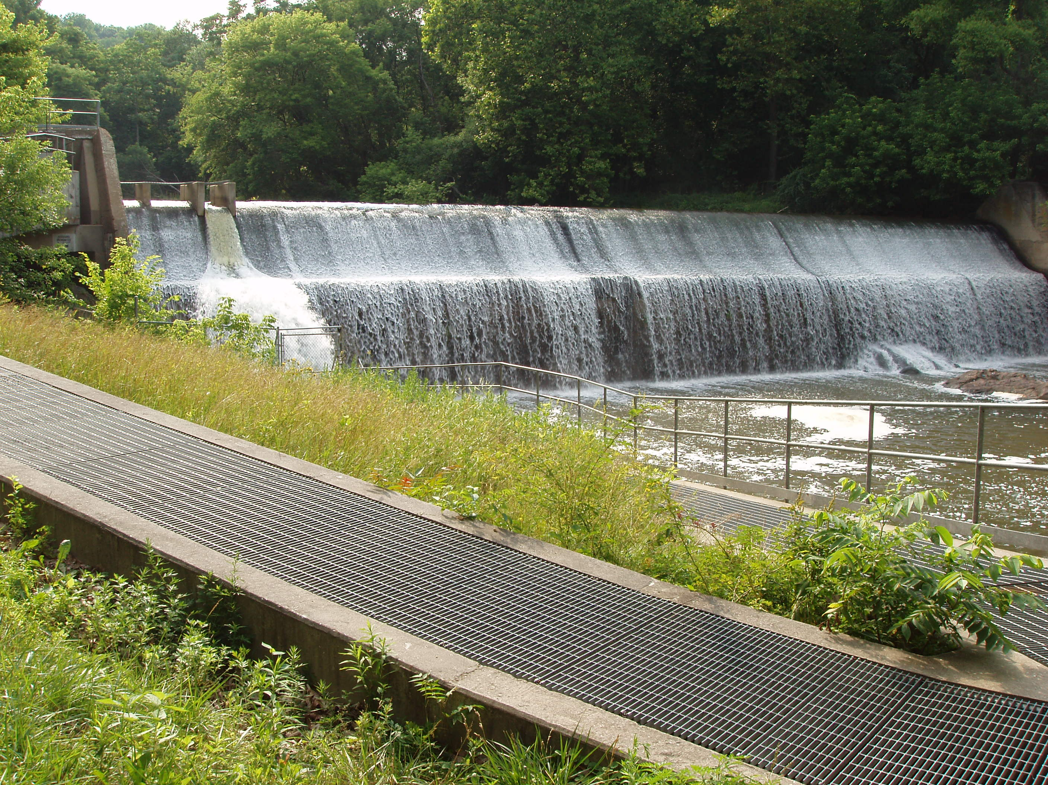
Chesapeake Fish Passage Prioritization Project: Overview
Mary Andrews
NOAA
Julie Devers
USFWS
Erik Martin
The Nature Conservancy
Chesapeake Bay Fish Passage Work Group

Slide 2
Key Drivers
Agencies shift toward targeted restoration
To target high priority dam removals and fish blockages based on our collective priorities
To have a consistent voice (Federal, State, local and non-profits) when advocating for bay-wide priority dam removals/passage projects
To justify additional funding
BEAN COUNTING
To act as a database for dam information, mileage opened and spatial tool to highlight our progress

Slide 3
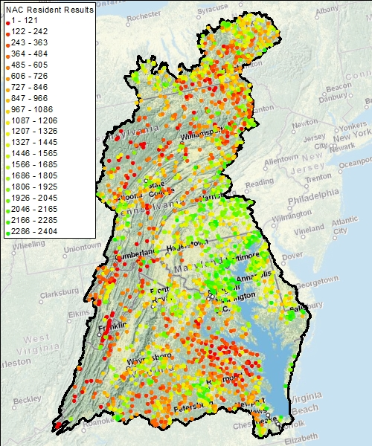
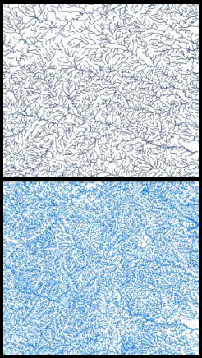
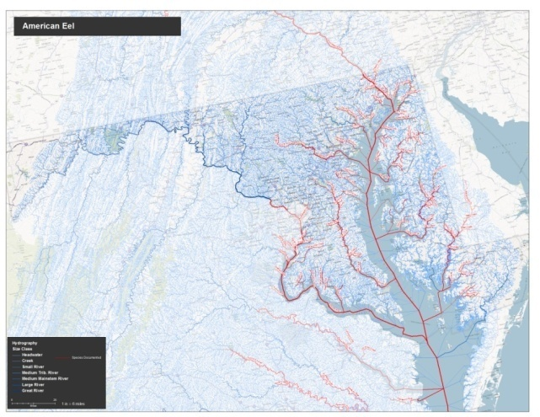
Chesapeake Bay Watershed: Anadromous Scenario
Uses 1:24k high-resolution National Hydrography Dataset
3,883 prioritized dams
Improved diadromous fish data
Ability to use tool for data management
Calculating miles opened
Map making
Ability to make changes to the prioritization
Select other ways to prioritize

Slide 4
CFPPP Metrics
Connectivity Status
Number of dams downstream to river mouth
Number of downstream fish passage facilities
Connectivity Improvement
Upstream functional network size.
Watershed and Local Condition Metric
Percent Impervious Surface in ARA of Upstream Functional Network
Percent Natural LC in ARA of Upstream Functional Network
Percent forested land cover in ARA of functional network (brook trout scenario)
Percent Impervious Surface in Contributing Watershed (potential)
Ecological Metrics
Number of anadromous species present downstream
American eel presence metric or American eel absence metric (exact metric TBD)
Stream Health
Size Metric
Number of upstream size classes >0.5 miles gained by removal
Small streams that connect directly to marine / estuarine habitat

Slide 5
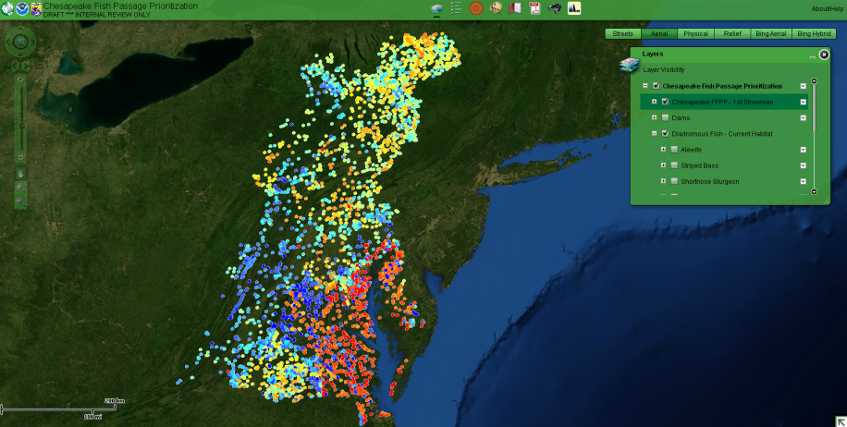
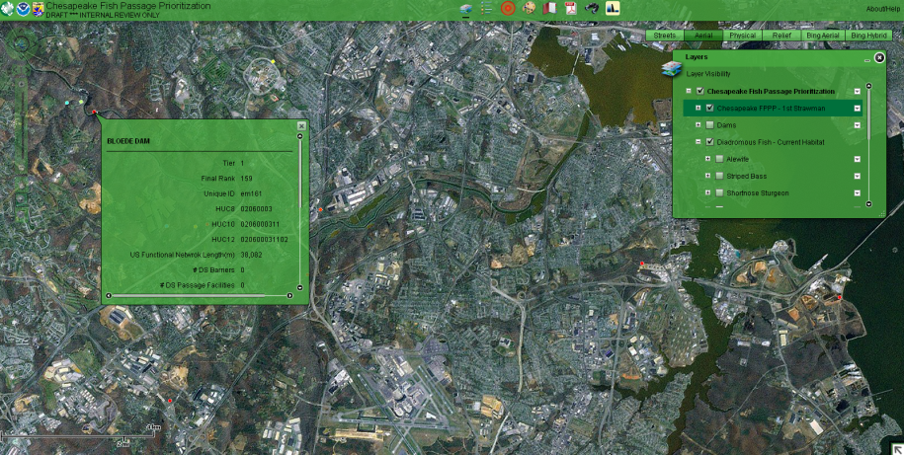
Decision Support Tool
Web map application
Shows the overall Chesapeake Bay Fish Passage Prioritization – displays the consensus based ranking upfront
Query results and view in the context of other relevant data
Allow user to work at a different scale(subwatershed, state, etc)
Allow user to create custom weight scenarios

Slide 6
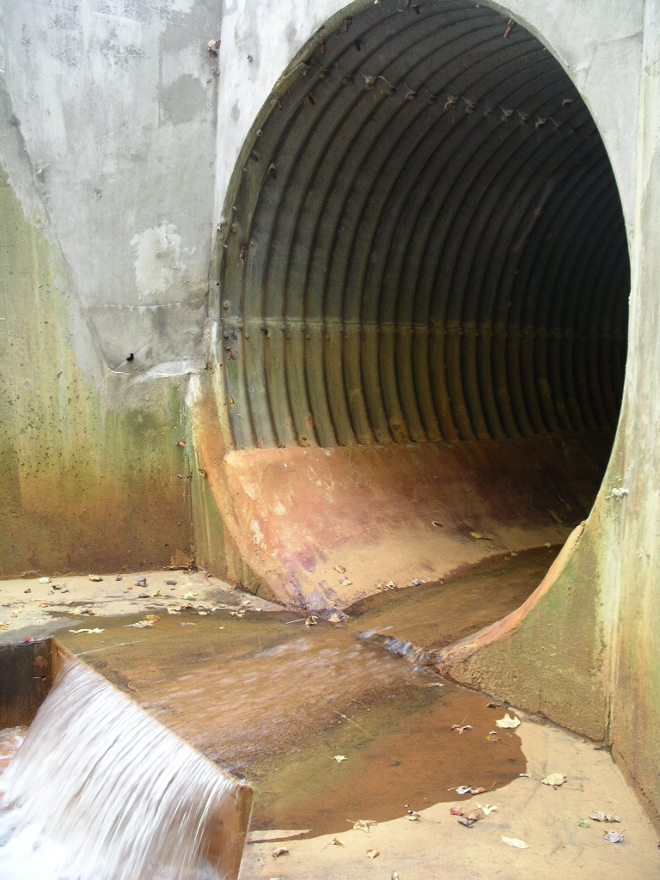
Road Crossings
144,788 total road crossings in Chesapeake Bay drainage
Vast majority of road crossings > 139,000 fall along small rivers and streams (drainages < 100 km²)
Field observations still the most reliable way to determine fish barriers
In Chesapeake, most road crossing barriers will impact resident species
Still a major issue for fish passage in general

Slide 7
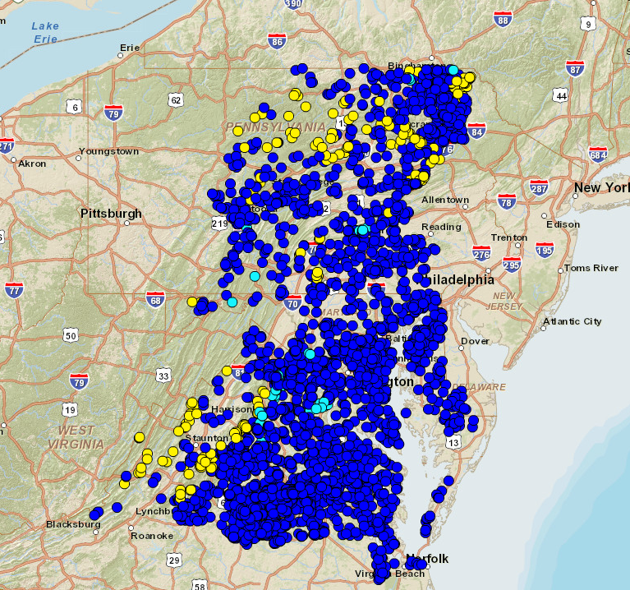
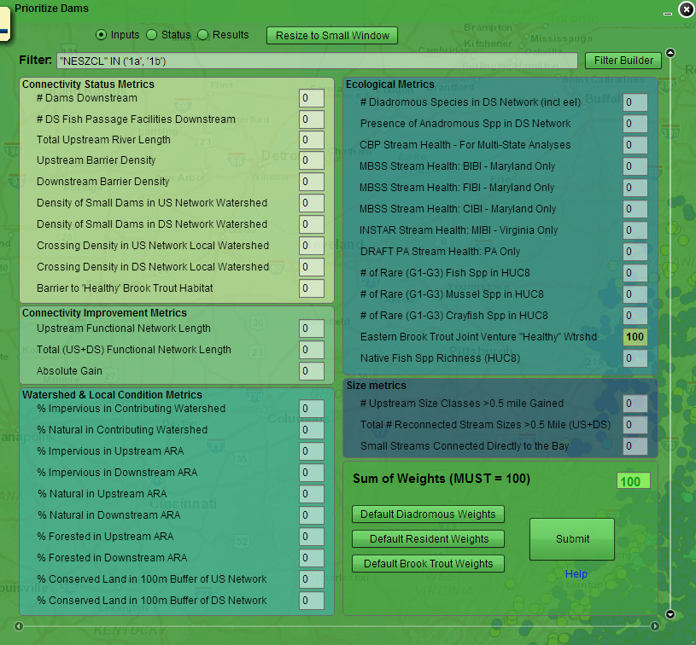
Addressing Road Crossings in CBFPPP
Road and Railroad crossings are not “prioritized” in the current GIS tool
37 times more roads crossings than dams
Select priority watershed based on dam ranking
Field assess road/railroad crossings in selected watershed

Slide 8
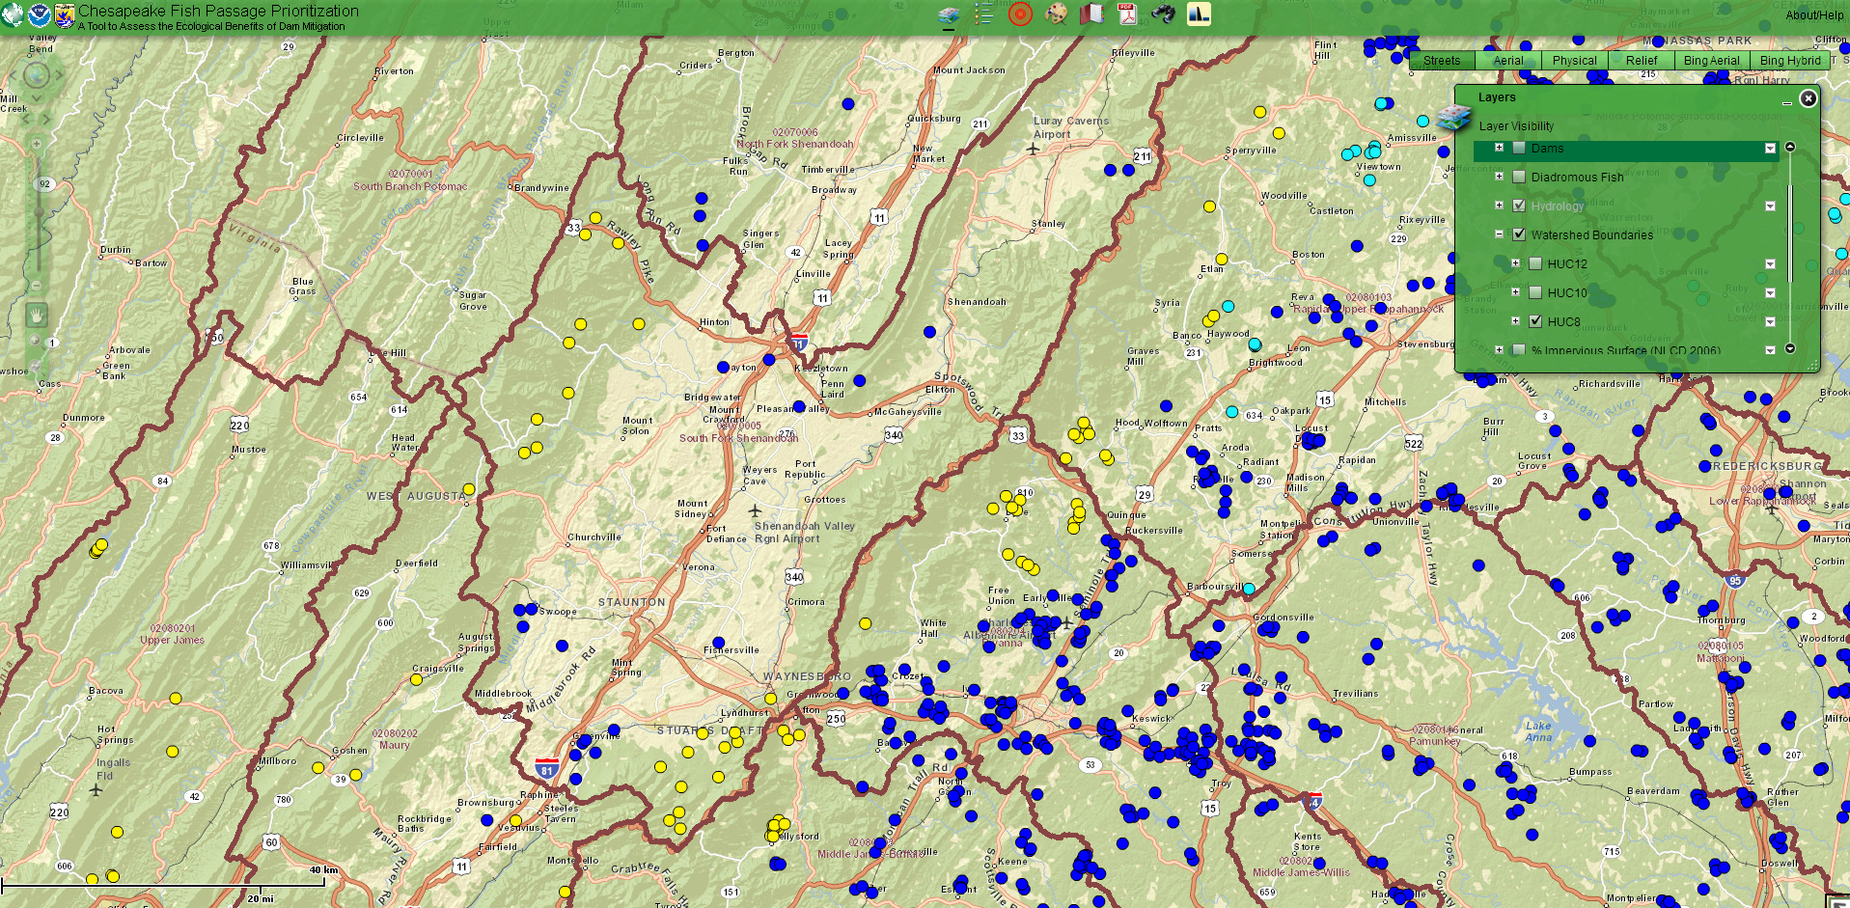
North Fork Shenandoah River– Brook Trout

Slide 9
Patapsco River – Anadromous Example

