Slide 1
DC’s Plans & Strategy for Stream & Wetland Restoration Efforts
Pete Hill
Peter.hill@dc.gov
202-535-2241
District Department
of the Environment

Slide 2
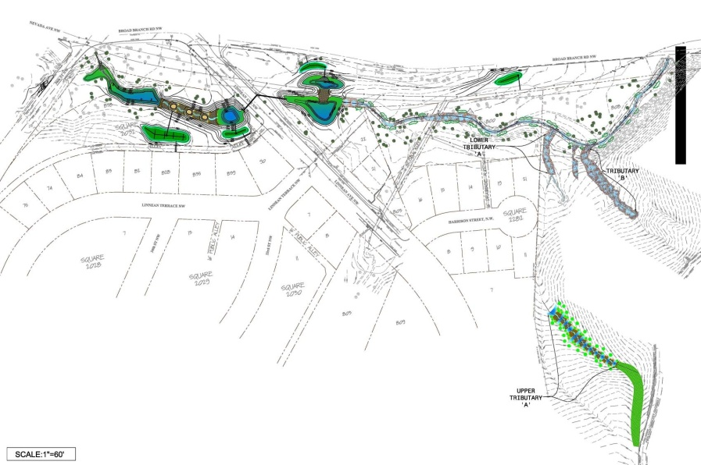
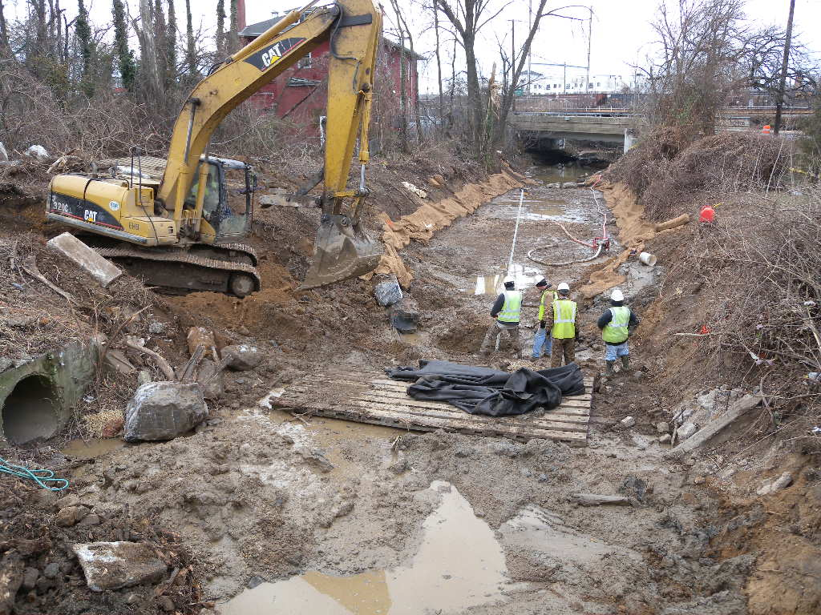
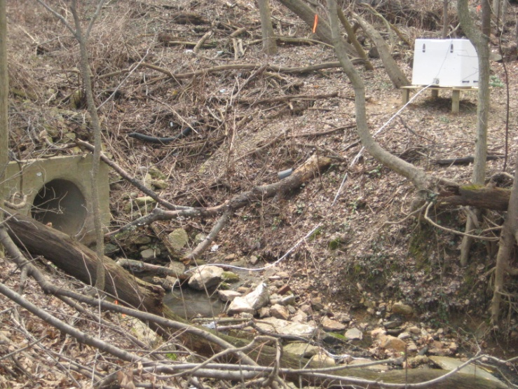
Current Restoration Projects
RSC Research
Stream restoration – District Lands
Stream daylighting

Slide 3
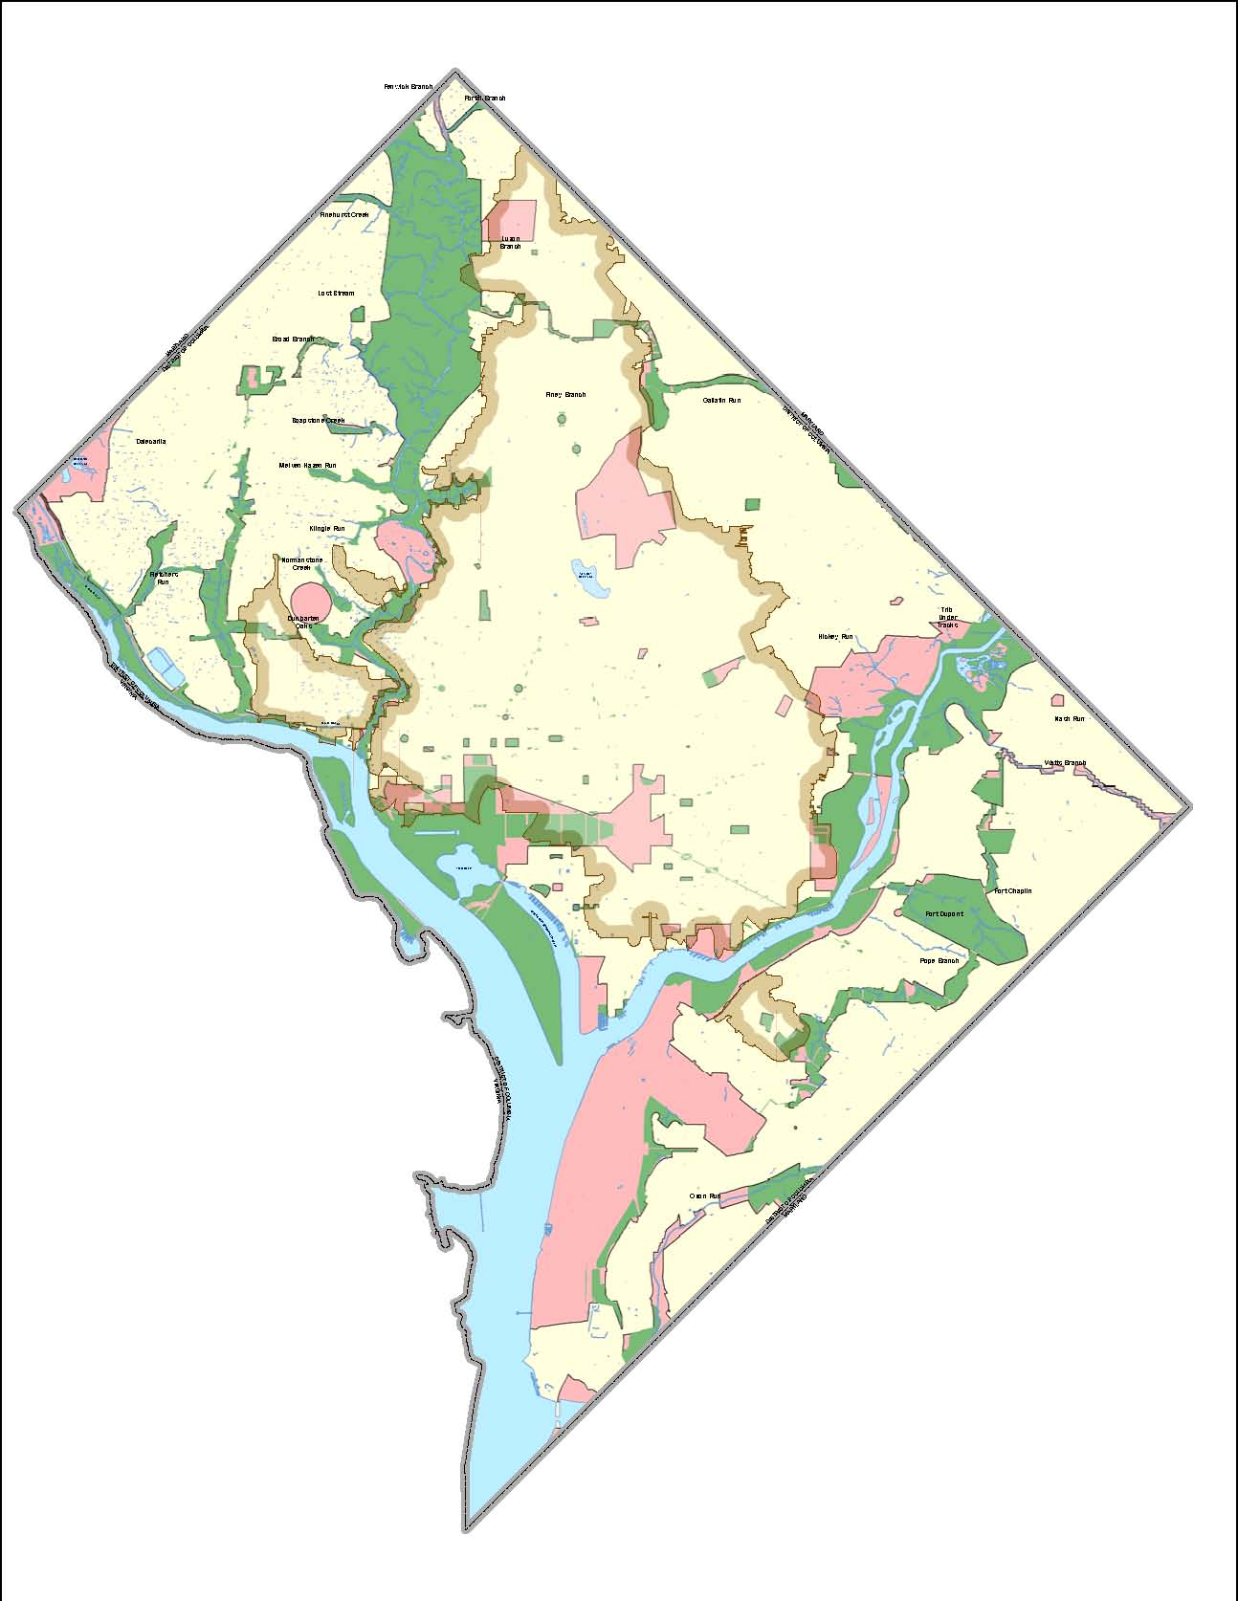
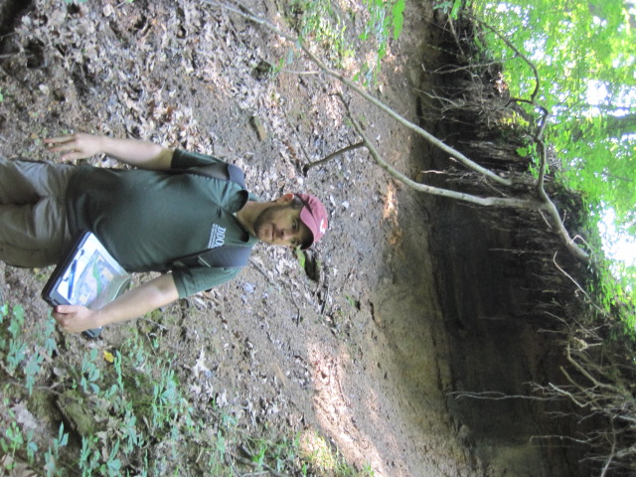
Strategy for Future Stream & Wetland Work
Coordination with Federal & District Partners
Outstanding issues
RSCs
Goose control
Sea walls
Project prioritization

Slide 4
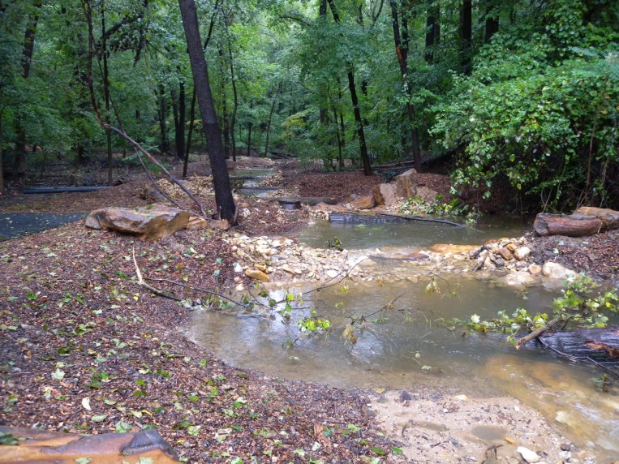
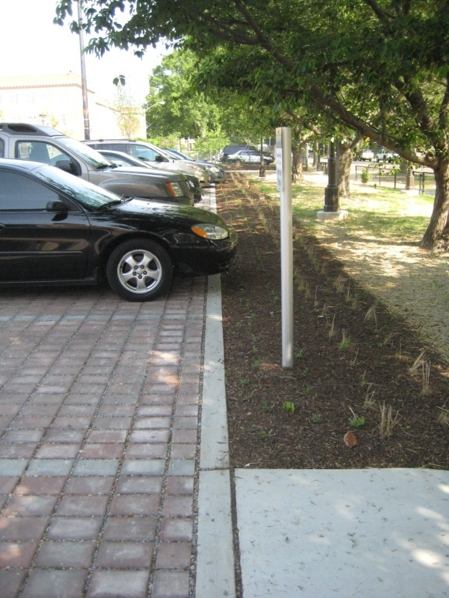
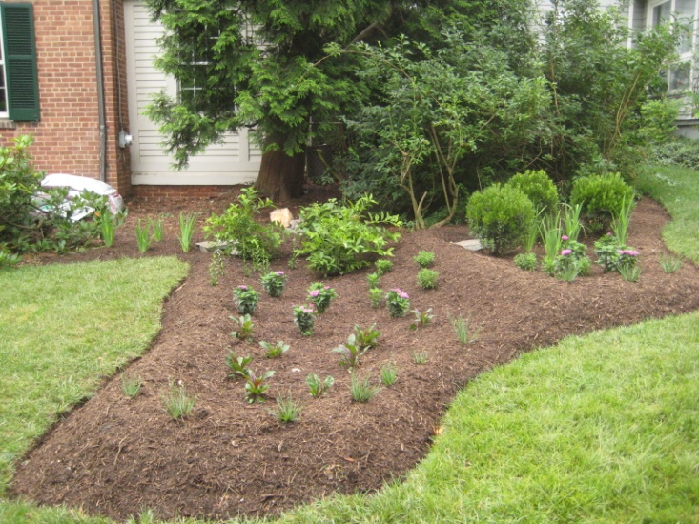
Scope for Stream/Wetland Restoration Efforts
Watershed Approach
Upland efforts combined with stream restoration
Watershed Implementation Plans
Holistic Approach
Trash reduction
Improving/repairing sewer lines
Creating wetlands
Upland LID

