Slide 1
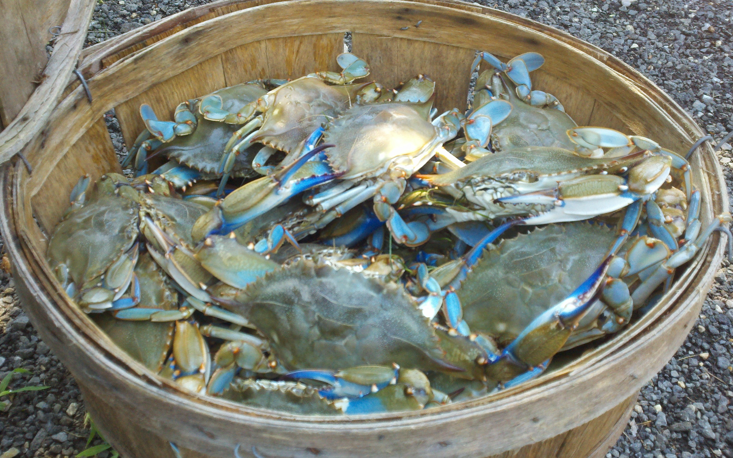
Cross-walking Local Land Use Data with Phase 6
Bryan Bloch
Chesapeake Bay Land Use Workgroup
January 30th, 2014

Slide 2
Delaware
Chesapeake Bay- 452, 360 acres
35% of total area in state
Primarily Ag (49%)
Forest/Wetland (37%)
Developed (10%)

Slide 3
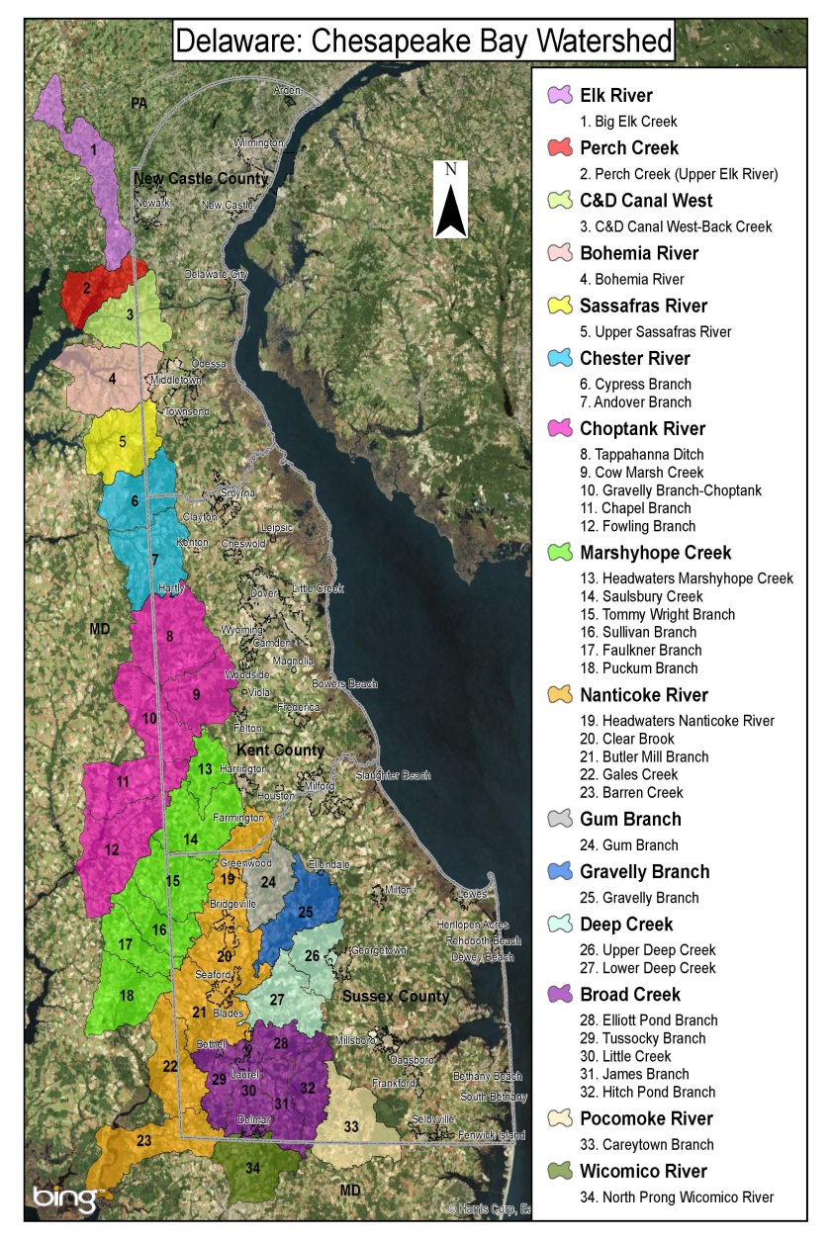
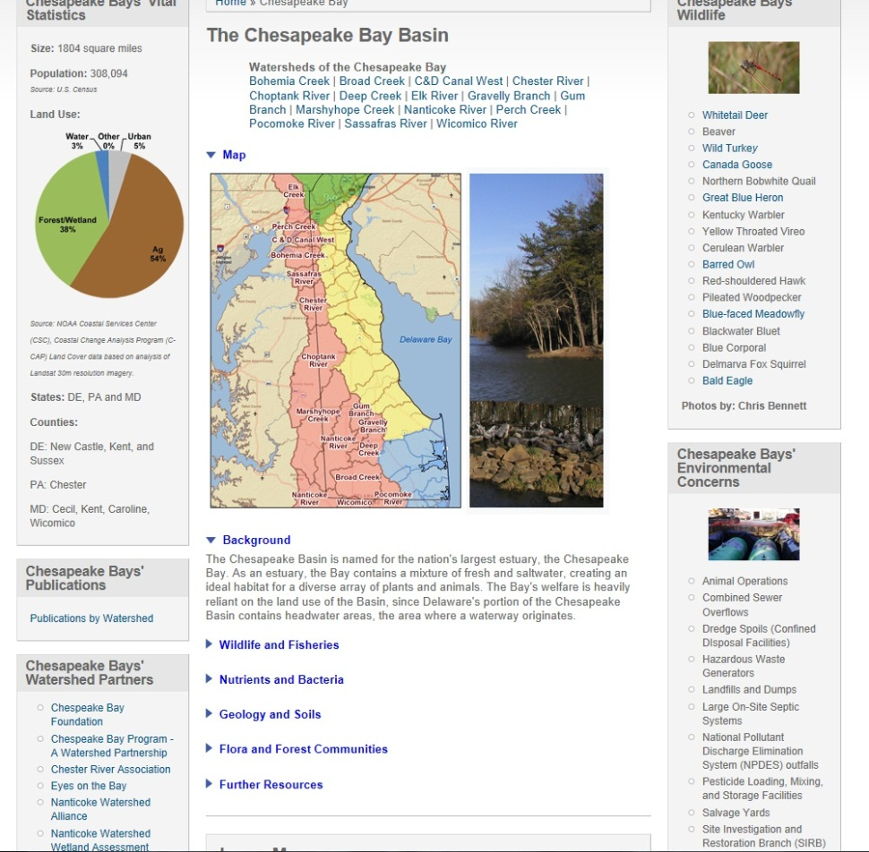
Chesapeake Bay
http://delawarewatersheds.org/chesapeake-bay/

Slide 4
Imagery and LiDAR
Imagery:
1937, 1954, 1961, 1968, 1992, 2002, 2006, 2007, 2009, 2011, 2012, 2013
LiDAR:
2007, 2012
Imagery Link: http://demac.udel.edu/data/aerial-photography#aerial-tiled

Slide 5
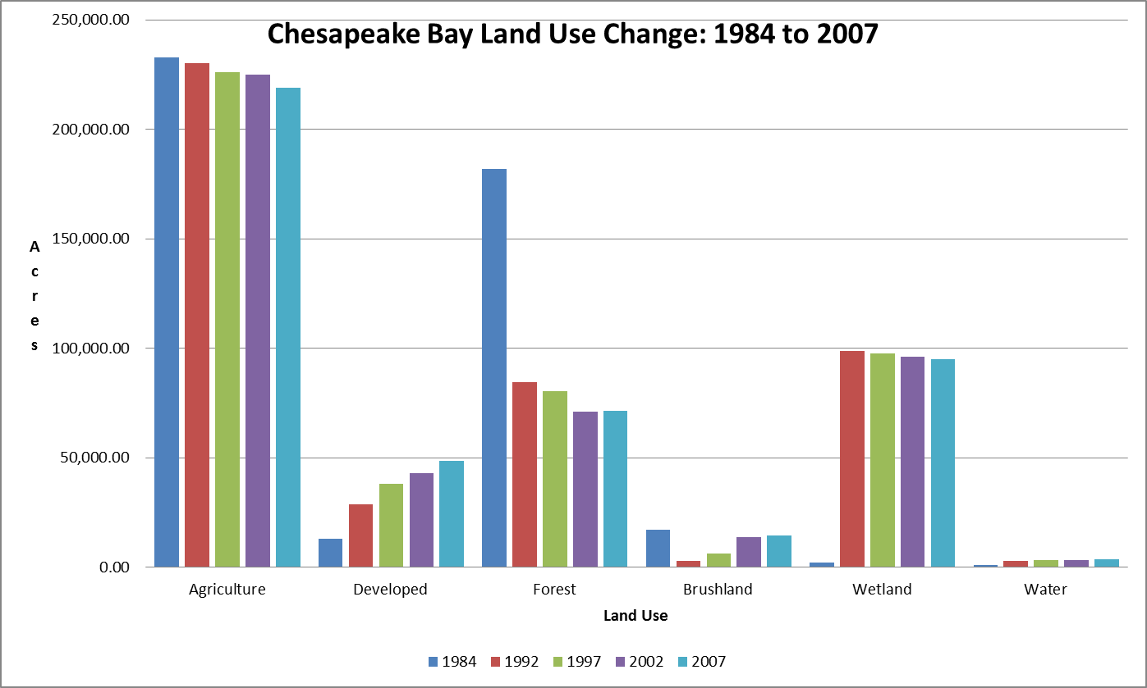
Land Use
Land Use Land Cover (LULC)
1984, 1992, 1997, 2002, 2007, 2012
-1984 – 15 acre mapping unit
-1992, 1997- 4 acre mapping unit
- 2002, 2007, 2012 – 2 acre mapping unit

Slide 6
Datasets (continued)
Public Lands
Impervious- based off 2007 LU/ Imagery
2012 Pending
Sewer & Wastewater CPCN’s Areas
MS4 Areas
Communities (including mobile home)
PLUS Projects (http://stateplanning.delaware.gov/plus/ )
DDA-Forest
Forest Cover, Forest Easements, Commercial Forest Plantation Act, Stewardship Plans, E+S Permits, Urban Tree Plantings
DDA-Agriculture
Districts, Easements, Young Farmer

Slide 7
Datasets (continued)
Wetlands-type; tidal vs. non-tidal
State Strategies
Stormwater-point based with drainage area, install date attribute ~MUDTRACKER
Wastewater
Small Onsite Systems-point based on centroid of parcel with system type. (Class H inspection GPS coords)
Large Onsite Systems
Spray Irrigation Sites
Sewer vs Non-Sewer-Ongoing, parcel based, sewer vs non-sewer statewide

Slide 8
Phase 6 Proposal-Agriculture
Farmsteads:
Impervious v pervious- Can determine using pervious/impervious data for farmsteads from LULC. Conservation districts can verify or in house. Acre size minimum, large vs small?
Regulated v unregulated
~Regulated- AFO/CAFO’s, Nutrient Management Plan properties, nurseries
~Unregulated-small vegetable stands (tedious, need size)
Crops:
Annual Reports HUC level. FSA Crop Ins. Confirm Nutrient Management
plans by onsite visit.
Pasture:
Pull out pasture data from LULC.
Confirm trampled v untrampled via
onsite, or aerials.

Slide 9
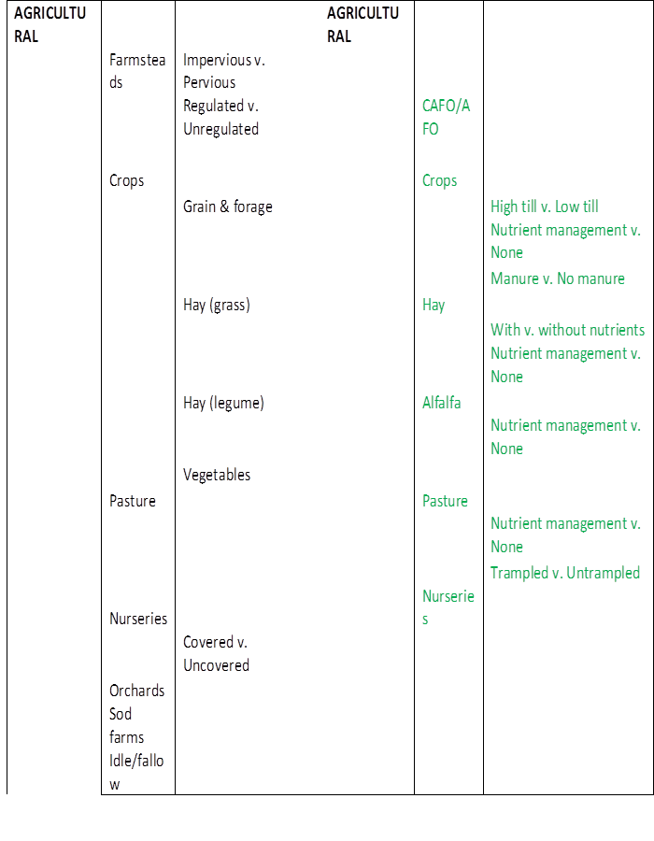
Phase 6 Proposal-Agriculture
Nurseries:
Digitize growing/green
house areas from
DNLA.
Orchards/Sod Farms:
Locate areas via aerial
imagery. Check DDA
for additional info or
ask business. Digitize
growing area. County
/local government
confirm.
Idle/Fallow Lands:
Confirm PLUS plans to recent
imagery. Have local jurisdictions
confirm status. Digitize open
area.

Slide 10
Phase 6 Proposal- Developed
DEVELOPED |  |  | DEVELOPED
 | Impervious surfaces |  |  | Impervious
 |  | Regulated v. Non-regulated |  |  | Regulated v. Non-regulated
 |  | Connected v. Disconnected
 |  | Residential v. Non-residential
 | Pervious surfaces |  |  | Pervious
 |  | Regulated v. Non-regulated |  |  | Regulated v. Non-regulated
 |  | Connected v. Disconnected
 |  | Residential v. Non-residential
 |  | Fertilized v. Unfertilized
 |  | Golf courses
 | Roads
 |  | Number of lanes
 |  | Congested vs. Uncongested
 |  | Connected vs. Disconnected
 | Construction
 | Urban Trees
Directly connected impervious area (DCIA): Area where runoff water flows without being filtered, slowed, or allowed to soak into soil. Breaking up such areas with plantings, swales, detention areas, etc. slows runoff, thus reducing flooding, erosion, and incision. It also lessens the load of pollutants carried in the runoff. (http://bluegreenbldg.org/technical-terms/)

Slide 11
Phase 6 Proposal-Developed
Impervious:
A. Regulated v Non-Regulated- Clip impervious MS4 area to 2007, 2012 layer.
B. Connected v Disconnected- Use with current 2007 layers, 2012. Look for gaps to stream (NHD).
~ Get local stormwater drainage networks if available.
~Check connectivity to MUDTRACKER. Need to have local jurisdictions confirm/create/update & need funding to educate/license to use spatial software.
C. Residential v non-residential-
~ Residential- Use LULC. Intersect impervious to determine density. Include MHP’s. Make sure to not include disconnected sheds, garages, barns or other animal shelter.
~Non-residential- Area that does not serve as permanent home, intended for business. Includes hotels. Break up Commercial vs Industrial. Institutional included in commercial
Pervious:
A. Regulated v Non-regulated-
If regulated refers to MS4, clip out MS4 coverage.
B. Connected v Disconnected- Based on storm event?
Ditches/artificial enhanced streams be connected.
C. Residential v Non-residential.
Use LULC. Clip out impervious areas.
D. Fertilized v unfertilized
Difficult to track for private homes. DNLA, DE Livable Lawns, willing commercial landscapers, golf courses, or surveys. Wastewater spray irrigation is tracked.
E. Golf Courses-
Digitize golf course areas. Wastewater data is available for courses that apply spray irrigation.

Slide 12
Phase 6 Proposal-Developed
Construction:
Tedious to record. Limited building permit data. Counties/municipalities will have to track building permit statuses. Issue will be GIS resources to complete this.
Urban Tree Planting:
Limited tracking due to various agencies/groups working on projects.
Currently seeking an applicant to GIS all previous grant sites state wide that were planted/funded by DFS. Complete by summer 2014.
Have records of tree planting locations and planting stock (container or BB stock) which based on species will give an estimate of size.
*DFS will be keeping GPS points from here on out.

Slide 13
Phase 6 Proposal-Developed
Roads:
Number of lanes- DEL-DOT has centerline data that has information for road width/number of lanes.
Congested vs Uncongested- DEL-DOT has roads classified by annual average daily traffic.
Connected vs Disconnected-Connected would mostly be bridges or stormwater runoff in urban areas. Disconnected- runoff into stormwater retention areas.
http://www.deldot.gov/information/pubs_forms/manuals/traffic_counts/

Slide 14
Phase 6 Proposal- Natural
Forest:
Upland v Floodplain v Riparian- Forested areas can be clipped/intersected to flood plain. Intersect to various soil types for upland characteristics.
Disturbed v undisturbed- What is the definition? Areas can be seen using aerial vs LULC. DDA Timber Harvest can pick up some areas. PLUS projects/comments
Harvest v unharvested- DE Forestry already collects this.
Large patch v small patch- Need definition. Will small patches along waterways (ditches, channeled streams) be riparian?
http://stateplanning.delaware.gov/plus/

Slide 15
Phase 6 Proposal-Natural
Wetlands:
Tidal vs Non-tidal- SWMP 2007 has been divided tidal, non-tidal, artificial. 2012 will be divided same.
Floodplain vs Upland- Intersect wetland to floodplain. Upland areas have to determine by soil profiles.
Scrub-shrub vs Forested- Already recorded in LULC. Digitized using aerials, or image classification tool in ArcGIS.
Beaches:
Definition- guarded, marine coastal waters.
Recreation Water Program monitors Nanticoke River (Riverfest) & Lums Pond (Triathlon/Duathlon)
~Shellfish & Recreational Water Programs monitored Nanticoke River for shellfish growing waters (roughly 10 years ago)
Water:
Use National Hydrography dataset. Uniform. Updated continuously. Waterbodies not included at 24k scale can be digitized via aerial imagery by counties/municipalities.
~Delaware has statewide tax ditch information.

Slide 16
Phase 6 Proposal-Wastewater
Sewer-Current coverage via districts/municipalities. (NPDES locations recorded)
~WWTP Treatment levels recorded
Spray irrigation sites recorded
*Currently working on statewide sewer layer vs non-sewer via parcels billed by county/municipalities

Slide 17
Phase 6 Proposal-Wastewater
Onsite Septic:
Currently recorded through DEN (tracking of onsite permits placed on centroid of parcel)
A. Distance from streams- Use CommunityVIZ or proximity analysis ESRI to NHD layer. Class H program will pin existing systems on an exact location on parcel
B. Mass drain fields- Large systems (>2,500 GPD) recorded in DEN
C. Shallow Drain Fields- Small systems (<2,500 GPD) permit recorded in DEN
D. Failing System- Class H Inspection statewide during property transfer. If found year to replace. Promulgation of new regulations exact location is now required and recorded in DEN. Use CIR or Landsat to look for wet areas on parcels.
E. Direct Discharges- NPDES tracked via point. Track leaking underground storage tanks, SIRB’S
http://www.nav.dnrec.delaware.gov/DEN3/Search/MapSearch.aspx

Slide 18
Conclusion
Delaware records a lot of data spatially
How to pick up areas that are not cost shared
Need definitions
Everything is based on funding
Need to revamp current databases for exact location not default centroid parcel or guess.
Land Use vs Imagery are planned to be on 5 year cycles
Other: Water Control BMP’s, Above Ground/Under Ground Storage Tanks

Slide 19
Special Thanks To:
Wetlands
Mark.Biddle@state.de.us
Stormwater
Sandra.Goodrow@state.de.us
Wastewater
Onsite Systems- Dave.Schepens@state.de.us
Class H Inspections- Scott.Eichholz@state.de.us
Large Systems- Derrick.Caruthers@state.de.us
Ronald.Graeber@state.de.us
DDA Forestry
Kyle.Hoyd@state.de.us
William.Seybold@state.de.us
DDA Agriculture
Mark.Davis@state.de.us
Sussex Conservation District
Debbie.Absher@de.nacdnet.net
Waste and Hazardous Substances
Elizabeth.Wolff@state.de.us
DE Dept of Transportation
Joshua.Thomas@state.de.us
Watershed Assessment
Bryan.Bloch@state.de.us

