Slide 1
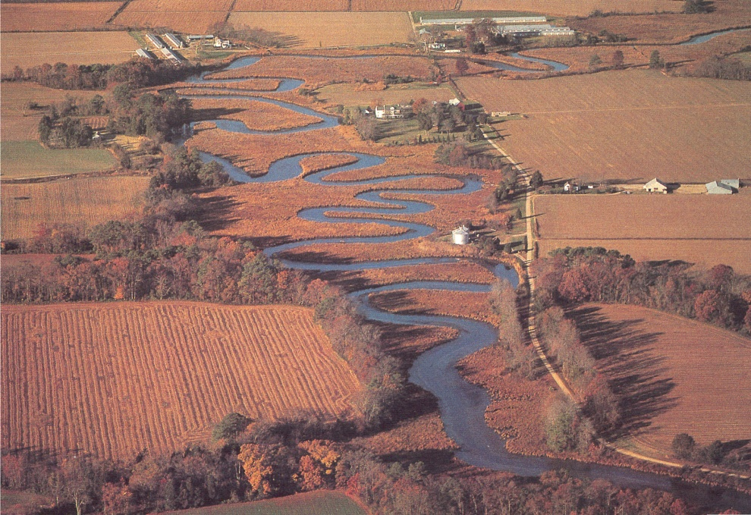
Restoring the Chesapeake One Agreement at a Time One Law at a Time One Step at a Time
Citizens Advisory Committee Ann Swanson
Executive Director
February 27, 2014 Chesapeake Bay Commission
Notes:
In my time before you I would like to cover the
History of the Bay Agreements and where we are now
Based upon what we know and the progress MD is making, provide some advice as to where MD should focus next.

Slide 2
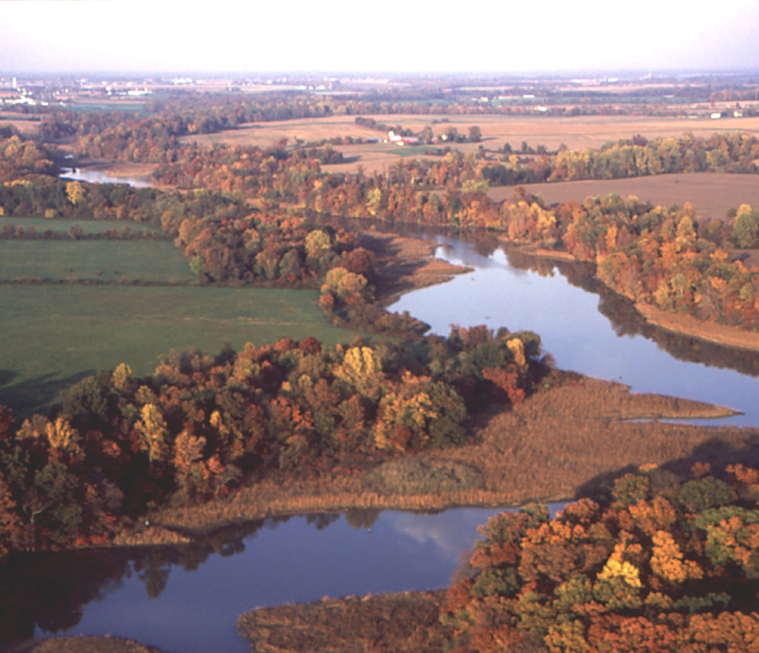
Briefing
THE COMMISSION
THE HISTORY of the BAY AGREEMTNS And the history they prompted
THE 2014 AGREEMENT Where are we in our restoration effort and what policy initiatives were launched to get us here?
THE CBC PRIORITIES

Slide 3
EARLY HISTORY
The Chesapeake Bay Restoration
A Short History - Key Events
1960s-70s Visible decline in Bay resources
1967 Chesapeake Bay Foundation established
1976-1982 EPA conducts 5-year Bay study
1980 Chesapeake Bay Commission established
1983 First Bay Agreement - Bay Program created
1987 Second Bay Agreement – Accountability
1992 Amendments to Agreement – Tributary Strategies
2000 Third Bay Agreement – Water Quality & Focus
1960s
2000
3
Notes:
In the late 1970’s, U.S. Senator Charles “Mac” Mathias (R-Md.) grew increasingly concerned about the “bad water” that watermen were reporting.
As Chairman of the Senate Committee with oversight authority for Chesapeake Bay, he sponsored a congressionally funded, $27 million, five-year study to analyze the Bay’s rapid loss of wildlife and aquatic life.
By the end of 1982, EPA and the states of the Bay watershed were completing the study, known as the Chesapeake Bay Research Program, that identified excess nutrient pollution as the main source of the Bay's degradation. These initial research findings led to the formation of the Chesapeake Bay Program as the means to restore the Bay.
As the Chesapeake Bay Research Program was reaching completion, the attention of all parties turned to a central question: “What would governments do to protect and restore the Bay and how would they manage that process?” EPA was drafting, with input from the states, its final recommendations based on the Bay Research Program, at which point the Federal investment would be complete. It became clear to the states that to remain coordinated and supported by the Federal government, the EPA needed to remain involved and an ongoing, managed partnership needed to be formed.
The first Chesapeake Bay Agreement was signed December 9, 1983 to launch this coordinated governance process to address the Bay’s pollution problems.
It had only three provisions and they were purely management oriented, namely:
the establishment of the Chesapeake Executive Council (EC)
the establishment of an implementation committee and
the maintenance of the liaison office in Annapolis, Maryland to support the Council and Committee.
Efforts under this agreement would last for four years, until 1987. Each signatory then returned to its home turf to address Bay pollution water quality, habitat, and living resources issues raised by the Research Program. The centerpiece of the action in Washington revolved around the Clean Water Act Amendments of 1983, which for the first time contained statutory language related to Chesapeake Bay. This would come to be known as Section 117.

Slide 4
EARLY HISTORY
The Chesapeake Bay Restoration
A Short History - Key Events
1960s-70s Visible decline in Bay resources
1967 Chesapeake Bay Foundation established
1976-1982 EPA conducts 5-year Bay study
1980 Chesapeake Bay Commission established
1983 First Bay Agreement - Bay Program created
1987 Second Bay Agreement – Accountability
1992 Amendments to Agreement – Tributary Strategies
2000 Third Bay Agreement – Water Quality & Focus
1960s
2000
4
Notes:
In the late 1970’s, U.S. Senator Charles “Mac” Mathias (R-Md.) grew increasingly concerned about the “bad water” that watermen were reporting.
As Chairman of the Senate Committee with oversight authority for Chesapeake Bay, he sponsored a congressionally funded, $27 million, five-year study to analyze the Bay’s rapid loss of wildlife and aquatic life.
By the end of 1982, EPA and the states of the Bay watershed were completing the study, known as the Chesapeake Bay Research Program, that identified excess nutrient pollution as the main source of the Bay's degradation. These initial research findings led to the formation of the Chesapeake Bay Program as the means to restore the Bay.
As the Chesapeake Bay Research Program was reaching completion, the attention of all parties turned to a central question: “What would governments do to protect and restore the Bay and how would they manage that process?” EPA was drafting, with input from the states, its final recommendations based on the Bay Research Program, at which point the Federal investment would be complete. It became clear to the states that to remain coordinated and supported by the Federal government, the EPA needed to remain involved and an ongoing, managed partnership needed to be formed.
The first Chesapeake Bay Agreement was signed December 9, 1983 to launch this coordinated governance process to address the Bay’s pollution problems.
It had only three provisions and they were purely management oriented, namely:
the establishment of the Chesapeake Executive Council (EC)
the establishment of an implementation committee and
the maintenance of the liaison office in Annapolis, Maryland to support the Council and Committee.
Efforts under this agreement would last for four years, until 1987. Each signatory then returned to its home turf to address Bay pollution water quality, habitat, and living resources issues raised by the Research Program. The centerpiece of the action in Washington revolved around the Clean Water Act Amendments of 1983, which for the first time contained statutory language related to Chesapeake Bay. This would come to be known as Section 117.

Slide 5
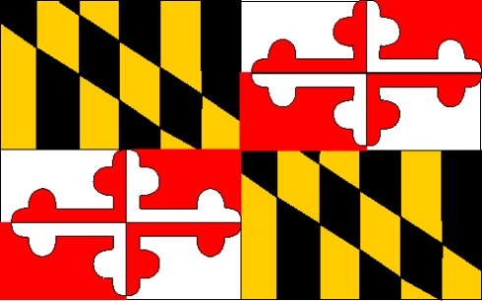
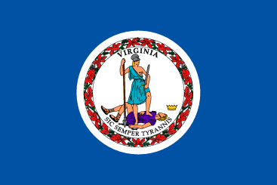
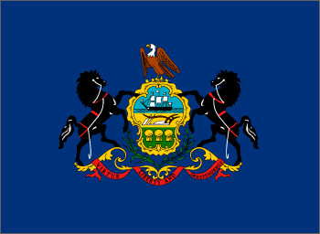

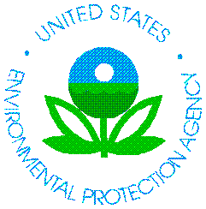
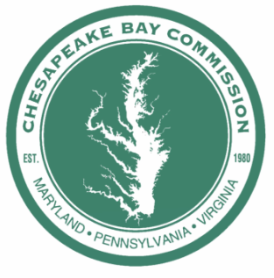

CHESAPEAKE BAY PROGRAM “born”
Governor of MD
Governor of VA
Governor of PA
Executive Council
EPA Administrator
Chair of Chesapeake Bay Commission
Mayor of DC
Notes:
5
The signatories of the Chesapeake Bay Agreement of 1983 became the Chesapeake Executive Council:
The Governors of Maryland, Pennsylvania and Virginia The Mayor of the District of Columbia The Administrator of the U.S. Environmental Protection Agency (EPA) The Chair of the Chesapeake Bay Commission
Established CBP operational goals
1. A Chesapeake Executive Council will be established which will meet at least twice yearly to
assess and oversee the implementation of coordinated plans.
The Council will consist of the appropriate Cabinet designees of the Governors and the Mayor of the District of Columbia and
the Regional Administrator of EPA. The Council will be initially chaired by EPA and will report
annually to signatories of this Agreement.
The Chesapeake Executive Council will establish an implementation committee of agency
representatives who will meet as needed to coordinate technical matters and to coordinate the
development and evaluation of management plans.
A liaison office for Chesapeake Bay activities will be established at EPA's Central Regional
Laboratory in Annapolis, Maryland, to advise and support the Council and committee.
Today, there’s world-wide recognition for our rich history of science, restoration and policy

Slide 6
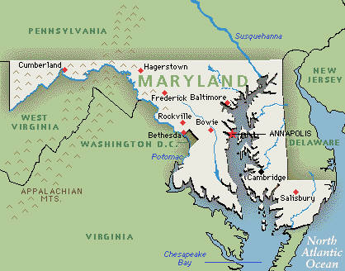
MARYLAND
Critical Areas (‘84)
Phosphate Detergent Ban (‘85)
Sediment & Erosion Control (’80, ‘84)
Stormwater Control Act ( ‘82-’86)
Rockfish Moratorium (’85)
Chesapeake Bay Trust (‘85)
Chesapeake Bay Fishing License (‘85)
Major Environmental
Legislation
1983-1987
Notes:
Sediment and erosion control: The program developed in 1970 is essentially the same that exists today with an approved plan being required for any earth disturbance of 5,000 square feet or more and 100 cubic yards or more.
In 1984, Maryland shifted the enforcement authority from local to State control and established delegation criteria. Later, as the program evolved, the program would be upgraded many times, in 1991 requiring NPDES stormwater discharge permits for construction activity ; in 1992 subjecting agricultural land management practices to enforcement action for sediment pollution ; and finally in 2011, establishing a maximum grading unit of 20 acres. But for the purposes of this discussion, note that after the 1983 agreement, increased attention to sediment and erosion control was fair game.
Stormwater was also on the move during this period of time. In 1982, Maryland passed its Stormwater Management Act ; in ’83, it adopted its Stormwater Management Regulations (COMAR 26.17.02); and in 1984 the local ordinances called for were implemented. By 1986, water quality management generally applied across Maryland, with the ‘first flush” rule that is generally equal to ½ inch of runoff over impervious area.
Rockfish Moratorium: In 1985, Maryland imposed a total moratorium on striped bass. Virginia followed by banning striped bass fishing in spawning areas and then, four years later under substantial Federal pressure from the ASMFC, Virginia also imposed a total ban on striped bass fishing.
Chesapeake Bay Trust: Established in 1985, is the only non-profit grant-making organization in Maryland dedicated to restoring the Chesapeake Bay and its rivers. 55m total since 1985 and $5.4m last year
Bay Fishing License: The Chesapeake Bay Sport Fishing License law was enacted in 1985

Slide 7
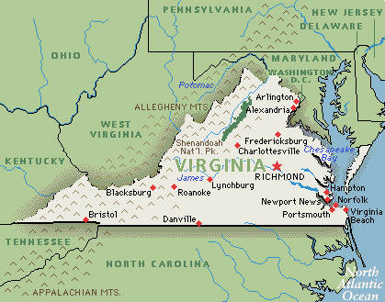
VIRGINIA
Water and Sewer Assistance Authority (‘86)
Water Facilities Revolving Fund (‘86)
Erosion and Sediment Control (‘86)
Phosphate Detergent Ban (‘87)
Dredged Material a Priority for Beach Nourishment (‘87)
Major Environmental
Legislation
1983-1987
Notes:
Water and Sewer Assistance Authority – Expanded; requires new treatment facilities to design for receiving septage from all on-site systems within their service area; idea- get on-site systems hooked-up to treatment facilities
Water Facilities Revolving Loan Fund – Created & since 1987 the Virginia Clean Water Revolving Loan Fund has provided more than $2.5 billion in low-interest loans for wastewater projects in Virginia localities.
Phosphate Detergent Ban- Created: removed phosphates from most cleaning agents and resulted in immediate reductions of 35% to 60% of phosphates being received at treatment facilities.
Erosion & Sediment Control – Improved enforcement capability by allowing inspectors to issue “stop work orders’ immediately while on site when a violation was identified.
Dredged Material a Priority for Beach Nourishment – Created: established beach nourishment as a priority for suitable dredged material to help maintain beaches and protect suitable shorelines from erosion.

Slide 8
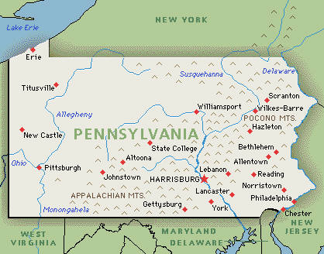
PENNSYLVANIA
ALREADY IN PLACE
Clean and Green Program
Agricultural Areas Act
Clean Streams Law
Sewage Facilities Act
Stormwater Facilities Act
NEW
Agricultural Non-point Source Abatement Program
Agricultural Cost-Share Program (targeted 6 lower Susquehanna River Basin counties)
Major Environmental
Initiatives
1983-1987
Notes:
Pennsylvania had a number of programs in place, some of which date back to the 1960’s – even 1930’s, which are designed to retain ag and forest lands through preferential tax. – Clean and Green and Agricultural Areas Act.
Pennsylvania already had in effect a “Clean Streams Law” enacted in 1937. This law was the basis for several regulatory programs including Erosion & Sedimentation and manure management planning requirements for all farms that handle manure, first developed in 1977.
Other laws that pre-date the first agreement include the Stormwater Facilities Act (1978), which requires counties to develop stormwater management plans and municipalities to enact ordinances consistent with the plan, and the Sewage Facilities Act (1965), which requires sewage facilities planning by municipalities for both community and individual systems.
NEW:
The Pennsylvania Agricultural Nonpoint Source Pollution Abatement Program, (1985 - $2m) Because of the high concentration of dairy farms and other livestock operations in the Commonwealth, more emphasis was placed on effective waste control and innovative manure marketing and management strategies in the PA program than in the case of either Maryland or Virginia.
The PA Agricultural cost-share program, the newest in the region, was initially targeted to specific watersheds located in six counties in the lower Susquehanna Basin. The program was since explained to include watersheds in four additional counties in the middle Susquehanna.

Slide 9
EVOLVING POLICY HISTORY
The Chesapeake Bay Restoration
A Short History - Key Events
1960s-70s Visible decline in Bay resources
1967 Chesapeake Bay Foundation established
1976-1982 EPA conducts 5-year Bay study
1980 Chesapeake Bay Commission established
1983 First Bay Agreement - Bay Program created
1987 Second Bay Agreement – Accountability
1992 Amendments to Agreement – Tributary Strategies
2000 Third Bay Agreement – Water Quality & Focus
1960s
2000
9
Notes:
1987 Second Agreement signed
By 1987, it was clear to the signatories of the 1983 agreement that a new agreement was needed to begin an era of basin-wide efforts to restore Chesapeake Bay.
The 1987 Chesapeake Bay Agreement marked a significant departure from the brief declaration of purpose and governance signed in 1983. The partners moved from the more general spirit of cooperation and coordination into a more specific, goal-oriented framework of interstate policy to drive very specific, meaningful and measurable targets and timeframes.
The new pact included 32 specific commitments and, in almost all cases, deadlines for achieving the identified objectives. It outlined six broad categories of focus including:
water quality
living resources
public access
population growth and development
public information and education, and
“governance,” or the overall coordination of all these efforts.
This Agreement marked the Chesapeake Bay Program as one of the premiere estuarine management programs in the nation.
To a large extent, the agreement re-defined the goals and roles for the states and federal agencies. It provided a focus to direct the efforts of all jurisdictions in the watershed and provided both specificity and a sense of urgency to the Bay Program. Most of these efforts required both administrative and legislative backing. As a signatory, the Bay Commission shared this responsibility.
Among the most notable goals, the agreement aimed to reduce nitrogen and phosphorus entering the Bay by 40 percent by 2000. It also called for an evaluation of this goal in 1991, based upon the new computer model.
Agreeing to numeric goals with specific deadlines was unprecedented in 1987, but the practice has since become a hallmark of the Bay Program as has the use of the model to guide these goals.
Five years later, through a set of 1992 amendments triggered by the 1991 re-evaluation, the Chesapeake Bay Program partners moved upstream to achieve this goal, re-committing to reduce nitrogen and phosphorous by 40 percent in the Bay’s largest tributaries by 2000, and to cap those nutrients once the goal was reached. They also brought air into the equation by recognizing it as a controllable load.
With the sewage treatment plants initially addressed, nonpoint source pollution – agriculture and stormwater -- would become a major focus.
The achievements of the 1987 Chesapeake Bay Agreement were mixed. On the one hand, it had spawned a diverse swath of legislation at the state and federal level that would likely not have occurred without its existence. It also provided us with clear, accountable goals by which to measure both progress and success. Conversely, the waters of the Chesapeake were still considered “dirty” in 2000.
Question: If we were not making our goals, were the aspirational goals still working?

Slide 10
MARYLAND
Striped Bass Mgmt. (‘88)
Agricultural Nutrient Management (‘88)
Sewage Treatment Plant Compliance (’90)
Chesapeake Bay License Plate Fund (’90)
Oil Spill Liability (’90)
Forest Conservation (‘91)
Recreational Boat Pollution (‘92, ’94,‘99)
Brown Fields (‘97)
Smart Growth (’97)
Rural Legacy (‘97)
Prohibition Hydraulic Clam Dredging (‘98)
Animal Waste Technology Fund (‘99)
Blue Crab Targets and Thresholds (‘99)
Major Environmental
Legislation
1988-1999
Notes:
Consolidated Lands Preservation ’90
Economic Growth, Resource Protection and Planning , ‘92
Susquehanna River Fish Passage Resolutions, ‘92
Nutrient Management Certification, ‘93
Phragmites Control, ‘96
Fisheries Management Planning, ‘97-’98

Slide 11
VIRGINIA
Chesapeake Bay Preservation Act (‘88)
Pop. Growth & Devpmt. Commission (‘89)
Striped Bass Moratorium (89)
Ag Equipment Tax Credit (‘90)
Wetlands Enforcement (‘90)
Oil Spill Liability (‘91)
Chesapeake Bay License Plate (‘92)
Forestry Water Quality Law (‘93)
Nutrient Mgmt. Certification (‘94)
Blue Crab Fishery Mgmt Plan (‘95)
Agricultural Stewardship Act (‘96)
Ag BMP Tax Credit (‘96)
Water Quality Improvement Act (‘97)
Poultry Waste Mgmt. Act (‘99)
Land Conservation Fndn. & Fund (‘99)
Major Environmental
Legislation
1988-1999
Notes:
Chesapeake Bay Preservation Act (‘88) – required Tidewater localities to design protective buffers adjacent to all waterbodies and wetlands and reduce phosphorus in stormwater runoff
Population Growth & Development Commission (‘89) – tasked with helping plan for increased population, shift from rural to urban living, expanding infrastructure concerns, etc.
Striped Bass Moratorium (89) – expanded restrictions to a complete ban on striped bass fishing
Ag Equipment Tax Credit (‘90) - Tax credit for purchase of advanced technology pesticide and fertilizer application equipment
Chesapeake Bay License Plate (‘92) – over 1,000 grants totaling nearly $7 million have been given to groups working to restore the bay and its tributaries
Forestry Water Quality Law (‘93) – established authority to require forestry BMPs and fine loggers not properly implementing BMPs
Nutrient Mgmt. Certification (‘94) – established required training & certification for public and private nutrient management plan writers
Agricultural Stewardship Act (‘96) – establish authority to investigate complaints against Ag operations and require correction of water quality problems
Ag BMP Tax Credit (‘96) – provided the opportunity for receiving a tax credit for personal expenses for installation of certain Ag water quality BMPs
Water Quality Improvement Act (‘97) – directs 10% of any budget surplus to fund point & nonpoint water quality improvements
Poultry Waste Mgmt. Act (‘99) – required a regulatory program governing the storage, treatment and management of poultry waste
Land Conservation Fdtn. & Fund (‘99) - establish permanent conservation easements and to purchase open spaces and parklands, lands of historic or cultural significance, farmlands and forests, and natural areas

Slide 12
PENNSYLVANIA
Phosphate Detergent Ban (‘89)
Farmland Preservation Program (‘89)
Agricultural Nutrient Management (‘93)
Environmental Education (‘93)
Brownfields Program (‘95)
Clean & Green (‘99)
Growing Greener I (‘99)
Major Environmental
Legislation
1988-1999
Notes:
Nutrient Management Law was in addition to existing Manure Management Manual requirements and required full nutrient management plans on farms that met a density threshold (animal units/acre instead of total animals).
The Environmental Education Act provides for an Environmental Education Fund and grant program. It also created an advisory board and required coordination between DEP and DOEd and regular reports to the Governor and GA.
“Clean & Green” is a preferential tax assessment program, that allows agricultural and forestland to be assessed for property tax purposes at the value of its current use, instead of its developed value. If land enrolled in C&G is converted to a non-conforming use, seven years’ of “rollback taxes” are imposed as a penalty.
“Growing Greener” legislation created the Environmental Stewardship Fund, initially funded at $650M over five years.

Slide 13
MORE POLICY HISTORY
The Chesapeake Bay Restoration
A Short History - Key Events
1960s-70s Visible decline in Bay resources
1967 Chesapeake Bay Foundation established
1976-1982 EPA conducts 5-year Bay study
1980 Chesapeake Bay Commission established
1983 First Bay Agreement - Bay Program created
1987 Second Bay Agreement – WQ Goals
1992 Amendments to Agreement – Tributary Strategies
2000 Third Bay Agreement (C2K) – Precursor to TMDL
2008 Water Quality Impairments Acknowledged
2010 Chesapeake Bay TMDL established
1960s
2011
13
Notes:
Chesapeake2000 (C2K) was ambitious.
Most Comprehensive
Most aspiration
Most Measurable
Most Time Sensitive (Deadline for most goals was 2010)
102 Commitments in 5 Categories
Tried to get out ahead of TMDL
Introduced headwater jurisdictions to the partnership
Introduction of Regulatory Drivers into a historically Voluntary Partnership
This agreement established more than 100 goals to:
Reduce pollution,
Restore habitat,
Promote sound land use, and
Engage the public.
Increasing federal regulatory actions; Growing perspective of what job will really take.

Slide 14
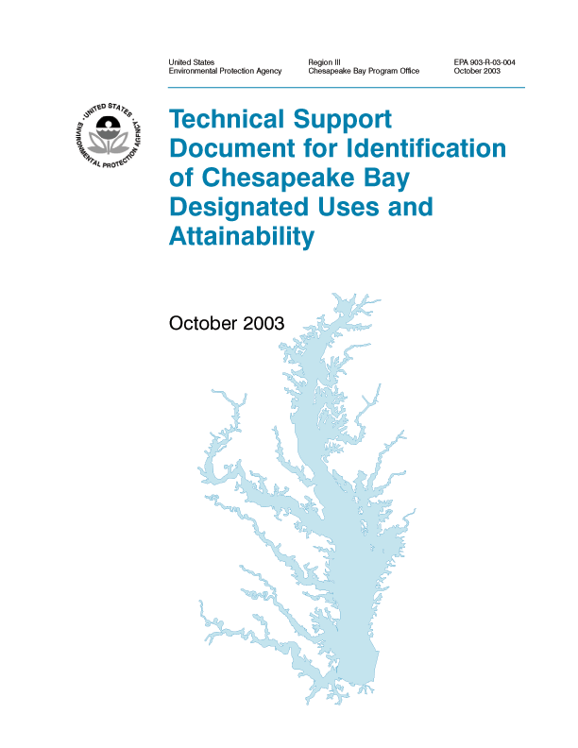
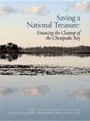
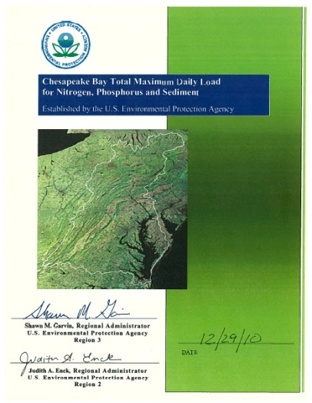
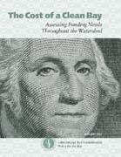
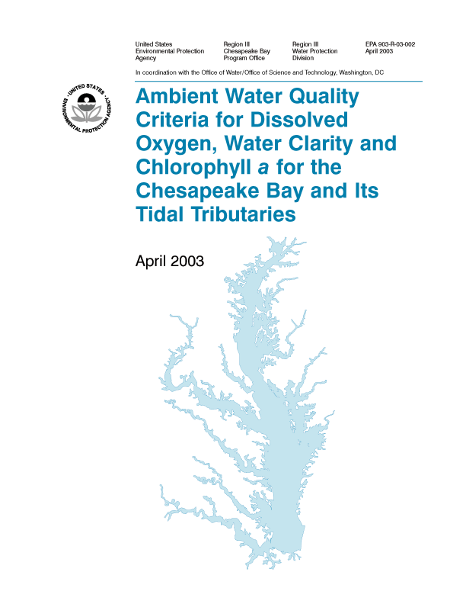
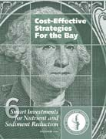
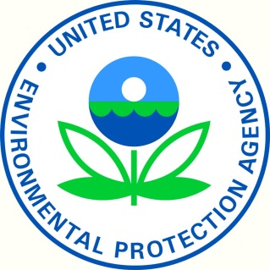
C2K Game Changers
3
Water Quality
Standards
Rising Costs &
Recession
Threat of Regulatory
Bay-wide TMDL
Notes:
The commitments of C2K prompted the
Development of Water Quality Standards that reshaped the permits throughout the watershed.
Prompted the Commission, and since the Bay Program, to investigate the cost of implementation and the most cost-effective practices, work that has impacted many state programs, the federal farm bill, and still resonates with policymakers today.
The TMDL

Slide 15
Legislation Post C2K (2000-)
Virginia
Pennsylvania
Maryland
Green Print ( ‘01)
Intro Non-native Species (‘01)
Smart Growth (‘01)
Bay Restoration Fund(’04,’12)
P Detergent Ban (‘06,’11)
Chesapeake and Coastal Bay Trust Fund (‘07)
Stormwater Management (‘07)
Clean Cars (’07)
Forest Preservation Act (’08)
Living Shorelines ( ’08)
Septic Tanks (’09, ‘12)
Lawn Fertilizer (‘11)
Stormwater Utilities (‘12)
Ag Certainty (‘13)
Land Preservation Tax Credit (‘00)
Stormwater Program Consolidation (‘05 & ‘13)
Nut. Credit Exchange (‘05)
Major Point Source Upgrades (‘05)
Crab Dredging Ban (‘08)
Phosphate Detergent Ban (’08)
Resource Mgmt. Planning (‘11)
Alternative On-site Sewage Systems (‘11)
Urban Lawn Fertilizer (‘12)
MPC Omnibus Amdts. (‘00)
Growing Greener (‘02)
Chesapeake Bay Watershed Education Program (‘04)
Water & Wastewater Treatment Bond (‘04)
Manure Hauler & Broker Certification (‘04)
Growing Greener II (‘05)
REAP (Ag. Trans. Tax Credit) (‘07)
Phosphate Detergent Ban (08)
H2O PA (‘08)
Notes:
Virginia
Stormwater: Merger of DCR programs with DEQ programs (Clean Water Act) – DEQ for 1 acre and up; Preservation Act up to 2500 square feet; brought together in 2005.
Resource Management Planning (Ag Certainty) – Regs now complete – DCR called for delay until DCR can get adequate software up and running (Ag Certainty will be based on 5 practices for cropland, hayland and pasture)
Nutrient Credit Exchange Trading – has now been expanded to allow for stormwater – they can access credits that are already banked by way of land conservation
Urban Law Fertilizer -- .9 lbs/1000 square feet
Major Point Source Upgrades – Bubble Permits; 125 Major Sources to 4 mg liter (1 billion); Addressed 70-80% of the loads
Land Preservation Tax: Emmett; Tax Credits you can sell if you cannot use them yourself; This is funded at around $100 million annually
Alt. On Site Sewage System: This was VA’s step towards alternative and nitrogen removing systems. How to get people to upgrade to N.
Crab Dredging Ban: Winter Crab Dredge Ban; Unfortunately, Legislature kept it that VMRC has to take this action annually. They did renew this for 2014.
Pennsylvania
MPC (Municipalities Planning Code) was updated in 2000 to promote intermunicipal cooperation, and consistency of local planning with county comprehensive planning. SB 300
REAP (Resource Enhancement and Protection Program) provides for transferable tax credits for the implementation of agricultural best management practices. Typically, $10 M/year is authorized and used within the first several days of the application period. SB 97
A dedicated funding source for Growing Greener I was created in 2002 (HB 2044) with the assessment of a tipping fee on trash deposited in PA landfills. GG II was a $625 M bond issue in 2005. (Approved by voter referendum).
The Advanced Energy Portfolio Standards require power companies to source a growing percent of their power from renewable sources, including biomass. SB 1030
The Chesapeake Bay Watershed Education Program authorized funding for $5,000 grants to schools beginning in 2004. It was modestly funded for the first few years but has not been funded since. HB 2775
The phosphate detergent ban was extended to dishwasher detergent in 2008. SB 1017
Voters approved a $250 M Water & Wastewater Treatment Bond in 2004, followed by creation of the H2O PA program in 2008, which authorized funding of up to $20M per project. SB 2
Manure Hauler and Broker Certification: HB 1809
Maryland
The Bay Restoration Fund (“Flush Tax”) was signed into law in 2004, ( SB 320). Wastewater is MD’s largest source of N and P, so MD decided to create a dedicated fund, financed by wastewater treatment plant users, to upgrade Maryland’s wastewater treatment plants with enhanced nutrient removal (ENR) technology in order to bring their largest 66 plants to wastewater effluent quality of 3 mg/l total nitrogen and 0.3 mg/l total phosphorus. In addition, a similar fee paid by septic system users will be utilized to upgrade onsite systems and implement cover crops to reduce nitrogen loading to the Bay. Md’s target for 2025 for N reductions is 10 million pounds. MD says will reach our 60% goal by 2017 largely from upgrading the 67 major WWTP’s. So this is a HUGE piece of our strategy to reduce our 10 million pounds of N.
The remaining 40% that we have to address by 2025 will likely be much harder and costlier to reduce. Stormwater is a part of that remaining 40% of our load.
$2.50 per month per household – upgraded to $5.00 in 2012 (HB 446) ; In 2018 BRF can be used for ENR at Major-Minor WWTP’s, then Minors, then for stormwater in local jurisdictions that enacted a stormwater fee. Required fee to revert back to $2.50/month beginning July 1, 2030.
The Trust Fund was enacted in 2007 special session, (HB 23). It is focused on funding the most effective non-point source pollution control projects. Dollars for the Trust Fund are generated through motor fuel tax and rental car tax in Maryland. It is anticipated that when fully-funded, the Trust Fund will generate $50M annually.
Adopted in 2007 (SB 103, HB131), The Maryland Clean Cars Program adopts California’s stricter vehicle emission standards. These standards became effective in Maryland for model year 2011 vehicles, significantly reducing a number of emissions including volatile organic compounds (VOCs) and nitrogen oxides (NOx). The NOx reduction was expected to be 2.9 tons/day greater than the existing Federal Tier 2 standards that were in place at the time of its adoption. Translated, this amounts to about 2.1 million lbs. year. The CO2 reductions are also substantial – in MD about 1/3 of all CO2 is emitted by cars.
Living Shorelines – stabilizations method in in tidal wetlands must be living shoreline, Some exemptions.
Forest Preservation Act- first of it’s kind no net loss forest policy to maintain states 40% tree canopy. Expands tool and creates new ones for landowners and local governments.
Stormwater Utilities - Watershed Protection and Restoration Program (SB 987, 2012) requires large MS-4 jurisdictions (pop. greater than 250,000) to Create a dedicated stormwater fee by July 2013 and to develop a stormwater plan to reduce polluted stormwater runoff. (Large MS-4 jurisdictions- Anne Arundel, Baltimore, Carroll, Charles, Frederick, Harford, Howard, *Montgomery, and Prince George’s counties and Baltimore City.)
Green Print, 2001( HB 1379)- aimed at protecting a network of ecologically valuable lands. New computer-based assessment, mapping, and targeting tools would be used to help identify the most strategic acquisitions. The five-year goal of the program is to protect 50,000 acres. Maryland's green infrastructure contains roughly two million acres of undeveloped land and is characterized as a system of "Green Hubs" (large habitat areas typically hundreds of acres in size) that are linked together by linear corridors of land referred to as "Green Links." DNR may use program funds to acquire real property interests in the network and provide grants to local governments and land trusts to acquire real property interests in the network.

Slide 16
1960s
The Chesapeake Bay Restoration :
A 50-Year History with a future
1960s-70s Visible decline in Bay resources
1967 Chesapeake Bay Foundation established
1976-1982 EPA conducts 5-year Bay study
1980 Chesapeake Bay Commission established
1983 First Bay Agreement - Bay Program created
1987 Second Bay Agreement – WQ Goals
1992 Amendments to Agreement – Tributary Strategies
2000 Third Bay Agreement – Precursor to TMDL
2008 Water Quality Impairments Acknowledged
2010 Chesapeake Bay TMDL established
2014 Fourth Bay Agreement – Measurable & Flexible
2017 60% of TMDL implemented
2025 TMDL practices fully implemented
2025
16
Notes:
Importance of Chesapeake Bay
History of Bay Program
Challenges (e.g. population, changing environmental conditions)
Role of local governments and other partners
Verification and Transparency
Expansion to include headwater states
Cost-effectiveness

Slide 17
Is the Content Right?
Are the rules of engagement clearly defined?
With flexibility as the hallmark, how will the decisions be made?
How will the goals and outcomes change in response to changing environmental , cultural and economic conditions?
How will local governments be effectively engaged?
Will new levels of transparency and verification also be hallmarks of this agreement?

Slide 18
Is the Content Right?
Toxics
Climate Change
Sea level Rise
Storm Frequency
Conowingo
Governance

Slide 19
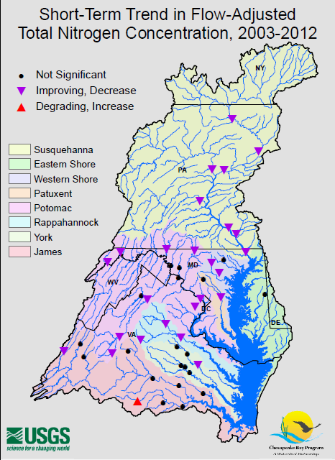
N
2003-2012
Notes:
Short Term Trend: Over the past 10 years, 54 percent of the monitoring stations show improving flow-adjusted nitrogen concentrations. Only one site showed degrading nitrogen conditions. Between 2003 and 2012:
25 out of 46 sites show improving flow-adjusted trends for nitrogen concentrations,
1 site shows degrading trends, and
20 sites show small changes that are not statistically significant.
Even long term trends (1985-2012) show 70 percent of monitoring sites showing improvement.
Based on our ….. WIP, we are on target to achieve our 2017 Nitrogen reduction goals due to upgrades to our WWTP (Flush Fee -- $....)
Wastewater treatment plants have upgraded almost to the limits of technology(3 mg/l)
Septics contribute almost no phosphorus load 9 (they are designed to remove P; not N)
Background:
Watershed Yield: Total Nitrogen yields ranged from 0.33 to 9.87 tons per square mile. Each of the 17 sites in the high yield category carries more than 3.4 tons of nitrogen per square mile of watershed. These sites are generally located on the Eastern Shore, Lower Susquehanna and Northern Potomac Watersheds. The lowest yields, which are less than 1.2 tons per square mile, are generally in the Upper Potomac and Southern Virginia Rivers.

Slide 20
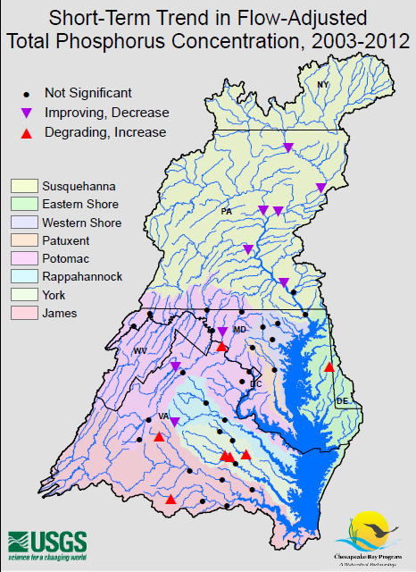
P
2003-2012
Notes:
P shows quite a different story
Short Term Trend: Over the past 10 years, 63 percent of the monitoring stations show little or no change in flow-adjusted phosphorus concentrations. Between 2003 and 2012:
9 out of 43 sites show improving flow-adjusted trends for phosphorus concentrations,
7 site shows degrading trends, and
27 sites show small changes that are not statistically significant.
Long Term Trends show 73 percent improving flow adjusted concentrations of phosphorus. Recent conditions are overtaking our long term gains.
EPA’s analysis of Maryland's milestones show that we are not on track to achieve our 2017 goals unless we enhance our agricultural and urban stormwater programs. Urban Runoff and Agriculture (manure).
MD:
Manure- 23%
Chemical fertilizer- 27%
Urban Runoff- 23%
Wastewater & Combined Sewer Overflow- 21%
Forest & Non-Tidal Atmospheric Deposition- 6%
BACKGROUND:
Long Term Trend: Seventy-three percent of long-term stream monitoring sites in the Chesapeake Bay Watershed show improving flow-adjusted concentrations of phosphorus. Between 1985 and 2012:
22 out of 30 sites show improving flow-adjusted trends for phosphorus concentrations,
4 sites show degrading trends, and
4 sites show small changes that are not statistically significant.
Watershed Yield: Total Phosphorus yields ranged from 0.036 to 0.57 tons per square mile. Each of the 17 sites in the high yield category carries more than 0.19 tons of phosphorus per square mile of watershed. High yielding sites were found in the Eastern Shore, Susquehanna, Potomac, and Rappahannock Watersheds. The lowest yields are generally in the western areas of the Bay watershed and the York River Basin.

Slide 21
CBC Priorities
STORMWATER
Financing, Turf, MS4, Financial Support
AGRICULTURE
Manure, RCPP, Financial Support, Certainty
ACCOUNTABILITY
Ver./Tracking,, BMP Approval,Offsets
NATURAL LANDSCAPES
TMDL, Acquisition

Slide 22

MARYLAND’S CHESAPEAKE BAY: It’s about protecting home
Ann Swanson
aswanson@chesbay.us
410-263-3420
Jane Hawkey/IAN

