Slide 1

State of the Bay
Status of the TMDL & the Resultant CBC Priorities
Presentation to
CBP Citizens Advisory Committee
Ann Swanson
Executive Director
aswanson@chesbay.us
February 23, 2017

Slide 2
Chesapeake Bay TMDL
2010: TMDL established
Phase I WIPs
Phase II WIPs
2017: MID-POINT ASSESSMENT
60% of needed actions
Updated Model
EPA Phase III Expectations Accounting for Growth
2018: Phase III WIPs
2025: 100% of needed actions
Notes:
Updated Model: Deploying an update of the watershed model that includes new BMPs, updated existing BMPs, and recalibrated for current monitoring data and new land use data that will give us a more accurate picture of what is happening gin the watershed.
Tow important pieces to the update are the information about Conowingo and the impacts from Climate Change (changing and water temperature; sea level rise; precipitation; storm events; evapotranspiration due to warmer temperature)_
EPA Expectations issued Expectations Document on Friday – outlines what their Expectations are for the Phase III WIPs;
Final due Spring 2017 after PSC retreat that will decide how Conowingo, Climate Change and Accounting for Growth will be handled.
Partnership Fatal Flaw review of the Phase 6 model will slip one month to June 30
Planning Targets in July
PSC Retreat was May – now either July or September or possibly both
Wiggle room comes from July – December when the Partnership Review of Phase III WIP Planning Targets was to take place
Draft Phase III WIPs August 2018
Final Phase III WIPs December 2018

Slide 3
Chesapeake Bay Watershed Nitrogen Reductions
1985-2015
318
242
59% Wastewater
39% Agriculture
2% Forest
Where did the nitrogen reductions come from?
Notes:
76 million lbs. since 1985

Slide 4
Chesapeake Bay Watershed Nitrogen Reductions
2015-2025
242
192
2025
2015
Where will the remaining nitrogen reductions* come from?
71% Agriculture
24% Urban Stormwater
5% Septic Systems
*Based on the jurisdictions’ Phase II WIPs.
Notes:
50 million lbs to go. What you can see here is that agriculture and stormwater holds the keys to clean water.

Slide 5
Maryland Nitrogen Loads
1985-2015
77
48
2015
1985
Where did the Nitrogen reductions come from?
66% Wastewater
33% Agriculture
1% Forest
Notes:
59% Baywide for Wastewater
39% Baywide for agriculture
Wastewater
Bay Restoration Fund
29 million lbs reduction

Slide 6
Virginia Nitrogen Loads: 1985-2015
85
59
2015
1985
71% Wastewater
26% Agriculture
3% Forest
Where did the Nitrogen reductions come from?
Notes:
59% Baywide for Wastewater
39% Baywide for agriculture
26 million lbs primarily from wastewater.
Wastewater:
Water Quality Improvement Act ($hundreds of Millions)
Budget
Trading Legislation (this established the Water Authority that decided which plant would go first, second and pushed back against the cost of upgrades – do we have enough engineers)
Agriculture
Natural Resources Commitment Fund (Funds the Cost share – sub fund of the Water Quality Improvement Fund; 1.2 of Recordation Fund -- $10 of every $20 Fund
Ag Certainty Program – Resource Management Plan Program
BMP Tax Credit

Slide 7
Pennsylvania Nitrogen Loads: 1985-2015
124
113
2015
1985
Where did the Nitrogen reductions
come from?
73% Agriculture
24% Wastewater
3% Forest
Notes:
59% Baywide for Wastewater
39% Baywide for agriculture
Agriculture
USDA Federal Funding
Nutrient Mgmt. Law (1993)
Growing Greener (Funded Watershed Mgmt. plans and BMPs, to some extent)
Education: Non-till and Cover crops
REAP: Jump No-Till (Transferable Tax Credit used to purchase no-till equipment)
Wastewater:
PennVest Money comes from EPA through the Revolving Loan Fund
Some state funding after the tributary strategies
PENNSYLVANIA BUDGET FY18
Department of Agriculture
7.6% increase in General Operations budget.
Eliminates Agricultural Research line item (again, he tried this last two years).
Department of Community and Economic Development
0.5% decrease in General Operations budget
No programs impacting environmental concerns seem impacted
Department of Conservation and Natural Resources
6% increase in General Operations budget.
Governor proposes to shift DCNR funding from General Fund back, in part, to Oil and Gas Leasing.
Budget assumed about $10M/year in additional royalties going to the OGL.
72.6% decrease in state parks budget through General Fund.
Replaces this cut ($43.5M) with revenue from Oil and Gas Lease Fund.
If realized, this would be an increase of $4M for state parks.
71.5% decrease in state forest budget through General Fund.
Replaces this cut ($21.4M) with revenue from Oil and Gas Lease Fund.
If realized, this would be an increase of $2M for state forests.
Department of Environmental Protection
3.4% decrease in General Operations budget.
2.0% increase in Environmental Protection Operations budget.
Chesapeake Bay line item is decreased by a very small amount ($54K).
Environmental Stewardship Fund
This fund takes revenue from the tipping fee and uses it to pay back debt financing for Growing Greener 2 as well as provide land and water conservation grants.
Governor proposes floating a bond to cover the ESF ($52M/ year) and taking the tipping fee revenue and putting it in the general fund.
Governor proposes to do this for only 3 years to save over a $100M in general funding.
New Watershed Protection Investments
Using $15M in proposed bonding, the Governor proposes three new investments in watershed activities
New $2M to expand the Chesapeake Bay Riparian Forest Buffer Program at DCNR
New $4.7M erosion and sediment management plans program at the Department of Agriculture
New $8.3M local water quality investments at the Department of Environmental Protection
A portion of these last two programs will support a rebate program to farmers to cover the costs for nutrient management, ag erosion and sediment control, storm water control, and ag BMPs.

Slide 8
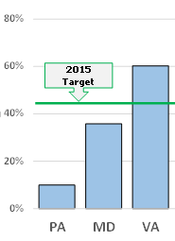
Maryland & Virginia’s Dedicated Funds Ensured Progress
Maryland
Bay Restoration Fund
  $139 M FY15
  Sewer bill surcharge
  WWTPs, septic, ag
Bay 2010 Trust Fund
  $39 M FY16
  Portion of rental car and fuel taxes
  Non-point source, incl. ag (MACS -$19M FY16)
Water Quality Bonds
Virginia
Water Quality Improvement Fund
  $59 M FY17
  10% of GF surplus
  WWTP and NRCF
Natural Resource Commitment Fund
  $62 M FY17
  WQIF, real estate recordation fee
  Technical assistance and cost-share
Ag Tax Credit Program
Notes:
Both Maryland and Virginia are “on-track. Because of their dedicated funds”
Maryland: FY 17 52.6M; FY16 50.2m; FY15 46.8
Bay Restoration Fund:
$5/month/household in Bay watershed (up from $2.50 prior to 2012 – reverts in 2025.
Five year history: FY11 $69M; FY12 $70M; FY13 $129M; FY14 $139M; FY15 $139M
Mostly for WWTP upgrades
60% of fees collected from septic users support cover crops under the MACS Program – Stormwater will be eligible in 2018.
Bay 2010 Trust Fund
Portion of Rental Car and Fuel Taxes – for strategic, cost-effective investments in nonpoint source pollution control, incl. agFY16 $39M
FY16 MACS got about half -- $19 M (research grant program, NGO, stream restoration, stormwater mgmt.)
Water Quality Bond Funding
varies between $3-10 million; in FY16 $6 million. FY$17 got O.
Staff at $11 million
Virginia: FY17 44.2M; FY16 22.7M; FY15 22.48
Water Quality Improvement Fund
10% of general fund surplus and 10% of unrestricted or uncommitted general fund balances; + bond proceeds
5 year funding history: FY13 $87.6M; FY14 $106M; FY17 $59M
Funds WWTP upgrades and Natural Resources Commitment Fund
Natural Resource Commitment Fund
WQIF + one-half of $20 real estate recordation fee
Funding generally $10-28M; FY17 $62M with $20M dedicated to Livestock Stream Exclusion
Funds TA to local SWCD and cost share BMPs
Agricultural Tax Credit Program
Roughly $1M annually
FY11 $982K; FY12 $1/4M; FY13 $1.1M; FY14 $888K; FY15 $643K
Tax credit of 25% of the first $70K of the taxpayers BMP cost, not to exceed $17,500 that is refundable if the credit exceeds the taxpayer’s liability.
The tax credit is also transferable
Pennsylvania: FY 15-17 $9M; FY 16
Annual cost when practices and geographies are prioritized for cost-effectiveness is $241.3 M (total Bay-wide is $634.1)

Slide 9
Comparing Nitrogen Load Reductions
1985-2015
Where did the remaining nitrogen reductions* come from?
Maryland
Pennsylvania
  73% Agriculture
  24% Wastewater
  3% Forest
66% Wastewater
33% Agriculture
1% Forest
Notes:
4 billion spent over past 30 years; unfortunately most of the money went to Wastewater
{PA has spent almost all of its money on wastewater reductions but it has only achieved 24% of the load reductions.

Slide 10
Comparing Nitrogen Load Reductions
2015-2025
Where will the remaining nitrogen reductions* come from?
Maryland
Pennsylvania
38% Agriculture
34% Urban
15% Wastewater
13% Septic
78% Agriculture
20% Urban
2% Septic

Slide 11
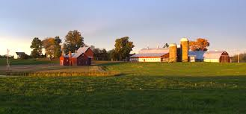
Chesapeake Bay Commission
Pennsylvania
4-Prong
Strategy
Water Protection Fund
Clean and Green
Lawn Fertilizer Bill
Federal Resources
Notes:
Pennsylvania’s Reboot
Created new Chesapeake Bay office in DEP
Redirected conservation district funding from education to inspection
PA in Balance partnership with Penn State
Prioritize watersheds for impact
ID new resources

Slide 12
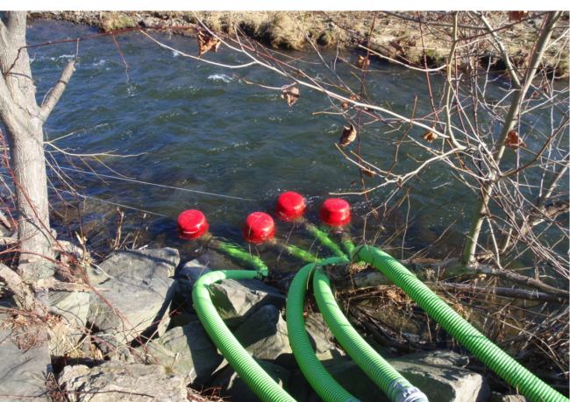
A Dedicated Fund for PENNSYLVANIA?
Pennsylvania Clean Water Fund
HB 2114: Large Water Users Fee
1/100 cent/gallon for withdrawals greater than 10,000 gallons a day.
1/10 cent/gallon consumptive uses greater than 10,000 gallons a day.
Revenue estimates are projected to be $245 million a year.
Will address 19,000 miles of impaired waters under Federal Clean Water Act Section 303(d).
Notes:
Amend Title 3, Chapter 14 (Soil & Water Conservation).
Money should be set-aside in its own separate fund, not a part of the General Fund, and non-reverting. It could also be enhanced through bond funding.
Anticipated Revenue generated: $245M/annually.
Purpose: Reduce non-point source pollution instead of point source pollution.
Funding through PENNVEST and CFA has historically been used for point sources and has been successful. Non-point source projects don't fit that mold.
Distribution: among the major watersheds of the Commonwealth, with the Chesapeake Bay receiving a higher proportion in early years and the distribution evening-out over time.
Within each watershed, the funds should be targeted to the geographic areas and sources that are priorities within that watershed – the priorities are likely to vary between the watershed.
Targeting must be able to occur at a scale that maximizes cost-effectiveness.
Bay Education: A small amount could be used to fund the Chesapeake Bay Watershed Education Program, which was established in 2004 but has not received an appropriation in several years.
By law, these are small (no more than $5K each) grants to schools for “meaningful outdoor watershed experiences” as called for in the Chesapeake Bay Watershed Agreement.
Eligibility: Eligible projects should include both technical assistance and practice implementation as well as a maintenance requirement, preferably involving easements.
Eligible applicants should be broad to promote innovation, especially in program delivery, such as non-profits leading efforts with the Plain Sect.
Funds should be cost-shared and limited in amount per project.
As a state program, it can leverage efforts to improve local water quality and address the 19,000 miles of Pennsylvania rivers and streams that are listed as “impaired.”
Federal Clean Water Act Section 303(d).

Slide 13
CBC
2017
Areas of Special Focus
Special Emphasis
Emerging Concern
Susquehanna/PA
Technical Assistance
Trump Transition
Oyster Sanctuaries
Chesapeake Bay Awareness Week
Nonwoven Wipes
Illicit Drug/ Pharmaceutical

Slide 14
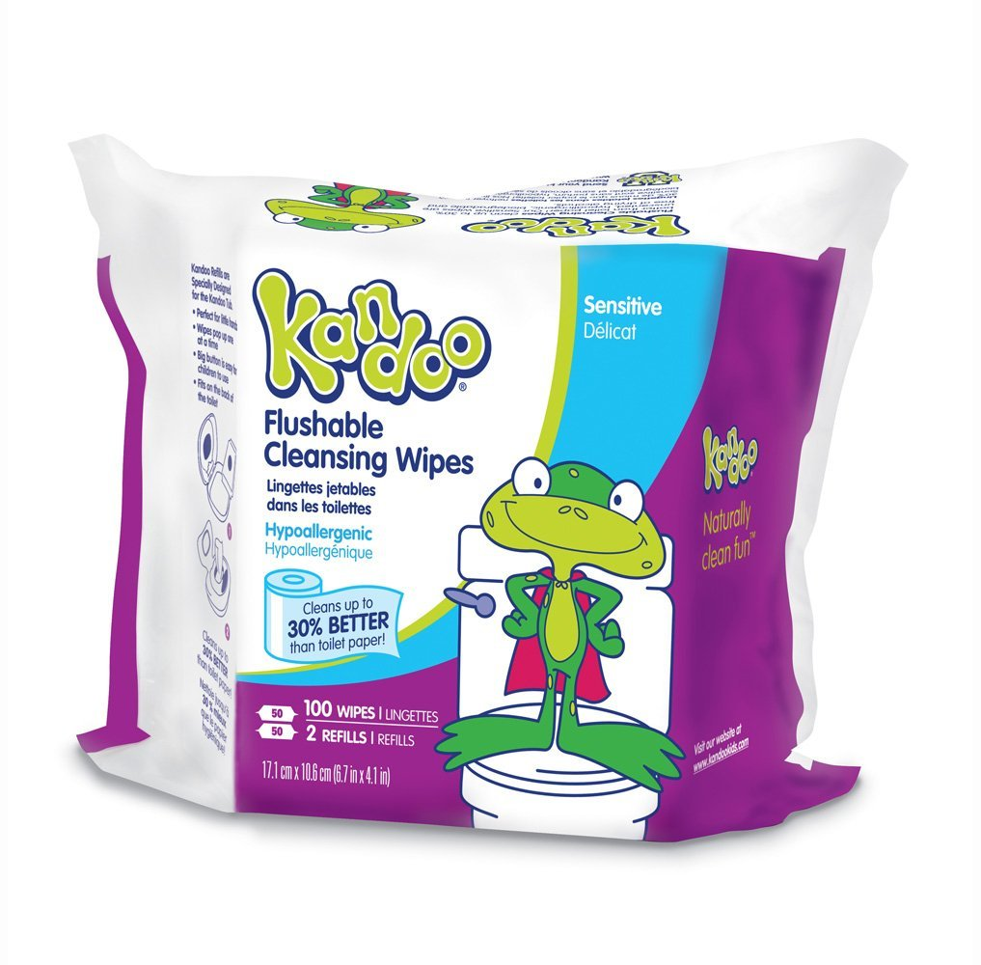
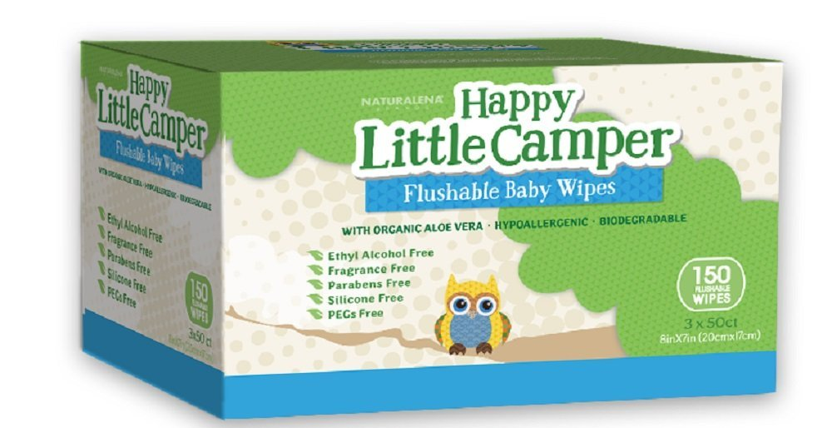


SB280
Proper Advertising & Labeling of
Nonwoven Disposable Products
Notes:
All marked as flushable.

Slide 15
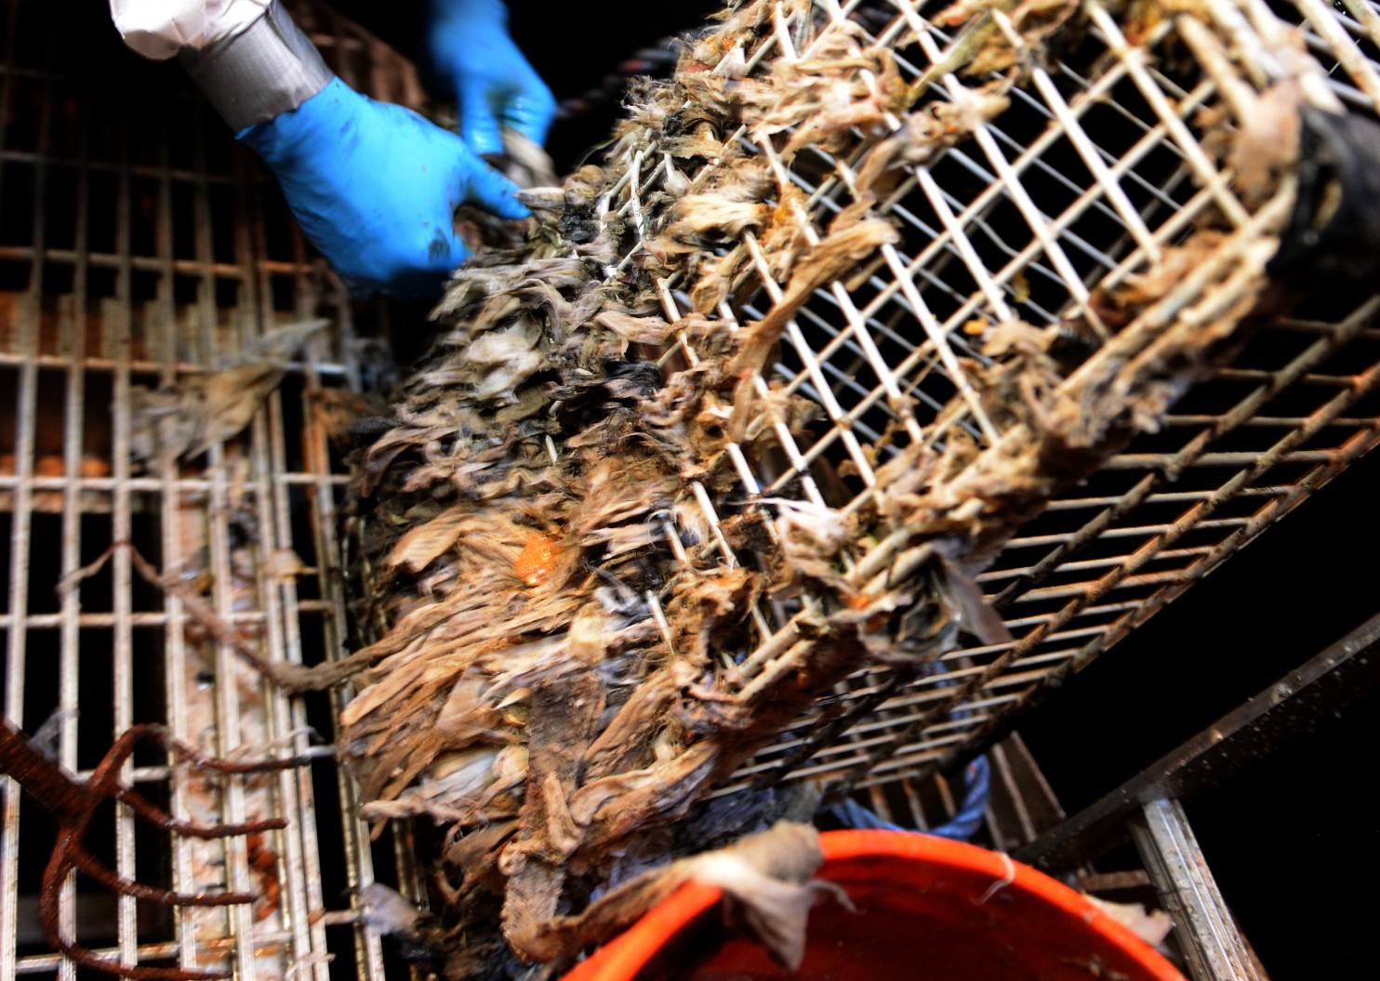
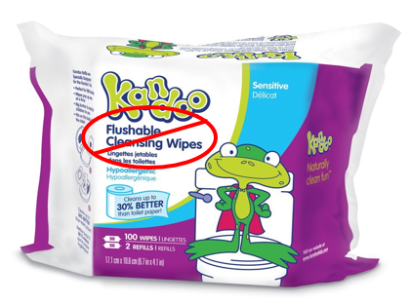
Nonwoven Wipes
manufactured in the U.S.
are NOT biodegradable and/or flushable.
Notes:
Non-Woven Wipes caught in screens, causing more man power and money to unclog.

Slide 16
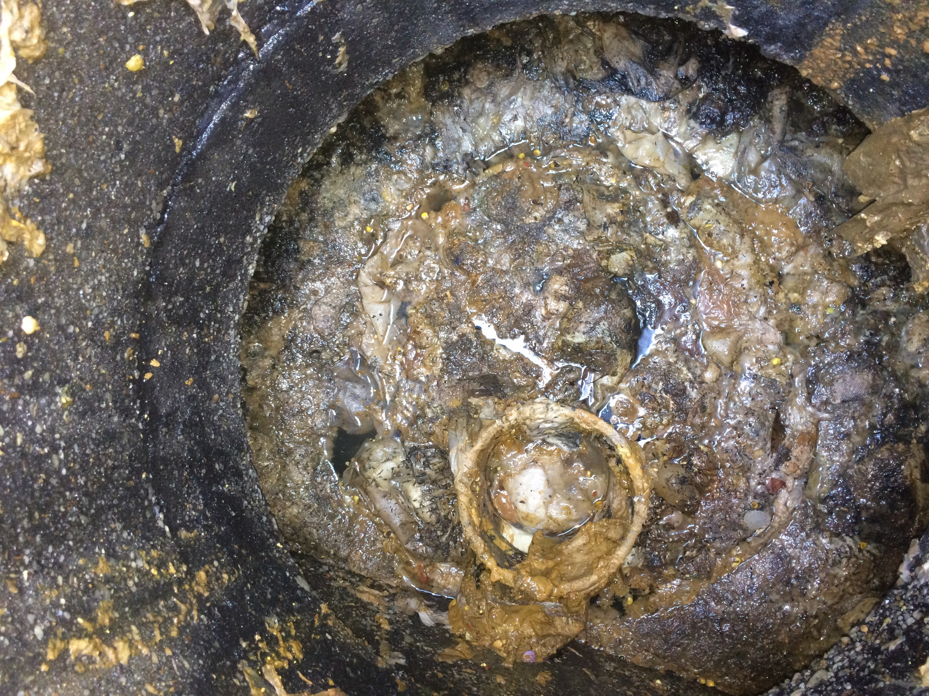
Glen Burnie, MD Septic Tank:
Clogged with
wet wipes and paper towels
Notes:
Warehouse Facility in Glen Burnie, MD 1/31/2017
Looking at a bad pump in a tank full of paper towels and wipes.

Slide 17
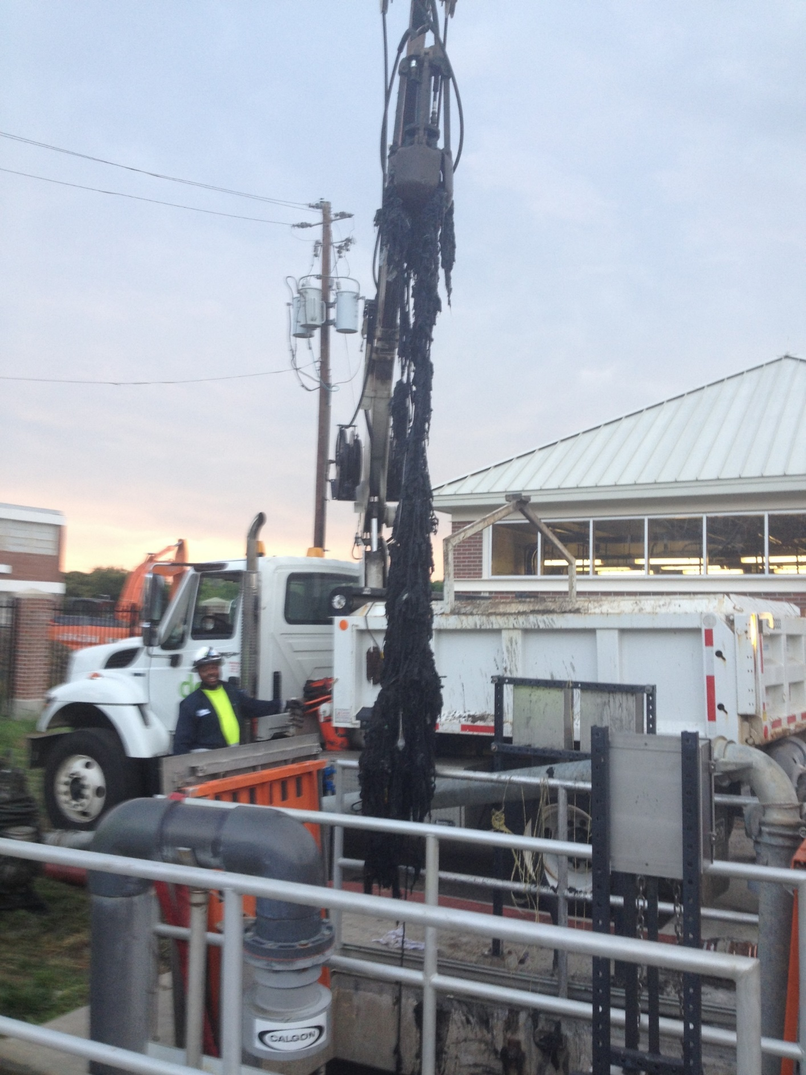
Upper Anacostia
Fatberg Removed From
Sewer Pipe
Wipes should
be clearly
marked
Do Not Flush
and disposed of
in the trash
Notes:
Upper Anacostia.

Slide 18
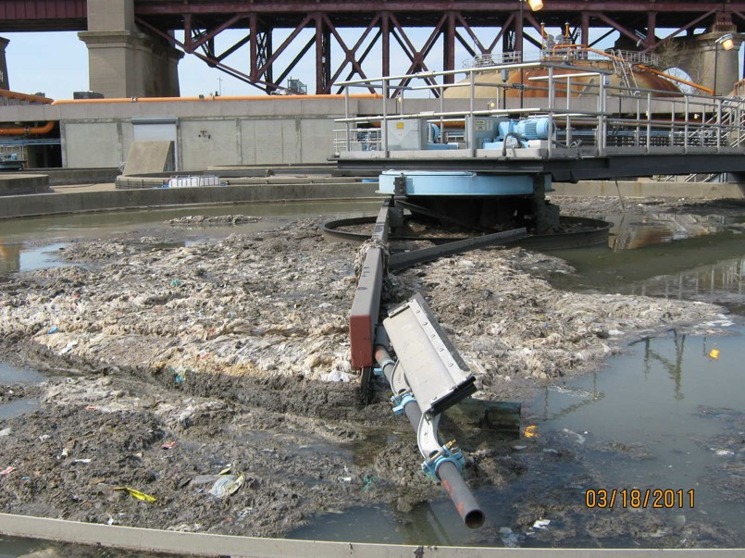
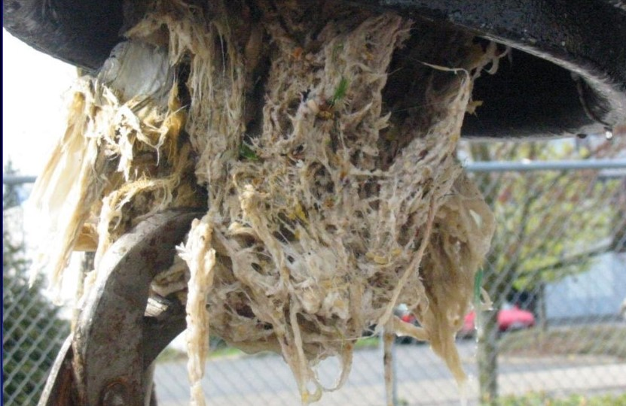
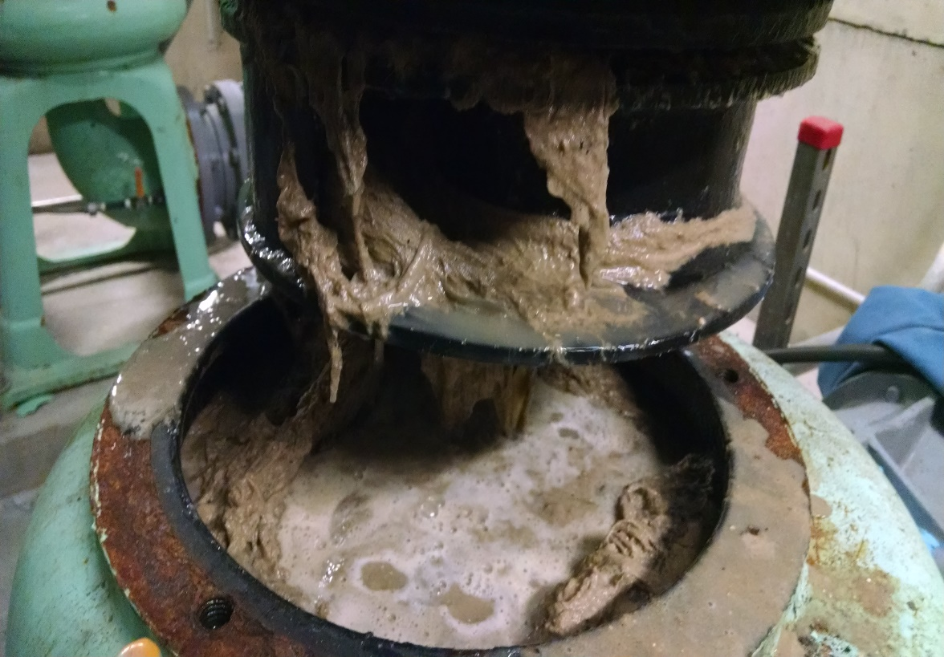
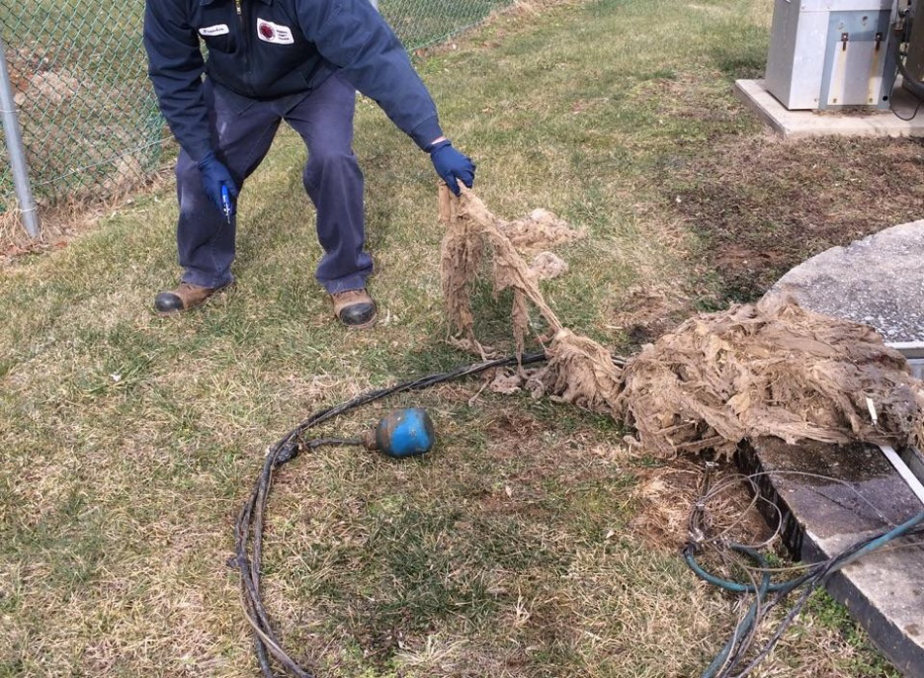
Effects of Flushable Wipes
Thickener
Grease Rags
Pump Clog
Ragging

Slide 19
Chesapeake Bay Awareness Week
June 3-11
Help create a commotion – join us! Better still, bring 20 people.
Chesapeake Executive Council Meeting June 8, 2017
Back to the Bay Day Mason Neck State Park, Lorton, VA June 10, 2017

Slide 20
Thank you.
Ann Swanson
Executive Director
aswanson@chesbay.us
410-263-3420
February 23, 2017

