Slide 1

2014 Chesapeake Executive Council
Planning Team Powerpoint
Conference Call info: 1-866-299-3188 Conference Code: 2675715
Online via Adobe Connect: https://epa.connectsolutions.com/comm
EC PRIVATE/Briefing book page: http://www.chesapeakebay.net/ecbrief/2014_executive_council_briefing_book
Planning Team Chair: Margaret Enloe 410-267-5740 menloe@chesapeakebay.net

Slide 2
Table of Contents Executive Council Planning Areas | CBP | Adv Com |  | DC | CBC | MD | PA | VA | EPA | DE | NY | WV
Planning
Planning Meeting Schedule
Priority Action Items for Today
Logistics
Location and Date
EC Chair Invitations
EC Member Confirmation
Content
Theme/Focus Areas
Agenda
Agenda - Annotated
State of the Program Package
Advisory Committee Reports
Communications
Media Plan
Media Schedule/deadlines
News Conference – staffing & Qs&As
Execution
Internal Website/Shared Directory
Briefing Materials (bios)
Meeting Day Logistics – Staffing, Security
Physical Layouts
Pending
Past Due
Task Complete

Slide 3
Schedule of Meetings for 2014
Propose Wednesday afternoons 3-4pm
Starting 3/26 – June
April 2, 9, 16, 23, 30
May 7, 14, 21, 28
June 4, 11, 18 (Debrief)

Slide 4
Agenda Items – Today (6/11/14)
  REVIEW EVERYTHING
    = changes/updated info

Slide 5
Logistics
Executive Council Member Confirmation
Confirmed Members
Contact: Margaret Enloe 410-267-5740 menloe@chesapeakebay.net
Availability Confirmed
Unconfirmed Members
MD Martin O’Malley, Governor (EC Chair)
CBC Rep. Ronald Miller (PA), Chair
DE Jack Markell, Governor
DC Vincent Gray, Mayor
EPA Gina McCarthy, Administrator
NY (new) Joe Martens, Commissioner, NY Dept of Env. Conserv.
PA Tom Corbett, Governor (for some portion, tbd)
VA Terry McAuliffe, Governor
WV (new) Scott Mandirola, Director, WV DEP, Div. Water & Waste Mgt.
USDA Ann Mills, Deputy Under Secretary (NRCS)

Slide 6
Logistics – Flow for the day
9:30-10AM EC Parking, Arrival/Greeting
EC Members vehicles will hv reserved spaces in front of main State Hs entrance and should enter under/behind (at right) large main exterior staircase (There will be someone to direct them).
EC members arrive & proceed to Conf Room 217 (2nd flr) where EC Chair will greet them and coffee will be served
10am-noon Public Meeting – Governor’s Reception Room (GRR), 2nd flr State House
10AM – EC Council enters Gov. Reception Room (adjacent to his office and conf room) as a group
11:45am – Noon Transition to lunch (fr. State Hs to Government Hs – across the street)
EC members and lunch attendees will leave the GRR, take the main stairwell to the 1st floor and proceed out of the main entrance to broad, outdoor main staircase directly across the street from Lawyers Mall and the House.
**EC members will stop on these stairs for first “official” group photo.
NOON – 1:15PM Private EC Luncheon – Government Hs. (Gov. O’Malley residence)
EC members will NOT need to show ID to enter Government House
EC enters GHs, pick up beverages and proceed to dining room and seats
At 1:10 (approx), there will be a Press Event briefing
TENTATIVE : on way out of GHs. EC will stop by table to sign “90-day letter”
**EC Members will stop outside entry to GHs for second “official” group photo (to be sure Gov Corbett is included)
1:10pm – 1:30pm Transition to Press Event
EC walks to press event – 4-5 blocks fr GHs. - Suggested route: State Circle>Francis St>Main St>Market Sq>Dock St
1:30-2:30 pm Press Event – Susan B. Campbell Park (downtown Annapolis/City Dock)
Facilitator (Jim Edward will ask ppl to take seats when Margaret notifies him of EC’s impending arrival)
EC enters from stage left
Gov O’Malley opens event, speaks, signs Agreement poster, invites other EC (at table to his right) to move to other table and sign
Each speaker will introduce next speaker (list will be taped to podium)
Gov. O’Malley will close out press event remarks after NY speaks; will open up to Media Q&A (which he will moderate)
Note: 10 parking spaces adjacent to park are reserved for EC members vehicles

Slide 7
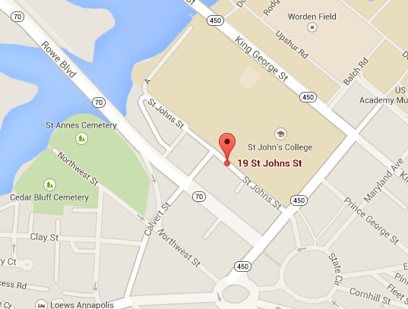
Logistics
Contact: Margaret Enloe 410-267-5740 menloe@chesapeakebay.net
Parking for staff/others
Calvert Garage
19 St. Johns Street
Annapolis, MD
(FREE)
State Hs

Slide 8
Logistics
Contact: Margaret Enloe 410-267-5740 menloe@chesapeakebay.net
Formal EC Chair Invitations
Status
Proposed mail date: May 5
Mailed 5/12

Slide 9
Execution
Briefing Materials
Status
What | Due for PSC | Due for EC | Status / Respons
EC Member Bios | n/a | May 8 | WV/NY outstanding
LGAC Report | n/a | May 27 | Mary Gattis
CAC Report | n/a | May 27 | Jessica Blackburn
STAC Report | n/a | May 27 | Natalie Gardner
State of the Program | ?? | May 27 | M Enloe – FINAL COMING!!
CB W’shed Agreement | ?? | May 27 | PSC 5.6.14 vers uploaded

Slide 10
EC Members | Security Contact | Public Affairs Contact | +1 (at lunch) | Notes (Dietary restrict?)
MD (Chair) - Martin O’Malley, Gov. | Cathy Decerbo, 443 336 3134 | Darlene Pisani, DNR dpisani@dnr.state.md.us | Joe Gill, Secretary DNR Bob Summers, Secretary MDE | none
CBC – Ronald Miller, Chair | none | Jennifer Donnelly, jdonnelly@chesbay.us | Ann Swanson, Executive Director of CBC, aswanson@chesbay.us; Cell: 410-507-0857 | None
DC - Vincent Gray – Mayor | Sgt. Reginald Powell Exec. Protect DC Metro Police Dept (202) 437-0219 reginald.powell@dc.gov | Donna Henry, DDOE donna.henry@dc.gov | Keith Anderson, Director, DDOE | None
DE – Jack Markell, Gov | Corporal Mike Lorditch michael.lorditch@state.de.us | Kelly Bachman, Comm/Soc Med kelly.bachman@state.de.us (302) 577-8495 | Ed Kee, Secretary, DE Dept of Agriculture Collin O’Mara, Secretary, De DNREC | No pork/shellfish pls
EPA – Gina McCarthy, Admin Advc: Jeff Tate - 202-480-4457 | Sam Wiggins, 202 306 3942 wiggins.samuel@epa.gov | Alisha Johnson johnson.alisha@epa.gov | Shawn Garvin – Region 3, Admin. | none
NY – Joe Martens, Commissioner | n/a | Ben Sears | none
PA – Tom Corbett, Gov | Trooper Dawson – brdawson@pa.gov Trooper Gardner | Amanda Wittman awitman@pa.gov | Chris Abruzzo, Secretary DEP | prefers low carb options avail
VA – Terry McAuliffe, Gov | First Sgt Marc S. Wiley Va SP, Exec Protective Office (804)786-8414 Cell (804)840-1450 marc.wiley@governor.virginia.gov | Brian Coy, Offc of Gov. McAuliffe 804-887-9147 Brian.Coy@governor.virginia.gov | Molly Ward – VA Secretary of Natural Resources cell: 757-771-2211 | none
WV – TENT: Scott Mandirola, Director | n/a/ | Teresa Koonz | none | no
USDA – Ann Mills, Dep Under Sec. (NRCS) | n/a | Rich Sims 202.690.2196 Richard.Sims@wdc.usda.gov | Rich Sims 202.690.2196 Richard.Sims@wdc.usda.gov | RECEIVED

Slide 11
Addtl Logistics: Meeting Addresses
Public Meeting: State House
100 State Circle
Annapolis, MD 21401
Luncheon: Governor’s House
100 State Circle
Annapolis, MD 21401
Press Event: Susan B. Campbell Park
1 Dock Street
Annapolis, MD 21401
(Rain location: State House, main floor lobby)

Slide 12
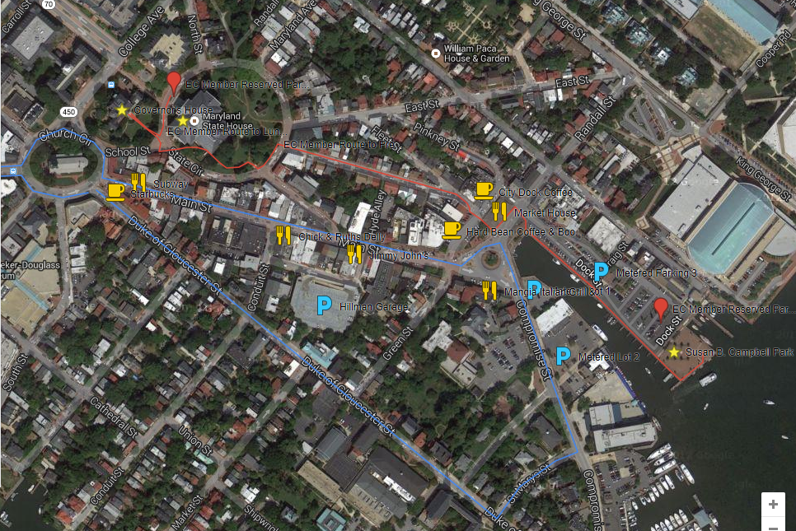
Logistics Map
= EC mtg locations
Red line = EC memb walking route
= EC memb parking
P = public pkg
Blue line = public transp/Circulator trolley
Coffee:
Starbucks
Hard Bean
City Dock
Sandwich Shops:
Subway
Chick & Ruth’s
Jimmy John’s
Market House
Parking Garages:
Knighton – West St.
Gotts – Calvert St.
Hillman – Main St. or Duke of Gloucester St.
Parking Lots:
Compromise St. or Dock St.
Public Transportation:
The Circulator trolley is free and stops near parking garages and lots.

Slide 13
Addtl Logistics: Nearby Hotel Addresses
Loews Annapolis Hotel
126 West Street
Annapolis, MD 21401
410-263-7777
O’Callaghan Annapolis Hotel
174 West Street
Annapolis, MD 21401
410-263-7700
The Westin Annapolis
100 Westgate Circle
Annapolis, MD 21401
410-972-4300
Double Tree by Hilton Hotel Annapolis
210 Holiday Court
Annapolis, MD 21401
410-224-3150
Holiday Inn Express Hotel & Suites Annapolis
2451 Riva Road
Annapolis, MD 21401
410-224-4317
Sheraton Annapolis Hotel
173 Jennifer Road
Annapolis, MD 21401
410-266-3131

Slide 14
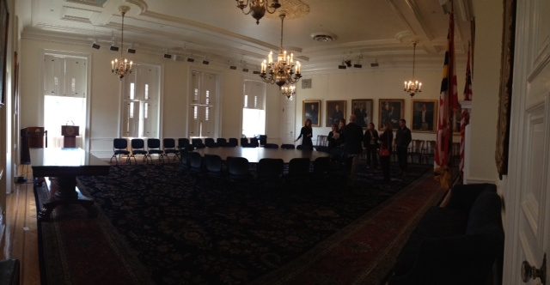
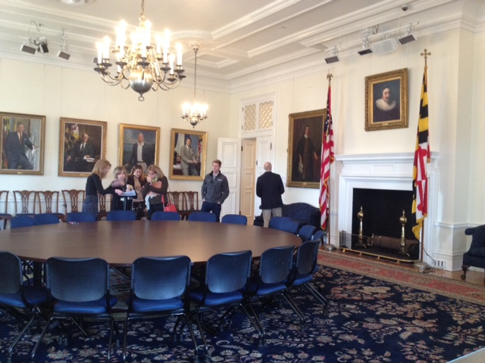
Logistics
Public Meeting:
State House 100 State Circle Annapolis, MD 21401
Capitol grounds - Governor’s Reception Rm
State house – 2ND FLR

Slide 15

Entry
Fireplace
EC Enters fr Here
Morning Meeting PUBLIC Governors Reception Room
Chairs for +1s
Logistics / Set up
EPA MD VA
Checklist:
State House to provide:
A/V
  Projector
  Screen
  Wireless internet
Chairs for guests
8ft tables w/linens
Table: Sign-in for press, agendas, etc needed outside of the room
Water pitchers & glasses
Overflow Rooms: no food allowed
House Chamber Lounge 1st floor
(40 people): televise, possible live feed
to outside
2. House Chambers (backup) 141 people
CBP to provide:
Nameplates
Gavel/strike plate
Laptop
Banner (placement TBD)
AV Table shown in two potential locations
8 ft
EC
table
8 ft
EC
table
Screen ??
+1’s
chairs
DC
PA
CBC
USDA
DE
NY
WV
CBP Dir
+1’s
chairs
EC Seating FINAL
8 ft
EC
table
8 ft
EC
table
student student student student
CAC LGAC STAC
AV Table
35 Chairs
35 Chairs
Reserved AC Chair/
Coord then students
Reserved GIT Chairs
Reserved PSC
AV Table
Aisle
Contact: Lori Mackey, CBPO
mackey.lori@epa.gov, (410)267-5715
Notes:
Students will be welcomed by Joe Gill and be at table to start.
Advisory Committee Chairs will be introduced & invited to table by EC Chair after students finish.

Slide 16
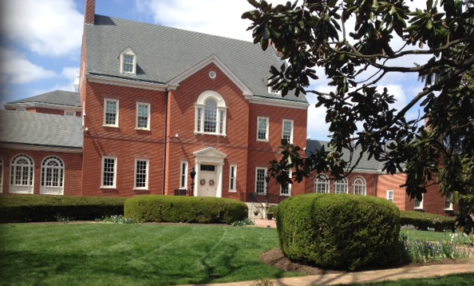
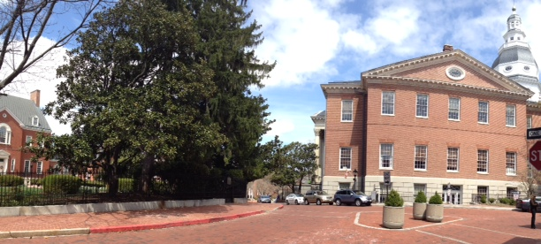
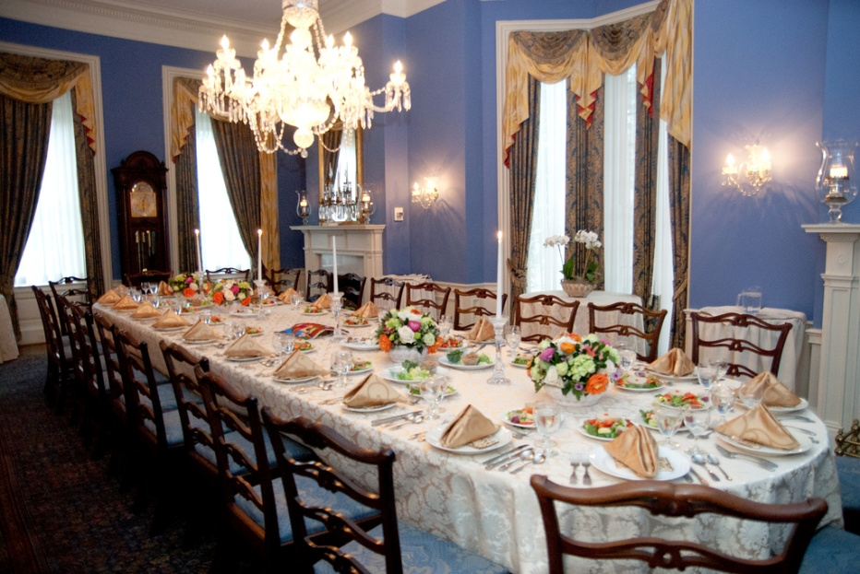
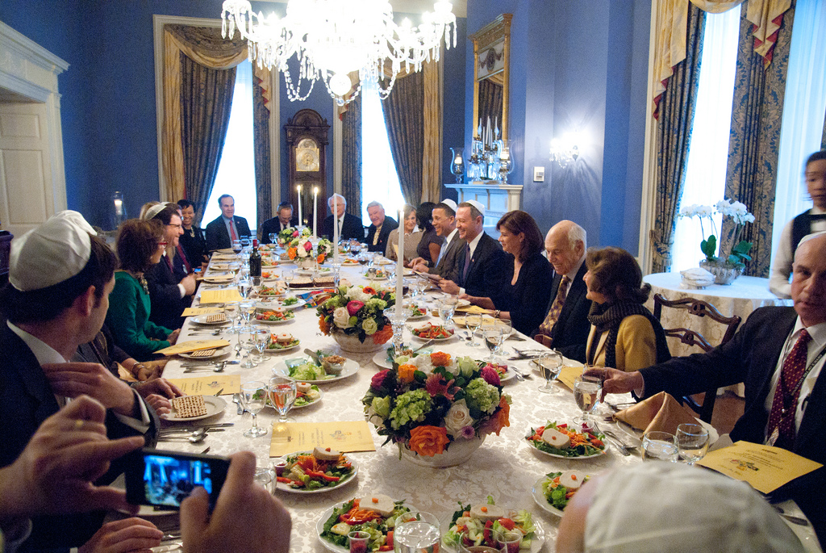
Logistics
Pvt EC Luncheon: Government House
100 State Circle, Annapolis, MD 21401
Capitol Grounds

Slide 17
Logistics / Set up
Lunch
Government House
Window
Projector Screen
See next slide for FINAL Seating
EC Table
Corbin, DiPasquale
Bisland
Enloe
(table w/chairs)
Wide Opening (no doors)
Letter
Signing table**
EC lunch menu
Spring Salad with Roasted Veg.
Maryland Crab Cakes*
Fresh Grilled Corn Salad
Parisienne Potatoes with Fried Shallots
Haricot Vert with Toasted Almonds
Lemon Bars
Chocolate Covered Strawberries
Chocolate Covered Sambuca Cookies
Coffee / Tea / Beverages
*An alternate dish will be served for those w/ allergy to shellfish.
** This table now for the “90 day letter” if that is something EC decides to do
Main entry
hall/foyer
Door fr main hall
Front Door
staircase
To kitchen

Slide 18
PRIVATE LUNCH -Government Hs.
FINAL SEATING – updated again 6.12.14
Projector Screen
USDA+1
USDA
NY
(not Gov)
EPA +1
EPA
CBC
CBC +1
DE +1
DE
EC Table
DC
DC +1
VA +1
VA
MD
MD +1
MD +2
WV
(not Gov)
DE +2
PA PA+1

Slide 19
EC Lunch menu
Plated lunch
Spring Salad with Roasted Vegetables
Maryland Crab Cakes* with Cocktail & Tartar Sauce
Fresh Grilled Corn Salad
Parisienne Potatoes with Fried Shallots
Haricot Verts with Toasted Almonds
Lemon Bars, Chocolate Covered Strawberries, Chocolate Covered Sambuca Cookies
Coffee / Tea / beverages
*An alternate dish will be served to those w/ allergy to shellfish.

Slide 20
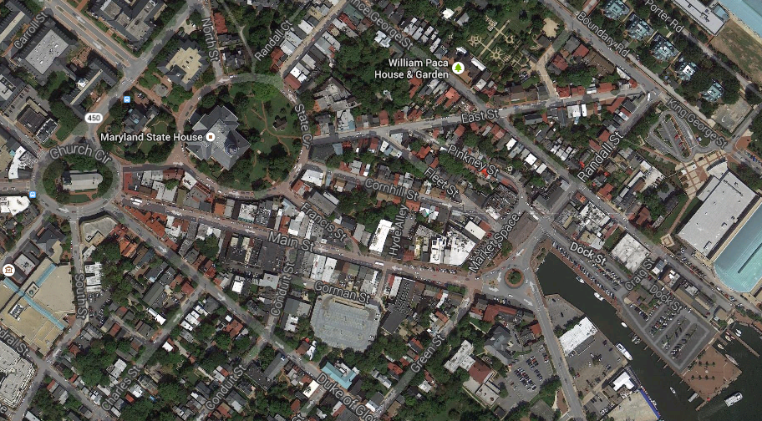
4-5 block walk from Gov. Hs to Press Event
(approx route; State Circle to Francis St to Main St to Mkt Sq to Dock St)

Slide 21
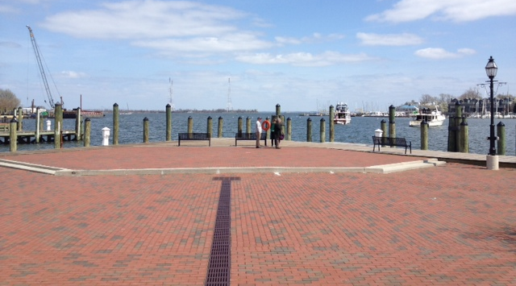
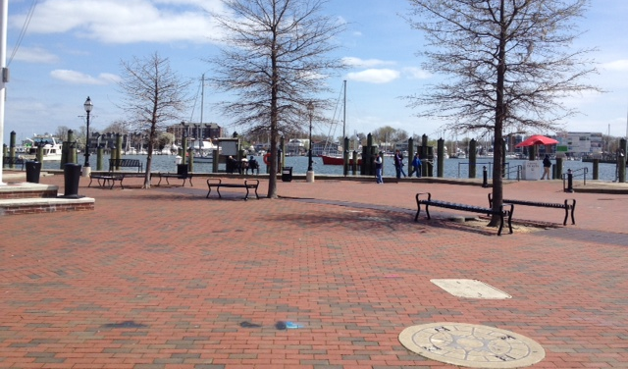
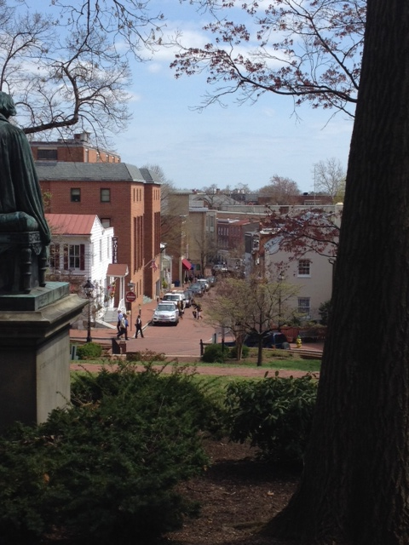
Logistics
Press Event: Susan B. Campbell Park
1 Dock Street, Annapolis, MD 21401
Center/Right Side
Left Side
Rain option
- State House, Lobby MAIN floor
4 block Walk from state hs to waterfront

Slide 22
Logistics / Set up
Seating order FINAL
News Conference Annapolis City Dock – Susan Campbell Park
(Open to the Public)
Checklist:
MD to provide/set up:
Podium w/ mic
Electricity
Chairs (75)
tables with chairs
Signing table & Pens
Sound system
  Table Mics
  Mult box
Water pitchers & glasses (10)
MD Conserv. Corp members – to hold flags & easel w/ Agreement
CBP to provide:
Flags
Logo
Easel for Agreement
Info: Parking, hotels, street
addresses for sites
NOTES:
WATER
Flags
Flags
USDA WV EPA CBC PA
MD VA DE DC NY
table w/ 5 chairs
and water
2 – mics
Podium w/mic &
Speaker
CBPO Logo
&
MULT BOX
table w/ 5 chairs
and water
2 – mics
35 Chairs
~28 Chairs
Aisle
No chairs; t.v. media section
Press
EC Enters from this direction
Table for press sign in
Easel for poster
Table for press sign in

Slide 23
Press Event
Agreement Signing
WATER
Flags
Flags
Upon EC Chair invitation, Ppl seated at this table move to other table & stand behind other seated members ; all then take turns signing sign (EC chair goes first)
USDA WV EPA CBC PA
MD VA DE DC NY
table w/ 5 chairs
and water
2 – mics
Podium w/mic &
Speaker
CBPO Logo
&
MULT BOX
Signing table
EC Enters from this direction

Slide 24
Content
Contact: Margaret Enloe 410-267-5740 menloe@chesapeakebay.net
Theme/Focus Areas
Status
Due Date: May 27
New Chesapeake Bay Watershed Agreement

Slide 25
Content
Agenda
Status
At a Glance
10-12 Morning Session – PUBLIC
12-1:30 Lunch - PRIVATE
(Concurrent for others: lunch)
1:30 Press Conference – Agreement poster signing

Slide 26
Meeting Agenda - Annotated
9:30 -10 EC members Arrive – meet in Conf Rm 217 to be Greeted by Gov. O’Malley
10-12 Morning Session – PUBLIC
10:00-10:10 Welcome, Agenda, Overview – EC Chair
10:10-10:25 Future of Bay restoration (4 student speakers)
10:25-11:45 Program Updates & Advisory Committees
(10:25-10:45) State of Program report – Nick DiPasquale, CBP (20mins) (10:45-10:50) Discussion w/ Director
(10:50-11:40) CAC, STAC, LGAC briefings (10 min ea. w/ 7min q&a after ea.)
11:40-45 Closing remarks/mtg adjourns
11:45-12 Move to lunch/group photo
12 – 1:15 EC Lunch – PRIVATE
1:15-1:30 Move to Press venue
1:30 Press Conference

Slide 27
Status
Private Lunch - agenda
12 - 1:15 Lunch & Topics for discussion
Agreement Goals & Outcomes
Need for transparency/openness
BayStat - http://baystat.maryland.gov/
1:10 Briefing for press event – Margaret
Photo opp upon exiting Govt Hs
Proposed walking route
EC Entrance at press event
Speaking order (list on podium, too)
Signing process
Q&A moderation
1:15-1:30 Transition to Press Conference
1:30 Press Conference

Slide 28
Press Event - Flow
Facilitator: Jim Edward will ask ppl to take seats when Margaret notifies him of EC’s impending arrival
EC enters from stage left
Gov O’Malley opens event, speaks, invites EC mem/rep from table to HIS right, to join others at left table to sign Agreement
Gov O’Malley returns to podium, intros next speaker
Each speaker will introduce next speaker
  List will be taped to podium
Close Out and Q&A Moderator (Gov. O’Malley)

Slide 29
Status
Press Event – Order of Speakers (final)
Each speaker is to introduce the next speaker;
List will be on the podium
1:30-1:37 MD - Gov. O’Malley (EC Chair)
1:37-1:42 Signing of the Agreement by EC
1:42-1:47 DE - Gov. Markell
1:47-1:52 PA - Gov. Corbett
1:52-1:57 VA - Gov. McAuliffe
1:57-2:02 DC – Mayor Gray
2:02-2:07 CBC – Rep. Miller
2:07-2:12 EPA – Admin. McCarthy
2:12-2:17 NY – Comm. Martens
2:17-2:20 Gov O’Malley returns to podium/closes out event
2:20-2:30 Media Q&A – moderated by EC Chair
Notes: WV & USDA have notified us they will not speak; time added in for signing.

Slide 30
Communications
Media Planning
Contact: Margaret Enloe 410-267-5740 margaret.enloe@chesapeakebay.net
Status
Components:
Media Advisory (sent 6/5 – reminder on 6/12)
News Release (almost complete 6/11)
Media Outlets
Messaging
Communications Workgroup – updated
Partner Leads – MD, VA doing own releases, too
Timeline

Slide 31
Communications
Schedule/Deadlines
Friday, May 23 | Media materials to Comm Wkgp /partners for review
Tuesday, May 27 | ALL BRIEFING BOOK MATERIALS POSTED
Monday, June 2 | Advance notice to select Media
Wed., june 11 | Briefing of EC Chair
Thurs. June 5 (noon) Friday, June 12 (COB) | Sending of Media Advisory Approval of all other media materials (News Release)
Thursday – June 12 (4pm) | CBP Bay Brief distributed with EC info; Reminder - media advisory
Friday, June 13 | Logistics team – final walk through at Capitol Bldg. (10am)
Sunday, June 15 | Deadline: media to confirm attendance
Event day | EC Meeting – staff/volunteers on site by 8a.m. Press Event – set up by noon pm
Notes on Handling of Media:
  Media will be invited to Press Conference specifically, welcome to attend public mtg
  Media check-in: Required. There will be a check-in table at a convenient location TBD.
  Press Conference: Media should use the microphone when asking questions and identify themselves and their news organization during the news conference.
  Interviews with EC members: Requests to interview specific EC members will be referred to the partner’s communications lead – Margaret Enloe - and take place after the news conference concludes. Time: TBD

Slide 32
Communications
Media Plan
Contact: Margaret Enloe
410-267-5740, menloe@chesapeakebay.net
Status
Due Date: May 23 (final)
Components:
Media Advisory –June 5 (formal)
There will be two advance notices to media announcing the EC Meeting. The 1st will be an unofficial notice; the 2nd formal advisory. The media advisory will public figures participating and details on event announce the press event, meeting and and expected signing of Agreement; it will list key location and time. Media will be asked to confirm attendance. Reminder will go out June 12, too.
Media Outlets
Advisory & E-versions of Media Kit to:
400 media outlets on Communication Office’s comprehensive list of media in the watershed. - 8-10 select pitches/phone calls:
  - The Associated Press, The Richmond Times-Dispatch, Virginian Pilot, The Daily Press in Norfolk, The Washington Post, The Baltimore Sun, The Capital in Annapolis, DC radio stations.

Slide 33
Communications
Media Plan
Contact: Margaret Enloe
410-267-5740, menloe@chesapeakebay.net
Components:
News Release & Media “kit” – June 16 – 1:30pm
Embargoed copy: Wednesday, June 11
Final copy: June 16 at 1pm – at start of EC press event, after new Chair announced.
Messages (pending further discussion w/ Comm Workgp):
Collaborative nature of Agreement (Writing/signing of the agreement)
Agreement’s Transparency & Accountability
Signing on by headwater states & what that means
The importance of public input in the development of the agreement
The importance of future public input in development of management strategies
Media Outlets – same as those who rec’d advisory

Slide 34
Communications
Media Plan
Contact: Margaret Enloe
410-267-5740, menloe@chesapeakebay.net
Messaging
The news release will provide key messaging and language for the overall theme and specific topics of the EC meeting
Communications Workgroup and Partner Leads
All media materials and plans will be reviewed by members of the Chesapeake Bay Program Communications Workgroup and the communications representatives identified by partners for the EC meeting. The purpose of this is to gain the expert advice of multiple communications professionals representing the full partnership.
Media Kit & Contents
The other documents in the media kit will support meeting (agenda, agreement, related materials (tbd). All will be posted on EC briefing webpage: http://www.chesapeakebay.net/ecbrief/2014_executive_council_briefing_book
A media kit will be provided via email and hard copy on the day of the EC meeting. It will contain:
  Contents: News release, Agreement, backgrounder, related materials

