Slide 1
What Is Verification… And Will I Know It When I See It?
Mark Dubin
Agricultural Technical Coordinator
University of Maryland Extension-College Park
WQGIT Verification Steering Committee Meeting
Annapolis, Maryland
June 19, 2012

Slide 2
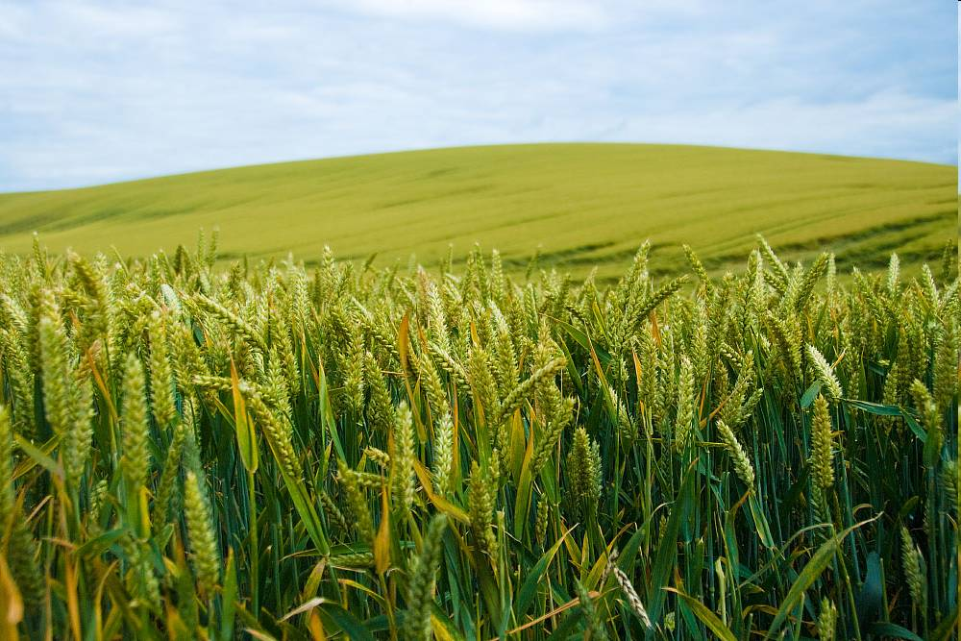
Mark Dubin Agricultural Technical Coordinator
University of Maryland Extension-College Park College of Agriculture and Natural Resources
USDA-NIFA Mid-Atlantic Water Program mdubin06@umd.edu
EPA Chesapeake Bay Program Office mdubin@chesapeakebay.net

Slide 3
Agricultural Verification
Verification Is Not A New Concept…

Slide 4
Agricultural Verification
…But The How And Why We Verify Has Changed.

Slide 5
Agricultural Verification
What Is Constant Over Time?
People Communicating.

Slide 6
Agricultural Verification
Annual Management Practices

Slide 7
Agricultural Verification
Structural Management Practices

Slide 8
Agricultural Verification
Feed Management Practices

Slide 9
Agricultural Verification
Data Management Practices

Slide 10
Agricultural Verification
Non-Cost Shared Management Practices

Slide 11
Agricultural Verification
Verify If Practices Are Properly Designed, Installed And Maintained…

Slide 12
Agricultural Verification
…And Verify If Practices Are Not.

Slide 13
Agricultural Verification
Verify If Practices Meet USDA or Other Conservation Design Standards…

Slide 14
Agricultural Verification
…Verify If A Functional Equivalent Practice…

Slide 15
Agricultural Verification
…And Verify If Neither.

Slide 16
Agricultural Verification
Verification Occurs Everyday…
…Identifying the How and Why Can Better Communicate the Benefits of Past, Current and Future Practices.

