Slide 1
Improved Assessment of Floodplain Location and Function
Megan Lang
USDA Forest Service
Beltsville, MD

Slide 2
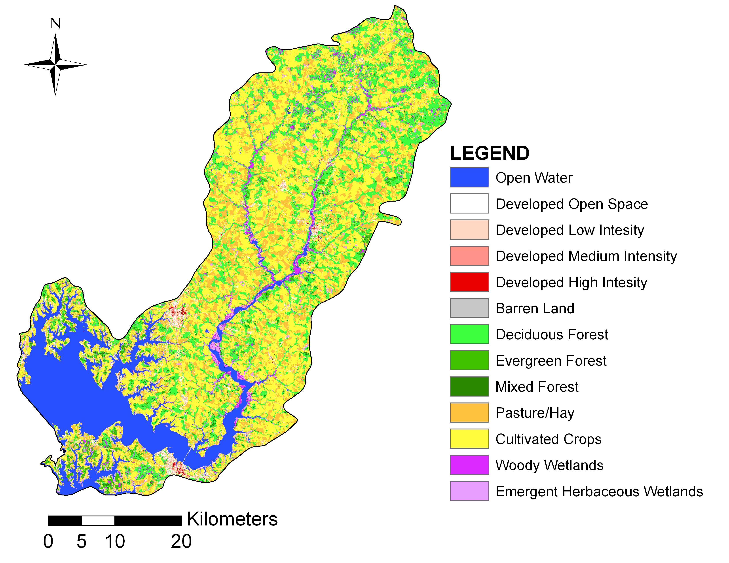
Choptank River Watershed
Primarily agricultural (58%)
Relatively flat and
extensively ditched
Major tributary of the
Chesapeake Bay
One of the most polluted
rivers in Maryland

Slide 3
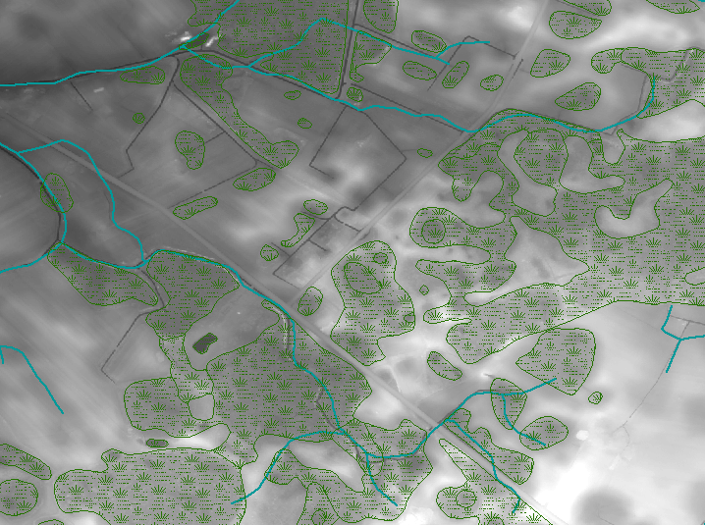
To best manage forested floodplains, we need to know where they are located.
We do not have an accurate stream map – especially lower order streams/ditches.
Page 3

Slide 4
Contribution of Geospatial Data
Relatively new, rapidly developing geospatial technologies provide enhanced information for improved decision support.
These data reveal relationships and trends that would not have been possible to discern in situ, provide information over larger areas, and can better parameterize decision support tools and models.
  These geospatial technologies include, but are not limited to, LiDAR and synthetic aperture radar or SAR.

Slide 5
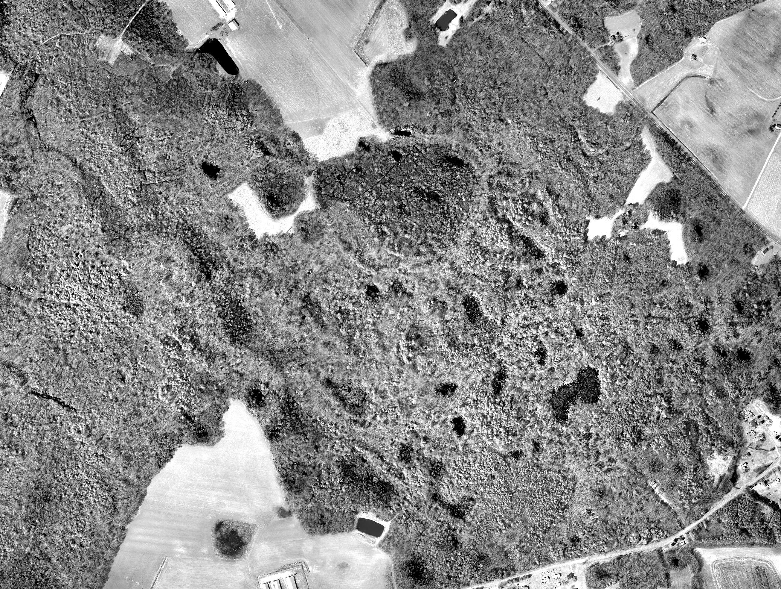
Why LiDAR?
LiDAR can reveal unmapped wetlands and surface water channels.
NIR Aerial Photograph

Slide 6
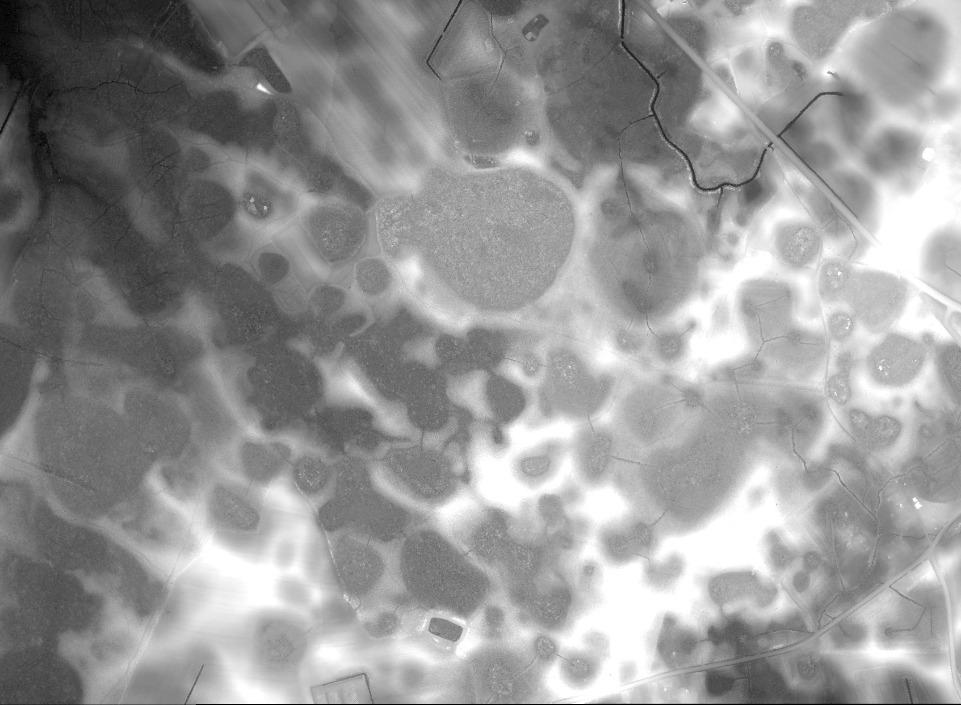
Why LiDAR?
LiDAR can reveal unmapped wetlands and surface water channels.
LiDAR DEM

Slide 7
LiDAR Based
Existing NHD
Existing stream datasets (NHD) contain more error than automatically generated LiDAR based products
More advanced image processing techniques hold promise for additional improvements.
 | High Res. NHD | 100,000 Threshold | NHD Plus | 300,000 Threshold
Omission Error | 49 % | 24 % | 77 % | 43 %
Commission Error | 26 % | 23 % | 31 % | 1 %
Overall Error | 37 % | 24 % | 54 % | 22 %
% Length | 65 % | 98 % | 31 % | 56 %
DEM
Stream dataset accuracy compared with the semi-automated dataset

Slide 8
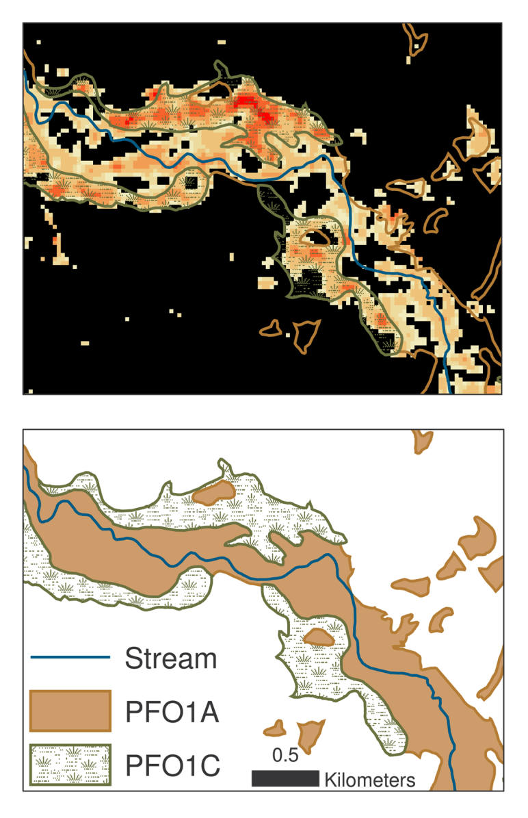
To best manage forested floodplains, we must be able to characterize their function.
Longer hydroperiod
Shorter hydroperiod
Indicators of floodplain function supported by geospatial analysis
  Buffer condition (e.g., plant type)
  Buffer dimensions
  Surface water connection with surrounding landscape and adjacent channel
  Wetland status and hydroperiod
  Geomorphology (e.g., levee)
  Floodplain slope and other indicators of geology
Upland Forest

Slide 9
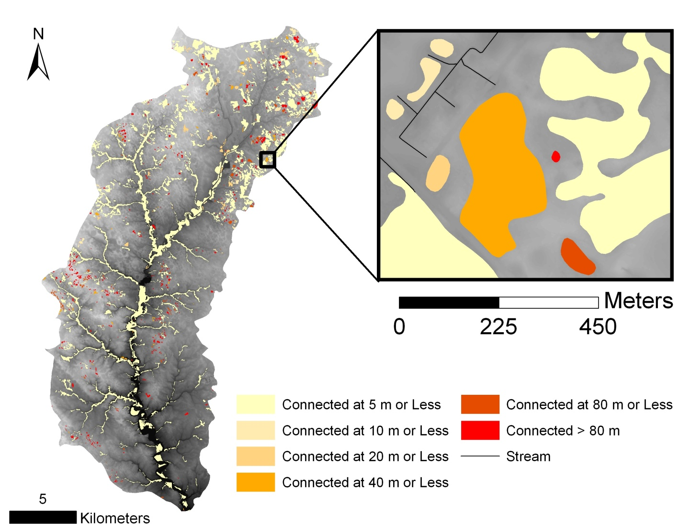
LiDAR to Inform Ecosystem Services
Closer Wetlands = more likely to be protected and have a more rapid effect on water quality.
Farther Wetlands = lend greater support to biodiversity
Distance Between Wetlands and Streams

Slide 10
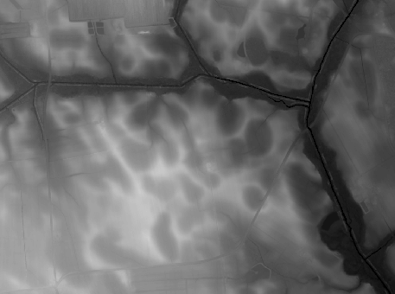
Crop Field
Ditch Bypassing Floodplain
Road
Berm Breach
Berm Preventing Flow to Stream
Channelized Stream
Contour to Encourage Drainage
Agricultural Field with Historic Wetlands
Oxbow: Denitrification Hotspot?

Slide 11
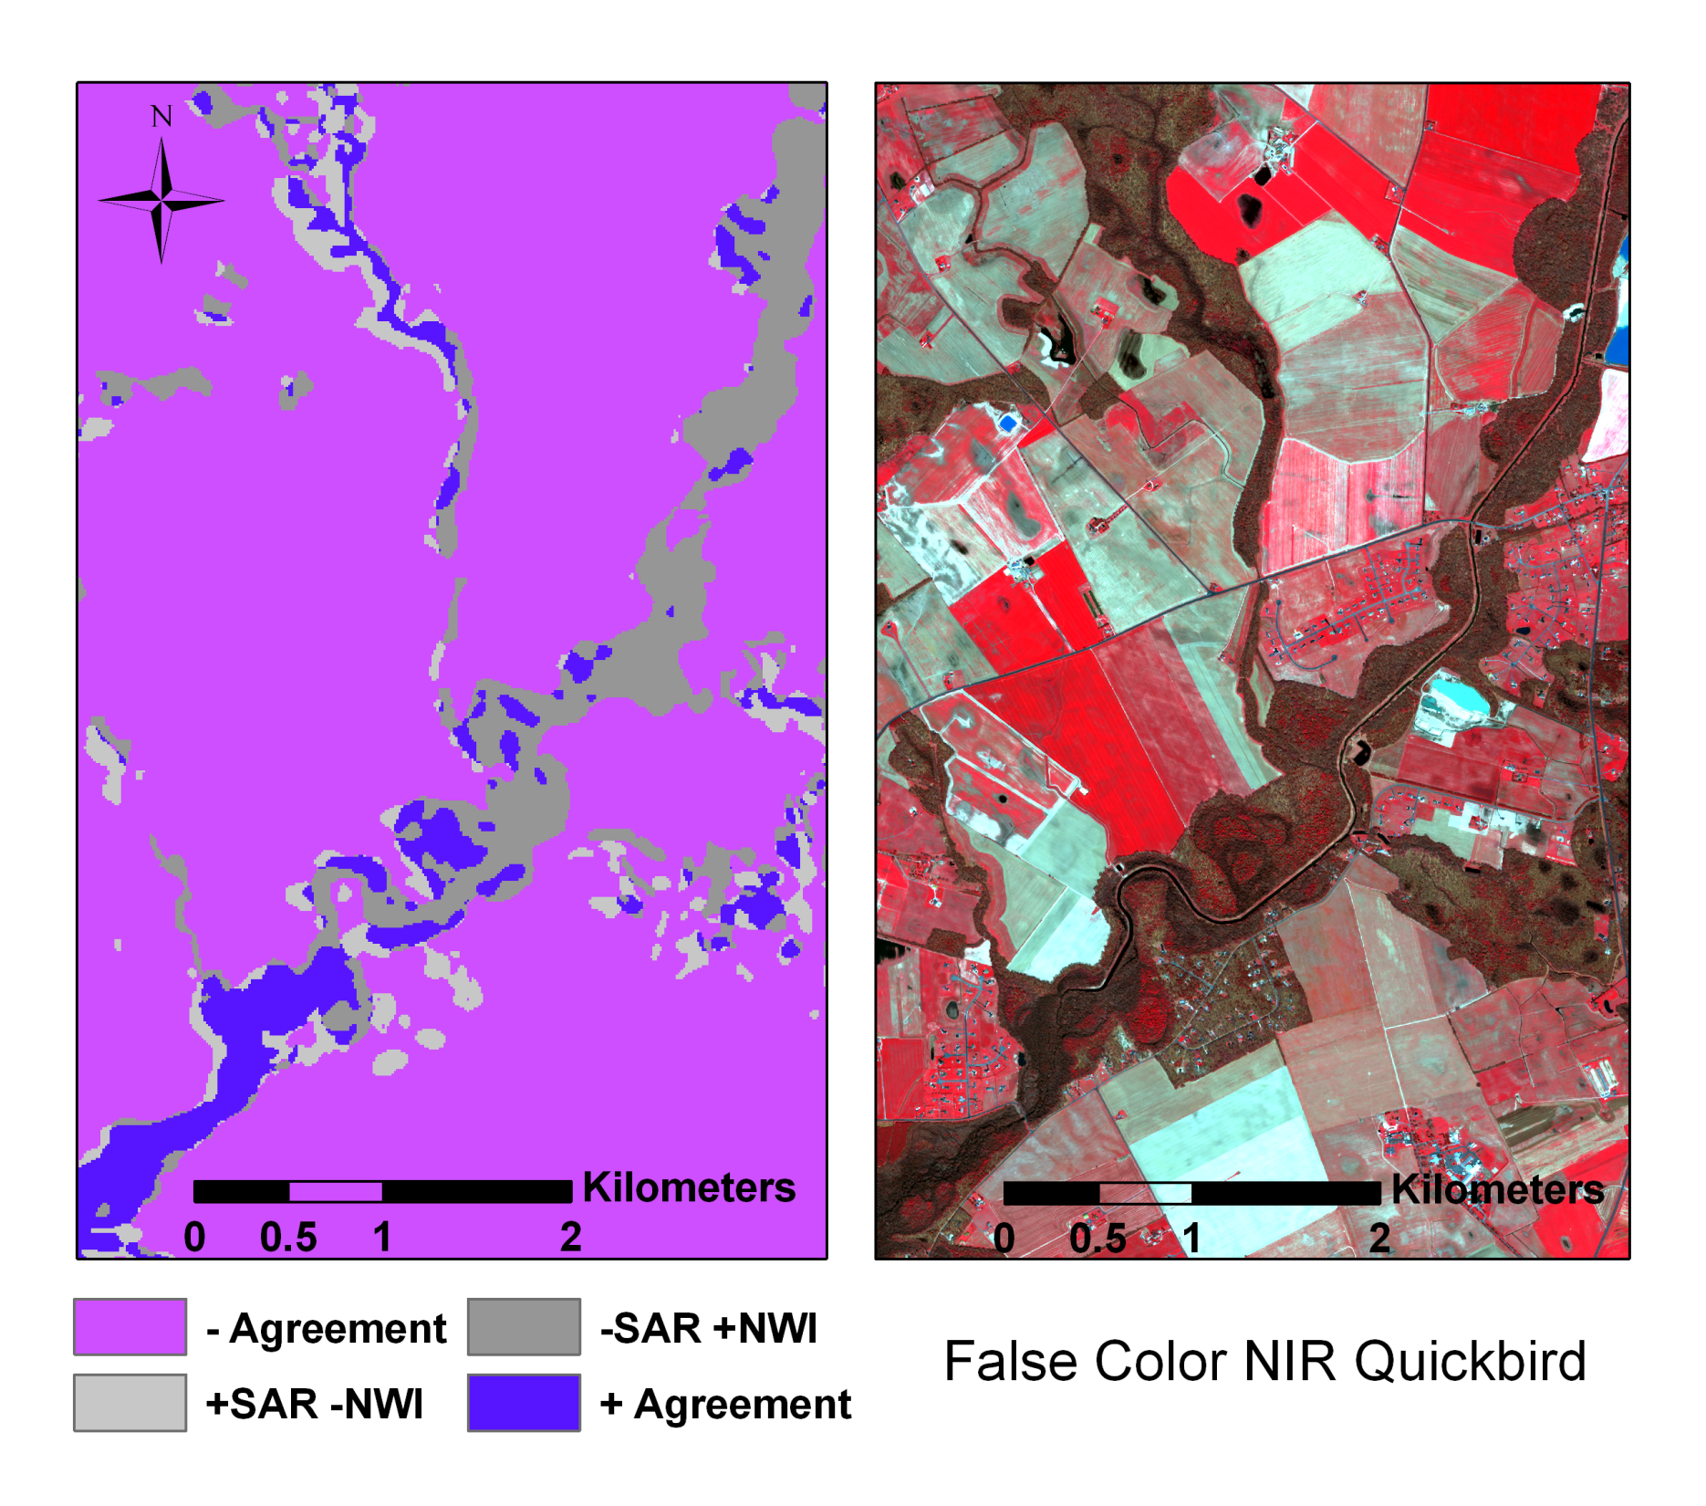
Stream
Channelized
Stream
Channelized
Connectivity Lost
Connectivity Lost
SAR wetland maps are based on inundation and soil moisture and reveal the affects of drainage on floodplain wetland status and function.

Slide 12
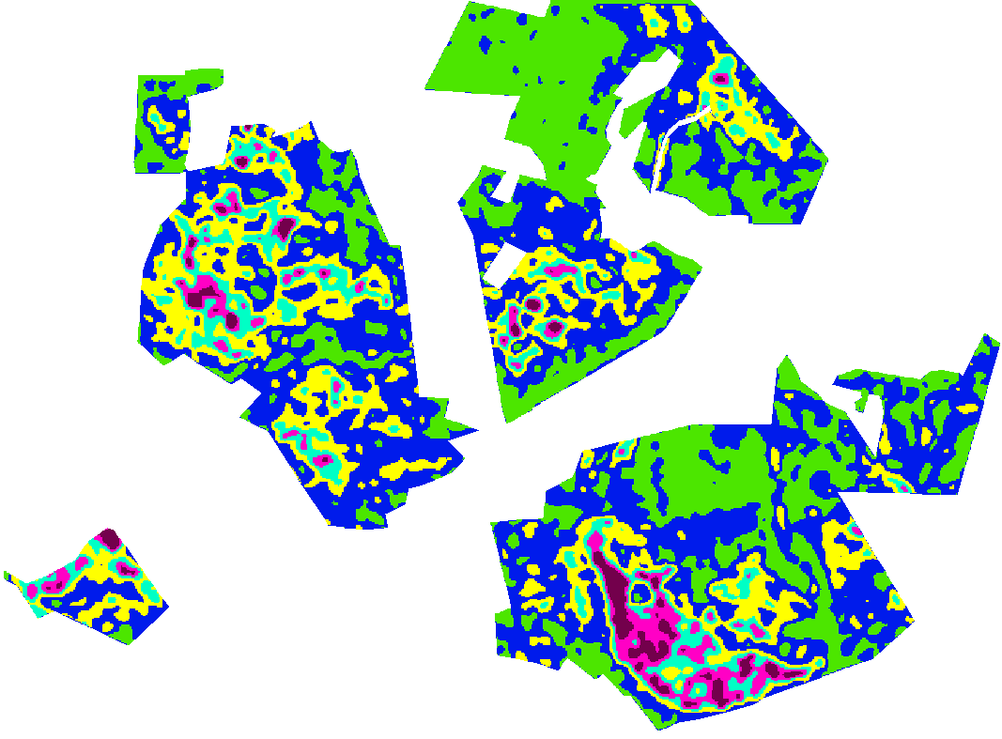
SAR Based Map of Early Growing Season Wetness
Forest Patches
Soil Moisture
SAR can be used to produce highly accurate maps of soil moisture and inundation that can be used to quantify multiple wetland functions including those controlling biogeochemical cycling and provision of habitat.

Slide 13
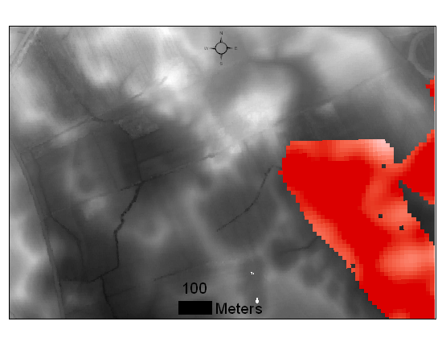
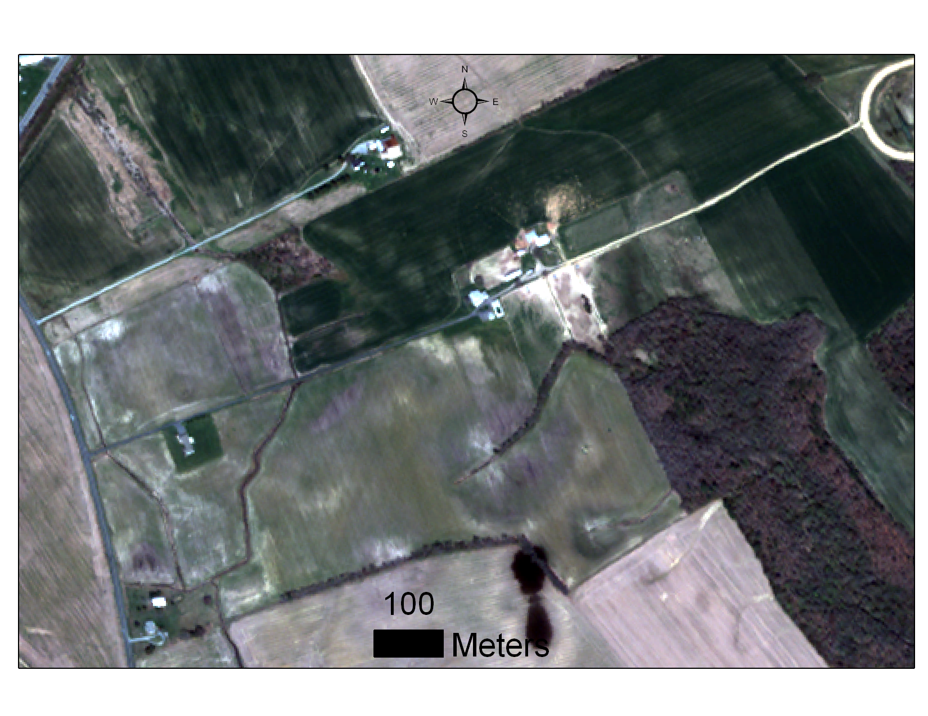
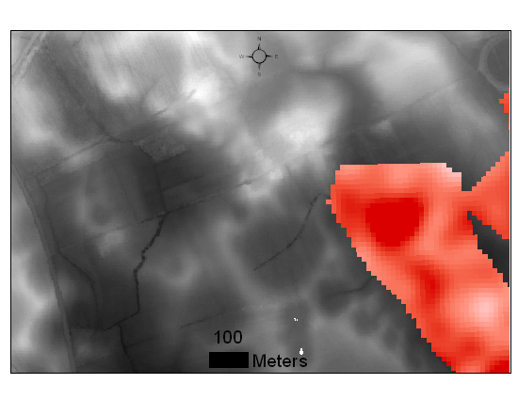
SAR + LiDAR Synergy
B
A
SAR and LiDAR have unique strengths and weaknesses; the power of these datasets can be increased significantly through data fusion.
Early Spring
B
A
Agricultural Fields
Forest
Ditch
Late Spring

Slide 14
Bottom Line
Remotely sensed data are a powerful and rapidly developing tools that can be used to improve the mapping and monitoring of floodplains to better inform decision making.
We need to bring together geospatial analysts and physical and biological scientists to better characterize these critical ecosystems.
Doing so would enhance our ability to assign improved levels of function (e.g., nutrient removal efficiencies) to floodplains.

Slide 15
Thank you!
For more information please contact Megan Lang at 301-504-5138 or mwlang@fs.fed.us.

