Slide 1
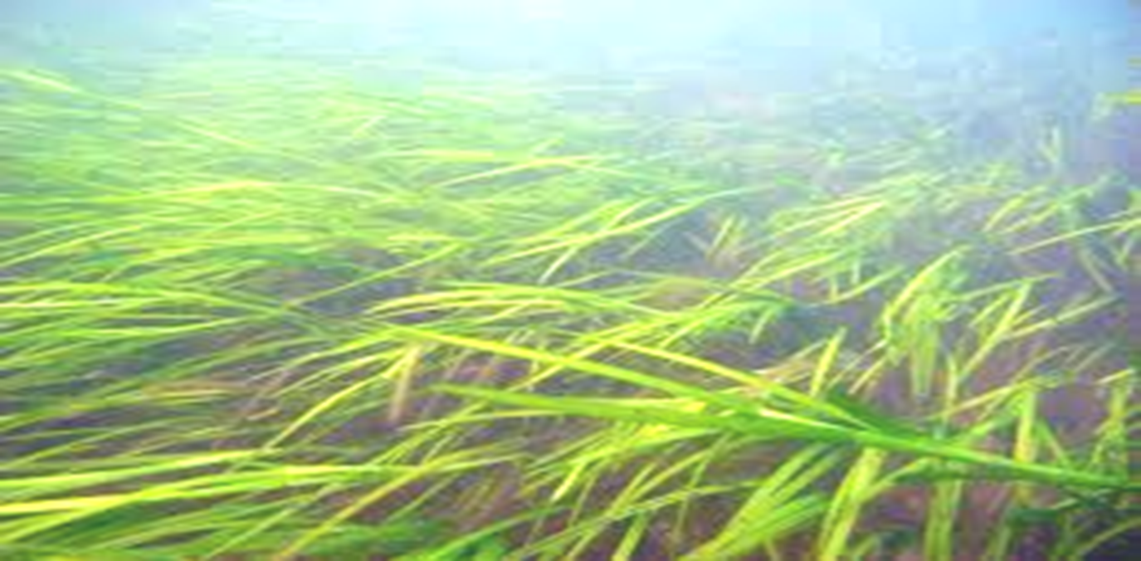

Relationships between inter-annual variability in water quality and SAV at broad scales in Chesapeake Bay
Christopher J. Patrick
Donald E. Weller
Smithsonian Environmental
Research Center

Slide 2
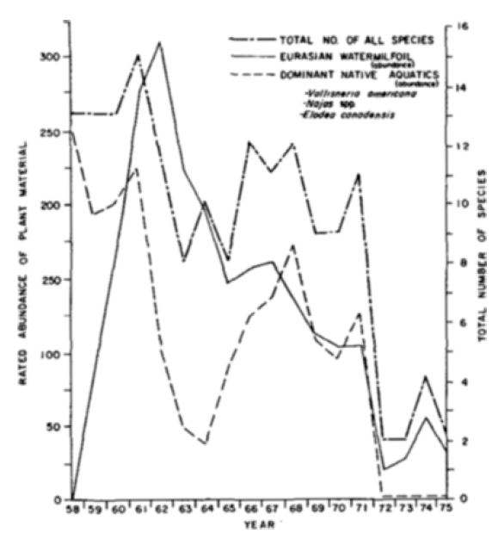
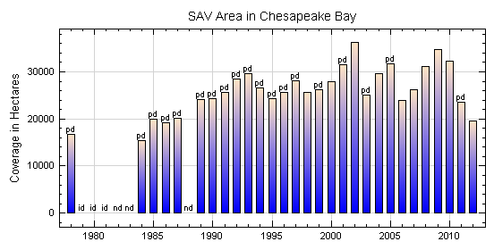
Temporal Changes in SAV Coverage
Total No. of All Species
Eurasian Watermilfoil
Dominant Natives
Abundance of plant material
Total # of Species
Change in Baywide SAV from 1978 to 2012
from: http://web.vims.edu/bio/sav/BayAreaChart.htm
Year
Change in SAV from 1958 to 1975 at the Susquehanna Flats
From: Orth & Moore 1984

Slide 4
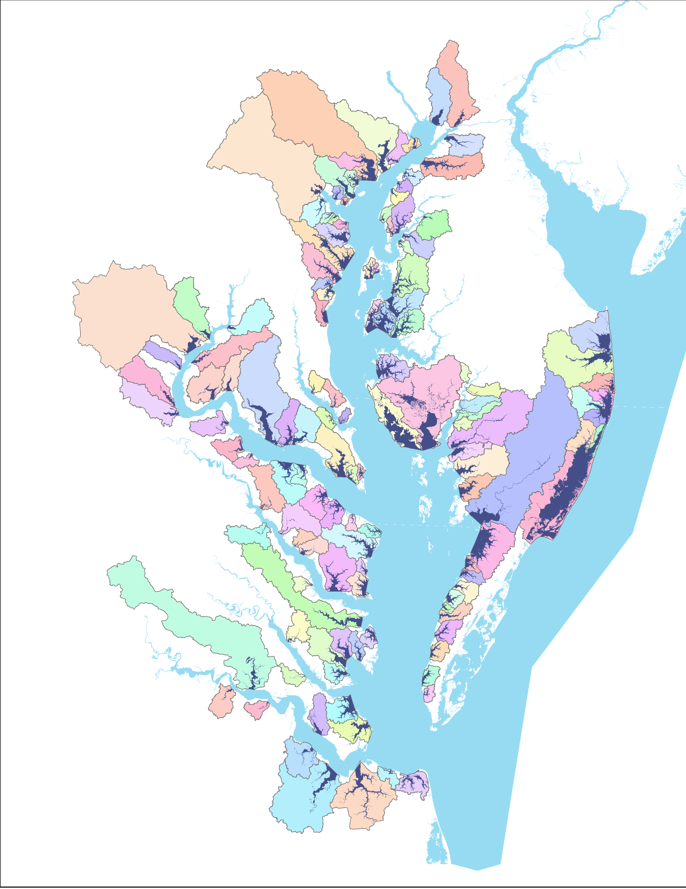
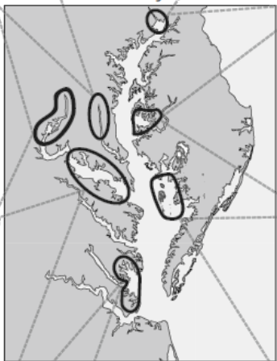

Slide 5
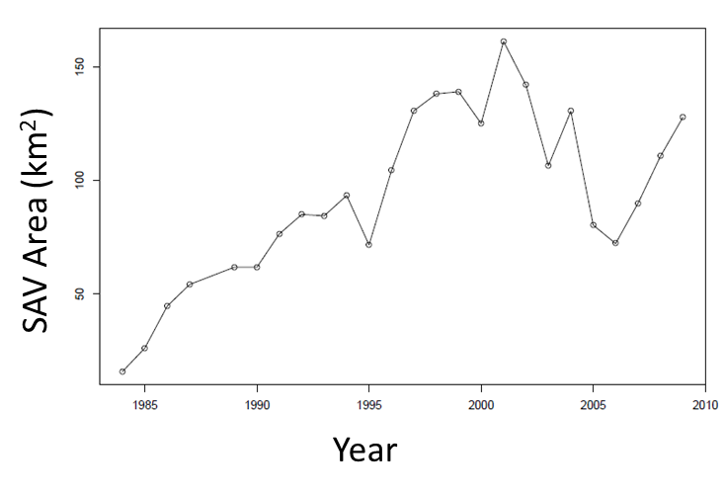

Slide 6
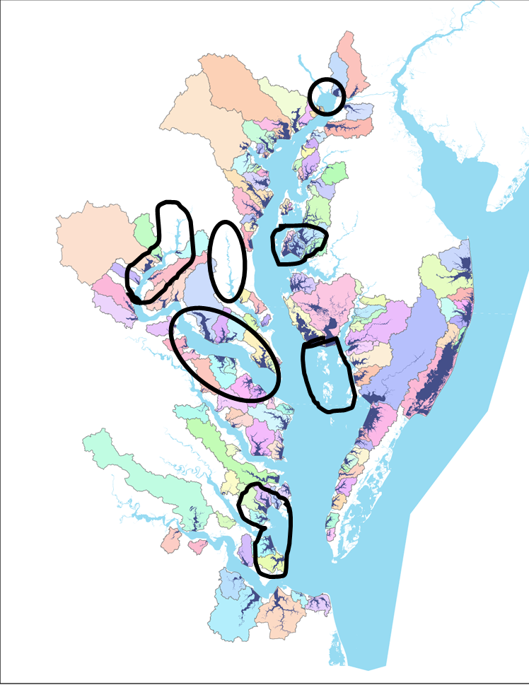
1 subestuaries
5 subestuaries
5 subestuaries
9 subestuaries
0 subestuaries
6 subestuaries

Slide 7
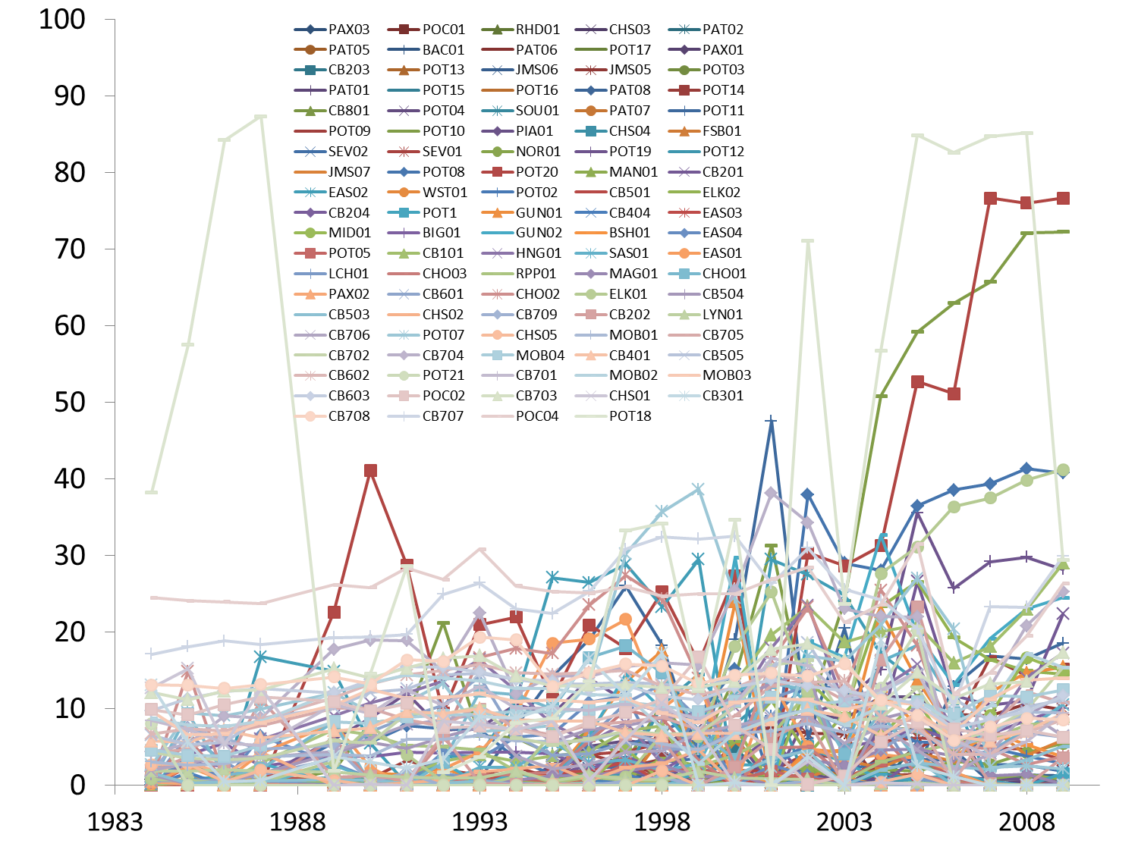
Density Weighted Occupied SAV Habitat
Years

Slide 8
Major Goal: Develop statistical models that explain inter-annual variability in SAV within subestuaries, to better understand inter-annual variability in SAV at the scale of Chesapeake Bay
Predictions:
Models fit within each salinity zone will differ from one another.
Differences between models for each salinity zone will be explained by differences in biology of SAV communities found in each salinity zone

Slide 9
PCA for time series analysis, AKA Empirical Orthogonal Function analysis, is a way to reduce the dimensionality of sets of time series composed of similar data in similar units. We then detrended series to remove global patterns so we could focus on short term variability (Torchin 2003) . This makes those data ready for standard time series analysis (Jassby et al. 1992, Cloern & Jassby 1995, Bjornsson & Venegas 1997)
Example: Polyhaline Zone Subestuaries
Outlier Time Series may unduly affect the mean

Slide 10
Polyhaline Zone
Temporal Mode 1 Polyhaline SAV Across Subestuaries
Temporal Mode1 – 86% of variation explained

Slide 11
Mesohaline – EOF Analysis
Temporal Mode 1 Mesohaline SAV Across Subestuaries
Temporal Mode1 – 57% of variation explained

Slide 12
Oligohaline – EOF Analysis
Temporal Mode 1 Mesohaline SAV Across Subestuaries
Temporal Mode1
– 49.4% of variation explained
Temporal Mode 2 – 24.6% of variation explained
Detrended Mode 1 Oligohaline SAV Across Subestuaries
Detrended Mode 2 Oligohaline SAV Across Subestuaries

Slide 13
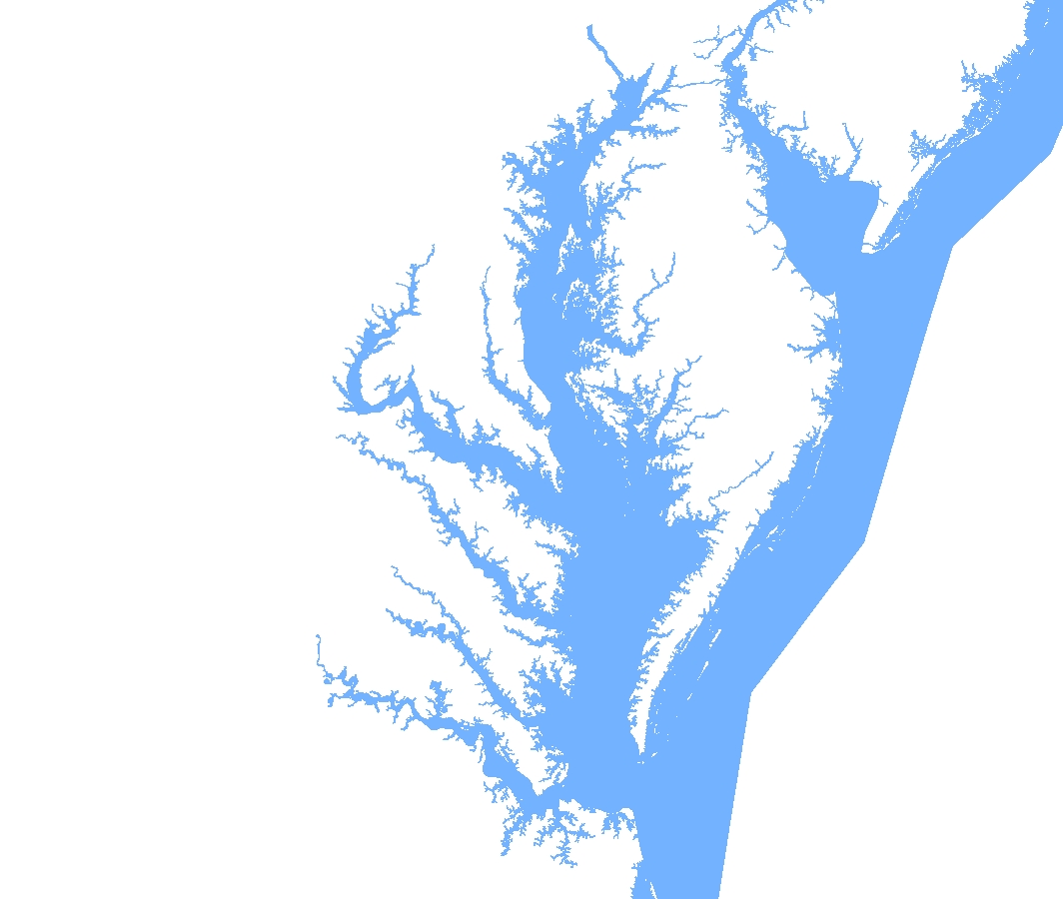
Chesapeake Bay
CBP Water Quality Database (1984 –Present)
Hundreds of sample sites.
Data collected monthly or
twice a month.
Data of interest:
TSS
DOC
Chla
Secchi Depth
USGS – River Input Monitoring Program
Nitrogen Loads from major rivers

Slide 14
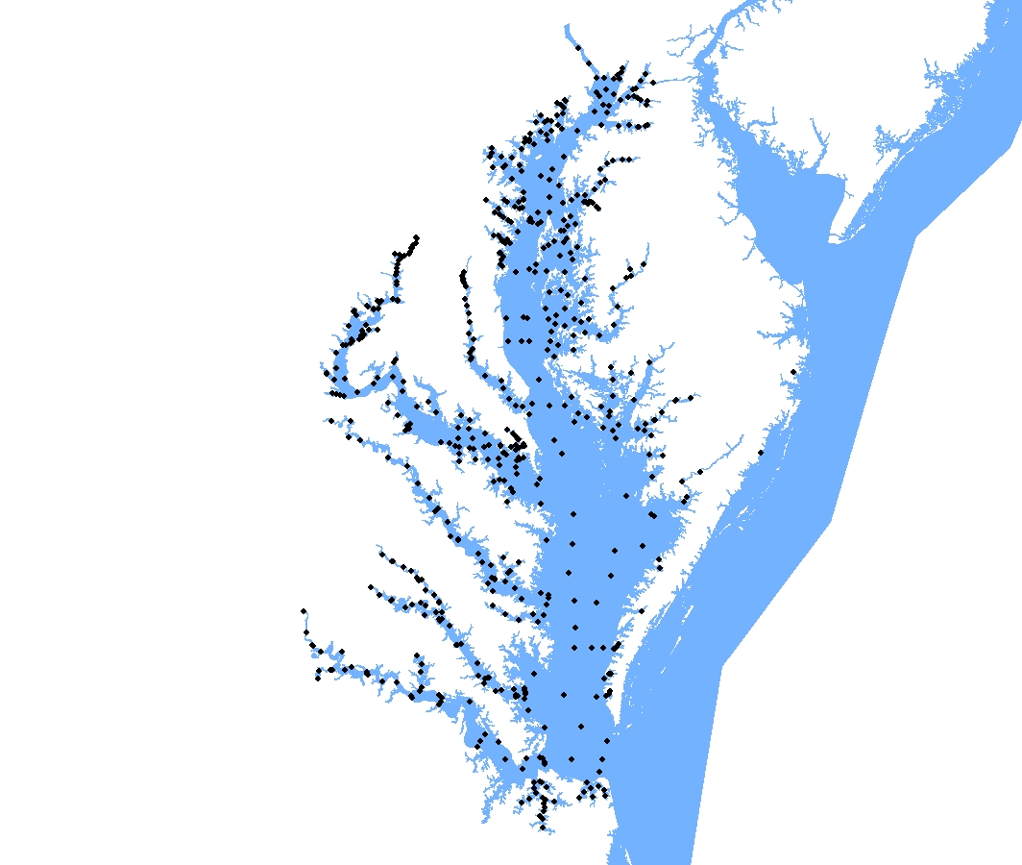
Chesapeake Bay
Chla Sampling Stations
614 Total

Slide 15
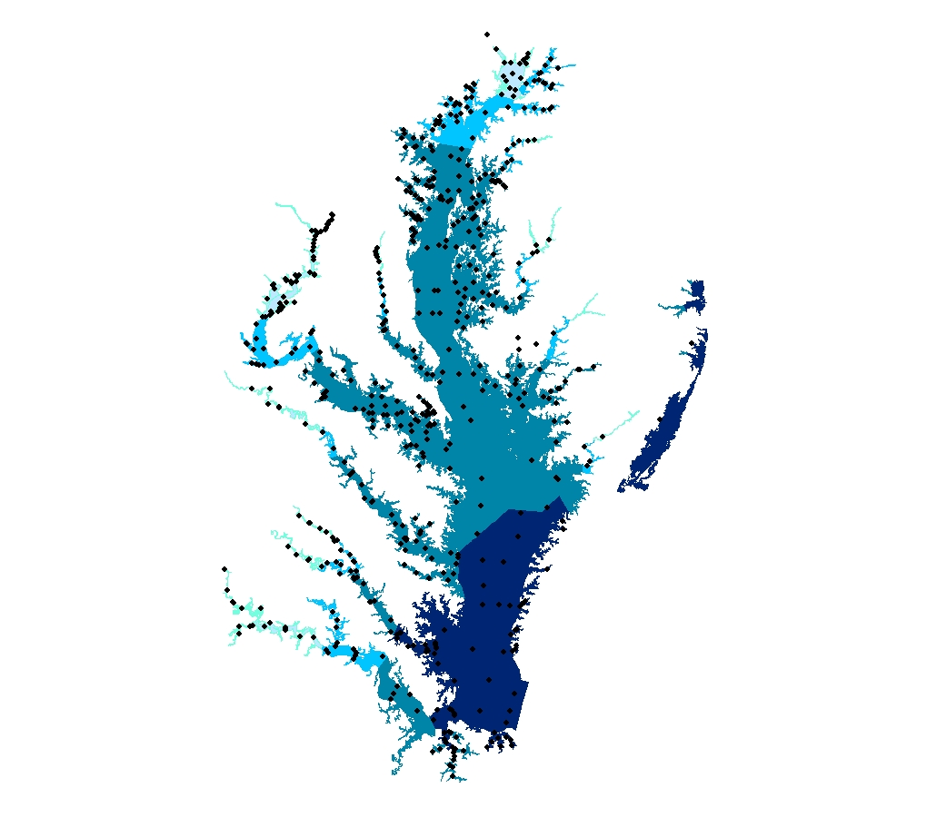
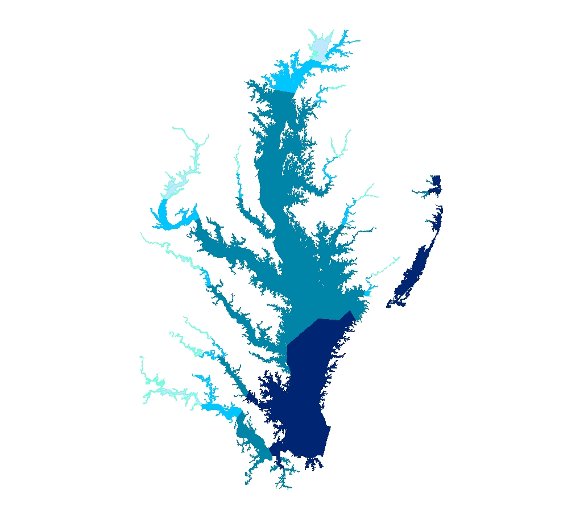
CBP Salinity Zones
Chla Sampling Stations
614 Total
Tidal fresh
Oligohaline
Mesohaline
Polyhaline

Slide 16
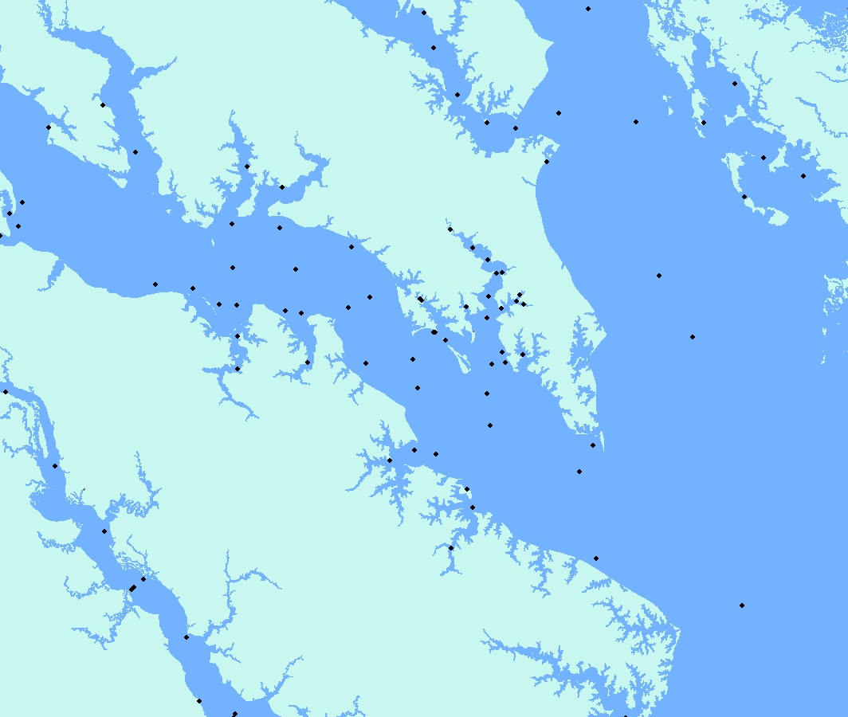
Mouth of the Potomac

Slide 17
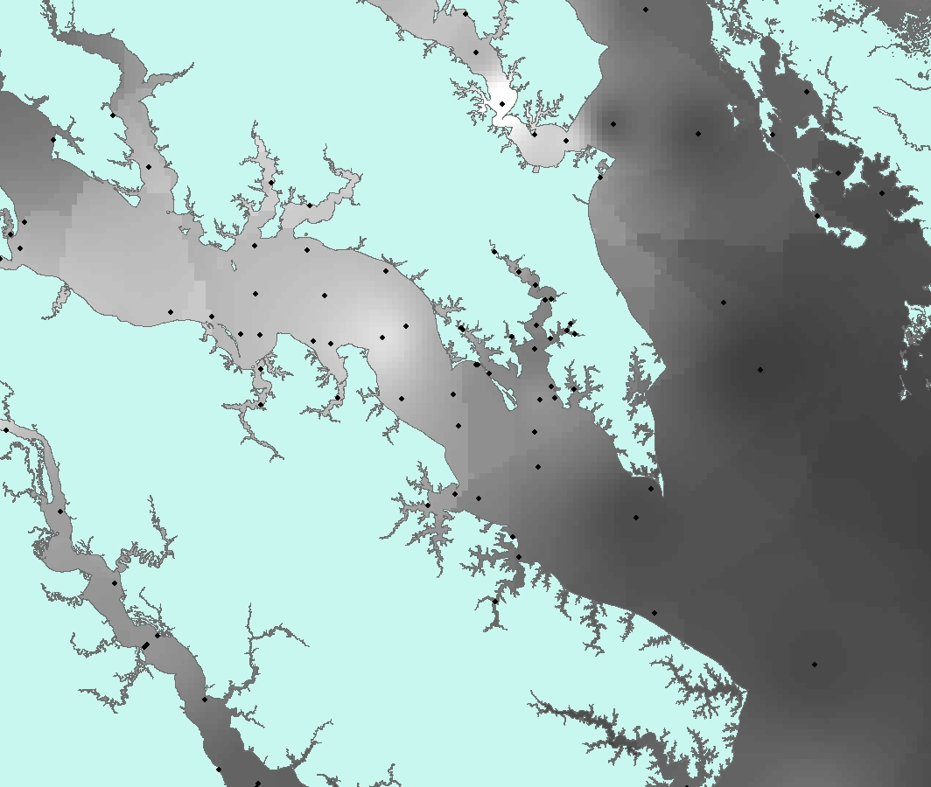
Mouth of the Potomac

Slide 18
Variables Considered
CBP-WQ Variables (mean, minimum, maximum)
Secchi Depth
TSS (Total Suspended Solids)
DOC (dissolved organic carbon)
Chla (growing season (March – October), March, April, May, and June)
USGS River Monitoring Data
Susquehanna River Nitrogen Load
Susquehanna River + Potomac River nitrogen load
Nitrogen load for all rivers feeding Chesapeake Bay
Cross Correlation Analysis within
each salinity zone

Slide 19
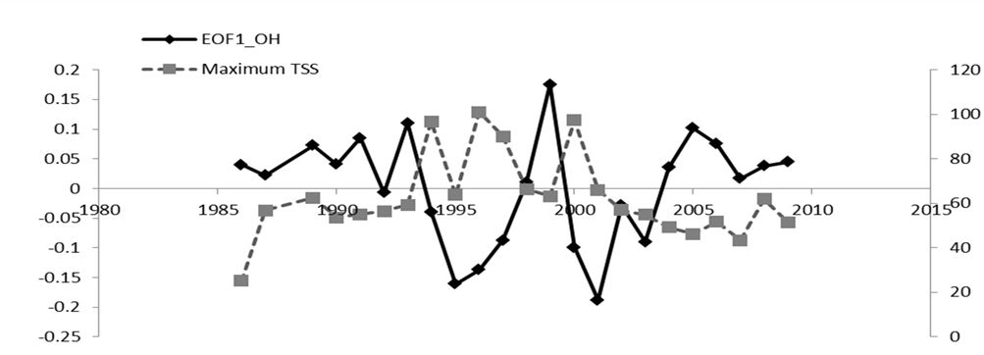
Oligohaline SAV
Maximum TSS is negatively cross correlated with SAV (time lagged two years)

Slide 20
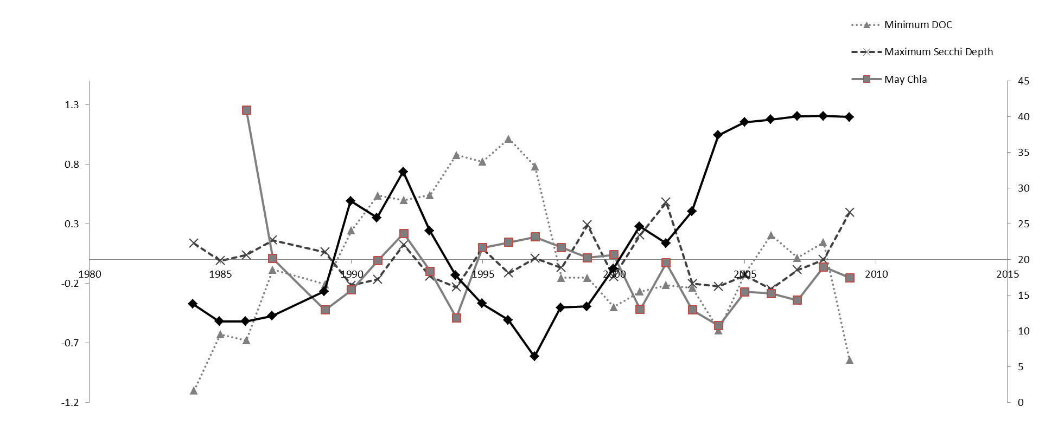
Oligohaline SAV
May Chla, Minimum DOC, Maximum Secchi Depth

Slide 21
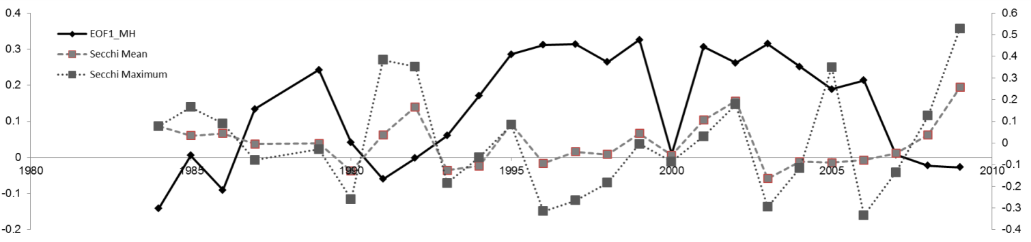
Mesohaline SAV
Significant negative cross correlation for:
Mean and Maximum Secchi Depth

Slide 22
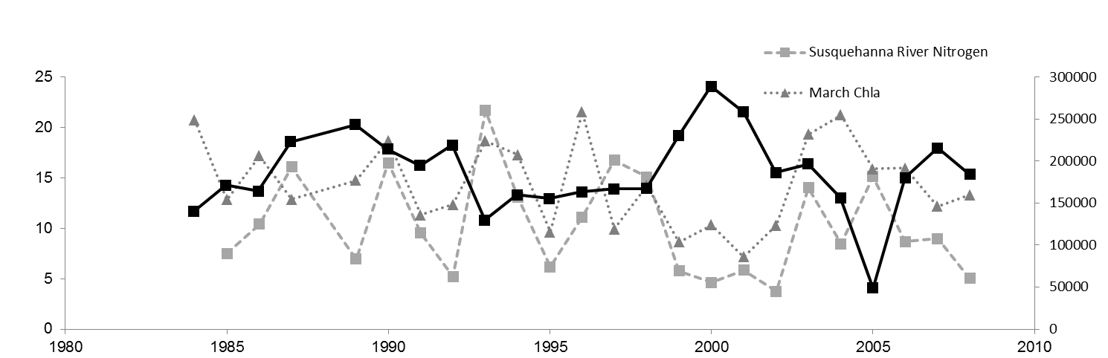
Polyhaline Zone SAV
Significant negative cross correlation with a one year time lag for:
March Chla, Susquehanna River Nitrogen, Whole Bay Nitrogen load, and Susqehanna River + Potomac River

Slide 23
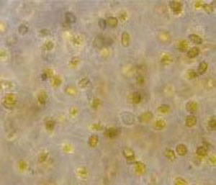
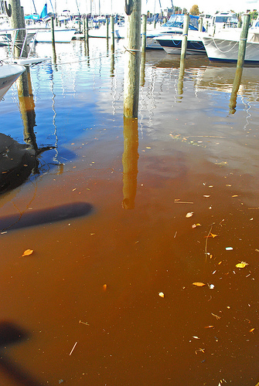
Oligohaline SAV
TSS, DOC, Secchi Depth
  Indicators of water clarity
May Chla ( coinciding with shoot emergence?)
  Phytoplankton blooms can reduce water clarity. Timing can be important (Gallegos et al. 2005)

Slide 24
Oligohaline SAV – Interesting Patterns
1993 - 1995
1999 - 2001

Slide 25
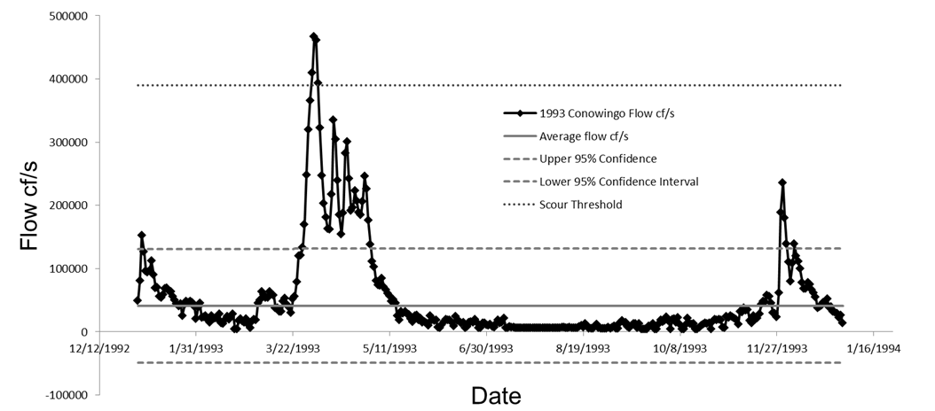
Major freshets in spring of 1993
Enough to move sediment from behind Conowingo Dam

Slide 26
Mesohaline SAV
Secchi Depth is indicative of water quality
c
Interesting decline
occurs in 1999
Orth et al. 2010 observed similar SAV declines at this time
c
c

Slide 27
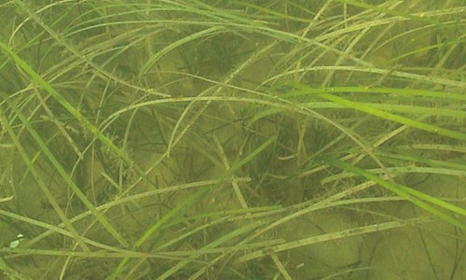
Polyhaline Zone SAV
Nitrogen Load
  linked to water clarity both directly and indirectly
March Chla ( coinciding with shoot emergence?)
  Phytoplankton blooms can reduce water clarity. Timing can be important (Gallegos et al. 2005)

Slide 28

Polyhaline Zone SAV – Interesting Patterns
1993 – 1994
Freshets?
2005 – 2006
Heat Stress Die Back

Slide 29
Conclusions
Predictors differ between the different salinity zones of the Bay
  Major drivers punctuated by short powerful events that exceed thresholds (either biological or physical)
Upper Bay – May Chla, DOC, TSS, Scour and burial from storms
Mid Bay – water clarity (measured by Secchi depth)
Lower Bay – March Chla, Susequehanna River Flows, possibly freshets, and heat stress
Management application:
Different management approaches to different regions of the bay?

Slide 30




Acknowledgements
Helpful comments: Matt Ogburn, Eva Marie Koch, Lee Karr, Chuck Gallegos, Tom Jordan, Matt Kornis
Data Sources : Chesapeake Bay Program, VIMS, MDNR
Funding: NOAA Grant MA08 Predicting Impacts of Multiple Stressors-- 654068 4120
Smithsonian Environmental
Research Center

Slide 31
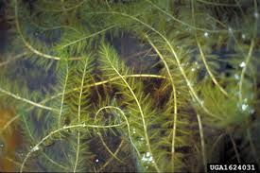
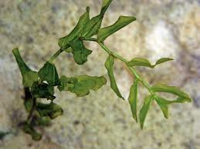
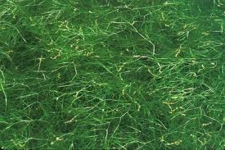
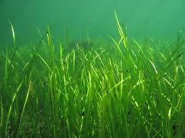
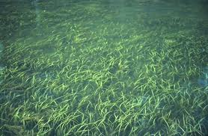
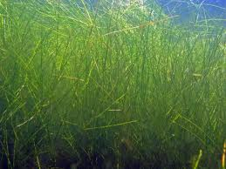
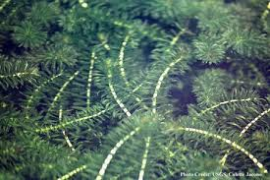
Low Salinity
High Salinity
C
2-4 %
10-37 %
4.1 – 35.7%
Eurasian Water Milfoil
Redhead Grass (Clasping Pondweed)
Ruppia
Eelgrass
2-9%
Some sand preference
Sand preference
Wild Celery
5-14%
C:
0.45 – 5.4%
Sago Pondweed
Hydrilla
Eelgrass is temperature stressed
Substrate preference
High needs for light
Substrate indifferent
Low light needs
Canopy forming species

