Slide 1
Impervious Surface Connectivity and Urban Stream Corridors
Land Use Workgroup Meeting
January 30, 2014
Steve Stewart
Baltimore County

Slide 2
Issues
Phase 5 of the CBP Watershed Model had no differences in loadings between high-density and low-density urban pervious and urban impervious.
The urban impervious land use had higher loading than the urban pervious land use and seemed to include stream erosion source loads as part of the impervious surface load.

Slide 3
Concepts
Difference between Total Impervious Cover and Directly Connected Impervious Cover – Implications for per Acre Loading
Urban Riparian Corridor as a Land Use – Clearly differentiate between impervious cover sources and stream corridor sources

Slide 4
Total Impervious Area (TIA) vs. Directly Connected Impervious Area (DCIA)

Slide 5
Definitions
Total Impervious Area (TIA): The total amount of impervious cover expressed as a %, includes DCIA.
Directly Connected Impervious Area (DCIA): That portion of the impervious area that drains directly to the storm drain system without flowing across pervious area.

Slide 6
Directly Connected Impervious

Slide 7
Disconnected Impervious

Slide 8
Analysis
Data sources
Baltimore County Water Quality Management Plans – SWMM section (10 plans, 5 with data useable in analysis.
Baltimore County Neighborhood Source Assessments used in developing Small Watershed Action Plans. (data analysis not complete and not included in this presentation)

Slide 9
Relationship of TIA to DCIA
Land Use | TIA | DCIA | Difference
Low Density Res. | 17 | 9.4 | 7.6
Medium Density Res. | 33.8 | 19.2 | 14.6
High Density Res. | 55.8 | 37.8 | 18
Commercial | 88.8 | 67 | 21.8
Industrial | 77 | 54 | 23
Institutional | 39.6 | 20.4 | 19.2
Open Urban | 5.8 | 20.4 | 19.2

Slide 10
Nitrogen
Land Use | TIA | DCIA | Average SWMM Model | Average SWMM Model Using CBP loading rates
Low Density Res. | 17 | 9.4 | 578.5 | 1,066
Medium Density Res. | 33.8 | 19.2 | 606.5 | 1,135
High Density Res. | 55.8 | 37.8 | 874.5 | 1,225
Commercial | 88.8 | 67 | 1491.5 | 1,360
Industrial | 77 | 54 | 1065.5 | 1,312
Institutional | 39.6 | 20.4
Open Urban | 5.8 | 20.4 | 0.82 | 1,020

Slide 11
Nitrogen Loading Rates by Land Use Comparison Between SWMM and CBP Models
Land Use | TIA | DCIA | Average SWMM Model | CBP Model loading rates using average TIA from SWMM | CBP Model loading rates using average DCIA from SWMM
Low Density Res. | 17 | 9.4 | 5.79 | 10.66 | 10.35
Medium Density Res. | 33.8 | 19.2 | 6.07 | 11.35 | 10.75
High Density Res. | 55.8 | 37.8 | 8.75 | 12.25 | 11.51
Commercial | 88.8 | 67 | 14.92 | 13.60 | 12.71
Industrial | 77 | 54 | 10.66 | 13.12 | 12.17
Institutional | 39.6 | 20.4
Open Urban | 5.8 | 20.4 | 3.59 | 10.20 | 10.04

Slide 12
Correlation Table
 | TIA | DCIA | CBP Load | SWMM Load
TIA |  | 1.00 | 0.94 | 0.94
DCIA | 1.00 |  | 1.00 | 0.97
CBP Load | 0.94 | 1.00 |  | 0.97
SWMM Load | 0.94 | 0.97 | 0.97

Slide 13
Phosphorus Loading Rates by Land Use Comparison Between SWMM and CBP Models
Land Use | TIA | DCIA | Average SWMM Model | CBP Model loading rates using average TIA from SWMM | CBP Model loading rates using average DCIA from SWMM
Low Density Res. | 17 | 9.4 | 0.55 | 0.49 | 0.40
Medium Density Res. | 33.8 | 19.2 | 0.60 | 0.69 | 0.52
High Density Res. | 55.8 | 37.8 | 0.84 | 0.95 | 0.74
Commercial | 88.8 | 67 | 1.22 | 1.34 | 1.08
Industrial | 77 | 54 | 1.33 | 1.20 | 0.93
Institutional | 39.6 | 20.4
Open Urban | 5.8 | 20.4 | 0.19 | 0.36 | 0.31

Slide 14
Observations
The differential between models is greater for low density residential and open urban (both low impervious cover categories).
The differential between SWMM results and CBP model is greater for nitrogen than phosphorus.
The differential is less when using DCIA versus TIA.
CBP urban loading rates are higher versus the SWMM rates.

Slide 15
Urban Riparian Corridor as a Land Use

Slide 16
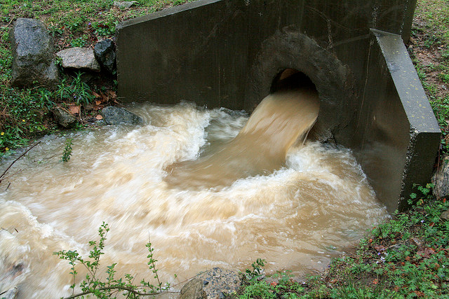
DCIA – Flow from Storm Drain

Slide 17
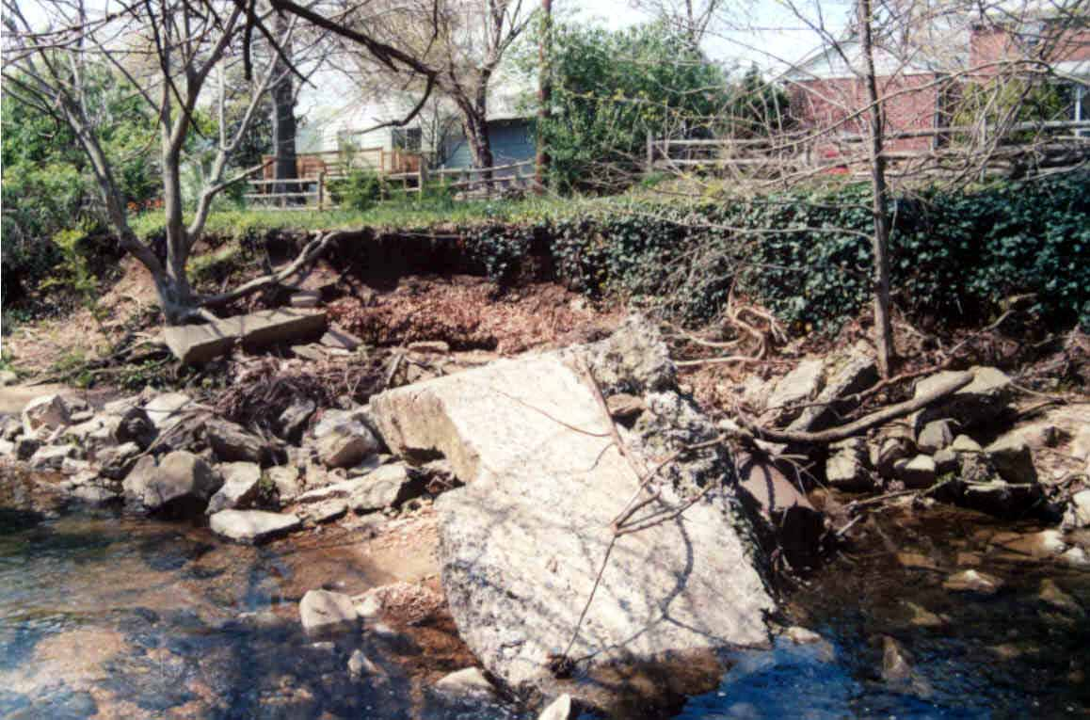
Urban Stream Channel Erosion Inadequate Buffer

Slide 18
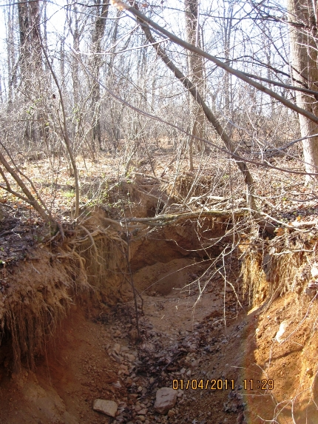
Urban Stream Channel Erosion With Buffer

Slide 19
Justification for a Urban Riparian Corridor Land Use
Many studies have demonstrated a relationship between increases in impervious cover and increased stream erosion.
Maryland stream based sediment TMDLs use a calculation to determine the relative proportion of the sediment load attributable to stream erosion
The Watershed Model does not include a stream layer that encompasses 1st, 2nd, and some 3rd order streams that are most propone to erosion due to urbanization.

Slide 20
Justification for a Urban Riparian Corridor Land Use
By including an urban riparian corridor land use, the impervious surface loading rates would decrease since they would no longer include the loads from stream channel erosion.
By having urban stream channel erosion as a source, attention can be focused on removing the channel erosion as a source, either by upland controls or stream channel restoration, or more likely by both.

Slide 21
Lower North Branch Patapsco River Water Quality Management Plan
Related the impervious surface coverage to stream channel enlargement through SWMM modeling.
Stream channel condition verified by stream corridor assessments and stream channel measurements.
Clearly a relationship between impervious cover and stream channel erosion.

Slide 22
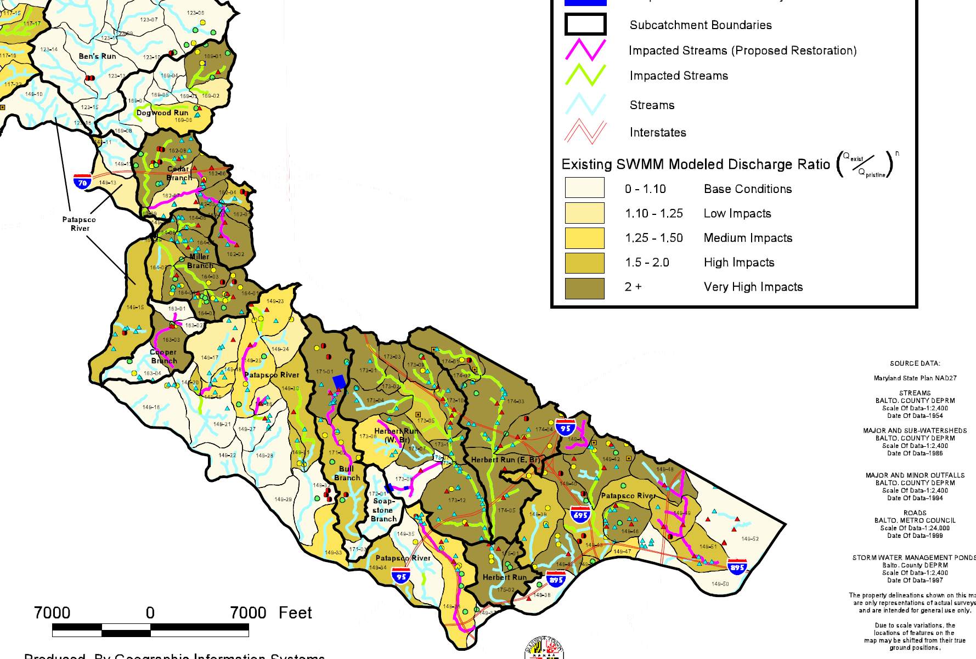
Lower North Branch Patapsco River Water Quality Management Plan

Slide 23
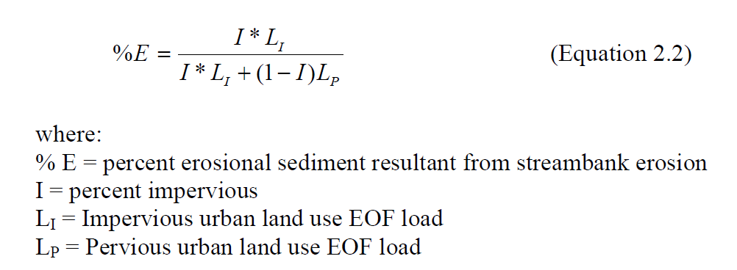
Equation for Determining Proportion of Sediment Load Due to Stream Channel Erosion

Slide 24
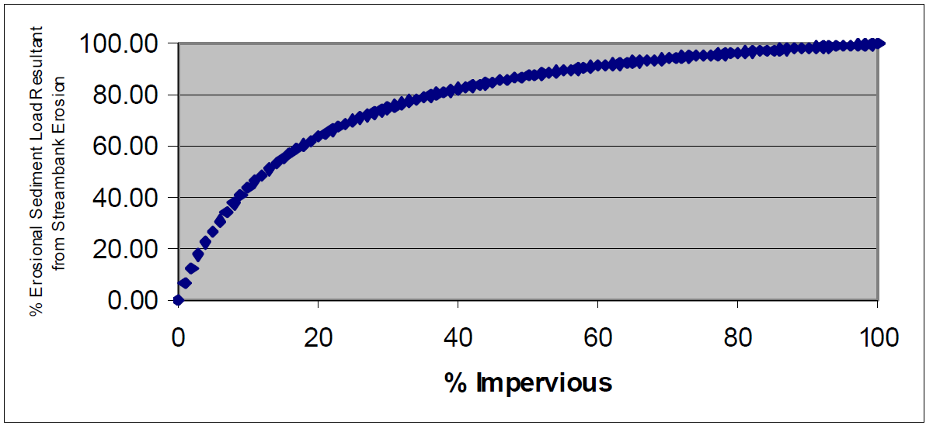
Proportion of Sediment Load due to Stream Channel Erosion

Slide 25
Riparian Corridor as a Land Use Conclusions
Methods exist to link stream channel erosion contribution to the sediment load.
Methods also exist with literature summarized by Stream Restoration – Expert Panel to link nitrogen and phosphorus loads to stream channel erosion.
With a little addition additional work, nitrogen and phosphorus load contributions resulting from loss of riparian corridor function could be determined.

