Slide 1
A COMPARISON STUDY OF TWO INSTRUMENTS FOR THE DETERMINATION OF NUTRIENT CONCENTRATIONS IN ESTUARINE WATER SAMPLES

Slide 2
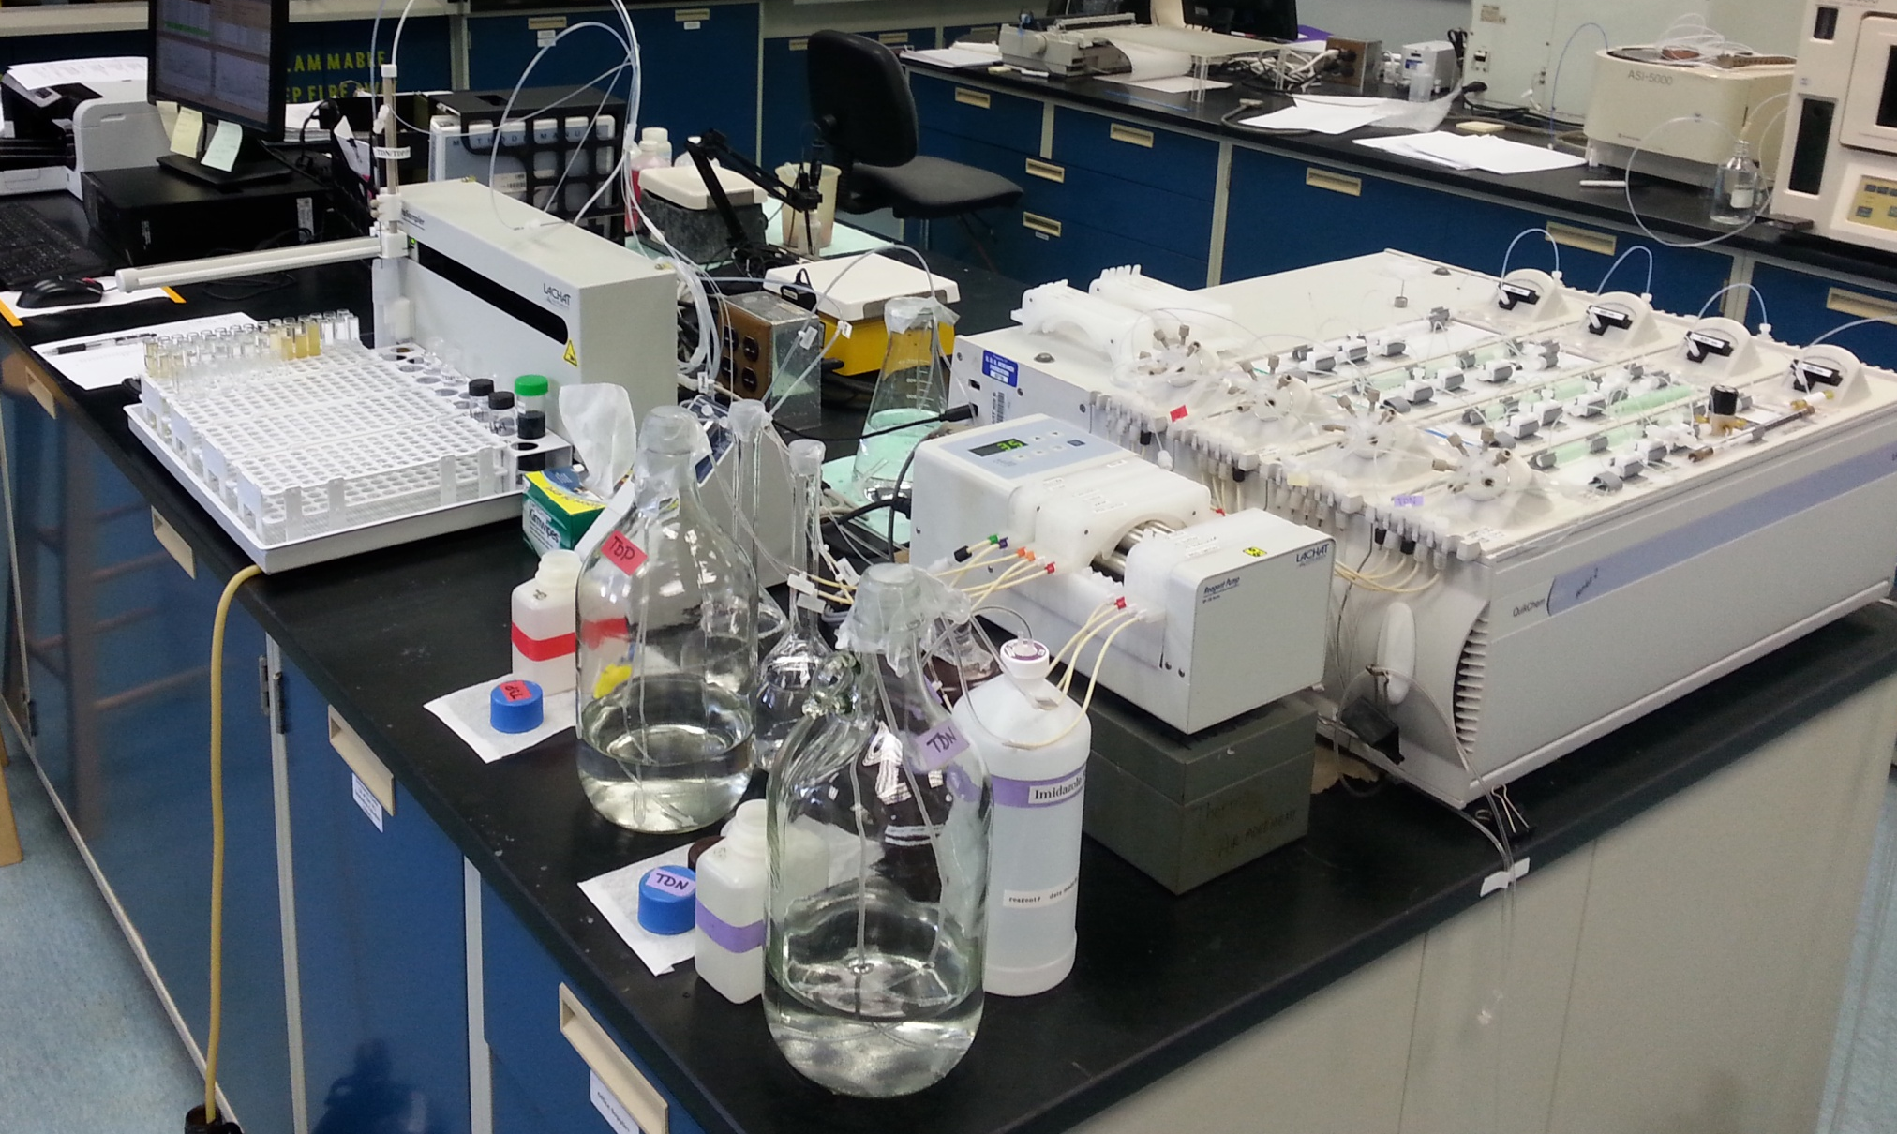

Slide 3
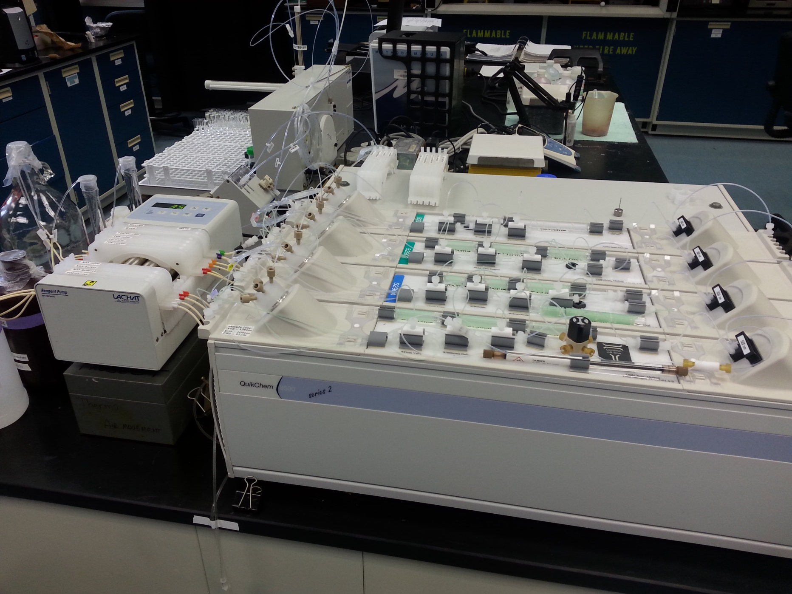

Slide 4
Parameters
Nitrate + Nitrite (NO23F)
Nitrite (NO2F)
Total Dissolved Nitrogen (TDN)
Orthophosphate (PO4F)
Total Dissolved Phosphate (TDP)
Particulate Phosphate (PP)
Ammonia (NH4F)
Silicate (SIF)

Slide 5
Reasons to Switch to Flow Injection
Detection of low level analytes
Speed of analysis
Cost compared to replacing with a new Skalar system
Less sample volume needed
Calibration curve automatically prepared
Automatic dilution of samples
Compact size of system
Ease of switching cartridges
Low maintenance
Consumables on instrument are less expensive (Example: teflon tubing versus glass coils)

Slide 6
CALIBRATIONS
An Artificial Saline Water (ASW) calibration curve has been used on the Skalar.
A Reagent Water calibration curve will be used on the Lachat prepared by the auto diluter.
Exceptions to calibration curves:
Particulate phosphate where a manual 1N Hydrochloric Acid curve will be used on both.
Manually prepared Reagent Water calibration curve for TDN/TDP analysis for Lachat. Manually prepared ASW calibration curve for TDN/TDP analysis for Skalar.

Slide 7
STUDY DESIGN
A minimum of 100 routine samples were analyzed.
Analyses were conducted on two or more sample days to take into account variability that may be associated with daily recalibration of the instrument.
Samples were analyzed on both instruments on the same day. PP filters were extracted in 20 mLs.
Samples included stations in the Chesapeake Bay Mainstem and Potomac River and were selected taking concentration, salinity and seasonal variability into account.

Slide 8
Study Design continued
Two calibration curves were used on the Lachat – one prepared in Artificial Sea Water (ASW) and one in Reagent Water. This was to account for variability that may occur due to matrix effects.
ASW calibration was used on the Skalar. The same ASW calibration standards were used on the Lachat.
Certified Reference Material (CRM) was manually prepared for both curves.

Slide 9
Initial Test Method Evaluation For Each Nutrient Parameter on the Lachat
A Method Detection Limit (MDL) study was performed.
Confirmation of the Limit of Detection (LOD)- This is the MDL
Reporting Limit Study
Confirmation of the Limit of Quantification (LOQ) (Reporting limit = LOQ)
Demonstration of Capability (DOC)
Carry over study

Slide 10
Lessons Learned

Slide 11
Ammonia
EDTA for buffer and 50% hypochlorite did not work on high saline/low nutrient samples.
Switched to Citrate/Tartrate buffer, same as used on Skalar.
Large bore tubing did not work for sample loop.
Lachat sent the high range cartridge. Analysis not working, and we discovered the problem. Modified the cartridge for low range ammonia with an extra coil.

Slide 12
Particulate Phosphate
1N HCL for calibration curve
Cannot use auto dilutor to make standards. Caused seals in auto dilutor to deteriorate
Need to use dedicated sample needle due to acid.
Changed dilution line to Reagent Water. When dilution line was 1N HCl, calibration curve would only work as 2nd Order.

Slide 13
Total Dissolved Nitrogen and Total Dissolve Phosphate
Reagent Water Carrier did not work
Hydroxide Carrier in Lachat method did not work
Using Digested Oxidizing Reagent as Carrier
Digestion is the same as used on the Skalar.
Need to use dedicated sample needle due to oxidizing reagent.
Imidizole buffer is used in place of Ammonium Chloride at Lachat’s suggestion to reduce issues with NH4F analysis. This also applies to NO23F and NO2F analyses.

Slide 14
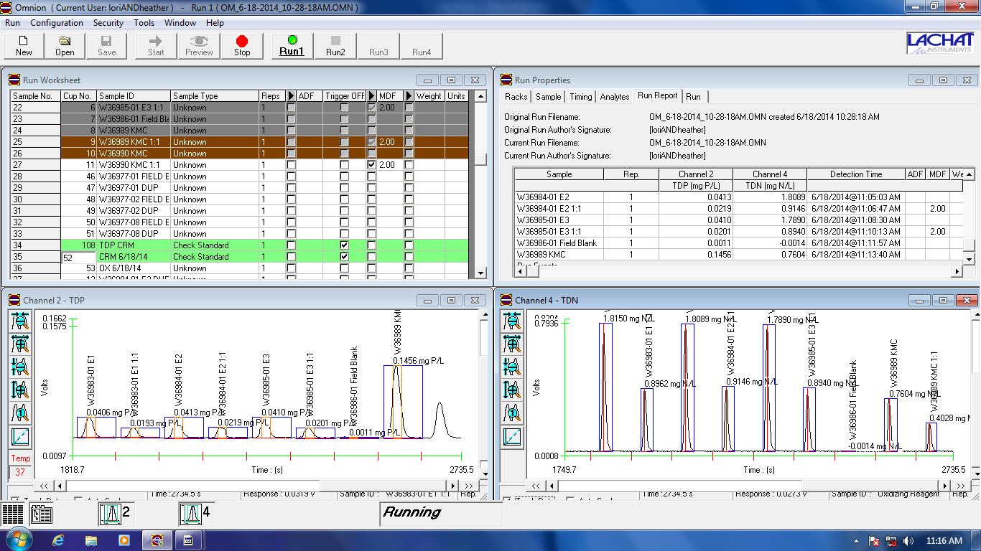

Slide 15
Conclusions from Studies
NH4F/SIF/TDP/PO4F/PP
NO23F/ NO2F/TDN
Overall the results suggest that for the concentration range that should be encountered during sampling in the Lower Chesapeake Bay mainstem any differences changing instruments should not result in a substantial change for these parameters.
Status and Trend analyses should be unaffected
No correction needed for data
The results suggest a bias between the instruments, with the Lachat having higher results compared to the Skalar.
The difference between instruments increases with increasing sample concentration.
It may be possible to develop correction factors or alternatively use statistical methods that take these effects into account (e.g. Blocked Seasonal Kendall analysis, Generalized Additive Models).

