Slide 1

Chesapeake Bay Update:
Citizens Advisory Committee
Russ Baxter
Deputy Secretary of Natural Resources
Office of Governor McAuliffe

Slide 2
“Current Events”
Chesapeake Bay Program
Submittal of 14-15 programmatic milestone “closeout report”
Draft 16-17 programmatic milestones and input deck submitted, currently under EPA review
Verification Plan “conditionally” approved, working with EPA to modify to satisfy EPA comments.
Awaiting public comment on Management Strategy workplans and undertaking final agency review

Slide 3
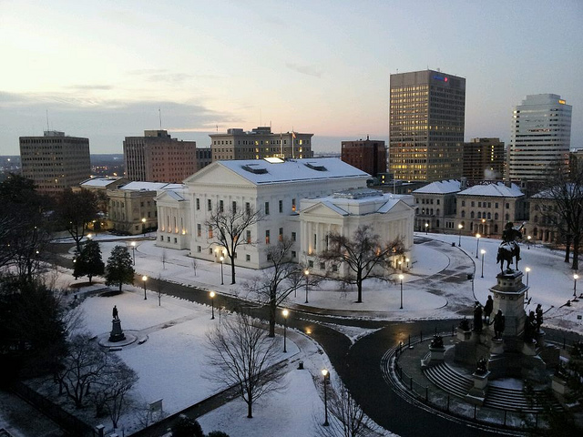
General Assembly
Yesterday was “crossover”
House and Senate Budgets will be released on Sunday
Final budget in March
Notes:
.

Slide 4
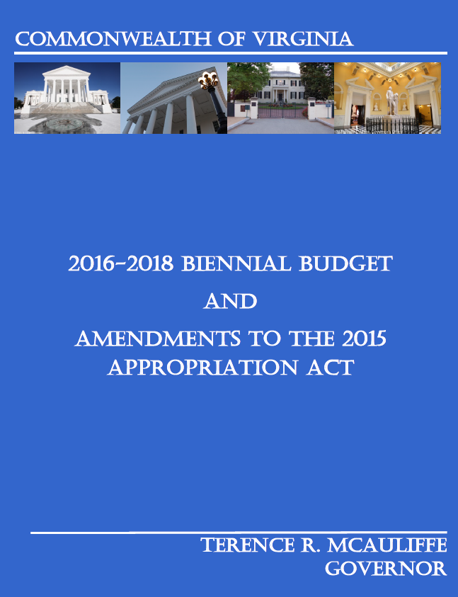

Slide 5
Governor’s Introduced Budget
Water Quality
Point Sources: $59 million for upgrades to municipal wastewater plants (included in bond package)
Nonpoint Sources: $61.7 for nonpoint source Best Management Practices (BMPs). $10 milllion in each year of the biennium from the recordation tax for agricultural BMPs ($8.8 million for BMPs, $1.2 million for technical assistance)
Of the $61.7 million, $19.6 million set aside for SL-6 backlog
Restoration of $1 million cut from recordation fee (dedicated source of funds to the Water Quality Improvement Fund to ag BMPs in previous fiscal year )
Parks, Land Conservation and Public Access
$140 million for infrastructure improvement at existing parks and opening of 2 previously purchased parks; Widewater in Stafford County and Biscuit Run in Albemarle County
$40 million for land acquisition including $2 million in each year of the biennium for Farmland Preservation, $2 million in each year of the biennium for the Virginia Land Conservation Foundation, $2 million in each year for the Virginia Battlefield Preservation Fund
Notes:
($51.8 million for ag. BMPs divided as follows: $26 million of for ag BMP cost-share statewide and $19.6 for the SL-6 (livestock stream exclusion) practice backlog split evenly between the Chesapeake Bay Watershed and the Southern Rivers watershed. $6.2 million to Soil and Water Conservation Districts for technical assistance to farmers to implement practices

Slide 6
General Assembly – Bay Related Bills and Budget Amendments under Consideration
Stormwater Local Assistance Fund ($50 million/yr budget amendment)
Additional funds for agricultural BMPs and support for SWCDs
Credit Trading for Sediments for MS4s
Modifications to Watershed General Permit Statute: (Complimentary to Executive Order 52)
Property Tax Exemption for Living Shorelines
Integration of Erosion & S, Stormwater and Chesapeake Bay Act requirements
Required turtle excluder devices in crab pots
Bernie Fowler resolution

Slide 7
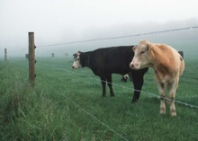

Slide 8
Livestock Stream Exclusion Incentives
100% guarantee began in late 2012
Sign-up before June 30, 2015
  Only for SL-6 practice
  No expiration on state guarantee of funding
  Must sign contract within 90 days of offer of funds
Sign up after June 30, 2015 – three options
  State cost share alone – 80% w/$70K cap
  100% + w/USDA-CREP if plant buffer
  RCPP - $1.45 million w/state match through Sept ’17 (available to producers from NRCS)
Notes:
The RCPP stream exclusion grant (portion) is $1.45M, available directly to agricultural producers from NRCS, that are in the specific targeted sub-watersheds, i.e. in TMDL bacteria Implementation Plan areas per information from DEQ (see the Word attachment page 2). It is open to all EQIP eligible livestock producers whose project areas fall entirely within the designated sub-watersheds.
Another $306K is being sent through DCR for both Chesapeake Bay Foundation (CBF) and the Virginia Department of Forestry (VDOF) for technical assistance from them to Virginia Chesapeake Bay farmers who also want to plant trees in their livestock stream exclusion buffers. This can be done to completed SL-6s via the FR-3 BMP, or added onto a new SL-6 during its pre-approval stage.
The RCPP financial assistance to eligible farmers is administered by NRCS per EQIP rules, with some additional conditions. NRCS Virginia Office has worked very closely with DCR on this in order to maximize the benefit of this relatively small grant. By comparison, EPA awarded $1.7M in Bay Grants for livestock stream exclusion last grant year and has just awarded an additional $1.7M to use by June 2016. I am currently in discussions with DEQ regarding any possibility of obtaining some 319 funds (tbd) for this purpose outside the Chesapeake Bay watershed next year. We are also hoping to obtain some of the Duke Energy settlement for SL-6.
There are additional RCPP ranking criteria (page 5) a separate sign-up period ending December 18, 2015 (page 4), and notification of preapprovals by NRCS by January 29, 2016. A special BMP pricing structure has also been created for this RCPP grant, in order to more closely estimate average actual BMP installation costs in the grant eligible areas.
EQIP rules do not allow NRCS to cover 100% of the BMP cost. Therefore, DCR (as we do with CREP), will provide a partial match (via WQIF funds) intended to cover the vast majority, and in many cases all, of the producers 25% share of the cost of the BMPs. This match percentage will be based on the special BMP pricing structure for this grant.

Slide 9
Livestock Stream Exclusion
“SL-6” Practice
  Minimum 10 year exclusion fence
  Minimum 35 foot vegetated buffer
  Alternative watering systems (troughs)
  Hardened stream crossings
  Pasture (grazing) management
  Fences protect the buffers and streams
  Stream crossings, troughs, and cross fencing assist with herd management

Slide 10
Sign Up for Livestock Stream Exclusion
More farmers signed up for first time for a cost-share program
>2,900 total SL-6 applications
  (incl. ~ 1,600 in Chesapeake Bay)
Benefits statewide of SL-6 initiative
  9.9M feet of stream protected
  131,000 animal units excluded
Notes:
(Beef Cow = 1 unit, Dairy Cow = 1.4, Goat = 0.1, Horse = 1, Sheep = 0.1, Swine = 0.18)

Slide 11
Status of Livestock Stream Exclusion
Backlog (Pending) SL-6 sign up - $68M
  ~1,300 still need funding statewide
  Chesapeake Bay <$34M (~670)
  Outside ChesBay >$34M (~630)
Additional benefits to Chesapeake Bay
  3.2M more feet of stream bank protected
  42,000 more animal units excluded

Slide 12
Reductions from SL-6 Initiative
Estimated benefit of $64M of SL-6 in Chesapeake Bay Watershed
Close 34% of the Nitrogen gap for agriculture
Close 13.6% of the sediment gap for agriculture
Plus considerable bacteria reductions to help many local TMDLs (bacteria is still number one impairment in local water bodies)

Slide 13


Slide 14
Resource Management Plans
Program established by bill proposed by ag interests passed in the 2011 session of the General Assembly
Implementing regs prepared by DCR and adopted by Soil and Water Conservation Board
RMPs encourage farmers to use a high level of conservation best management practices to reduce nutrient and sediment runoff by offering a “safe harbor” (or certainty) from any new state requirements, except VPDES permits or requirements under the state Chesapeake Bay Preservation Act.
Certainty is effective for nine years.
Compliance inspections every three years.
A farmer may withdraw at any time.

Slide 15
Resource Management Plan Features
Livestock stream exclusion fence
35 foot vegetated buffer for cropland and hayland
Soil loss reduced to “tolerance” or “T”
Nutrient Management Plan
BMP schedule tailored to an individual farm
SWCDs administer and ensure compliance
DCR reviews SWCD RMP programs
Notes:
The soil loss tolerance rate (T) is the maximum rate of annual soil loss that will permit crop productivity to be sustained economically and indefinitely on a given soil. Erosion is considered to be greater than T if either the water (sheet & rill) erosion or the wind erosion rate exceeds the soil loss tolerance rate.

Slide 16
Resource Management Plan Progress
Original goal of 40 RMPs by Dec ’15
Revised goal 274 RMPs/47K acres in Ches Bay
Already 280 RMPs/47K acres all in Ches Bay
SWCDs review then implementation follows
2016 contracts will be for both Chesapeake Bay and Southern Rivers
Notes:
For Resource Management Plans in (calendar) 2016, DCR is offering:
$120,000 in Chesapeake Bay (requests from Private Planners was for $240K but Bay grant requires completion by June 2016, so we could not use more Bay grant funds this time). Calendar 2015 was for $472K in the ChesBay.
$65,000 in the OCB ($100K was available but Planners only asked for $65K). We have asked them to consider doing more, and given them until December 2016 to complete. DCR is awaiting answers. This will be the first (real) effort to expand RMPs into the OCB.

Slide 17
Ms4 Phase I Permit Update
Phase I Permits issued for Fairfax, Prince William, Chesterfield, Henrico, Arlington
6 draft Phase I permits for Hampton Roads permittees (Chesapeake, Hampton, Norfolk, Virginia Beach, Portsmouth and Newport News) currently in draft form.
Revised drafts provided to permittees and EPA on 11/24/15.
Received comments from EPA on 1/28/16. DEQ staff working to address EPA comments.
DEQ staff met with HR Phase I permittees and HRPDC on 1/29/16 to discuss remaining issues

Slide 18
Ms4 Update
Chesapeake Bay TMDL Action Plans
88 Phase II Small MS4s located in Chesapeake Bay watershed.
75 existing MS4 permittees actions plans that were due October 1, 2015.
72 Chesapeake Bay TMDL Action Plans received (including two newly designated permittees’ plans submitted early).
All reviewed within 90 days of receipt.
44 Approved
23 Conditionally Approved (provided when proposed plans met the overall intent of the reduction requirements and only slight revisions or corrections were necessary)
1 Denied
4 Reviews in Process
5 existing permittees failed to submit. Working through compliance process to get plans submitted.
Newly Designated MS4 permittees not required to submit action plans until 2018.

Slide 19

THE END

